Slide 1
INTERMEDIATE MICROECONOMIC THEORY
Chapter 6: Demand

Slide 2
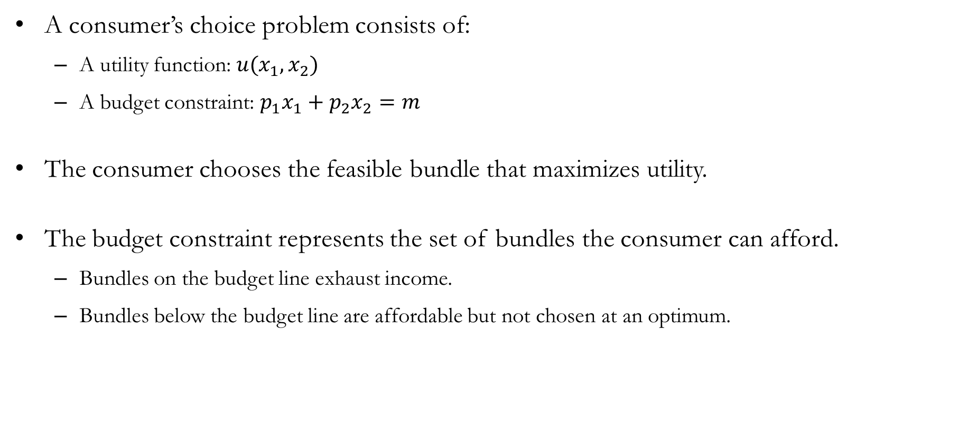
Recap: Choice
A consumer’s choice problem consists of:
  A utility function: $u(x_{1},x_{2})$
  A budget constraint: $p_{1}x_{1}+p_{2}x_{2}=m$
The consumer chooses the feasible bundle that maximizes utility.
The budget constraint represents the set of bundles the consumer can afford.
  Bundles on the budget line exhaust income.
  Bundles below the budget line are affordable but not chosen at an optimum.

Slide 3
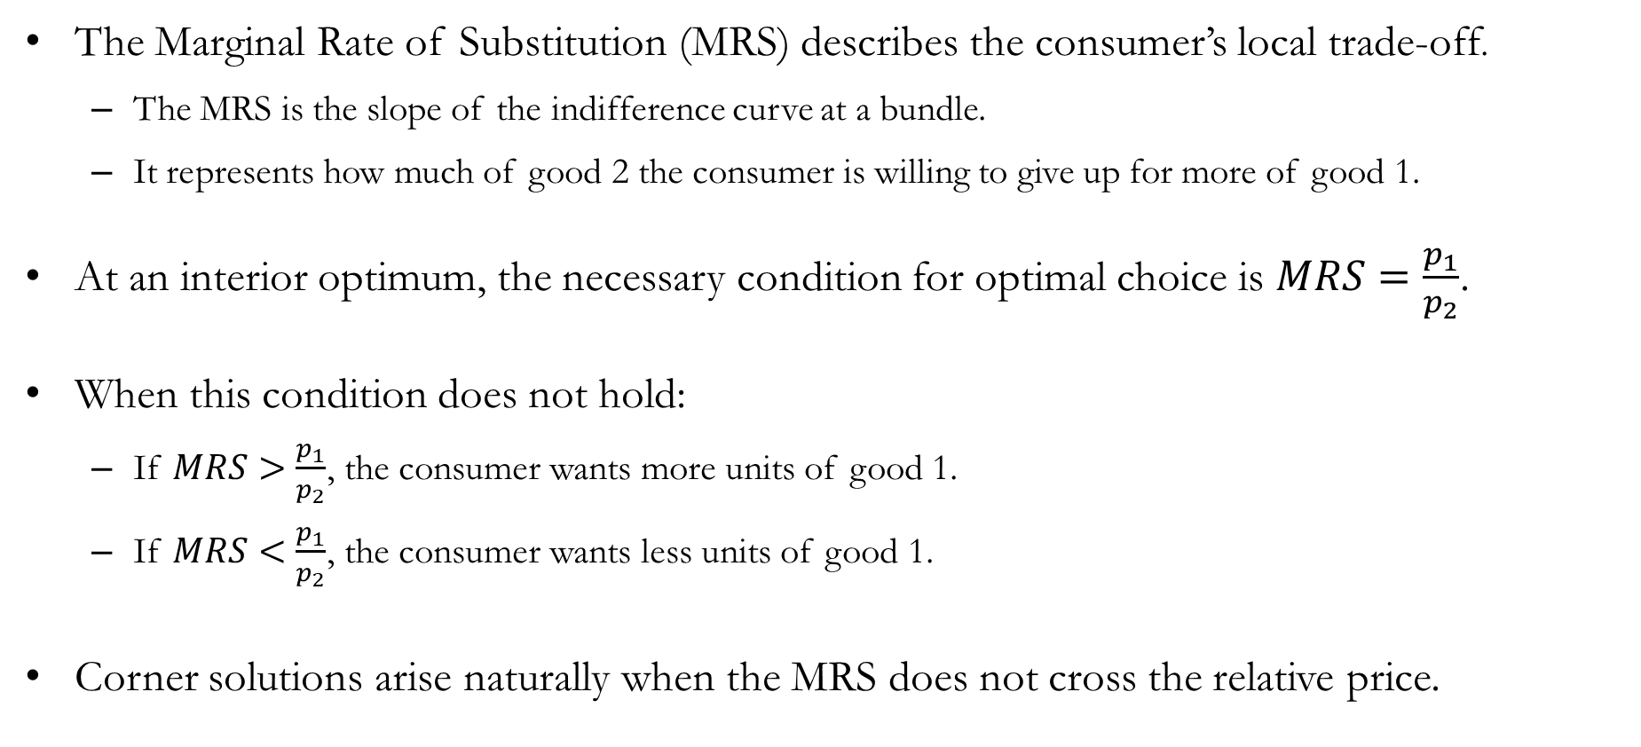
Recap: Choice
The Marginal Rate of Substitution (MRS) describes the consumer’s local trade-off.
  The MRS is the slope of the indifference curve at a bundle.
  It represents how much of good 2 the consumer is willing to give up for more of good 1.
At an interior optimum, the necessary condition for optimal choice is $MRS=\frac{p_{1}}{p_{2}}$.
When this condition does not hold:
  If $MRS>\frac{p_{1}}{p_{2}}$, the consumer wants more units of good 1.
  If $MRS<\frac{p_{1}}{p_{2}}$, the consumer wants less units of good 1.
Corner solutions arise naturally when the MRS does not cross the relative price.

Slide 4
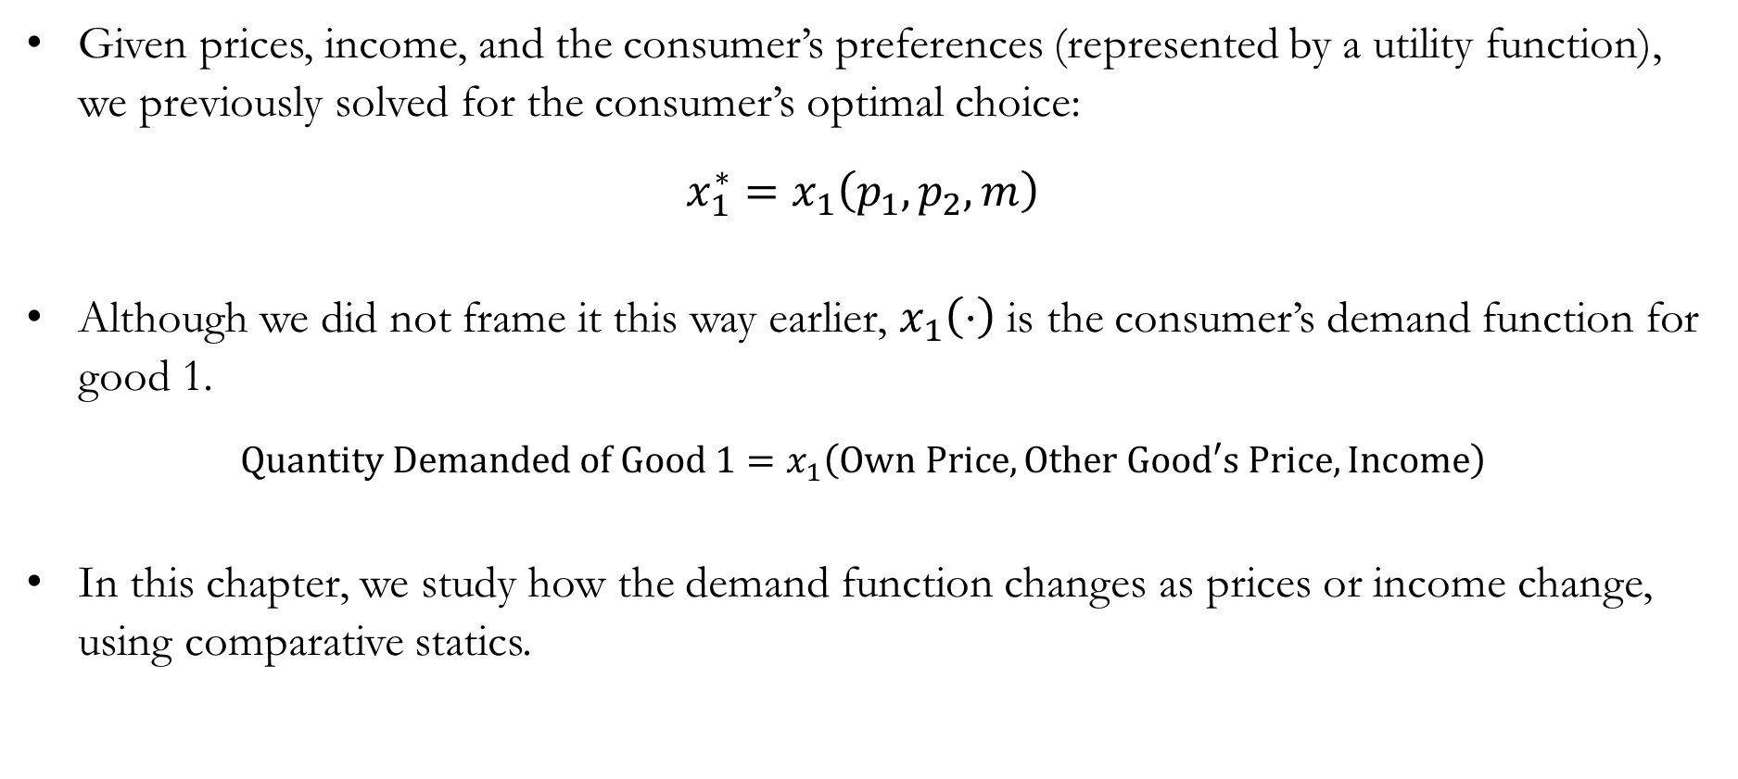
The Demand Function
Given prices, income, and the consumer’s preferences (represented by a utility function), we previously solved for the consumer’s optimal choice:
$$x_{1}^{∗}=x_{1}\left(p_{1},p_{2},m\right)$$
Although we did not frame it this way earlier, $x_{1}\left(⋅\right)$ is the consumer’s demand function for good 1.
$$\text{Quantity} \text{Demanded} \text{of} \text{Good}\text{ 1}=x_{1}\left(\text{Own} \text{Price}, \text{Other} \text{Good}\text{′}\text{s} \text{Price}, \text{Income}\right)$$
In this chapter, we study how the demand function changes as prices or income change, using comparative statics.

Slide 5
Changes in Consumer Income:
The Engel Curve

Slide 6
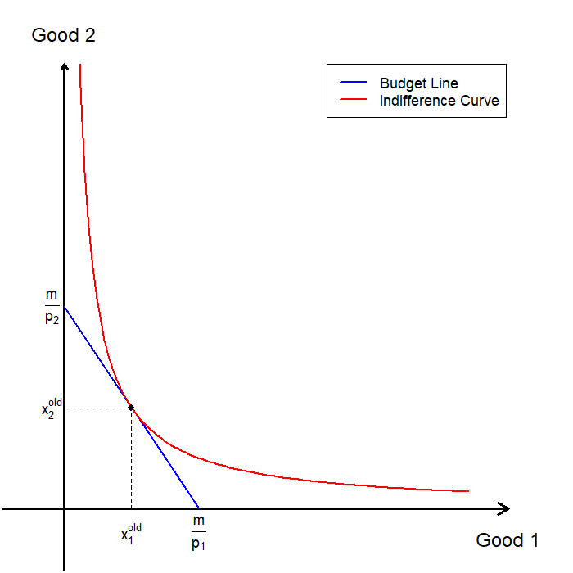
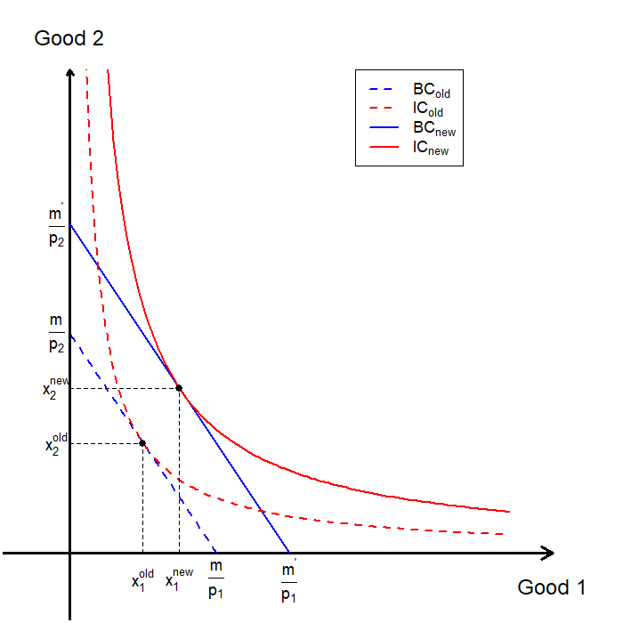
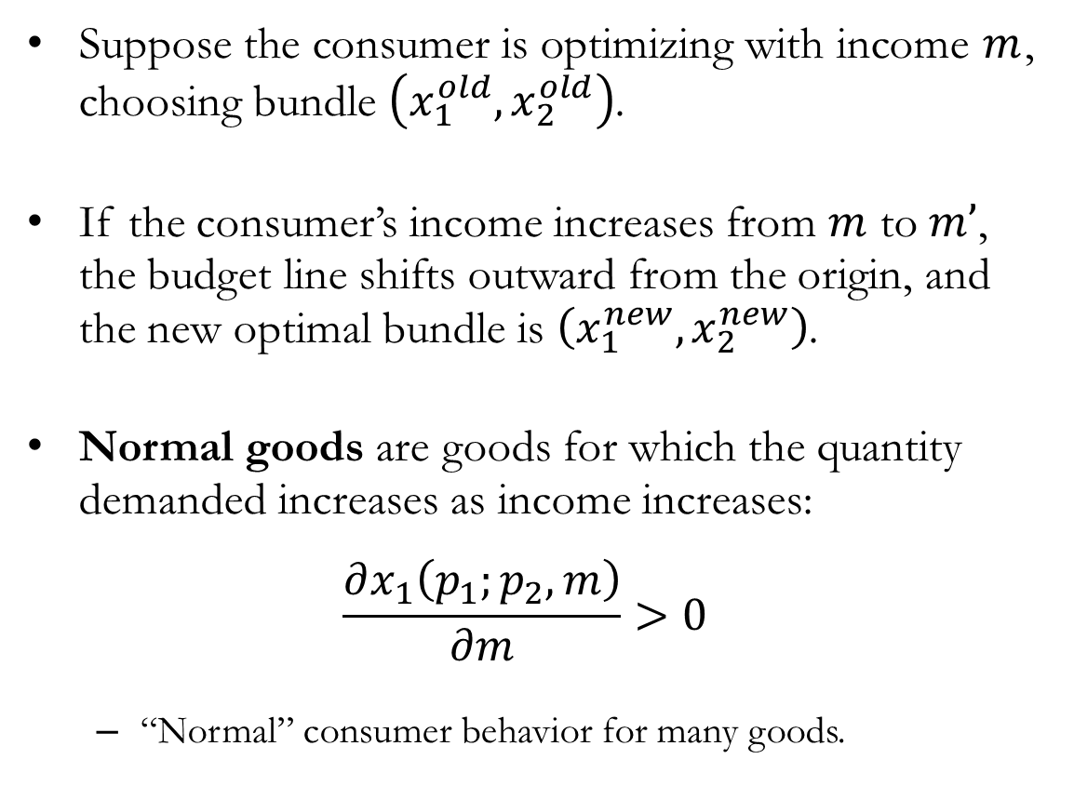
Comparative Statics: Normal Goods
Suppose the consumer is optimizing with income $m$, choosing bundle $\left(x_{1}^{old},x_{2}^{old}\right)$.
If the consumer’s income increases from $m$ to $m’$, the budget line shifts outward from the origin, and the new optimal bundle is $\left(x_{1}^{new},x_{2}^{new}\right)$.
Normal goods are goods for which the quantity demanded increases as income increases:
$$\frac{∂x_{1}\left(p_{1};p_{2},m\right)}{∂m}>0$$
  “Normal” consumer behavior for many goods.

Slide 7
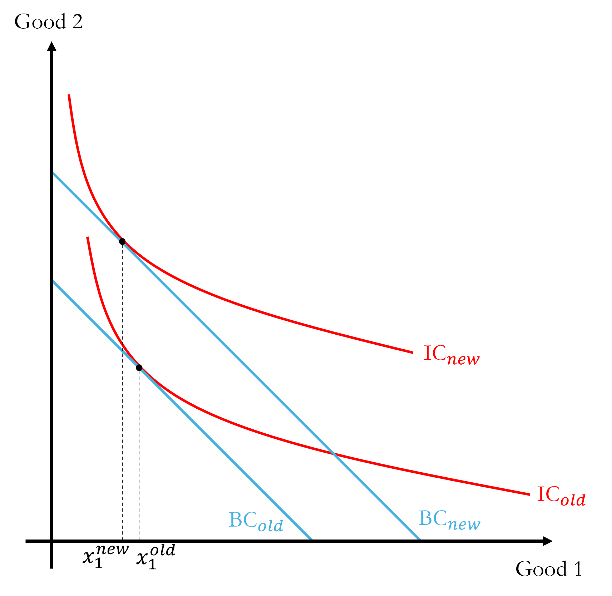
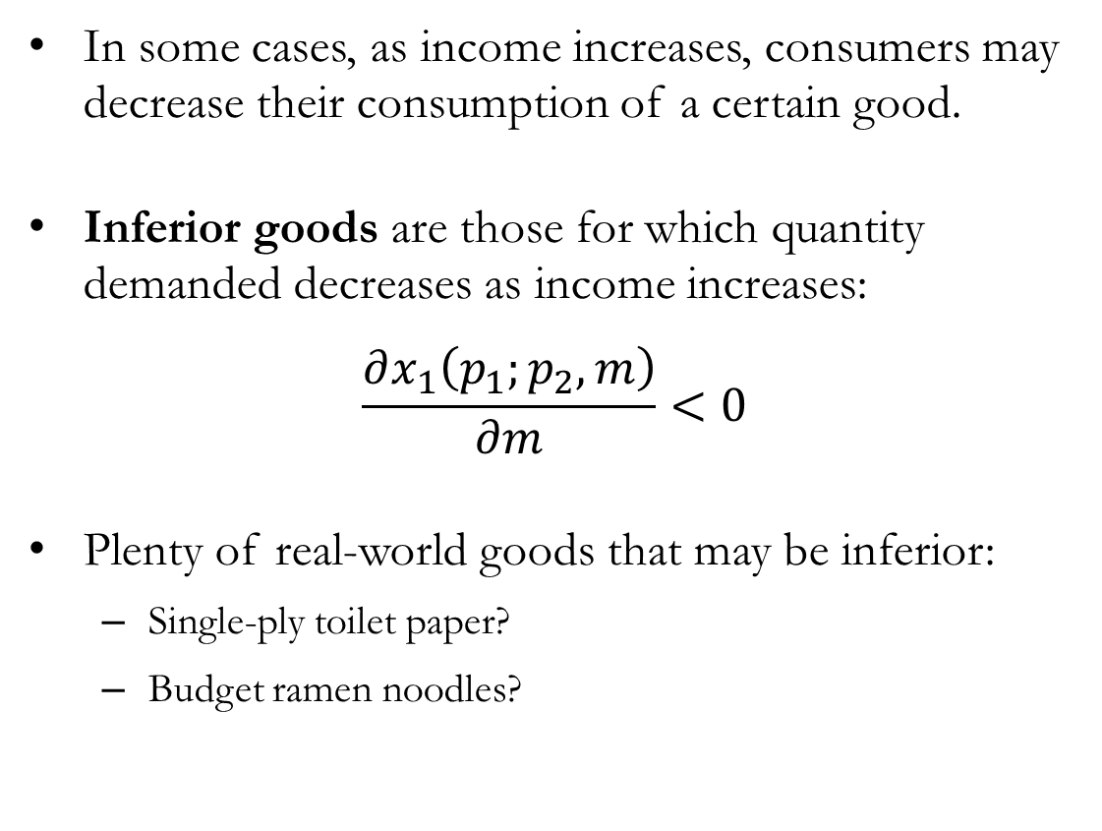
Comparative Statics: Inferior Goods
In some cases, as income increases, consumers may decrease their consumption of a certain good.
Inferior goods are those for which quantity demanded decreases as income increases:
$$\frac{∂x_{1}\left(p_{1};p_{2},m\right)}{∂m}<0$$
Plenty of real-world goods that may be inferior:
  Single-ply toilet paper?
  Budget ramen noodles?

Slide 8
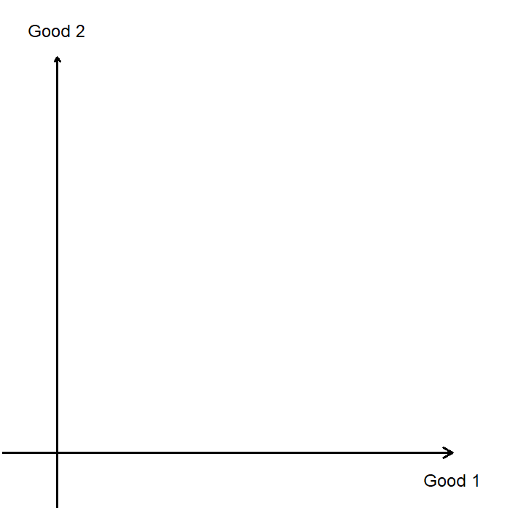
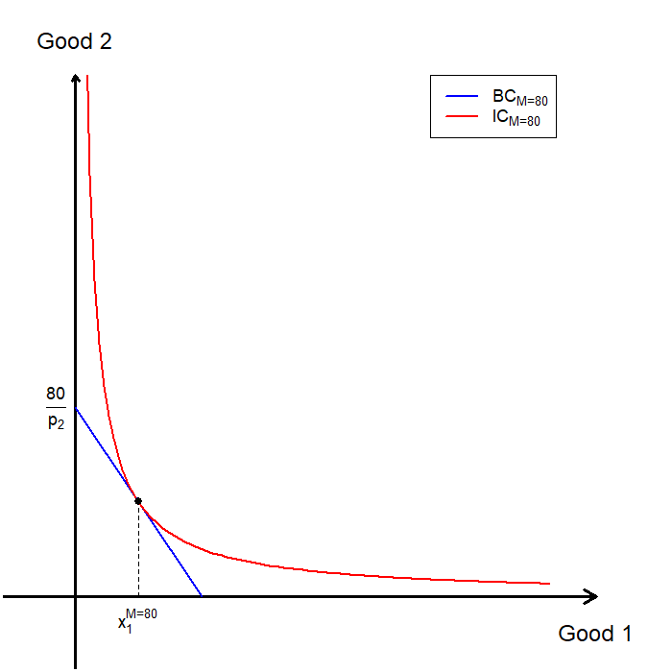
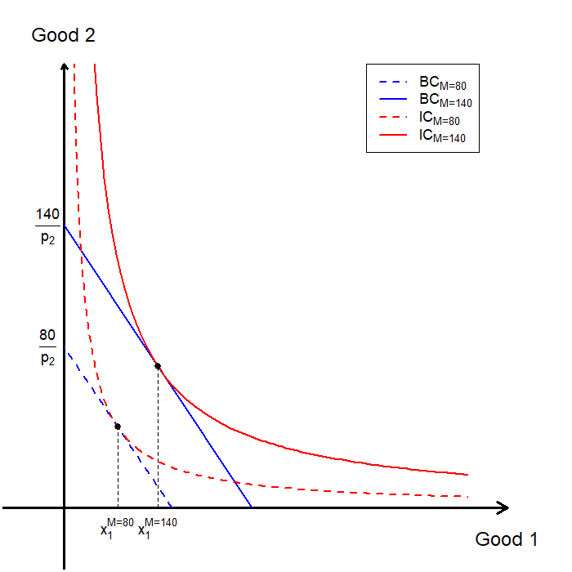
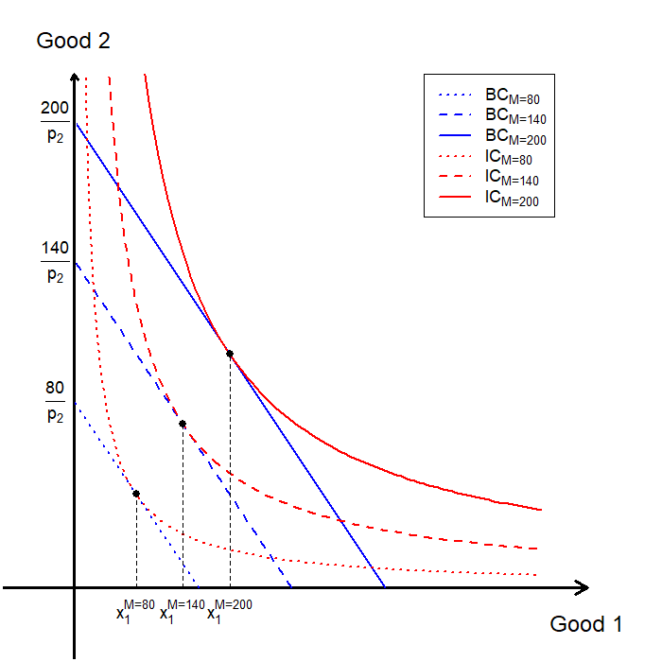
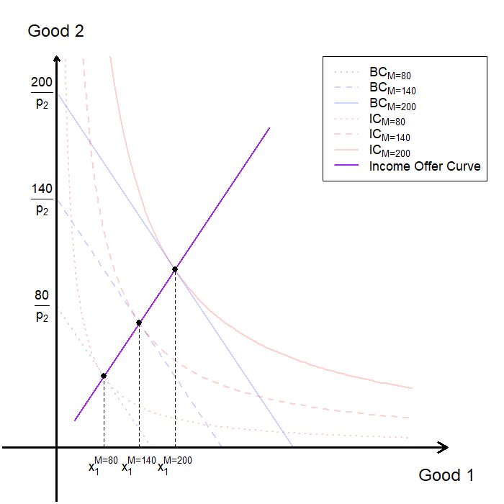
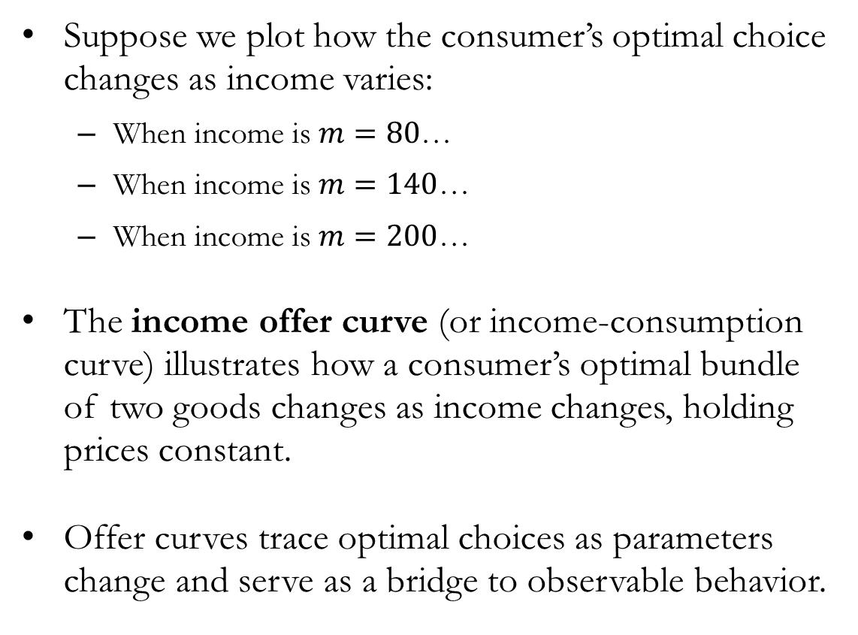
Comparative Statics: The Income Offer Curve
Suppose we plot how the consumer’s optimal choice changes as income varies:
  When income is $m=80$…
  When income is $m=140$…
  When income is $m=200$…
The income offer curve (or income-consumption curve) illustrates how a consumer’s optimal bundle of two goods changes as income changes, holding prices constant.
Offer curves trace optimal choices as parameters change and serve as a bridge to observable behavior.

Slide 9

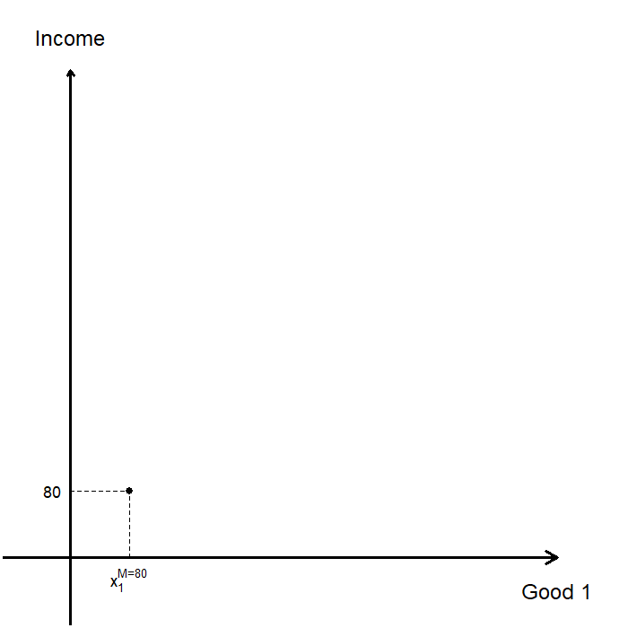
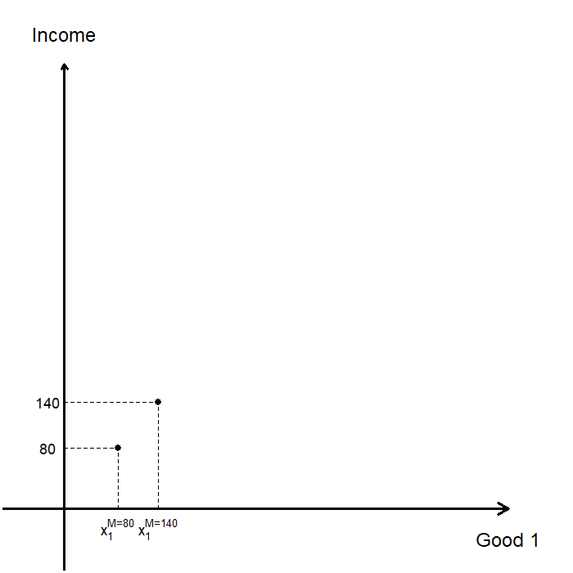
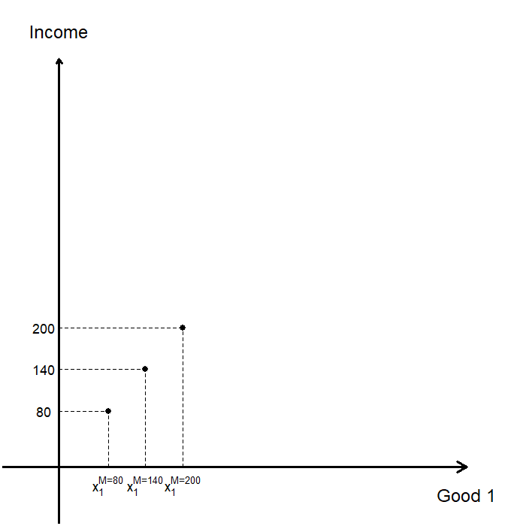
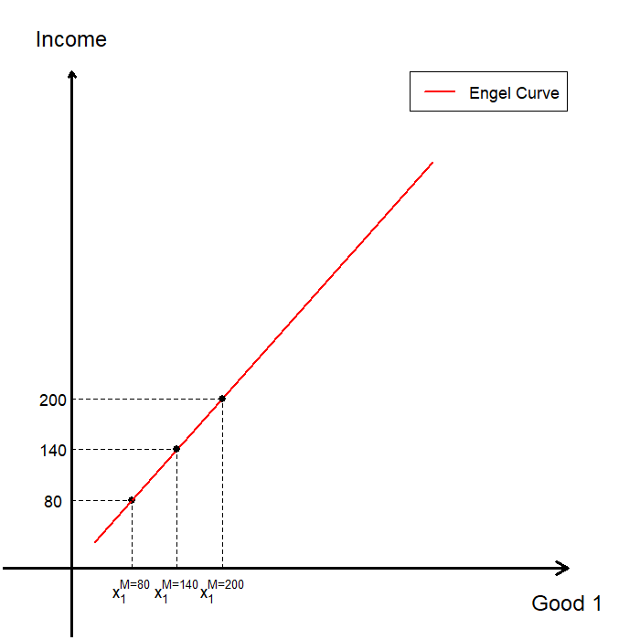
The Income Offer Curve and the Engel Curve

Slide 10
Comparative Statics: The Engel Curve
The Engel curve shows how a consumer’s optimal consumption of a specific good changes as income varies, holding prices constant.
  Isolates income effects, allowing us to understand how preferences respond to income changes independently of prices.
  Unlike the utility function, which is not observable, the Engel curve allows us to learn about preferences using observable data.
The shape of the Engel curve provides information about the consumer’s preferences, including:
  Whether the good is normal (The consumer purchases more of good 1 when income rises).
    Whether the good a luxury good (The consumer’s purchases of good 1 increase more than proportionally as income rises).
    Whether the good a necessary good (The consumer’s purchases of good 1 increase less than proportionally as income rises).
  Whether the good is inferior (The consumer purchases less of good 1 when income rises).

Slide 11
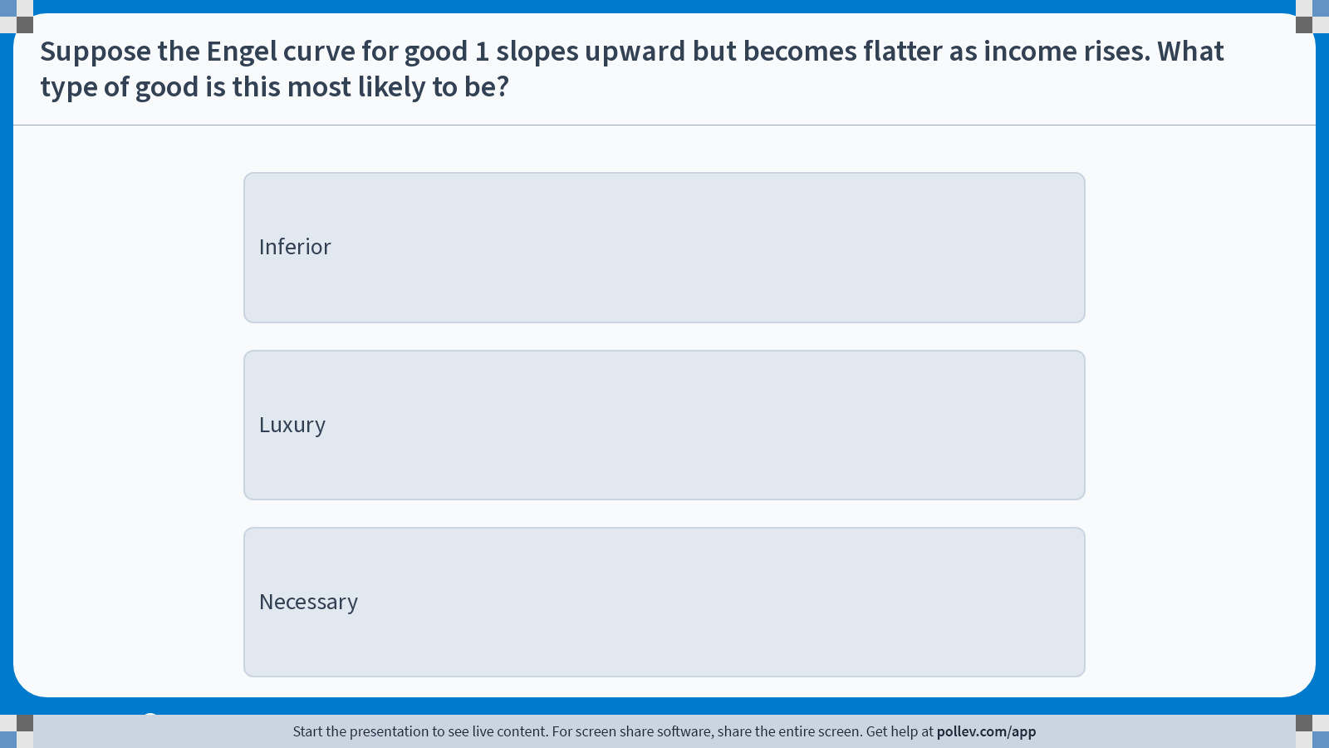
Poll Everywhere multiple choice poll instructions screen
Activity Title: Suppose the Engel curve for good 1 slopes upward but becomes flatter as income rises. What type of good is this most likely to be?
Slide 11
Notes:
Do not modify the notes in this section to avoid tampering with the Poll Everywhere activity.
More info at polleverywhere.com/support
Suppose the Engel curve for good 1 slopes upward but becomes flatter as income rises. What type of good is this most likely to be?
https://www.polleverywhere.com/multiple_choice_polls/powR9RlTLi9v8fvLFz4UD?display_state=instructions&activity_state=opened&state=opened&flow=Engagement&onscreen=persist

Slide 12
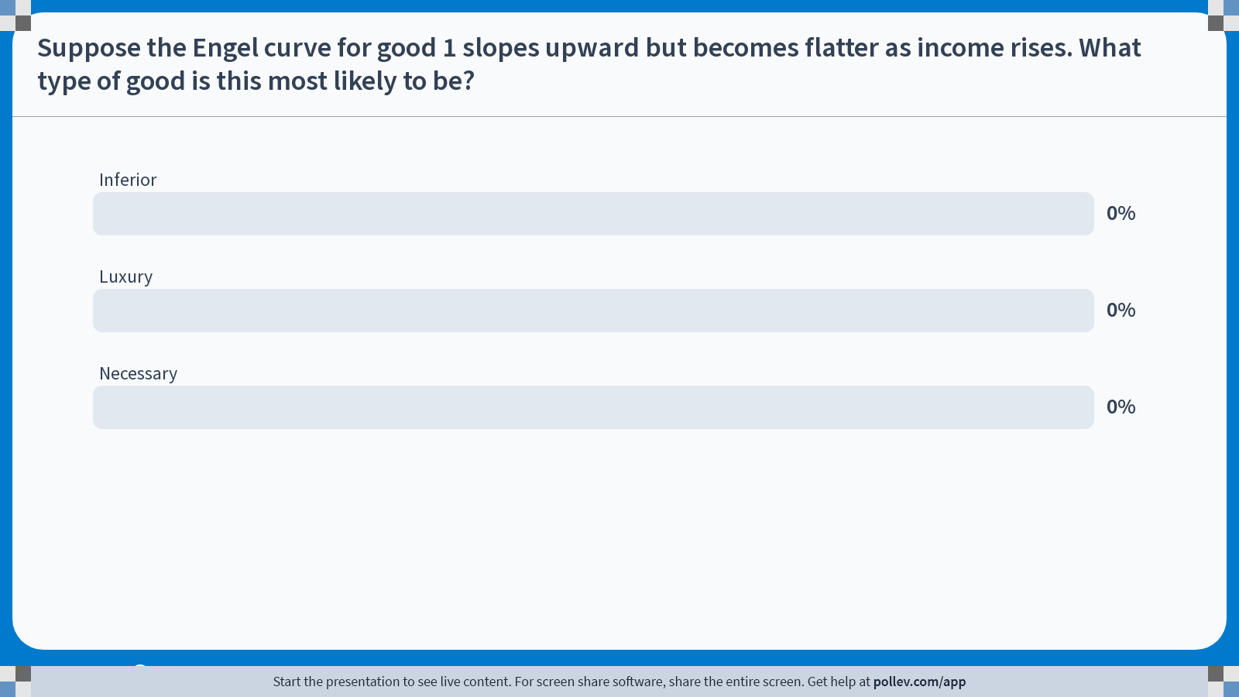
Poll Everywhere multiple choice poll chart screen
Activity Title: Suppose the Engel curve for good 1 slopes upward but becomes flatter as income rises. What type of good is this most likely to be?
Slide 13
Notes:
Do not modify the notes in this section to avoid tampering with the Poll Everywhere activity.
More info at polleverywhere.com/support
Suppose the Engel curve for good 1 slopes upward but becomes flatter as income rises. What type of good is this most likely to be?
https://www.polleverywhere.com/multiple_choice_polls/powR9RlTLi9v8fvLFz4UD?display_state=chart&activity_state=closed&state=closed&flow=Engagement&onscreen=persist

Slide 13
In-class Poll #1
Luxury
  An upward-sloping Engel curve indicates that the good is normal, since consumption increases as income rises.
  When the Engel curve becomes flatter as income increases, quantity demanded rises more than proportionally with income.
  Goods whose consumption grows more than proportionally with income are classified as luxuries.
Incorrect Answers:
  Inferior: Inferior goods would display ranges where quantity demanded falls as income rises.
  Necessary: Necessities increase less than proportionally with income. With income on the vertical axis, that pattern would correspond to an Engel curve that becomes steeper, not flatter.

Slide 14
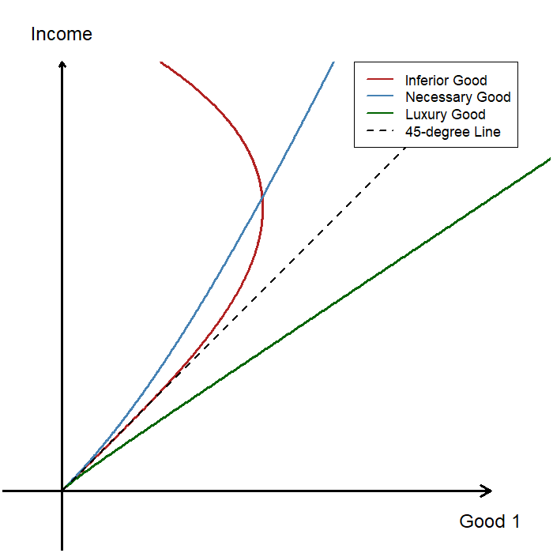
The Engel Curve: Interpretation
If good 1 is a normal good, the Engel curve slopes upward.
  If good 1 is a luxury good, the Engel curve lies to the right of the 45-degree line.
  If good 1 is a necessary good, the Engel curve lies to the left of the 45-degree line.
If good 1 is an inferior good, the Engel curve slopes downward over some range of income.
  In a two-good model with a binding budget constraint, both goods cannot be inferior at the same time.

Slide 15
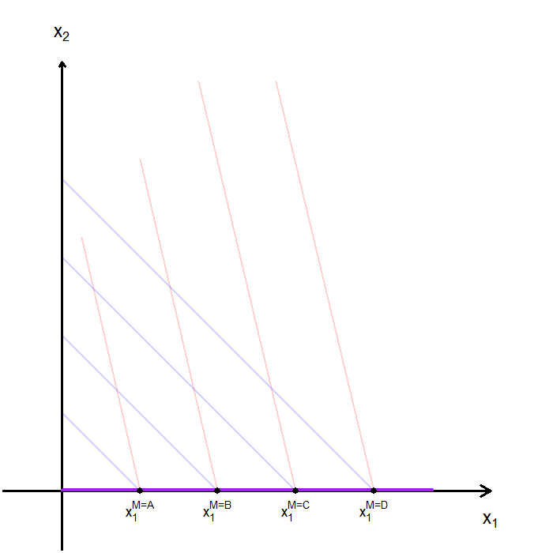
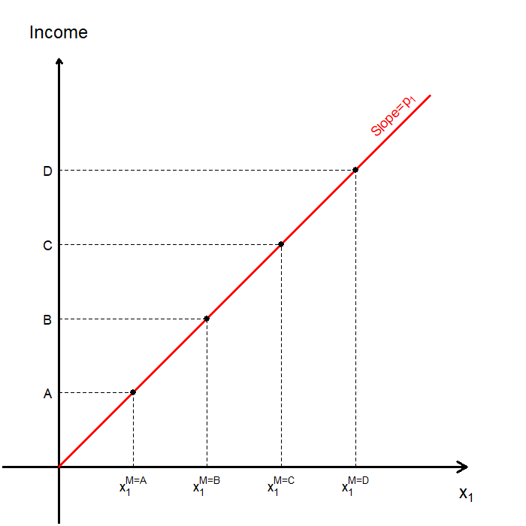
The Engel Curve: Perfect Substitutes

Slide 16
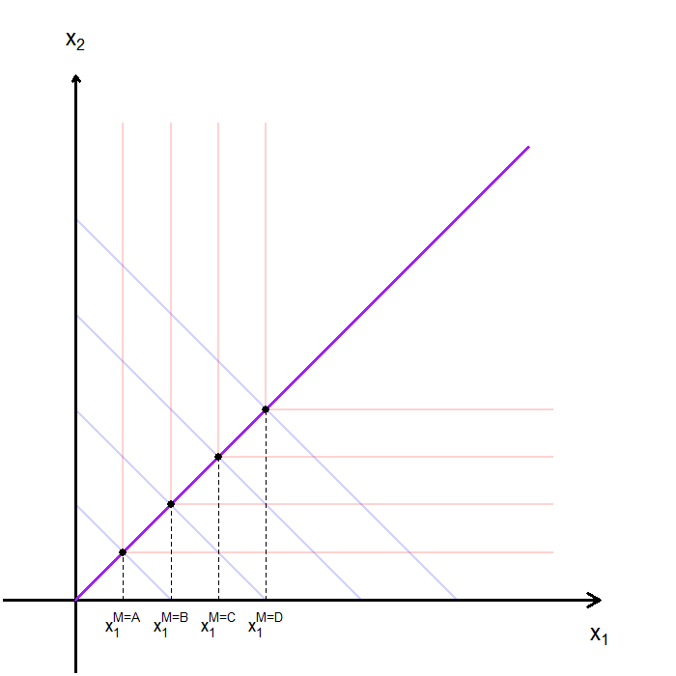
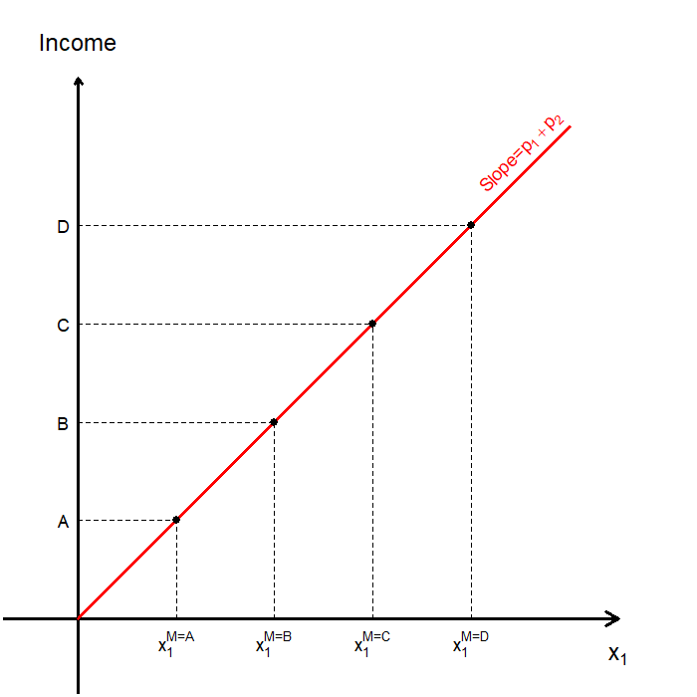
The Engel Curve: Perfect Complements

Slide 17
Consolidation: Income Changes and Demand
We study how a consumer’s optimal choice responds to changes in economic parameters.
When income changes and prices are held fixed:
  Optimal choices trace out the income offer curve.
  Projecting the income offer curve onto one good gives the Engel curve.
The Engel curve isolates income effects:
  It shows how consumption responds to income, independent of prices.
  The shape of the Engel curve allows us to classify goods as normal, inferior, luxury, or necessity.
These objects link utility maximization to observable consumption behavior.

Slide 18
Changes in Consumer Income:
The (Walrasian) Demand Curve

Slide 19
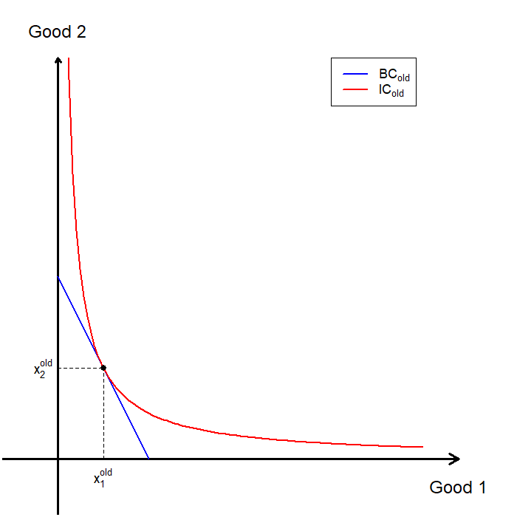
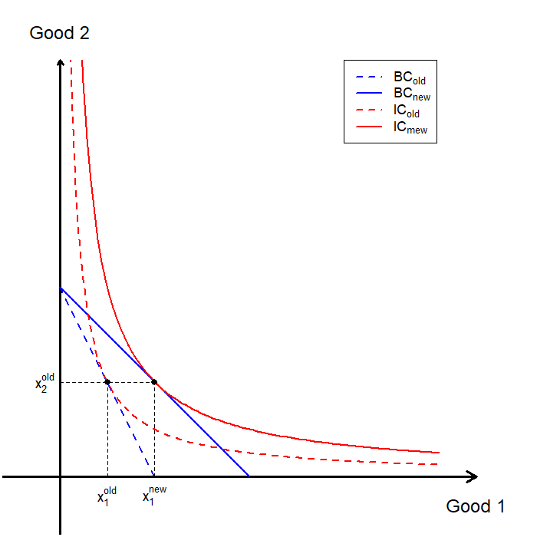
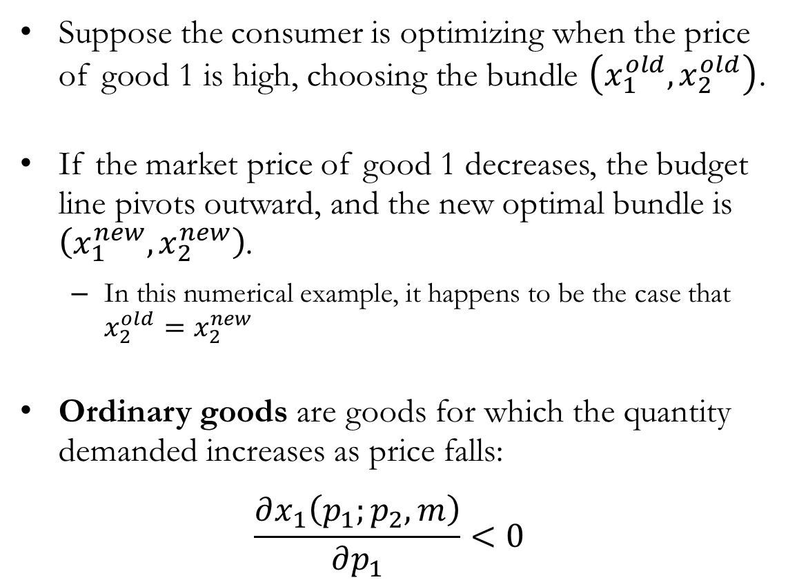
Comparative Statics: Ordinary Goods
Suppose the consumer is optimizing when the price of good 1 is high, choosing the bundle $\left(x_{1}^{old},x_{2}^{old}\right)$.
If the market price of good 1 decreases, the budget line pivots outward, and the new optimal bundle is $\left(x_{1}^{new},x_{2}^{new}\right)$.
  In this numerical example, it happens to be the case that $x_{2}^{old}=x_{2}^{new}$
Ordinary goods are goods for which the quantity demanded increases as price falls:
$$\frac{∂x_{1}\left(p_{1};p_{2},m\right)}{∂p_{1}}<0$$

Slide 20
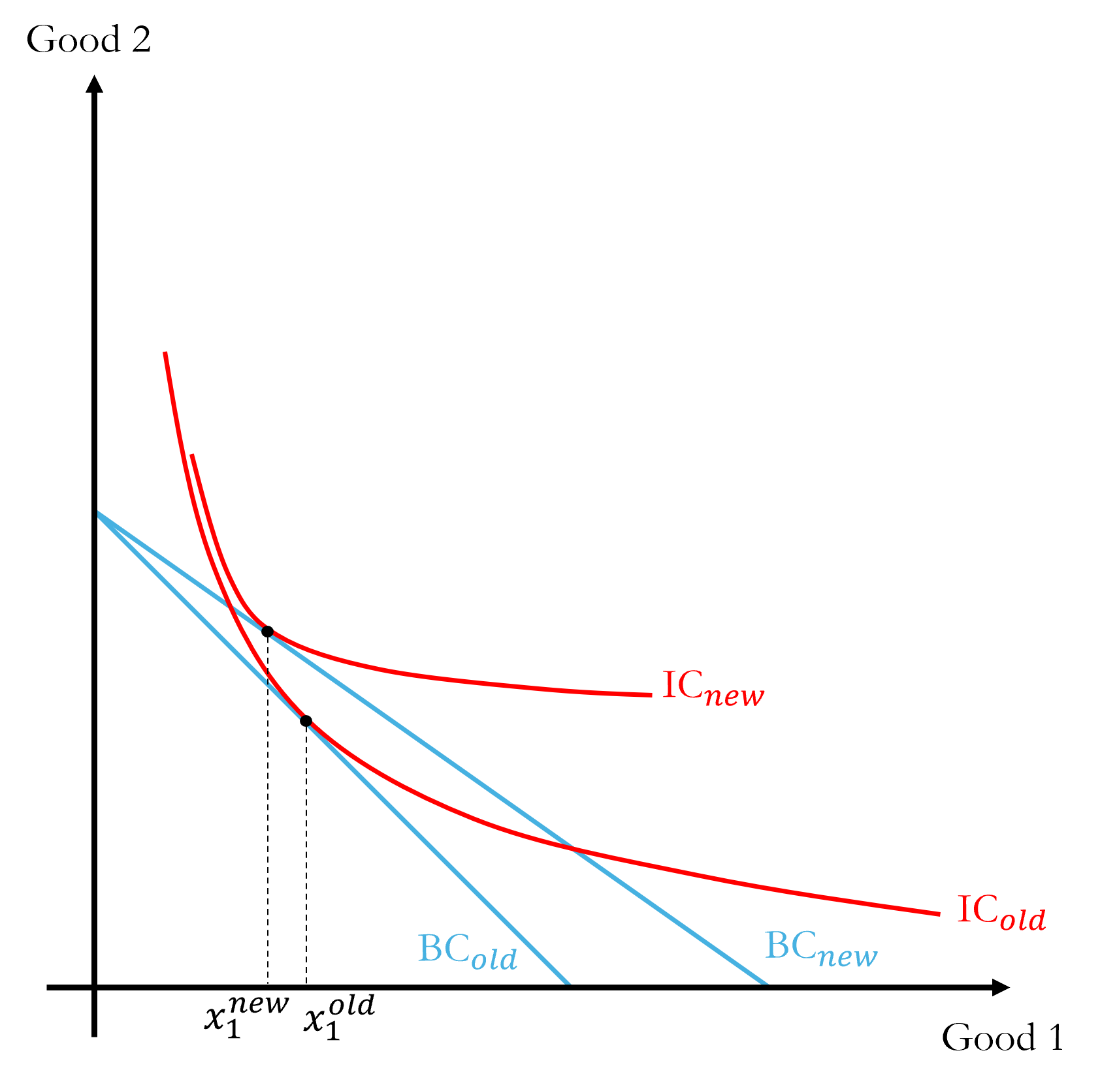
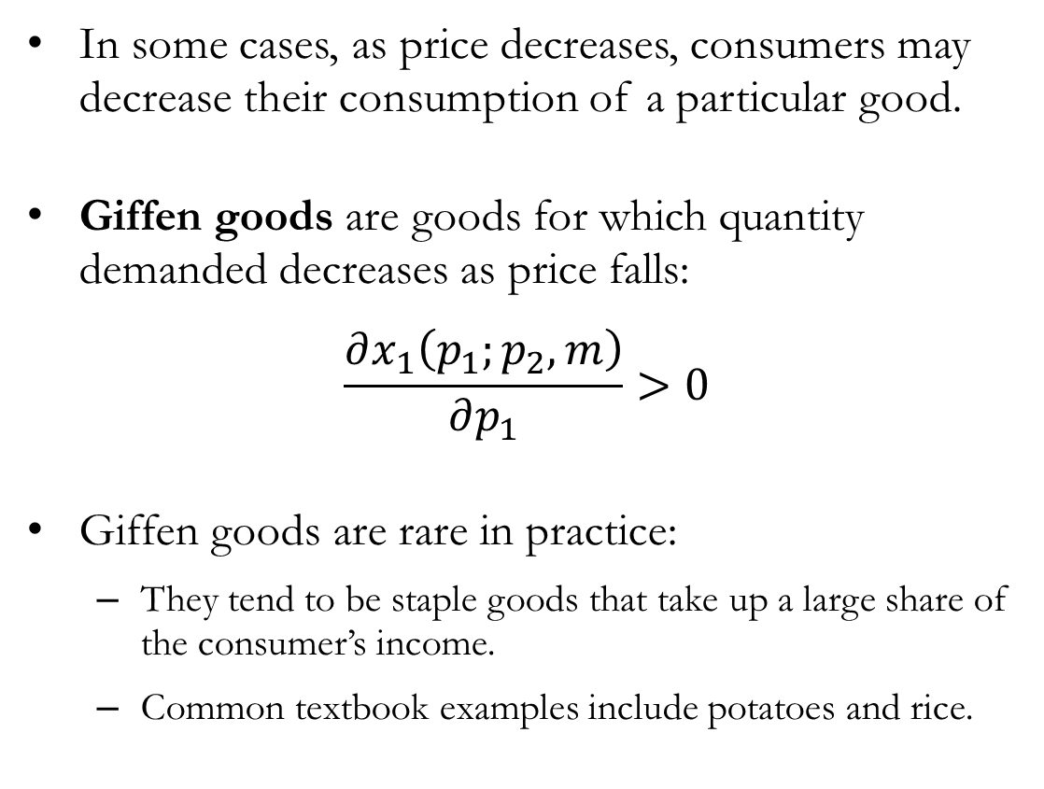
Comparative Statics: Giffen Goods
In some cases, as price decreases, consumers may decrease their consumption of a particular good.
Giffen goods are goods for which quantity demanded decreases as price falls:
$$\frac{∂x_{1}\left(p_{1};p_{2},m\right)}{∂p_{1}}>0$$
Giffen goods are rare in practice:
  They tend to be staple goods that take up a large share of the consumer’s income.
  Common textbook examples include potatoes and rice.

Slide 21
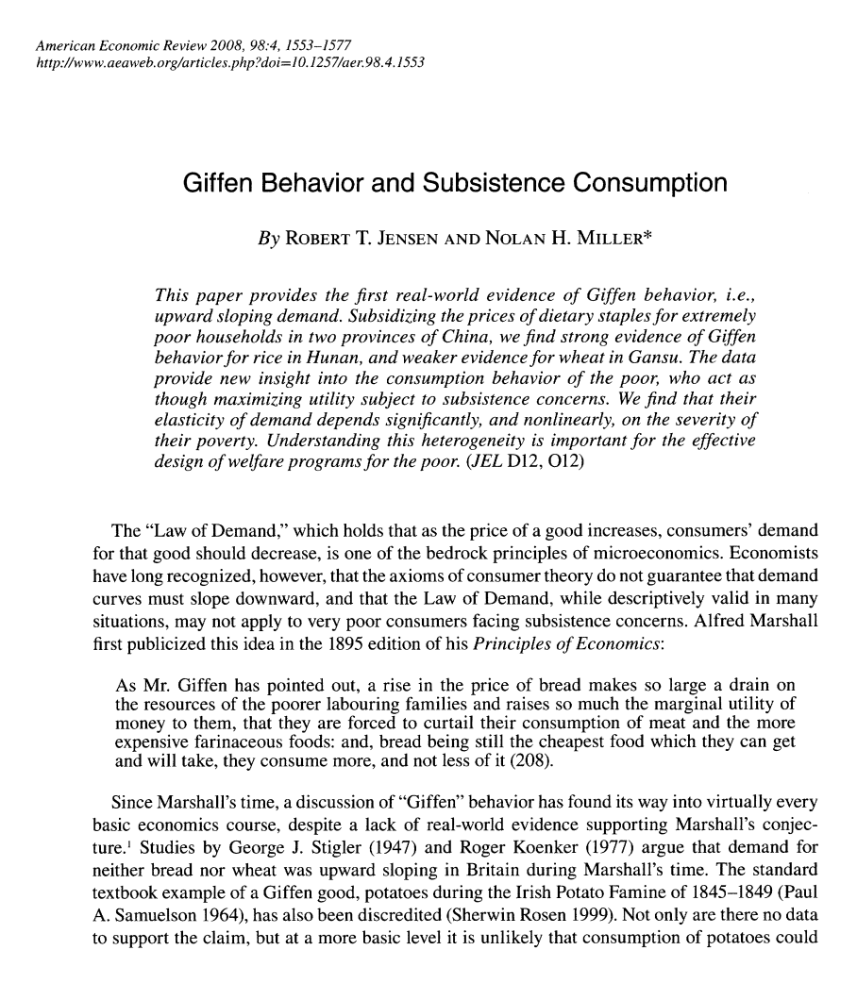
Detour: Giffen Goods
The canonical examples of Giffen goods involve staple foods consumed by very low-income households:
  Low-income households allocate a large share of their income to a staple food (e.g., rice, potatoes).
  When the price of the staple food falls, the household experiences a large increase in real income.
  With higher real income, the household substitutes away from the staple food toward higher-quality foods.
  As a result, the quantity demanded of the staple food falls when its price falls, implying an upward-sloping demand curve.

Slide 22
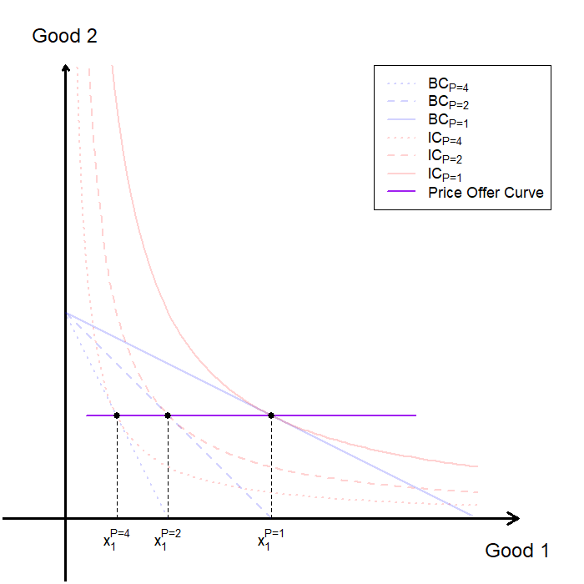
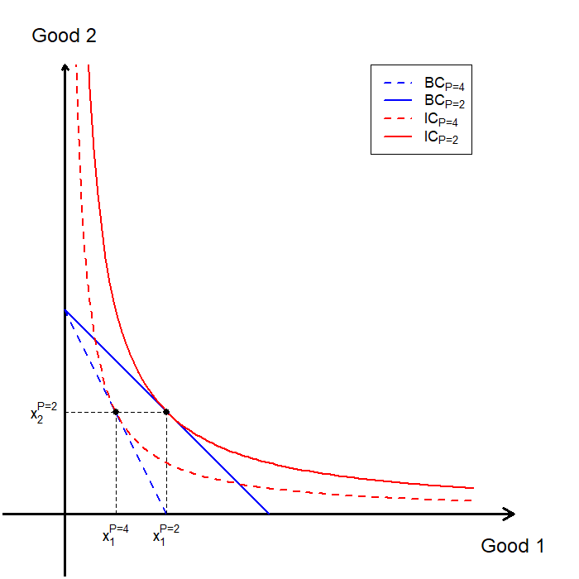
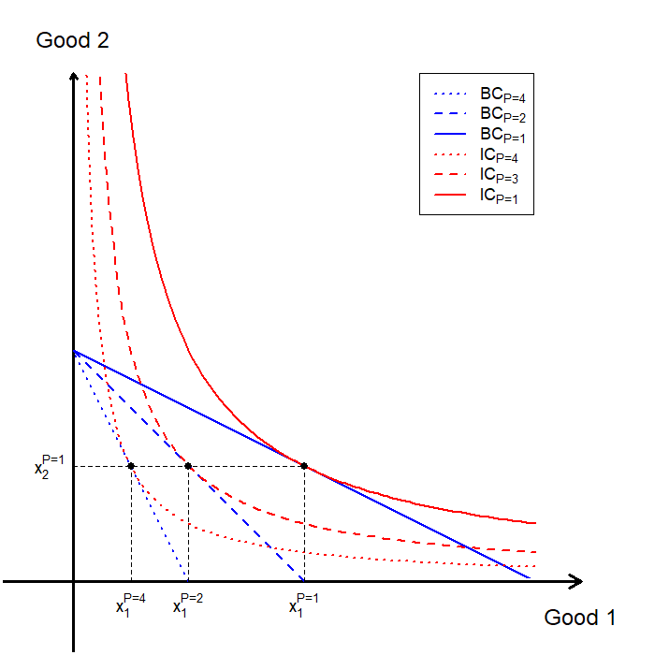
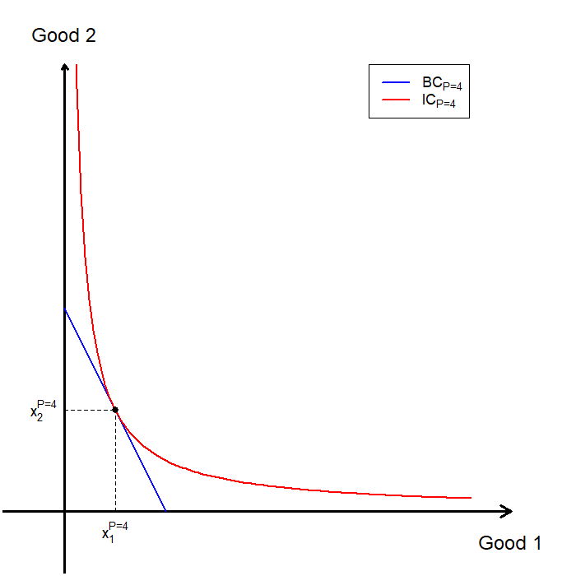
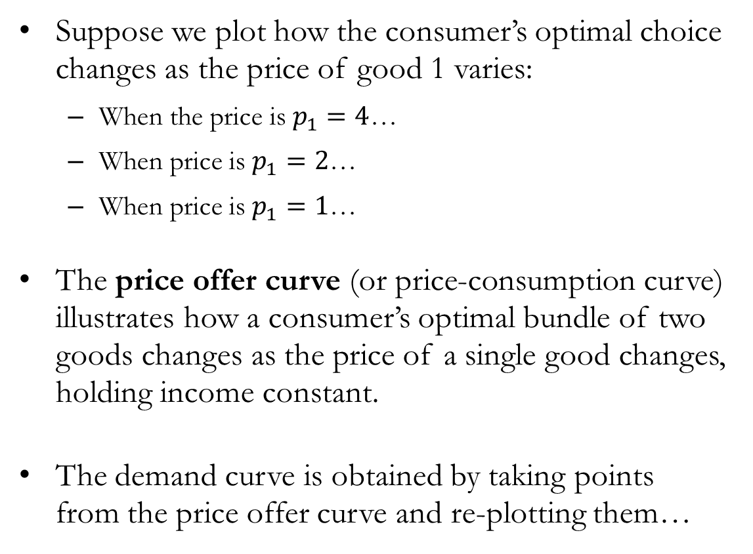
Comparative Statics: The Price Offer Curve
Suppose we plot how the consumer’s optimal choice changes as the price of good 1 varies:
  When the price is $p_{1}=4$…
  When price is $p_{1}=2$…
  When price is $p_{1}=1$…
The price offer curve (or price-consumption curve) illustrates how a consumer’s optimal bundle of two goods changes as the price of a single good changes, holding income constant.
The demand curve is obtained by taking points from the price offer curve and re-plotting them…

Slide 23
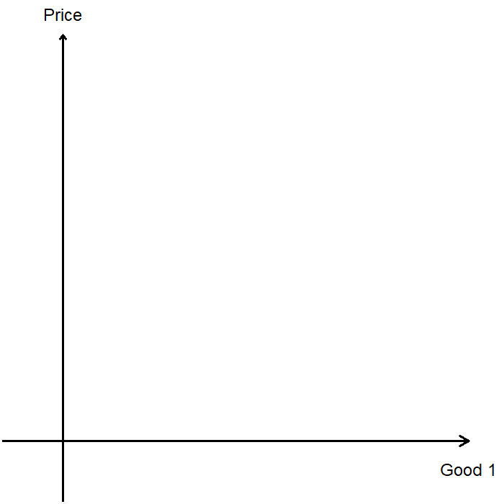
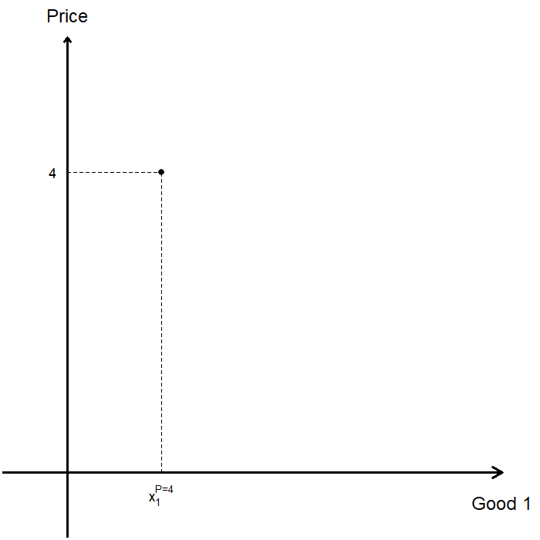
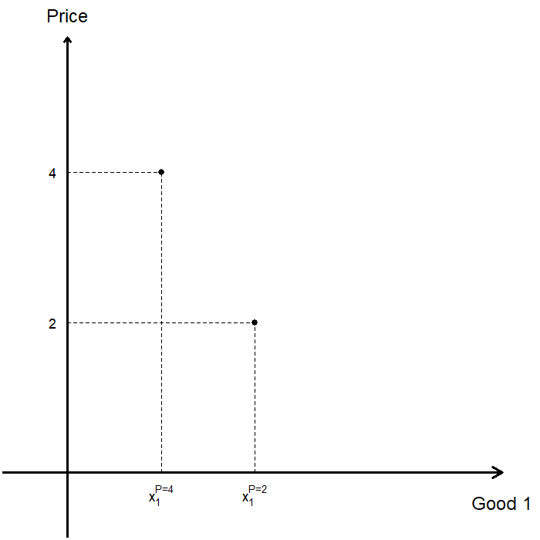
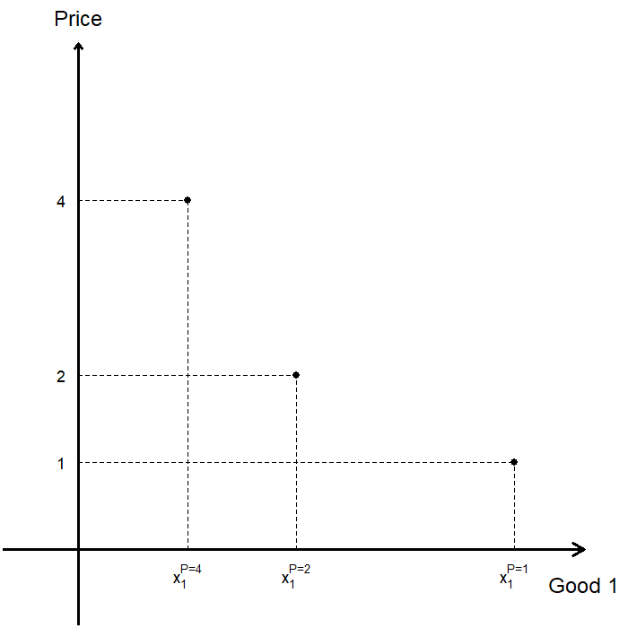
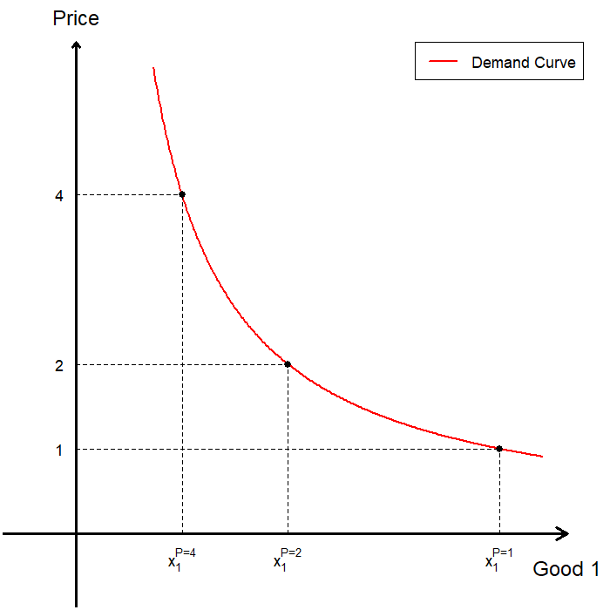
The Price Offer Curve and the Demand Curve

Slide 24
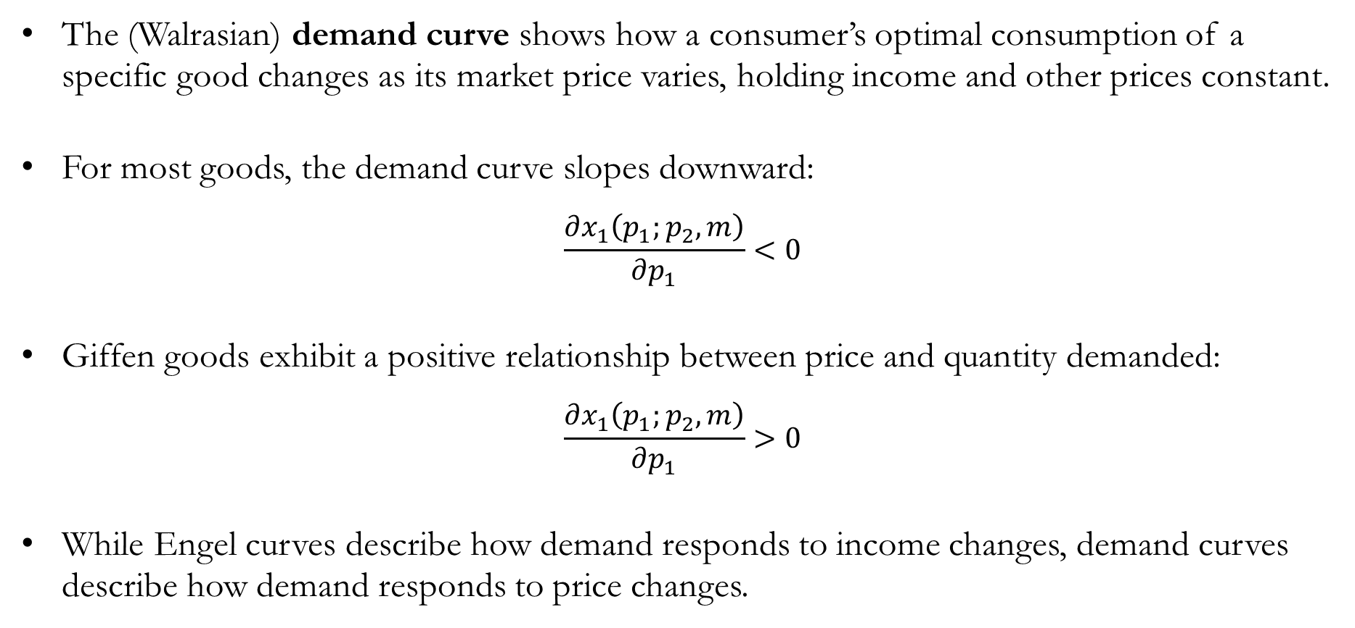
Comparative Statics: The Demand Curve
The (Walrasian) demand curve shows how a consumer’s optimal consumption of a specific good changes as its market price varies, holding income and other prices constant.
For most goods, the demand curve slopes downward:
$$\frac{∂x_{1}\left(p_{1};p_{2},m\right)}{∂p_{1}}<0$$
Giffen goods exhibit a positive relationship between price and quantity demanded:
$$\frac{∂x_{1}\left(p_{1};p_{2},m\right)}{∂p_{1}}>0$$
While Engel curves describe how demand responds to income changes, demand curves describe how demand responds to price changes.

Slide 25
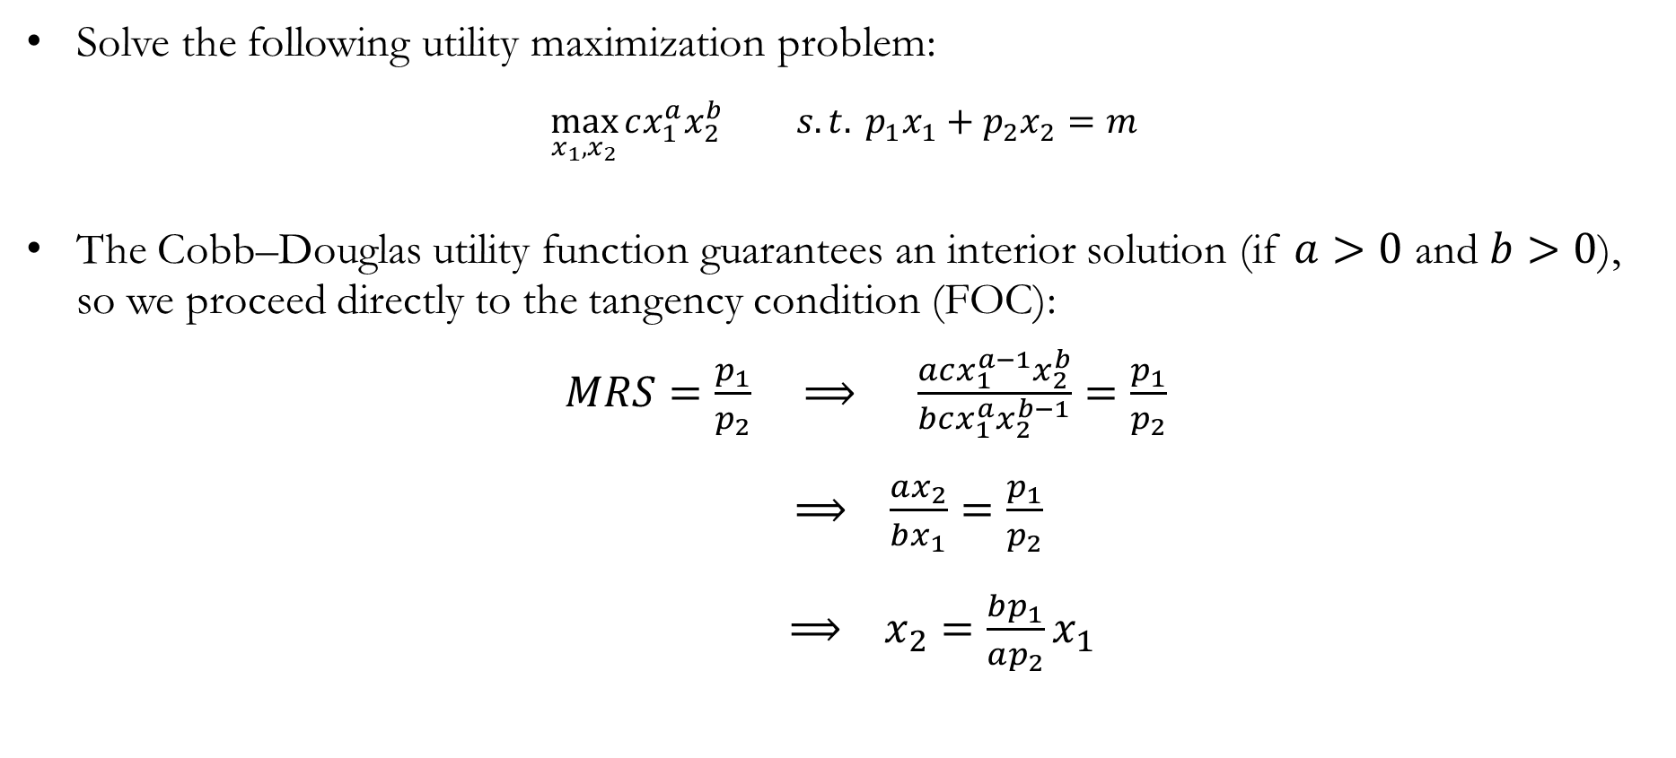
Demand Function: Cobb-Douglas
Solve the following utility maximization problem:
$$\max_{x_{1},x_{2}}{cx_{1}^{a}x_{2}^{b}} s.t. p_{1}x_{1}+p_{2}x_{2}=m$$
The Cobb–Douglas utility function guarantees an interior solution (if $a>0$ and $b>0$), so we proceed directly to the tangency condition (FOC):
$MRS=\frac{p_{1}}{p_{2}} ⟹ \frac{acx_{1}^{a−1}x_{2}^{b}}{bcx_{1}^{a}x_{2}^{b−1}}=\frac{p_{1}}{p_{2}}$
$⟹ \frac{ax_{2}}{bx_{1}}=\frac{p_{1}}{p_{2}}$
$⟹ x_{2}=\frac{bp_{1}}{ap_{2}}x_{1}$

Slide 26
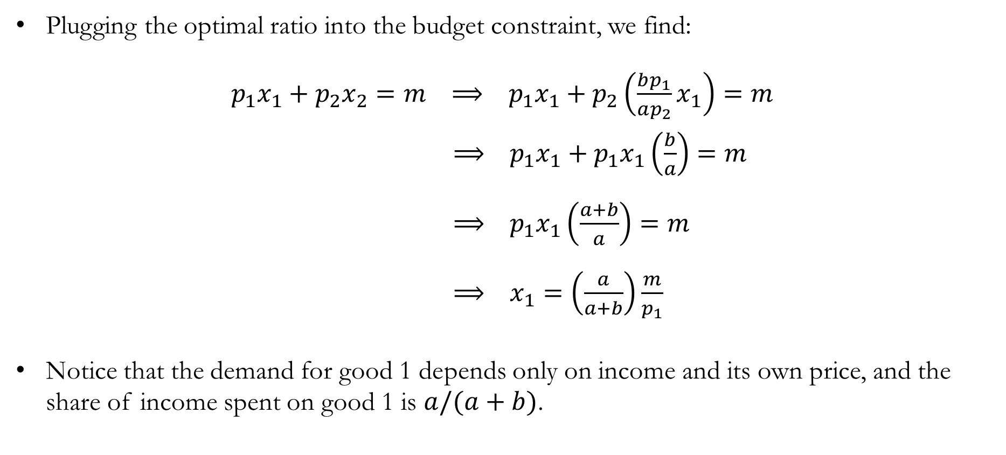
Demand Function: Cobb-Douglas
Plugging the optimal ratio into the budget constraint, we find:
$p_{1}x_{1}+p_{2}x_{2}=m ⟹ p_{1}x_{1}+p_{2}\left(\frac{bp_{1}}{ap_{2}}x_{1}\right)=m$
$⟹ p_{1}x_{1}+p_{1}x_{1}\left(\frac{b}{a}\right)=m$
$⟹ p_{1}x_{1}\left(\frac{a+b}{a}\right)=m$
$⟹ x_{1}=\left(\frac{a}{a+b}\right)\frac{m}{p_{1}}$
Notice that the demand for good 1 depends only on income and its own price, and the share of income spent on good 1 is $a/(a+b)$.

Slide 27
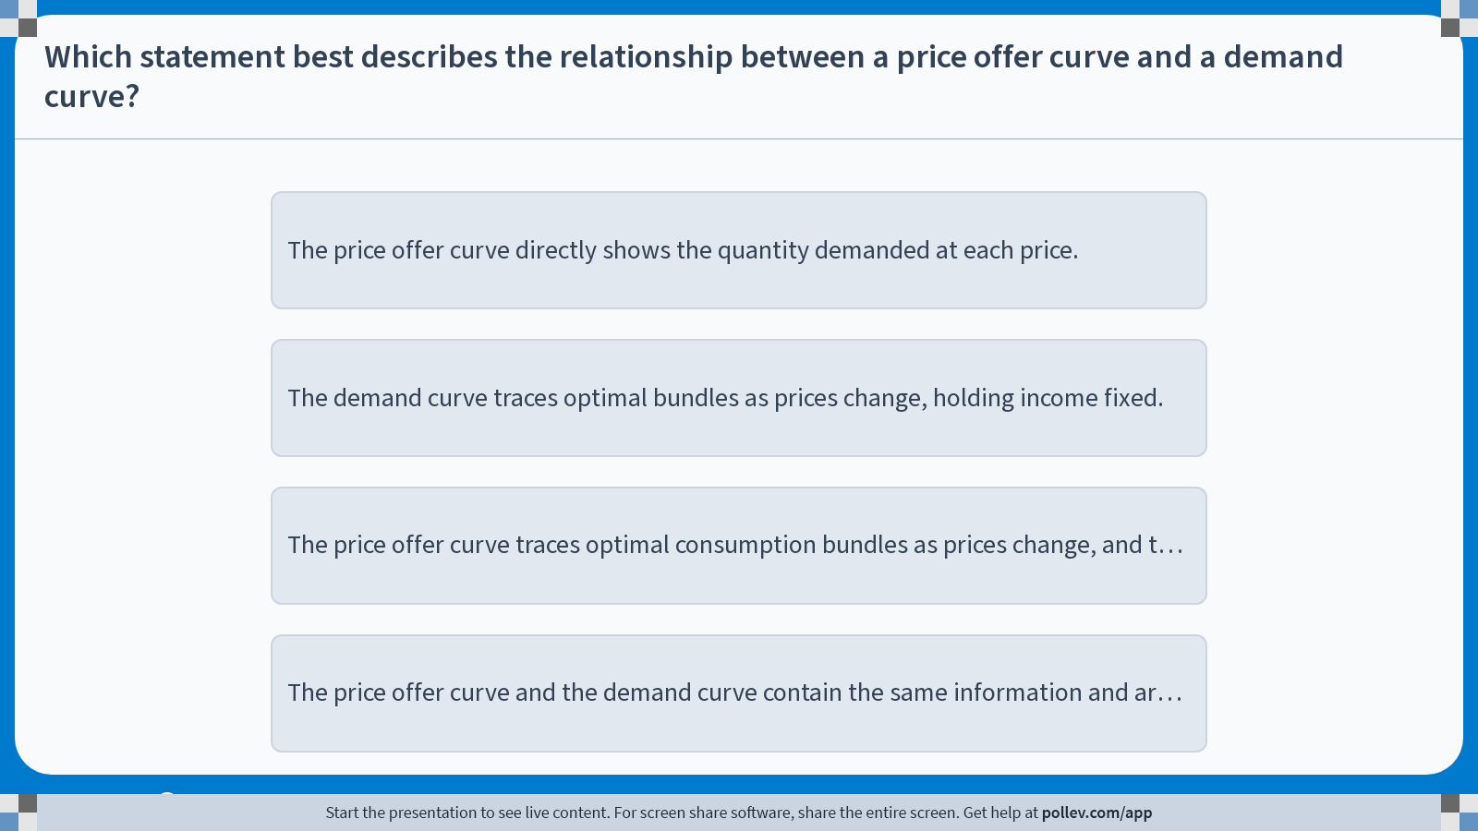
Poll Everywhere multiple choice poll instructions screen
Activity Title: Which statement best describes the relationship between a price offer curve and a demand curve?
Slide 24
Notes:
Do not modify the notes in this section to avoid tampering with the Poll Everywhere activity.
More info at polleverywhere.com/support
Which statement best describes the relationship between a price offer curve and a demand curve?
https://www.polleverywhere.com/multiple_choice_polls/zFzt7RZXdDBnRcAXnx1CH?display_state=instructions&activity_state=opened&state=opened&flow=Engagement&onscreen=persist

Slide 28
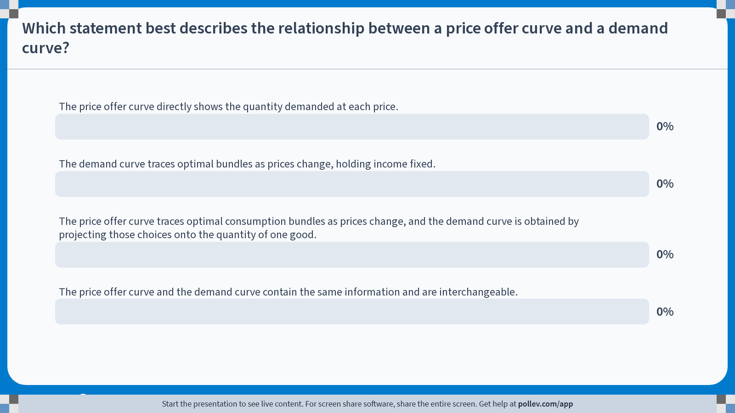
Poll Everywhere multiple choice poll chart screen
Activity Title: Which statement best describes the relationship between a price offer curve and a demand curve?
Slide 26
Notes:
Do not modify the notes in this section to avoid tampering with the Poll Everywhere activity.
More info at polleverywhere.com/support
Which statement best describes the relationship between a price offer curve and a demand curve?
https://www.polleverywhere.com/multiple_choice_polls/zFzt7RZXdDBnRcAXnx1CH?display_state=chart&activity_state=closed&state=closed&flow=Engagement&onscreen=persist

Slide 29
In-class Poll #2
The price offer curve traces optimal consumption bundles as prices change, and the demand curve is obtained by projecting those choices onto the quantity of one good.
  The price offer curve shows how the consumer’s entire optimal bundle changes as prices vary, holding income and preferences fixed.
  Each point on the price offer curve corresponds to an optimal choice in commodity space.
  The demand curve is constructed by projecting these optimal choices onto the axis for a single good.
  This yields the quantity demanded at each price.
Incorrect Answers:
  A: The price offer curve shows bundles, not quantities of a single good.
  B: The demand curve does not trace bundles, but it shows the quantity of one good as a function of price.
  D: The two curves are related but serve different roles and are not interchangeable.

Slide 30
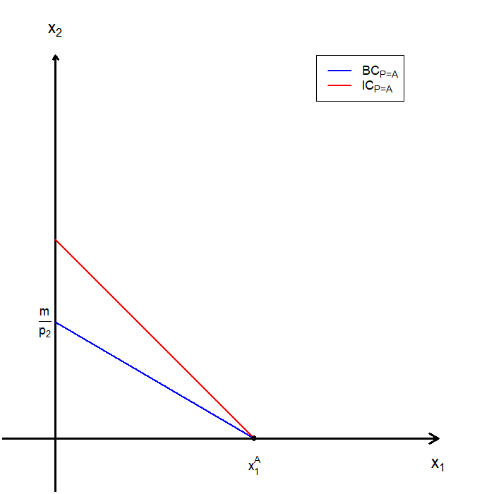
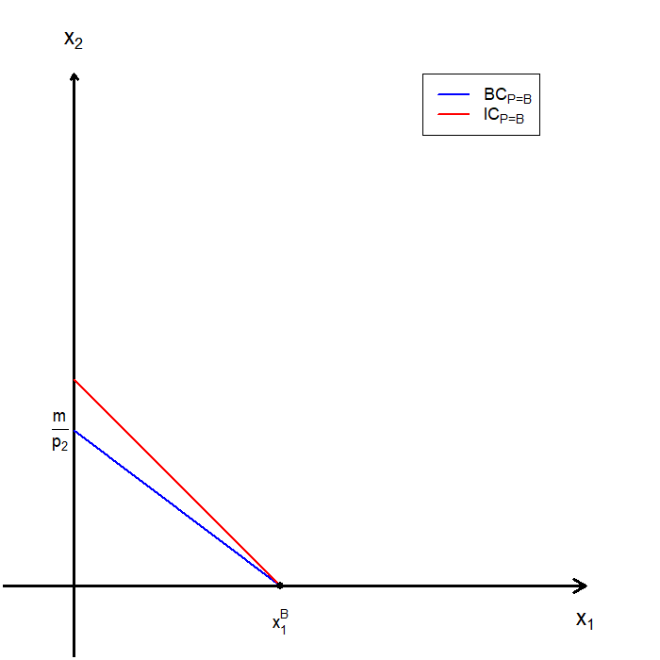
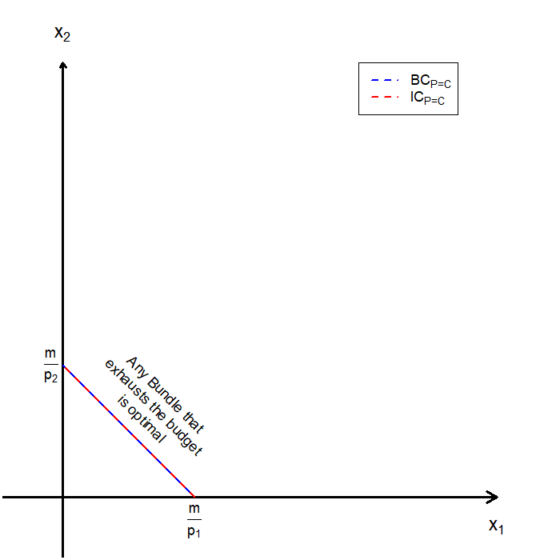
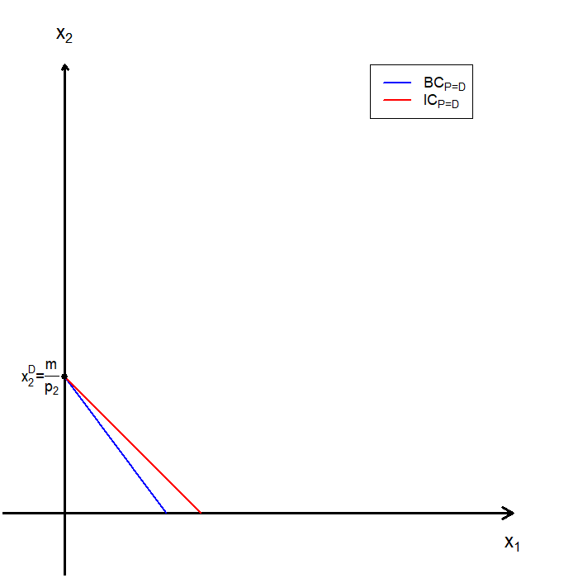






The Demand Curve: Perfect Substitutes

Slide 31

Demand Function: Perfect Substitutes
Solve the following utility maximization problem:
$$\max_{x_{1},x_{2}}{ax_{1}+bx_{2}} s.t. p_{1}x_{1}+p_{2}x_{2}=m$$
Since utility is linear, the consumer compares utility per dollar spent, and the consumer’s optimal choice follows this rule:
$\frac{a}{p_{1}}>\frac{b}{p_{2}} ⟹$ Exclusively purchase good 1.
$\frac{a}{p_{1}}<\frac{b}{p_{2}} ⟹$ Exclusively purchase good 2.
$\frac{a}{p_{1}}=\frac{b}{p_{2}} ⟹$ Any bundle that exhaust income.

Slide 32

Demand Function: Perfect Substitutes
The demand correspondence is then:
$x_{1}=\left\{\begin{aligned}\frac{m}{p_{1}} , \\ Any number between 0 and\frac{m}{p_{1}}, \\ 0 ,\end{aligned}\right.$ $\begin{matrix}if \frac{a}{p_{1}}>\frac{b}{p_{2}} \\ if \frac{a}{p_{1}}=\frac{b}{p_{2}} \\ if \frac{a}{p_{1}}<\frac{b}{p_{2}}\end{matrix}$

Slide 33
The Demand Curve: Perfect Complements
PLEASE TRY AT HOME

Slide 34

Demand Function: Perfect Complements
Solve the following utility maximization problem:
$$\max_{x_{1},x_{2}}{ min\{ax_{1},bx_{2}\}} s.t. p_{1}x_{1}+p_{2}x_{2}=m$$
The optimal ratio must follow (see Chapter 5):
$$ax_{1}=bx_{2} ⟹ x_{2}=\frac{a}{b}x_{1}$$
Plugging the optimal ratio into the budget constraint, we find:
$p_{1}x_{1}+p_{2}x_{2}=m ⟹ p_{1}x_{1}+p_{2}\left(\frac{a}{b}x_{1}\right)=m$
$⟹ x_{1}\left(p_{1}+\frac{a}{b}p_{2}\right)=m$
$⟹ x_{1}=\frac{m}{\left(p_{1}+\frac{a}{b}p_{2}\right)}$

Slide 35



The Inverse Demand Function
The demand curve for good 1 is found by fixing $p_{2}$ and $m$, and plotting the quantity demanded $x_{1}$ as a function of $p_{1}$.
$$x_{1}=x_{1}\left(p_{1};p_{2},m\right)$$
Equivalently, we can invert this relationship and plot the inverse demand function, which gives the price as a function of quantity demanded:
$$p_{1}=p_{1}\left(x_{1};p_{2},m\right)$$
The inverse demand curve plays a central role in measuring consumer willingness to pay.

Slide 36

The Inverse Demand Function: Interpretation
Recall that at an interior optimum, a consumer with well-behaved preferences satisfies the following first-order condition:
$$\left|MRS\right|=\frac{p_{1}}{p_{2}}$$
Suppose, for simplicity, that good 2 is the numeraire $\left(p_{2}=1\right)$. The condition becomes:
$$p_{1}=\left|MRS\right|$$
Therefore, at the consumer’s optimal bundle, the inverse demand function can be interpreted as marginal willingness to pay for good 1 (measured in units of good 2).

Slide 37
Consolidation: Price Changes and Demand
The (Walrasian) demand curve shows:
  How optimal consumption of a good changes as its price varies,
  Holding income and preferences fixed.
The inverse demand curve re-expresses this relationship, giving the price at which a consumer is just willing to purchase a given quantity.
Interpreting inverse demand:
  Each point corresponds to the consumer’s marginal willingness to pay for an additional unit.
  Higher quantities are associated with lower marginal willingness to pay.
Inverse demand provides a useful economic interpretation of demand curves, and it will play a central role in measuring consumer surplus in the next chapter.

Slide 38
Recap & Preview

Slide 39
Recap: Demand
We studied how a consumer’s optimal choice responds to changes in parameters.
The Engel curve describes how optimal consumption of a good changes as income varies, holding prices fixed.
The shape of the Engel curve allows us to classify goods:
  Normal goods: Consumption increases as income rises.
  Inferior goods: Consumption decreases over some income range.
  Luxury goods: Consumption increases more than proportionally with income.
  Necessities: Consumption increases less than proportionally with income.
Engel curves are observable objects that help us infer preferences from data.

Slide 40
Recap: Demand
The (Walrasian) demand curve shows how optimal consumption changes as the price of a good varies, holding income fixed.
From the consumer’s choice problem, we derived demand functions that describe optimal consumption as a function of prices, income, and the consumer’s preferences.
We examined special cases:
  Perfect substitutes.
  Perfect complements.
  Giffen goods.
Comparative statics provide the bridge between individual optimization and market demand.

Slide 41
Preview: Consumer’s Surplus
In the next chapter, we shift focus from choice to economic welfare.
We focus on two central questions:
  How much does a consumer benefit from participating in a market?
  How do changes in prices affect consumer well-being?
We introduce consumer’s surplus as a measure of the net benefits from consumption.
Using demand curves, we will:
  Define consumer surplus formally.
  Interpret consumer surplus graphically.
  Measure changes in consumer surplus from price changes.

