Slide 1
INTERMEDIATE MICROECONOMIC THEORY
Chapter 4: Utility

Slide 2
Recap: Preferences
Preferences describe how a consumer ranks bundles of goods.
Axioms: Completeness, Reflexivity, Transitivity, (Weak) Monotonicity, Convexity, and Continuity
Preferences are represented graphically using indifference curves:
Each indifference curve represents bundles the consumer views as equally desirable.
(In general) Indifference curves further from the origin correspond to more preferred bundles.
The Marginal Rate of Substitution (MRS) measures the rate at which a consumer is willing to trade one good for another while remaining indifferent.
MRS is the slope of the indifference curve at a point.
MRS represents the consumer’s marginal willingness to pay for one good in terms of the other.
The MRS is diminishing as consumption shifts toward more of one good.

Slide 3
Utility

Slide 4
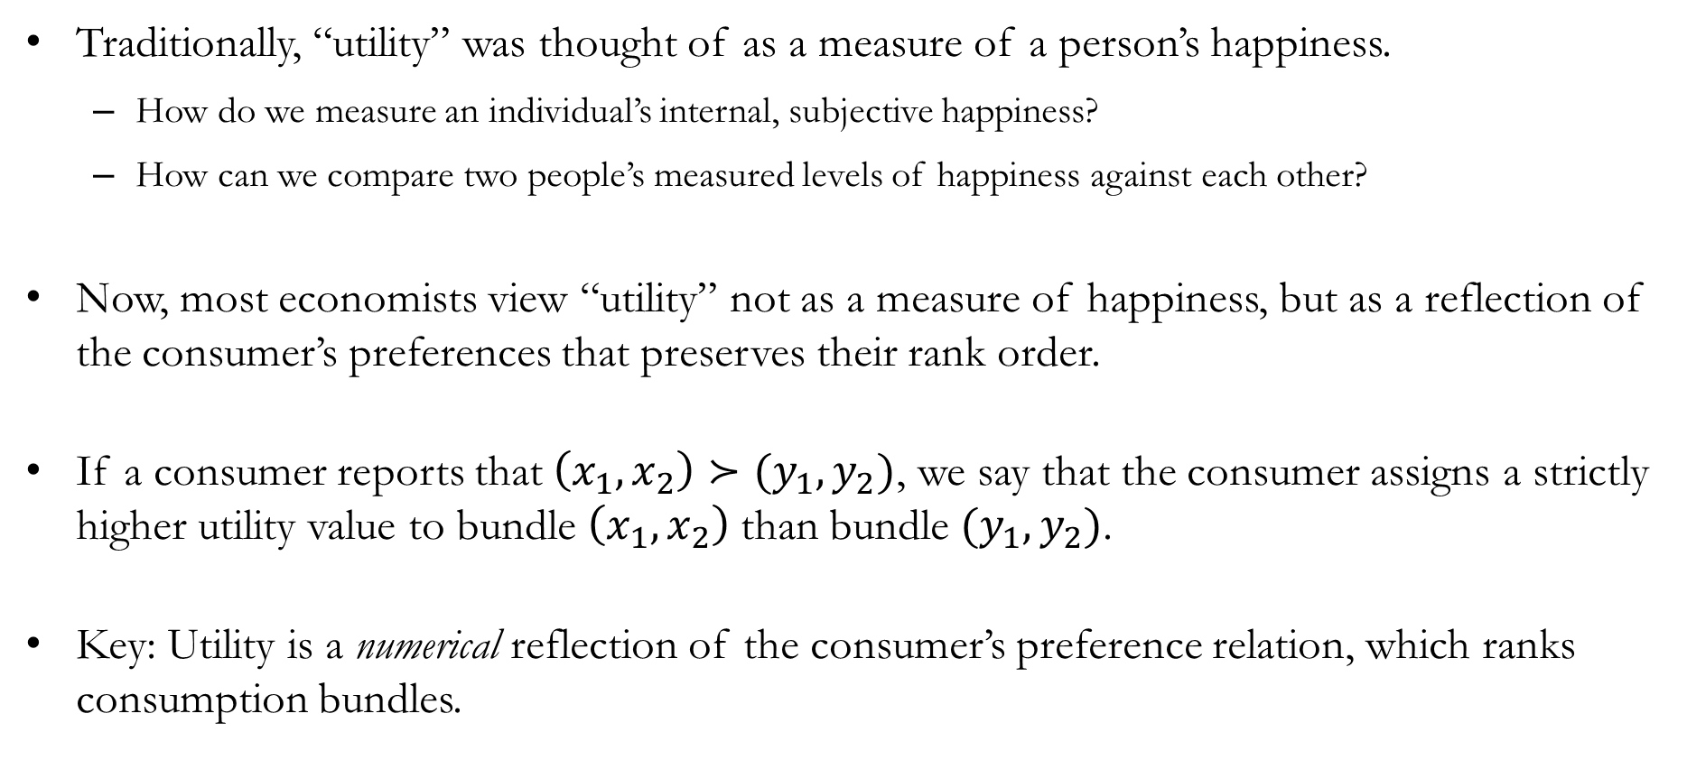
Utility
Traditionally, “utility” was thought of as a measure of a person’s happiness.
How do we measure an individual’s internal, subjective happiness?
How can we compare two people’s measured levels of happiness against each other?
Now, most economists view “utility” not as a measure of happiness, but as a reflection of the consumer’s preferences that preserves their rank order.
If a consumer reports that $\left(x_{1},x_{2}\right)≻(y_{1},y_{2})$, we say that the consumer assigns a strictly higher utility value to bundle $\left(x_{1},x_{2}\right)$ than bundle $(y_{1},y_{2})$.
Key: Utility is a numerical reflection of the consumer’s preference relation, which ranks consumption bundles.

Slide 5
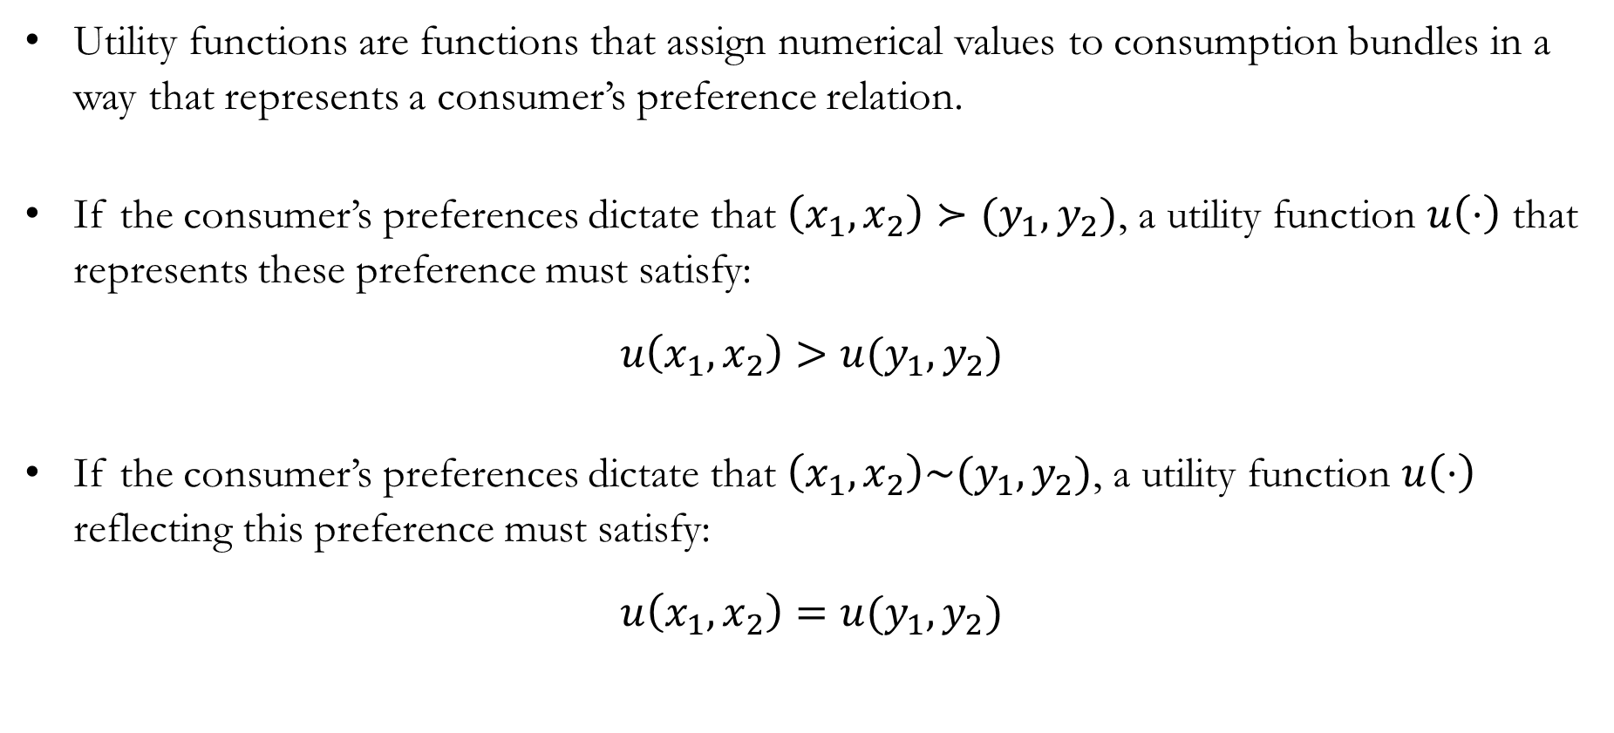
Utility Functions
Utility functions are functions that assign numerical values to consumption bundles in a way that represents a consumer’s preference relation.
If the consumer’s preferences dictate that $\left(x_{1},x_{2}\right)≻(y_{1},y_{2})$, a utility function $u\left(⋅\right)$ that represents these preference must satisfy:
$$u\left(x_{1},x_{2}\right)>u(y_{1},y_{2})$$
If the consumer’s preferences dictate that $\left(x_{1},x_{2}\right)\sim (y_{1},y_{2})$, a utility function $u\left(⋅\right)$ reflecting this preference must satisfy:
$$u\left(x_{1},x_{2}\right)=u(y_{1},y_{2})$$

Slide 6
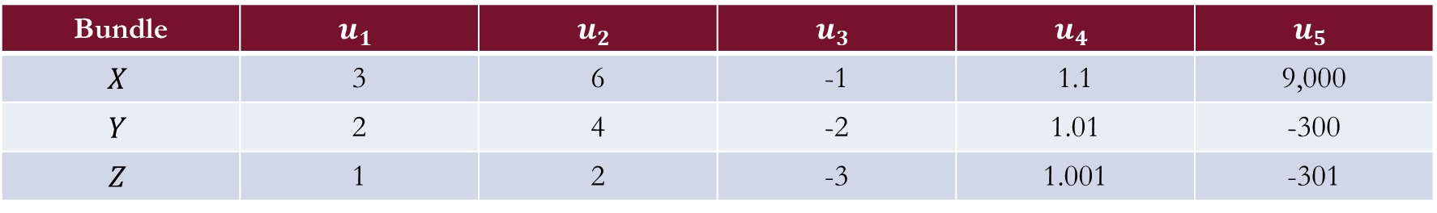
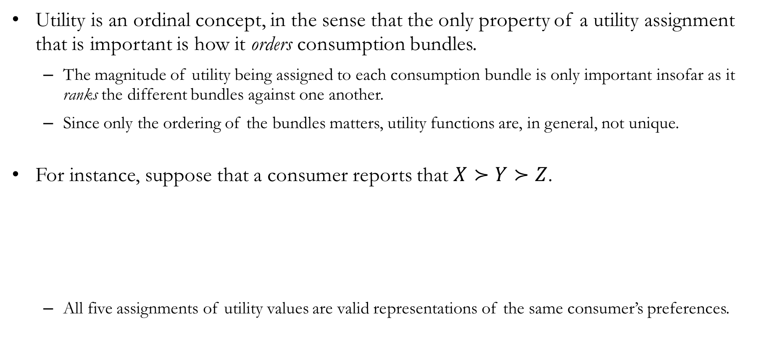
Ordinal Utility
Utility is an ordinal concept, in the sense that the only property of a utility assignment that is important is how it orders consumption bundles.
The magnitude of utility being assigned to each consumption bundle is only important insofar as it ranks the different bundles against one another.
Since only the ordering of the bundles matters, utility functions are, in general, not unique.
For instance, suppose that a consumer reports that $X≻Y≻Z$.
All five assignments of utility values are valid representations of the same consumer’s preferences.
Bundle | $$u_{1}$$ | $$u_{2}$$ | $$u_{3}$$ | $$u_{4}$$ | $$u_{5}$$
$$X$$ | 3 | 6 | -1 | 1.1 | 9,000
$$Y$$ | 2 | 4 | -2 | 1.01 | -300
$$Z$$ | 1 | 2 | -3 | 1.001 | -301

Slide 7
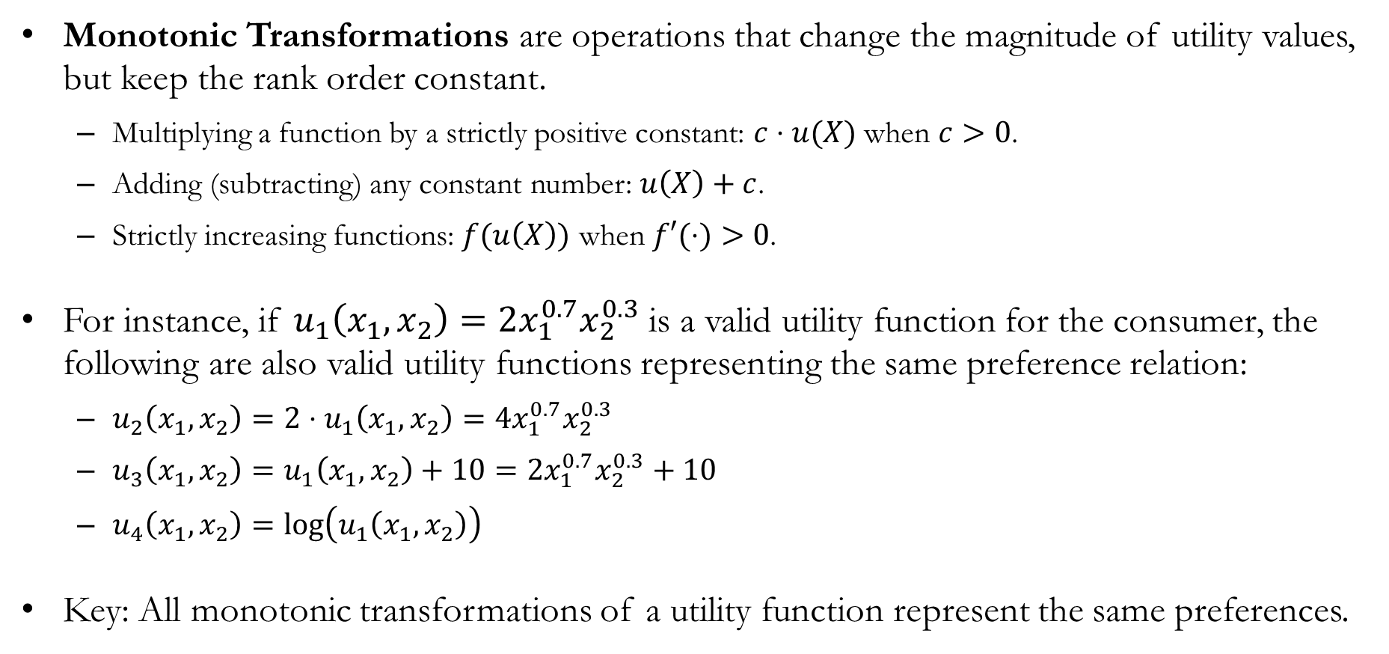
Monotonic Transformations of Utility Functions
Monotonic Transformations are operations that change the magnitude of utility values, but keep the rank order constant.
Multiplying a function by a strictly positive constant: $c⋅u(X)$ when $c>0$.
Adding (subtracting) any constant number: $u\left(X\right)+c$.
Strictly increasing functions: $f(u\left(X\right))$ when $f′(⋅)>0$.
For instance, if $u_{1}\left(x_{1},x_{2}\right)=2x_{1}^{0.7}x_{2}^{0.3}$ is a valid utility function for the consumer, the following are also valid utility functions representing the same preference relation:
$u_{2}\left(x_{1},x_{2}\right)=2⋅u_{1}\left(x_{1},x_{2}\right)=4x_{1}^{0.7}x_{2}^{0.3}$
$u_{3}\left(x_{1},x_{2}\right)=u_{1}\left(x_{1},x_{2}\right)+10=2x_{1}^{0.7}x_{2}^{0.3}+10$
$u_{4}\left(x_{1},x_{2}\right)=log\left(u_{1}\left(x_{1},x_{2}\right)\right)$
Key: All monotonic transformations of a utility function represent the same preferences.

Slide 8
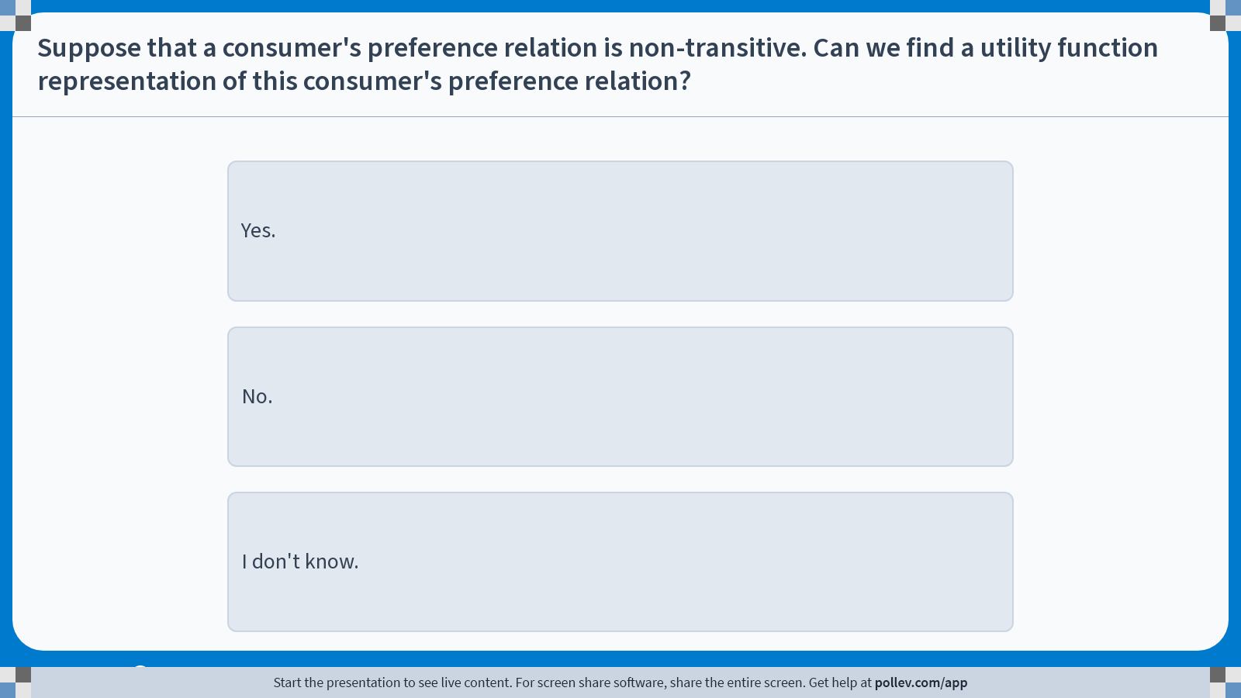
Poll Everywhere multiple choice poll instructions screen Activity Title: Suppose that a consumer's preference relation is non-transitive. Can we find a utility function representation of this consumer's preference relation? Slide 8
Notes:
Do not modify the notes in this section to avoid tampering with the Poll Everywhere activity. More info at polleverywhere.com/support Suppose that a consumer's preference relation is non-transitive. Can we find a utility function representation of this consumer's preference relation? https://www.polleverywhere.com/multiple_choice_polls/xVRyb4Z6GFDz6JFqbM7dP?display_state=instructions&activity_state=opened&state=opened&flow=Engagement&onscreen=persist

Slide 9
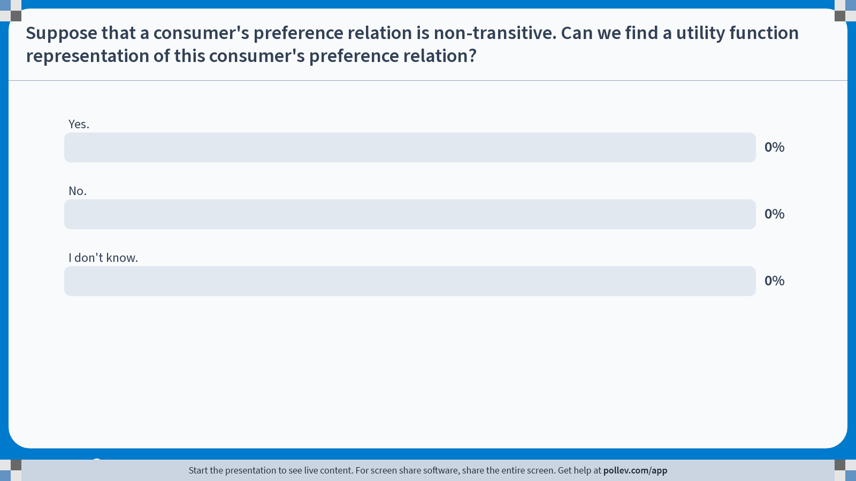
Poll Everywhere multiple choice poll chart screen Activity Title: Suppose that a consumer's preference relation is non-transitive. Can we find a utility function representation of this consumer's preference relation? Slide 10
Notes:
Do not modify the notes in this section to avoid tampering with the Poll Everywhere activity. More info at polleverywhere.com/support Suppose that a consumer's preference relation is non-transitive. Can we find a utility function representation of this consumer's preference relation? https://www.polleverywhere.com/multiple_choice_polls/xVRyb4Z6GFDz6JFqbM7dP?display_state=chart&activity_state=closed&state=closed&flow=Engagement&onscreen=persist

Slide 10
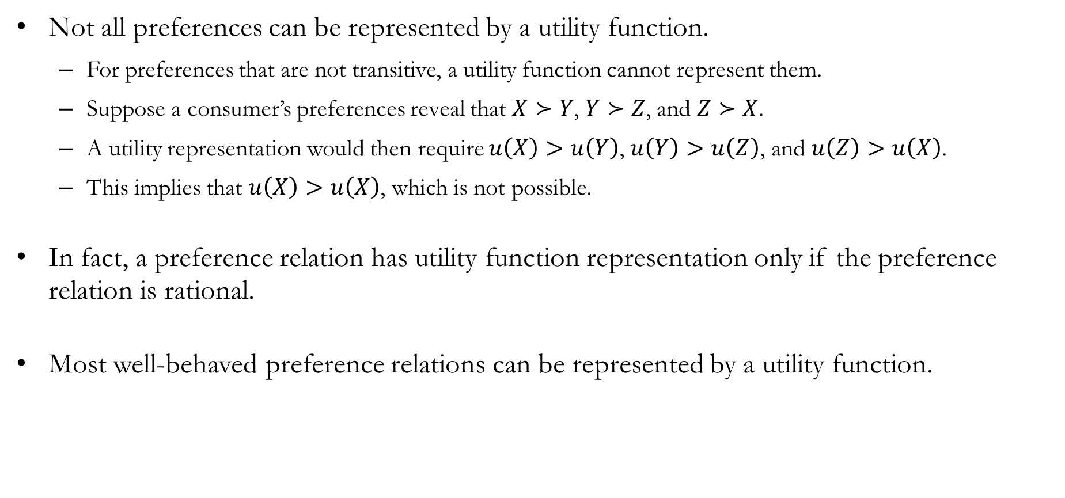
Utility Function Representation
Not all preferences can be represented by a utility function.
For preferences that are not transitive, a utility function cannot represent them.
Suppose a consumer’s preferences reveal that $X≻Y$, $Y≻Z$, and $Z≻X$.
A utility representation would then require $u\left(X\right)>u\left(Y\right)$, $u\left(Y\right)>u\left(Z\right)$, and $u\left(Z\right)>u\left(X\right)$.
This implies that $u\left(X\right)>u\left(X\right)$, which is not possible.
In fact, a preference relation has utility function representation only if the preference relation is rational.
Most well-behaved preference relations can be represented by a utility function.

Slide 11
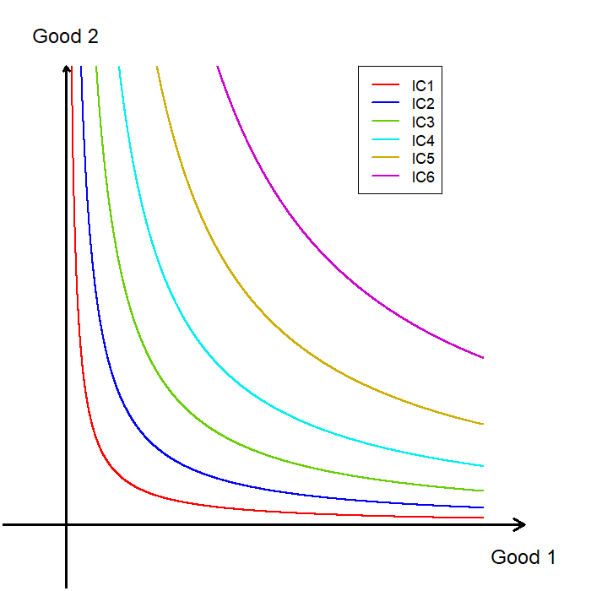
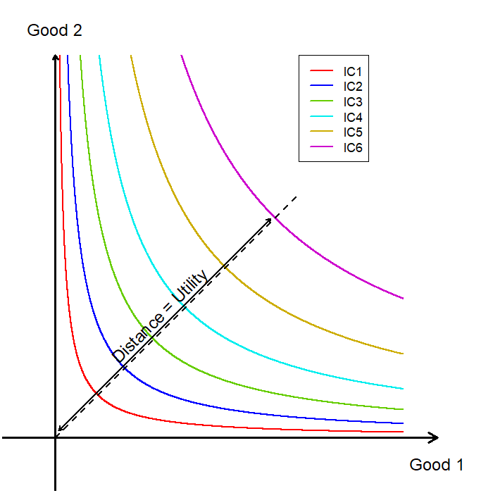
Constructing a Utility Function
For instance, suppose we are given an indifference map with six indifference curves:
Any bundle on the outermost indifference curve (IC6) is preferred to any bundle on the other five indifference curves.
Therefore, bundles on indifference curves further outward should be assigned higher utility values.
One possible construction is to plot a 45-degree line and assign utility values based on distance from the origin.
This is one example of how a utility function can be constructed from preferences, but it is not the approach we will use going forward.

Slide 12
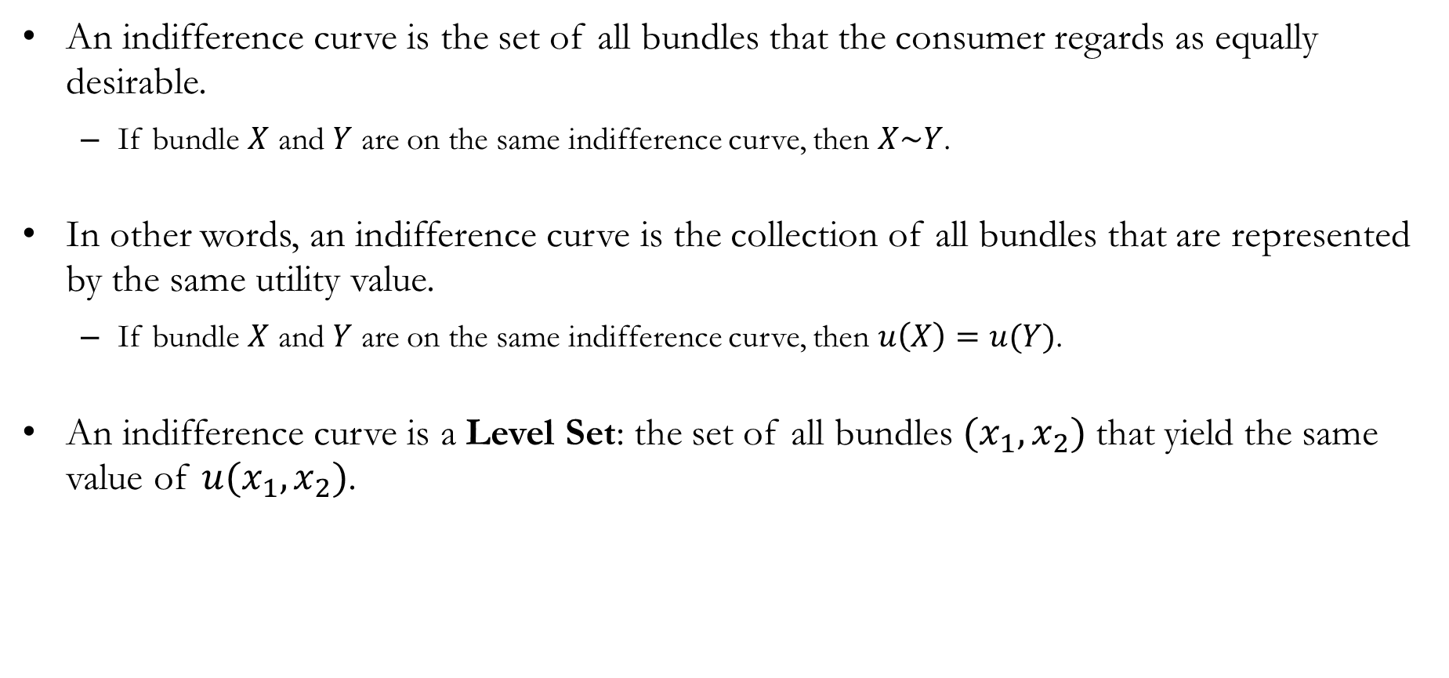
Utility Functions and Indifference Curves
An indifference curve is the set of all bundles that the consumer regards as equally desirable.
If bundle $X$ and $Y$ are on the same indifference curve, then $X\sim Y$.
In other words, an indifference curve is the collection of all bundles that are represented by the same utility value.
If bundle $X$ and $Y$ are on the same indifference curve, then $u\left(X\right)=u(Y)$.
An indifference curve is a Level Set: the set of all bundles $(x_{1},x_{2})$ that yield the same value of $u(x_{1},x_{2})$.

Slide 13
Commonly Used
Utility Functions

Slide 14
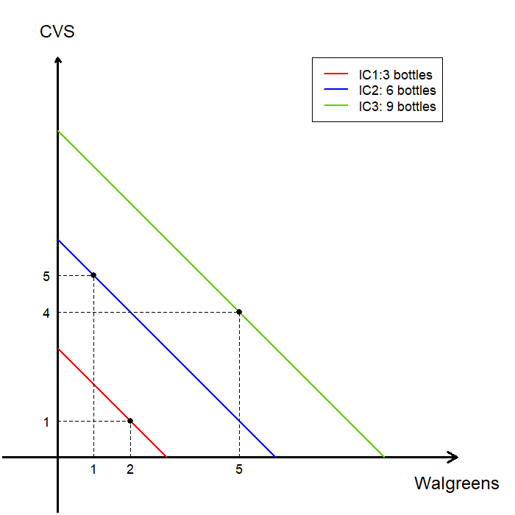
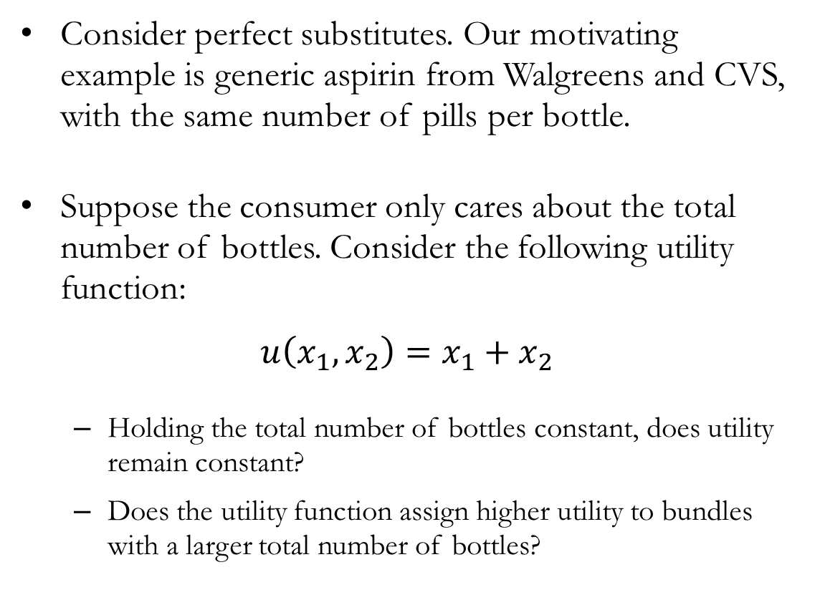
Perfect Substitutes
Consider perfect substitutes. Our motivating example is generic aspirin from Walgreens and CVS, with the same number of pills per bottle.
Suppose the consumer only cares about the total number of bottles. Consider the following utility function:
$$u\left(x_{1},x_{2}\right)=x_{1}+x_{2}$$
Holding the total number of bottles constant, does utility remain constant?
Does the utility function assign higher utility to bundles with a larger total number of bottles?

Slide 15
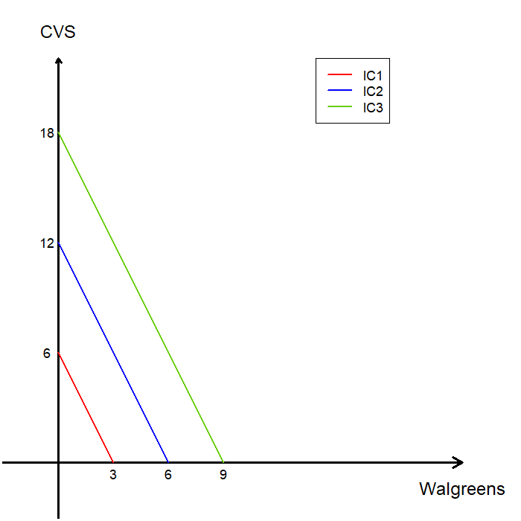
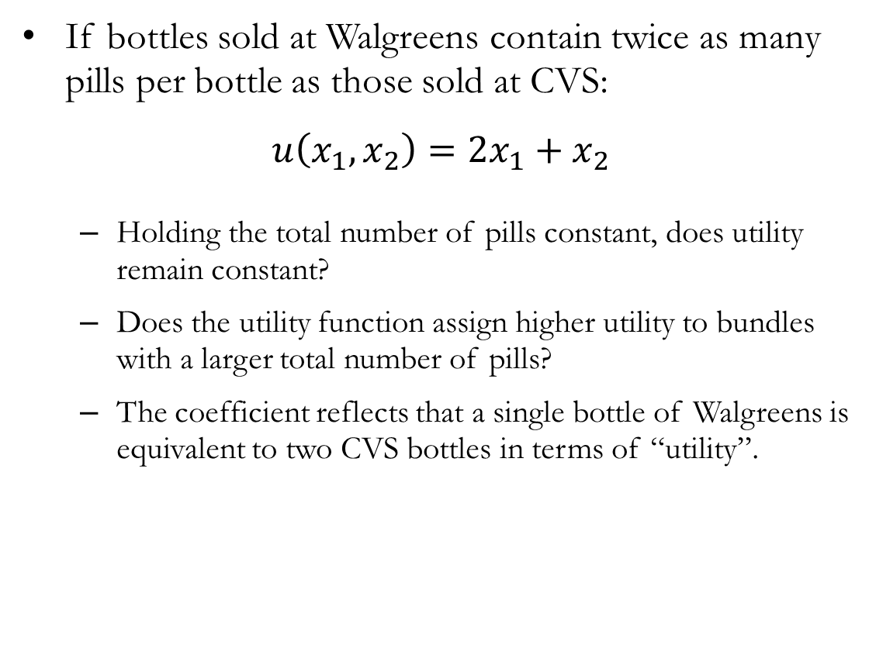
Perfect Substitutes
If bottles sold at Walgreens contain twice as many pills per bottle as those sold at CVS:
$$u\left(x_{1},x_{2}\right)={2x}_{1}+x_{2}$$
Holding the total number of pills constant, does utility remain constant?
Does the utility function assign higher utility to bundles with a larger total number of pills?
The coefficient reflects that a single bottle of Walgreens is equivalent to two CVS bottles in terms of “utility”.

Slide 16
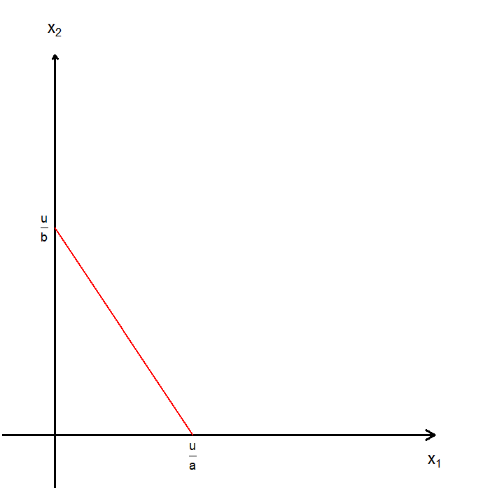
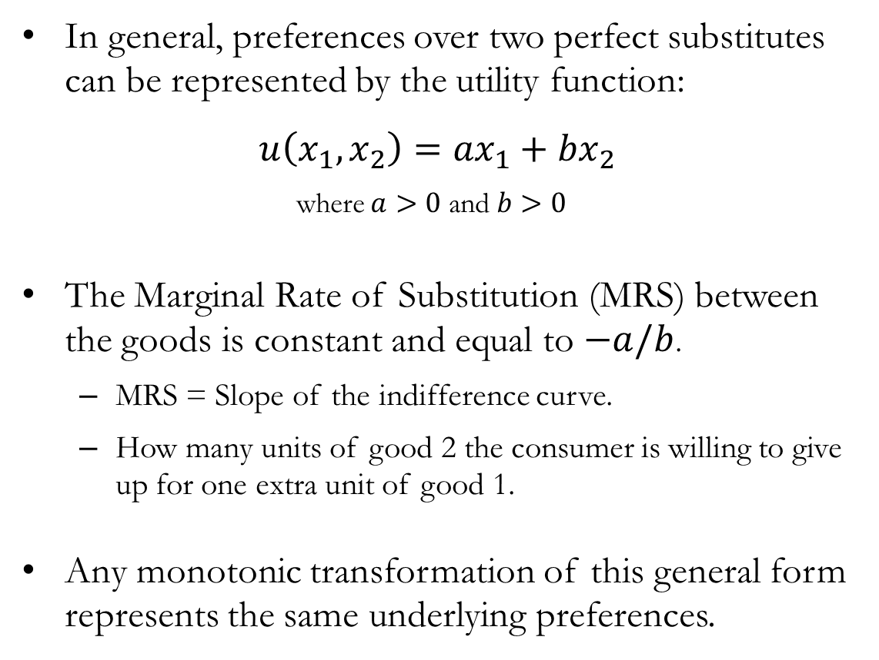
Perfect Substitutes
In general, preferences over two perfect substitutes can be represented by the utility function:
$$u\left(x_{1},x_{2}\right)={ax}_{1}+{bx}_{2}$$
where $a>0$ and $b>0$
The Marginal Rate of Substitution (MRS) between the goods is constant and equal to $−a/b$.
MRS = Slope of the indifference curve.
How many units of good 2 the consumer is willing to give up for one extra unit of good 1.
Any monotonic transformation of this general form represents the same underlying preferences.

Slide 17
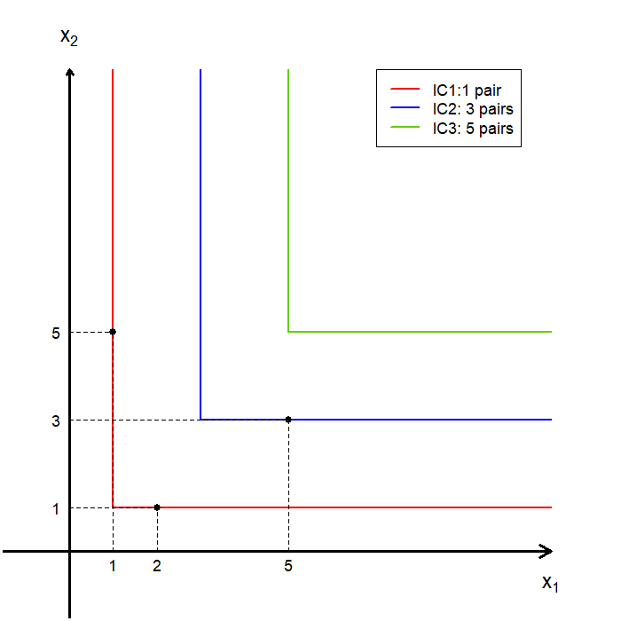
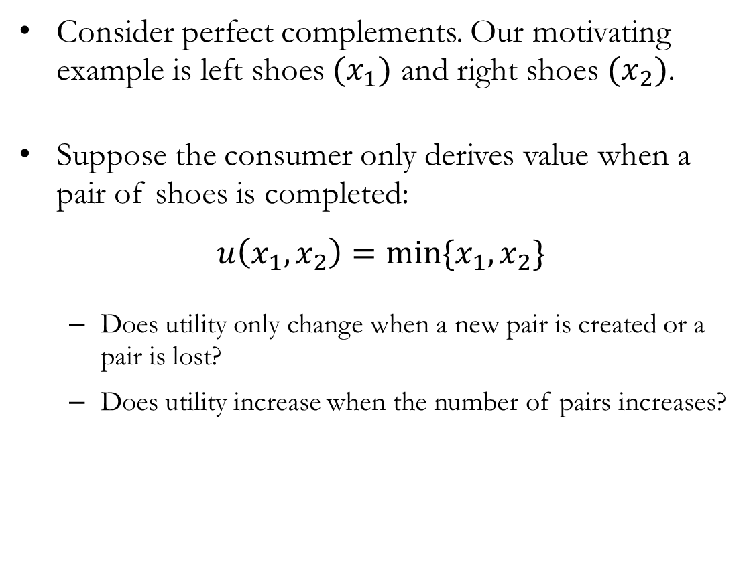
Perfect Complements
Consider perfect complements. Our motivating example is left shoes $(x_{1})$ and right shoes $(x_{2})$.
Suppose the consumer only derives value when a pair of shoes is completed:
$$u\left(x_{1},x_{2}\right)=min⁡\{x_{1},x_{2}\}$$
Does utility only change when a new pair is created or a pair is lost?
Does utility increase when the number of pairs increases?

Slide 18
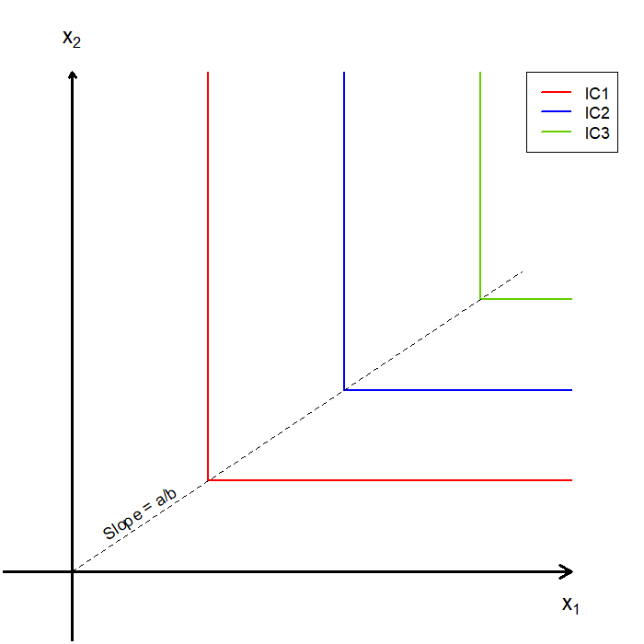
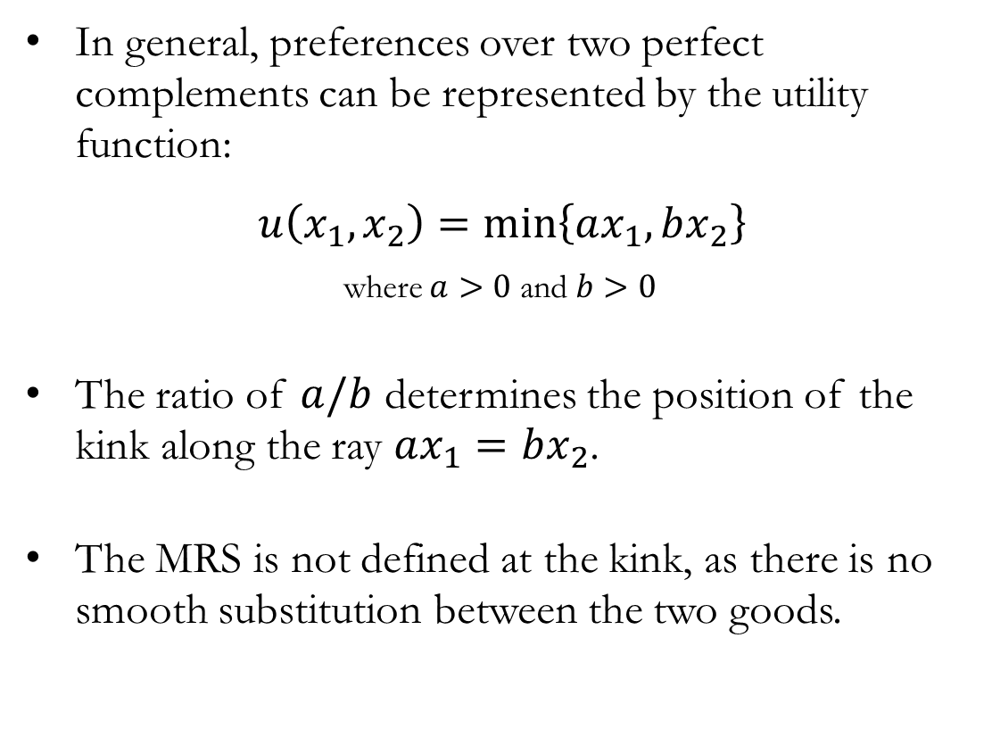
Perfect Complements
In general, preferences over two perfect complements can be represented by the utility function:
$$u\left(x_{1},x_{2}\right)=\min\left\{ax_{1},bx_{2}\right\}$$
where $a>0$ and $b>0$
The ratio of $a/b$ determines the position of the kink along the ray $ax_{1}=bx_{2}$.
The MRS is not defined at the kink, as there is no smooth substitution between the two goods.

Slide 19
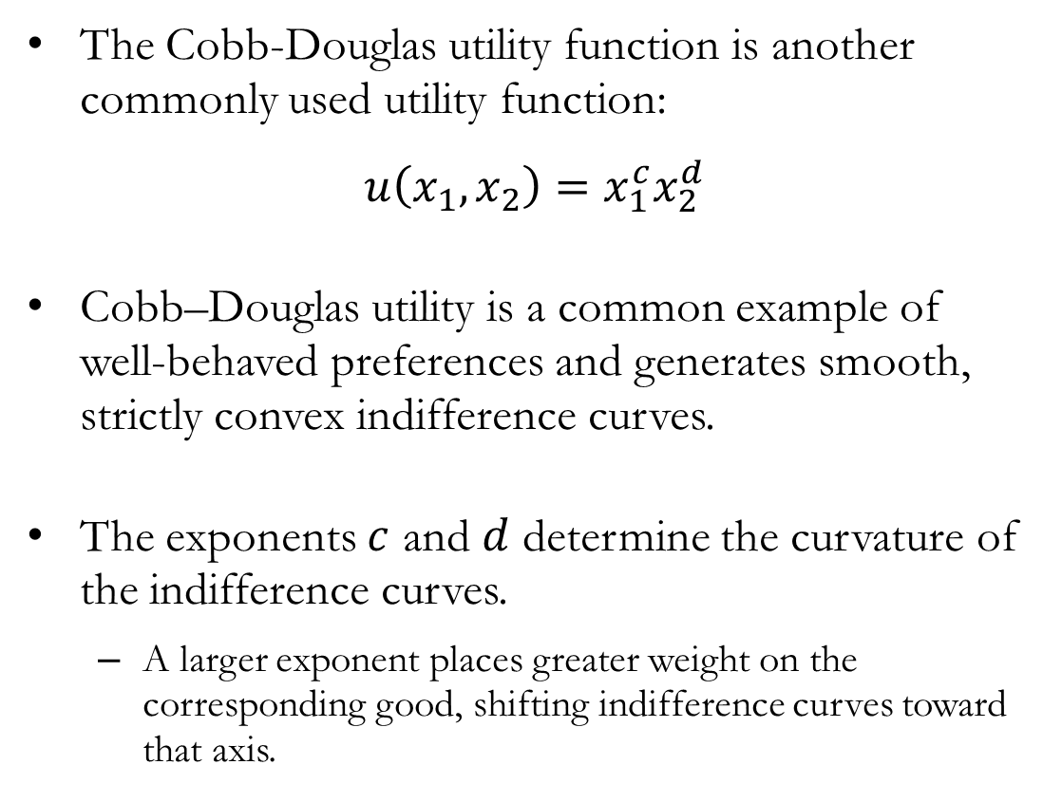

Cobb-Douglas Preferences
The Cobb-Douglas utility function is another commonly used utility function:
$$u\left(x_{1},x_{2}\right)=x_{1}^{c}x_{2}^{d}$$
Cobb–Douglas utility is a common example of well-behaved preferences and generates smooth, strictly convex indifference curves.
The exponents $c$ and $d$ determine the curvature of the indifference curves.
A larger exponent places greater weight on the corresponding good, shifting indifference curves toward that axis.
$$c=1,d=1$$

Slide 20
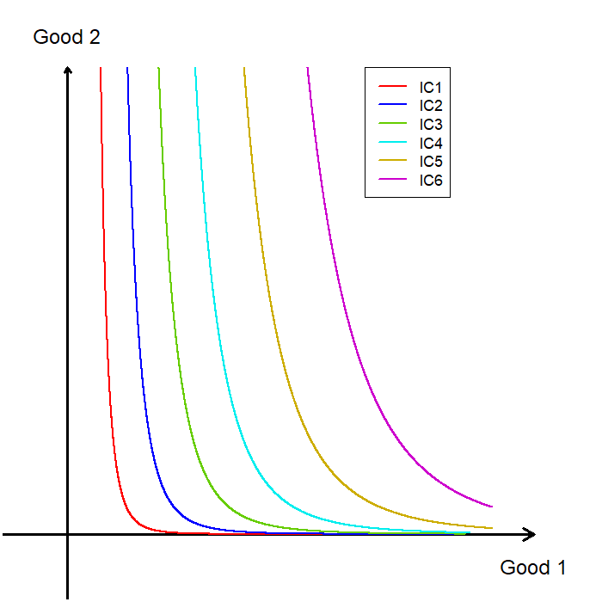
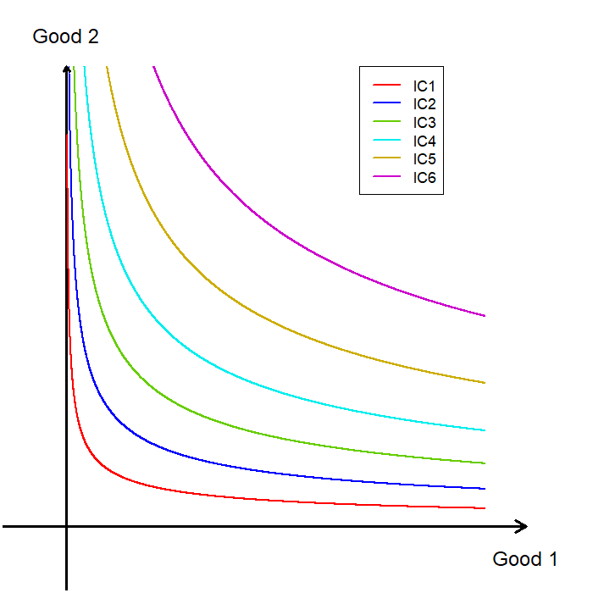


Cobb-Douglas Preferences
$$c=\frac{5}{3},d=\frac{1}{3}$$
$$c=\frac{2}{3},d=\frac{4}{3}$$

Slide 21
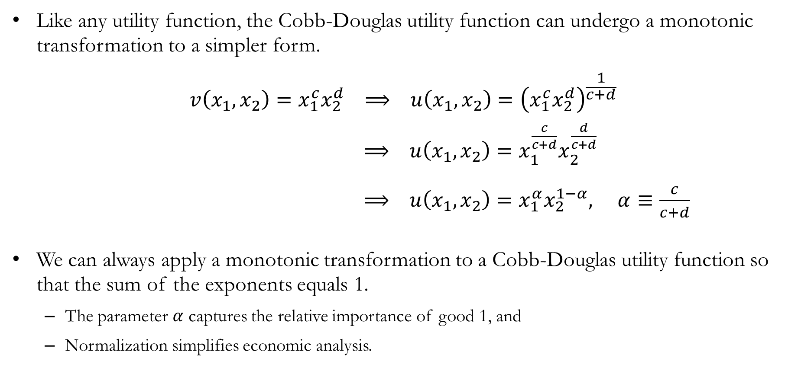
Cobb-Douglas Preferences
Like any utility function, the Cobb-Douglas utility function can undergo a monotonic transformation to a simpler form.
$$v\left(x_{1},x_{2}\right)=x_{1}^{c}x_{2}^{d} ⟹ u\left(x_{1},x_{2}\right)={\left(x_{1}^{c}x_{2}^{d}\right)}^{\frac{1}{c+d}}$$
$⟹ u\left(x_{1},x_{2}\right)=x_{1}^{\frac{c}{c+d}}x_{2}^{\frac{d}{c+d}}$
. $⟹ u\left(x_{1},x_{2}\right)=x_{1}^{α}x_{2}^{1−α}, α≡\frac{c}{c+d}$
We can always apply a monotonic transformation to a Cobb-Douglas utility function so that the sum of the exponents equals 1.
The parameter $α$ captures the relative importance of good 1, and
Normalization simplifies economic analysis.

Slide 22
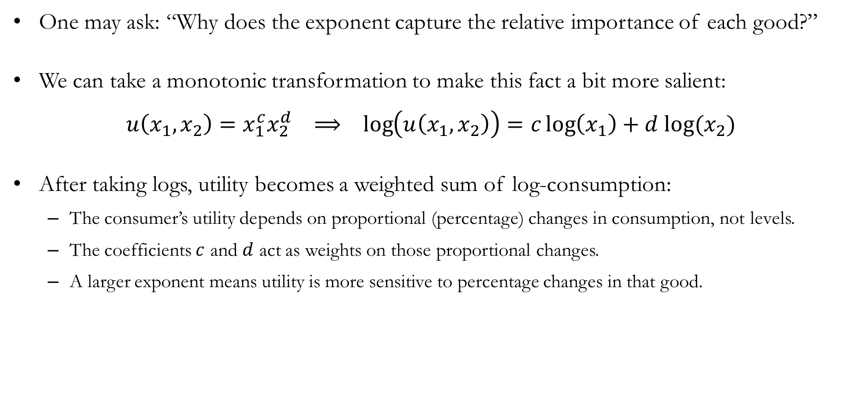
Advanced: Cobb-Douglas Exponents
One may ask: “Why does the exponent capture the relative importance of each good?”
We can take a monotonic transformation to make this fact a bit more salient:
$$u\left(x_{1},x_{2}\right)=x_{1}^{c}x_{2}^{d} ⟹ \log\left(u\left(x_{1},x_{2}\right)\right)=c\log\left(x_{1}\right)+d log⁡(x_{2})$$
After taking logs, utility becomes a weighted sum of log-consumption:
The consumer’s utility depends on proportional (percentage) changes in consumption, not levels.
The coefficients $c$ and $d$ act as weights on those proportional changes.
A larger exponent means utility is more sensitive to percentage changes in that good.

Slide 23
Marginal Utility and
the Marginal Rate of Substitution

Slide 24
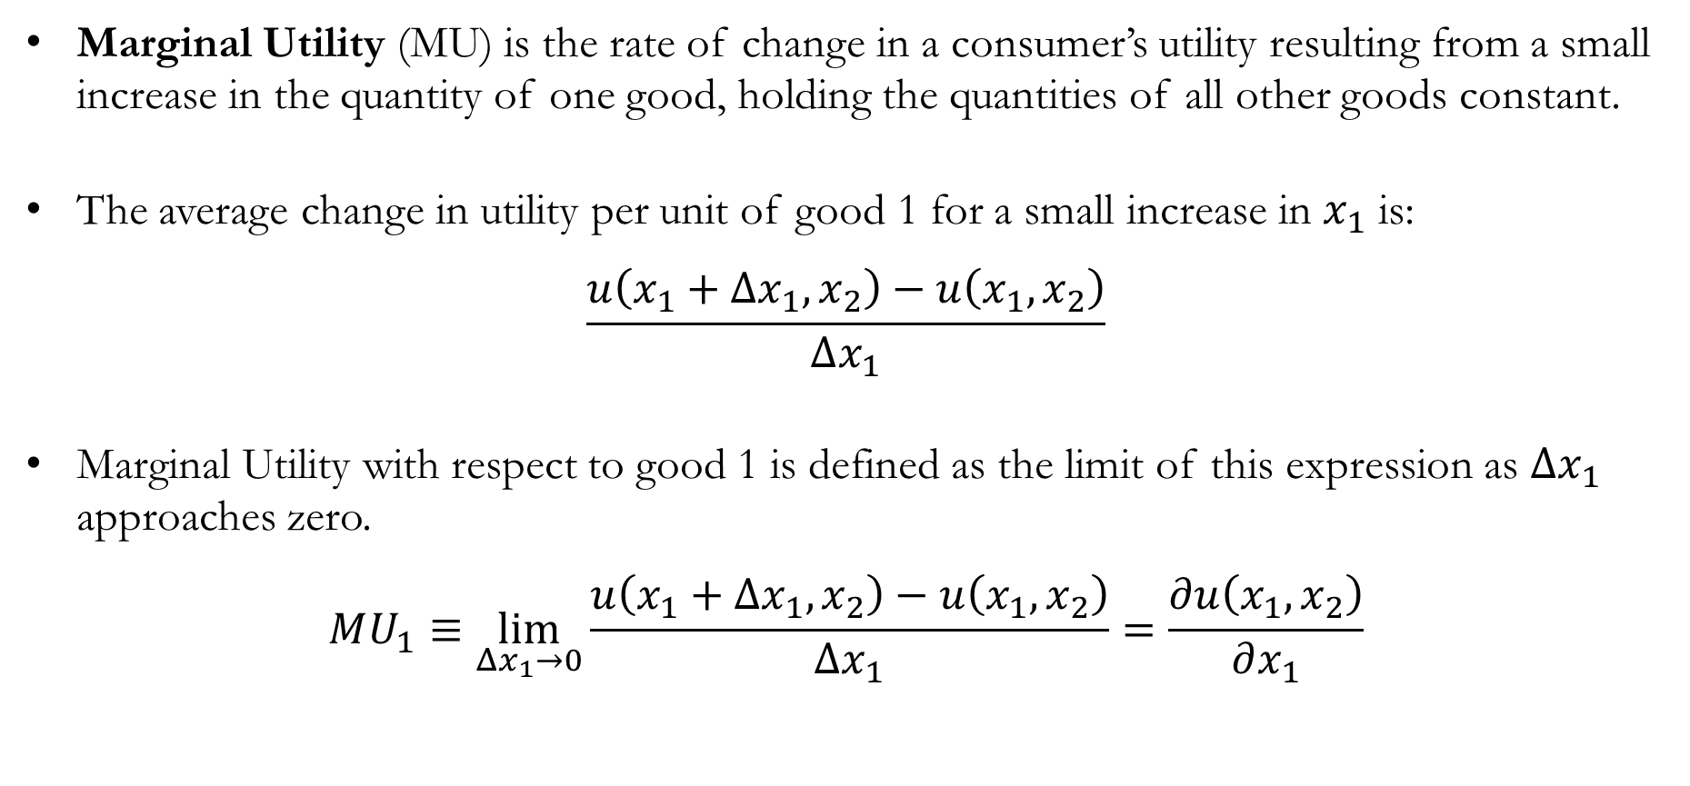
Marginal Utility
Marginal Utility (MU) is the rate of change in a consumer’s utility resulting from a small increase in the quantity of one good, holding the quantities of all other goods constant.
The average change in utility per unit of good 1 for a small increase in $x_{1}$ is:
$$\frac{u\left(x_{1}+Δx_{1},x_{2}\right)−u\left(x_{1},x_{2}\right)}{Δx_{1}}$$
Marginal Utility with respect to good 1 is defined as the limit of this expression as $Δx_{1}$ approaches zero.
$$MU_{1}≡\lim_{Δx_{1}→0}{\frac{u\left(x_{1}+Δx_{1},x_{2}\right)−u\left(x_{1},x_{2}\right)}{Δx_{1}}}=\frac{∂u\left(x_{1},x_{2}\right)}{∂x_{1}}$$

Slide 25
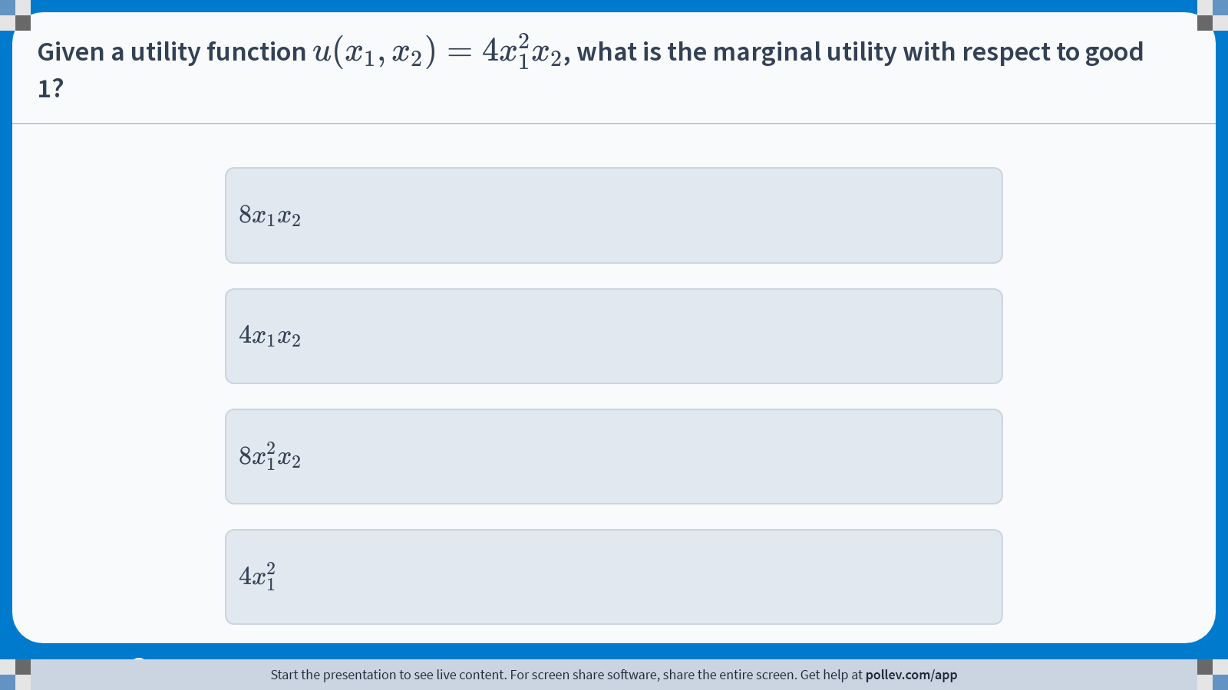
Poll Everywhere multiple choice poll instructions screen Activity Title: Given a utility function $$u(x_1,x_2)=4x_1^2x_2$$, what is the marginal utility with respect to good 1? Slide 25
Notes:
Do not modify the notes in this section to avoid tampering with the Poll Everywhere activity. More info at polleverywhere.com/support Given a utility function $$u(x_1,x_2)=4x_1^2x_2$$, what is the marginal utility with respect to good 1? https://www.polleverywhere.com/multiple_choice_polls/KmDOMVnsPTmkaS1gqr2Eg?display_state=instructions&activity_state=opened&state=opened&flow=Engagement&onscreen=persist

Slide 26
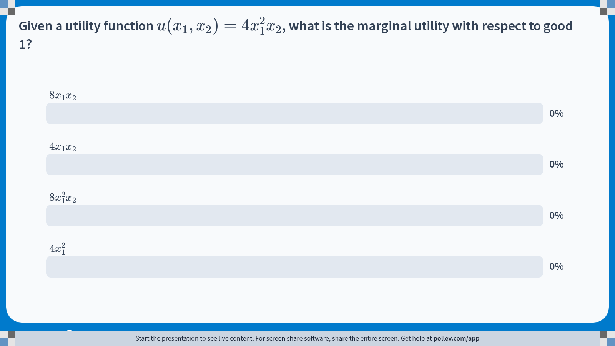
Poll Everywhere multiple choice poll chart screen Activity Title: Given a utility function $$u(x_1,x_2)=4x_1^2x_2$$, what is the marginal utility with respect to good 1? Slide 27
Notes:
Do not modify the notes in this section to avoid tampering with the Poll Everywhere activity. More info at polleverywhere.com/support Given a utility function $$u(x_1,x_2)=4x_1^2x_2$$, what is the marginal utility with respect to good 1? https://www.polleverywhere.com/multiple_choice_polls/KmDOMVnsPTmkaS1gqr2Eg?display_state=chart&activity_state=closed&state=closed&flow=Engagement&onscreen=persist

Slide 27
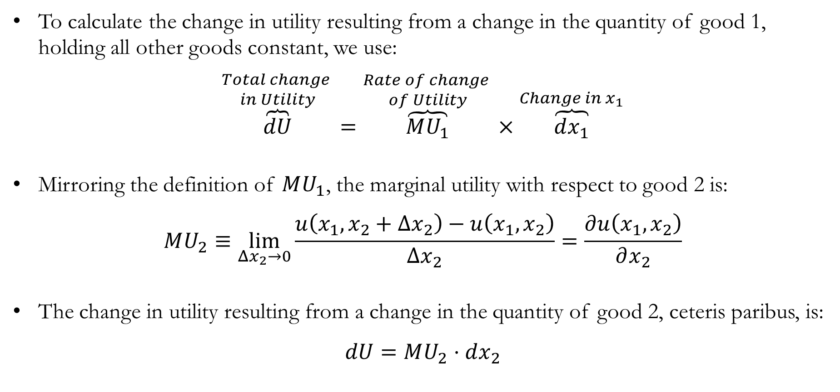
Marginal Utility
To calculate the change in utility resulting from a change in the quantity of good 1, holding all other goods constant, we use:
$$\overset{\begin{aligned}Total change \\ in Utility\end{aligned}}{\overbrace{dU}}=\overset{\begin{aligned}Rate of change \\ of Utility\end{aligned}}{\overbrace{MU_{1}}}×\overset{Change in x_{1}}{\overbrace{dx_{1}}}$$
Mirroring the definition of $MU_{1}$, the marginal utility with respect to good 2 is:
$$MU_{2}≡\lim_{Δx_{2}→0}{\frac{u\left(x_{1},x_{2}+Δx_{2}\right)−u\left(x_{1},x_{2}\right)}{Δx_{2}}}=\frac{∂u\left(x_{1},x_{2}\right)}{∂x_{2}}$$
The change in utility resulting from a change in the quantity of good 2, ceteris paribus, is:
$$dU=MU_{2}⋅dx_{2}$$

Slide 28
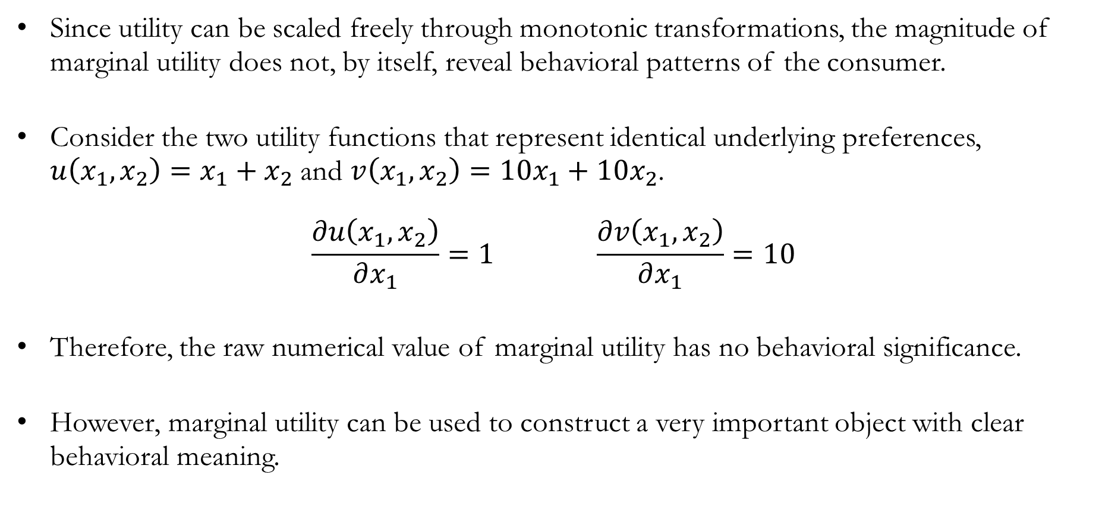
Marginal Utility
Since utility can be scaled freely through monotonic transformations, the magnitude of marginal utility does not, by itself, reveal behavioral patterns of the consumer.
Consider the two utility functions that represent identical underlying preferences, $u\left(x_{1},x_{2}\right)=x_{1}+x_{2}$ and $v\left(x_{1},x_{2}\right)=10x_{1}+10x_{2}$.
$$\frac{∂u\left(x_{1},x_{2}\right)}{∂x_{1}}=1 \frac{∂v\left(x_{1},x_{2}\right)}{∂x_{1}}=10$$
Therefore, the raw numerical value of marginal utility has no behavioral significance.
However, marginal utility can be used to construct a very important object with clear behavioral meaning.

Slide 29
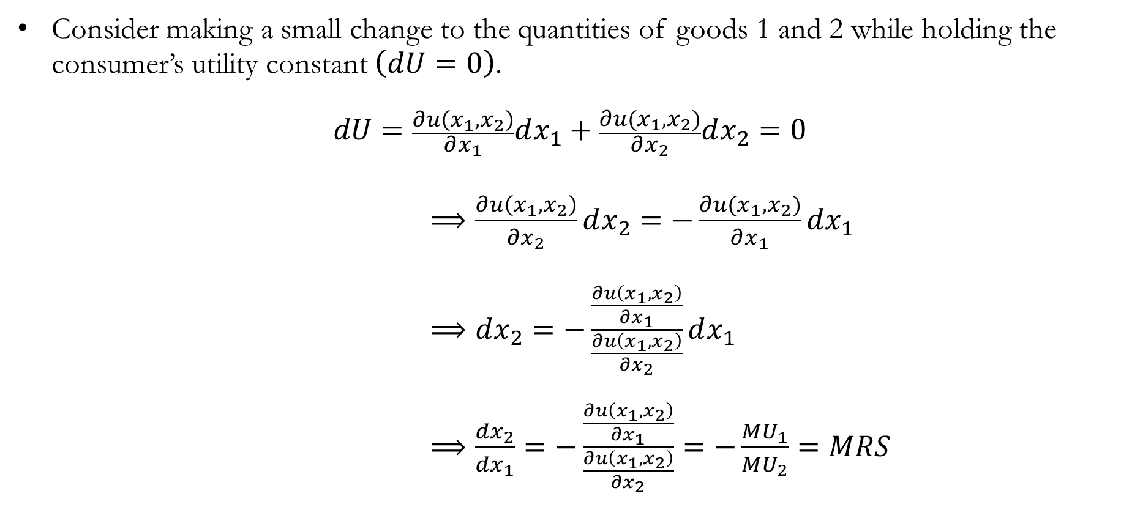
Deriving the Marginal Rate of Substitution
Consider making a small change to the quantities of goods 1 and 2 while holding the consumer’s utility constant $\left(dU=0\right)$.
$$dU=\frac{∂u\left(x_{1},x_{2}\right)}{∂x_{1}}dx_{1}+\frac{∂u(x_{1},x_{2})}{∂x_{2}}dx_{2}=0$$
$⟹\frac{∂u\left(x_{1},x_{2}\right)}{∂x_{2}}dx_{2}=−\frac{∂u(x_{1},x_{2})}{∂x_{1}}dx_{1}$
$⟹dx_{2}=−\frac{\frac{∂u\left(x_{1},x_{2}\right)}{∂x_{1}}}{\frac{∂u\left(x_{1},x_{2}\right)}{∂x_{2}}}dx_{1}$
$⟹\frac{dx_{2}}{dx_{1}}=−\frac{\frac{∂u\left(x_{1},x_{2}\right)}{∂x_{1}}}{\frac{∂u\left(x_{1},x_{2}\right)}{∂x_{2}}}=−\frac{MU_{1}}{MU_{2}}=MRS$

Slide 30
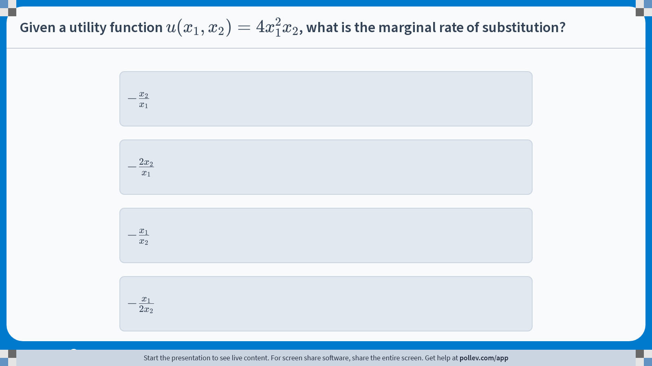
Poll Everywhere multiple choice poll instructions screen Activity Title: Given a utility function $$u(x_1,x_2)=4x_1^2x_2$$, what is the marginal rate of substitution? Slide 30
Notes:
Do not modify the notes in this section to avoid tampering with the Poll Everywhere activity. More info at polleverywhere.com/support Given a utility function $$u(x_1,x_2)=4x_1^2x_2$$, what is the marginal rate of substitution? https://www.polleverywhere.com/multiple_choice_polls/QL5ZzcMB4qcFMUh6o3UQJ?display_state=instructions&activity_state=opened&state=opened&flow=Engagement&onscreen=persist

Slide 31
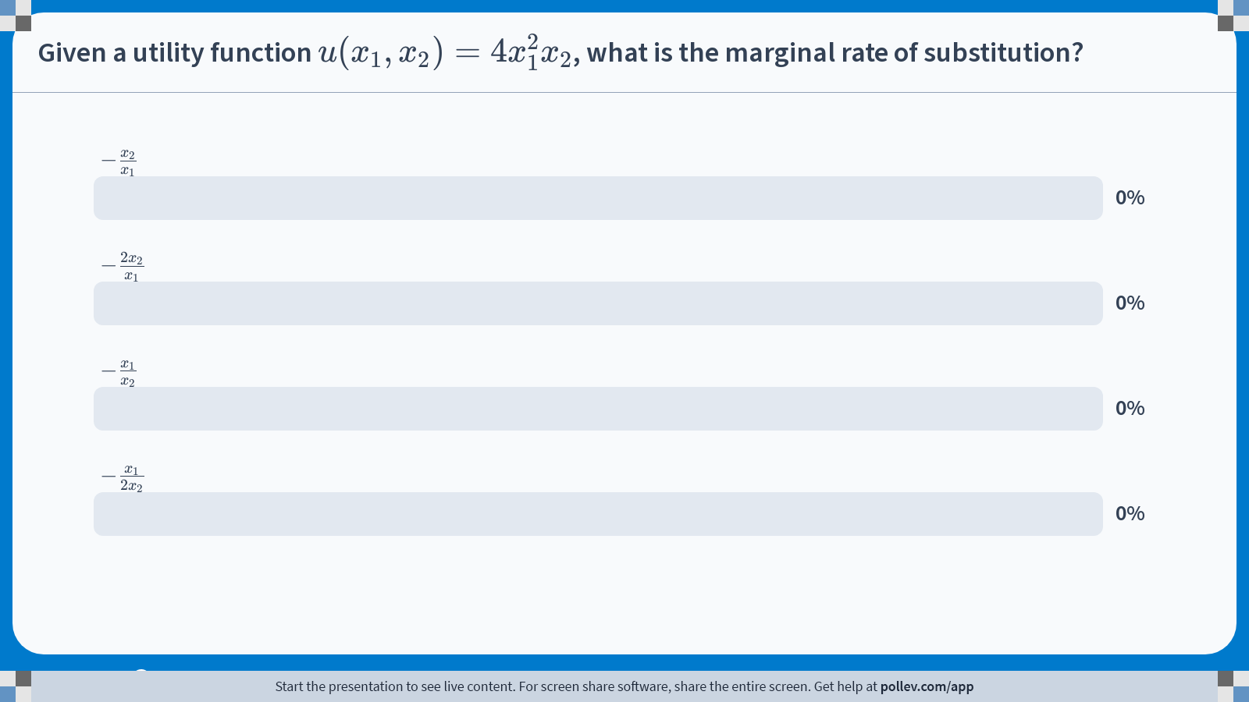
Poll Everywhere multiple choice poll chart screen Activity Title: Given a utility function $$u(x_1,x_2)=4x_1^2x_2$$, what is the marginal rate of substitution? Slide 32
Notes:
Do not modify the notes in this section to avoid tampering with the Poll Everywhere activity. More info at polleverywhere.com/support Given a utility function $$u(x_1,x_2)=4x_1^2x_2$$, what is the marginal rate of substitution? https://www.polleverywhere.com/multiple_choice_polls/QL5ZzcMB4qcFMUh6o3UQJ?display_state=chart&activity_state=closed&state=closed&flow=Engagement&onscreen=persist

Slide 32
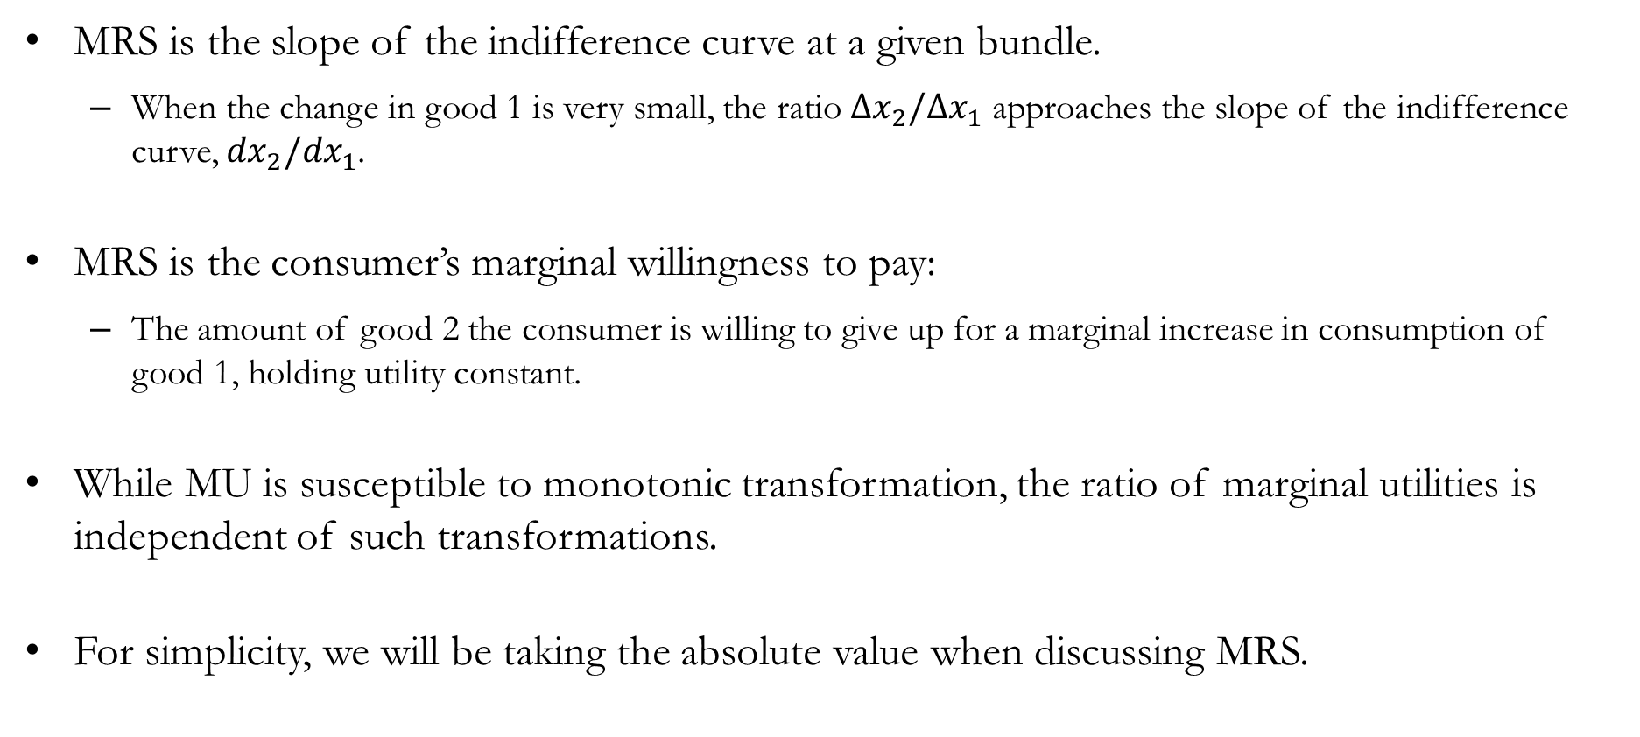
Recap: Interpretations of MRS
MRS is the slope of the indifference curve at a given bundle.
When the change in good 1 is very small, the ratio $Δx_{2}/Δx_{1}$ approaches the slope of the indifference curve, ${dx}_{2}/{dx}_{1}$.
MRS is the consumer’s marginal willingness to pay:
The amount of good 2 the consumer is willing to give up for a marginal increase in consumption of good 1, holding utility constant.
While MU is susceptible to monotonic transformation, the ratio of marginal utilities is independent of such transformations.
For simplicity, we will be taking the absolute value when discussing MRS.

Slide 33
Recap & Preview

Slide 34
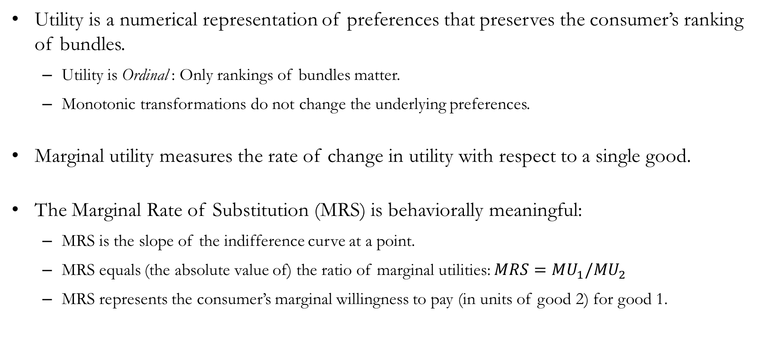
Recap: Utility
Utility is a numerical representation of preferences that preserves the consumer’s ranking of bundles.
Utility is Ordinal : Only rankings of bundles matter.
Monotonic transformations do not change the underlying preferences.
Marginal utility measures the rate of change in utility with respect to a single good.
The Marginal Rate of Substitution (MRS) is behaviorally meaningful:
MRS is the slope of the indifference curve at a point.
MRS equals (the absolute value of) the ratio of marginal utilities: $MRS=MU_{1}/MU_{2}$
MRS represents the consumer’s marginal willingness to pay (in units of good 2) for good 1.

Slide 35
Preview: Choice
Preferences describe what consumers like, and utility gives us a convenient way to represent those preferences.
To make an actual choice, consumers face constraints: Limited income and market prices.
In the next chapter, we combine:
Preferences: Utility functions and indifference curves.
Constraints: Budget constraint.
This allows us to answer a central question in microeconomics: Which bundle does the consumer choose, given prices and income?

