Slide 1
INTERMEDIATE MICROECONOMIC THEORY
Chapter 3: Preferences

Slide 2
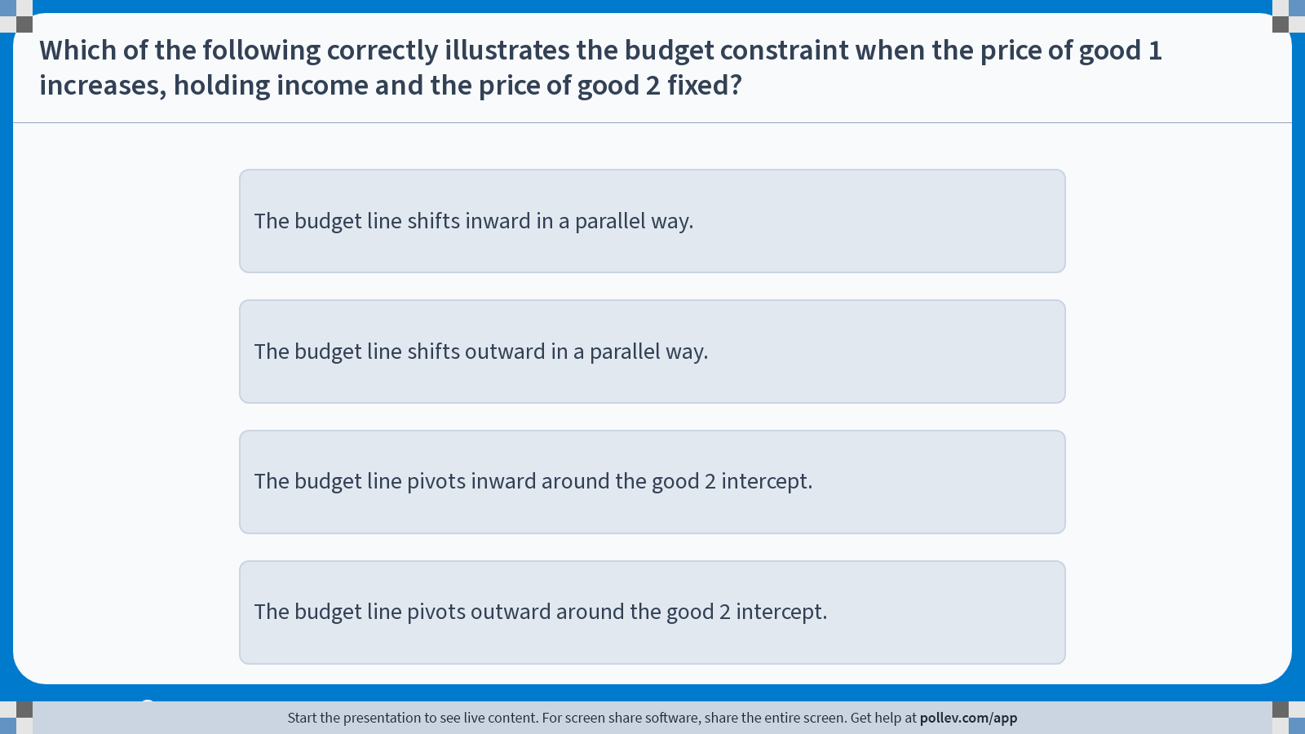
Poll Everywhere multiple choice poll instructions screen Activity Title: Which of the following correctly illustrates the budget constraint when the price of good 1 increases, holding income and the price of good 2 fixed? Slide 3
Notes:
Do not modify the notes in this section to avoid tampering with the Poll Everywhere activity. More info at polleverywhere.com/support Which of the following correctly illustrates the budget constraint when the price of good 1 increases, holding income and the price of good 2 fixed? https://www.polleverywhere.com/multiple_choice_polls/nlSRVYW19BwPpuCcxMPIx?display_state=instructions&activity_state=opened&state=opened&flow=Engagement&onscreen=persist

Slide 3
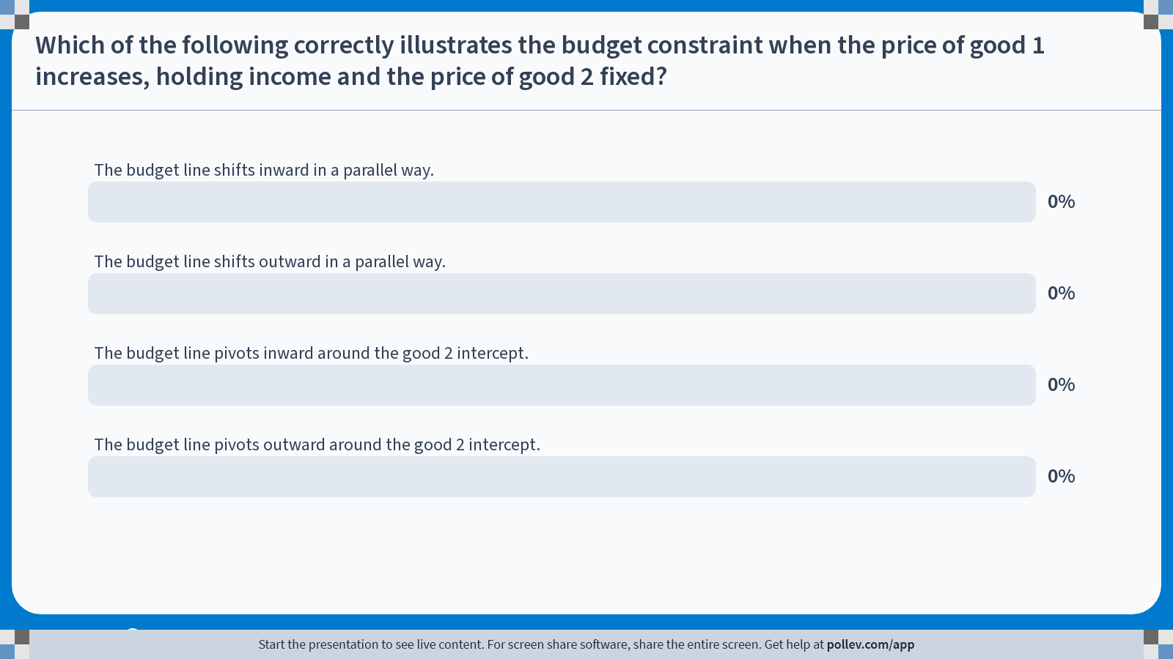
Poll Everywhere multiple choice poll chart screen Activity Title: Which of the following correctly illustrates the budget constraint when the price of good 1 increases, holding income and the price of good 2 fixed? Slide 5
Notes:
Do not modify the notes in this section to avoid tampering with the Poll Everywhere activity. More info at polleverywhere.com/support Which of the following correctly illustrates the budget constraint when the price of good 1 increases, holding income and the price of good 2 fixed? https://www.polleverywhere.com/multiple_choice_polls/nlSRVYW19BwPpuCcxMPIx?display_state=chart&activity_state=closed&state=closed&flow=Engagement&onscreen=persist

Slide 4
Recap: Budget Constraints
The budget constraint describes the set of bundles a consumer can afford given income and prices.
The budget line is the boundary of the affordable set:
Intercepts show the maximum consumption of one good if all resources are spent on it.
The slope reflects relative prices and the market trade-off.
Comparative statics:
Changes in income shift the budget line inward or outward, without changing its slope.
Changes in prices pivot the budget line, changing its slope.
Using a numeraire simplifies analysis by focusing on relative prices.

Slide 5
Preference Relations

Slide 6
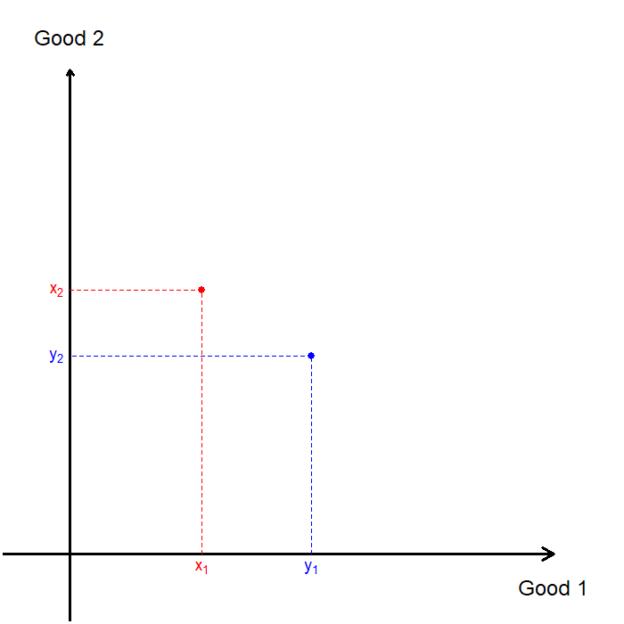
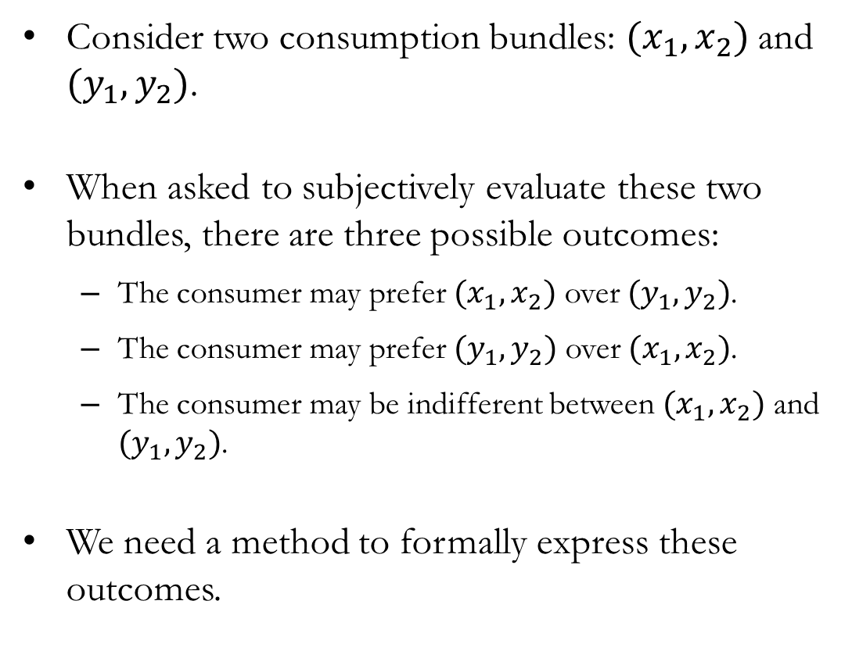
Preferences
Consider two consumption bundles: $(x_{1},x_{2})$ and $(y_{1},y_{2})$.
When asked to subjectively evaluate these two bundles, there are three possible outcomes:
The consumer may prefer $(x_{1},x_{2})$ over $(y_{1},y_{2})$.
The consumer may prefer $(y_{1},y_{2})$ over $(x_{1},x_{2})$.
The consumer may be indifferent between $(x_{1},x_{2})$ and $(y_{1},y_{2})$.
We need a method to formally express these outcomes.

Slide 7
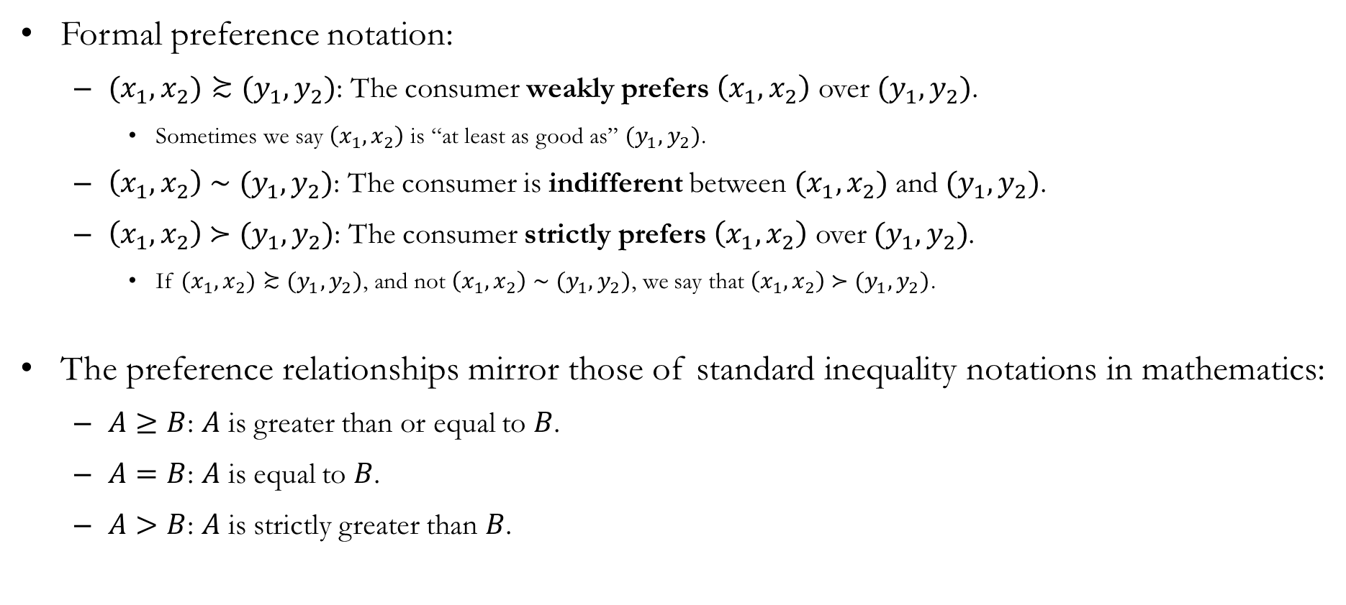
Preference Relations
Formal preference notation:
$(x_{1},x_{2})≿(y_{1},y_{2})$: The consumer weakly prefers $\left(x_{1},x_{2}\right)$ over $(y_{1},y_{2})$.
Sometimes we say $\left(x_{1},x_{2}\right)$ is “at least as good as” $(y_{1},y_{2})$.
$\left(x_{1},x_{2}\right) \text{∼} (y_{1},y_{2})$: The consumer is indifferent between $(x_{1},x_{2})$ and $(y_{1},y_{2})$.
$\left(x_{1},x_{2}\right) \text{≻} (y_{1},y_{2})$: The consumer strictly prefers $\left(x_{1},x_{2}\right)$ over $(y_{1},y_{2})$.
If $(x_{1},x_{2})≿(y_{1},y_{2})$, and not $\left(x_{1},x_{2}\right) \text{∼} (y_{1},y_{2})$, we say that $\left(x_{1},x_{2}\right) \text{≻} (y_{1},y_{2})$.
The preference relationships mirror those of standard inequality notations in mathematics:
$A≥B$: $A$ is greater than or equal to $B$.
$A=B$: $A$ is equal to $B$.
$A>B$: $A$ is strictly greater than $B$.

Slide 8
Axioms of Preference
Completeness
Reflexivity
Transitivity
Monotonicity
Convexity
Continuity
Preference relations that satisfy completeness, reflexivity, and transitivity are said to be Rational.
Rationality does not imply realism, nor does it imply optimal behavior.
Rationality ensures preferences are internally consistent.
We will restrict attention to preferences that are rational.
These additional axioms are often imposed when we study “well-behaved” preferences.
These assumptions give us nicer geometry and sharper predictions.

Slide 9
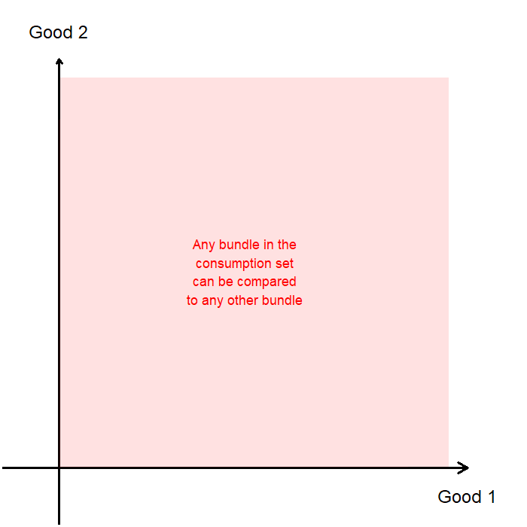
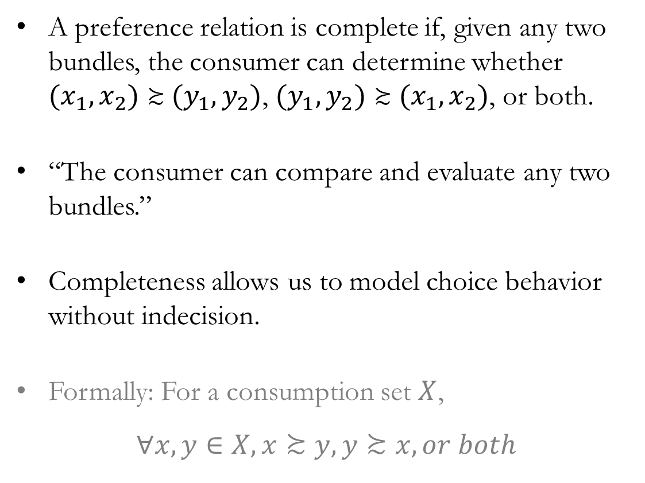
Axioms of Preference: Completeness
A preference relation is complete if, given any two bundles, the consumer can determine whether $(x_{1},x_{2})≿(y_{1},y_{2})$, $(y_{1},y_{2})≿(x_{1},x_{2})$, or both.
“The consumer can compare and evaluate any two bundles.”
Completeness allows us to model choice behavior without indecision.
Formally: For a consumption set $X$,
$$∀x,y∈X, x≿y, y≿x, or both$$

Slide 10
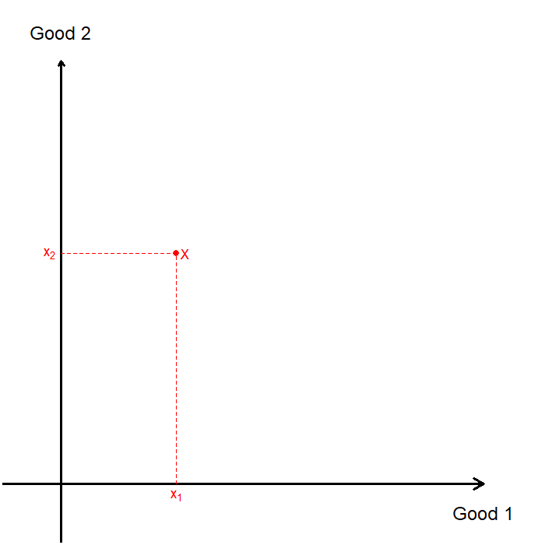
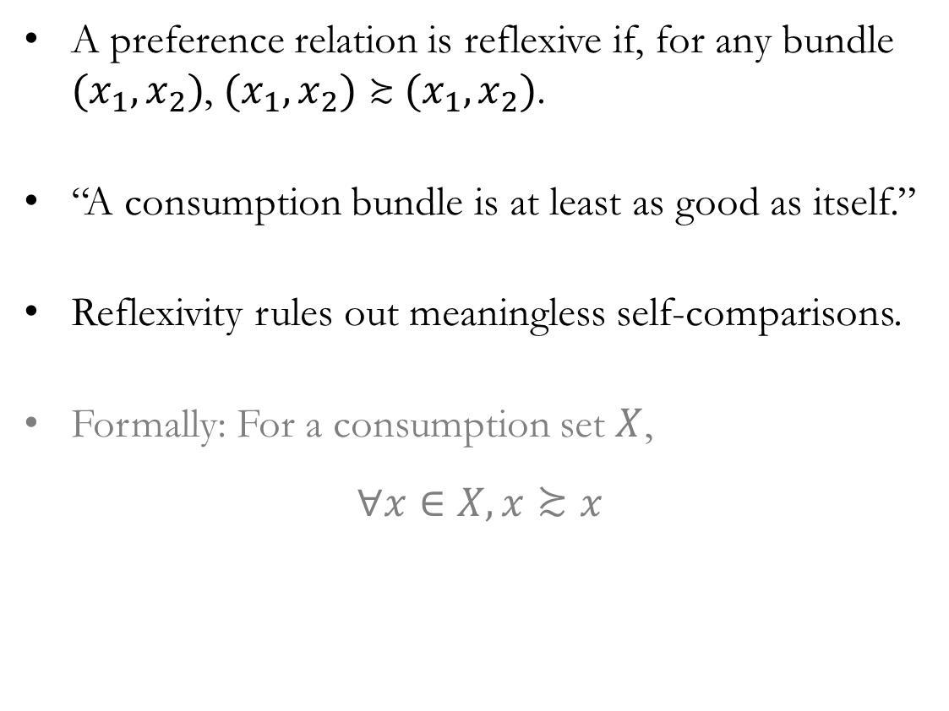
Axioms of Preference: Reflexivity
A preference relation is reflexive if, for any bundle $(x_{1},x_{2})$, $(x_{1},x_{2})≿(x_{1},x_{2})$.
“A consumption bundle is at least as good as itself.”
Reflexivity rules out meaningless self-comparisons.
Formally: For a consumption set $X$,
$$∀x∈X, x≿x$$

Slide 11
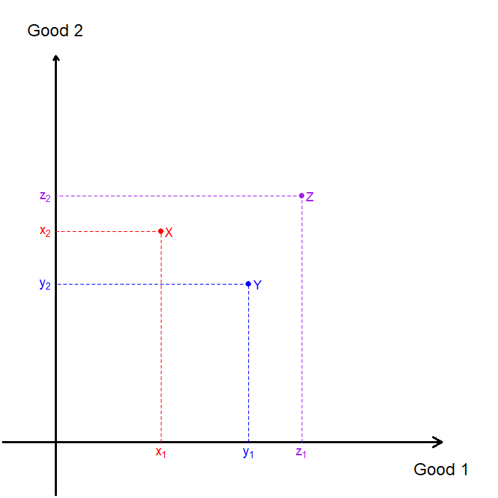
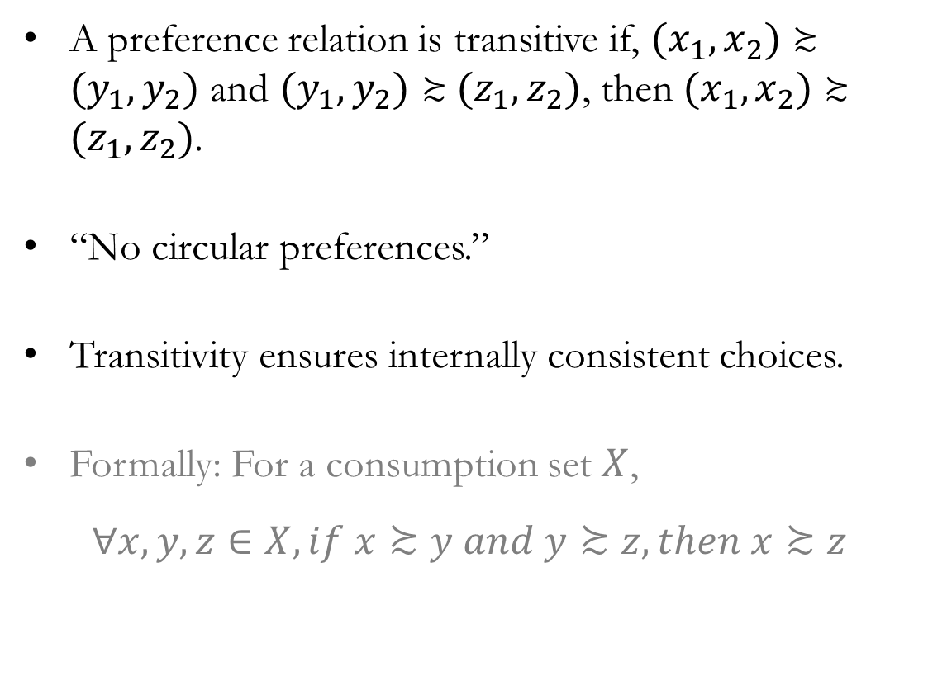
Axioms of Preference: Transitivity
A preference relation is transitive if, $(x_{1},x_{2})≿(y_{1},y_{2})$ and $(y_{1},y_{2})≿(z_{1},z_{2})$, then $(x_{1},x_{2})≿(z_{1},z_{2})$.
“No circular preferences.”
Transitivity ensures internally consistent choices.
Formally: For a consumption set $X$,
$$∀x,y,z∈X, if x≿y and y≿z, then x≿z$$

Slide 12
Indifference Curves

Slide 13
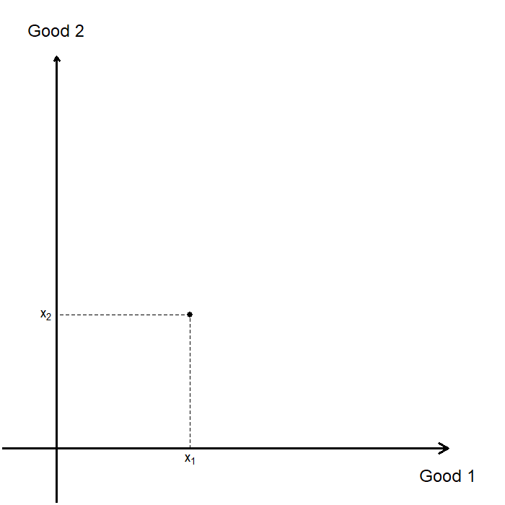
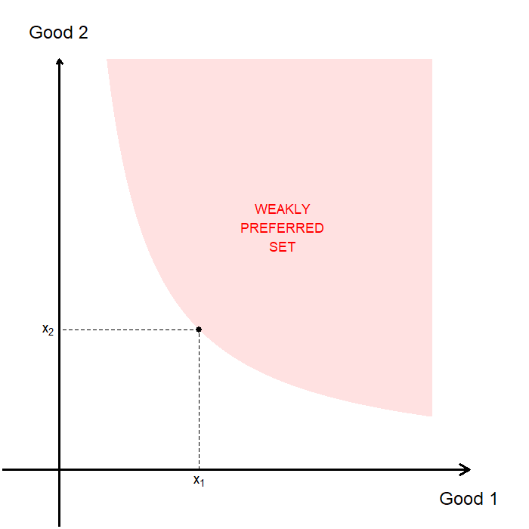
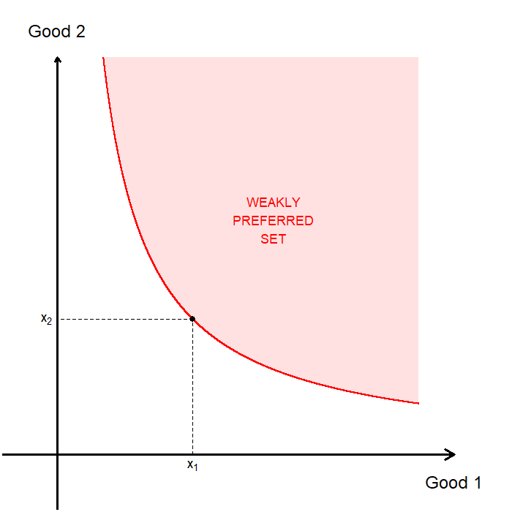
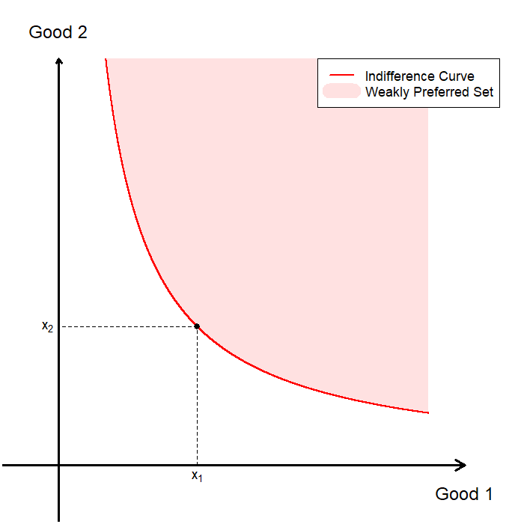
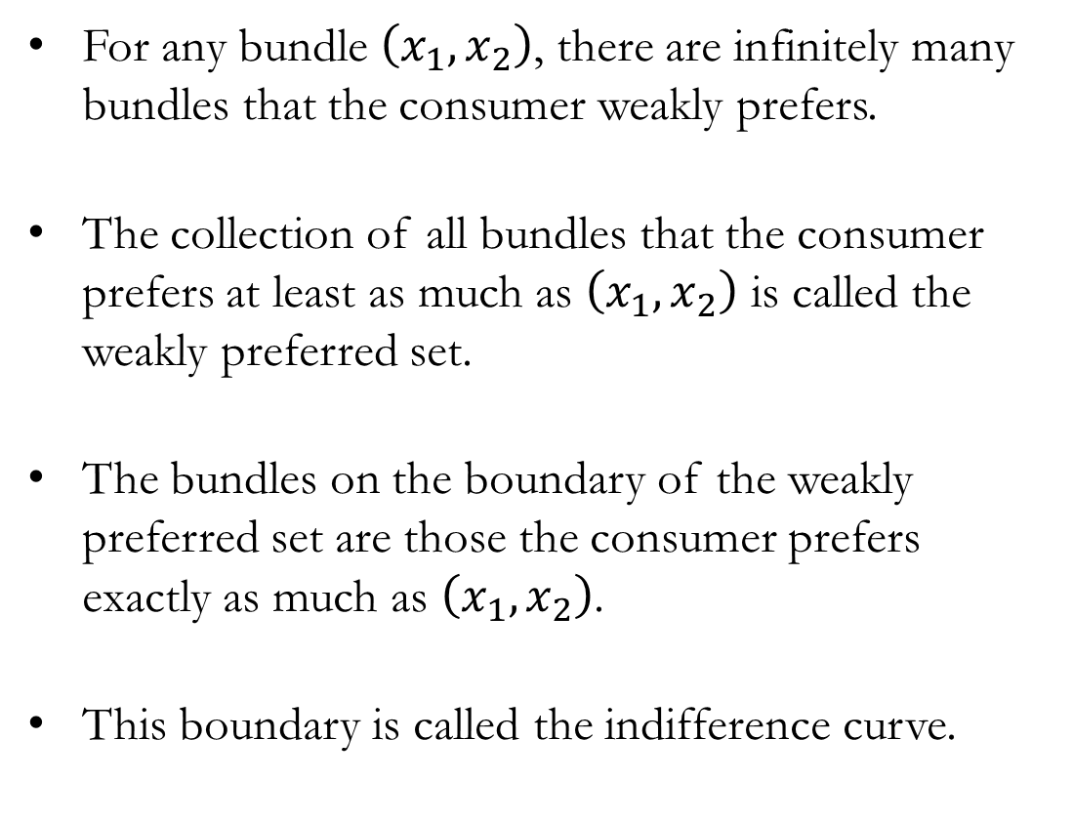
Visualizing Preferences
For any bundle $\left(x_{1},x_{2}\right)$, there are infinitely many bundles that the consumer weakly prefers.
The collection of all bundles that the consumer prefers at least as much as $\left(x_{1},x_{2}\right)$ is called the weakly preferred set.
The bundles on the boundary of the weakly preferred set are those the consumer prefers exactly as much as $\left(x_{1},x_{2}\right)$.
This boundary is called the indifference curve.

Slide 14

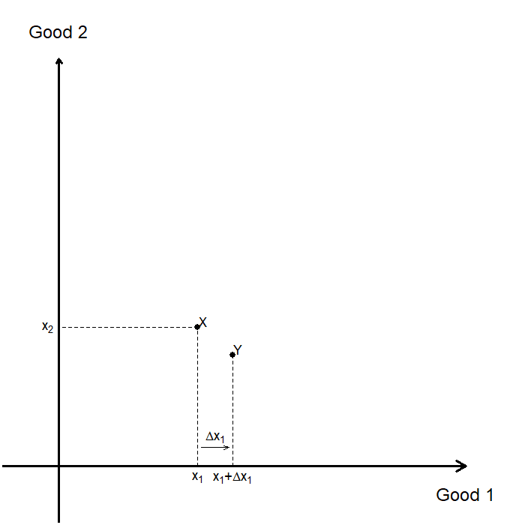
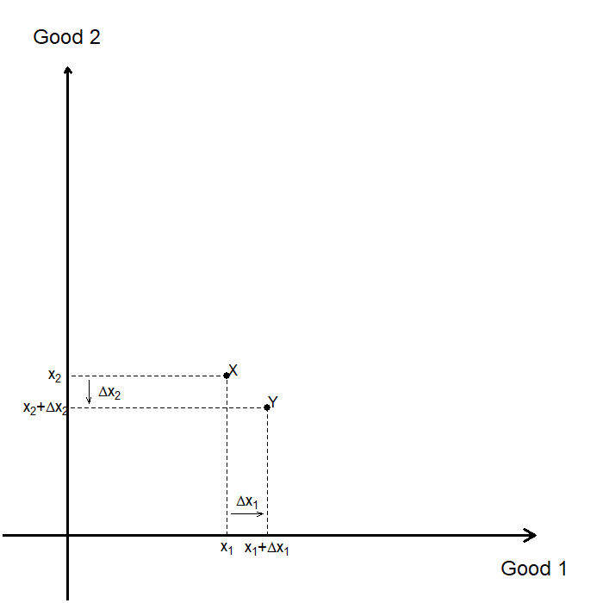
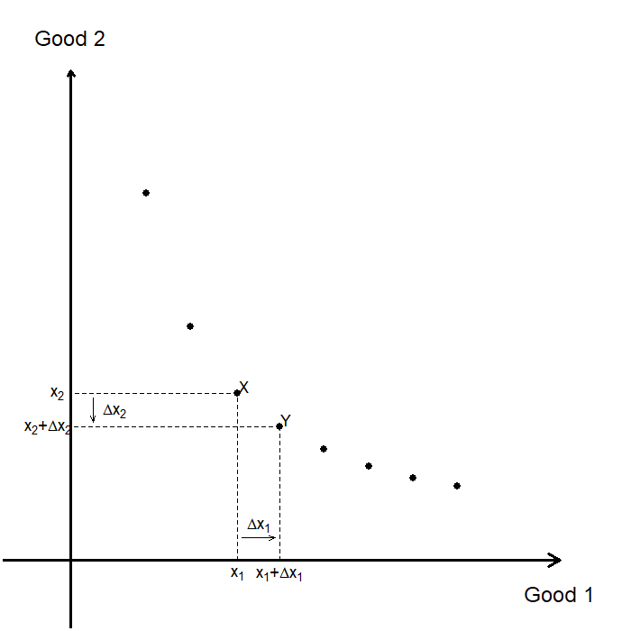
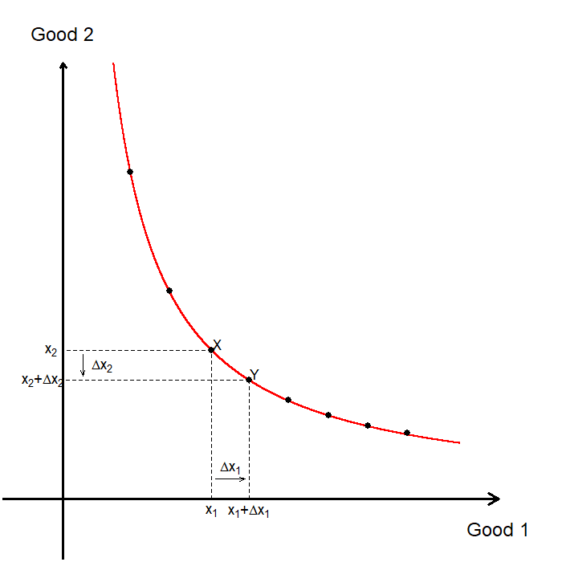
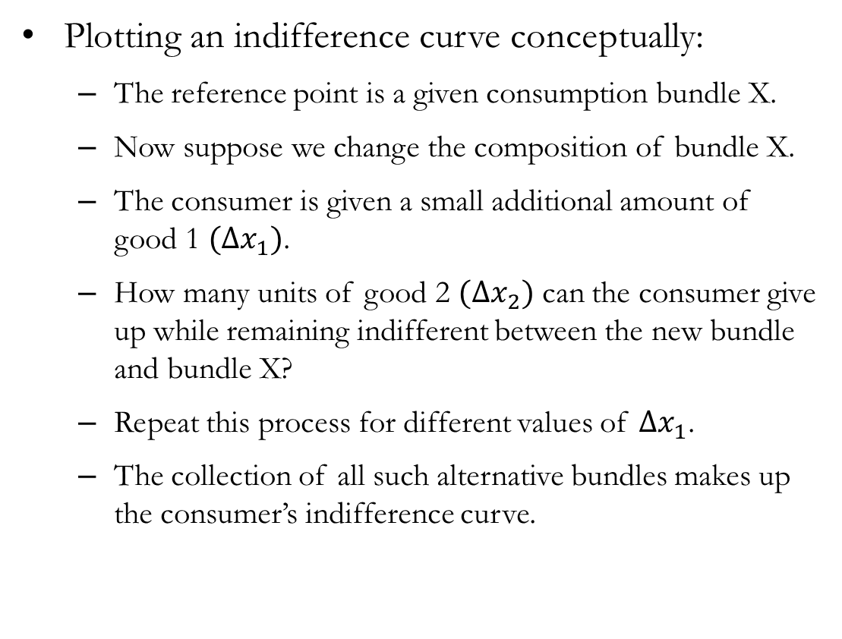
Constructing an Indifference Curve
Plotting an indifference curve conceptually:
The reference point is a given consumption bundle X.
Now suppose we change the composition of bundle X.
The consumer is given a small additional amount of good 1 $(Δx_{1})$.
How many units of good 2 $(Δx_{2})$ can the consumer give up while remaining indifferent between the new bundle and bundle X?
Repeat this process for different values of $Δx_{1}$.
The collection of all such alternative bundles makes up the consumer’s indifference curve.

Slide 15
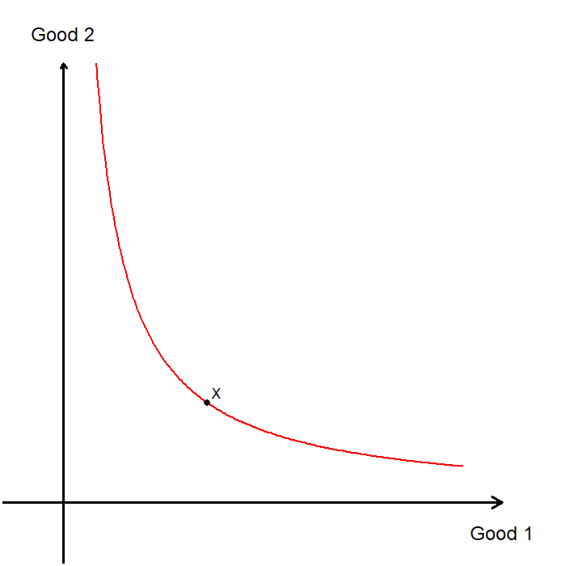
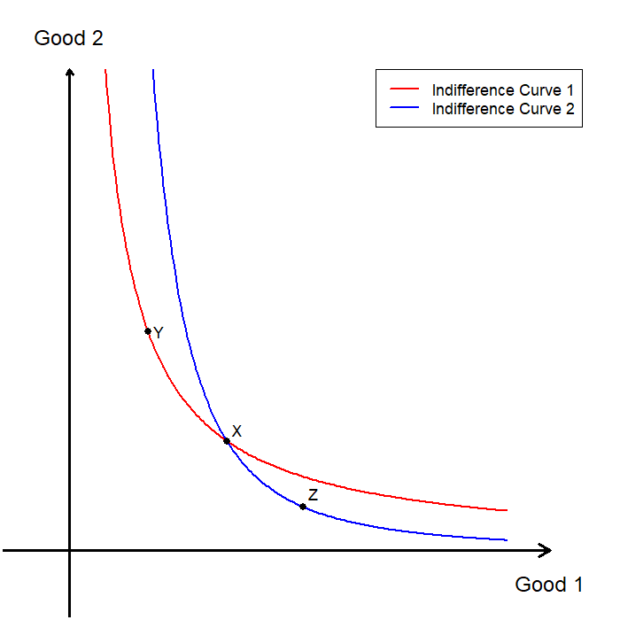
Uniqueness of the Indifference Curve
For a given preference relation, there is exactly one indifference curve through any bundle.
In particular, two indifference curves for the same preference relation cannot intersect (or touch).
Suppose that there are two indifference curves that both pass through the bundle X.
Choose some bundle Y on indifference curve 1 (X~Y), and some bundle Z on indifference curve 2 (X~Z).
Transitivity implies that Y~Z.
Then they must be on the same indifference curve.

Slide 16
Indifference Curves:
Special Cases

Slide 17
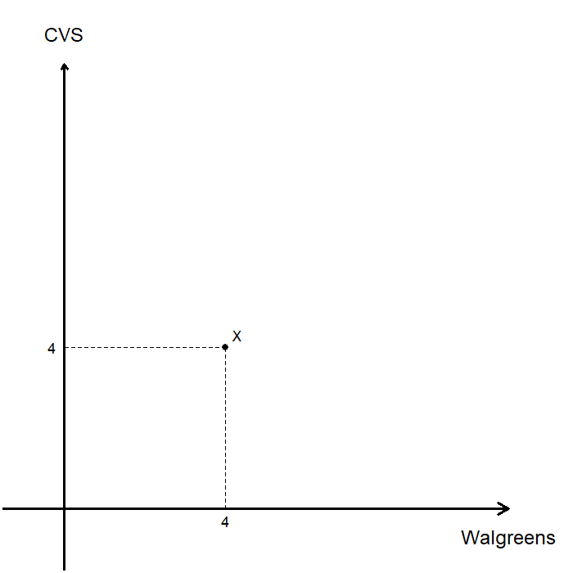
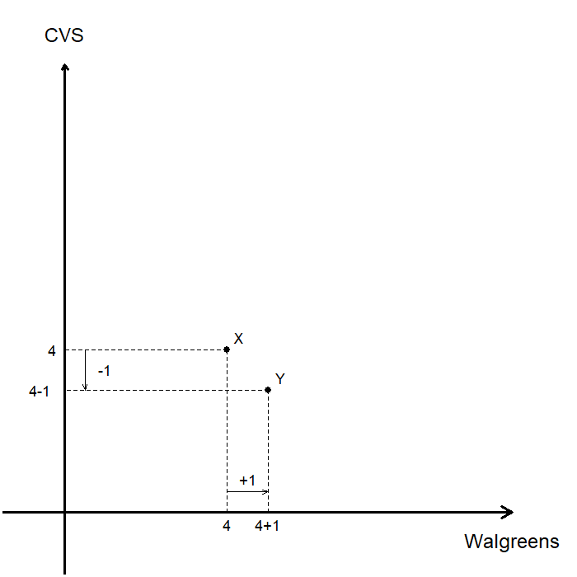
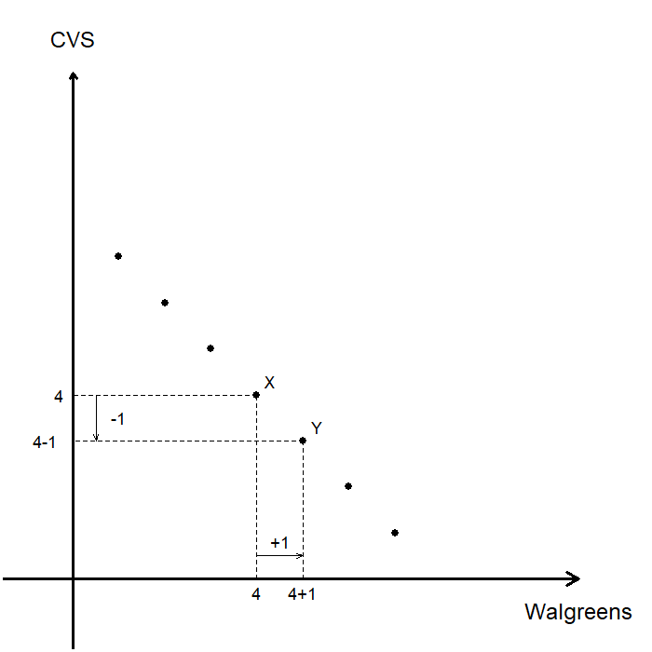
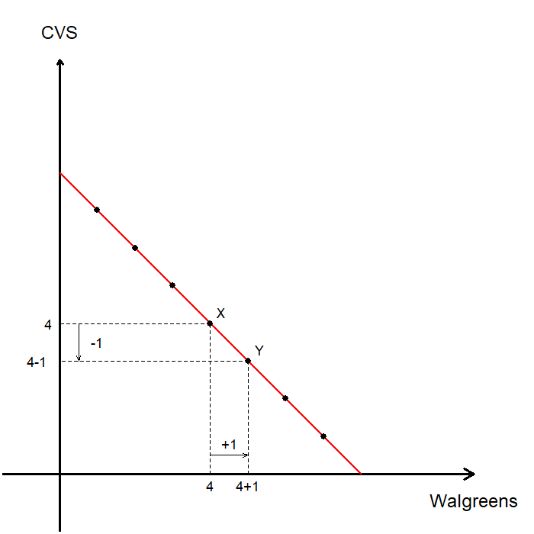
Perfect Substitutes
Two goods are perfect substitutes when consumers are willing to substitute one good for the other at a constant rate.
Consider generic Aspirin from Walgreens vs. CVS.
Suppose bundle X represents (4,4).
The consumer would be indifferent between giving up one bottle from CVS and receiving one additional bottle from Walgreens.
In fact, as long as the consumer ends up with 8 bottles in total (regardless of store), they are indifferent.
The indifference curve for two perfect substitutes is a straight line.

Slide 18
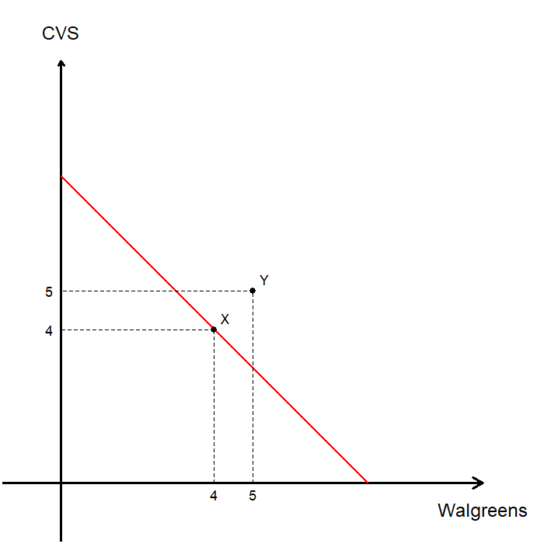
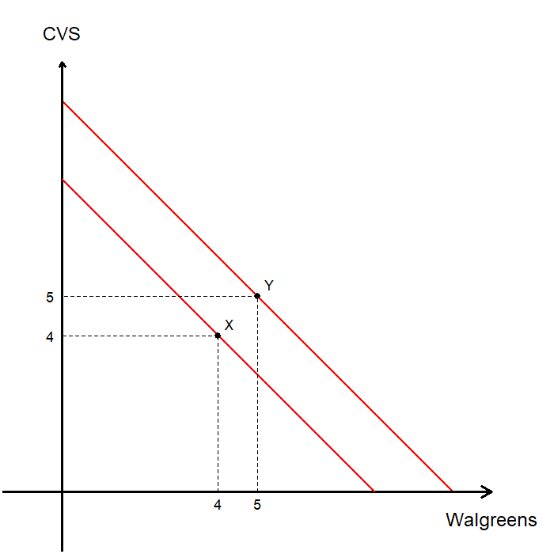
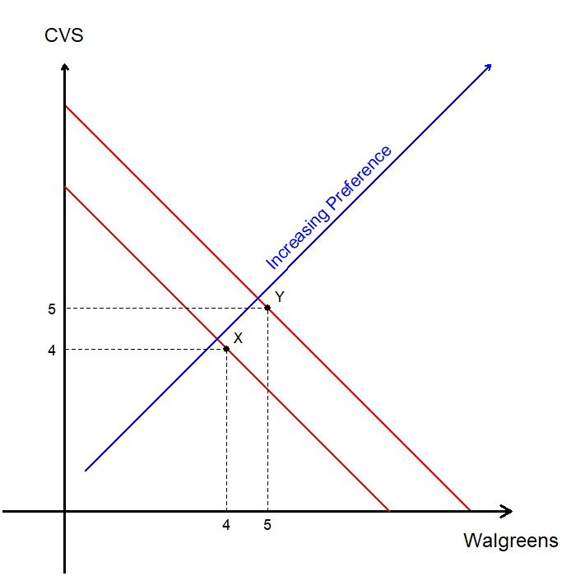
Perfect Substitutes: Better or Worse Off
How would the consumer feel about an alternative bundle, Y?
The consumer would prefer a bundle with 10 total bottles of aspirin to a bundle with 8 total bottles.
Let’s construct an indifference curve with bundle Y as the reference point.
Indifference curves farther from the origin represent bundles that are more preferred by the consumer.

Slide 19
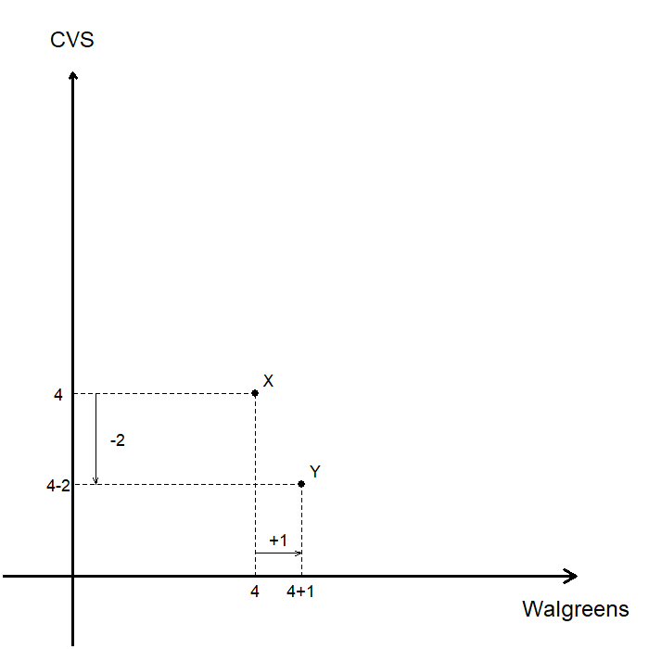
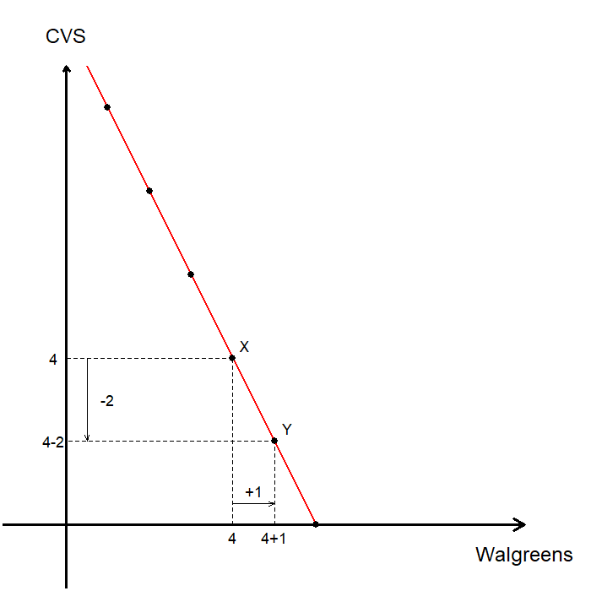
Perfect Substitutes: Substitution Ratios
If a bottle of aspirin at Walgreens contains 40 pills, while a bottle at CVS contains 20 pills, then the trade-off would not be 1:1.
For every extra Walgreens bottle, the consumer is willing to give up 2 CVS bottles to remain indifferent.
Repeating this reasoning for other bundles yields the consumer’s indifference curve.
The slope of the indifference curve reflects the consumer’s subjective trade-off ratio between the two goods.

Slide 20

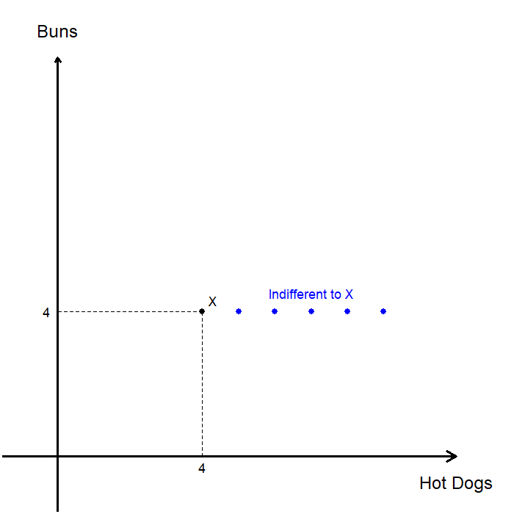
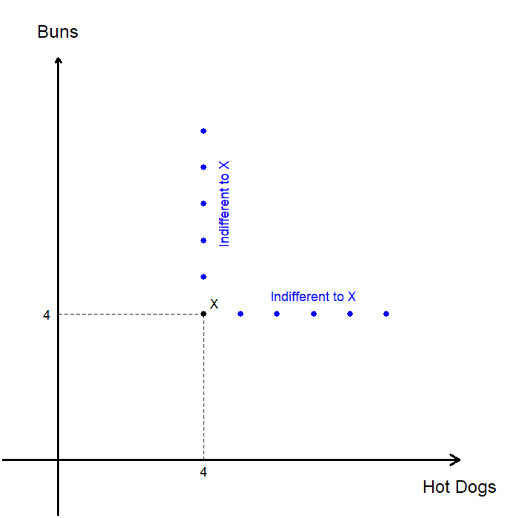
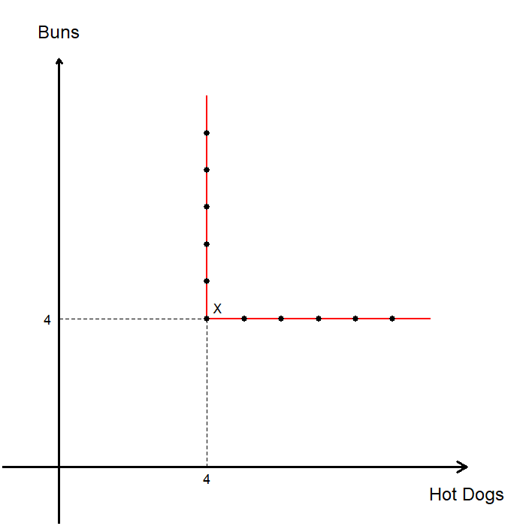
Perfect Complements
Two goods are perfect complements when they are always consumed together in fixed proportions.
Consider hot dogs and hot dog buns.
Suppose bundle X represents (4,4).
Assume the consumer only values matched pairs, in a 1:1 proportion.
Extra hot dogs without additional buns do not make the consumer better off.
Extra buns without additional hot dogs do not make the consumer better off.
The consumer’s indifference curve is L-shaped.

Slide 21
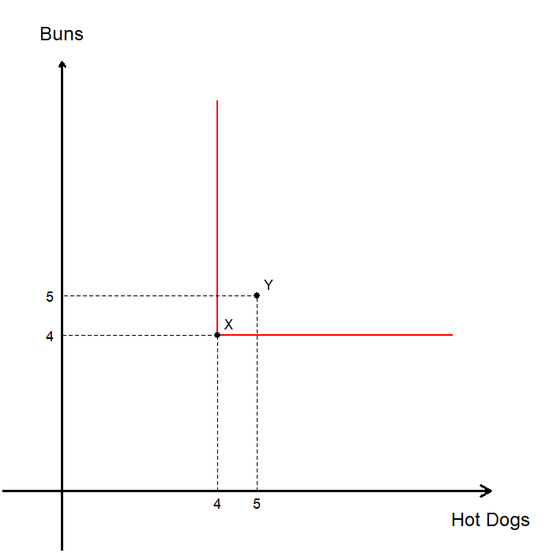
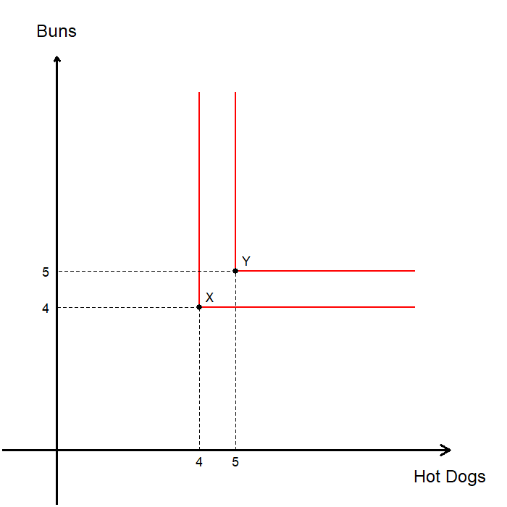
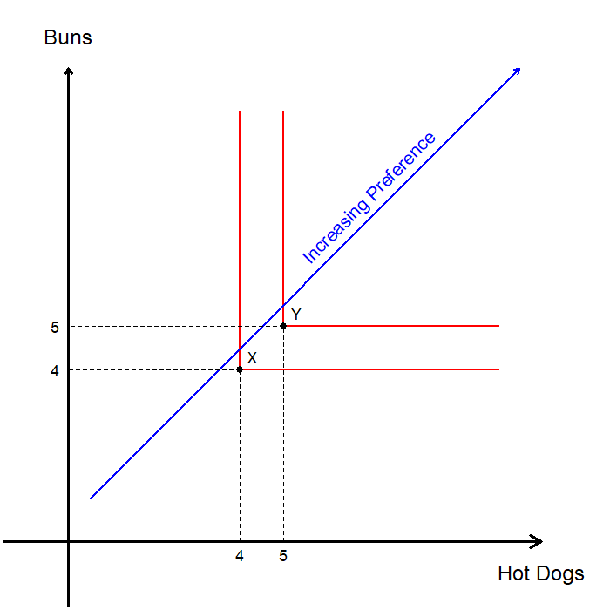
Perfect Complements: Better or Worse Off
How would the consumer feel about an alternative bundle, Y?
The consumer would prefer Y over X, as they can enjoy 5 complete hot dogs instead of 4.
Let’s construct an indifference curve with bundle Y as the reference point.
Indifference curves farther from the origin represent bundles that are more preferred by the consumer.

Slide 22
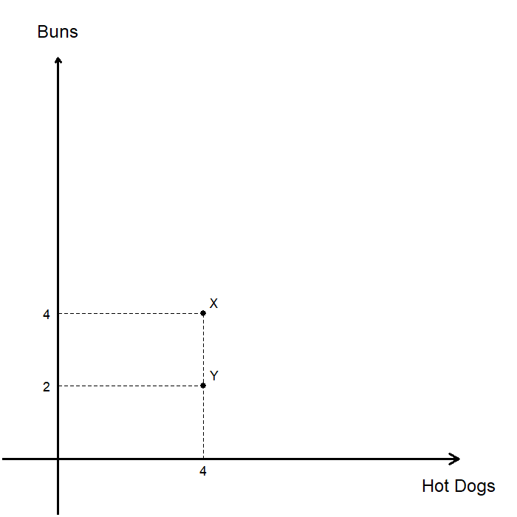
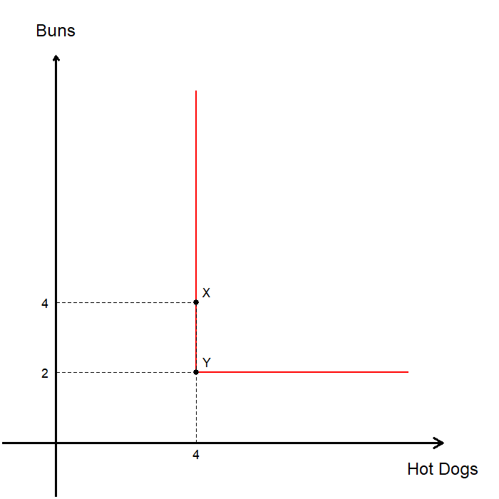
Perfect Complements: Consumption Ratios
If the consumer always combines 1 hot dog bun with 2 hot dogs, what would change?
The consumer would be indifferent between bundles X and Y.
Repeating this reasoning for other bundles yields the consumer’s indifference curve.
The location of the kink reflects the consumer’s fixed consumption ratio between the two goods.

Slide 23
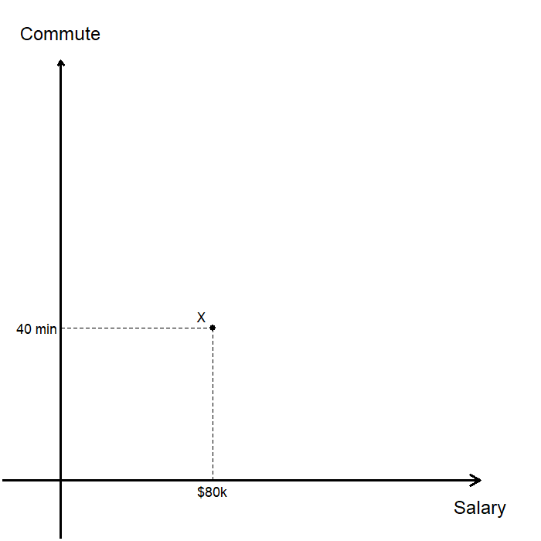
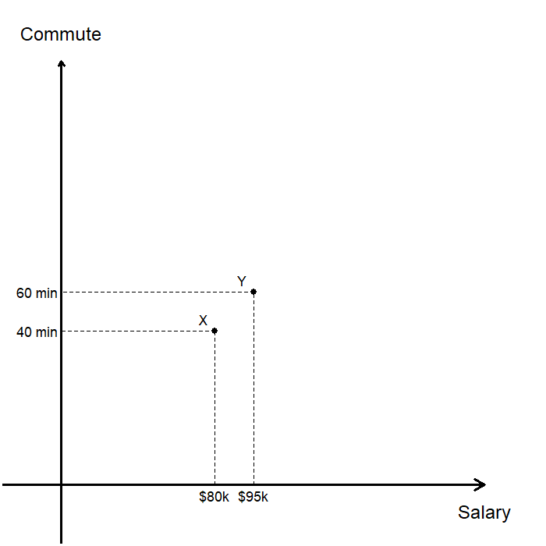
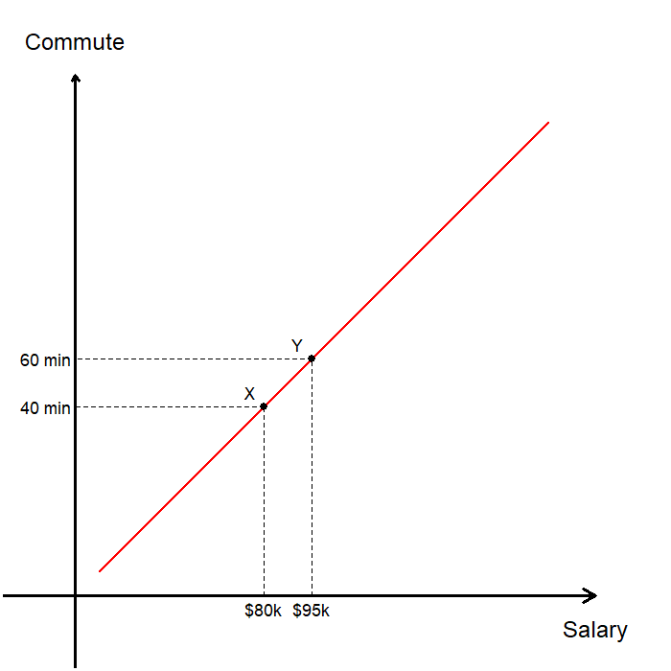
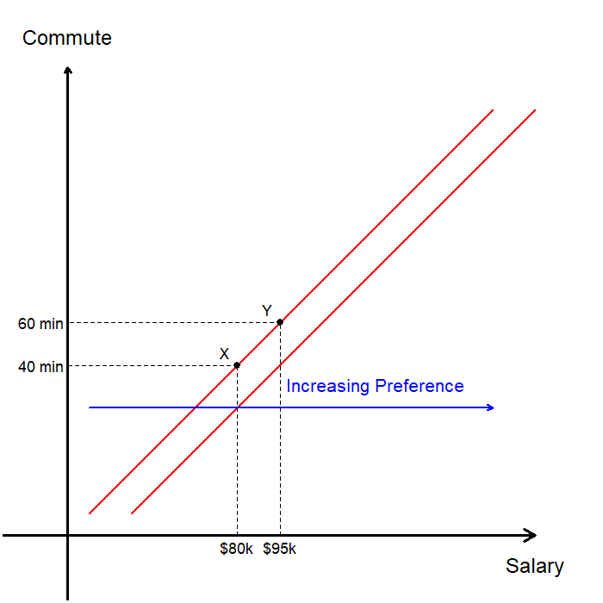
Bads
A bad is a commodity for which less is preferred to more, holding everything else constant.
We assume that salary is a good, and commute time is a bad for the consumer.
The consumer’s current job is represented as X.
For an increase in commute time, the consumer requires a higher salary to remain indifferent, such as at Y.
When one good is a bad, indifference curves slope upward.
The consumer is better off on indifference curves located further to the right.

Slide 24
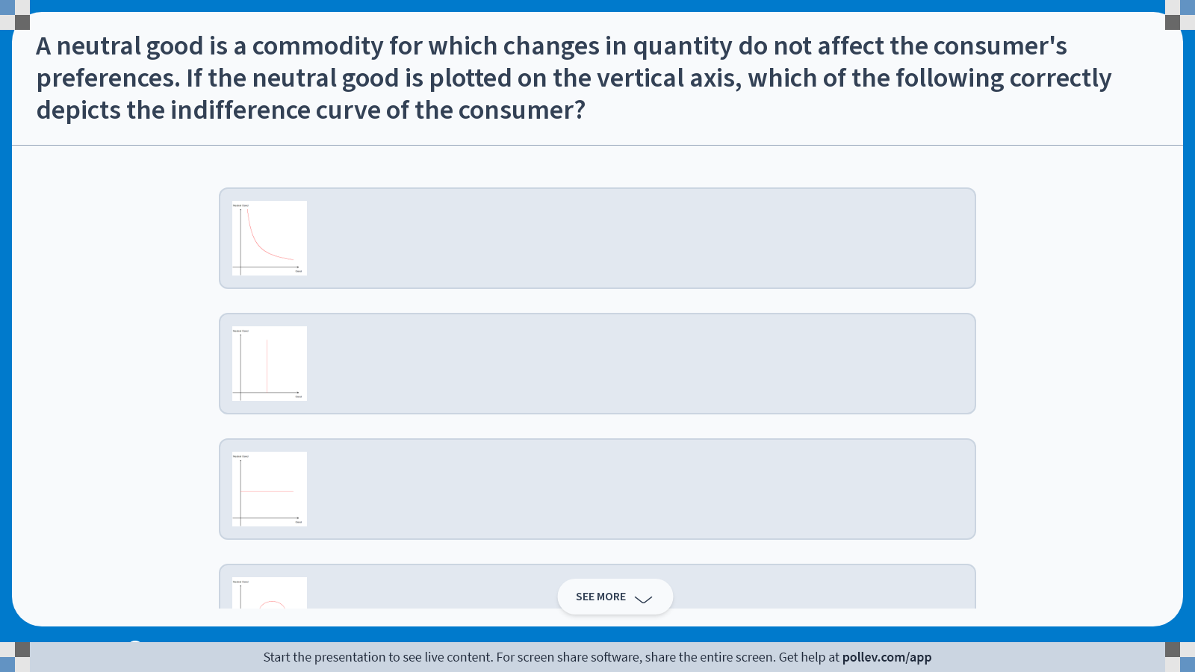
Poll Everywhere multiple choice poll instructions screen Activity Title: A neutral good is a commodity for which changes in quantity do not affect the consumer's preferences. If the neutral good is plotted on the vertical axis, which of the following correctly depicts the indifference curve of the consumer? Slide 22
Notes:
Do not modify the notes in this section to avoid tampering with the Poll Everywhere activity. More info at polleverywhere.com/support A neutral good is a commodity for which changes in quantity do not affect the consumer's preferences. If the neutral good is plotted on the vertical axis, which of the following correctly depicts the indifference curve of the consumer? https://www.polleverywhere.com/multiple_choice_polls/6cSFb7iJFVN9KMaKbOvlN?display_state=instructions&activity_state=opened&state=opened&flow=Engagement&onscreen=persist

Slide 25
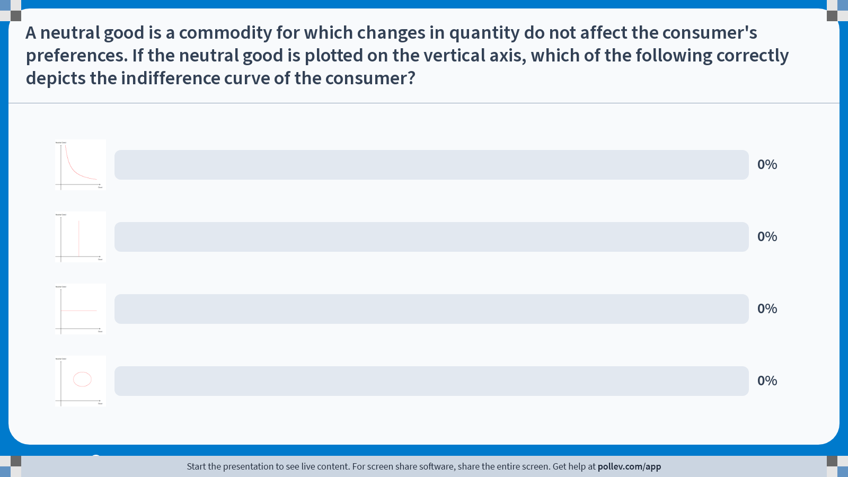
Poll Everywhere multiple choice poll chart screen Activity Title: A neutral good is a commodity for which changes in quantity do not affect the consumer's preferences. If the neutral good is plotted on the vertical axis, which of the following correctly depicts the indifference curve of the consumer? Slide 24
Notes:
Do not modify the notes in this section to avoid tampering with the Poll Everywhere activity. More info at polleverywhere.com/support A neutral good is a commodity for which changes in quantity do not affect the consumer's preferences. If the neutral good is plotted on the vertical axis, which of the following correctly depicts the indifference curve of the consumer? https://www.polleverywhere.com/multiple_choice_polls/6cSFb7iJFVN9KMaKbOvlN?display_state=chart&activity_state=closed&state=closed&flow=Engagement&onscreen=persist

Slide 26
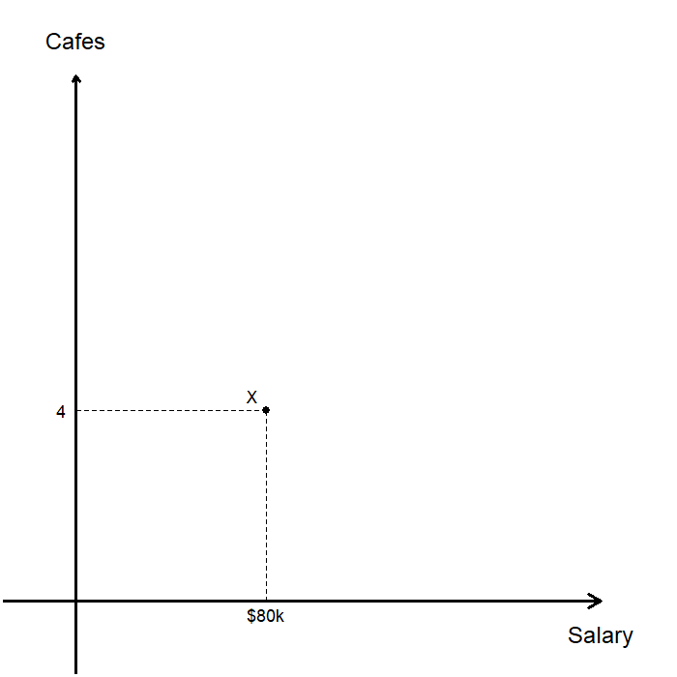
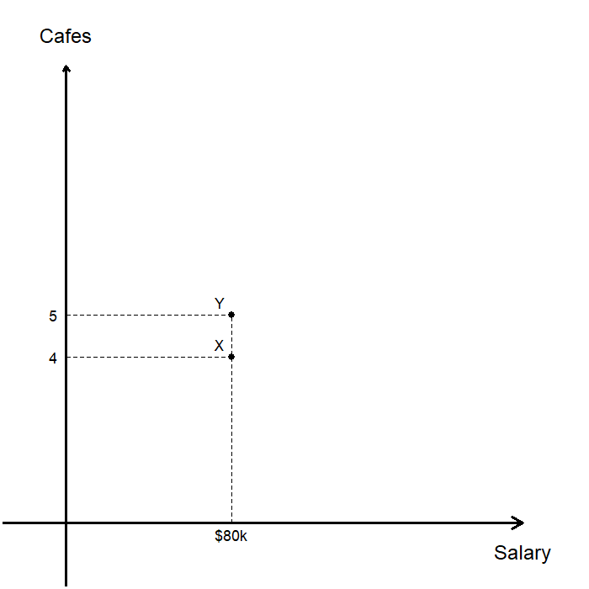
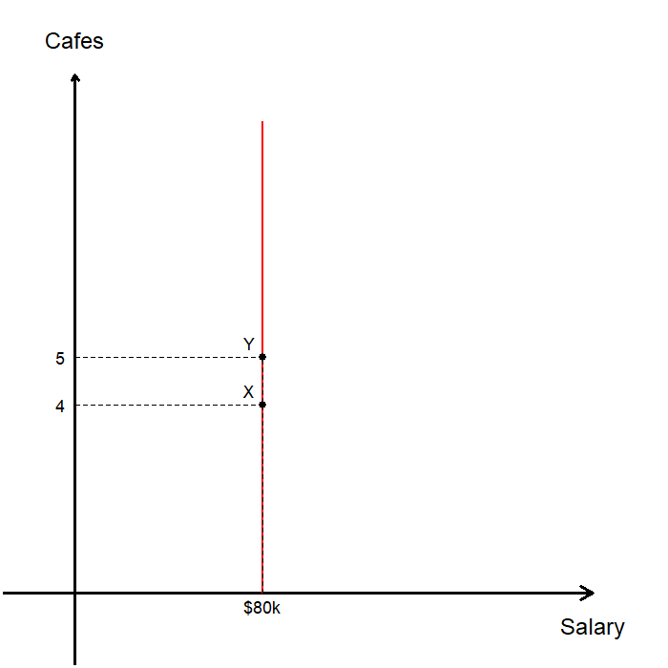
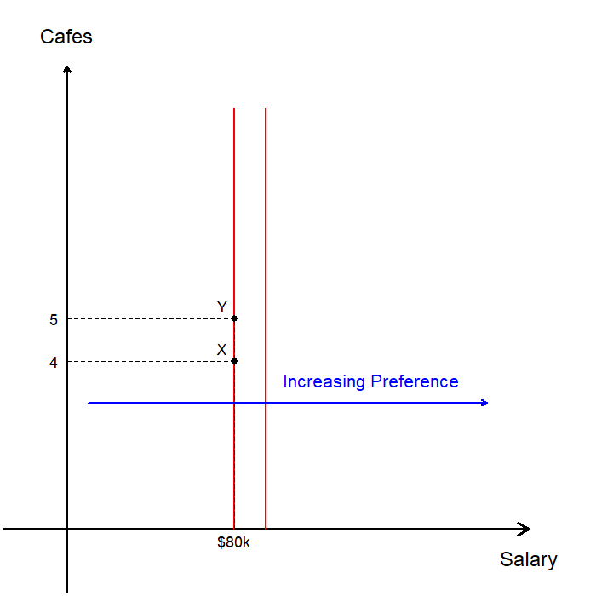
Neutral Goods
A neutral good is a commodity for which changes in quantity do not affect the consumer’s preferences.
We assume that salary is a good, and the number of cafes near the office is a neutral good.
The consumer’s current job is represented as X.
If the number of cafes increases without a change in salary, the consumer’s preferences remain unchanged.
When one good is neutral and plotted on the vertical axis, indifference curves are vertical lines.
The consumer is better off on indifference curves located further to the right.

Slide 27



Satiation
Preferences may feature a bundle (a bliss point ), such that bundles closer to this point are preferred.
Suppose the consumer’s bliss point is 5 cups of coffee and 5 bagels per week.
When the consumer has more than 5 cups of coffee, additional coffee becomes a bad.
When the consumer has more than 5 bagels, additional bagels becomes a bad.
Indifference curves are closed and surround the bliss point.
The consumer is better off on indifference curves that are closer to the bliss point.

Slide 28
Well-Behaved Preferences

Slide 29
Axioms of Preference
Completeness: We can compare any two bundles.
Reflexivity: A bundle is at least as good as itself.
Transitivity: No circular preferences.
Monotonicity: The more the better.
Convexity: Variety is better than extremes.
Continuity: Indifference curves are unbroken.

Slide 30


Axioms of Preference: Monotonicity
A preference relation is monotone if, whenever one bundle has at least as much of every good as another, the consumer strictly prefers the bundle with more.
“The more the better.”
Under monotonicity, indifference curves cannot slope upward.
Formally: (Strong) Monotonicity
$$x≥y and x≠y, then y≻z$$

Slide 31


Axioms of Preference: Convexity
A preference relation is convex if consumers prefer more balanced bundles to extreme bundles.
“Variety is better than extremes.”
X: Relatively more of good 2 and relatively less of good 1.
Y: Relatively more of good 1 and relatively less of good 2.
Z: A more balanced combination of both goods.
Under convex preferences, the consumer prefers bundle Z to either extreme bundle.
As a result, under convex preferences, indifference curves are bowed inward toward the origin.

Slide 32

Axioms of Preference: Continuity
A preference relation is continuous if small changes in a bundle lead to only small changes in preferences.
Continuity ensures that indifference curves are smooth and unbroken, rather than having gaps or sudden jumps.
We are skipping the formal definitions of convexity and continuity, as it is far beyond the scope of this course.

Slide 33
The Marginal Rate of Substitution

Slide 34





Marginal Rate of Substitution(-ish)
The Marginal Rate of Substitution (MRS) is the rate at which a consumer is willing to trade one good for another while remaining indifferent.
Let’s see what MRS looks like on a graph:
A consumer is currently consuming bundle X.
The consumer is given some extra units of good 1.
We then ask how many units of good 2 the consumer is willing to give up to remain indifferent to bundle X.
This exchange ratio, $Δx_{2}/Δx_{1}$, approximates the MRS.
Formally, the MRS is the slope of the indifference curve at point X, ${dx}_{2}/{dx}_{1}$.

Slide 35

Interpretations of MRS
MRS is the slope of the indifference curve at a given bundle.
When the change in good 1 is very small (the “run” is near zero), the ratio $Δx_{2}/Δx_{1}$ approaches the slope of the indifference curve, ${dx}_{2}/{dx}_{1}$.
MRS is the consumer’s marginal willingness to pay:
The amount of good 2 the consumer is willing to pay for a marginal amount of extra consumption of good 1, holding the consumer equally satisfied.
MRS reflects the consumer’s internal tradeoff between the two goods, not a market tradeoff.
It depends on preferences and the current bundle, not on prices.

Slide 36



Diminishing MRS
If preferences are convex, the marginal rate of substitution is diminishing as we move along an indifference curve.
Diminishing MRS means that as the consumer has more of good 1, they are willing to give up fewer units of good 2 for an additional unit of good 1.
When good 1 is scarce, the consumer values it highly. As it becomes abundant, they are less willing to trade for it.

Slide 37
Recap & Preview

Slide 38
Recap: Preferences
Preferences describe how a consumer ranks bundles of goods.
Axioms: Completeness, Reflexivity, Transitivity, Monotonicity, Convexity, and Continuity
Preferences are represented graphically using indifference curves:
Each indifference curve represents bundles the consumer views as equally desirable.
(In general) Indifference curves further from the origin correspond to more preferred bundles.
The Marginal Rate of Substitution (MRS) measures the rate at which a consumer is willing to trade one good for another while remaining indifferent.
MRS is the slope of the indifference curve at a point.
MRS represents the consumer’s marginal willingness to pay for one good in terms of the other.
The MRS is diminishing as consumption shifts toward more of one good.

Slide 39
Preview: Utility
Preferences tell us which bundles are better than others, but by themselves they do not determine a unique choice.
In the next chapter, we introduce utility:
A numerical representation of the consumer’s preferences.
A way to assign numbers to bundles that preserve rankings.
Utility allows us to translate preferences into a form that is easier to analyze using math.
Combining utility with the budget constraint allows us to solve the consumer’s optimization problem.

