Slide 1
INTERMEDIATE MICROECONOMIC THEORY
Chapter 2: Budget Constraint

Slide 2
Preview
Economists assume that individual consumers aim to purchase the best bundle of goods and services that they can afford.
This statement sounds reasonable at first, but it contains several vague terms that we need to define clearly.
For instance, what does it mean for a bundle of goods and services to be the “best”?
Also, what does it mean to say that a consumer “can afford” a bundle of goods and services?
In this chapter, we formally define the latter by deriving the consumer’s budget constraint.

Slide 3
Budget Constraint Basics

Slide 4
The Budget Constraint
We can consume any bundle of goods and services, as long as we can afford it.
How can we formalize this idea to examine the consumer’s choice?
How can we express the statement above in a graph?
How can we translate these words into math?
To make the idea of affordability precise, we need a simple economic environment.
Let’s start off with a simple model with two goods.

Slide 5
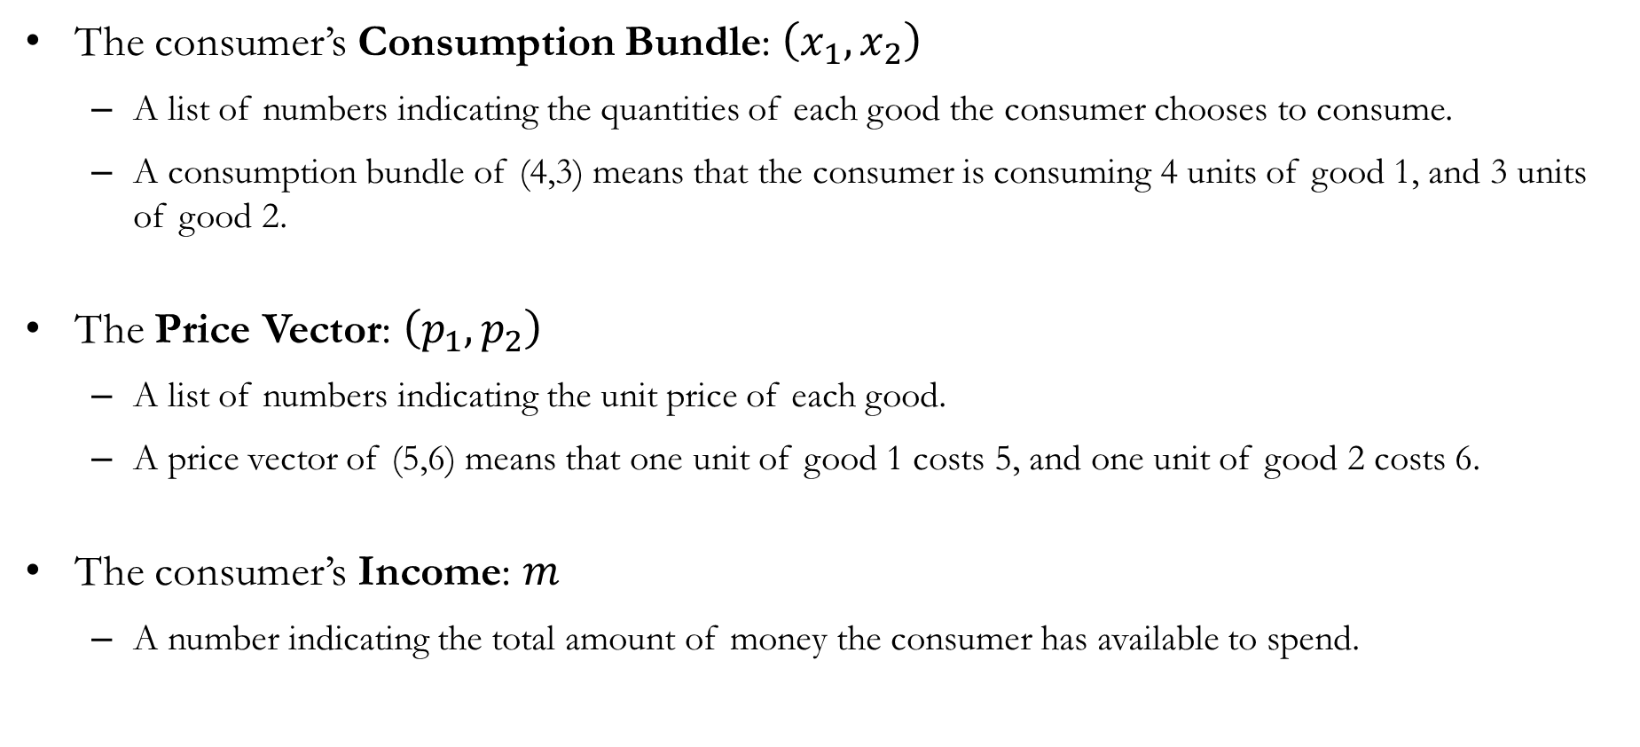
Formalizing the Budget Constraint
The consumer’s Consumption Bundle: $\left(x_{1}, x_{2}\right)$
A list of numbers indicating the quantities of each good the consumer chooses to consume.
A consumption bundle of (4,3) means that the consumer is consuming 4 units of good 1, and 3 units of good 2.
The Price Vector: $\left(p_{1}, p_{2}\right)$
A list of numbers indicating the unit price of each good.
A price vector of (5,6) means that one unit of good 1 costs 5, and one unit of good 2 costs 6.
The consumer’s Income: $m$
A number indicating the total amount of money the consumer has available to spend.

Slide 6
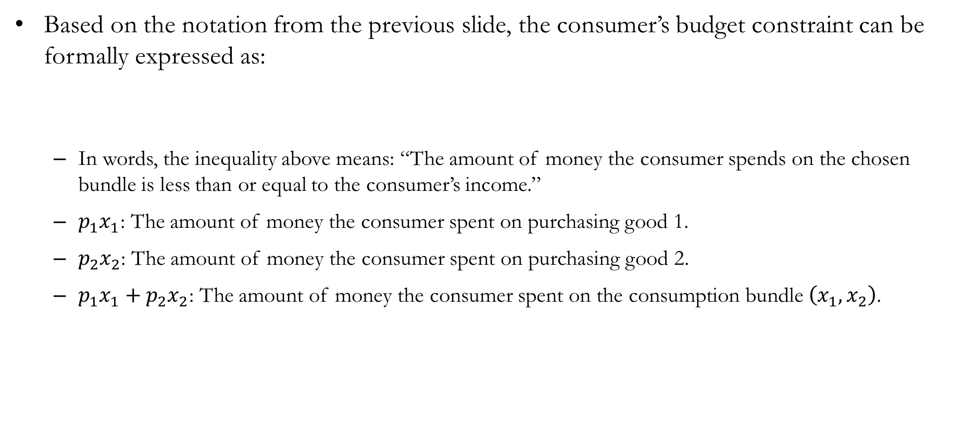
Formalizing the Budget Constraint
Based on the notation from the previous slide, the consumer’s budget constraint can be formally expressed as:
In words, the inequality above means: “The amount of money the consumer spends on the chosen bundle is less than or equal to the consumer’s income.”
$p_{1}x_{1}$: The amount of money the consumer spent on purchasing good 1.
$p_{2}x_{2}$: The amount of money the consumer spent on purchasing good 2.
$p_{1}x_{1}+p_{2}x_{2}$: The amount of money the consumer spent on the consumption bundle $\left(x_{1},x_{2}\right)$.
$$p_{1}x_{1}+p_{2}x_{2}≤m$$

Slide 7
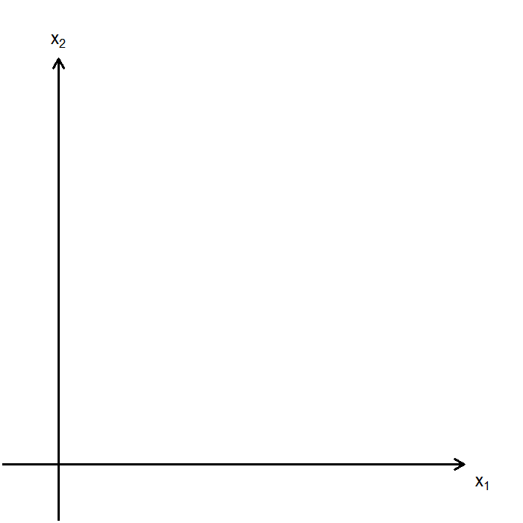
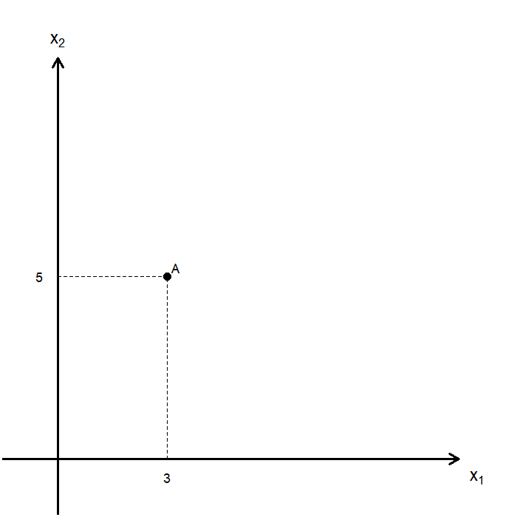
Visualizing the Budget Constraint
To visualize the consumer’s choice, we plot a graph with one axis representing the amount of good 1 chosen and the other representing the amount of good 2 chosen.
Any consumption bundle can be expressed as a point in the space spanned by the two axes.
For instance, the consumption bundle (3,5) is represented by point A, where the consumer chooses 3 units of good 1 and 5 units of good 2.

Slide 8
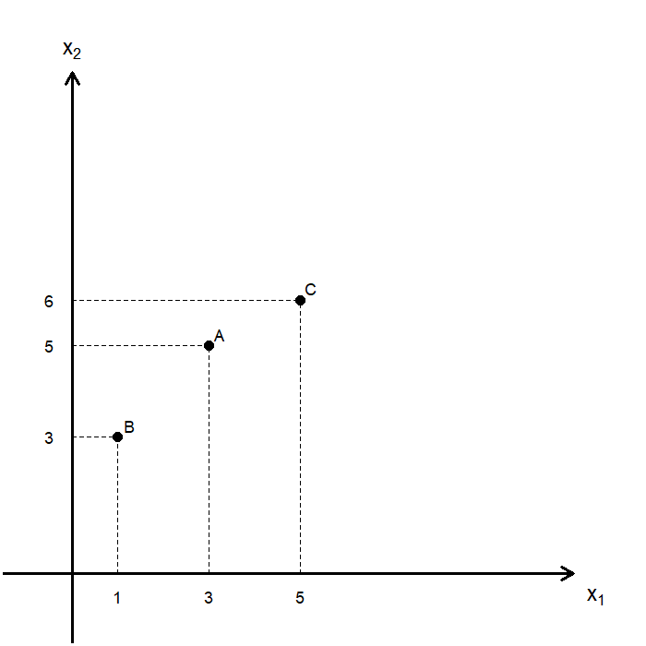
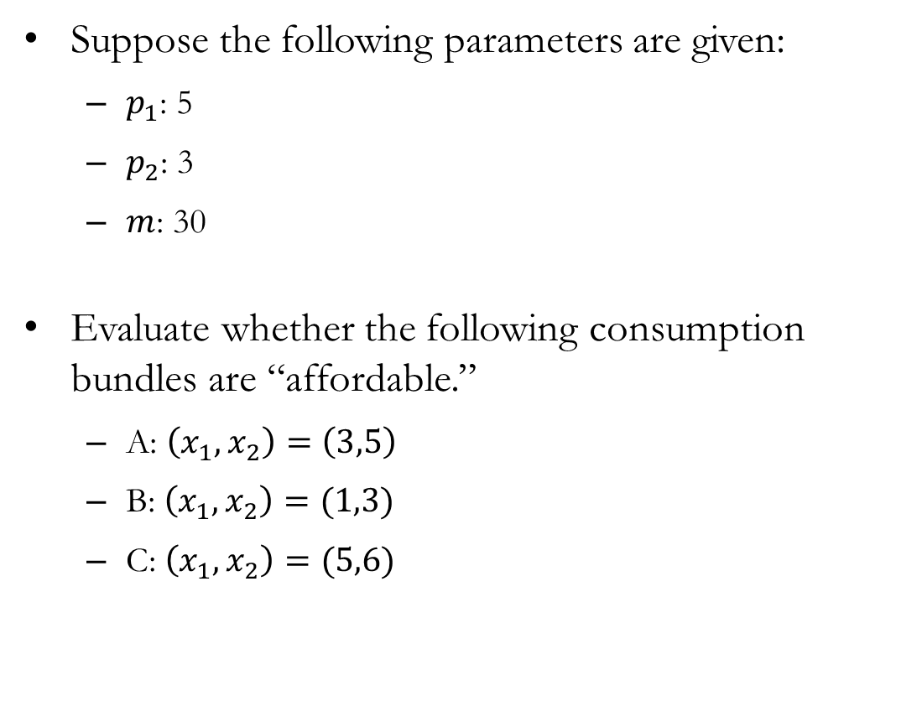
Visualizing the Budget Constraint
Suppose the following parameters are given:
$p_{1}$: 5
$p_{2}$: 3
$m$: 30
Evaluate whether the following consumption bundles are “affordable.”
A: $\left(x_{1}, x_{2}\right)=\left(3,5\right)$
B: $\left(x_{1}, x_{2}\right)=(1,3)$
C: $\left(x_{1}, x_{2}\right)=(5,6)$

Slide 9
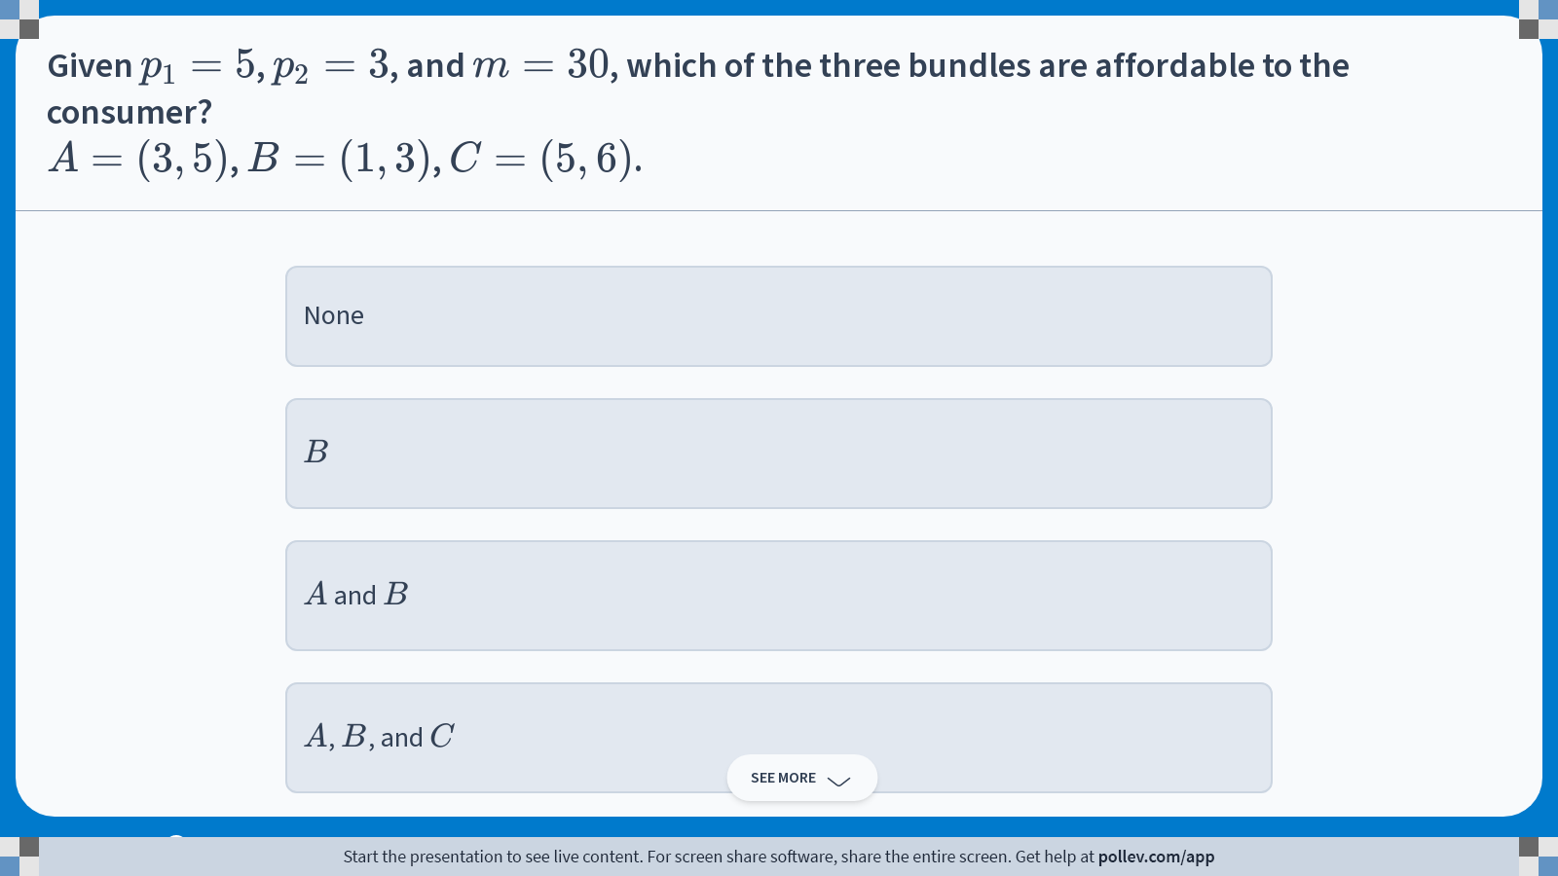
Poll Everywhere multiple choice poll instructions screen Activity Title: Given $$p_1=5$$, $$p_2=3$$, and $$m=30$$, which of the three bundles are affordable to the consumer?$$A=(3,5)$$, $$B=(1,3)$$, $$C=(5,6)$$. Slide 9
Notes:
Do not modify the notes in this section to avoid tampering with the Poll Everywhere activity. More info at polleverywhere.com/support Given $$p_1=5$$, $$p_2=3$$, and $$m=30$$, which of the three bundles are affordable to the consumer?$$A=(3,5)$$, $$B=(1,3)$$, $$C=(5,6)$$. https://www.polleverywhere.com/multiple_choice_polls/QTgjaE5k3JkVAHn4aqv5e?display_state=instructions&activity_state=opened&state=opened&flow=Engagement&onscreen=persist

Slide 10
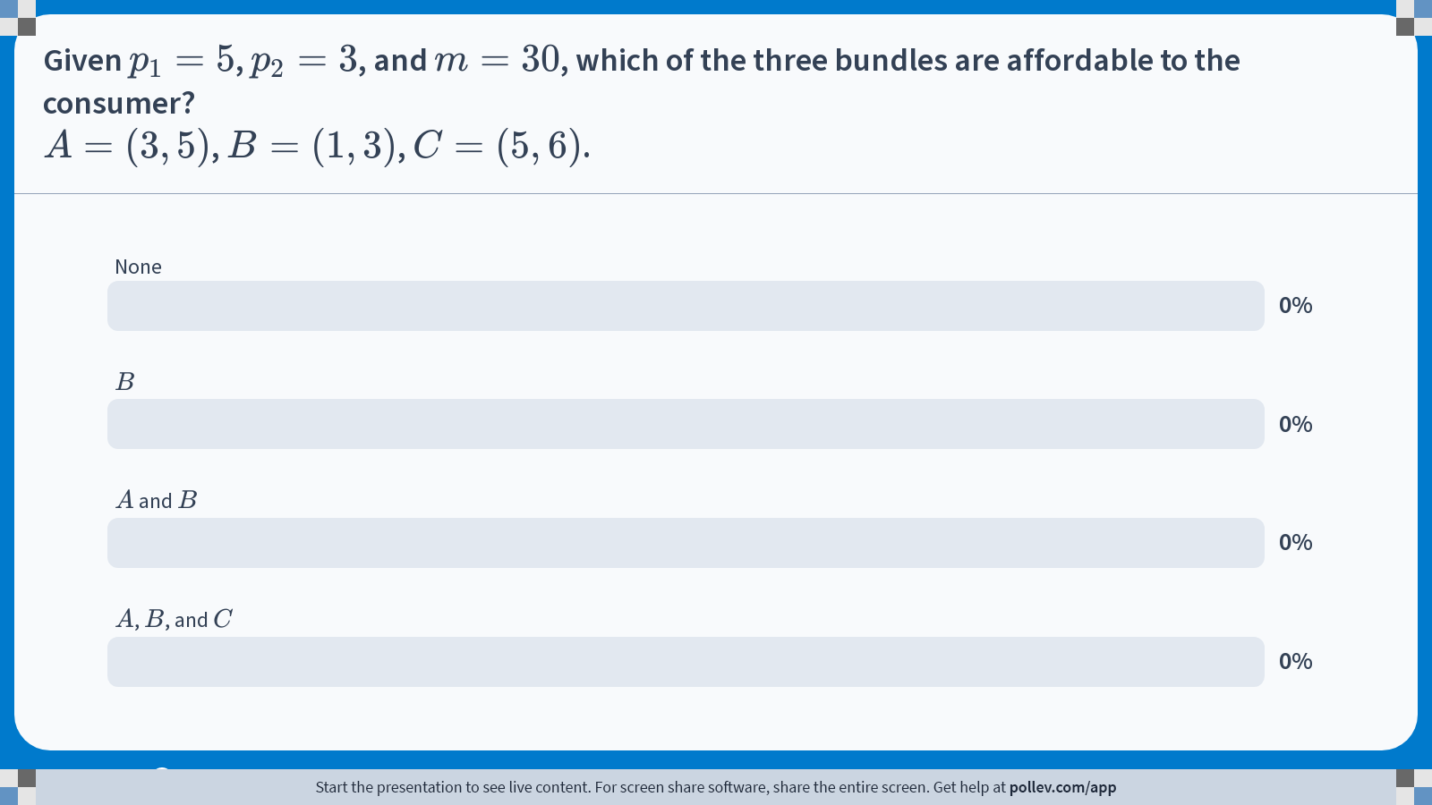
Poll Everywhere multiple choice poll chart screen Activity Title: Given $$p_1=5$$, $$p_2=3$$, and $$m=30$$, which of the three bundles are affordable to the consumer?$$A=(3,5)$$, $$B=(1,3)$$, $$C=(5,6)$$. Slide 11
Notes:
Do not modify the notes in this section to avoid tampering with the Poll Everywhere activity. More info at polleverywhere.com/support Given $$p_1=5$$, $$p_2=3$$, and $$m=30$$, which of the three bundles are affordable to the consumer?$$A=(3,5)$$, $$B=(1,3)$$, $$C=(5,6)$$. https://www.polleverywhere.com/multiple_choice_polls/QTgjaE5k3JkVAHn4aqv5e?display_state=chart&activity_state=closed&state=closed&flow=Engagement&onscreen=persist

Slide 11
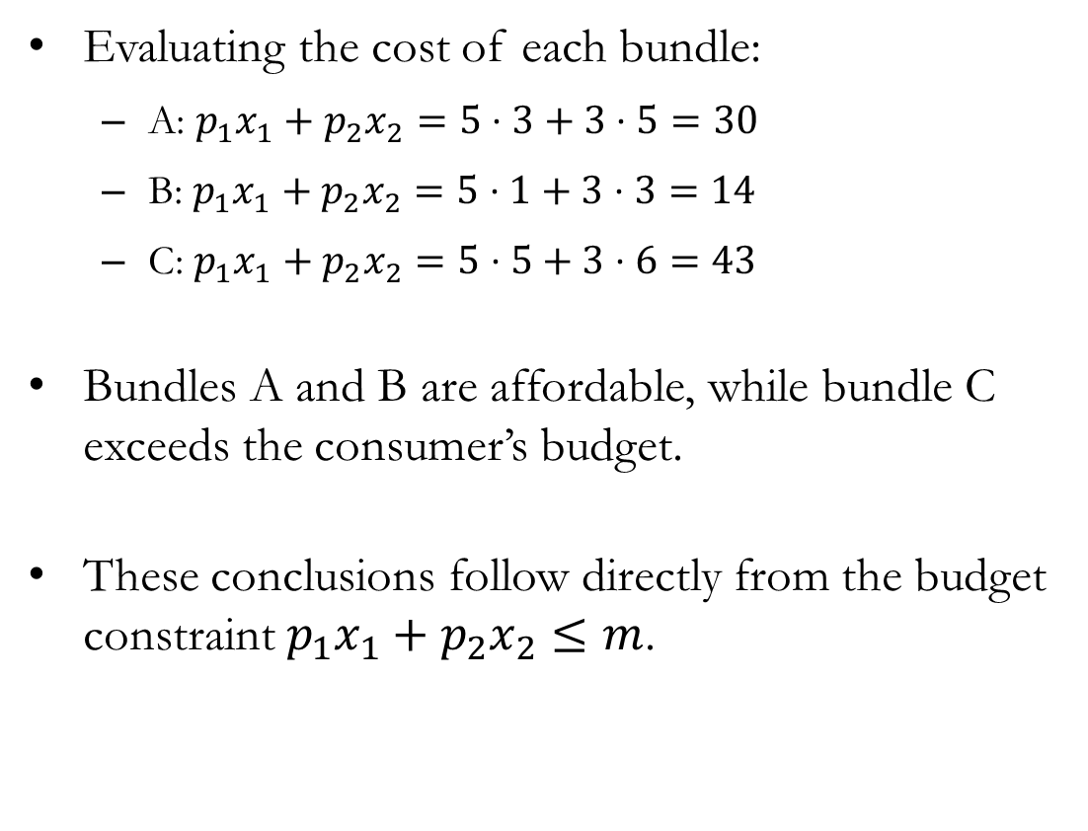
Visualizing the Budget Constraint
Evaluating the cost of each bundle:
A: $p_{1}x_{1}+p_{2}x_{2}=5⋅3+3⋅5=30$
B: $p_{1}x_{1}+p_{2}x_{2}=5⋅1+3⋅3=14$
C: $p_{1}x_{1}+p_{2}x_{2}=5⋅5+3⋅6=43$
Bundles A and B are affordable, while bundle C exceeds the consumer’s budget.
These conclusions follow directly from the budget constraint $p_{1}x_{1}+p_{2}x_{2}≤m$.

Slide 12
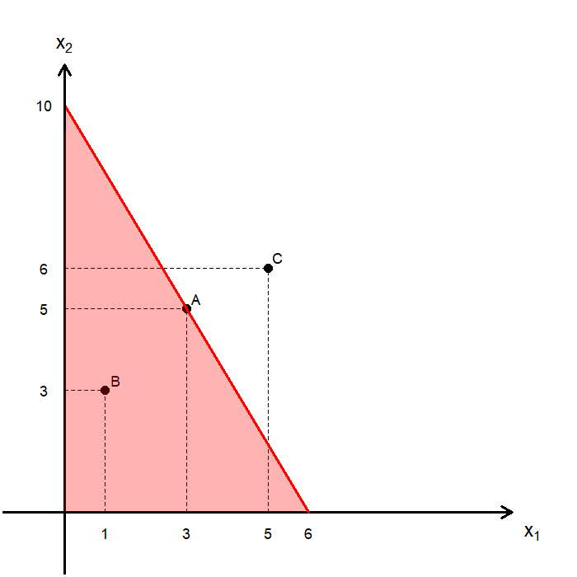
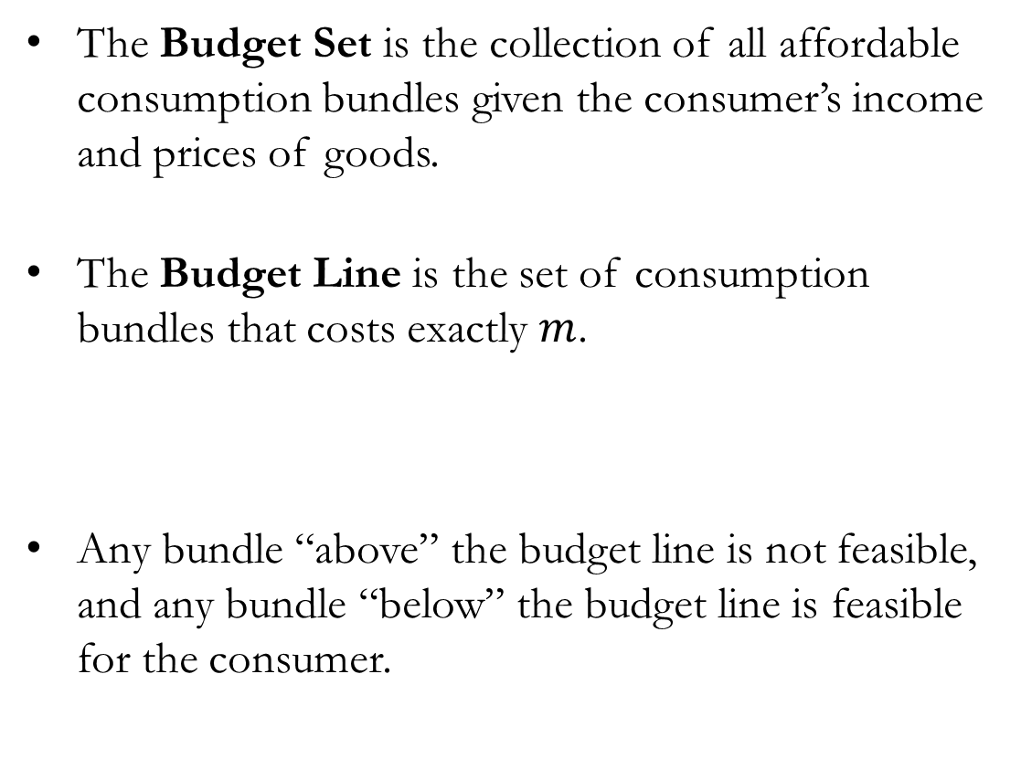

Visualizing the Budget Constraint
The Budget Set is the collection of all affordable consumption bundles given the consumer’s income and prices of goods.
The Budget Line is the set of consumption bundles that costs exactly $m$.
Any bundle “above” the budget line is not feasible, and any bundle “below” the budget line is feasible for the consumer.
$$p_{1}x_{1}+p_{2}x_{2}=m$$

Slide 13
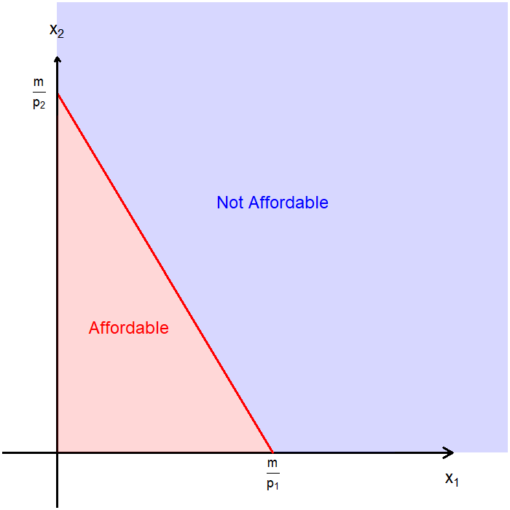
Anatomy of the Diagram
The graph can be divided into two regions by the budget line.
The set of all affordable bundles (the budget set), and
The set of all bundles that are not affordable.
The budget line is the boundary of the budget set and represents all bundles that exactly exhaust the consumer’s budget.
The intercepts show the maximum amount of one good the consumer can afford if all income is spent on that good.

Slide 14
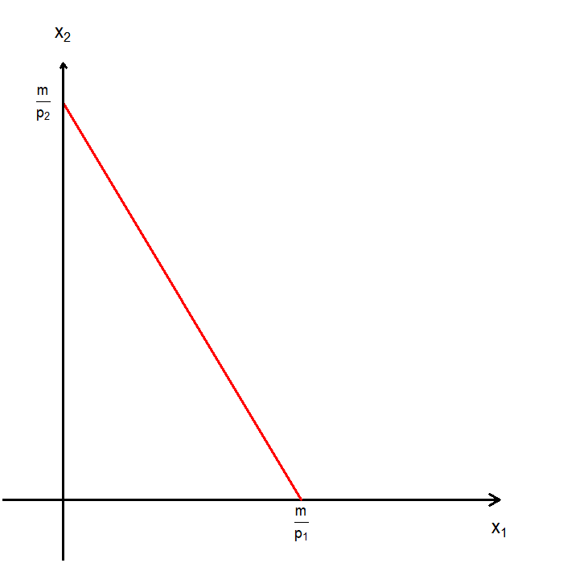
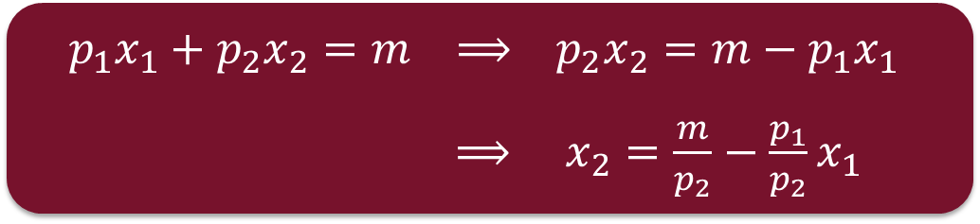
Anatomy of the Diagram: Slope
The slope of the budget line is going to be a very important object.
The slope of the budget line tells us “How many units of good 2 the consumer must give up to consume one extra unit of good 1.”
In other words, it tells us the objective rate of exchange between goods 1 and 2.
$$p_{1}x_{1}+p_{2}x_{2}=m ⟹ p_{2}x_{2}=m−p_{1}x_{1}$$
$⟹ x_{2}=\frac{m}{p_{2}}−\frac{p_{1}}{p_{2}}x_{1}$

Slide 15
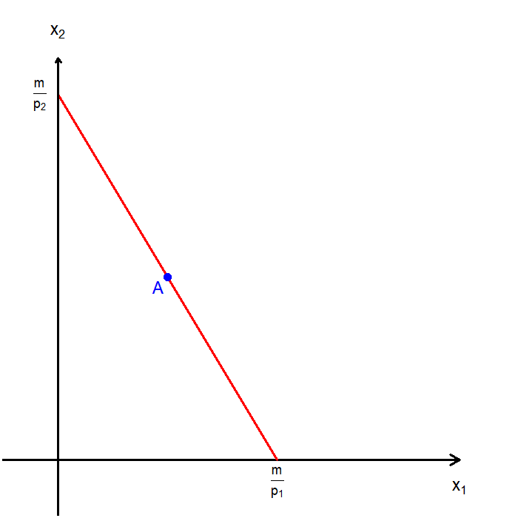
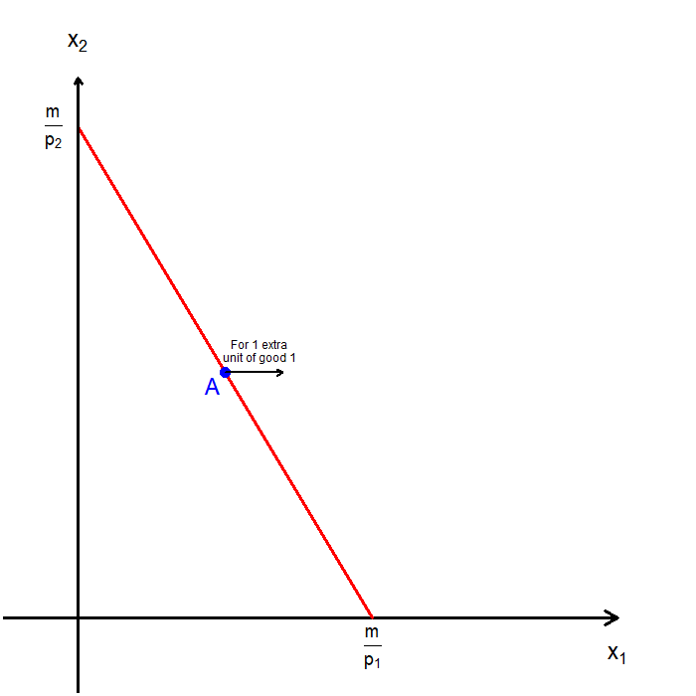
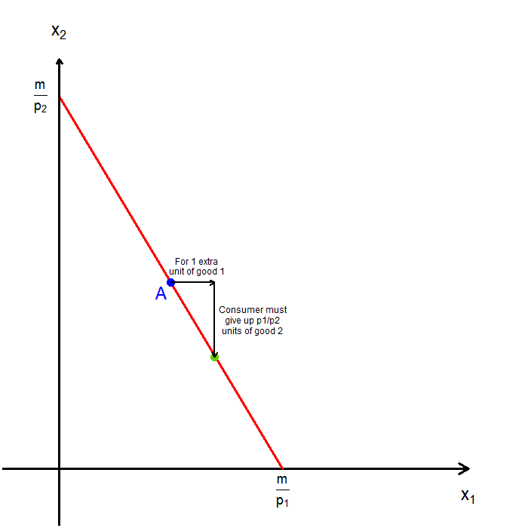
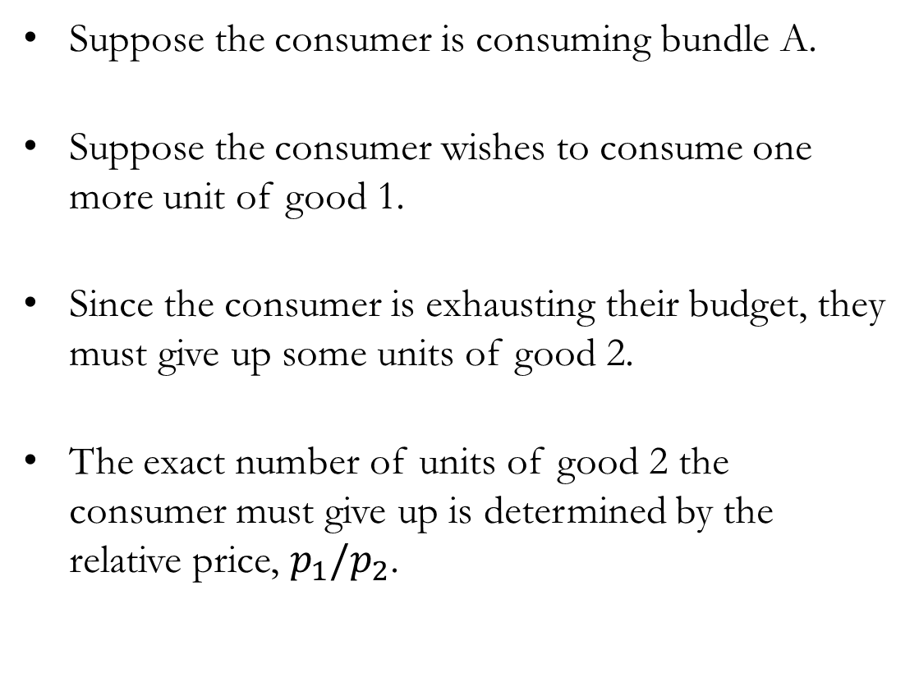
Anatomy of the Diagram: Slope
Suppose the consumer is consuming bundle A.
Suppose the consumer wishes to consume one more unit of good 1.
Since the consumer is exhausting their budget, they must give up some units of good 2.
The exact number of units of good 2 the consumer must give up is determined by the relative price, $p_{1}/p_{2}$.

Slide 16
Quick Recap and Preview
The slope of the budget line tells us what the consumer has to give up in the market.
This trade-off is determined entirely by prices and income.
So far, we have described what is affordable, not what the consumer will choose.
Later, when we talk about preferences, we will ask what the consumer is willing to give up.

Slide 17
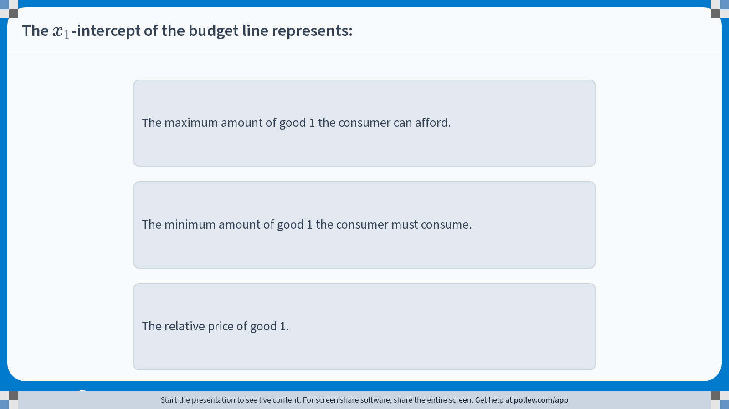
Poll Everywhere multiple choice poll instructions screen Activity Title: The $$x_1$$-intercept of the budget line represents: Slide 17
Notes:
Do not modify the notes in this section to avoid tampering with the Poll Everywhere activity. More info at polleverywhere.com/support The $$x_1$$-intercept of the budget line represents: https://www.polleverywhere.com/multiple_choice_polls/arCqwore2FCgAJnq6Y2oi?display_state=instructions&activity_state=opened&state=opened&flow=Engagement&onscreen=persist

Slide 18
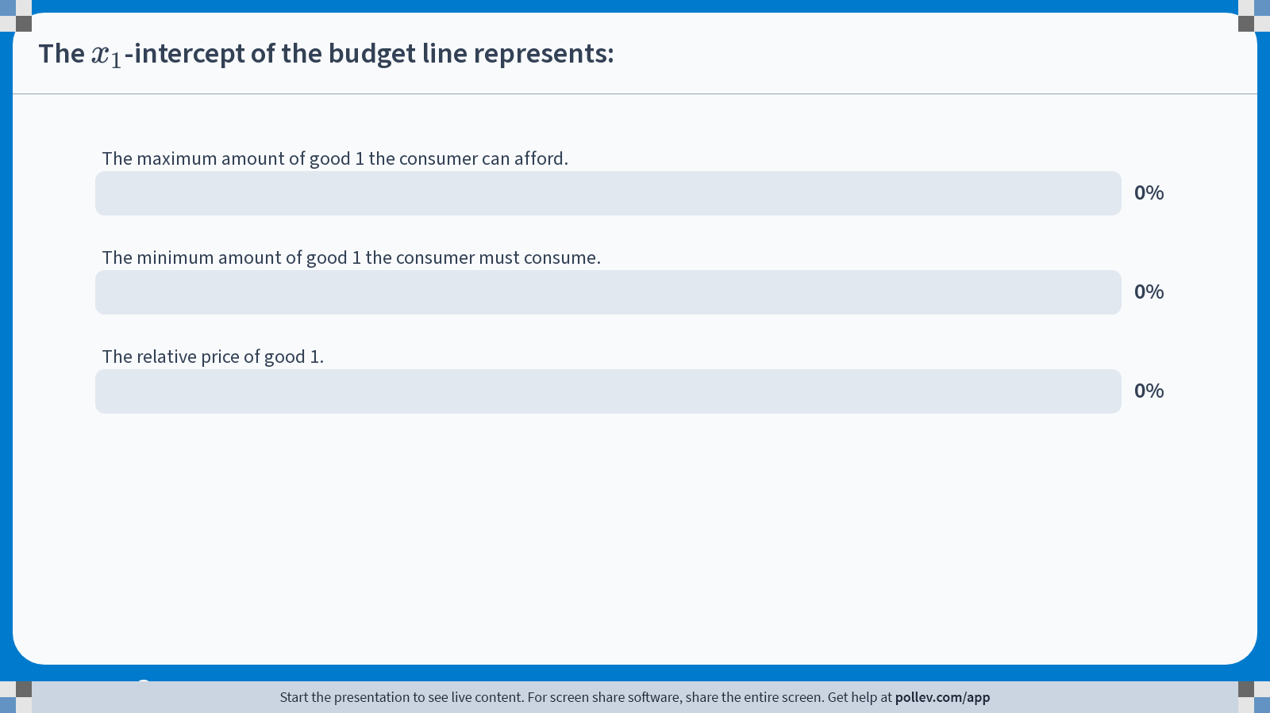
Poll Everywhere multiple choice poll chart screen Activity Title: The $$x_1$$-intercept of the budget line represents: Slide 19
Notes:
Do not modify the notes in this section to avoid tampering with the Poll Everywhere activity. More info at polleverywhere.com/support The $$x_1$$-intercept of the budget line represents: https://www.polleverywhere.com/multiple_choice_polls/arCqwore2FCgAJnq6Y2oi?display_state=chart&activity_state=closed&state=closed&flow=Engagement&onscreen=persist

Slide 19
Budget Constraint: Comparative Statics

Slide 20
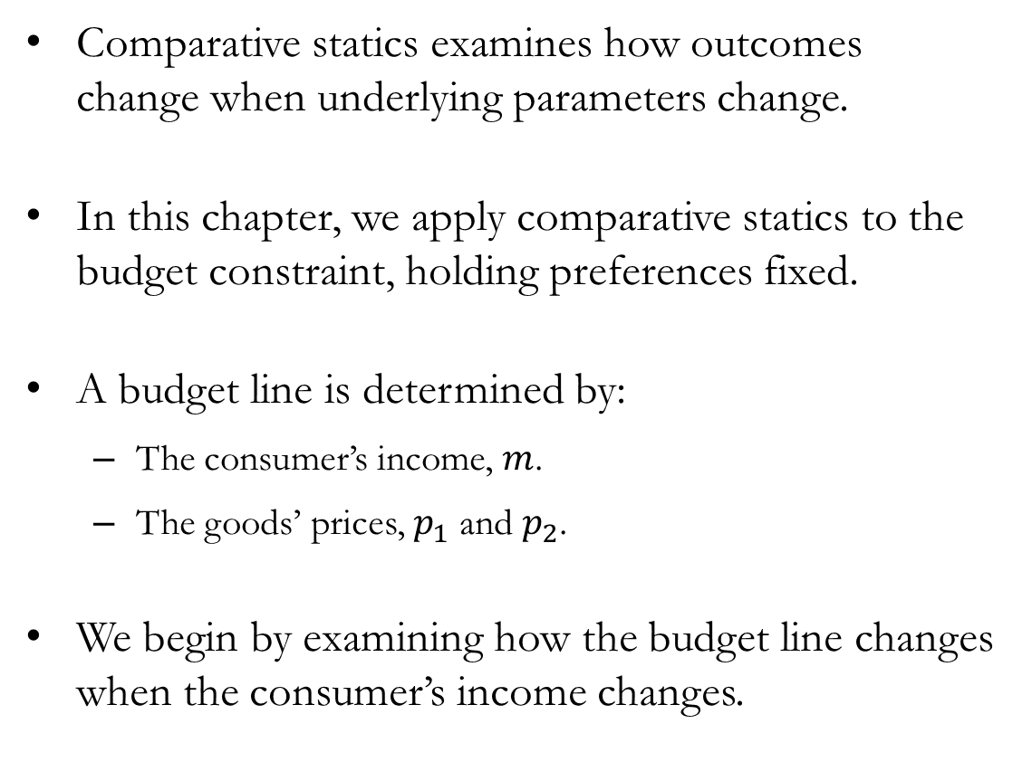
Comparative Statics
Comparative statics examines how outcomes change when underlying parameters change.
In this chapter, we apply comparative statics to the budget constraint, holding preferences fixed.
A budget line is determined by:
The consumer’s income, $m$.
The goods’ prices, $p_{1}$ and $p_{2}$.
We begin by examining how the budget line changes when the consumer’s income changes.

Slide 21
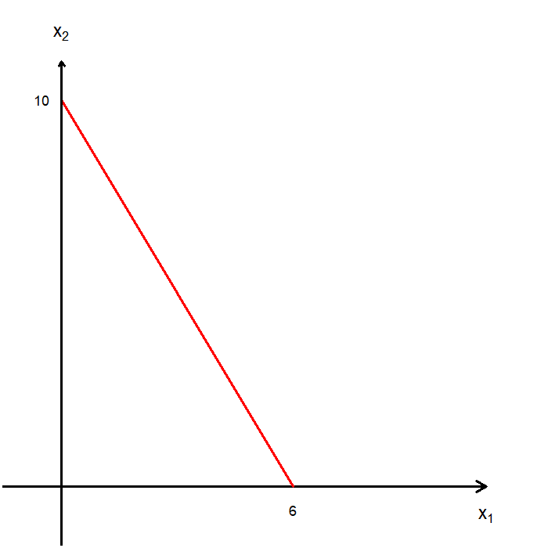
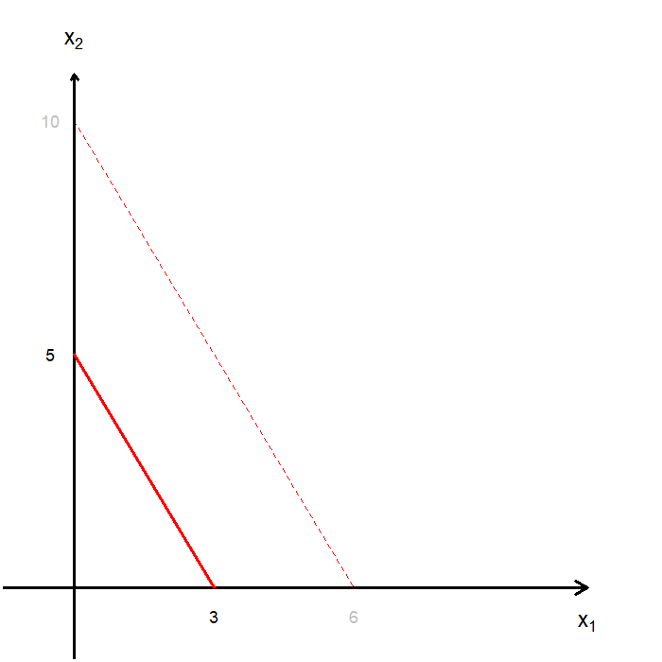
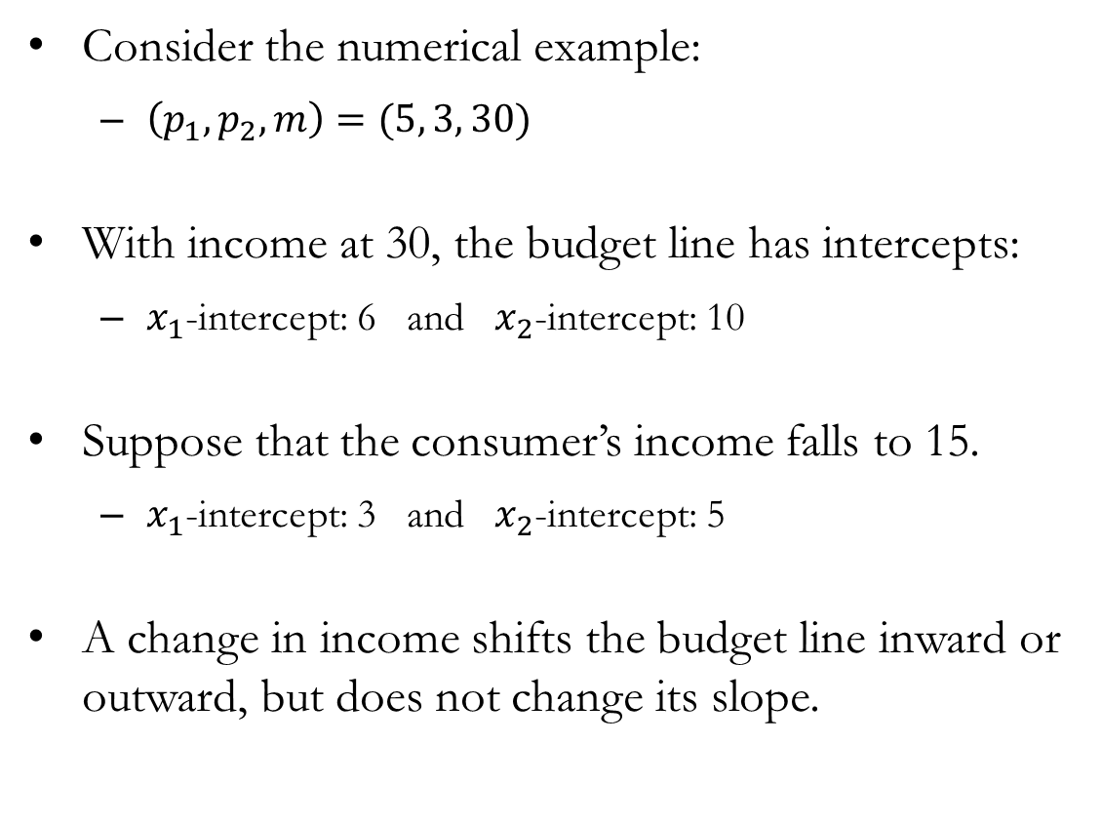
Comparative Statics: Changes in Income
Consider the numerical example:
$\left(p_{1}, p_{2}, m\right)=(5, 3, 30)$
With income at 30, the budget line has intercepts:
$x_{1}$-intercept: 6 and $x_{2}$-intercept: 10
Suppose that the consumer’s income falls to 15.
$x_{1}$-intercept: 3 and $x_{2}$-intercept: 5
A change in income shifts the budget line inward or outward, but does not change its slope.

Slide 22
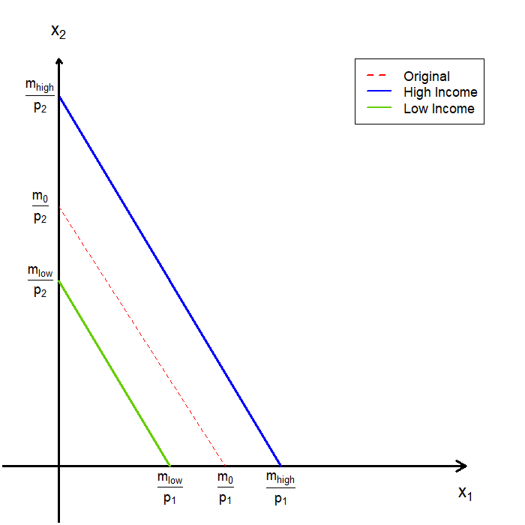
Comparative Statics: Changes in Income
A change in income causes a parallel shift of the budget line.
Higher income shifts the budget line outward.
Lower income shifts the budget line inward.
As income changes, the set of affordable bundles expands or contracts.
Because relative prices do not change, the slope of the budget line remains the same.

Slide 23
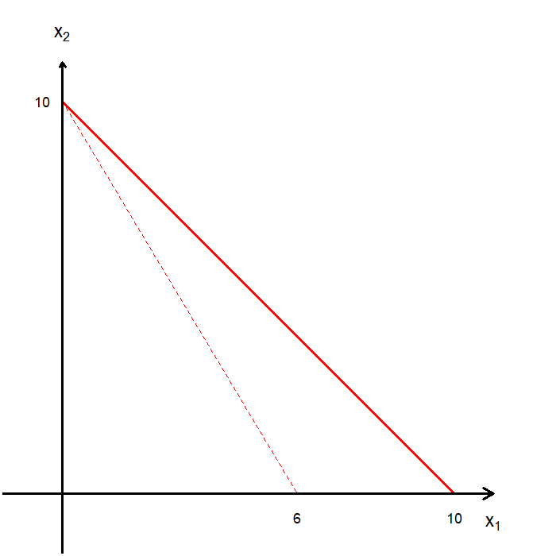
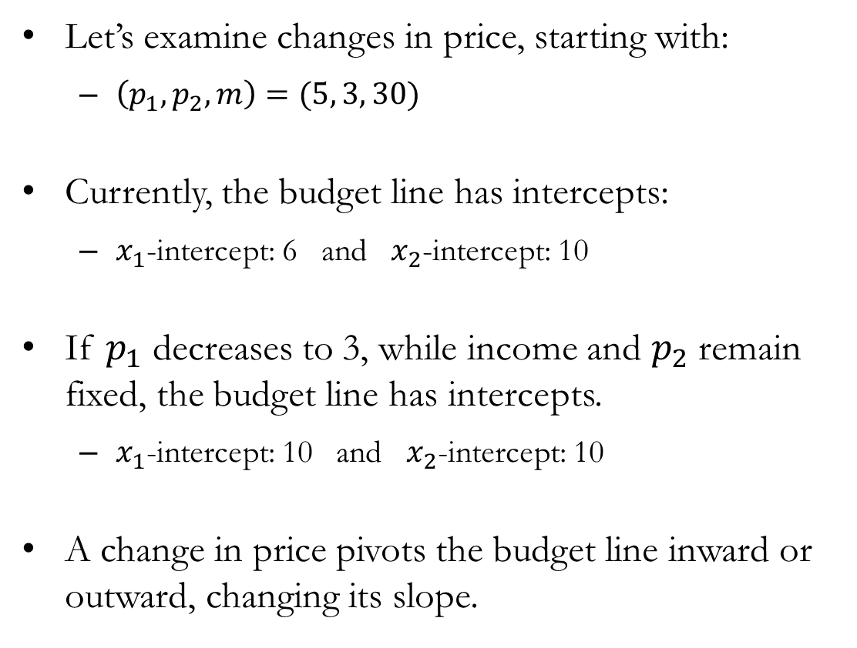
Comparative Statics: Changes in Price
Let’s examine changes in price, starting with:
$\left(p_{1}, p_{2}, m\right)=(5, 3, 30)$
Currently, the budget line has intercepts:
$x_{1}$-intercept: 6 and $x_{2}$-intercept: 10
If $p_{1}$ decreases to 3, while income and $p_{2}$ remain fixed, the budget line has intercepts.
$x_{1}$-intercept: 10 and $x_{2}$-intercept: 10
A change in price pivots the budget line inward or outward, changing its slope.

Slide 24
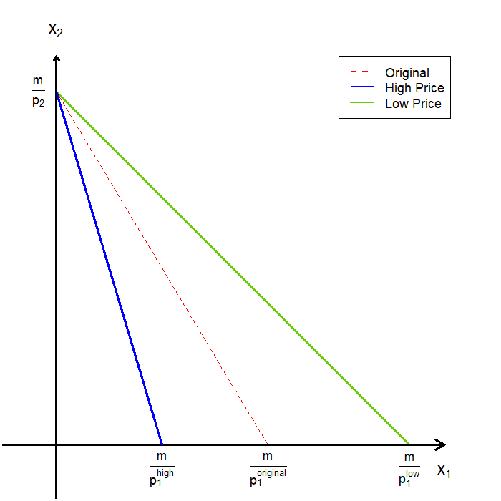
Comparative Statics: Changes in Price
Changes in price causes a pivot of the budget line.
Falling prices leads to a pivot outward.
Rising prices leads to a pivot inward.
The budget line pivots around the intercept of the good whose price does not change.
As prices change, the set of affordable bundles changes asymmetrically.
Because relative prices change, the slope of the budget line changes.

Slide 25
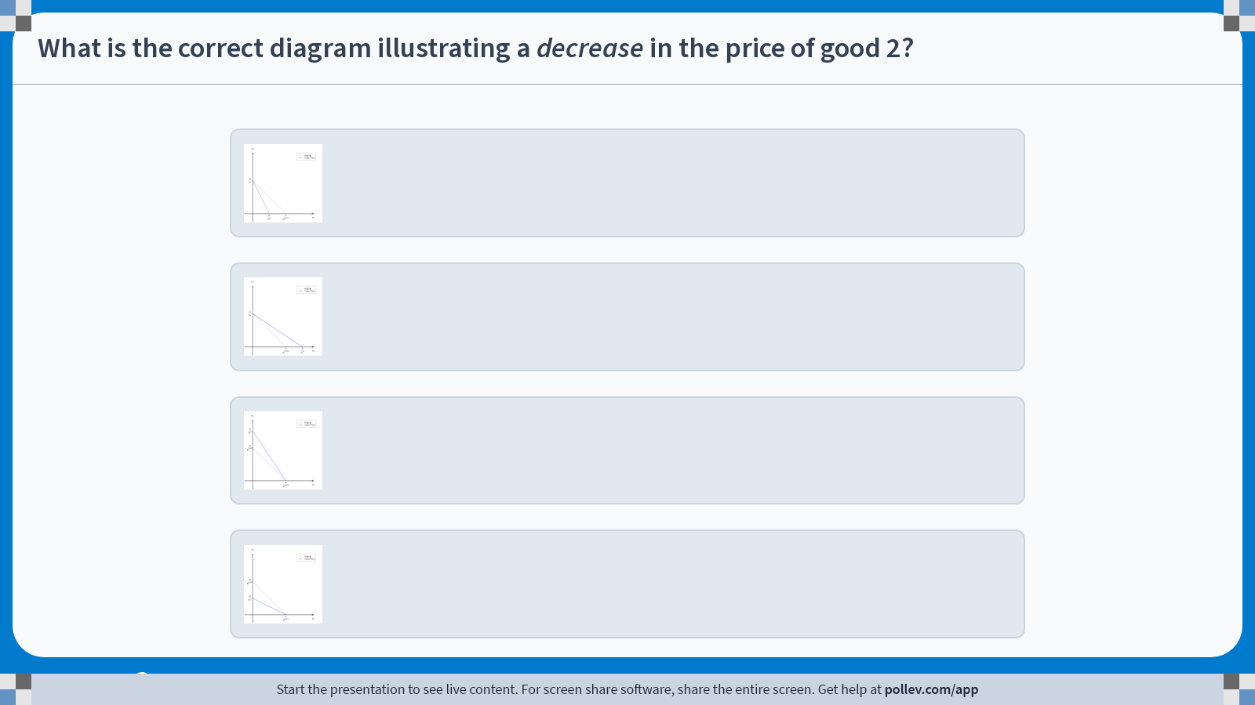
Poll Everywhere multiple choice poll instructions screen Activity Title: What is the correct diagram illustrating a decrease in the price of good 2? Slide 21
Notes:
Do not modify the notes in this section to avoid tampering with the Poll Everywhere activity. More info at polleverywhere.com/support What is the correct diagram illustrating a decrease in the price of good 2? https://www.polleverywhere.com/multiple_choice_polls/kyRg6IvYfNbgedX4mVVHB?display_state=instructions&activity_state=opened&state=opened&flow=Engagement&onscreen=persist

Slide 26
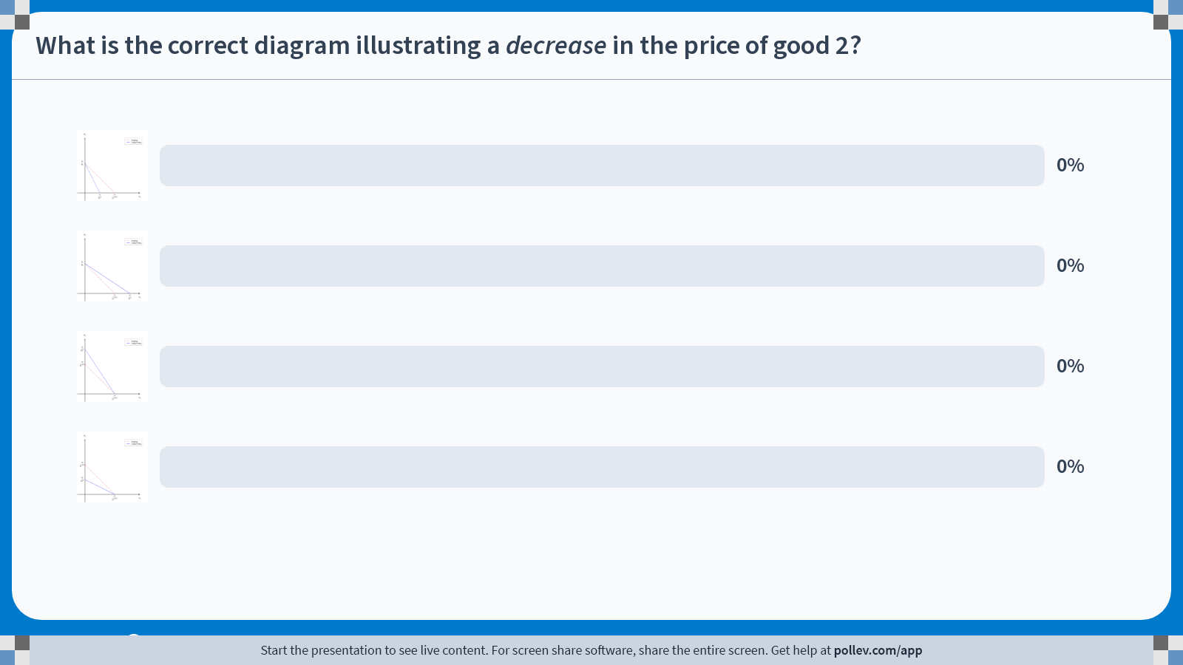
Poll Everywhere multiple choice poll chart screen Activity Title: What is the correct diagram illustrating a decrease in the price of good 2? Slide 23
Notes:
Do not modify the notes in this section to avoid tampering with the Poll Everywhere activity. More info at polleverywhere.com/support What is the correct diagram illustrating a decrease in the price of good 2? https://www.polleverywhere.com/multiple_choice_polls/kyRg6IvYfNbgedX4mVVHB?display_state=chart&activity_state=closed&state=closed&flow=Engagement&onscreen=persist

Slide 27
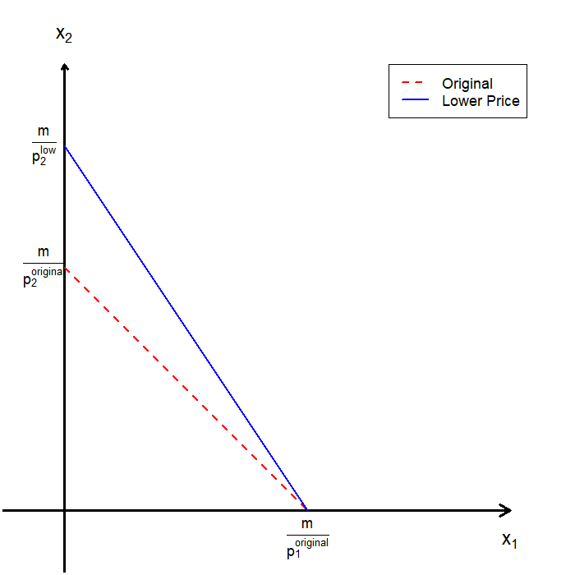
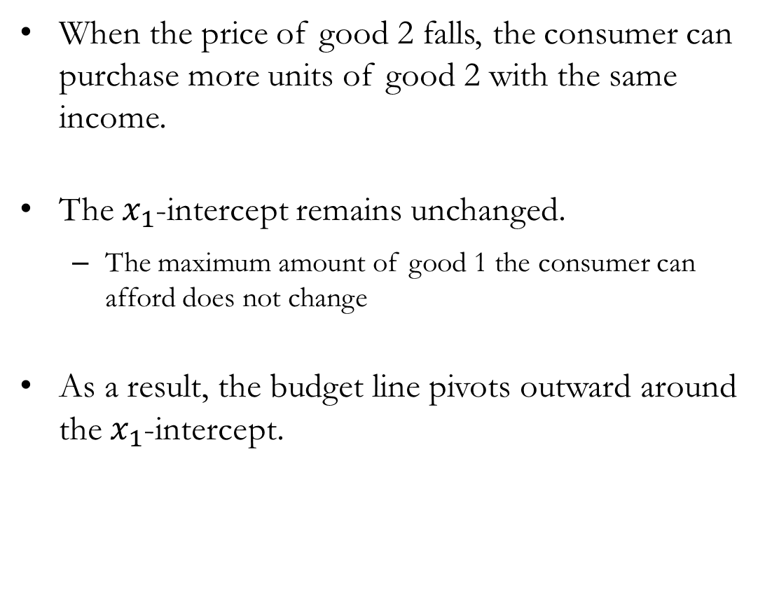
Comparative Statics: Changes in Price
When the price of good 2 falls, the consumer can purchase more units of good 2 with the same income.
The $x_{1}$​-intercept remains unchanged.
The maximum amount of good 1 the consumer can afford does not change
As a result, the budget line pivots outward around the $x_{1}$​-intercept.

Slide 28
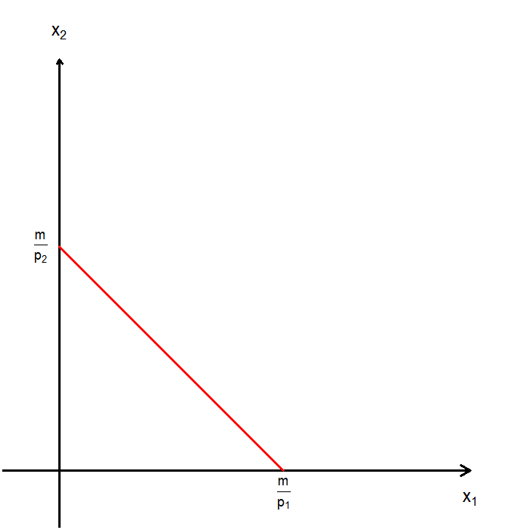
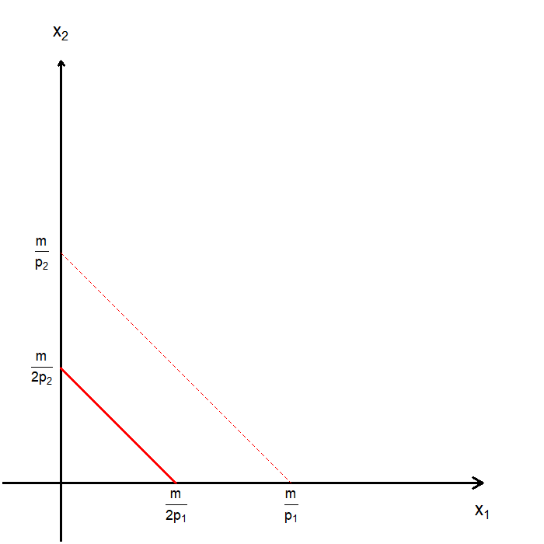
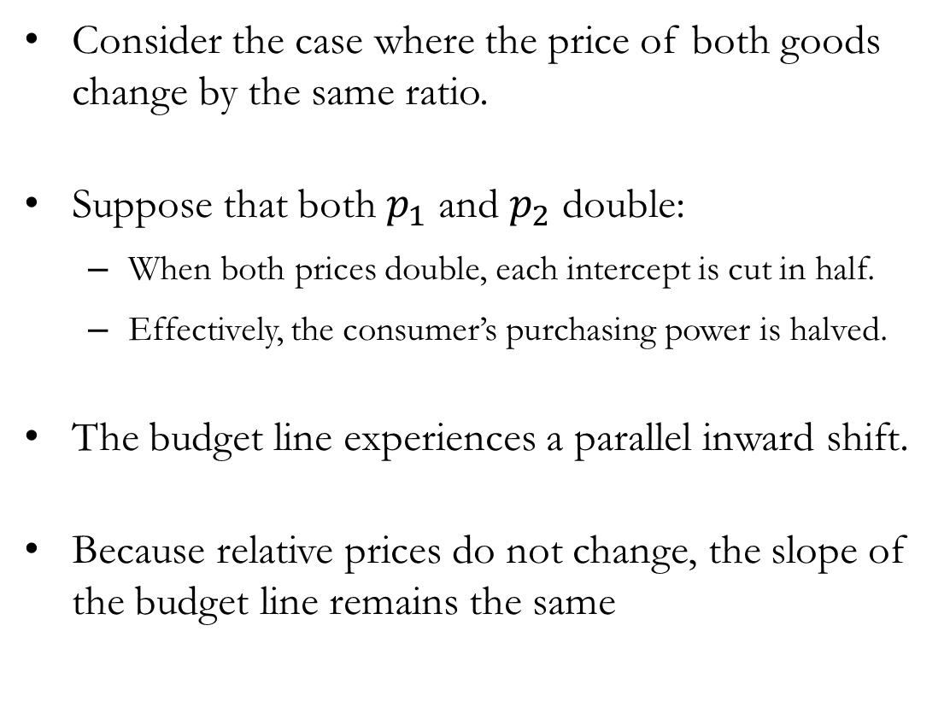
Comparative Statics: Changes in Prices
Consider the case where the price of both goods change by the same ratio.
Suppose that both $p_{1}$ and $p_{2}$ double:
When both prices double, each intercept is cut in half.
Effectively, the consumer’s purchasing power is halved.
The budget line experiences a parallel inward shift.
Because relative prices do not change, the slope of the budget line remains the same

Slide 29
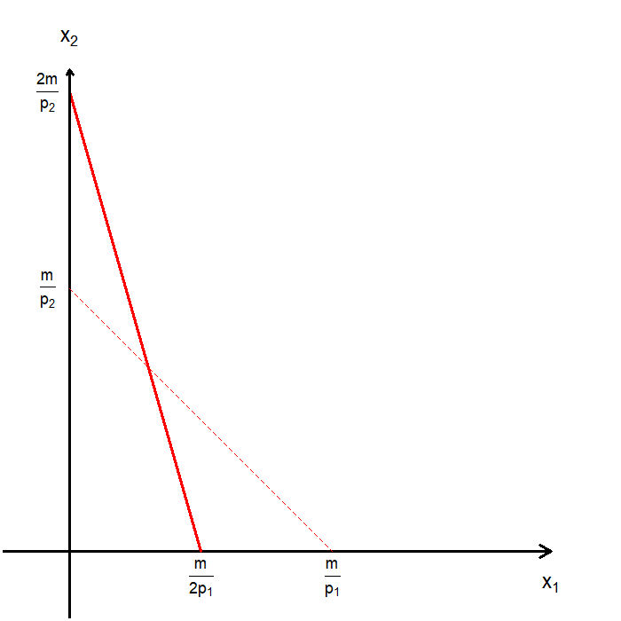
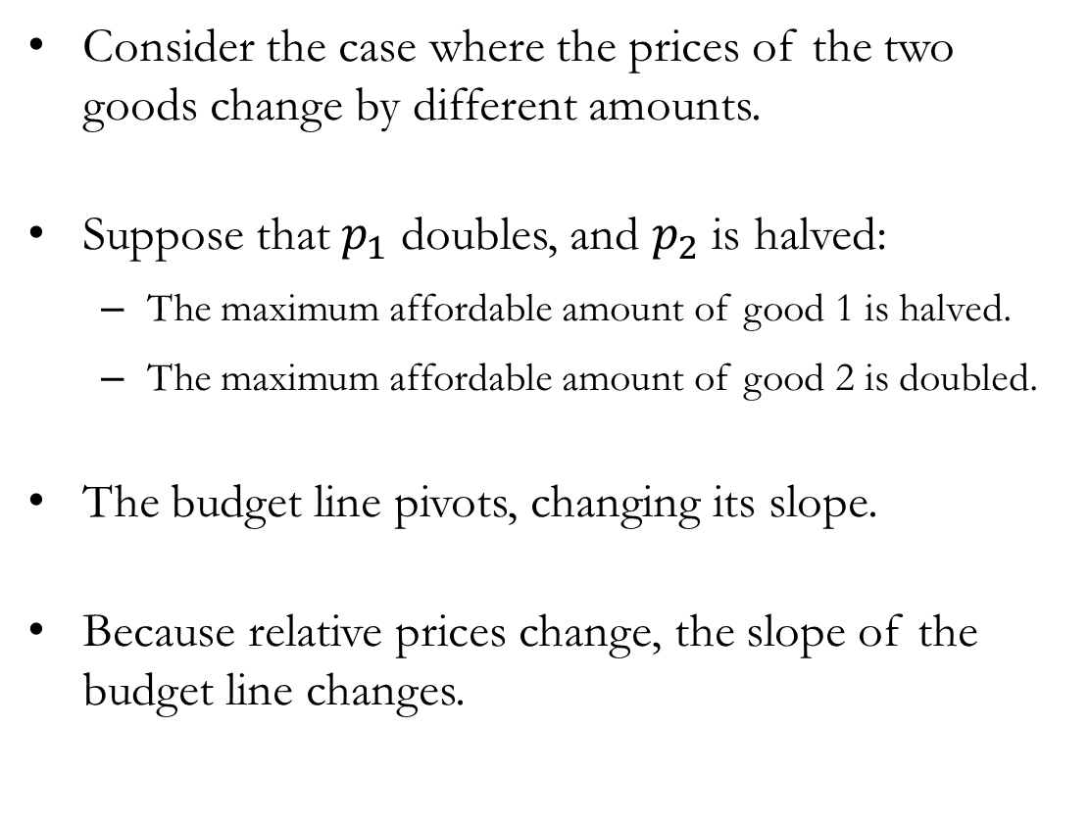
Comparative Statics: Changes in Prices
Consider the case where the prices of the two goods change by different amounts.
Suppose that $p_{1}$ doubles, and $p_{2}$ is halved:
The maximum affordable amount of good 1 is halved.
The maximum affordable amount of good 2 is doubled.
The budget line pivots, changing its slope.
Because relative prices change, the slope of the budget line changes.

Slide 30
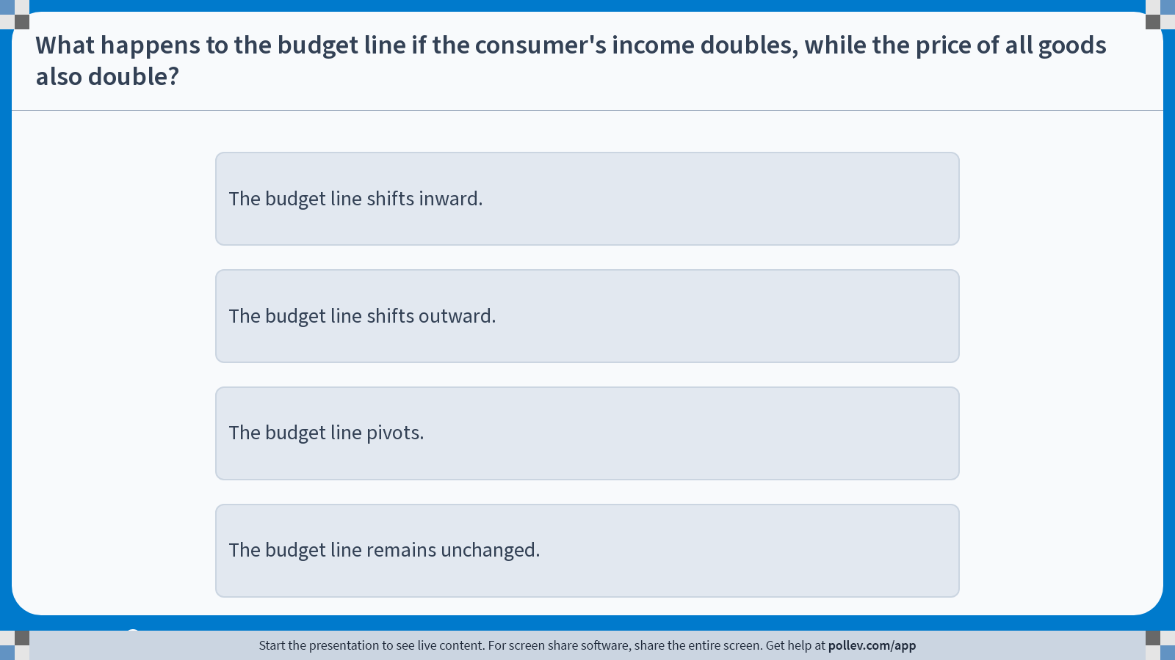
Poll Everywhere multiple choice poll instructions screen Activity Title: What happens to the budget line if the consumer's income doubles, while the price of all goods also double? Slide 26
Notes:
Do not modify the notes in this section to avoid tampering with the Poll Everywhere activity. More info at polleverywhere.com/support What happens to the budget line if the consumer's income doubles, while the price of all goods also double? https://www.polleverywhere.com/multiple_choice_polls/WEyD0iX2h4VdViyB1NNdg?display_state=instructions&activity_state=opened&state=opened&flow=Engagement&onscreen=persist

Slide 31
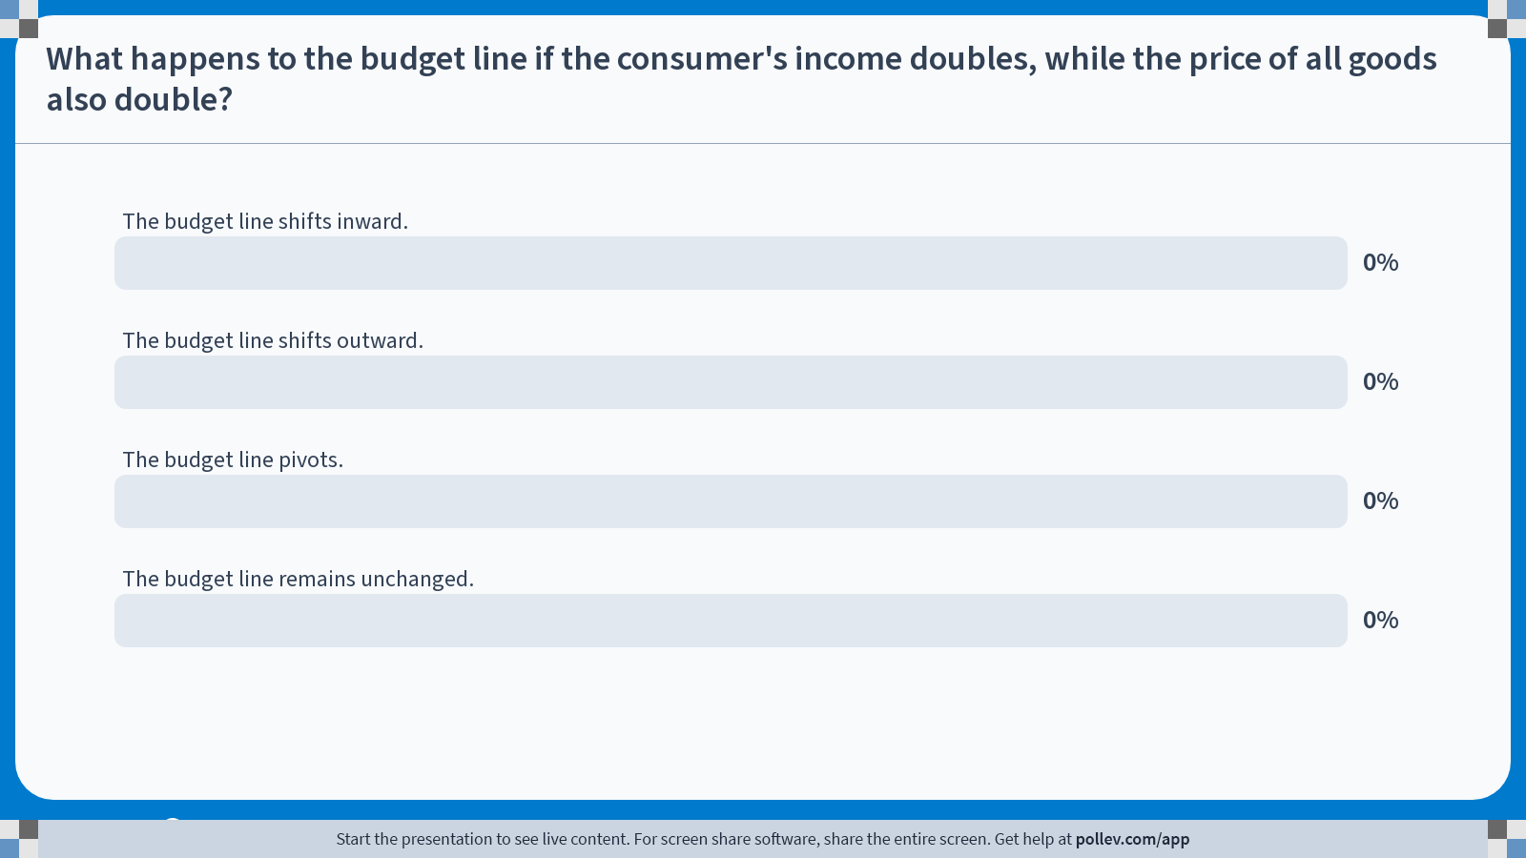
Poll Everywhere multiple choice poll chart screen Activity Title: What happens to the budget line if the consumer's income doubles, while the price of all goods also double? Slide 28
Notes:
Do not modify the notes in this section to avoid tampering with the Poll Everywhere activity. More info at polleverywhere.com/support What happens to the budget line if the consumer's income doubles, while the price of all goods also double? https://www.polleverywhere.com/multiple_choice_polls/WEyD0iX2h4VdViyB1NNdg?display_state=chart&activity_state=closed&state=closed&flow=Engagement&onscreen=persist

Slide 32
Budget Constraint: Extensions and Advanced Issues

Slide 33
The Two-Goods Restriction
At first glance, modeling choice using only two goods may seem overly restrictive.
In reality, consumers choose among many goods and services.
Choices depend on relative prices, not on the total number of goods.
In economics, we often simplify by measuring all prices relative to one good.
This good is called the numeraire (or composite good ), and its price is normalized to 1.
Roughly speaking, when we use a numeraire, one good plays the role of “everything else” that income can be spent on.

Slide 34

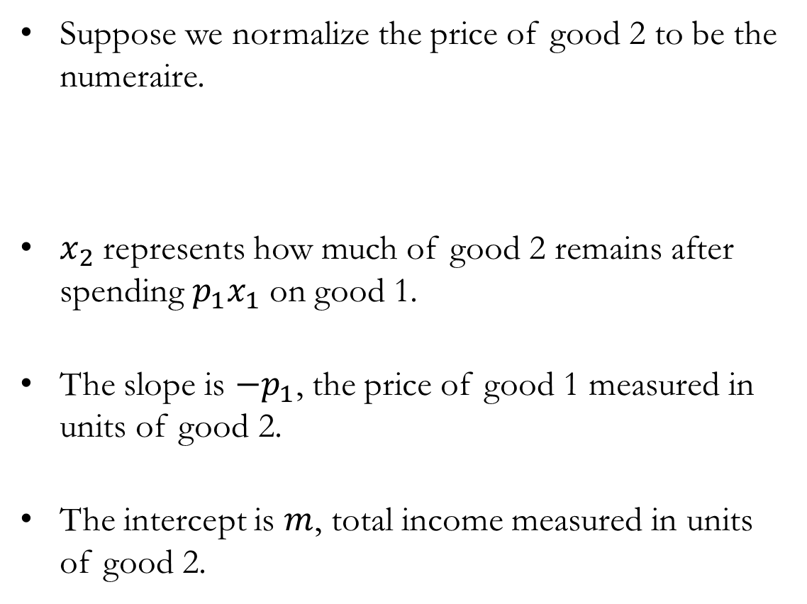

The Two-Goods Restriction: Numeraire
Suppose we normalize the price of good 2 to be the numeraire.
$x_{2}$ represents how much of good 2 remains after spending $p_{1}x_{1}$ on good 1.
The slope is $−p_{1}$​, the price of good 1 measured in units of good 2.
The intercept is $m$, total income measured in units of good 2.
$$p_{1}x_{1}+x_{2}=m ⟹ x_{2}=m−p_{1}x_{1}$$

Slide 35
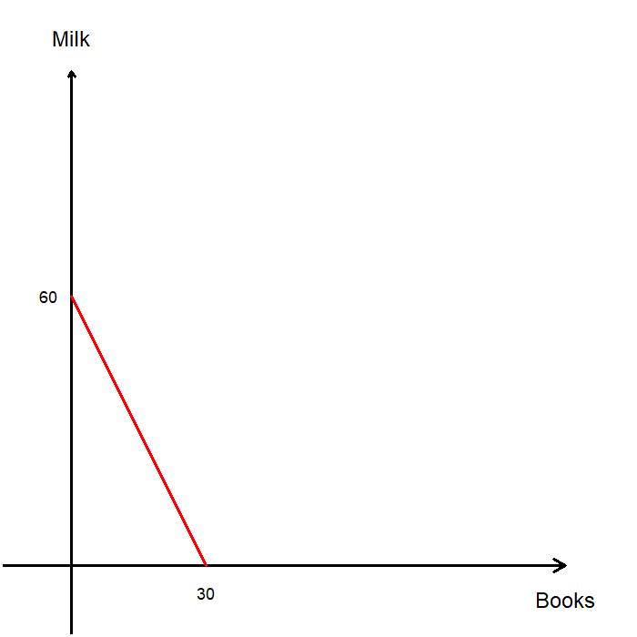
Extensions: Multiple Constraints
Suppose a consumer has a budget of $300, with books priced at $10 and milk priced at $5.
With only a budget constraint, all affordable combinations of books and milk can be represented by a single budget line.
Consumption requires time, not just money.
Even if a consumer can afford extremely large quantities of a good, they may not have enough time to consume it.

Slide 36
Extensions: Multiple Constraints
Suppose a consumer has 100 hours available for consumption.
Reading one book takes 2 hours.
Drinking one gallon of milk takes 4 hours.
Time spent consuming books and milk cannot exceed the total time available.
This gives rise to a time constraint, separate from the budget constraint.

Slide 37
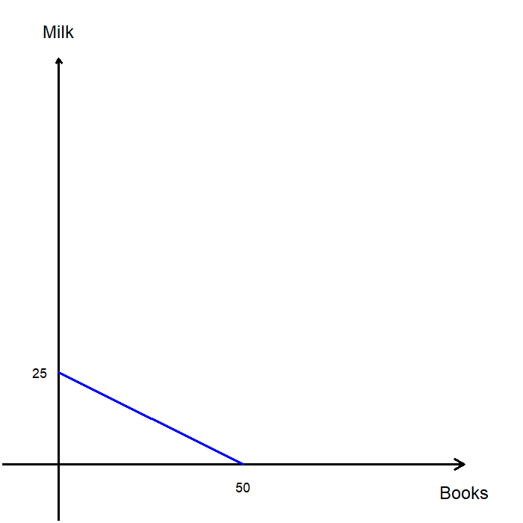

Extensions: Multiple Constraints
The time constraint line can be expressed as:
The intercepts show the maximum consumption possible if all time is spent on one good:
Up to 50 books if no milk is consumed.
Up to 25 gallons of milk if no books are consumed.
The slope reflects the time tradeoff between goods.
This time constraint plays the same role as a budget constraint, but with time instead of money.
$$2×\left(Books\right)+4×(Milk)=100$$

Slide 38
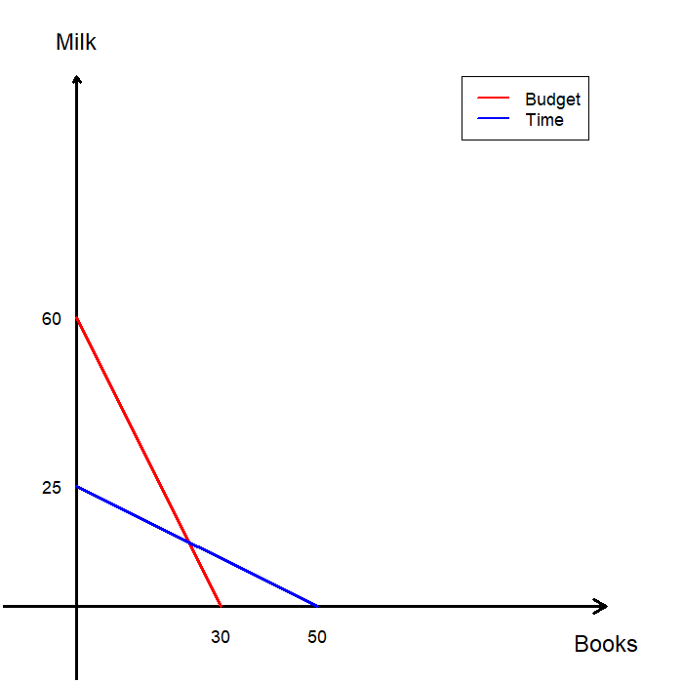
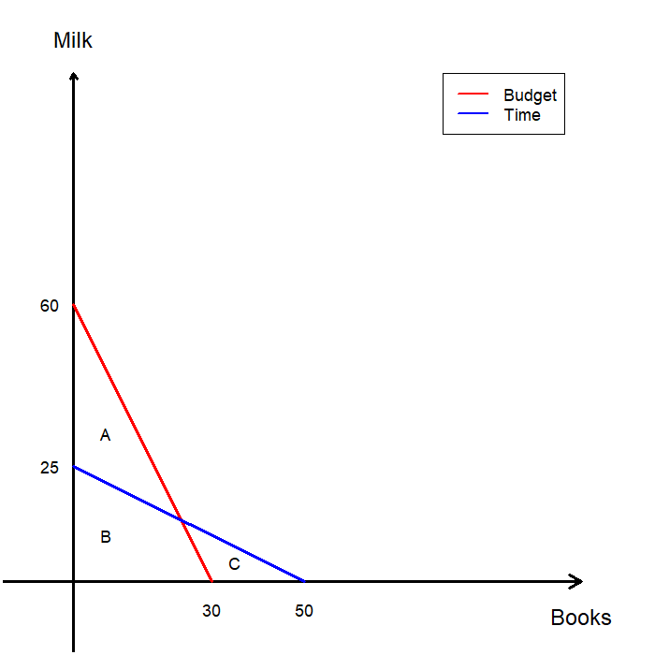
Extensions: Multiple Constraints
We overlay the time constraint on the existing budget constraint.
Evaluate which of the three areas represents bundles the consumer can actually choose from.
A: Satisfies the budget, but not time constraint.
B: Satisfies both budget and time constraints.
C: Satisfies the time, but not budget constraint.
The consumer’s feasible set is the set of bundles that satisfy both constraints, B.

Slide 39
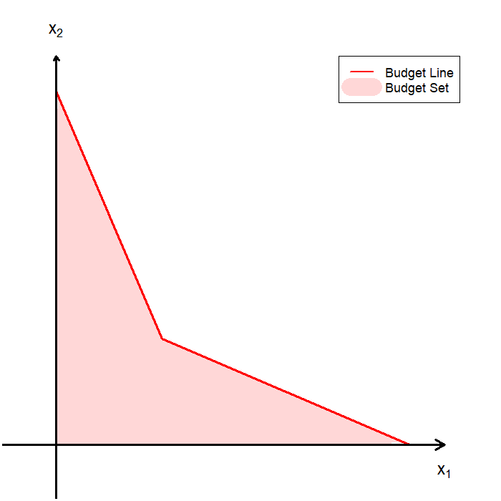

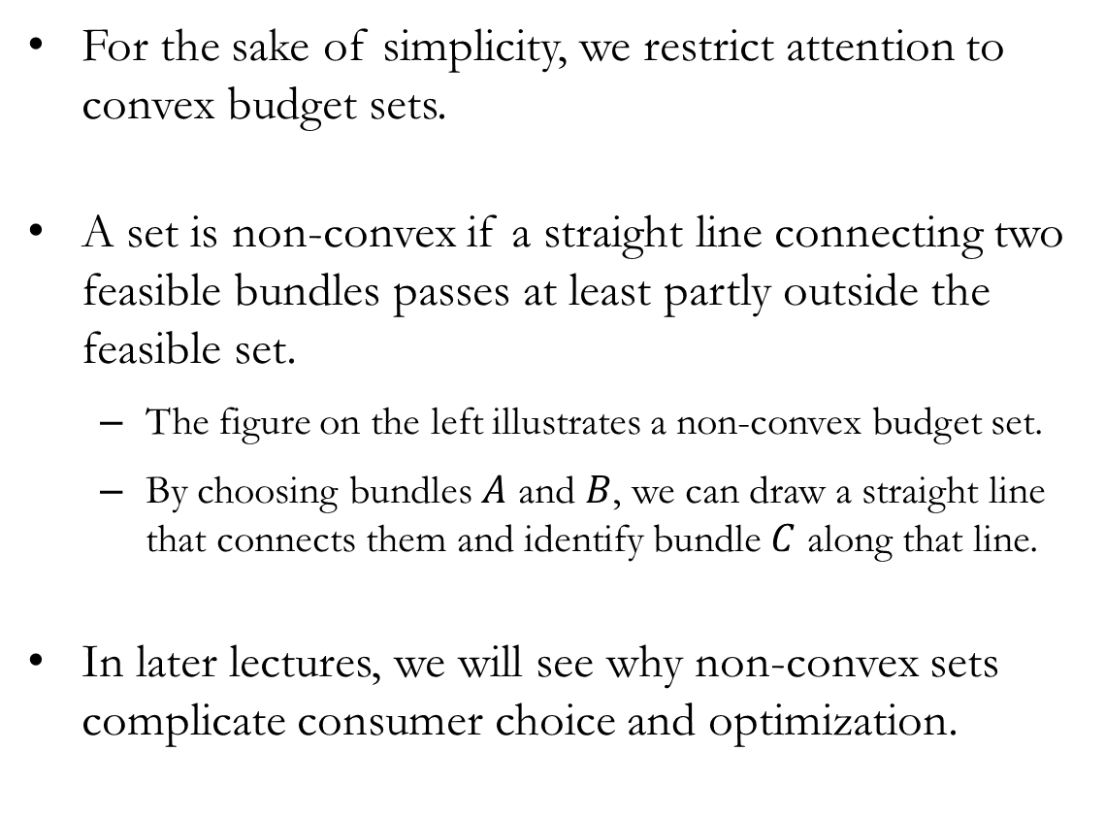
Advanced: Convex Budget Sets
For the sake of simplicity, we restrict attention to convex budget sets.
A set is non-convex if a straight line connecting two feasible bundles passes at least partly outside the feasible set.
The figure on the left illustrates a non-convex budget set.
By choosing bundles $A$ and $B$, we can draw a straight line that connects them and identify bundle $C$ along that line.
In later lectures, we will see why non-convex sets complicate consumer choice and optimization.

Slide 40
Recap & Preview

Slide 41
Recap: Budget Constraints
The budget constraint describes the set of bundles a consumer can afford given income and prices.
The budget line is the boundary of the affordable set:
Intercepts show the maximum consumption of one good if all resources are spent on it.
The slope reflects relative prices and the market trade-off.
Comparative statics:
Changes in income shift the budget line inward or outward, without changing its slope.
Changes in prices pivot the budget line, changing its slope.
Using a numeraire simplifies analysis by focusing on relative prices.

Slide 42
Preview: Preferences
Affordability alone does not determine choice.
To explain which bundle is chosen, we need a way to describe tastes.
In the next chapter, we introduce preferences:
How consumers compare bundles.
What it means for one bundle to be preferred to another.
Combining preferences with the budget constraint allows us to analyze optimal choices.
Choice arises from the interaction of what is affordable and what is preferred.

