Slide 1
INTERMEDIATE MICROECONOMIC THEORY
Chapter 1: Introduction

Slide 2
Announcements: About Me
Brian H. Park
First year at Concordia College
Ph.D. in Applied Economics and Management, Cornell University
B.A. in Economics, Korea University
Research Interests
Environmental Economics and Demographic Economics
Climate Change and Migration Pattern of Agricultural Workers
Interactions of Border Enforcement Policies and International Migration
Influence of Pop Culture on Fertility Intent of Married Couples

Slide 3
Administration

Slide 4
Announcements: Contact
Email: HPARK3@cord.edu
Please include BUSN301 in the subject line, and my target response is within 1 business day.
Office: Grant Center 101
Regular Office Hours
Mondays & Wednesdays 12:30 PM to 2:00 PM, and
By appointment via Calendly
Calendly: calendly.com/brianhwpark
Book on-demand office hours in 15-minute increments
Calendar opens 10 days in advance, with a minimum of 90 minutes notice
For longer sessions, you may book 2~3 sessions in a row
e.g. Book a session at 2:00 PM, and another at 2:15 PM for a meeting from 2:00 PM through 2:30 PM.

Slide 5
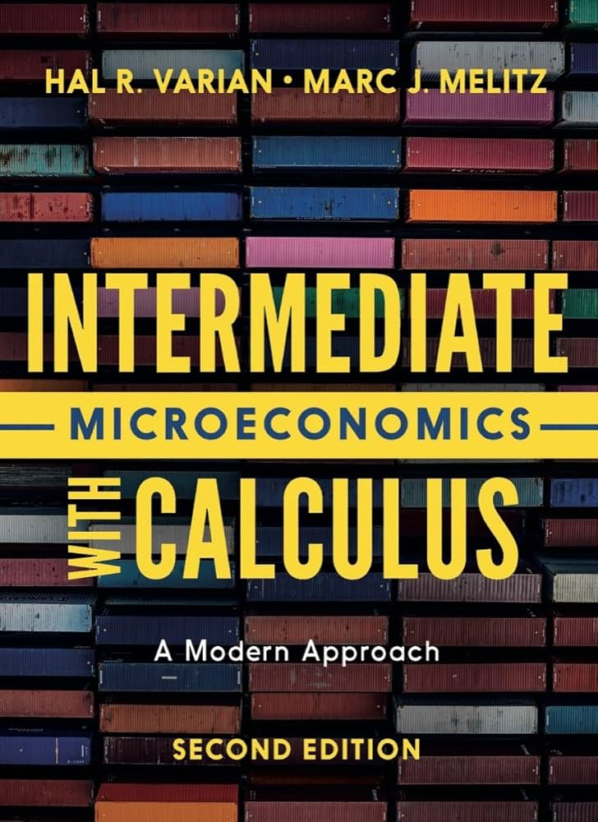
Announcements: Textbook
Intermediate Microeconomics with Calculus
2nd Edition
Hal R. Varian & Marc J. Melitz
W. W. Norton
Lecture notes to be distributed over Moodle
Previous editions are acceptable

Slide 6
Policies: Grading
The final letter grade to be calculated using your end of semester Grand Total score.
Grand Total #1: Balanced
33% for Homework, 33% for Quizzes, 34% for the Final Exam
Grand Total #2: Rewarding Consistency
40% for Homework, 40% for Quizzes, 20% for the Final Exam
Grand Total #3: The “Hail Mary” option
15% for Homework, 15% for Quizzes, 70% for the Final Exam
At the end of the term, any additional credit will be added to each grand total, and the highest of the three Grand Total scores is used to determine your letter grade.

Slide 7
Policies: Attendance
Attendance may be checked at the beginning of each class session.
Each student is permitted one unexcused absence per calendar month without penalty.
Attendance does not directly factor into a student’s Grand Total score; however, it will be used to determine recovery rates following each quiz.
Five or more unexcused absences (excluding the monthly no-penalty absences) over the duration of the term may result in a failing grade.
The criteria for determining whether an absence is excused or unexcused will follow Concordia College policy, with final discretion resting with the instructor.

Slide 8
Policies: Problem Sets
Problem sets will be assigned periodically as take-home assignments.
The format (not necessarily content) of the problem set will closely match that of the in-class quizzes and final exam, with minor deviations.
Late submissions:
Any late submission will incur a deduction of 10% of the graded result.
For every 12-hour delay, an additional 10% will be deducted from the graded result.
Late submissions past 72 hours of the deadline will not be accepted and will result in a grade of 0.
Students with approved documentation or extenuating circumstances may be granted a deduction-free extension at the instructor’s discretion.

Slide 9
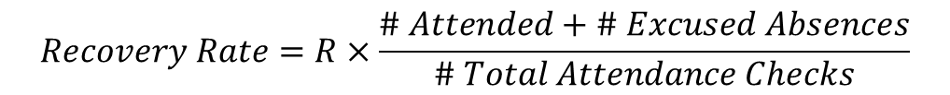
Policies: Quizzes
Up to 6 closed-book, in-class quizzes will be administered throughout the semester.
Because quizzes are designed to be low-stakes and frequent check-ins, students will have opportunities to recover deducted points.
To participate in grade recovery, students must review their graded material, demonstrate a clear understanding of the error, and present the correct answer to the instructor in person during office hours.
The proportion of points that a student can recover is directly tied to their attendance rate. Assuming a maximum recovery rate of R%, the recovery rate is calculated as:
$$Recovery Rate=R×\frac{\# Attended+\# Excused Absences}{\# Total Attendance Checks}$$

Slide 10
Policies: Quizzes
Regardless of the recovery rate, the maximum number of points a student may recover shall not exceed 25% of the total score for each quiz.
A missed quiz without an approved reason will result in a grade of zero.
Make-up quizzes must be approved by the instructor and are granted only for documented or unavoidable conflicts.
Examples of commonly approved reasons include illness, medical appointments that cannot be rescheduled, family emergencies, and College-sponsored activities.
Personal scheduling conflicts or non-emergency commitments are generally not considered valid reasons for a make-up quiz.

Slide 11
Policies: Final
A comprehensive, closed-book final exam will be administered on the date determined by the Registrar’s Office.
The final exam will follow the quiz format, with length and complexity adjusted for the extended test period.
There will be no opportunity to recover deducted points. Students may request that their entire final exam be regraded to check for grading errors.
A missed final exam without an approved reason will result in a grade of zero.
Make-up final exams must be approved by the instructor and are granted exclusively for documented or unavoidable conflicts.

Slide 12
Policies: General
Extra credit opportunities may be offered on rare occasions at the instructor’s discretion.
The maximum number of extra credit points that may be applied to a student’s Grand Total score will not exceed 5 points.
Students are responsible for checking their Concordia email and the course learning platform regularly for announcements.

Slide 13
Math Review

Slide 14
Why Math?
Over the course of the semester, we study how economic agents make decisions:
How consumers choose what to buy
How workers choose how much to work
How firms choose how much to produce
Answering these questions requires understanding the incentives agents face and the constraints they operate under.
Economists use models to describe these decision-making processes in a disciplined and internally consistent way.
Mathematics allows us to:
Clearly state assumptions and constraints
Derive implications and predictions from the model

Slide 15
Mathematical Tools for Intermediate Micro
Exponents
Slopes
Derivatives
Partial Derivatives
Systems of Equations
Unconstrained Optimization
Constrained Optimization: To be covered later in the semester.

Slide 16
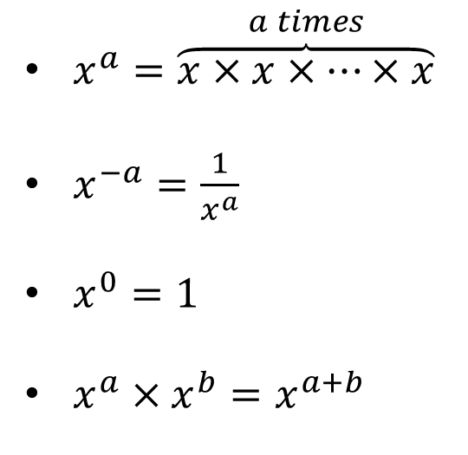
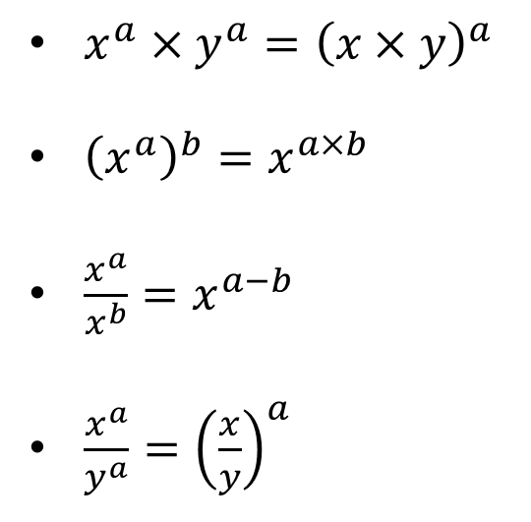
Exponents
Exponents appear frequently in utility maximization and cost minimization problems.
Below are basic definitions and rules for working with exponents:
$x^{a}=\overset{a times}{\overbrace{x×x×⋯×x}}$
$x^{−a}=\frac{1}{x^{a}}$
$x^{0}=1$
$x^{a}×x^{b}=x^{a+b}$
$x^{a}×y^{a}={\left(x×y\right)}^{a}$
${\left(x^{a}\right)}^{b}=x^{a×b}$
$\frac{x^{a}}{x^{b}}=x^{a−b}$
$\frac{x^{a}}{y^{a}}={\left(\frac{x}{y}\right)}^{a}$

Slide 17
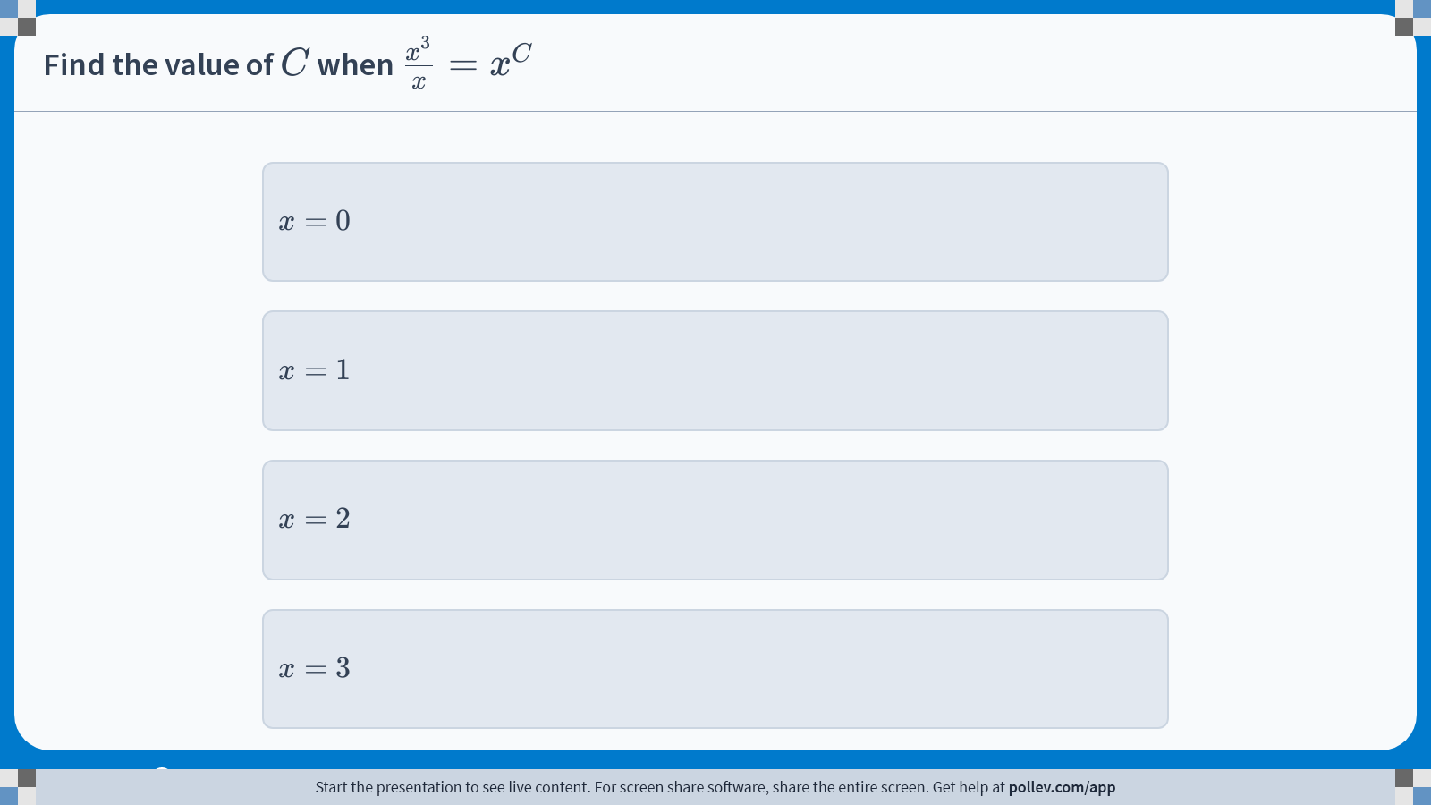
Poll Everywhere multiple choice poll instructions screen Activity Title: Find the value of $$C$$ when $$\\frac{x^3}{x}=x^C$$ Slide 20
Notes:
Do not modify the notes in this section to avoid tampering with the Poll Everywhere activity. More info at polleverywhere.com/support Find the value of $$C$$ when $$\\frac{x^3}{x}=x^C$$ https://www.polleverywhere.com/multiple_choice_polls/Yswwk34G3F5DbL0T4lPoX?display_state=instructions&activity_state=opened&state=opened&flow=Engagement&onscreen=persist

Slide 18
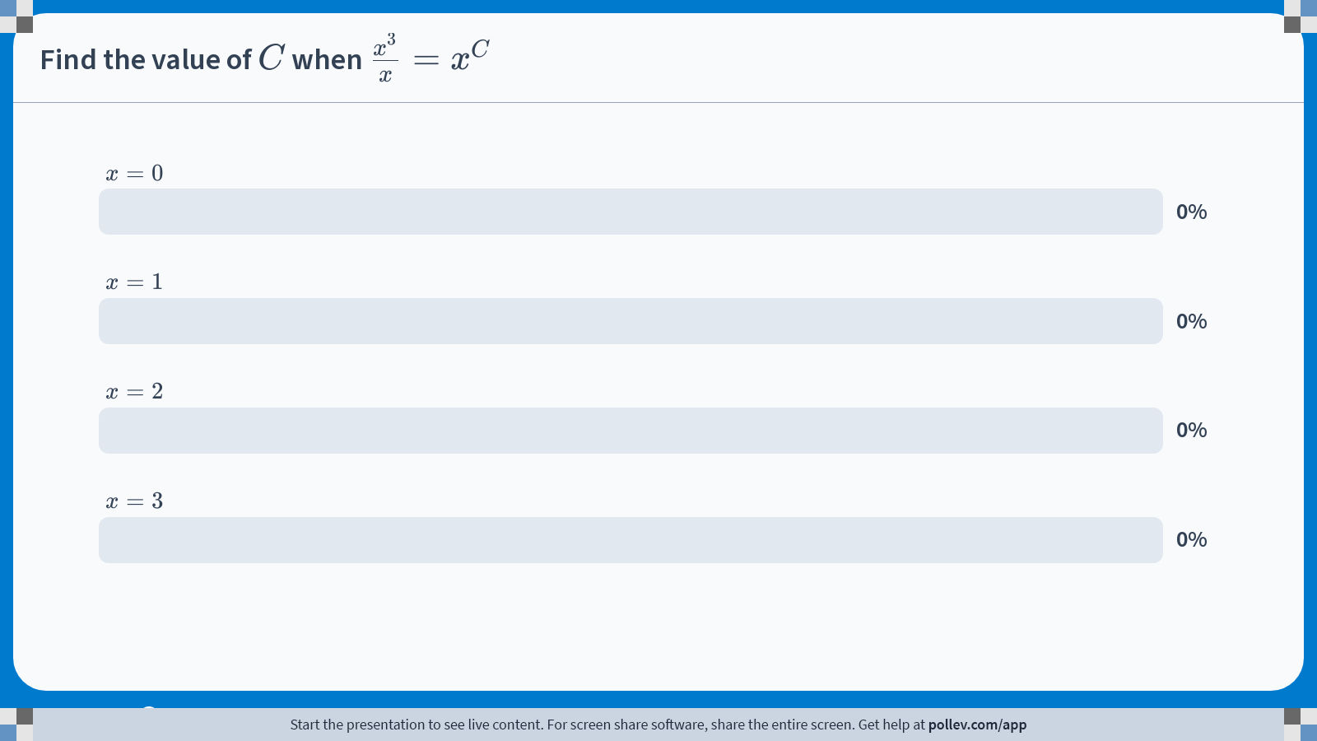
Poll Everywhere multiple choice poll chart screen Activity Title: Find the value of $$C$$ when $$\\frac{x^3}{x}=x^C$$ Slide 22
Notes:
Do not modify the notes in this section to avoid tampering with the Poll Everywhere activity. More info at polleverywhere.com/support Find the value of $$C$$ when $$\\frac{x^3}{x}=x^C$$ https://www.polleverywhere.com/multiple_choice_polls/Yswwk34G3F5DbL0T4lPoX?display_state=chart&activity_state=closed&state=closed&flow=Engagement&onscreen=persist

Slide 19
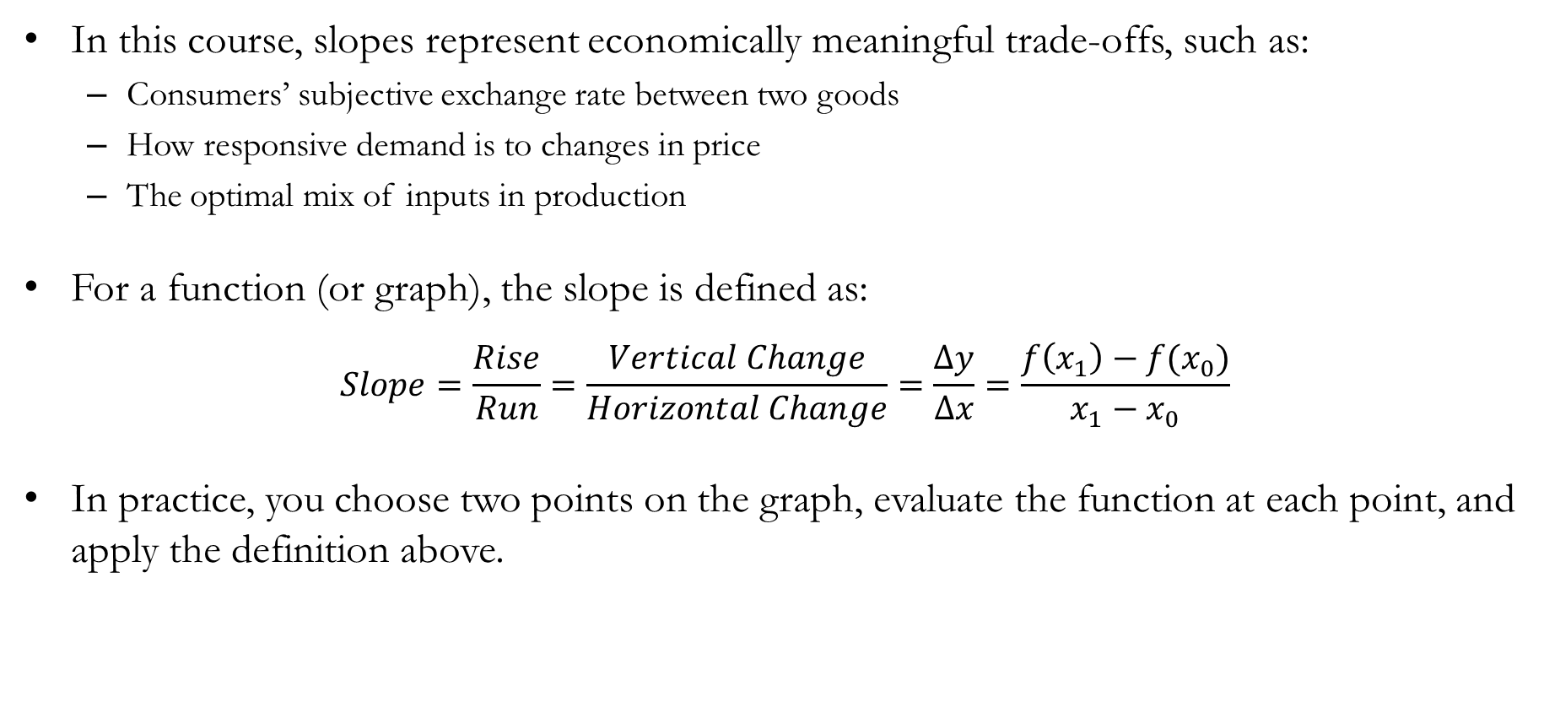
Slopes
In this course, slopes represent economically meaningful trade-offs, such as:
Consumers’ subjective exchange rate between two goods
How responsive demand is to changes in price
The optimal mix of inputs in production
For a function (or graph), the slope is defined as:
$$Slope=\frac{Rise}{Run}=\frac{Vertical Change}{Horizontal Change}=\frac{∆y}{∆x}=\frac{f\left(x_{1}\right)−f(x_{0})}{x_{1}−x_{0}}$$
In practice, you choose two points on the graph, evaluate the function at each point, and apply the definition above.

Slide 20
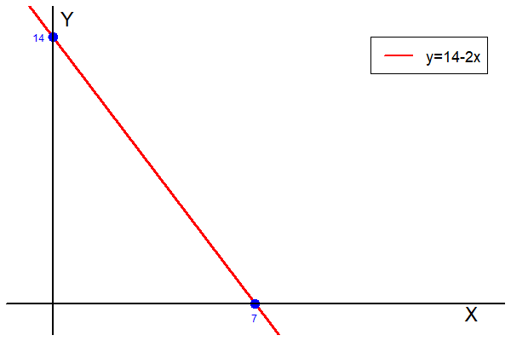
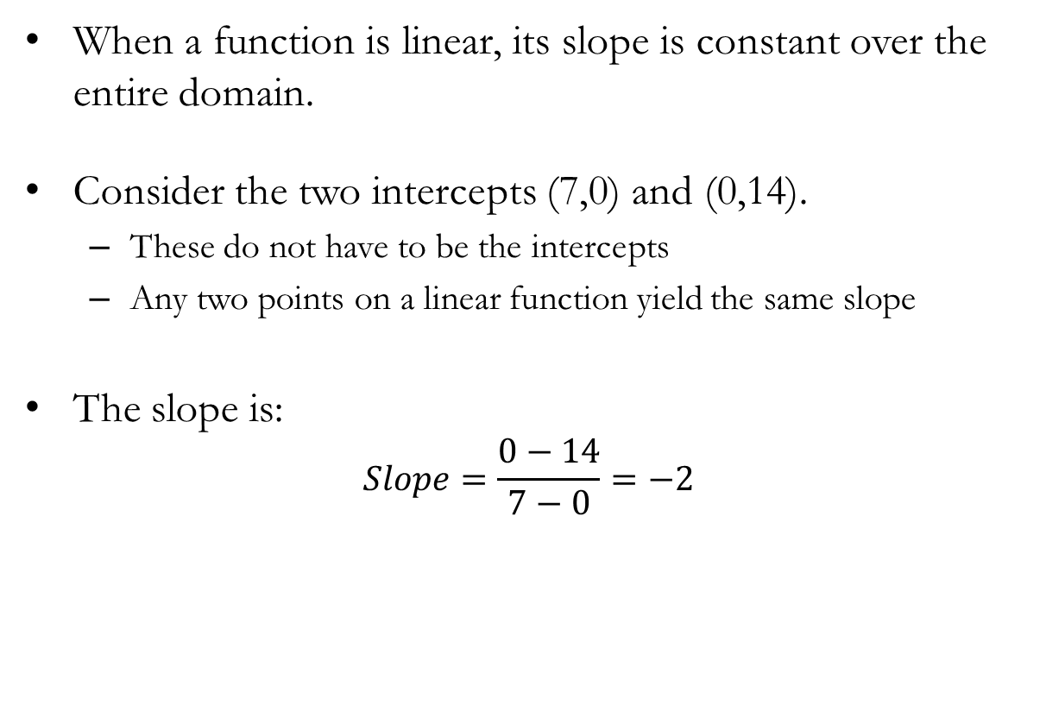
Slopes of Linear Functions
When a function is linear, its slope is constant over the entire domain.
Consider the two intercepts (7,0) and (0,14).
These do not have to be the intercepts
Any two points on a linear function yield the same slope
The slope is:
$$Slope=\frac{0−14}{7−0}=−2$$

Slide 21
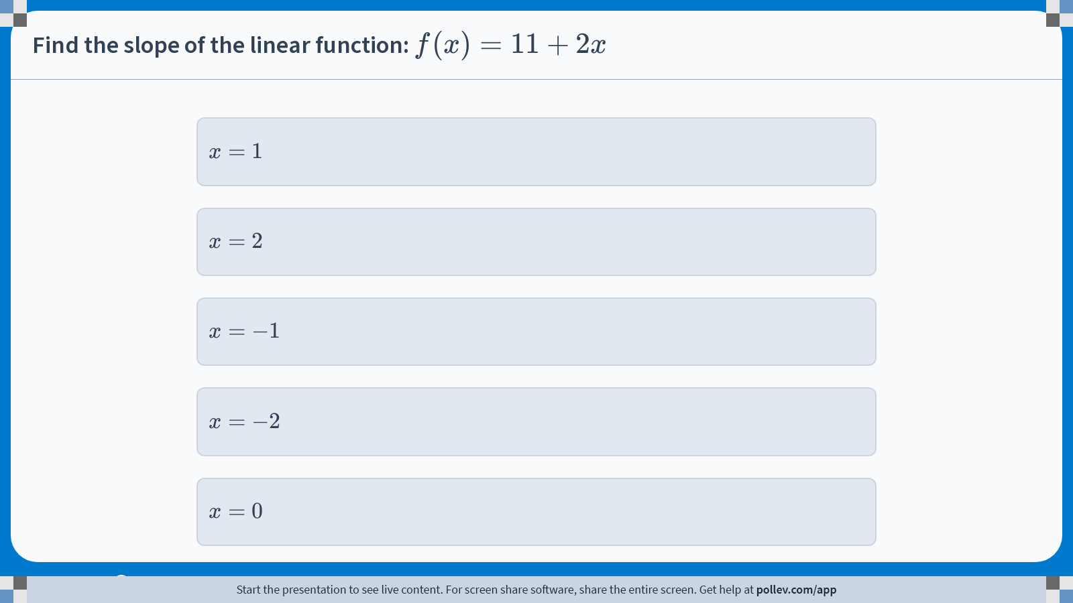
Poll Everywhere multiple choice poll instructions screen Activity Title: Find the slope of the linear function: $$f(x)=11+2x$$ Slide 24
Notes:
Do not modify the notes in this section to avoid tampering with the Poll Everywhere activity. More info at polleverywhere.com/support Find the slope of the linear function: $$f(x)=11+2x$$ https://www.polleverywhere.com/multiple_choice_polls/XI6zqZIwn8w5BWqUdl0Il?display_state=instructions&activity_state=opened&state=opened&flow=Engagement&onscreen=persist

Slide 22
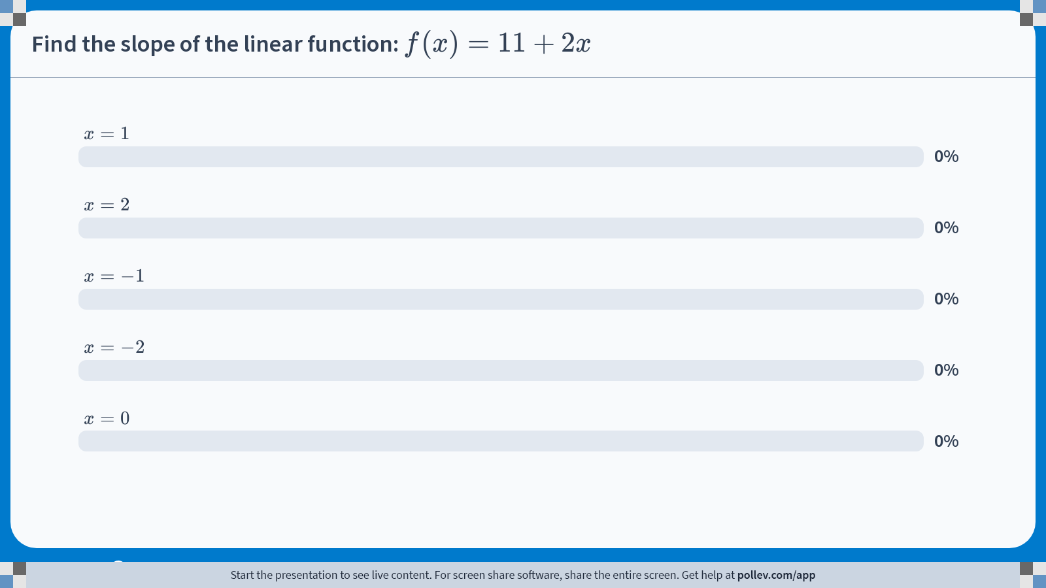
Poll Everywhere multiple choice poll chart screen Activity Title: Find the slope of the linear function: $$f(x)=11+2x$$ Slide 26
Notes:
Do not modify the notes in this section to avoid tampering with the Poll Everywhere activity. More info at polleverywhere.com/support Find the slope of the linear function: $$f(x)=11+2x$$ https://www.polleverywhere.com/multiple_choice_polls/XI6zqZIwn8w5BWqUdl0Il?display_state=chart&activity_state=closed&state=closed&flow=Engagement&onscreen=persist

Slide 23
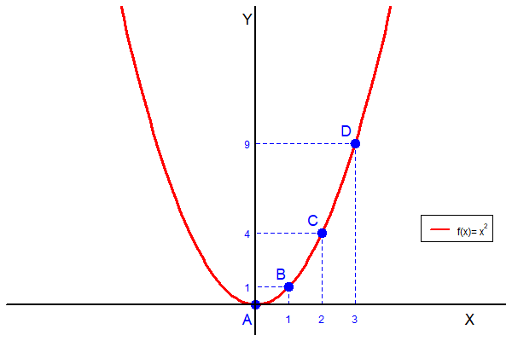
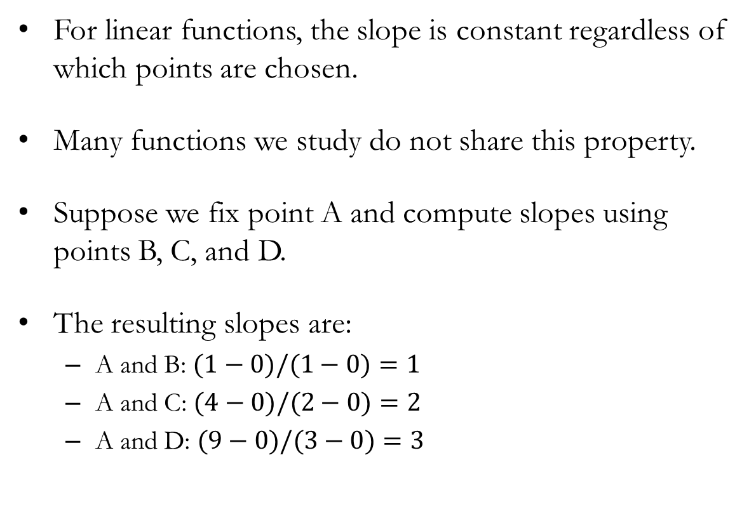
Slopes of Nonlinear Functions
For linear functions, the slope is constant regardless of which points are chosen.
Many functions we study do not share this property.
Suppose we fix point A and compute slopes using points B, C, and D.
The resulting slopes are:
A and B: $(1−0)/(1−0)=1$
A and C: $(4−0)/(2−0)=2$
A and D: $(9−0)/(3−0)=3$

Slide 24
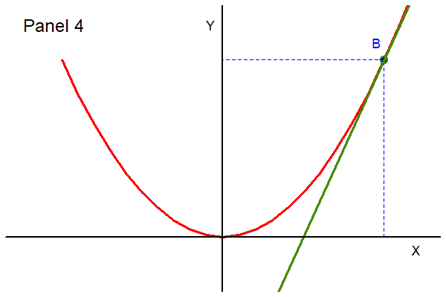
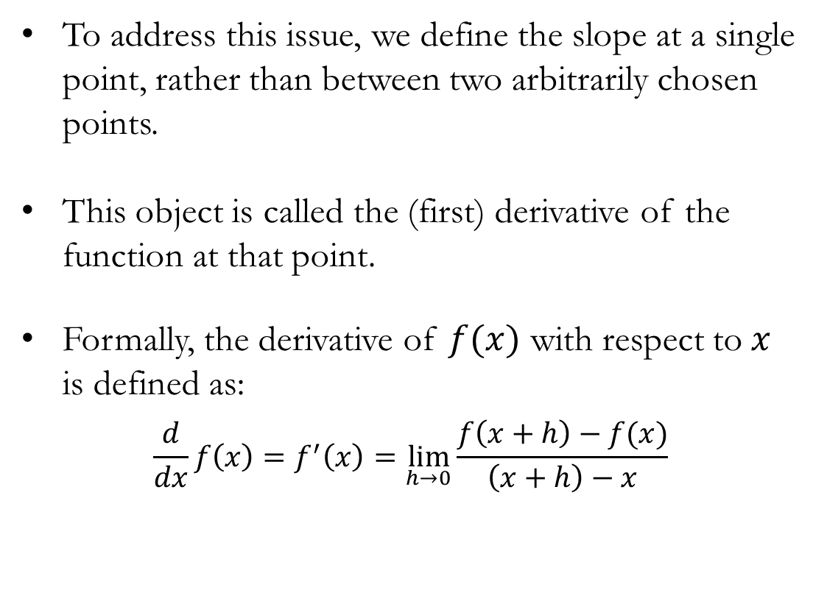
The Derivative
To address this issue, we define the slope at a single point, rather than between two arbitrarily chosen points.
This object is called the (first) derivative of the function at that point.
Formally, the derivative of $f(x)$ with respect to $x$ is defined as:
$$\frac{d}{dx}f\left(x\right)=f^{′}\left(x\right)=\lim_{h→0}{\frac{f\left(x+h\right)−f(x)}{\left(x+h\right)−x}}$$

Slide 25
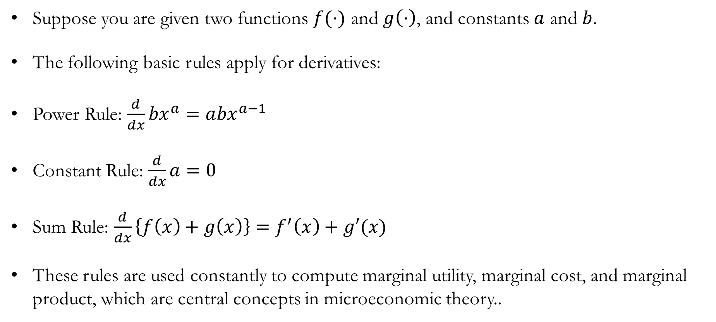
Derivative Rules: Core
Suppose you are given two functions $f(⋅)$ and $g\left(⋅\right)$, and constants $a$ and $b$.
The following basic rules apply for derivatives:
Power Rule: $\frac{d}{dx}{bx}^{a}=a{bx}^{a−1}$
Constant Rule: $\frac{d}{dx}a=0$
Sum Rule: $\frac{d}{dx}\left\{f\left(x\right)+g\left(x\right)\right\}=f^{′}\left(x\right)+g′(x)$
These rules are used constantly to compute marginal utility, marginal cost, and marginal product, which are central concepts in microeconomic theory..

Slide 26
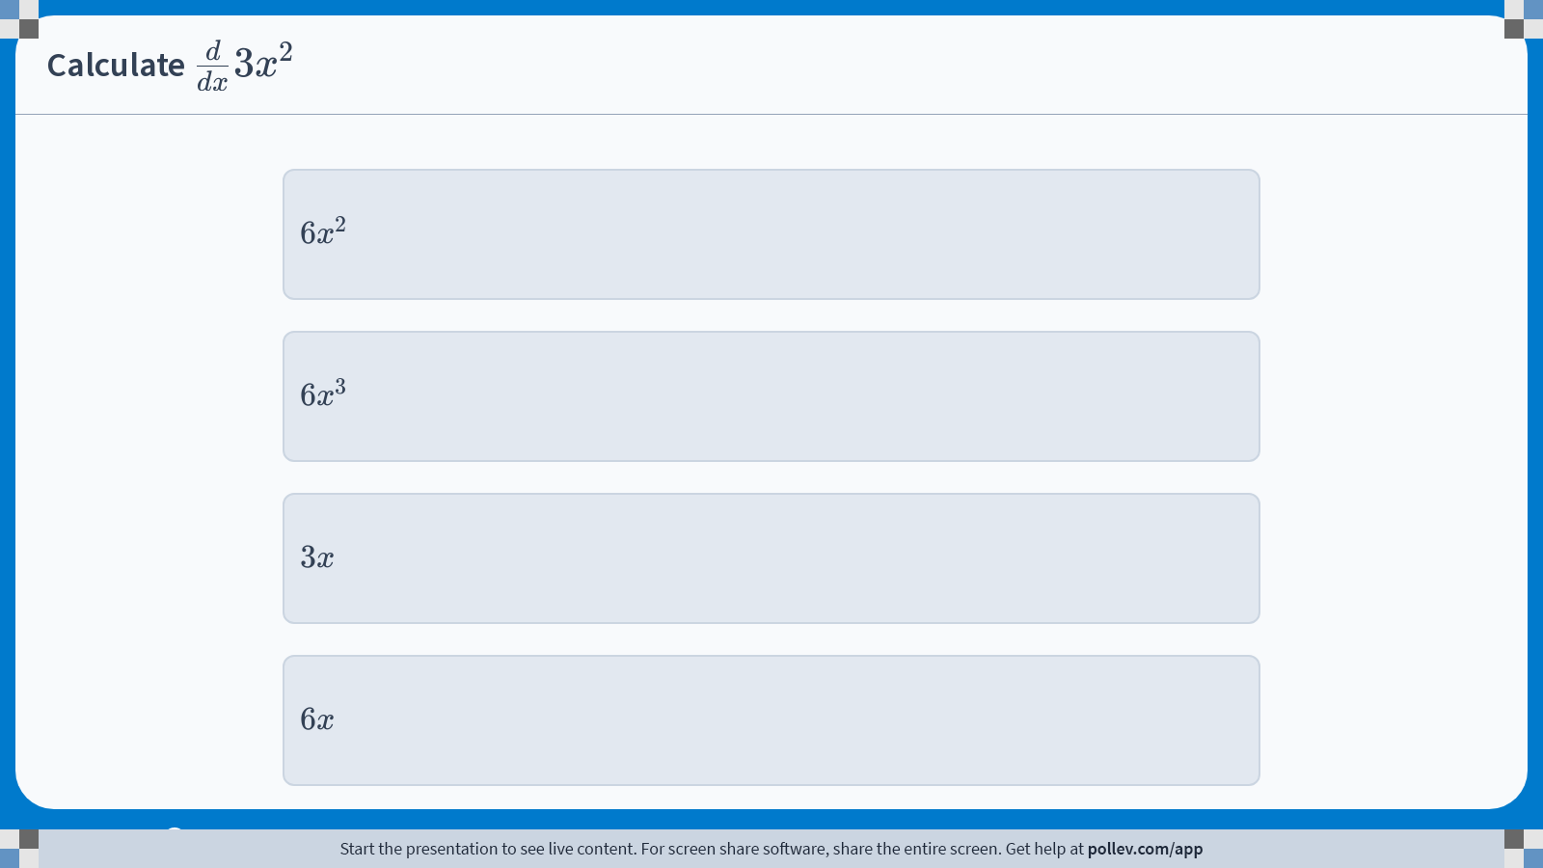
Poll Everywhere multiple choice poll instructions screen Activity Title: Calculate $$\\frac{d}{dx}3x^2$$ Slide 29
Notes:
Do not modify the notes in this section to avoid tampering with the Poll Everywhere activity. More info at polleverywhere.com/support Calculate $$\\frac{d}{dx}3x^2$$ https://www.polleverywhere.com/multiple_choice_polls/MnyxnyMXxWjfJiZ0bPCf2?display_state=instructions&activity_state=opened&state=opened&flow=Engagement&onscreen=persist

Slide 27
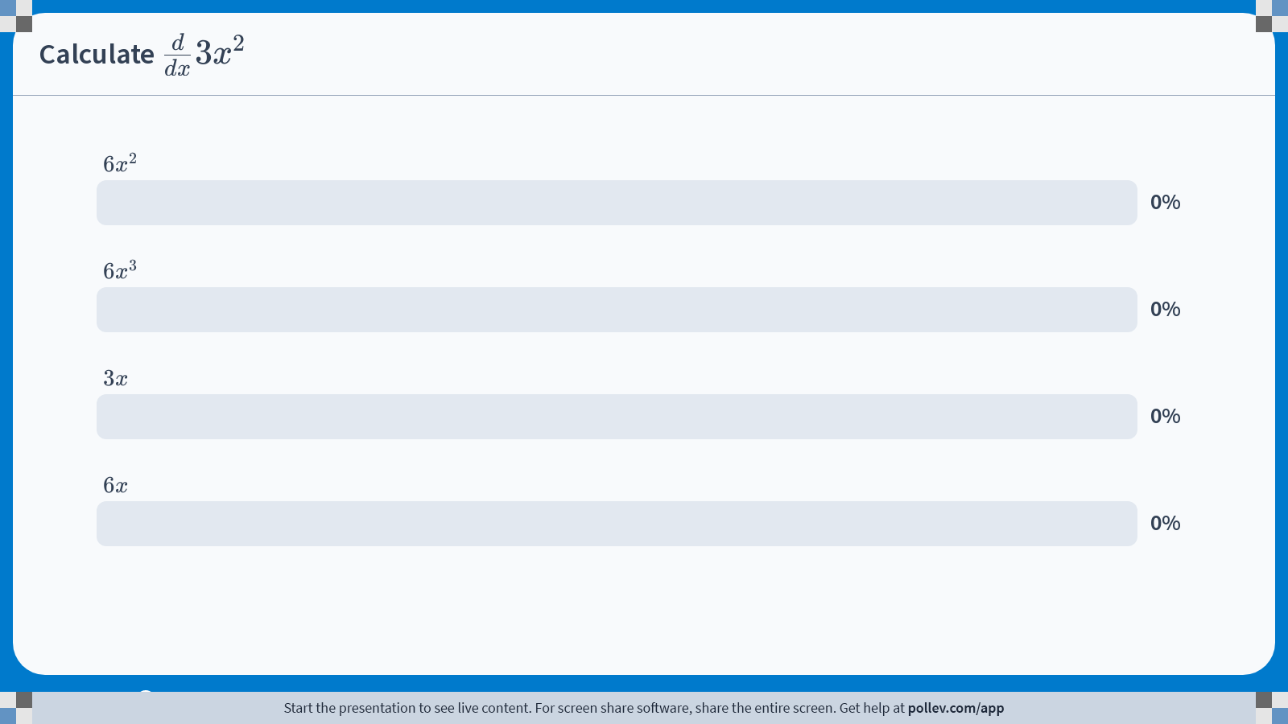
Poll Everywhere multiple choice poll chart screen Activity Title: Calculate $$\\frac{d}{dx}3x^2$$ Slide 31
Notes:
Do not modify the notes in this section to avoid tampering with the Poll Everywhere activity. More info at polleverywhere.com/support Calculate $$\\frac{d}{dx}3x^2$$ https://www.polleverywhere.com/multiple_choice_polls/MnyxnyMXxWjfJiZ0bPCf2?display_state=chart&activity_state=closed&state=closed&flow=Engagement&onscreen=persist

Slide 28

Derivative Rules: Occasional
The following three rules are used less frequently, but are useful to know:
Product Rule: $\frac{d}{dx}\left\{f\left(x\right)×g\left(x\right)\right\}=f^{′}\left(x\right)g(x)+f\left(x\right)g′(x)$
Quotient Rule: $\frac{d}{dx}\left(\frac{f(x)}{g(x)}\right)=\frac{f^{′}\left(x\right)g\left(x\right)−f\left(x\right)g^{′}(x)}{g{\left(x\right)}^{2}}$
Chain Rule: $\frac{d}{dx}f\left(g\left(x\right)\right)=f^{′}\left(g\left(x\right)\right)g′(x)$

Slide 29
Partial Derivatives
In this course, we will often work with functions that depend on more than one variable. In these cases, we use partial derivatives.
A partial derivative measures how a function changes with respect to one variable at a time, holding all other variables constant.
Operationally, partial derivatives follow the same rules as ordinary derivatives.
The only difference is that variables we are not differentiating with respect to are treated as constants.

Slide 30
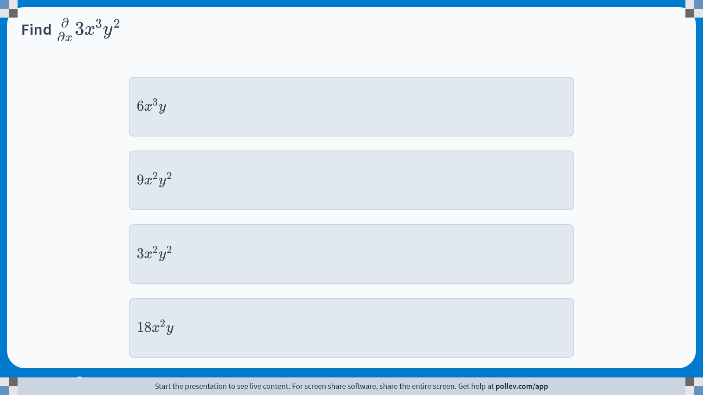
Poll Everywhere multiple choice poll instructions screen Activity Title: Find $$\\frac{\\partial}{\\partial x}3x^3y^2$$ Slide 30
Notes:
Do not modify the notes in this section to avoid tampering with the Poll Everywhere activity. More info at polleverywhere.com/support Find $$\\frac{\\partial}{\\partial x}3x^3y^2$$ https://www.polleverywhere.com/multiple_choice_polls/3dOsWfZ8wOdr433uwObGQ?display_state=instructions&activity_state=opened&state=opened&flow=Engagement&onscreen=persist

Slide 31
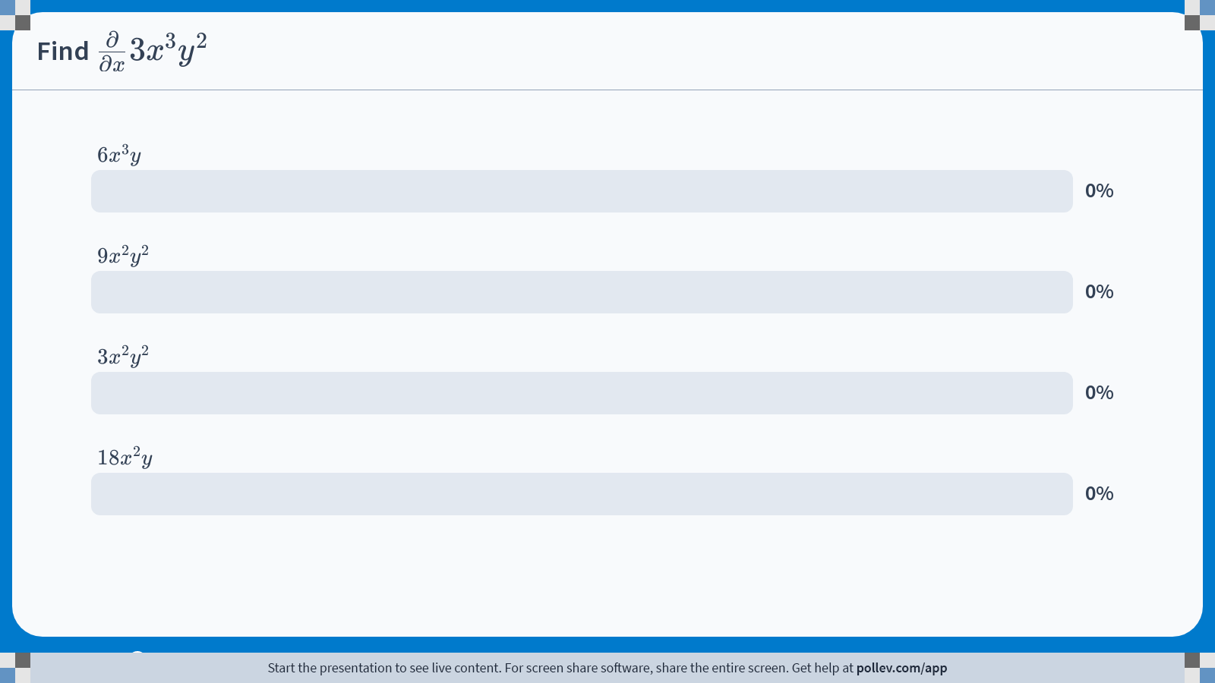
Poll Everywhere multiple choice poll chart screen Activity Title: Find $$\\frac{\\partial}{\\partial x}3x^3y^2$$ Slide 32
Notes:
Do not modify the notes in this section to avoid tampering with the Poll Everywhere activity. More info at polleverywhere.com/support Find $$\\frac{\\partial}{\\partial x}3x^3y^2$$ https://www.polleverywhere.com/multiple_choice_polls/3dOsWfZ8wOdr433uwObGQ?display_state=chart&activity_state=closed&state=closed&flow=Engagement&onscreen=persist

Slide 32
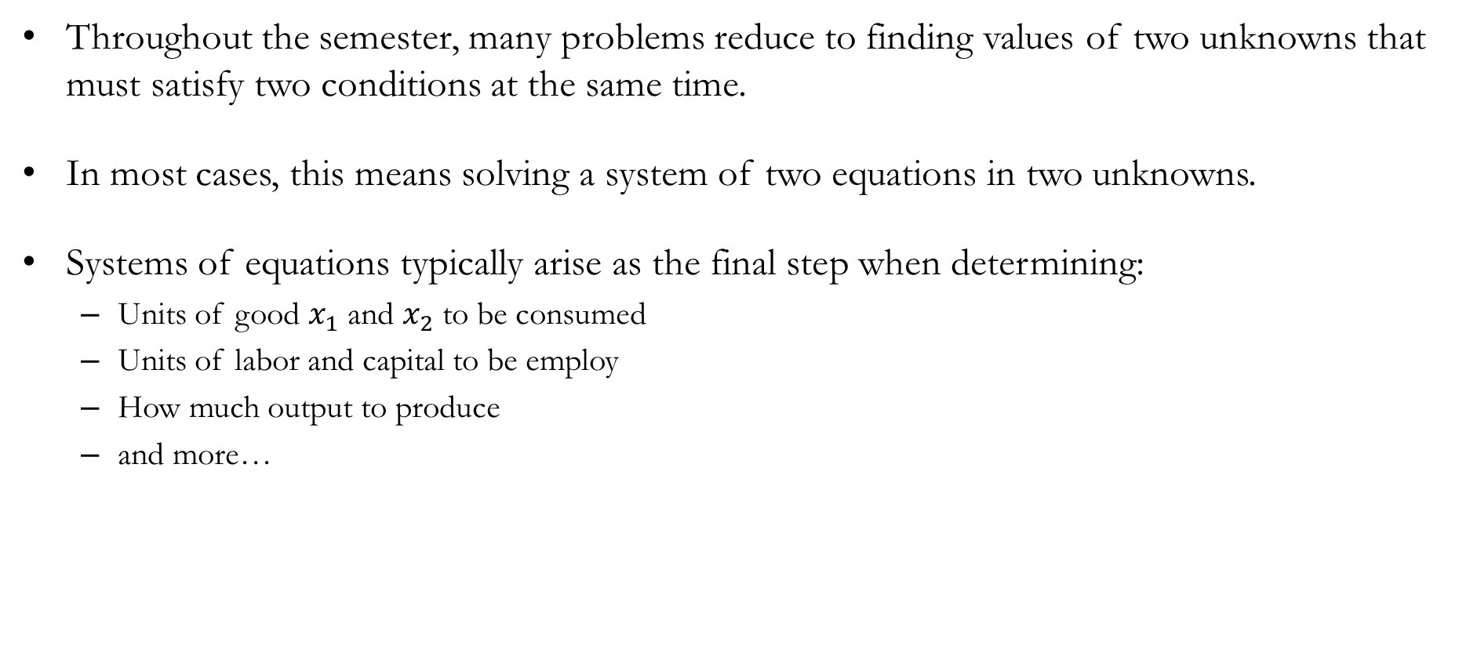
Systems of Equations
Throughout the semester, many problems reduce to finding values of two unknowns that must satisfy two conditions at the same time.
In most cases, this means solving a system of two equations in two unknowns.
Systems of equations typically arise as the final step when determining:
Units of good $x_{1}$ and $x_{2}$ to be consumed
Units of labor and capital to be employ
How much output to produce
and more…

Slide 33
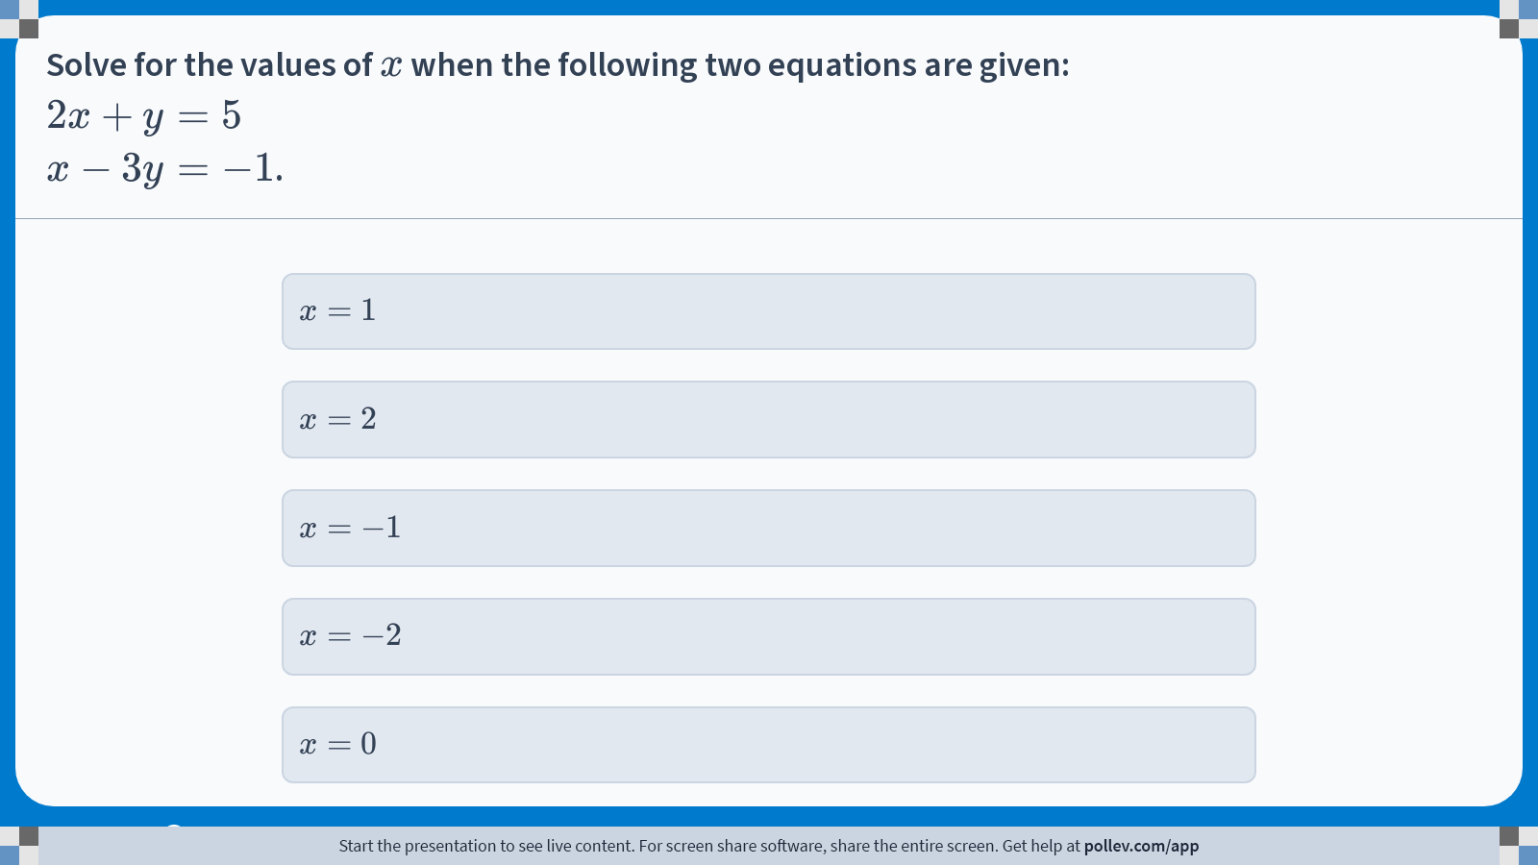
Poll Everywhere multiple choice poll instructions screen Activity Title: Solve for the values of $$x$$ when the following two equations are given:$$2x+y=5$$$$x-3y=-1$$. Slide 17
Notes:
Do not modify the notes in this section to avoid tampering with the Poll Everywhere activity. More info at polleverywhere.com/support Solve for the values of $$x$$ when the following two equations are given:$$2x+y=5$$$$x-3y=-1$$. https://www.polleverywhere.com/multiple_choice_polls/O6p2Jn2fMOtSxspr0UqGn?display_state=instructions&activity_state=opened&state=opened&flow=Engagement&onscreen=persist

Slide 34
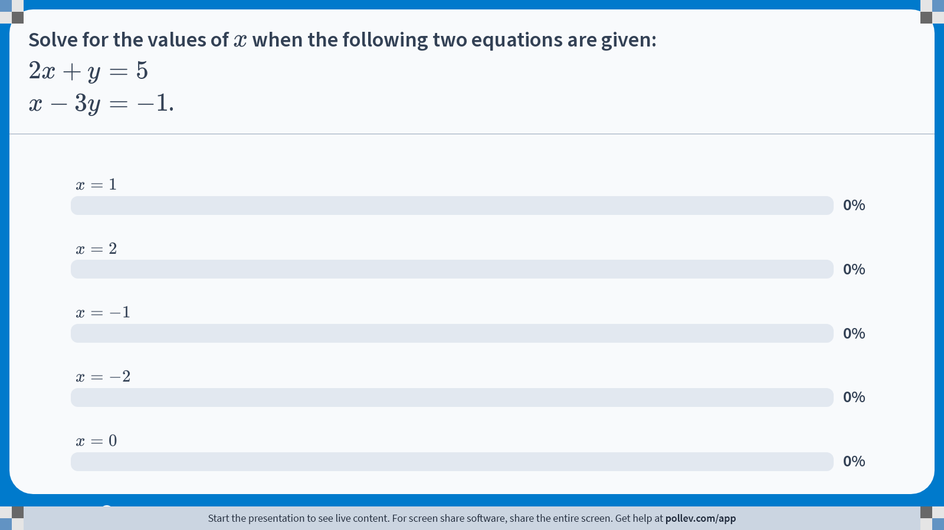
Poll Everywhere multiple choice poll chart screen Activity Title: Solve for the values of $$x$$ when the following two equations are given:$$2x+y=5$$$$x-3y=-1$$. Slide 19
Notes:
Do not modify the notes in this section to avoid tampering with the Poll Everywhere activity. More info at polleverywhere.com/support Solve for the values of $$x$$ when the following two equations are given:$$2x+y=5$$$$x-3y=-1$$. https://www.polleverywhere.com/multiple_choice_polls/O6p2Jn2fMOtSxspr0UqGn?display_state=chart&activity_state=closed&state=closed&flow=Engagement&onscreen=persist

Slide 35
Unconstrained Optimization
In many economic problems, agents choose a value of a decision variable to maximize or minimize an objective function.
In unconstrained optimization problems, this choice is not restricted by an explicit constraint.
Typical examples include:
Maximizing profit with respect to output
Maximizing utility with respect to a choice variable
Minimizing cost when input is adjustable
Solving these problems involves identifying points where small changes in the choice variable do not improve the objective.

Slide 36
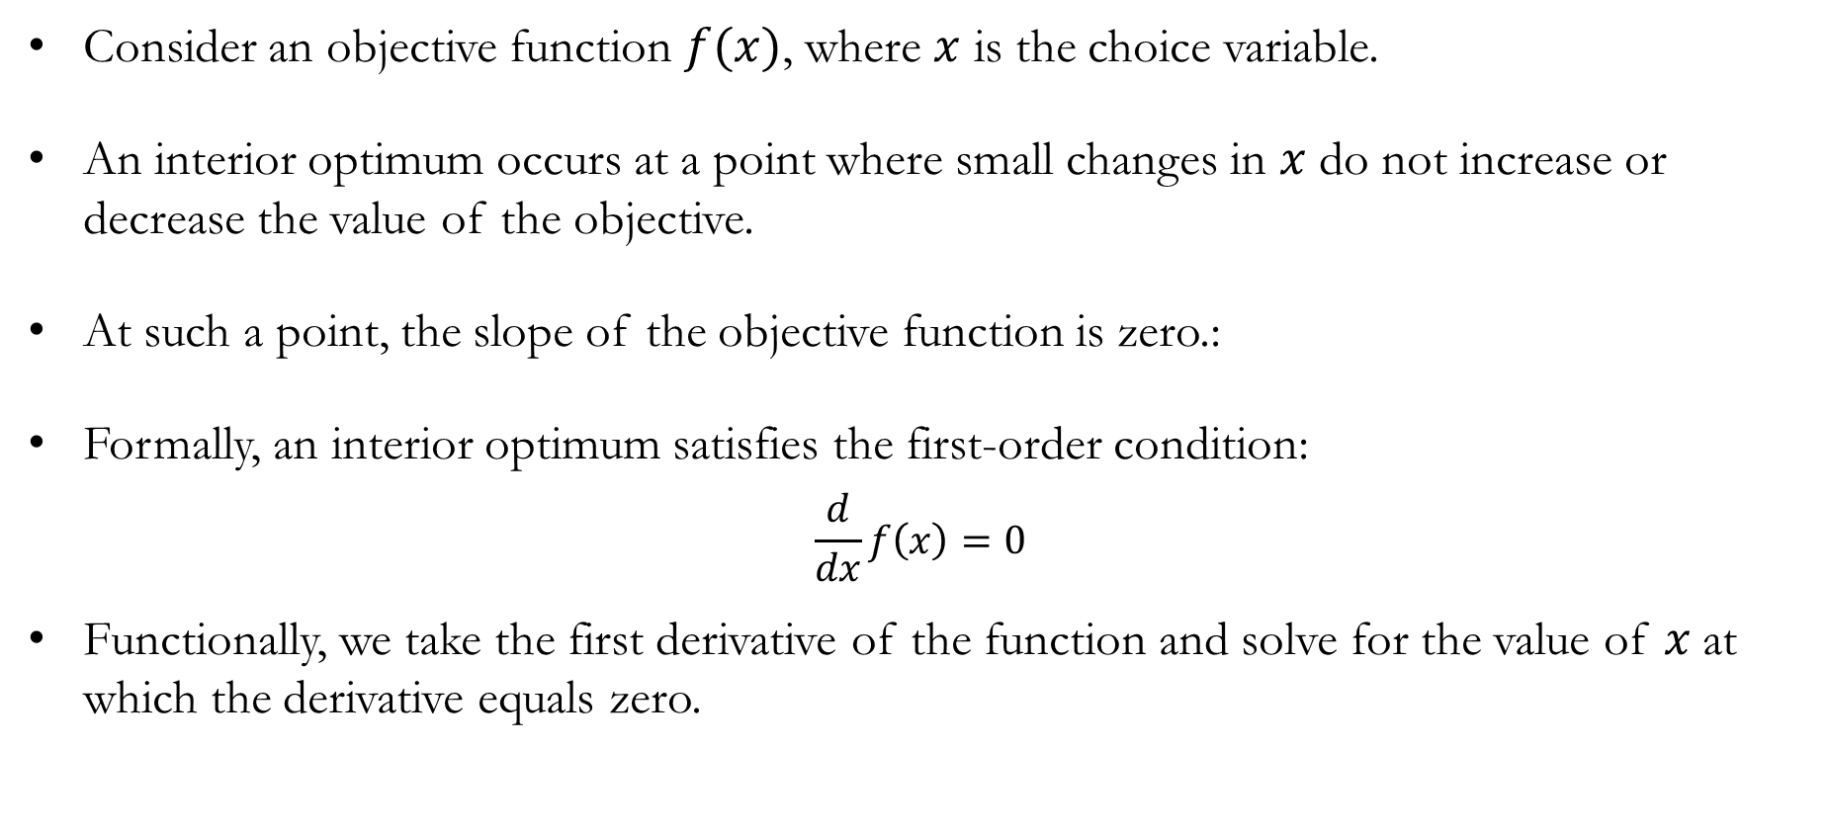
Unconstrained Optimization: First-Order Condition
Consider an objective function $f(x)$, where $x$ is the choice variable.
An interior optimum occurs at a point where small changes in $x$ do not increase or decrease the value of the objective.
At such a point, the slope of the objective function is zero.:
Formally, an interior optimum satisfies the first-order condition:
$$\frac{d}{dx}f\left(x\right)=0$$
Functionally, we take the first derivative of the function and solve for the value of 𝑥 at which the derivative equals zero.

Slide 37
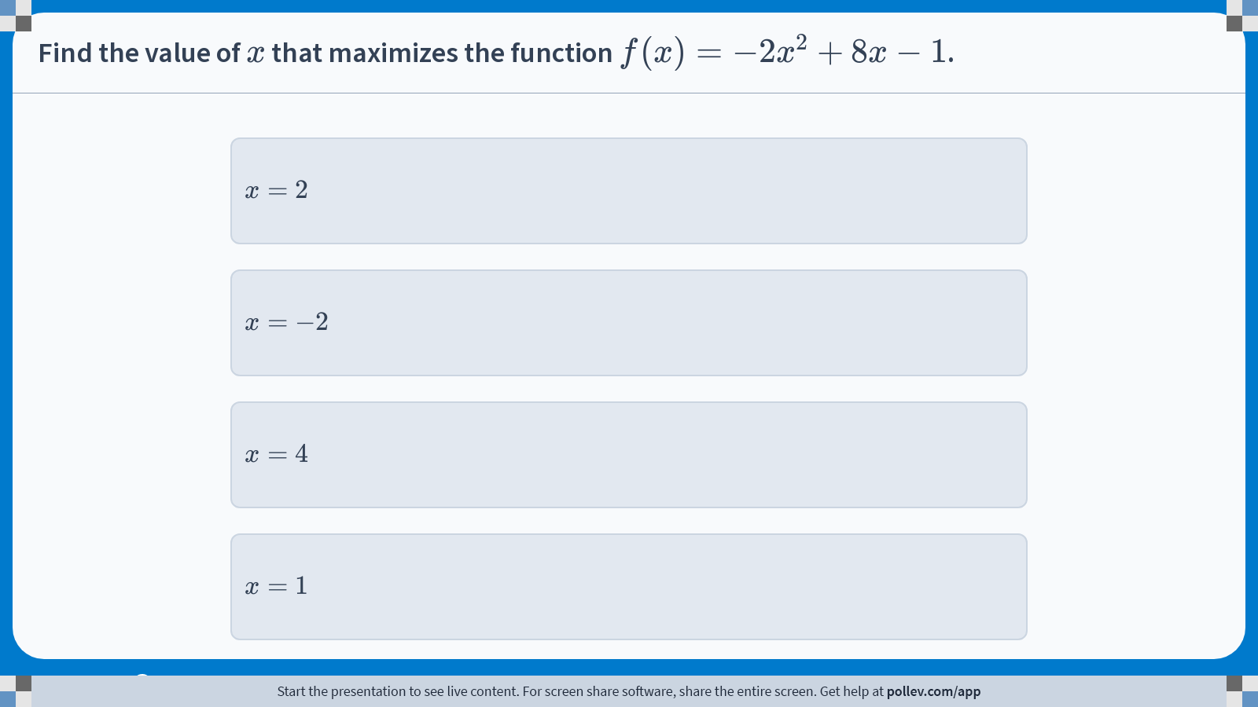
Poll Everywhere multiple choice poll instructions screen Activity Title: Find the value of $$x$$ that maximizes the function $$f(x)=-2x^2+8x-1$$. Slide 37
Notes:
Do not modify the notes in this section to avoid tampering with the Poll Everywhere activity. More info at polleverywhere.com/support Find the value of $$x$$ that maximizes the function $$f(x)=-2x^2+8x-1$$. https://www.polleverywhere.com/multiple_choice_polls/03wgudWY7A4LEAMk7UcD8?display_state=instructions&activity_state=opened&state=opened&flow=Engagement&onscreen=persist

Slide 38
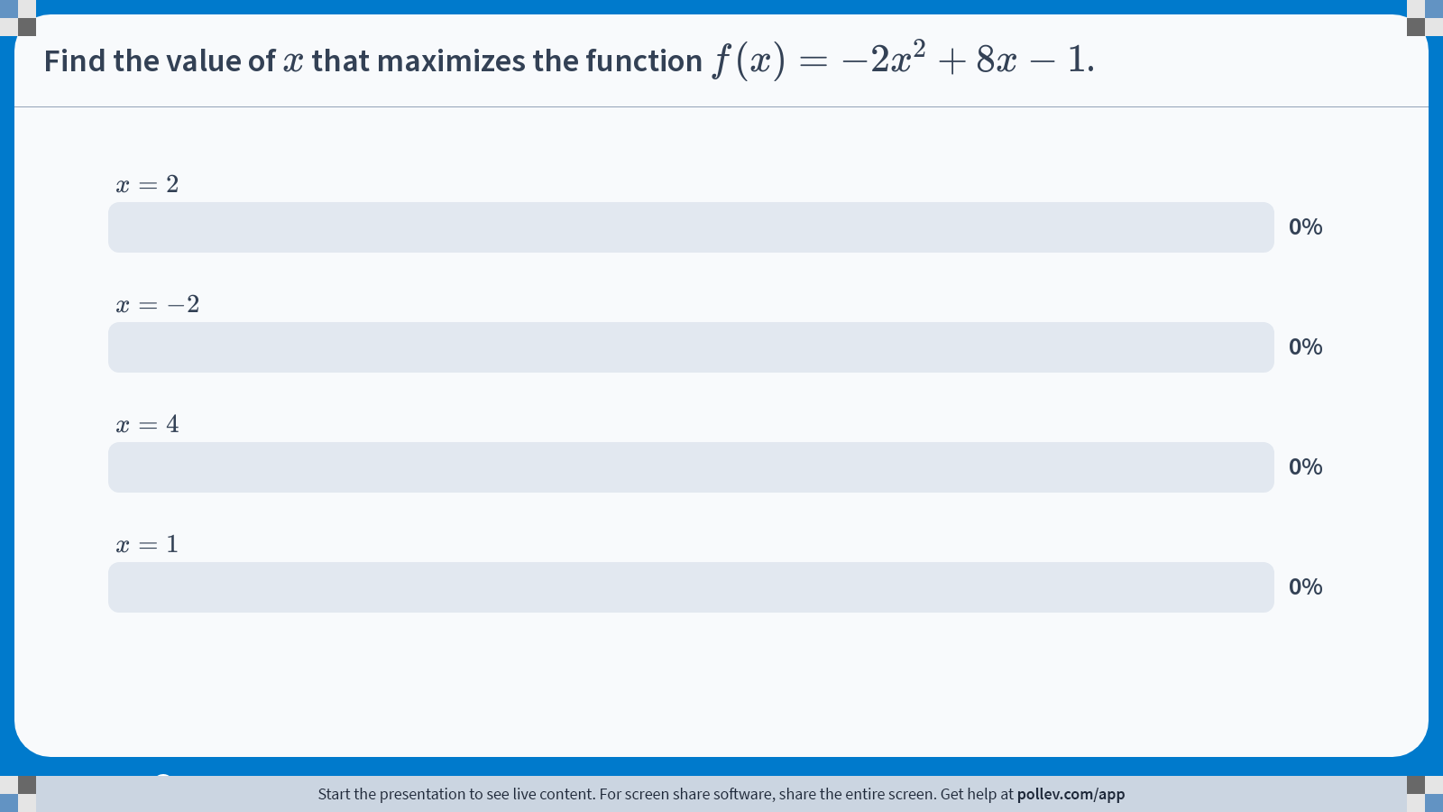
Poll Everywhere multiple choice poll chart screen Activity Title: Find the value of $$x$$ that maximizes the function $$f(x)=-2x^2+8x-1$$. Slide 39
Notes:
Do not modify the notes in this section to avoid tampering with the Poll Everywhere activity. More info at polleverywhere.com/support Find the value of $$x$$ that maximizes the function $$f(x)=-2x^2+8x-1$$. https://www.polleverywhere.com/multiple_choice_polls/03wgudWY7A4LEAMk7UcD8?display_state=chart&activity_state=closed&state=closed&flow=Engagement&onscreen=persist

Slide 39
Preview

Slide 40
Preview
We now turn to consumer theory, which studies how individuals make choices under scarcity.
We begin by representing scarcity mathematically using the budget constraint.
Although we start with monetary budgets, this framework generalizes to other forms of scarcity, including time, land, and resources, across many areas of economics.

