Slide 1
PRINCIPLES OF GLOBAL ECONOMICS
Chapter 30: The Monetary System

Slide 2
Preview
In recent chapters we measured key indicators of the economy: output through GDP, the cost of living through the CPI, and the health of the labor market through unemployment.
This chapter turns to the foundation that supports all of these indicators, which is the monetary system.
We study what money is and how economists classify it.
We examine how the Federal Reserve and the banking system determine the money supply.
We build the tools needed to understand how monetary policy shapes inflation and overall economic activity in later chapters.

Slide 3
Money

Slide 4
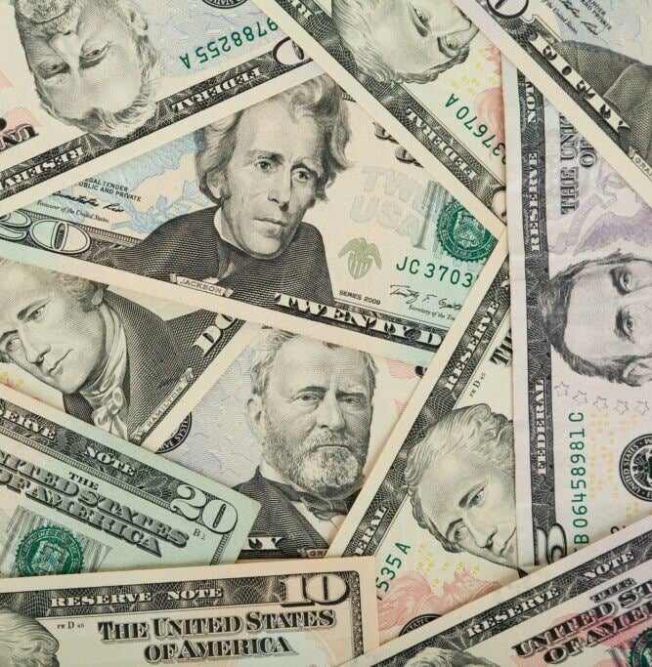
Defining Money
In everyday language, we think of money as the items we regularly use to buy goods and services.
Without money, we would need to barter.
  Bartering requires a double coincidence of wants: each party must want what the other offers at the same time.
  Money removes this requirement, making trade far easier and more efficient.
In Economics, money is any asset that serves three key functions:
  Medium of Exchange
  Unit of Account
  Store of Value

Slide 5
The Three Functions of Money
Medium of Exchange
  An item that buyers give to sellers when they want to purchase goods or services.
  e.g., In the local café, customers pay dollars (money) and receive coffee (a good).
Unit of Account
  The yardstick people use to post prices and record debts.
  e.g., If a cup of coffee costs $4.10, we can say that a new MacBook Pro priced at $1,599 is worth about 390 cups of coffee.
Store of Value
  An item that people can use to transfer purchasing power from the present to the future.
  e.g., Eggs are a poor store of value because it is difficult to keep them from losing value over time.
  e.g., “Wealth” is a term that encompass an asset class that can act as a store of value.

Slide 6

Kinds of Money
In early stages of human civilization, money took the form of Commodity Money.
  Money that takes the form of a commodity with intrinsic value.
  Historically, precious metals such as gold or silver was widely used as money.
  In prisoner-of-war camps during WW2, cigarettes were used as money.
Most forms of money in modern times is Fiat Money.
  Money without intrinsic value that is used as money by government decree.
  “This note is legal tender for all debts, public and private.”
Cryptocurrencies represent a new proposal for money, which neither has intrinsic value, nor is established by the decree of a government.

Slide 7
Measures of Money Supply
Economists measure the money supply using liquidity-based aggregates.
  Liquidity: The ease with which an asset can be converted into the economy’s medium of exchange.
M1: Most liquid forms of money that can be spent immediately.
  Currency: Paper money and coins held by the public.
  Demand Deposits: Checking Accounts.
  Savings deposits (since 2020), other checkable deposits and traveler’s checks.
M2: Includes everything in M1 plus slightly less liquid assets.
  Everything in M1.
  Small time deposits (CDs).
  Retail money market mutual funds (MMMFs).

Slide 8
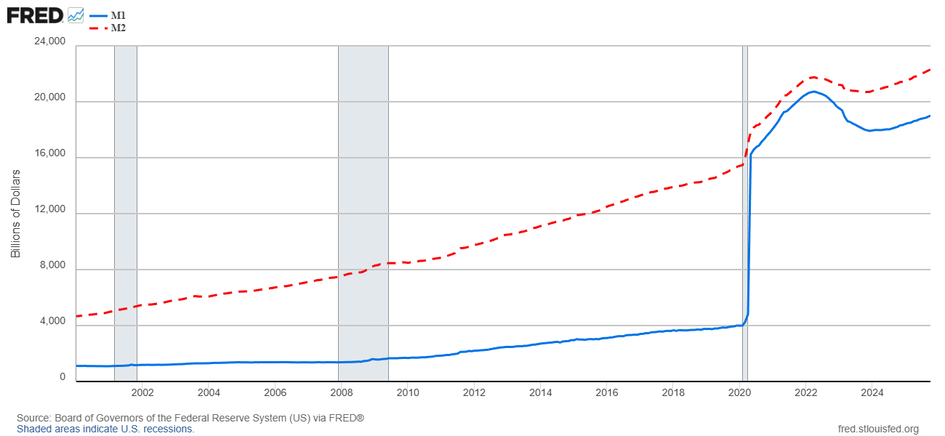
Measures of Money Supply

Slide 9
The Federal Reserve

Slide 10
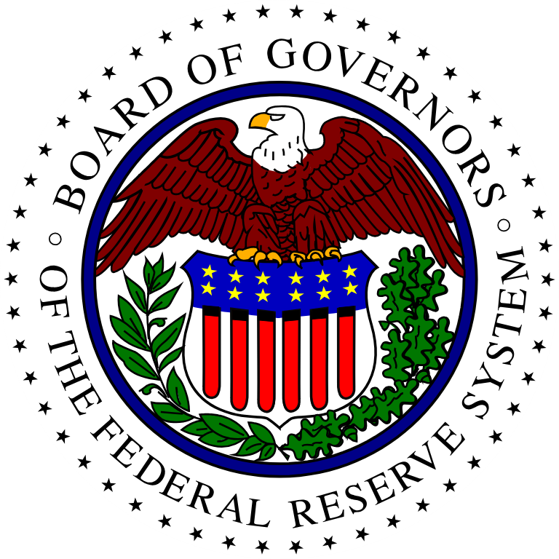
The Federal Reserve System
Most economies establish a Central Bank, an institution designed to oversee the banking system and regulate the quantity of money in the economy.
The central bank of the United States is the Federal Reserve (the Fed).
The two main tasks of the Fed:
  Regulate banks and ensure the health of the banking system.
  Control the quantity of money available in the economy.
The dual mandate of the Fed:
  Pursue the economic goals of maximum employment and price stability.

Slide 11
The Fed and Monetary Policy
The Federal Open Market Committee (FOMC) is the branch of the Fed that determines the direction of monetary policy.
Monetary policy involves the setting of the money supply by policymakers in the central bank.
In the U.S., the Fed’s monetary policy involves three main tools:
  Open-Market Operations (OMOs)
  Controlling Key Interest Rates
  Setting Reserve Requirements
Detour: Fiscal policies are conducted by Congress and the executive branch, and involves adjusting government spending and taxes.

Slide 12
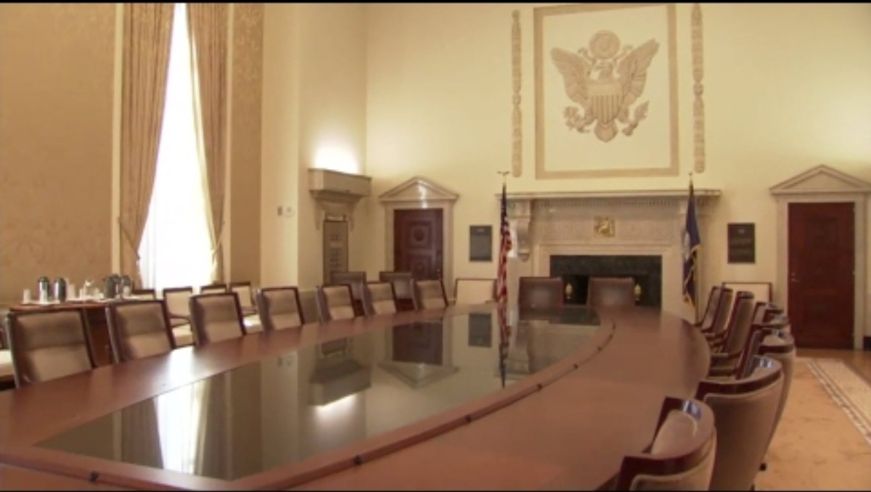
Philadelphia Fed (2017, April 3). Segment 405: The Role of the FOMC [Video]. YouTube. https://youtu.be/GmeZ8t2zth8?si=P4EVc5-y7-LrSlWS

Slide 13
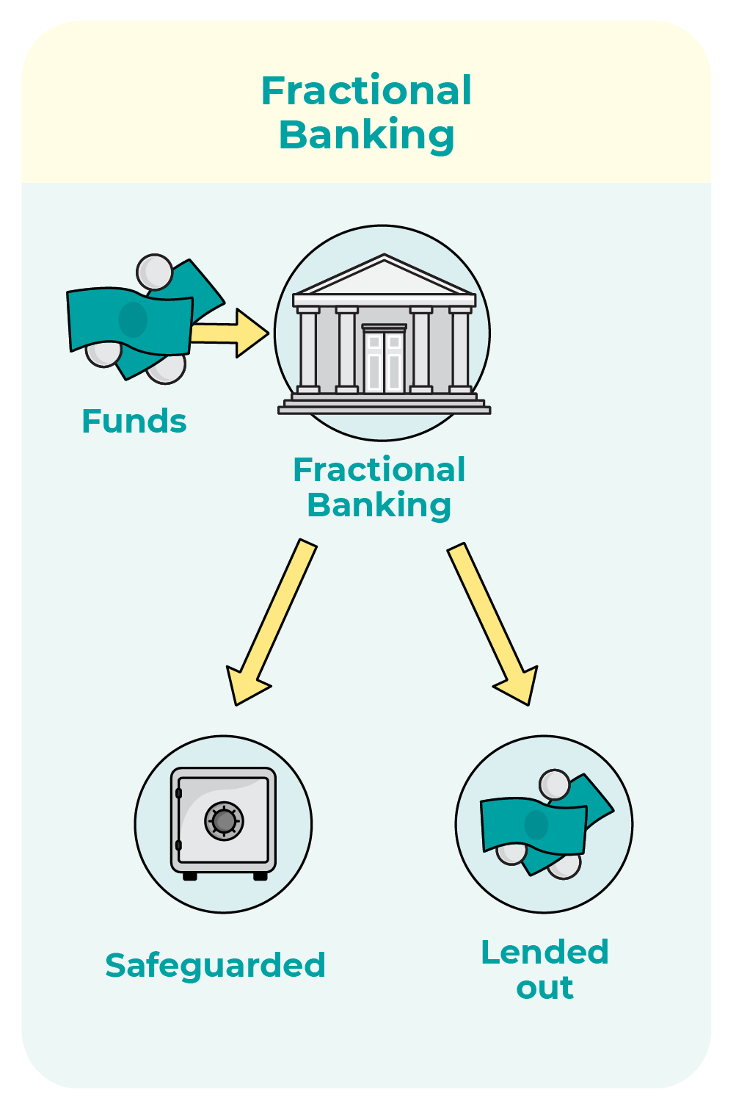
Fractional-Reserve Banking
Fractional-Reserve Banking refers to a banking system in which banks hold only a fraction of deposits as reserves.
When commercial banks receive a deposit, they can choose to:
  Keep a portion of the deposit as reserves
  Lend a portion of the deposit out as loans
Banks’ decisions about how much of their deposits to hold as reserves can affect the money supply in the economy.
If banks choose to keep all deposits as reserves, the money supply in the economy is not affected further.
But if they choose to keep only a fraction as reserves…

Slide 14
Fractional-Reserve Banking
Suppose that all banks in the economy keep exactly 10% of deposits as reserves.
Agent #1 makes a deposit of $100,000 at Bank A.
Bank A keeps $10,000 as reserves and lends out $90,000 to Agent #2.
Agent #2 spends the $90,000 which ends up as deposits in Bank B.
Bank B keeps $9,000 as reserves and lends out $81,000 to Agent #3.
Agent #3 spends the $81,000 which ends up as deposits in Bank C.
Bank C keeps $8,100 as reserves and lends out $72,900 to Agent #3.
…and so on…

Slide 15
Fractional-Reserve Banking
Let’s see how much each bank “has”:
  Bank A “has” $100,000 − $10,000 in Reserves, and $90,000 in loans.
  Bank B “has” $90,000 − $9,000 in Reserves, and $81,000 in loans.
  Bank C “has” $81,000 − $8,100 in Reserves, and $72,900 in loans.
  Bank D “has” $72,900 − $7,290 in Reserves, and $65,610 in loans.
  Bank E “has” $65,610 − $6,561 in Reserves, and $59,049 in loans.
  …and so on
Adding all that the banks “have,” the total amount of money created is $1,000,000.
$$100000+90000+81000+79200+⋯=\frac{100000}{1−0.9}=1000000$$

Slide 16
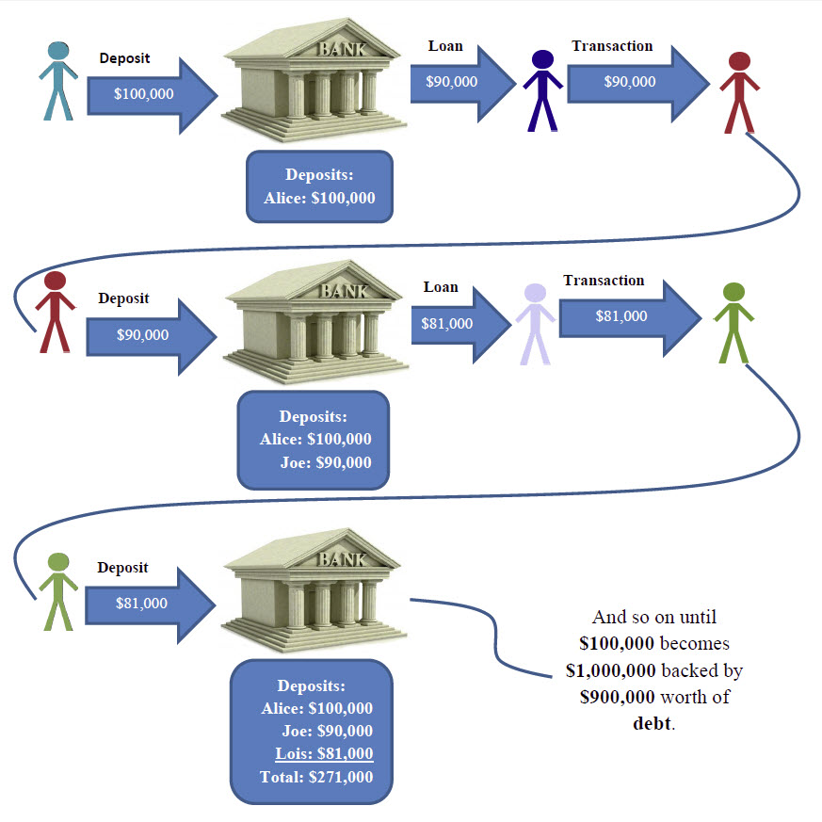
Fractional-Reserve Banking
The fraction of deposits that banks hold as reserves is called the Reserve Ratio.
The Money Multiplier is the amount of money created from each dollar of reserves, and it equals the reciprocal of the reserve ratio.
  The higher the reserve ratio, the less money is created.
  The lower the reserve ratio, the more money is created.
In our example, the reserve ratio is 10%, so the money multiplier is its reciprocal, 10.
  If the reserve ratio is 5%, the money multiplier is 20.
  If the reserve ratio is 25%, the money multiplier is 4.

Slide 17

The Wall Street Journal (2023, March 13). The Silicon Valley Bank Collapse, Explained | WSJ
[Video]. YouTube. https://youtu.be/YDwDMF_f5rM?si=lzwEuEJ_iglW-f31

Slide 18
Monetary Policy: Reserve Ratios
The Fed can influence the money supply by influencing the economy’s reserve ratio.
One method the Fed uses to do this is setting Reserve Requirements, which establish the minimum fraction of deposits that banks must hold as reserves.
  Since March 2020, the required reserve ratio has been set to 0%.
  Theoretically, if banks choose to hold no excess reserves and the reserve ratio is zero, the money multiplier becomes infinite.
The Fed can also adjust the interest rate that it pays banks on the reserves they hold at the Fed.
  Introduced in 2008 as a response to the Great Recession.
  Higher interest rates on reserves encourage banks to hold more reserves.
  Lower interest rates on reserves encourage banks to hold fewer reserves and to lend more.

Slide 19
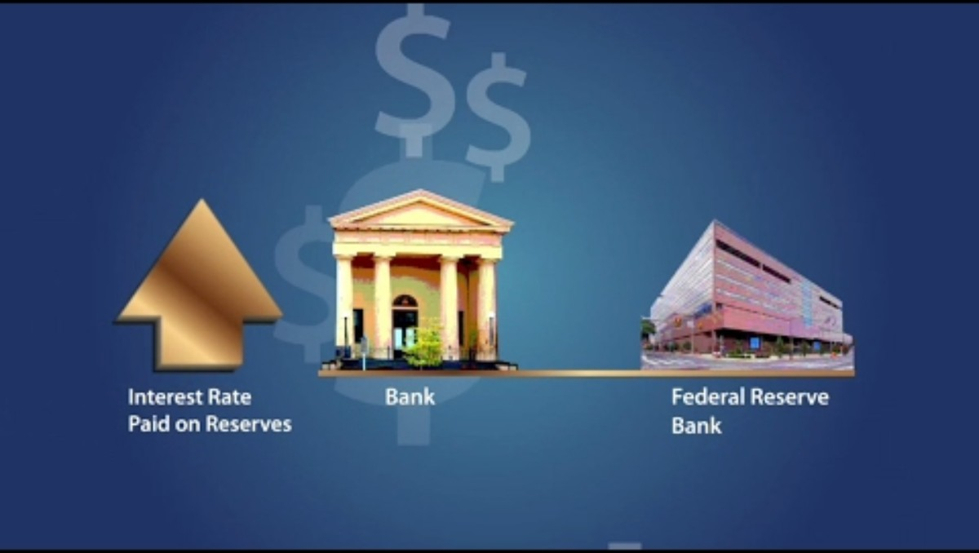
Philadelphia Fed (2017, April 3). Segment 408: Interest on Reserves [Video]. YouTube. https://youtu.be/COprvpWoOo8?si=NSnKwaN8Vv8t0kgb

Slide 20
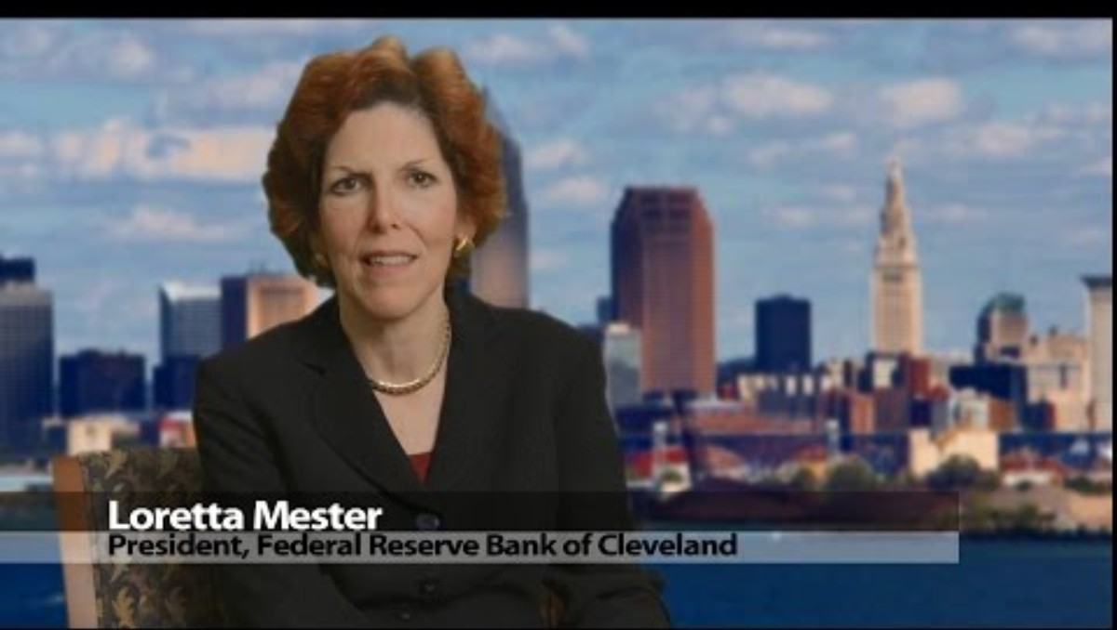
Philadelphia Fed (2017, April 3). Segment 409: Reserve Requirements [Video]. YouTube. https://youtu.be/OZDgPqX56Rg?si=4zDoojjLVjsO8MJs

Slide 21
Monetary Policy: Open Market Operations
Historically, the primary tool of the Fed’s monetary policy has been Open-Market Operations.
Open-Market Operations are the purchase and sale of U.S. government bonds by the Fed.
When the Fed wants to increase the money supply, it purchases government bonds from the public.
  Some of the dollars received by the public are held as currency, increasing the money supply dollar for dollar.
  Some of the dollars are deposited in banks, where each deposited dollar can increase the money supply by more than one dollar through the fractional-reserve banking system.
To decrease the money supply, the Fed does the opposite and sells government bonds to the public, reducing the amount of money in circulation.

Slide 22
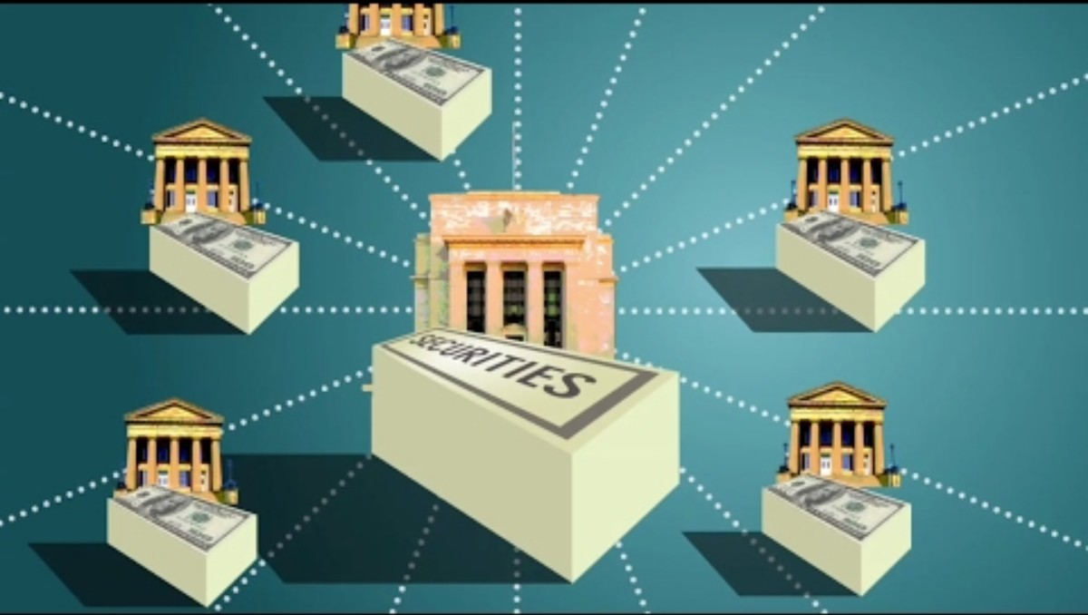
Philadelphia Fed (2017, April 3). Segment 406: Open Market Operations [Video]. YouTube. https://youtu.be/jvRwFkDdWZU?si=fja56XBX94kllQIF

Slide 23
Monetary Policy: Interest Rates
The Fed also acts as the “lender of last resort,” lending money to commercial banks if their reserves are insufficient to satisfy regulators, meet depositor withdrawals, make new loans, or address other business needs.
Traditionally, banks borrow money from the Fed through the discount window, and the interest rate the Fed charges banks for these loans is called the Discount Rate.
Another key interest rate that the Fed indirectly influences is the Federal Funds Rate, the interest rate at which banks make overnight loans of reserves to one another.
  The Fed does not have direct control over the federal funds rate, but deploy a variety of tools to indirectly influence the outcome.
In modern practice, the Fed influences interest rates mainly by targeting the federal funds rate, not by frequent use of the discount window.

Slide 24
Monetary Policy: Interest Rates
The Fed announces a target for the federal funds rate.
The Fed uses open-market operations to change the supply of reserves.
  Open-market purchases increase reserves, making lending cheaper so the federal funds rate falls.
  Open-market sales decrease reserves, making lending more expensive so the federal funds rate rises.
The Fed sets the interest rate it pays on reserve balances.
  This serves as a floor under the federal funds rate, since no bank will lend reserves at an interest rate below what it can earn risk-free from the Fed.
The Fed uses overnight reverse repurchase agreements (reverse repos)
  In a reverse repo, financial institutions lend cash to the Fed overnight, and the Fed provides Treasury securities as collateral, temporarily reducing cash in the system
  This provides a floor for nonbank institutions, reinforcing the lower bound of the federal funds rate.

Slide 25

Philadelphia Fed (2017, April 3). Segment 407: The Discount Rate [Video]. YouTube. https://youtu.be/fVfAMsFvyxo?si=4wTQuGBH_ppNfe_N

Slide 26
Recap of Chapter 30

Slide 27
Recap
Defining Money
  Money serves three key functions: Medium of exchange, unit of account, store of value.
Measuring the Money Supply
  M1 includes currency, demand deposits, and other highly liquid assets.
  M2 includes M1 along with savings deposits, small time deposits, and retail money market funds.
Fractional-Reserve Banking
  Banks keep only a fraction of deposits as reserves.
  Lending out deposits increases the money supply.
  The money multiplier equals one divided by the reserve ratio.
  A lower reserve ratio leads to more money creation.

Slide 28
Recap
The Federal Reserve System
  The Fed regulates banks and oversees the financial system.
  The Fed controls the money supply.
  The FOMC sets the direction of monetary policy.
  The Fed’s dual mandate focuses on maximum employment and price stability.
Monetary Policy Tools
  Open-market purchases increase reserves and raise the money supply.
  Open-market sales decrease reserves and reduce the money supply.
  Interest on reserve balances sets a floor under the federal funds rate.
  Reserve requirements determine how much banks must hold as reserves.

