Slide 1
PRINCIPLES OF GLOBAL ECONOMICS
Chapter 29: Unemployment

Slide 2
Preview
Up to this point, we have been learning how economists measure economic activity and understand growth and inflation.
We examined GDP as a measure of Aggregate Output.
We studied how the CPI captures changes in the cost of living, Inflation.
In this chapter, we turn to another key macroeconomic indicator: Unemployment.
How economists define who is employed, unemployed, or not in the labor force.
Why measuring unemployment is more complicated than it appears.
What the different types of unemployment are.
Why some unemployment is unavoidable in a dynamic economy.

Slide 3
Identifying Unemployment

Slide 4

Defining Unemployment
In the U.S., the Bureau of Labor Statistics (BLS) measures unemployment.
Any person age 16 or older in the civilian noninstitutional population is categorized into one of three groups:
Employed
Unemployed
Not in the Labor Force
Note:
Civilian: Excludes members of the armed forces.
Noninstitutional: Excludes people residing in prisons, mental hospitals, or long-term care homes.

Slide 5
Employed vs. Unemployed
The BLS defines an Employed person as anyone age 16 or older in the civilian noninstitutional population who…
Did any work at all (at least 1 hour) as paid employees, or
Worked in their own business, profession, or in their own farm, or
Worked 15 hours or more as unpaid workers in an enterprise operated by a family member, or
Was not working but had a job or business from which they were temporarily absent, whether or not they were paid during the absence.
The BLS defines Unemployed person as anyone age 16 or older in the civilian noninstitutional population who…
Are not currently employed, and
Are currently available for work, and
Have actively looked for work in the prior 4 weeks.

Slide 6

In vs. Not in the Labor Force
The group of people who are classified as employed or unemployed make up an economy’s Labor Force.
The BLS defines a person as not in the labor force if they are neither employed nor actively looking for work.
This includes people who do not want a job
It also includes marginally attached workers who are discouraged from seeking jobs or who are only conditionally interested in certain jobs.

Slide 7
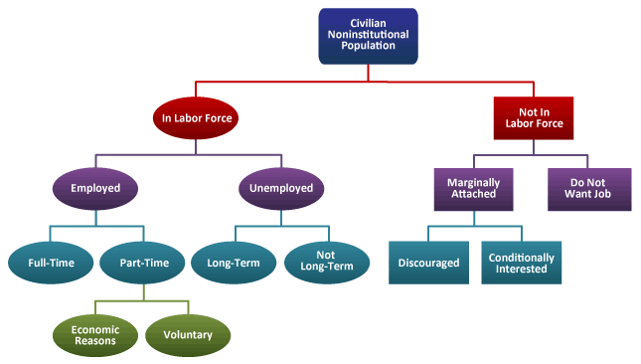
Defining Unemployment

Slide 8
The Unemployment Rate
The unemployment rate is the percentage of the labor force that is unemployed:
The labor force is the total number of workers who are either employed or unemployed:
The labor-force participation rate (LFPR) is the percentage of the adult population that is in the labor force:
Unemployment Rate = $\frac{\text{Number} \text{of} \text{Unemployed} }{\text{Labor} \text{Force}}$ $×100$
Labor Force = Number of Employed + Number of Unemployed
Labor Force Participation Rate= $\frac{\text{Labor} \text{Force} }{\text{Adult} \text{Population}}$ $×100$

Slide 9
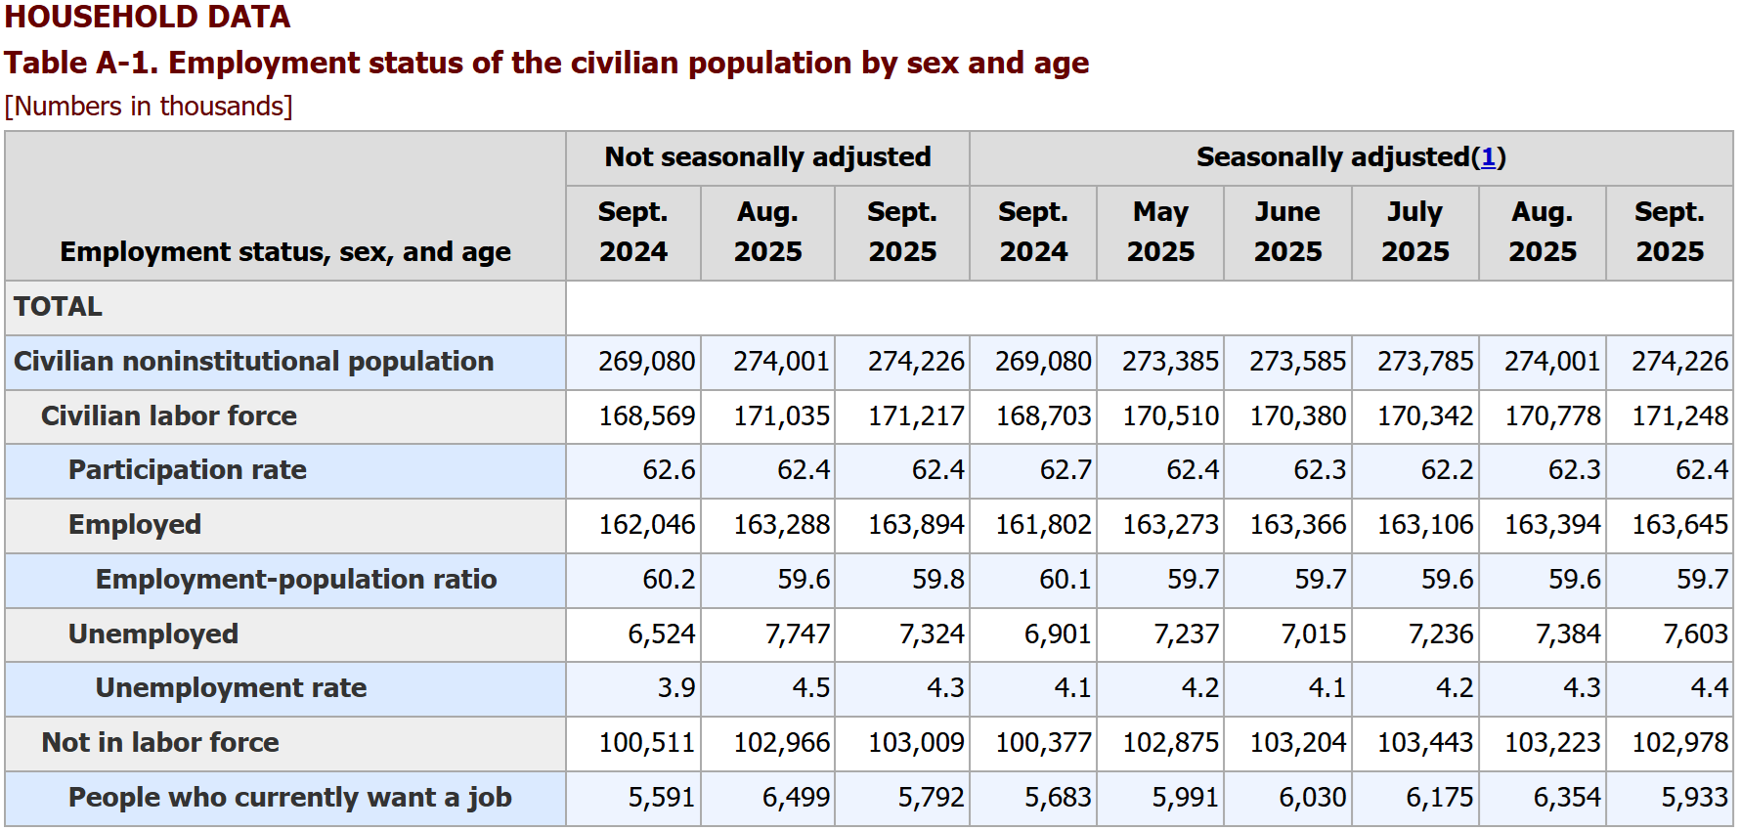
The Labor Market: September 2025

Slide 10
Types of Unemployment
The Natural Rate of Unemployment is the normal rate of unemployment around which the unemployment rate fluctuates, and includes two types of unemployment:
Frictional Unemployment
Structural Unemployment
Cyclical Unemployment is the deviation of unemployment from the natural rate.
The observed unemployment rate fluctuates around the natural rate, and the size of the deviation changes from year to year.
The current estimate of the natural rate of unemployment (4th quarter of 2025) is 4.31%.
The most recent unemployment rate (September 2025) is 4.4%, which is slightly above the natural rate.

Slide 11
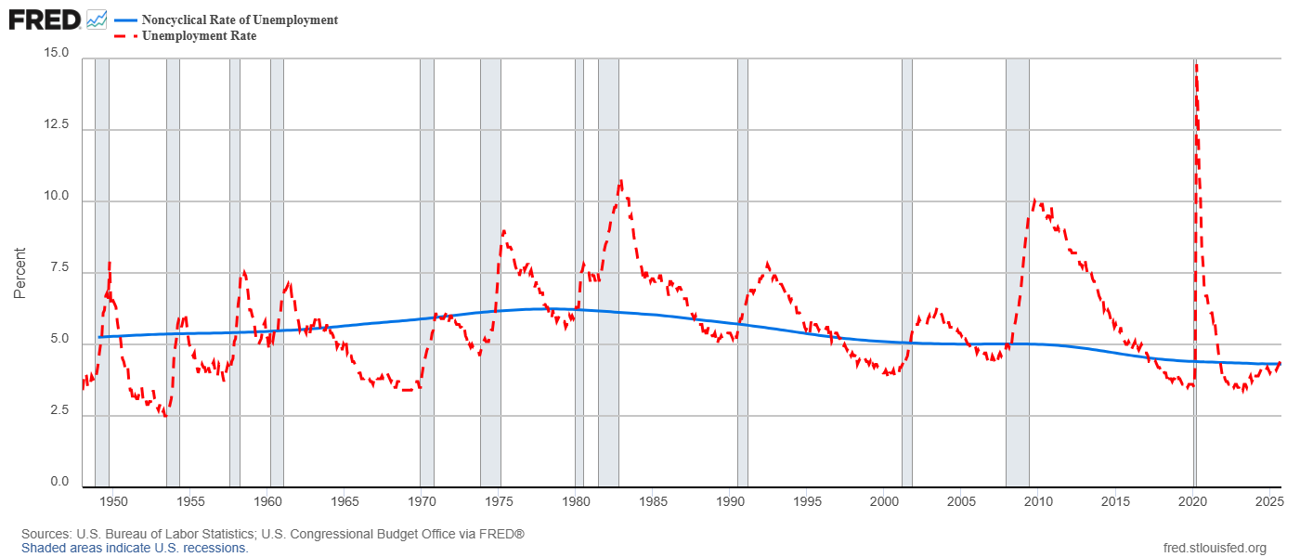
The Natural Rate of Unemployment

Slide 12
Challenges in Measuring Unemployment
Measuring unemployment is not straightforward:
It is easy to distinguish those who are employed from those who are not employed.
It is more difficult to distinguish between those who are unemployed and those who are out of the labor force.
People move in and out of the labor force frequently:
About one third of the unemployed are recent entrants, such as new graduates who often find jobs relatively quickly.
Some people who report being unemployed may not be actively searching and may be claiming unemployment status to qualify for benefits.
Discouraged Worker Effect
Almost half of all unemployment spells end when individuals stop searching for work and leave the labor force.

Slide 13
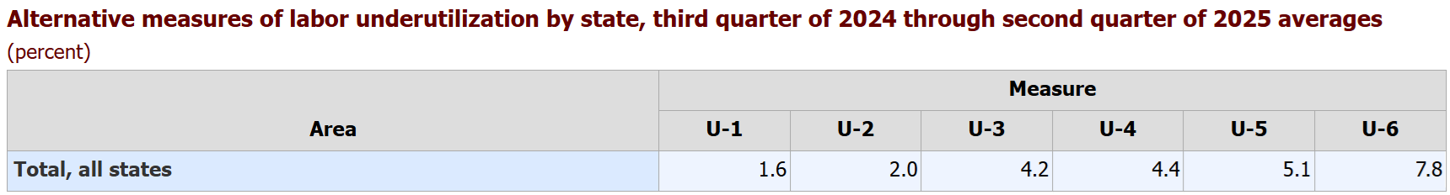
Alternate Measures
Due to these challenges, the BLS reports several measures of labor underutilization:
U-1: Persons unemployed 15 weeks or longer, as a percent of the civilian labor force
U-2: Job losers and persons who completed temporary jobs, as a percent of the civilian labor force
U-3: Total unemployed, as a percent of the civilian labor force (the official unemployment rate)
U-4: Total unemployed plus discouraged workers, as a percent of the civilian labor force plus discouraged workers
U-5: Total unemployed, plus discouraged workers, plus all other marginally attached workers, as a percent of the civilian labor force plus all marginally attached workers
U-6: Total unemployed, plus all marginally attached workers, plus total employed part time for economic reasons, as a percent of the civilian labor force plus all marginally attached workers.

Slide 14
Length of Unemployment
Most spells of unemployment are short, but most unemployment observed at any given time is long-term.
Most people who become unemployed find jobs relatively quickly.
Most of the economy’s unemployment problem is due to the smaller group of workers who remain jobless for long periods.
This is similar to how a few people with very high incomes can pull the average income above the median.
How does this make sense?
Suppose you run a weekly survey of people visiting the local unemployment office over a year.
You meet 52 who are unemployed for a week, and 3 who remain unemployed for the entire year.
94.5% of the people you meet find a job within a week, so most spells of unemployment are short.
Long-term unemployed account for 75 percent of the unemployment observed at any given time, so most unemployment at a point in time is long-term.

Slide 15
Frictional and Structural
Unemployment

Slide 16
Frictional Unemployment
Even in a well-functioning economy, there is a natural level of unemployment made up of frictional and structural unemployment.
Frictional Unemployment is unemployment that results from the time it takes for workers to search for jobs that best match their skills, preferences, and circumstances.
The labor market experiences constant churn:
Workers voluntarily separate from their jobs in search of better opportunities.
Most employment in the U.S. is at-will, which makes job turnover easier for both workers and firms.
On average, each corporate job posting receives around 250 applications, but only 4 to 6 applicants are interviewed, and only 1 is hired (Glassdoor, 2024)
Frictional unemployment is inevitable because the economy, workers, and job opportunities are always changing.

Slide 17
Reducing Frictional Unemployment
Frictional unemployment is unavoidable, but the amount of frictional unemployment can be reduced by improving how information is disseminated.
The internet can speed up the job search process and help match workers to openings more quickly.
Government-run employment agencies can help spread information about available jobs.
College career offices and networking events also help workers and firms find each other more effectively.
Public policies such as unemployment insurance may increase frictional unemployment.
Government programs partially protects the incomes of workers who become unemployed.
Although this reduces the hardship of unemployment, it may increase its duration.
Because the immediate pressure to accept a job is reduced, recipients may take longer to search for a better match.

Slide 18
Structural Unemployment
Structural Unemployment is unemployment that results from fundamental changes in the economy that prevent the labor market from providing a job for everyone who wants one at the prevailing wage.
The economy is constantly evolving, which can create structural unemployment:
Technological progress can make certain occupations obsolete while expanding employment in new industries.
International trade can change which skills are valued in the economy, leading to job losses in some sectors and gains in others.
Wages may be set above the market-clearing level (for example, due to minimum wage laws, unions, or efficiency-wage policies), creating an excess supply of labor.

Slide 19
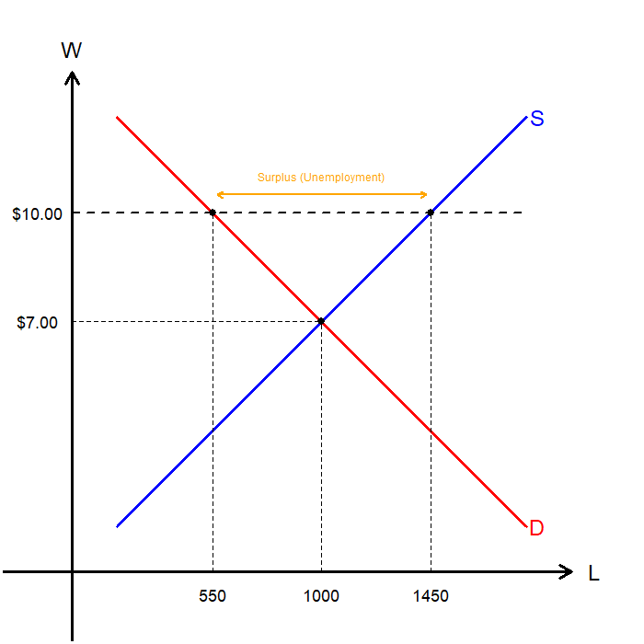
Structural Unemployment: Minimum Wage
When a minimum wage is binding, it forces the wage to be above the market-clearing level.
The higher wage attracts more workers to supply labor.
The higher wage discourages some employers from hiring as many workers.
The excess supply of labor leads to unemployment.
Minimum wage affects a small share of workers, so the amount of unemployment caused by a binding minimum wage is limited.
Nevertheless, the minimum wage provides a clear example of how wage floors set above the equilibrium level create unemployment.

Slide 20

Structural Unemployment: Unions
Unions are worker associations that bargain with employers over wages, benefits, and working conditions.
Collective bargaining gives workers more influence than they would have as individuals.
If negotiations fail, unions may call a strike, which reduces production and increases pressure on firms to agree to higher wages.
Union workers typically earn about 10 to 20% more than similar nonunion workers.
When union wages are set above the equilibrium wage…
Higher wages attract more workers to unionized jobs.
Higher labor costs reduce the quantity of labor demanded by firms.
The difference between labor supplied and labor demanded creates structural unemployment.

Slide 21
Structural Unemployment: Unions
Critics argue that unions can reduce economic efficiency and equity.
By raising wages above the competitive level, unions reduce employment in unionized firms.
Structural unemployment increases because the wage does not adjust to clear the labor market.
Higher union wages in one sector can lower wages in nonunion sectors as displaced workers move elsewhere.
The result can be an allocation of labor that is both inefficient and inequitable.
Advocates argue that unions can improve workers’ welfare and balance employer power.
Unions can counteract employer market power, especially in situations where firms have significant bargaining leverage.
Collective bargaining allows workers to negotiate not just wages but job attributes such as hours, benefits, leave policies, and job security.
By addressing workplace concerns, unions may increase morale, reduce turnover, and improve productivity.

Slide 22

Structural Unemployment: Efficiency Wages
Efficiency-wage theory provides another explanation for unemployment that persists.
Firms may voluntarily pay wages above the equilibrium level.
Higher wages can increase worker efficiency and, in some cases, raise firm profitability.
As with minimum wages and unions, above-equilibrium wages generate an excess supply of labor and lead to structural unemployment.
Unlike minimum wages and unions, efficiency wages arise from the firm’s own incentives.

Slide 23
Structural Unemployment: Unions
Mechanisms through which above-equilibrium wages can raise worker efficiency:
Worker Health: Higher wages allow workers to afford adequate nutrition, which raises productivity.
Worker Turnover: Higher wages reduce quitting, which lowers hiring and training costs.
Worker Quality: Higher wages attract a stronger applicant pool and improve workforce quality.
Worker Effort: Workers exert greater effort when high wages increase the cost of losing the job
Worker Morale: Workers who feel fairly treated and valued are more productive.
Even though above-equilibrium wages raise firm efficiency, they also create structural unemployment.
Firms employ fewer workers at the higher wage.
The supply of labor exceeds the number of jobs available.

Slide 24
Recap of Chapter 29

Slide 25
Recap
Defining Unemployment
Employed: Worked for pay, self-employed, or temporarily absent from a job.
Unemployed: Not employed, available for work, and actively seeking work.
Labor Force: All employed and unemployed individuals.
Not in Labor Force: Not employed and not actively looking for work.
Challenges in Measuring and Interpreting Unemployment Rates
Frequent movement in and out of the labor force makes classification difficult.
Discouraged and marginally attached workers are not counted as unemployed.
Not all unemployment spells end with a job, complicating interpretation.
Alternative BLS measures (U-1 to U-6) capture broader forms of underutilization.
Most spells of unemployment are short, but most unemployment observed at any given time is long-term.

Slide 26
Recap
Types of Unemployment
Frictional: Short-term unemployment from job search and labor-market churn.
Structural: Unemployment caused by wages set above equilibrium or long-term shifts in the economy.
Cyclical: Fluctuations in unemployment associated with the business cycle
Natural Rate of Unemployment
The normal level of unemployment that the economy experiences in the long run.
Consists of frictional and structural unemployment.
Some unemployment is unavoidable, even in a healthy economy, because both workers and firms operate in a constantly changing environment.

