Slide 1
PRINCIPLES OF GLOBAL ECONOMICS
Chapter 25: Measuring the Cost of Living

Slide 2
Preview
We previously explored nominal GDP, real GDP, and the GDP deflator as tools to measure inflation.
However, when you hear inflation discussed in the news, it is usually not based on the GDP deflator.
In this chapter, we examine a more widely used measure of inflation, the Consumer Price Index (CPI).
The Consumer Price Index measures the overall cost of goods and services purchased by a typical consumer.

Slide 3
The Consumer Price Index

Slide 4

The Consumer Price Index
The Bureau of Labor Statistics (BLS) calculates the CPI each month using five steps:
  Fix the Basket
  Find the Prices
  Compute the Basket’s Cost
  Choose a Base Year and Compute the Index
  Compute the Inflation Rate
Suppose an economy produces three types of goods:
  Bagels
  Coffee
  Diamond Rings

Slide 5
Step 1: Fix the Basket
The first step is to determine which goods and services are most important to typical consumers.
The BLS surveys consumers to assess the importance of each good and service.
Suppose that survey data show that in a given month a typical consumer purchases:
  30 Bagels
  20 cups of Coffee
  0 Diamond Rings
The fixed basket will therefore include 30 bagels, 20 cups of coffee, and 0 units of diamond rings.
Diamond rings, although produced in the economy, are excluded from the basket.

Slide 6
Step 2: Find the Prices
The next step is to find the unit price of each good and service.
Good / Service | Quantity in Basket | Unit Price | Price of Item in Basket
Bagels | 30 | $5
Coffee | 20 | $4
Diamond Rings | 0 | $7,000

Slide 7
Step 3: Compute the Basket’s Cost
The next step is to find the total cost of the representative basket.
  In this example, the cost of 30 bagels in the basket is $150.
  The cost of 20 cups of coffee in the basket is $80.
  Diamond rings are not included in the basket, so their contribution is $0.
  The total cost of the basket is therefore $230.
Good / Service | Quantity in Basket | Unit Price | Price of Item in Basket
Bagels | 30 | $5 | $150
Coffee | 20 | $4 | $80
Diamond Rings | 0 | $7,000 | $0

Slide 8
Step 4: Choose a Base Year and Compute the Index
The next step is to choose a base year.
  The cost of the basket at 2023 prices is $217.50
  The cost of the basket at 2024 prices is $228
  The cost of the basket in 2025 prices is $230
Year | Price of Bagels | Price of Coffee | Price of Diamond Rings
2023 | $4.75 | $3.75 | $3,500
2024 | $5 | $3.9 | $4,850
2025 | $5 | $4 | $7,000

Slide 9

Step 4: Choose a Base Year and Compute the Index
The next step is to compute the index.
For example, the CPI for 2025 with a base year of 2023 is approximately 105.75 which means that the price of the basket in 2025 is 105.75% of the price of the basket in 2023.
  Note that this does NOT mean prices increased by 105.75%.
  A CPI of 105.75 means that if the basket cost $100 in 2023, the same basket costs $105.75 in 2025.
The specific choice of base year does not matter for calculating CPI.
  The CPI measures percentage changes in prices, which are the same regardless of the base year.
  Try verifying this with a basket that costs $200 in Year 1 and $220 in Year 2.
CPI = $\frac{\text{Price} \text{of} \text{Basket} \text{in} \text{Current} \text{Year}}{\text{Price} \text{of} \text{Basket} \text{in} \text{Base} \text{Year}}×\text{100}$

Slide 10

Step 5: Compute the Inflation Rate
The next step is to compute the inflation rate.
The inflation rate (based on CPI) between 2023 and 2025 is:
$$\frac{\text{105.75}\text{− }\text{100}}{\text{100}}×\text{100} \text{=} \text{5.75\%}$$
  Which means that prices are 5.75% higher than in 2023.
Inflation Rate from Year A and Year B = $\frac{\text{CPI} \text{in} \text{Year} \text{B}\text{ − }\text{CPI} \text{in} \text{Year} \text{A}}{\text{CPI} \text{in} \text{Year} \text{A}}×\text{100}$

Slide 11
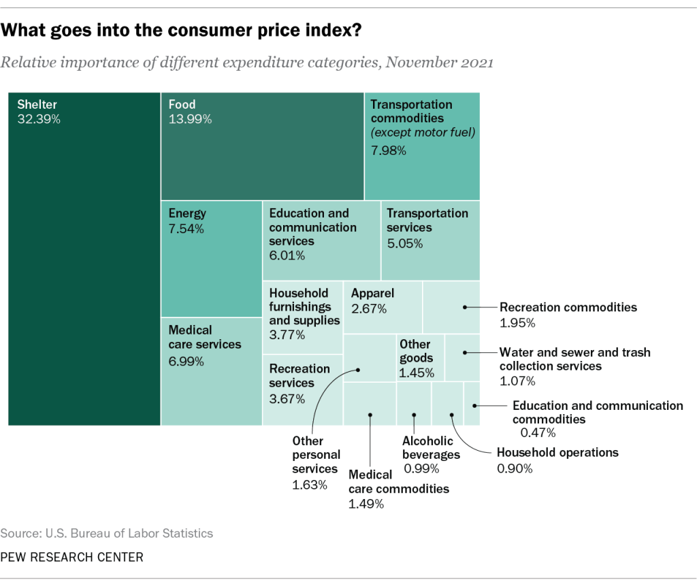
Other Issues: CPI
The example we used earlier was a simplified version of how the BLS calculates the CPI.
The figure shows the typical expenditure weights used in constructing the CPI.
The BLS also calculates:
  Core CPI, which measures the overall cost of consumer goods and services excluding food and energy.
  The Producer Price Index (PPI), which measures the prices received by domestic producers for their output.

Slide 12
Problems in Measuring the Cost of Living
The CPI aims to measure changes in the cost of living, but it is not a perfect measure.
Issue #1: Substitution Bias
  Prices do not change proportionately, which means that some items’ prices increase faster than others.
  Consumers substitute toward goods that become relatively cheaper, mitigating the effect of inflation.
  Because the CPI uses a fixed basket, it ignores this and overstates the increase in the cost of living.
  Therefore, CPI tends to overstate the increases in the cost of living.
Issue #2: Introduction of New Goods
  The introduction of new goods increases variety, allows consumers to find products that more closely meet their needs.
  In effect, each dollar becomes more valuable.
  A fixed basket does not capture the reduction in the cost of living that comes from greater variety.
  Therefore, CPI tends to overstate the increases in the cost of living.

Slide 13
Problems in Measuring the Cost of Living
Issue #3: Unmeasured Quality Change
  Improvements in the quality of goods in the basket increase the value of each dollar.
  The BLS adjusts prices for quality changes when possible, but quality is difficult to measure accurately.
  Therefore, CPI tends to overstate the increases in the cost of living.
These issues create an upward bias in the CPI of about 0.5 to 1.0% per year.
This is important because Social Security payments and many contracts have COLAs (Cost Of Living Allowance) tied to the CPI.
In the 1990s, it was estimated that the CPI’s bias cost taxpayers $1 trillion every 12 years in unnecessary COLAs in Social Security and government pension payments!!!

Slide 14
GDP Deflator Index vs. CPI
Both the CPI and the GDP deflator measure the overall level of prices, but they differ in important ways.
Difference #1: What is included
  The GDP deflator measures the prices of all goods and services produced domestically.
  The CPI measures the prices of all goods and services bought by consumers, including imports.
Difference #2: How goods are weighted
  The CPI uses a fixed basket of goods and services.
  The GDP deflator uses a changing basket, because it reflects current production.
Although the CPI and the GDP deflator sometimes diverge, especially during large changes in oil prices, they usually tell a similar story about inflation.

Slide 15
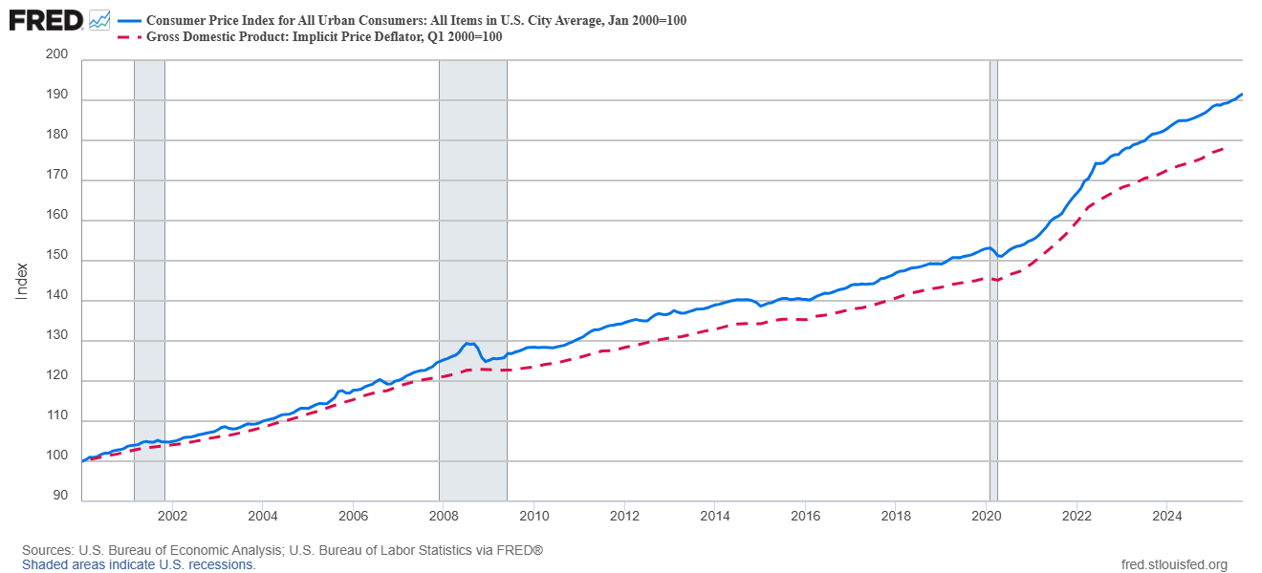
CPI vs. GDP Deflator Index

Slide 16
Adjustments for Inflation

Slide 17
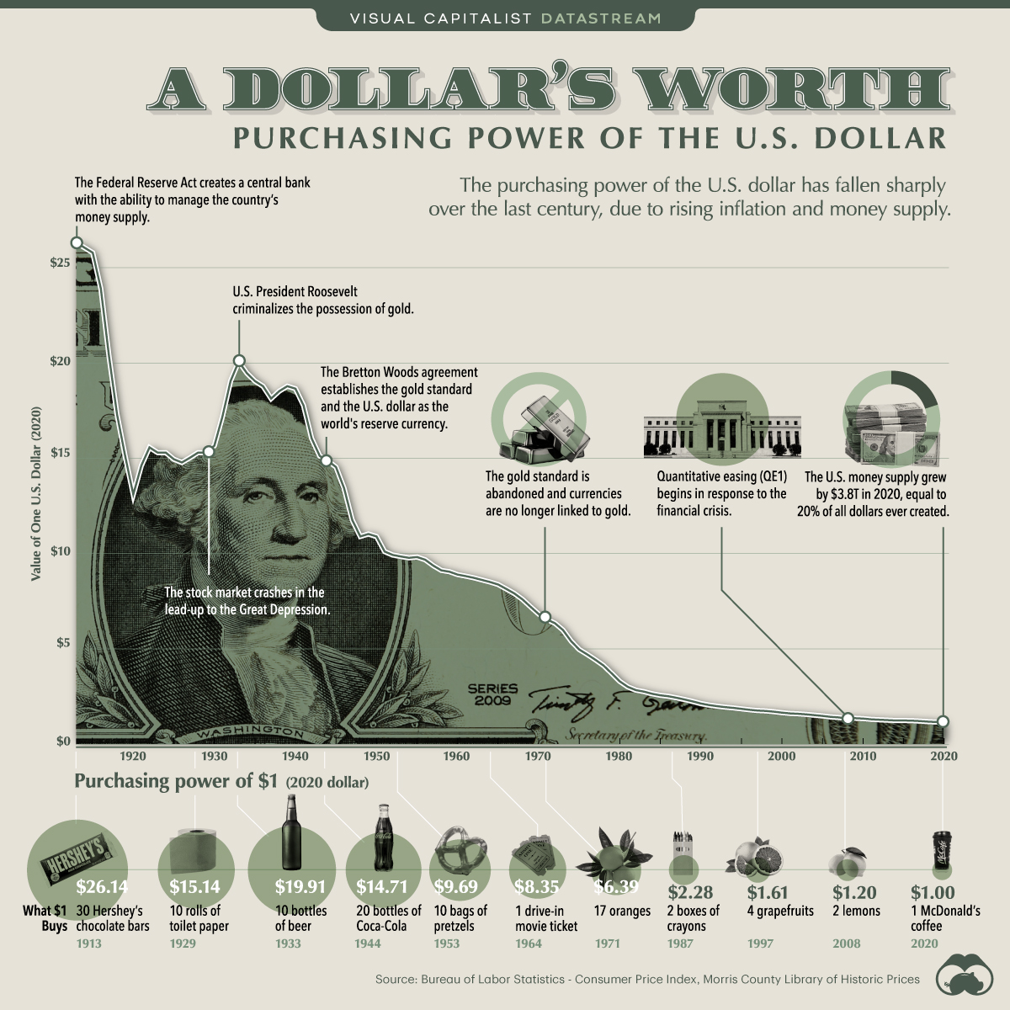
Dollar Figures from Different Times
When comparing dollar amounts from different years, inflation makes direct comparisons misleading.
Consider these two statistics:
  The median household income in 2000 was $42,148.
  The median household income in 2025 is $74,580.
Did the median household income in the U.S. increase between these two periods?
  In nominal terms, yes.
  In real terms, we need additional information about prices in each year.

Slide 18
Dollar Figures from Different Times
To compare dollar figures between periods, we use the following formula:
Using real-world data:
  CPI in January 2000: 169.3
  CPI in September 2025: 324.4
  The equivalent of $42,148 in January 2000 is about $80,760 in September 2025.
  This means the typical U.S. household in 2025 is earning less real purchasing power than the typical household in 2000.
Today’s Dollars = Year X’s Dollars $× \frac{\text{Price} \text{Level} \text{Today}}{\text{Price} \text{Level} \text{in} \text{Year} \text{X}}$
$42,148 $× \frac{\text{324.4}}{\text{169.3}}$ = $80,760.85

Slide 19
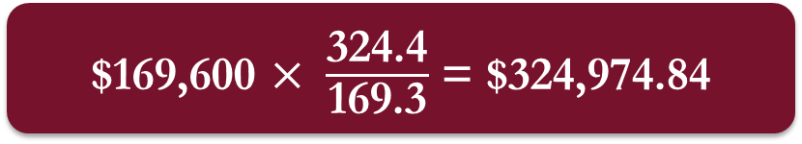
Exercise: The Price of Housing
Some real-world statistics are given below:
  CPI in January 2000: 169.3
  CPI in September 2025: 324.4
  Median U.S. new home value in 2000: $169,600
What is the equivalent of a new home price in 2000 in 2025 dollars?
  If housing prices had increased only at the overall rate of inflation, the median new home price in 2025 would be about $325,000.
  According to the Census Bureau, the actual median new home price in 2025 was $413,500, which is well above what inflation alone would predict.
$169,600 $× \frac{\text{324.4}}{\text{169.3}}$ = $324,974.84

Slide 20
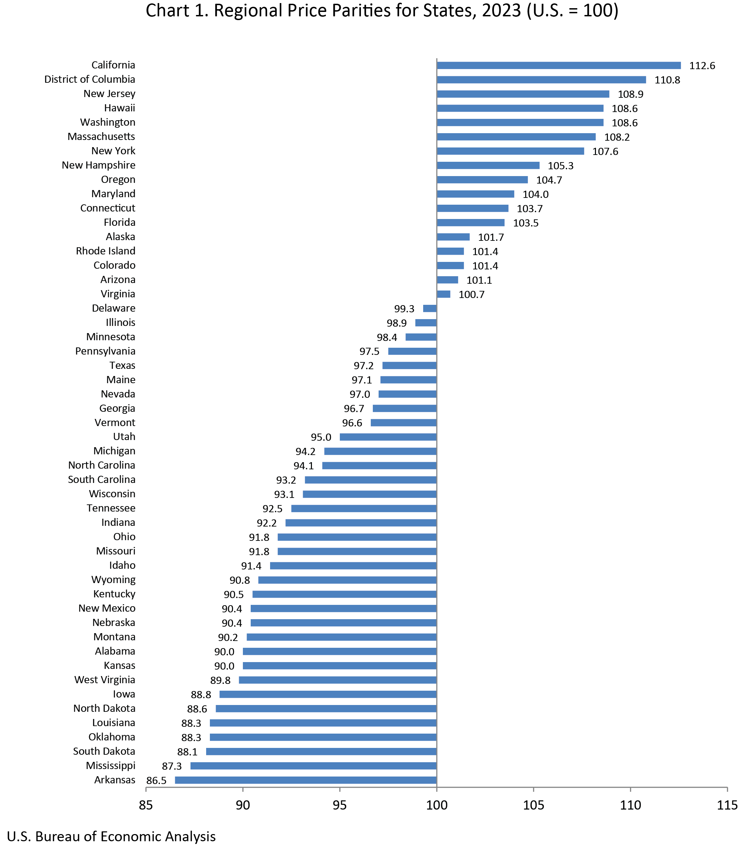
Dollar Figures Across Regions
Another dimension to consider is regional variation in the cost of living.
The BLS produces Regional Price Parity (RPP), which measure differences in the cost of living across states.
  The state with the highest RPP is California (112.6), where the cost of living is 12.6% higher than the U.S. average.
  The state with the lowest RPP is Arkansas (86.5), where the cost of living is 13.5% lower than the national average.
The BLS also reports RPP statistics at the Metropolitan Statistical Area (MSA) level:
  The Fargo MSA has an RPP of 89.41.
  The cost of living is 10.59% lower than the U.S. average.

Slide 21
Nominal vs. Real Interest Rates
Correcting economic variables for inflation is important in general, but especially for interest rates:
  The Nominal Interest Rate ( i ) is the rate as usually reported, without adjusting for inflation.
  The Real Interest Rate (r ) is the nominal rate corrected for inflation.
The relationship between nominal and real interest rates is given by the Fisher Equation:
Suppose a bank offers 6 percent interest on long-term deposits. How would you feel about this deal when…
  Annual inflation is 10%?
  Annual inflation is 2%?
Real Interest Rate = Nominal Interest Rate – Inflation Rate

Slide 22
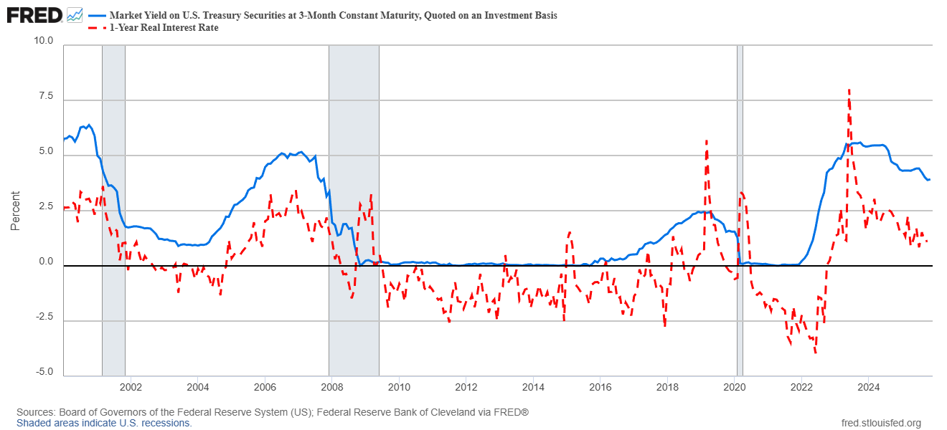
Nominal vs. Real Interest Rates

Slide 23
Recap of Chapter 25

Slide 24
Recap
The Consumer Price Index (CPI) measures the overall cost of goods and services purchased by a typical consumer.
The BLS calculates the CPI in five steps: fix the basket, find the prices, compute the basket’s cost, choose a base year and compute the index, and compute the inflation rate.
A CPI of 100 refers to the base-year price level, and changes in CPI measure percentage changes in prices.
The CPI has several measurement issues that create an upward bias in the CPI of about 0.5 to 1.0% per year.

Slide 25
Recap
The CPI and the GDP deflator both measure overall price levels but differ in some ways:
  The CPI includes consumer goods and services, including imports.
  The GDP deflator includes domestically produced goods and services and excludes imports.
  The CPI uses a fixed basket, while the GDP deflator uses a changing basket.
To compare dollar values across time, nominal amounts must be converted using price indices into real terms that adjust for changes in the overall price level across time.
Regional Price Parity (RPP) indices measure differences in cost of living across states and metropolitan areas.
Nominal and real interest rates are related through the Fisher Equation.

