Slide 1
PRINCIPLES OF GLOBAL ECONOMICS
Chapter 17 & 18: Imperfect Competition

Slide 2
Preview
Up to this point, we analyzed the behavior of firms in two extreme market structures:
  Firms in perfect competition, which have no market power.
  A monopoly, which faces no competition and has maximum market power.
In reality, most markets exhibit imperfect competition, where firms hold some degree of market power while still facing competitive pressure.
Two market structures that lie between perfect competition and monopoly are:
  Monopolistic Competition
  Oligopoly
These structures fall between the extremes of perfect competition and monopoly and better reflect the characteristics of many real-world markets.

Slide 3
Monopolistic Competition

Slide 4
Characteristics of Monopolistic Competition
Monopolistic Competition: A market structure in which many firms sell products that are similar, but not identical.
Many Firms:
  Many firms compete for the same group of customers.
Product Differentiation:
  Each firm offers a product that is slightly different from those of its competitors.
  This gives each firm some market power and a downward-sloping demand curve.
(Add-on for the Long-Run) Free Entry and Exit:
  Firms can enter or exit the market without significant barriers.
  The number of firms adjusts until economic profits are driven to zero.

Slide 5
Characteristics of Monopolistic Competition
A comparison between the three types of market structures we have been covering is given in the table below:
 | Perfect Competition | Monopolistic Competition | Monopoly
Number of Firms | Many | Many | One
Free Entry/Exit | Yes | Yes | No
Long-run Profit | Zero | Zero | Positive
Products | Identical | Similar | No Substitute
Market Power | No (P=MC) | Yes (P>MC) | Yes (P>MC)
Demand Curve | Horizontal | Downward-sloping | Downward-sloping

Slide 6
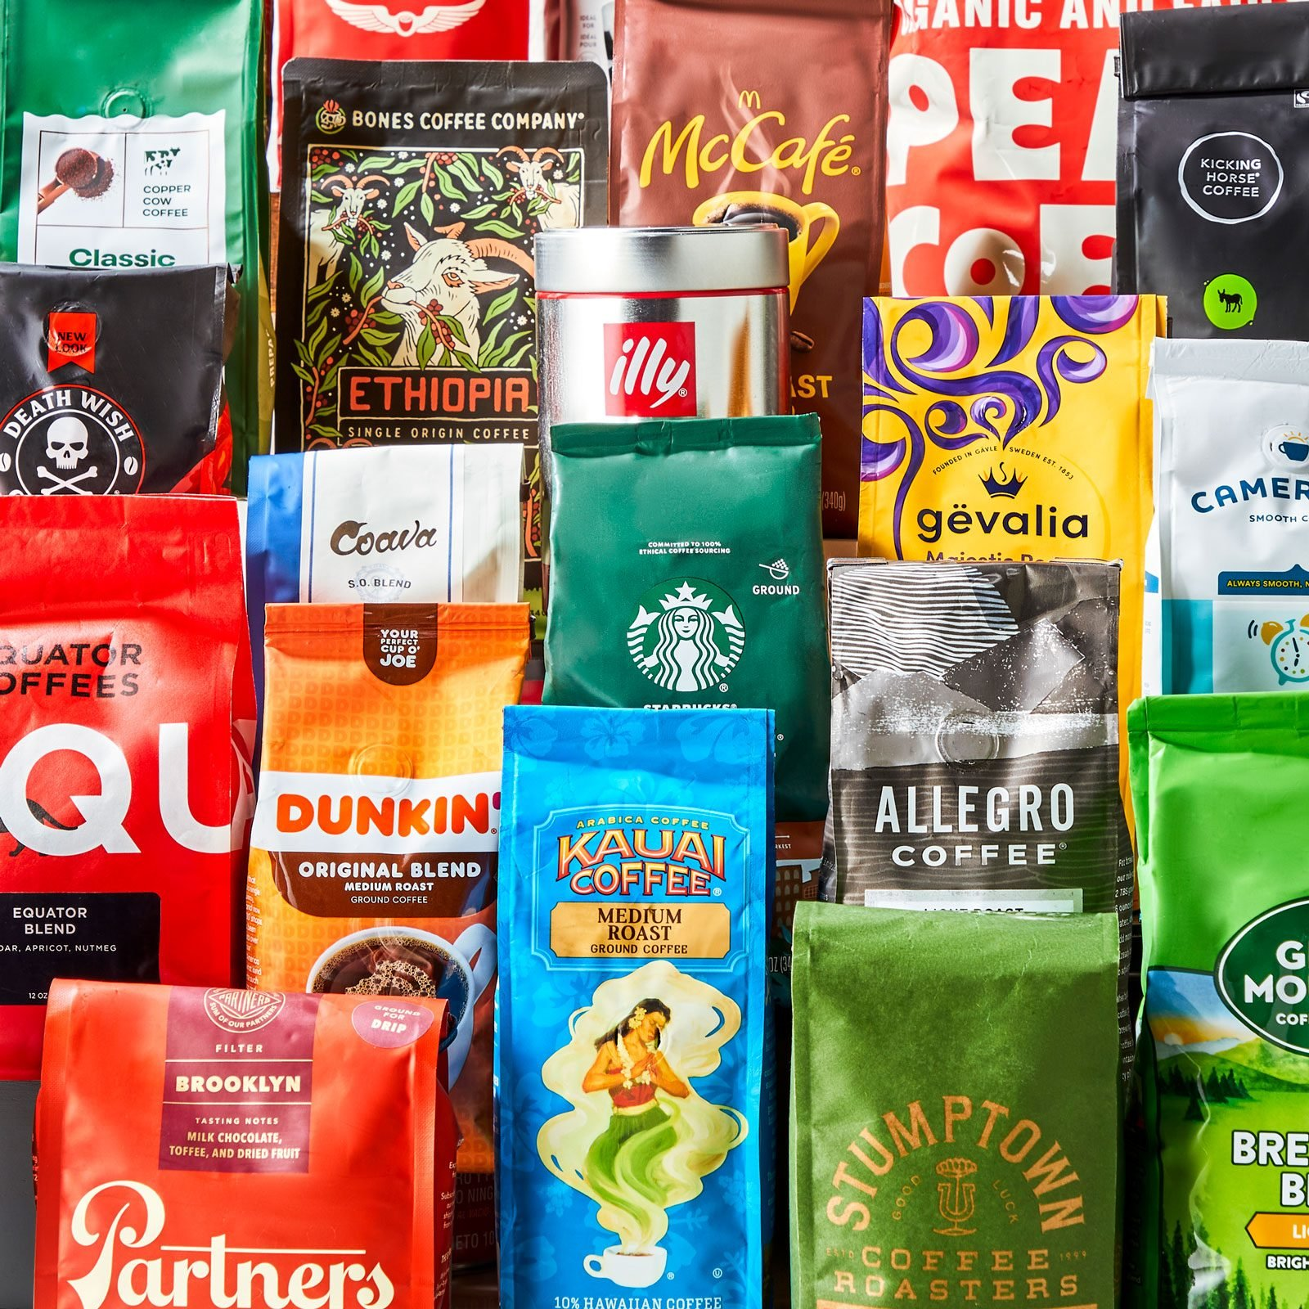
Monopolistic Competition: Coffee
The packaged coffee bean industry is an example of monopolistic competition.
Many Firms:
  Hundreds of brands in the U.S. alone.
Product Differentiation:
  The actual differences are often subtle, but customers perceive them as distinct products.
Other examples:
  Fast Food: McDonald’s, Burger King, Wendy’s, etc.
  Everyday Clothing: H&M, Zara, Uniqlo, etc.

Slide 7

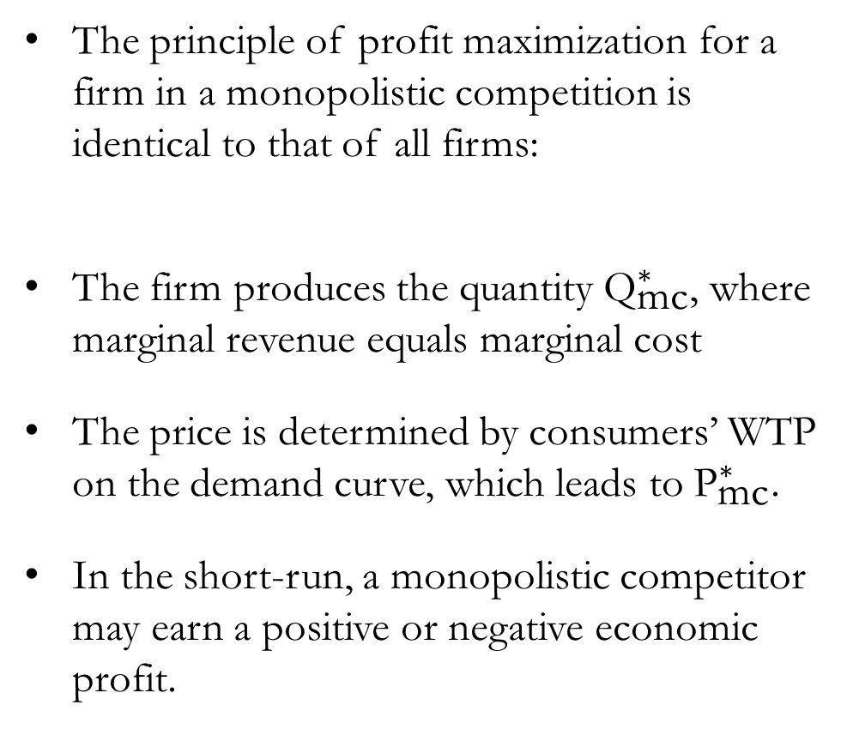

Profit Maximization in Monopolistic Competition (SR)
Cost and
Revenue
The principle of profit maximization for a firm in a monopolistic competition is identical to that of all firms:
The firm produces the quantity ${\text{Q}}_{\text{m}\text{c}}^{∗}$, where marginal revenue equals marginal cost
The price is determined by consumers’ WTP on the demand curve, which leads to ${\text{P}}_{\text{m}\text{c}}^{∗}$.
In the short-run, a monopolistic competitor may earn a positive or negative economic profit.
MC
Profit is maximized when MR=MC
ATC
$${\text{P}}_{\text{m}\text{c}}^{∗}$$
MR
D
$${\text{Q}}_{\text{mc}}^{∗}$$
Output

Slide 8


Profit Maximization in Monopolistic Competition (SR)
Cost and
Revenue
Cost and
Revenue
MC
MC
ATC
ATC
$${\text{P}}_{\text{m}\text{c}}^{∗}$$
Positive
Profit
Negative
Profit
$${\text{P}}_{\text{m}\text{c}}^{∗}$$
MR
D
MR
D
$${\text{Q}}_{\text{mc}}^{∗}$$
Output
$${\text{Q}}_{\text{mc}}^{∗}$$
Output

Slide 9
Profit Maximization in Monopolistic Competition (LR)
If firms are earning positive profits in the short run:
  Positive economic profits signal new firms to enter the market.
  New entrants introduce differentiated products, increasing the total number of products available.
  As a result, the demand faced by each existing firm decreases.
  Each firm’s demand curve shifts to the left.
  Economic profits fall until they are driven to zero.
If firms are incurring losses in the short run:
  Some firms exit the market.
  The number of products in the market decreases.
  The demand faced by each remaining firm increases.
  Each firm’s demand curve shifts to the right.
  Economic losses shrink until profits return to zero.

Slide 10

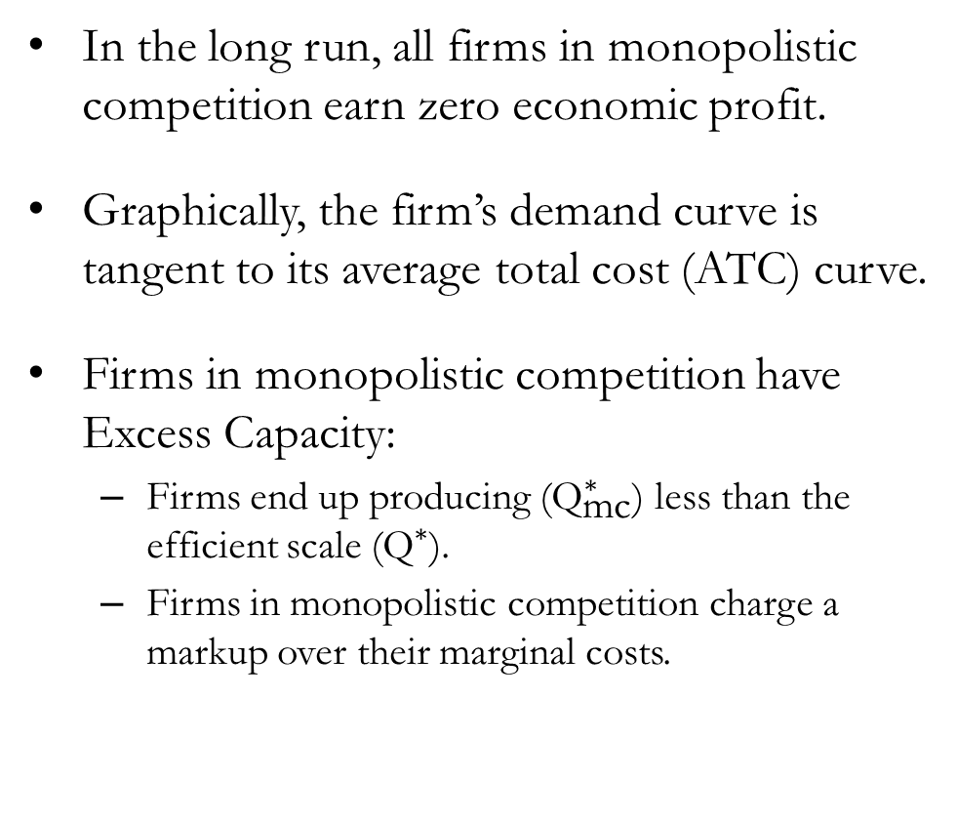


Profit Maximization in Monopolistic Competition (LR)
Cost and
Revenue
In the long run, all firms in monopolistic competition earn zero economic profit.
Graphically, the firm’s demand curve is tangent to its average total cost (ATC) curve.
Firms in monopolistic competition have Excess Capacity:
  Firms end up producing (${\text{Q}}_{\text{mc}}^{∗}$) less than the efficient scale (${\text{Q}}^{∗}$).
  Firms in monopolistic competition charge a markup over their marginal costs.
MC
ATC
$${\text{P}}_{\text{m}\text{c}}^{∗}$$
Markup
MR
D
$${\text{Q}}_{\text{mc}}^{∗}$$
$${\text{Q}}^{∗}$$
Output

Slide 11
Monopolistic Competition and Social Welfare
The outcome of monopolistic competition is not socially optimal.
The main reason is markup pricing, which leads to some consumers valuing the good above the marginal cost of production but below the market price being unable to purchase the good.
Regulation is relatively difficult compared to the case of a single monopoly producer:
  Enforcing the rule MR=MC would guarantee that the socially desirable quantity is produced.
  Many firms produce differentiated products, and estimating marginal costs for each producer is burdensome.
  Estimating the individual demand curve and marginal revenue curve for each firm is even more challenging.
  Firms in monopolistic competition earn zero profits in the long run, so forcing them to lower prices to marginal cost would lead to economic losses.

Slide 12
Monopolistic Competition and Social Welfare
Another source of inefficiency is the number of firms competing in a market with monopolistic competition, since there can be either too many or too few firms.
Consider a situation where a new firm enters the monopolistically competitive market.
Two externalities arise due to this new entrant:
  Product-variety externality: Consumers benefit from the introduction of a new product, so the entrant creates a positive externality for consumers.
  Business-stealing externality: Incumbent firms lose customers and profit when new competitors enter the market, so the entrant imposes a negative externality on existing firms.
The relative size of these opposing externalities is very difficult to measure.

Slide 13








Shifts in Demand
Cost and
Revenue
Initially, the firm is earning zero economic profit, as shown in the graph.
Suppose that the demand for the firm’s good increases due to effective marketing.
The demand curve shifts to the right (and the MR curve shifts as well).
The firm increases its output and raises its price according to consumers’ WTP (D).
With the increase in demand, the firm now earns positive economic profit.
MC
ATC
$${\text{P}}_{\text{m}\text{c}}^{1}$$
Positive
Profit
$${\text{P}}_{\text{m}\text{c}}^{0}$$
$${\text{MR}}_{0}$$
$${\text{MR}}_{1}$$
$${\text{D}}_{0}$$
$${\text{D}}_{1}$$
$${\text{Q}}_{\text{mc}}^{0}$$
$${\text{Q}}_{\text{mc}}^{1}$$
Output

Slide 14
Advertising
Firms engaged in monopolistic competition are most likely to invest in marketing campaigns (compared to firms in perfectly competitive markets or monopoly producers).
Common critiques of advertising argue that:
  Advertisements exist primarily to manipulate consumers’ tastes rather than to inform them.
  Advertisements creates a desire that otherwise may not have existed.
  Advertisements can impede competition by convincing consumers that products are more differentiated than they truly are, which allows firms to charge a higher markup.
Defenders of advertising argue that:
  Advertisements provide real information about products, helping consumers learn about new options.
  Advertising can foster competition by making consumers more aware of alternative choices.
  Advertisements can be a credible signal of quality, because a firm that is willing to spend large amounts of money on marketing is more likely to have a high-quality product.

Slide 15
Oligopoly

Slide 16

Characteristics of Oligopoly
Oligopoly: A market structure in which only a few sellers offer (nearly) identical products.
In an oligopolistic market, firms act strategically:
  Because there are only a few major sellers, each firm’s actions can significantly affect the profits of others, prompting them to react.
  Firms consider these potential reactions when making their own decisions.
This concept of interdependence leads us to Game Theory, the study of how people behave in strategic situations.

Slide 17

Oligopolies: Commercial Aircraft Manufacturing
The commercial airline manufacturing industry is a textbook case of an oligopolistic market.
  Airbus and Boeing together account for roughly 90% of all large commercial aircraft orders worldwide.
  The remaining share is divided among much smaller producers such as Embraer and COMAC.
This industry demonstrates the interdependence described on the previous slide.
  Each firm closely monitors the other’s pricing, new model development, and production schedules.
  Decisions about capacity, technology, and entry into new aircraft segments are made with the expected reaction of the rival in mind.

Slide 18
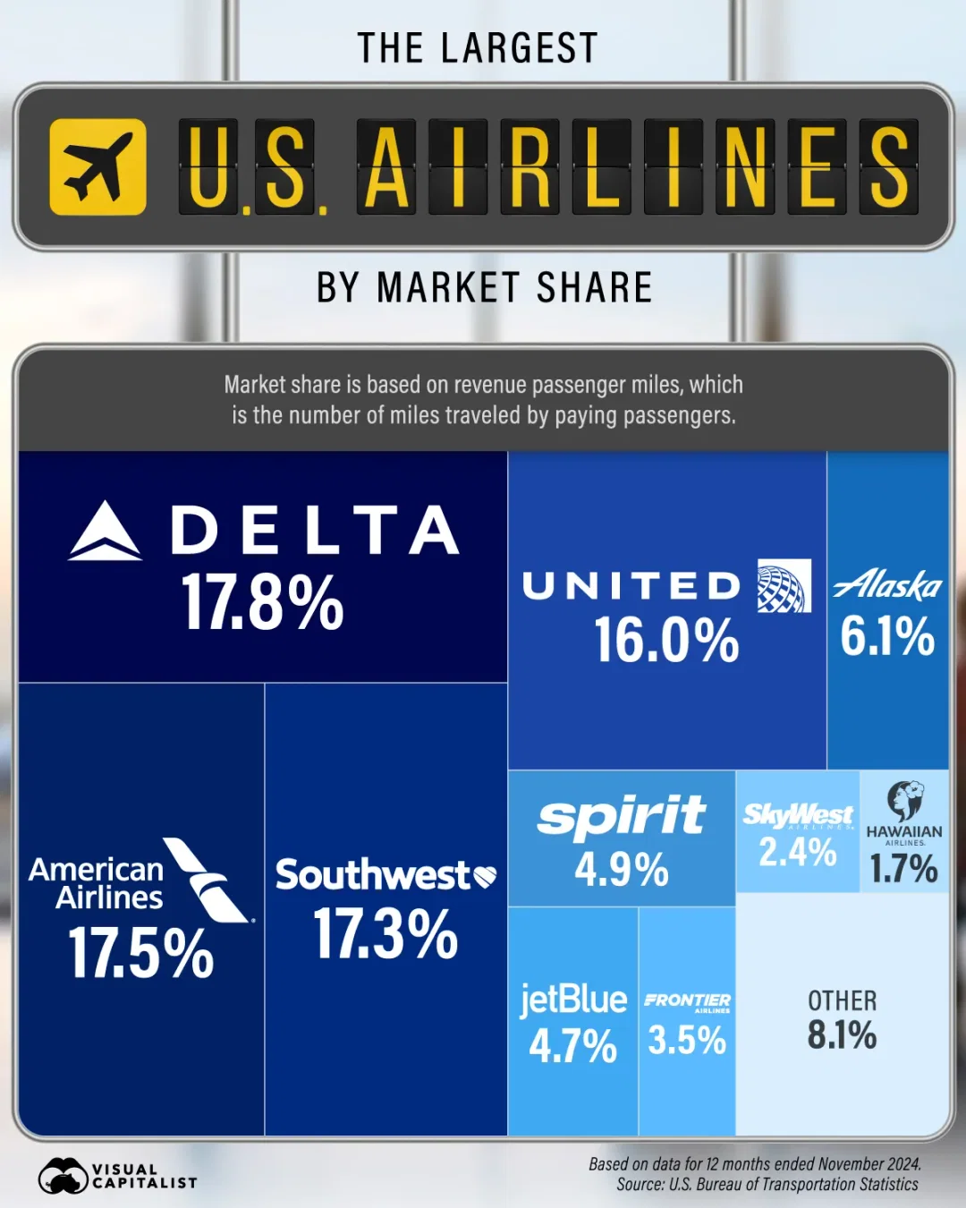
Oligopolies: Commercial Airline Industry
The U.S. commercial airline industry is another textbook case of an oligopolistic market.
  The top 4 airlines control roughly 70% of total market share.
  Delta, American, United, and Southwest are the dominant firms in the industry.
This concentration means that each major airline carefully considers how competitors might respond to changes in pricing, schedules, and service quality.
  Firms often match price changes from rivals.
  They compete on routes, loyalty programs, and capacity decisions while anticipating the reactions of the other large carriers.

Slide 19


Profit Maximization in Oligopolies
Consider the simplest form of an oligopoly, known as a duopoly, where only two sellers compete in the market.
Suppose there are two competing firms in the replicant industry: Tyrell Corporation and Wallace Corporation.
Each firm produces artificial human “replicants” that are similar in quality and ability.
If both firms cooperate, what is the best course of action?
  They should coordinate their output so that the total output is equal to the monopoly level.
  By doing so, they would effectively operate as a single monopolist and share the resulting profit.

Slide 20
Profit Maximization in Oligopolies
Q | P | TR
0 | $120 | $0
1 | $110 | $110
2 | $100 | $200
3 | $90 | $270
4 | $80 | $320
5 | $70 | $350
6 | $60 | $360
7 | $50 | $350
8 | $40 | $320
9 | $30 | $270
10 | $20 | $200
11 | $10 | $110
12 | $0 | $0
Suppose for simplicity that both firms have a marginal cost of production equal to zero.
If this market was perfectly competitive:
  Market price would equal marginal cost at $0.
  The efficient quantity of replicants would be 12 units.
If this market had a single monopoly producer:
  At 6 replicants, profit is maximized as $360.
  The resulting market price would be set at $60.
If the two firms collude to form a cartel:
  They jointly produce 6 units, matching the monopoly quantity.
  Each firm receives half of the profit earning a profit of $180.

Slide 21

NBC News (2015, July 1). DOJ Probing Airlines Over Alleged Collusion on Ticket Prices | NBC
Nightly News [Video]. YouTube. https://youtu.be/y0eQ6TPsPY8?si=QXPG-xRNJPV6b6jy

Slide 22
Profit Maximization in Oligopolies
Q | P | TR
0 | $120 | $0
1 | $110 | $110
2 | $100 | $200
3 | $90 | $270
4 | $80 | $320
5 | $70 | $350
6 | $60 | $360
7 | $50 | $350
8 | $40 | $320
9 | $30 | $270
10 | $20 | $200
11 | $10 | $110
12 | $0 | $0
Suppose the two firms agreed to work jointly and produce 3 units of replicants each, earning $180 in profits.
If you were the CEO of either of the two firms:
  If we increase output by one unit, the total market quantity rises to 7 and the price falls to $50.
  We would sell 4 units at $50 each, earning $200 in profits.
  We can increase our profit by breaking the agreement.
  Our competitor faces the same incentives.
  If we keep output at 3 units while the competitor cheats, they sell 4 units, and we sell only 3.
  We would sell 3 units at $50 each, earning $150 in profits.
  So, it is rational to break the agreement and produce 4 units.

Slide 23
Profit Maximization in Oligopolies
Q | P | TR
0 | $120 | $0
1 | $110 | $110
2 | $100 | $200
3 | $90 | $270
4 | $80 | $320
5 | $70 | $350
6 | $60 | $360
7 | $50 | $350
8 | $40 | $320
9 | $30 | $270
10 | $20 | $200
11 | $10 | $110
12 | $0 | $0
Both firms would be better off if they stick to the collusion agreement and operate like a cartel. But each firm has an incentive to cheat on the agreement:
  If both firms produce 4 units of replicants, total output is 8.
  The market price falls to $40, and each firm earns $160 in profit.
If you were the CEO of either firm:
  If we increase output by one unit, the total market quantity rises to 9 and the price falls to $30.
  We would sell 5 units at $30 each, lowering our profits to $150.
  If we decrease output by one unit, the total market quantity falls to 7 and price rises to $50.
  We would sell 3 units at $50 each, lowering our profits to $150.

Slide 24
The Equilibrium for an Oligopoly
Nash Equilibrium: A situation in which economic actors interacting with one another each choose their best strategy given the strategies that all the other actors have chosen.
  For the duopoly between Tyrell Corporation and Wallace Corporation, each firm producing an output of 4 replicants and selling them for $40 each, earning $160, is a Nash Equilibrium.
  Neither firm has an incentive to change its strategy (its chosen quantity of output) at this equilibrium.
When firms in an oligopoly individually choose production to maximize profit:
  They produce a quantity greater than the quantity produced by a monopoly.
  They produce a quantity less than the quantity produced under perfect competition.
  The resulting oligopoly price is lower than the monopoly price but higher than the competitive price.
Oligopoly outcomes lie between monopoly and perfect competition, since each firm has market power, but not enough to behave like a monopolist.

Slide 25
Size of an Oligopoly
There are two opposing effects that firms in an oligopoly face:
  Output Effect: Selling more output at the current market price increases profit.
  Price Effect: Increasing production raises total quantity in the market and lowers the market price.
When the output effect dominates, firms increase production. When the price effect dominates, firms decrease production.
The greater the number of firms competing in an oligopoly:
  Each firm accounts for a smaller share of the market and is less concerned about its own effect on the market price.
  The output effect becomes stronger relative to the price effect.
  Therefore, firms tend to increase production, taking advantage of the output effect.
As the number of firms increases, the oligopoly outcome moves closer to the competitive outcome.

Slide 26
Policies Towards Oligopolies
Antitrust Laws:
  The Sherman Act (1890): “Every person who shall monopolize, or attempt to monopolize, or combine or conspire with any person or persons to monopolize any part of the trade or commerce among the several States, or with foreign nations, shall be deemed guilty of a misdemeanor, and on conviction thereof, shall be punished by…”
  Clayton Act (1914): Plaintiffs who could prove that they were damaged by an illegal arrangement to restrain trade could sue and recover three times the damages sustained.
While most economists agree that regulations against collusion between firms in an oligopoly are desirable, the current laws also prohibit certain business practices whose effects are less clear.
  Resale Price Maintenance
  Predatory Pricing
  Bundling

Slide 27
Resale Price Maintenance (RPM)
A practice in which a manufacturer sets the price at which retailers must sell its product.
  At first glance, RPM may appear anticompetitive because it prevents retailers from competing on price.
  Courts have sometimes viewed RPM as an antitrust violation for this reason.
Some economists defend RPM, arguing that it is not intended to reduce competition:
  If a manufacturer wanted to exert market power, it could raise the wholesale price instead of dictating the retail price.
  Manufacturers have no incentive to suppress competition among retailers, since a cartel of retailers would reduce total sales and harm the manufacturer.
RPM can also serve a legitimate purpose:
  Manufacturers may want retailers to provide services such as product demonstrations, knowledgeable staff, and pleasant showrooms.
  Without RPM, discount retailers could free ride by offering lower prices while relying on the service provided by full-service stores.

Slide 28
Predatory Pricing
A situation in which a firm cuts prices to a level intended to drive a rival out of the market.
  The concern is that once the rival exits, the firm can regain market power and raise prices again.
  This behavior is often alleged in antitrust cases.
Some economists argue that predatory pricing is rarely profitable:
  To drive out a rival, the firm must set prices below cost, which generates losses.
  The dominant firm often bears most of these losses because it serves most of the market.
  The smaller rival can reduce output and limit its losses, making it more likely to survive the price war.
Ongoing debates in antitrust policy:
  When, if ever, is predatory pricing a rational and profitable strategy?
  Can policymakers or courts reliably distinguish aggressive competition from predatory intent?

Slide 29
Bundling
A practice in which two or more products are sold together as a package for a single price.
  A firm with a highly demanded product could force buyers to accept a less desirable product as part of the package, which could expand its market power.
The Economic Rebuttal:
  If buyers place zero value on the weak product, bundling does not raise their willingness to pay.
  A firm cannot increase market power simply by attaching a worthless product to a valuable one.
However, bundling can be used as a form of price discrimination:
  Selling products separately may lead buyers to purchase only the item they value most.
  By offering a bundle, the firm can set a single combined price that captures more of each buyer’s total willingness to pay.
The overall welfare effects remain uncertain, and bundling continues to be controversial.

Slide 30

CNBC (2019, September 6). What Google, Facebook And Apple Can Learn From Microsoft’s
1998 Antitrust Fight [Video]. YouTube. https://youtu.be/e33Go6gbL7s?si=fLKefXklh-Y7Htla

Slide 31
Game Theory

Slide 32
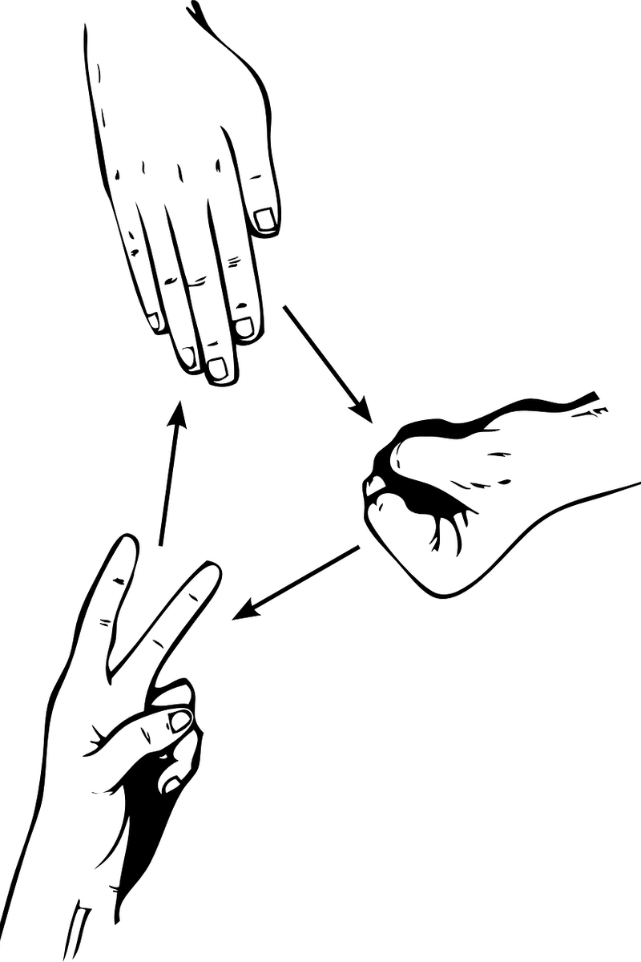
Game Theory
Game Theory examines strategic behavior:
  Players make decisions while considering the decisions of others.
  A player’s best choice often depends on what other players are expected to choose.
A game consists of four basic elements:
  Players: The decision-makers in the game.
  Strategies: The possible actions each player can take.
  Payoffs: The rewards each player receives for each combination of strategies.
  Information: What each player knows when making a decision.
Rock–paper–scissors would be an example of a simple strategic game where actions are revealed simultaneously.

Slide 33
Prisoner’s Dilemma
Suppose two criminals, Harry and Marv, have been captured by the local police.
The State has enough evidence to convict them of the minor crime of carrying an unregistered firearm, so each would spend 1 year in prison.
The DA’s office suspects that these two criminals are responsible for a high-profile kidnapping case, but they lack the evidence needed to convict them of the serious crime.
The police question Harry and Marv in separate rooms and offer each of them the following deal:
  “Right now, you are facing 1 year in prison. But if you confess to the kidnapping charges and implicate your partner, we will give you immunity and you can go free. Your partner will receive 20 years in prison. If you both confess, you will each receive 10 years in prison.”
Obviously, the best option for Harry and Marv would be to both remain silent…?

Slide 34
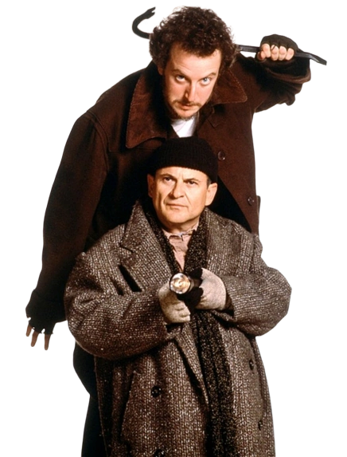
Prisoner’s Dilemma
Players:
  Harry
  Marv
Payoffs:
Information:
  Harry and Marv make their decisions simultaneously.
  Harry and Marv both know the rules and payoffs of the game.
Strategies:
  Cooperate (C): Remaining silent.
  Defect (D): Confess and implicate partner.
Harry’s Choice | Marv’s Choice | Harry’s Payoff | Marv’s Payoff
C | C | 1 year | 1 year
C | D | 20 years | 0 years
D | C | 0 years | 20 years
D | D | 10 years | 10 years

Slide 35
Prisoner’s Dilemma
Let us walk through Harry’s decision. Harry knows that Marv has been given the same deal as him, but he is unsure whether Marv will choose to Cooperate (C) or Defect (D).
If Marv chooses to Cooperate (C):
  If Harry chooses to cooperate (C), he receives a payoff of 1 year in prison.
  If Harry chooses to defect (D), he receives a payoff of zero years in prison (immunity).
If Marv chooses to Defect (D):
  If Harry chooses to cooperate (C), he receives a payoff of 20 years in prison.
  If Harry chooses to defect (D), he receives a payoff of 10 years in prison.
Notice that for Harry, choosing to defect (D) is a Dominant Strategy, the best strategy for a player regardless of the opponent’s choice..

Slide 36
Prisoner’s Dilemma
This game is symmetrical, which means that:
  Harry and Marv have the same available strategies.
  The payoffs are structured the same for both players.
  The game looks the same from either player’s perspective.
  So, Marv’s dominant strategy is to defect (D) as well.
In the end we find the Nash Equilibrium where…
  Both Harry and Marv choose the best strategy given the strategy they expect the other to follow: defect (D). As a result, each goes to prison for 10 years.
  If both Harry and Marv had cooperated (C), they each would have gone to prison for 1 year, which is a better outcome for the pair.
This illustrates the Prisoners’ Dilemma, a paradox in which defecting is rational for each individual, even though cooperation would lead to a higher payoff for both.

Slide 37
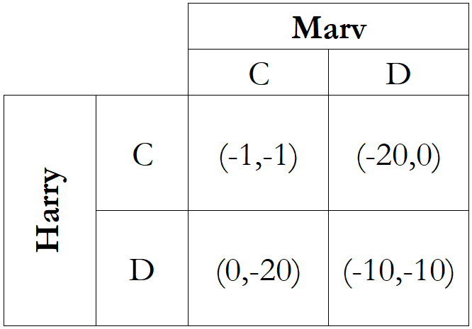
The Normal Form
We can summarize the game in the form of a table, which we call the Normal Form representation of the game.
In the table, we can find…
  The players: Harry and Marv
  The strategies: Cooperate (C), Defect (D)
  The payoffs: Shown as ordered pairs (Harry’s payoff, Marv’s payoff).
Now let’s see how we can find the Nash Equilibrium of this game using the normal form representation.

Slide 38
The Normal Form: Harry’s Point of View
If we assume Marv will cooperate (C):
  Choosing C pays off -1.
  Choosing D pays off 0.
  Choosing D is the best response.
If we assume Marv will defect (D):
  Choosing C pays off -20.
  Choosing D pays off -10.
  Choosing D is the best response.
Now, let’s analyze this game from Marv’s point of view.

Slide 39
The Normal Form: Marv’s Point of View
If we assume Harry will cooperate (C):
  Choosing C pays off -1.
  Choosing D pays off 0.
  Choosing D is the best response.
If we assume Harry will defect (D):
  Choosing C pays off -20.
  Choosing D pays off -10.
  Choosing D is the best response.
We can see that the Nash Equilibrium is found at (D,D) where both players choose to defect.

Slide 40

Exercise: Prisoner’s Dilemma Revisited
Two competing merchants: Antonio and Shylock.
Two levels of prices: High (H) or Low (L).
The payoff structure is as follows:
  If both Antonio and Shylock choose H, they each earn $500 in profits.
  If both Antonio and Shylock choose L, they each earn $200 in profits.
  If one chooses H while the other chooses L, the merchant who chooses H earns $50 in profits, while the merchant who chooses L earns $800 in profits.
Task: Represent this game in its normal form and find the Nash equilibrium.

Slide 41
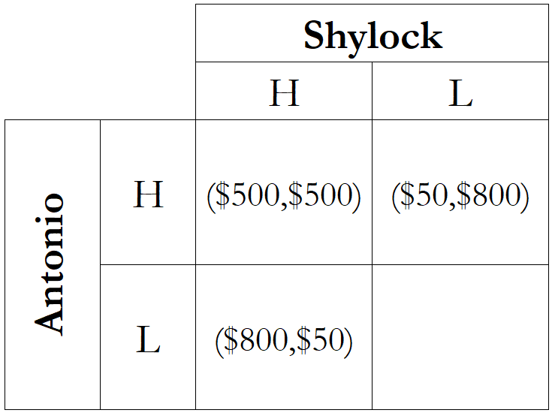
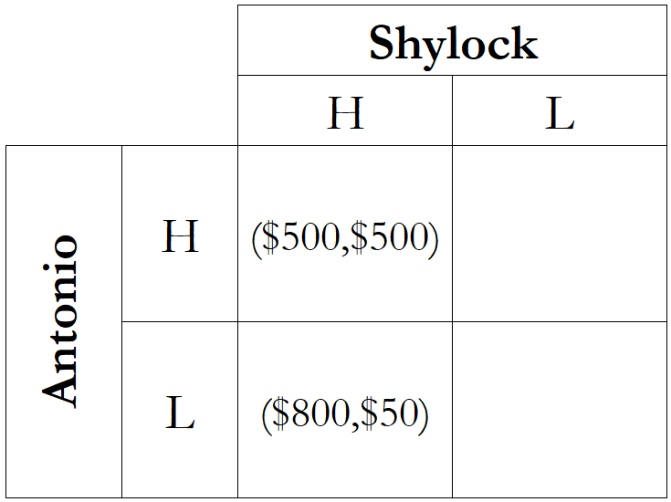
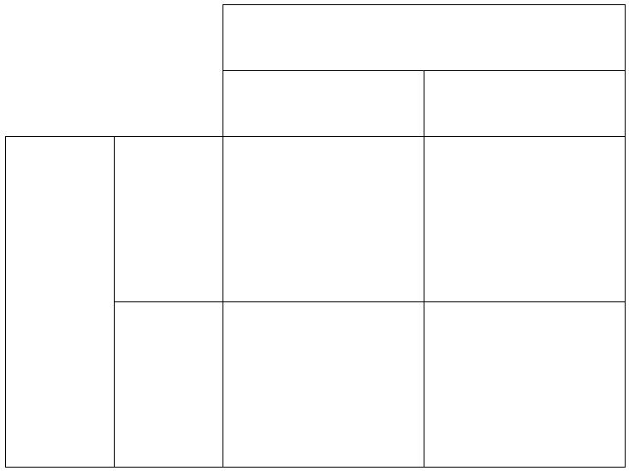
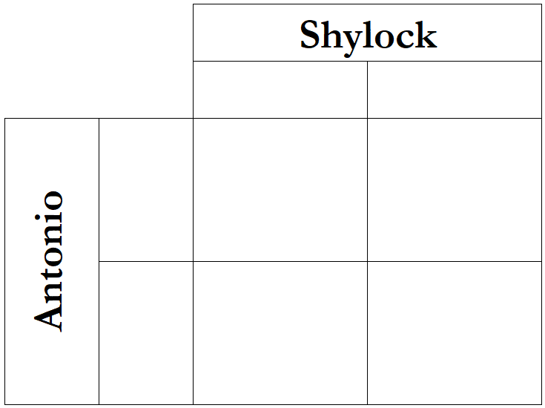
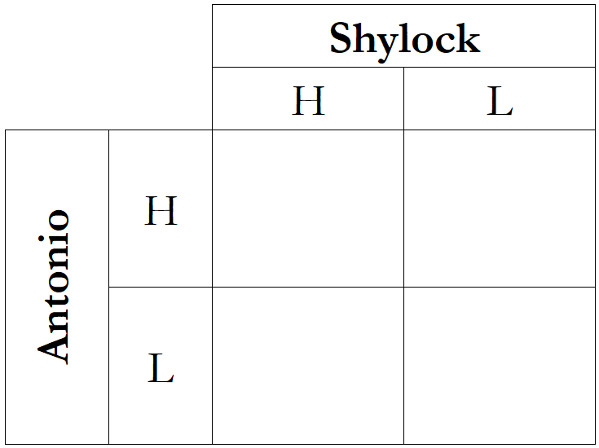
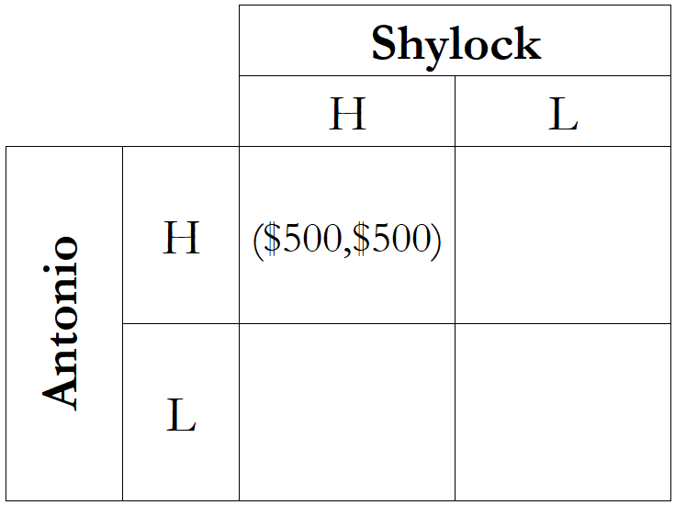
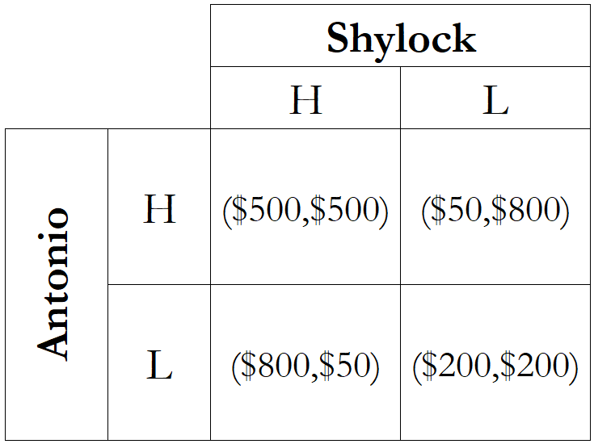
Exercise: Finding the Normal Form Representation
Start by assigning players to rows (Antonio) and columns (Shylock).
Write down each of their actions.
Fill out the corresponding payoffs:
  When both choose H, they each earn $500.
  If Antonio chooses L and Shylock chooses H, Antonio earns $800, and Shylock earns $50.
  If Antonio chooses H and Shylock chooses L, Antonio earns $50, and Shylock earns $800.
  When both choose L, they each earn $200.

Slide 42
Exercise: Finding the Nash Equilibrium
Antonio’s Point of View:
  If Shylock chooses H, my best response is to choose L and earn $800 in profit.
  If Shylock chooses L, my best response is to choose L and earn $200 in profit.
Shylock’s Point of View:
  If Antonio chooses H, my best response is to choose L and earn $800 in profit.
  If Antonio chooses L, my best response is to choose L and earn $200 in profit.
The Nash Equilibrium is found at (L,L).

Slide 43
Potential for Cooperation: Repeated Games
In reality, not all criminals or duopolies fall into the trap of the prisoner’s dilemma.
Game theory offers a potential reason: many games are repeated over time.
Suppose the game between Antonio and Shylock is played every week when they receive a new shipment of goods.
Either player can adopt a “trigger strategy” that states:
  “As long as you keep choosing H (cooperate), I will keep choosing H as well.”
  “If you choose L (defect) even once, I will switch to L forever.”
The short-term benefit of defecting lasts only a week, while the punishment continues for as long as the relationship does, which creates an incentive for long-term cooperation.

Slide 44
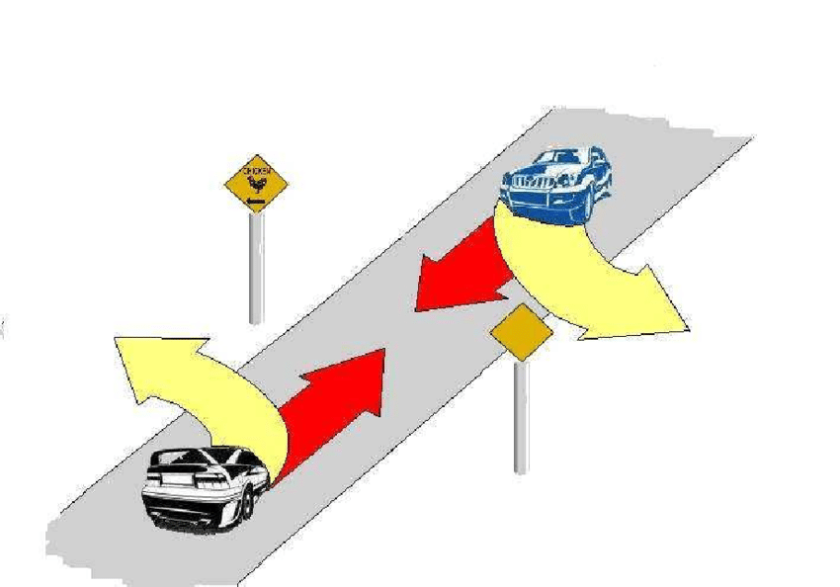
Hawk-Dove Game
Players:
  Driver A
  Driver B
Payoffs:
Information:
  A and B make their decisions simultaneously.
  A and B both know the rules and payoffs of the game.
Strategies:
  Hawk (H): Driving Straight.
  Dove (D): Swerving to Avoid.
A’s Choice | B’s Choice | A’s Payoff | B’s Payoff
H | H | -100 | -100
H | D | 5 | -5
D | H | -5 | 5
D | D | 0 | 0

Slide 45
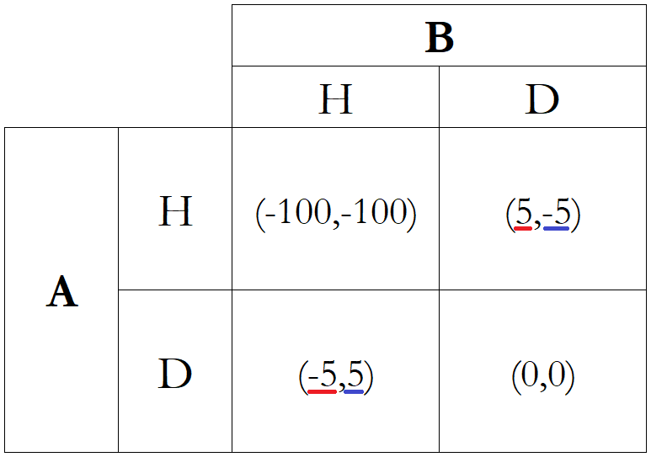
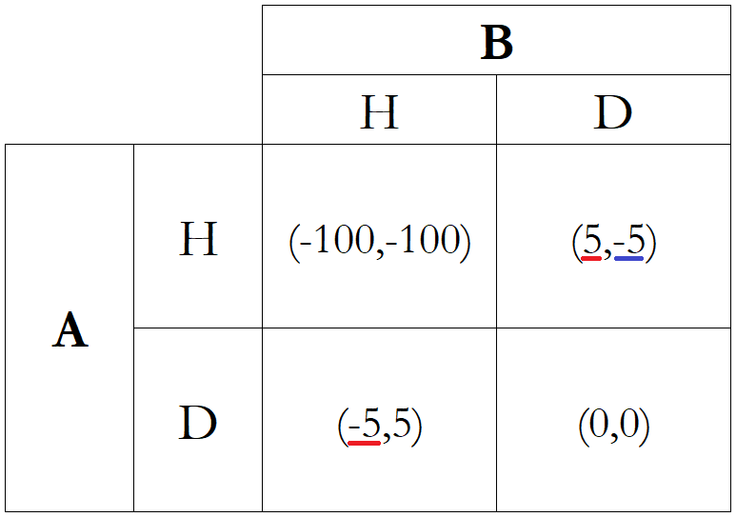
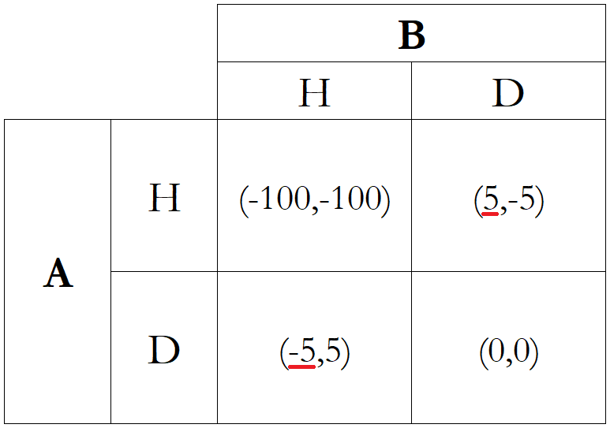
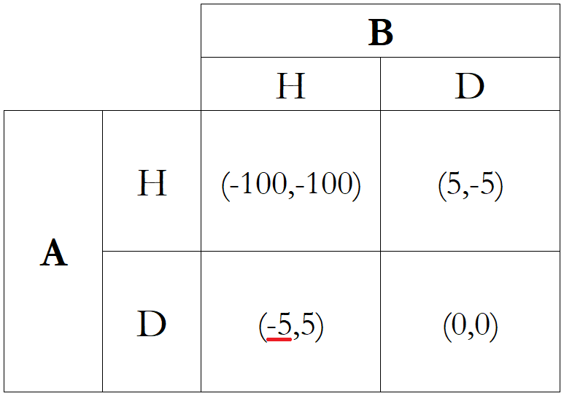
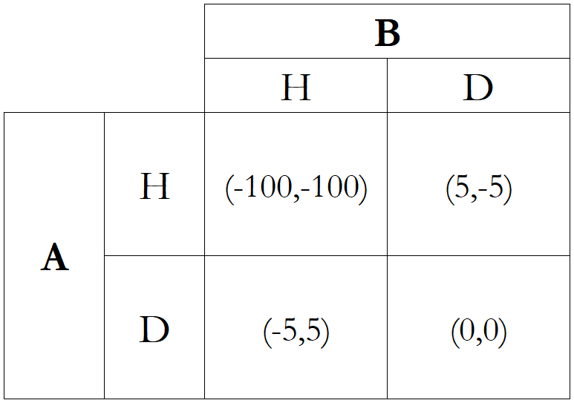
Hawk-Dove Game
Represent the game in the normal form.
Consider Driver A:
  If driver B plays H, the best response is D.
  If driver B plays D, the best response is H.
Consider Driver B:
  If driver A plays H, the best response is D.
  If driver A plays D, the best response is H.
There are two Nash Equilibria:
  (H, D) and (D, H)
  One player swerves away, while the other drives straight.

Slide 46
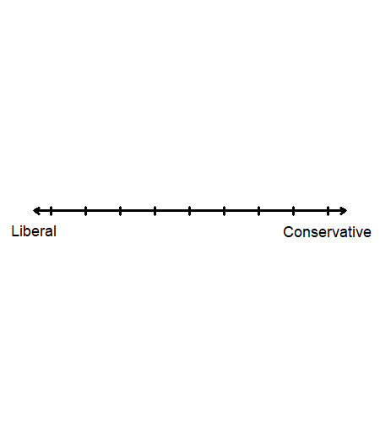
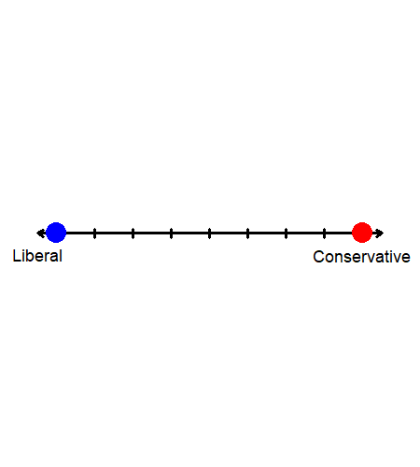
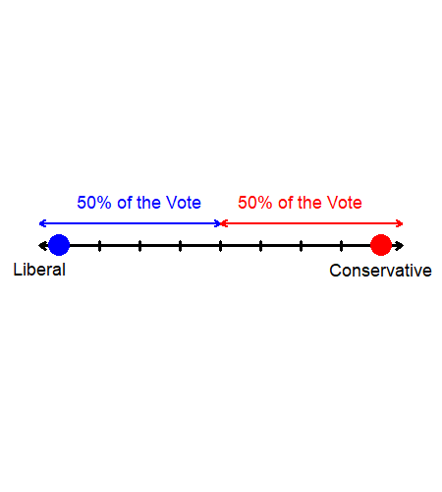
Hotelling’s Law
Hotelling’s Law (1929) states that it is rational for producers to make their products as similar as possible.
An application of this idea is the Median Voter Theorem (1948).
Suppose there are two political candidates positioned at the far ends of the liberal–conservative spectrum.
Assume that voters are uniformly distributed along this spectrum and that each voter chooses the candidate closest to their own viewpoint.
As a result, each candidate receives 50% of the vote.

Slide 47
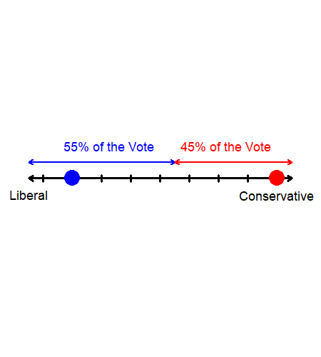
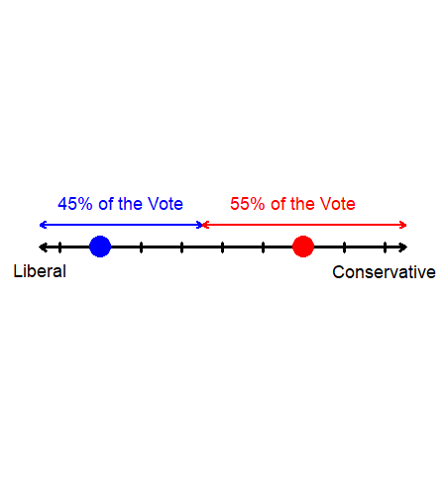
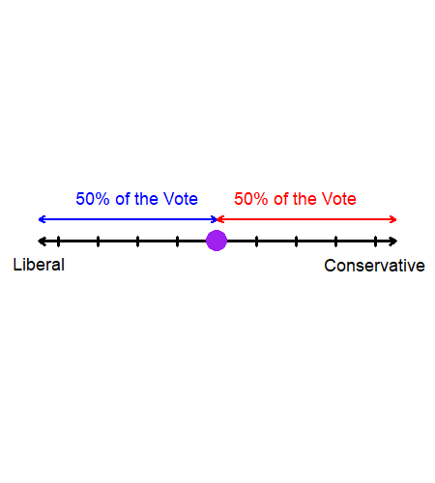
Hotelling’s Law
By offering a slightly more moderate viewpoint, any candidate may increase their share of the vote.
Suppose that the liberal candidate moderates their tone to increase their share to 55% of the vote.
Then, the conservative candidate would move further toward the median to gain more votes.
This process continues until both candidates converge to appeal to the median voter.
When there are two or more dimensions of competition, Hotelling’s Law can still be applied.

Slide 48
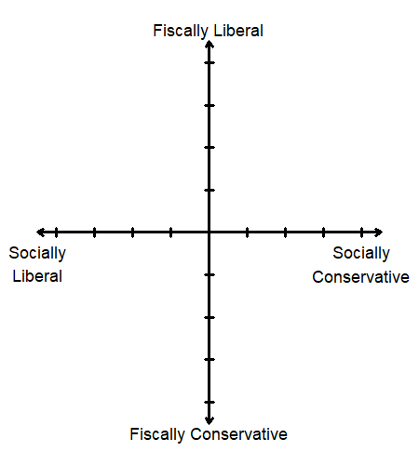
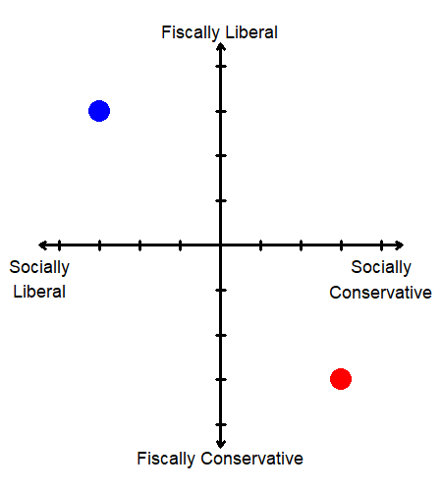
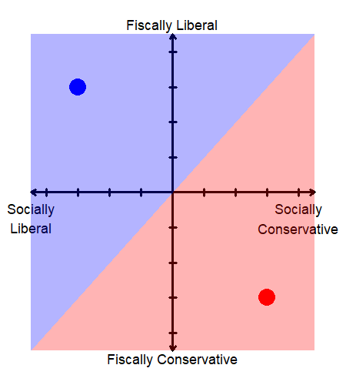
Hotelling’s Law
Suppose voters now care about two topics: fiscal policies and social policies.
One candidate starts out being both fiscally and socially liberal, while the other begins as fiscally and socially conservative.
Voters choose the candidate who is “closest” to their own viewpoints across both dimensions.
Candidates have incentives to move toward the median voter, since shifting toward the center increases their share of votes.

Slide 49
Dynamic Games: Decision Trees
In some games, players’ actions are not revealed simultaneously.
  e.g., Chess is the classical example of dynamic (or sequential) games.
  e.g., In oligopolies, incumbent firms “act” first, and then entrants “react.”
Suppose that the rule of a game is given as follows:
  P1 makes the first move, and they can choose Up (U) or Down (D).
  P2 observes this choice, and then they can choose either Top (T) or Bottom (B).
  U→T: Player 1’s payoff is 12, Player 2’s payoff is 14.
  U→B: Player 1’s payoff is 7, Player 2’s payoff is 7.
  D→T: Player 1’s payoff is 5, Player 2’s payoff is 4.
  D→B: Player 1’s payoff is 9, Player 2’s payoff is 21.
When analyzing a game that is played sequentially, we typically use decision trees.

Slide 50
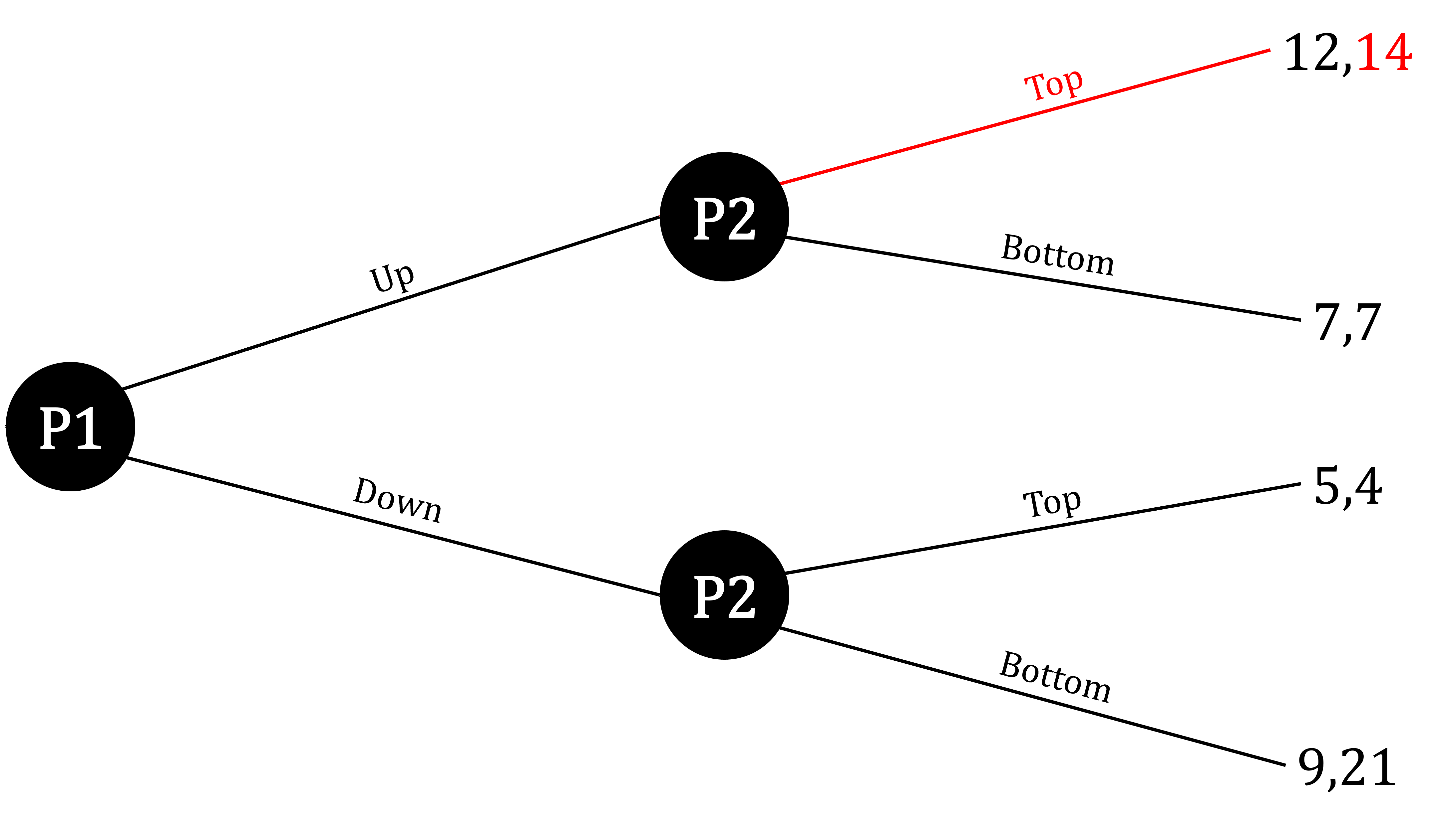
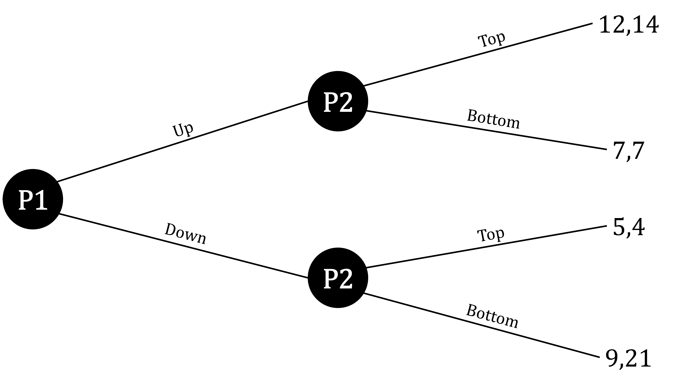
Dynamic Games: Decision Trees
This is the game represented as a game tree, which contains information on the players, actions, and payoffs.
We solve this game by “backward induction,” which involves starting from the very last decision that can be made.
If P1 had played U, P2 can…
  Play T and receive a payoff of 14, or
  Play B and receive a payoff of 7.
Since P2 prefers a payoff of 14, P2 would choose T if P1 chooses U.

Slide 51
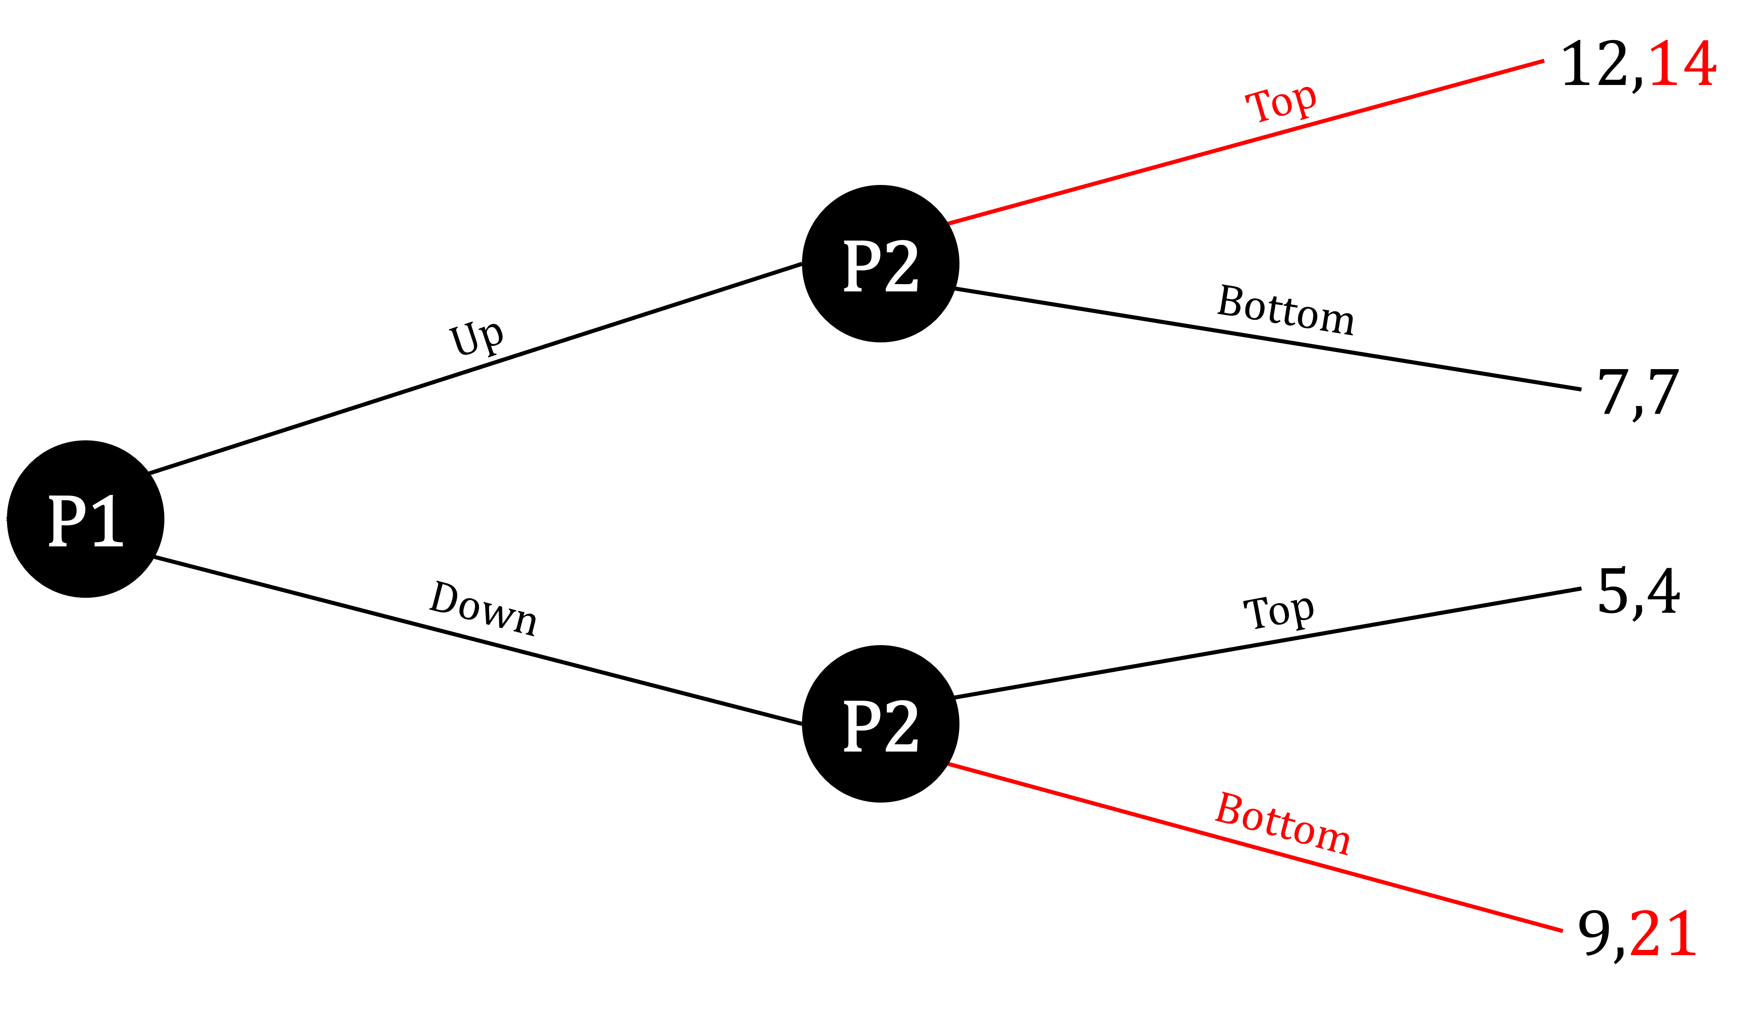
Dynamic Games: Decision Trees
If P1 had played D, P2 can…
  Play T and receive a payoff of 4, or
  Play B and receive a payoff of 21.
Since P2 prefers a payoff of 21, P2 would choose B if P1 chooses D.
P1 knows this is how P2 will respond:
  P2 will play T if P1 chooses U
  P2 will play B if P1 chooses D
P2’s strategy can be written down as “TB.”

Slide 52
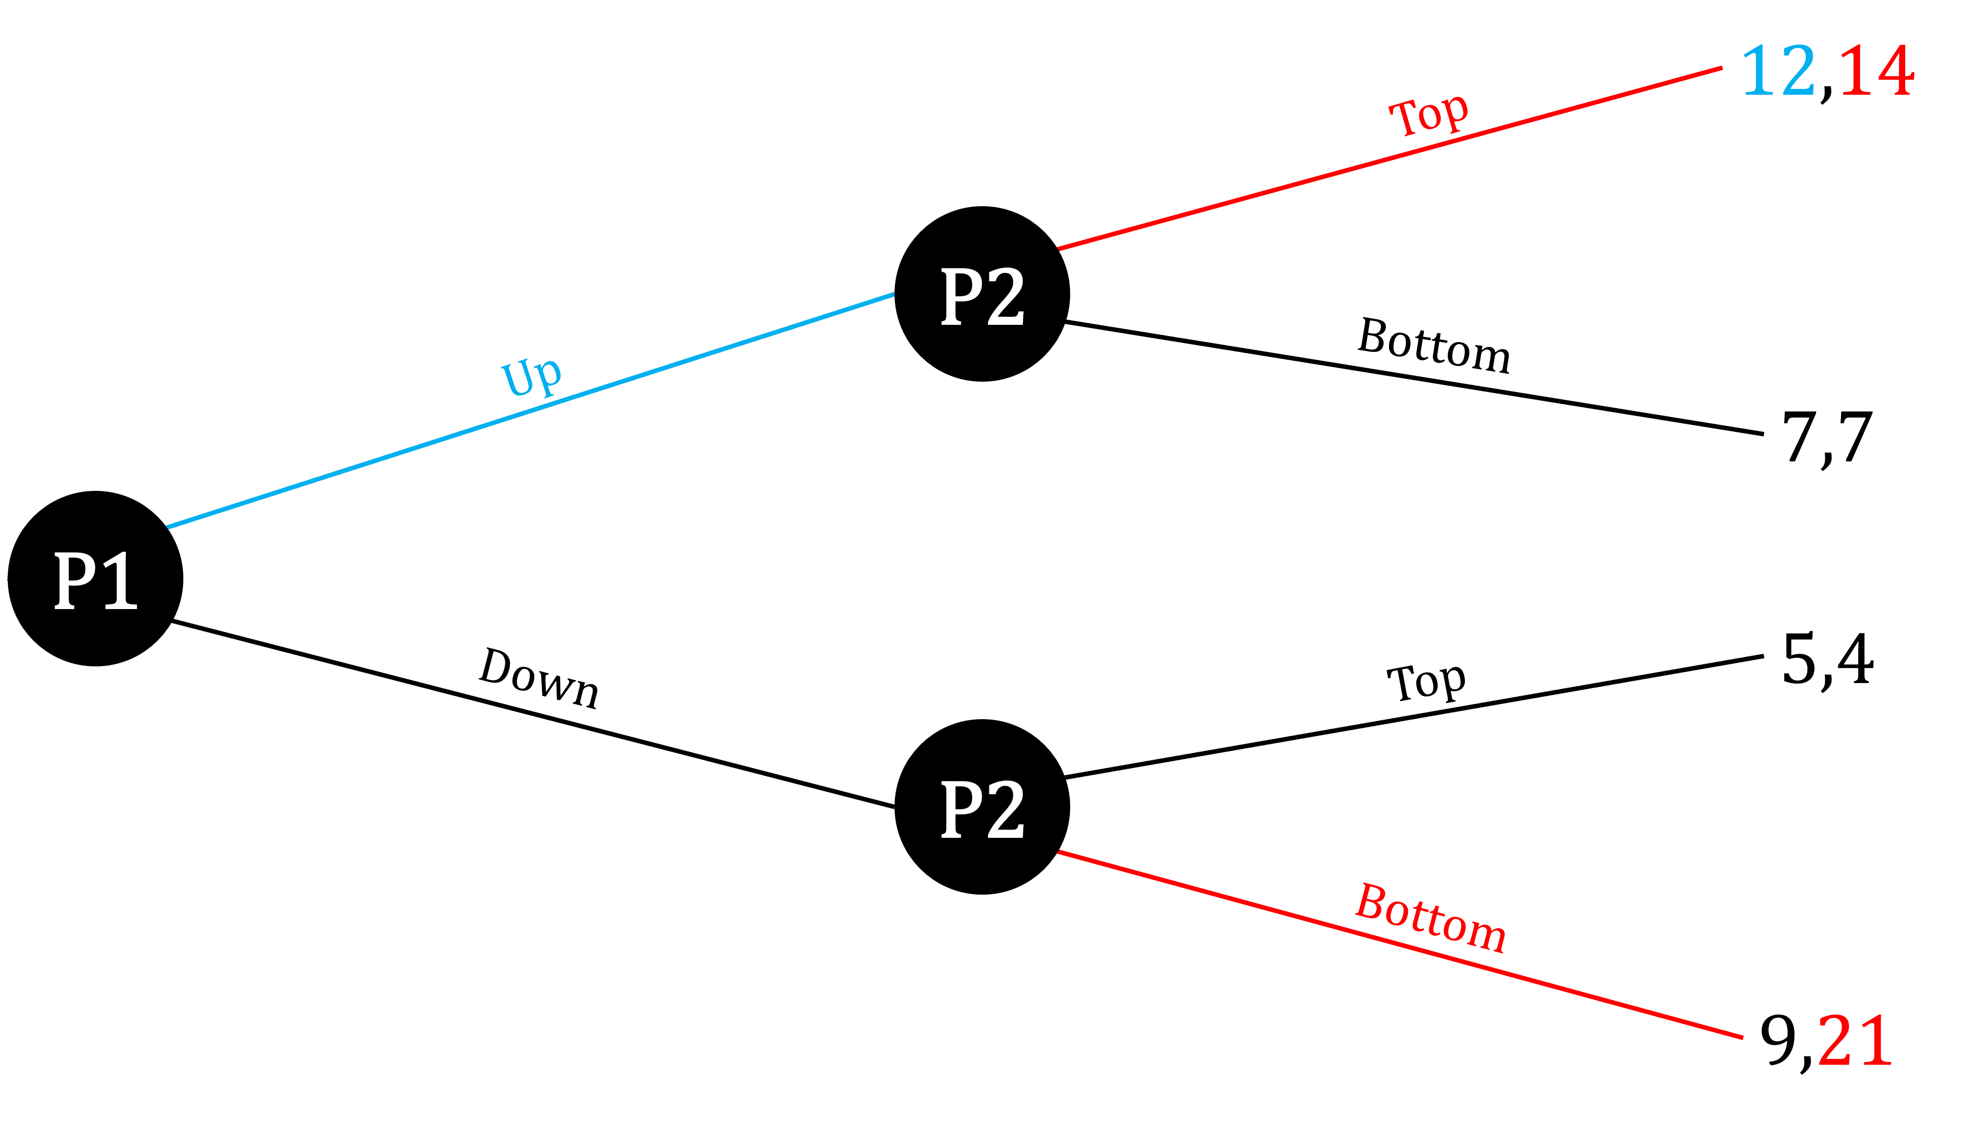
Dynamic Games: Decision Trees
P1’s decision:
  If P1 plays U, P2 plays T, and P1 receives 12.
  If P1 plays D, P2 plays B, and P1 receives 9.
Since P1 prefers a payoff of 12, P1 chooses U.
The Nash Equilibrium of this game:
  (U, TB)
  P1 plays U; P2 plays T if given the chance after U, and B if given the chance after D.

Slide 53
Dynamic Games: Pirate Game
Consider this game, which is a version of the ultimatum game.
A group of five rational pirates (Alice, Ben, Claire, David, and Emily, in order of seniority) find 100 gold coins, which they must distribute among themselves.
  The pirates take turns proposing a distribution of gold coins, starting with the captain Alice.
  All pirates including the captain vote yea or nay.
  If a majority agrees or if the votes are tied, the coins are distributed according to the proposal and the game ends.
  If the majority rejects the proposal, the captain walks the plank, and the next most senior pirate becomes the new captain.
  The pirates are not allowed to collude or coordinate beforehand.
  Each pirate’s goal is to survive while getting as many gold coins as possible.
If you are Alice, what is the best proposal you can make?

Slide 54
Dynamic Games: Pirate Game
We can solve this sequential game by using backward induction, where we begin our analysis with the final round of the game.
If David and Emily are the only pirates left, David proposes (100, 0):
  David votes yea, Emily votes nay, and the motion passes.
  Both David and Emily understand that this is the endgame.
  Claire also understands that this is the outcome if their proposal is rejected.
Now consider the stage where Claire, David, and Emily remain. Claire proposes (99, 0, 1):
  Emily knows that if they vote nay, they will end up with 0 coins in the next round.
  Claire and Emily vote yea, David votes nay, and the motion passes.
  Claire, David, and Emily all anticipate this outcome.
  Ben also understands that this is the outcome if their proposal is rejected..

Slide 55
Dynamic Games: Pirate Game
Next, Ben’s proposal should be (99, 0, 1, 0):
  David knows that rejecting the offer leads to 0 coins when Emily becomes captain.
  Ben and David vote yea, Claire and Emily vote nay, and the motion passes.
  Ben, Claire, David, and Emily all know this will occur.
  Alice also understands that this is the outcome if their proposal is rejected.
With all this information, Alice’s optimal proposal is (98, 0, 1, 0, 1):
  Claire and Emily know that if they reject the deal, they will each end up with 0 coins.
  Alice, Claire, and Emily vote yea, Ben and David vote nay, and the motion passes.

Slide 56
Recap of Chapter 17 & 18

Slide 57
Recap
 | Perfect Competition | Monopolistic Competition | Oligopoly | Monopoly
Number of Firms | Many | Many | Few | One
Free Entry/Exit | Yes | Yes | Some | No
Long-run Profit | Zero | Zero | Positive | Positive
Products | Identical | Similar | Identical or Similar | No Substitute
Market Power | No (P=MC) | Yes (P>MC) | Yes (P>MC) | Yes (P>MC)
Demand Curve | Horizontal | Downward-sloping | Downward-sloping | Downward-sloping

Slide 58
Recap
Monopolistic competition blends elements of monopoly and perfect competition.
  In the long run, economic profit is zero because of free entry and exit.
  Firms face downward-sloping demand curves and charge prices above marginal cost
  Excess capacity and positive markups arise because firms do not produce at the minimum of the ATC curve.
Oligopolies behave strategically, and outcomes depend on whether firms cooperate or compete.
Game theory explains why cooperative outcomes are difficult to sustain when firms cannot commit to agreements.
Repeated interactions can support cooperation if firms use credible punishment strategies.

