Slide 1
PRINCIPLES OF GLOBAL ECONOMICS
Chapter 16: Monopoly

Slide 2
Preview
Up to this point, we have examined how firms interact in perfectly competitive markets.
In a perfectly competitive market:
  Many buyers and sellers, identical products, free entry and exit.
  Price equals marginal cost, resulting in a socially efficient outcome.
But real-world markets often look different:
  A few firms dominate each industry.
  Barriers prevent entry and allow firms to influence price.
What happens to prices, output, and welfare when one firm holds market power?
In this chapter, we examine the most extreme form of market power: the monopoly.

Slide 3
Monopoly

Slide 4

Monopolies
Monopoly: A firm that is the sole seller of a product without close substitutes.
True monopolies are rare in large-scale markets, but some firms hold dominant positions:
  Microsoft: ~75% of the world’s operating systems.
  Google: ~90% of all global online searches.
A monopoly remains the only seller because potential competitors cannot enter the market.
Therefore, the fundamental cause of monopoly power is Barriers to Entry.

Slide 5

Causes of Monopolies: Monopoly Resources
If a key resource required to produce a good or service is owned by a single firm, other firms cannot produce that good.
The South African firm De Beers once controlled up to 80% of global diamond production.
Even De Beers was not a pure monopoly, since it never controlled 100% of the market.
Exclusive ownership of a key resource can create monopoly power, but such cases are relatively rare in practice.

Slide 6
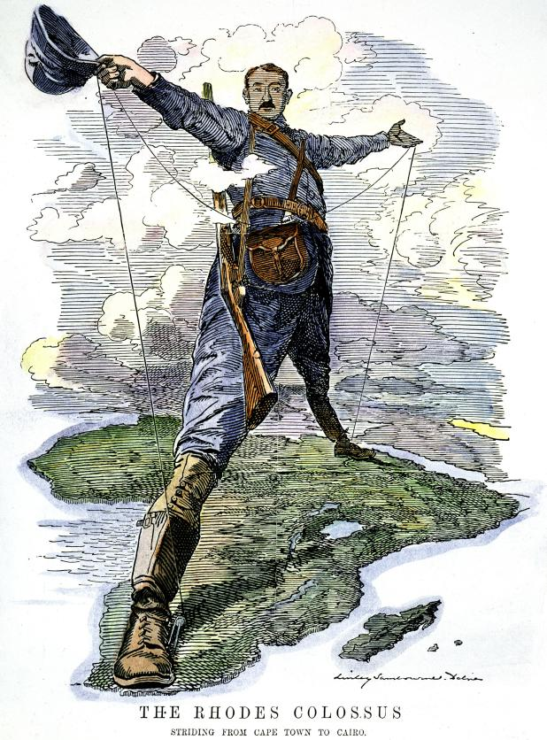
Historical Example: Cecil Rhodes and De Beers
Cecil Rhodes founded De Beers Consolidated Mines in 1888, merging mining operations in South Africa.
Through exclusive ownership of diamond mines, De Beers dominated (up to 80%) global supply.
Regulated global diamond prices by stockpiling gems and releasing them slowly to maintain scarcity.
De Beers’ monopoly began to erode in the late 20th century as new producers entered the market.
De Beers remains a classic example of a resource-based monopoly built on market control and artificial scarcity.

Slide 7
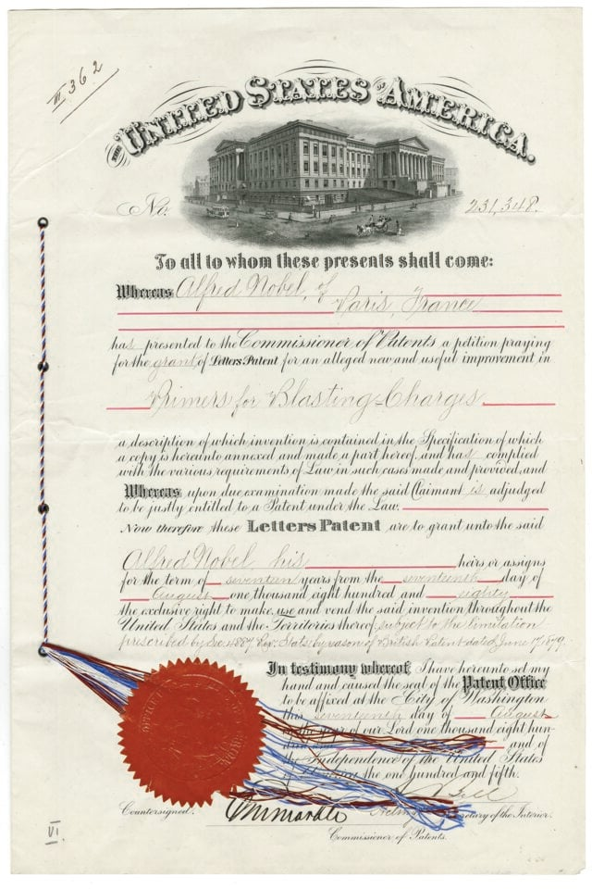
Causes of Monopolies: Government-Created
Governments may grant a single firm the exclusive right to sell a good or service.
Governments often enforce intellectual property protections:
  Patents: Grant the inventor of a novel, original, and non-obvious invention an exclusive right to produce and sell it for 20 years.
  Copyrights: Protect the creators of literary, artistic, musical, and software works for the life of the author plus 70 years, or 95 years for works owned by corporations.
Benefit: Increases incentives for innovation and creative activity.
Cost: Leads to monopoly pricing in the market.

Slide 8

Historical Example: The East India Company
The British East India Company (EIC) was granted exclusive rights over all English trade east of the Cape of Good Hope by the English Crown in 1600.
For nearly 200 years, the EIC faced little to no competition:
  It set prices for spices, tea, textiles, and opium.
  It dictated terms of trade with local producers and buyers in India and China.
The EIC maintained its monopoly power as a state-sanctioned monopoly until the Charter Act of 1833.

Slide 9
Causes of Monopolies: Natural Monopolies
Cost and
Revenue
Natural Monopoly: A type of monopoly that arises when a single firm can supply a good or service to an entire market at a lower cost than two or more firms could.
This happens when there are economies of scale.
  Industries characterized by extremely high fixed costs and low marginal costs often end up as a natural monopoly.
  The more customers the firm serves, the lower its average total cost (ATC).
The firm’s ATC curve is decreasing, and its MC curve lies below the ATC curve.
ATC
MC
Output

Slide 10
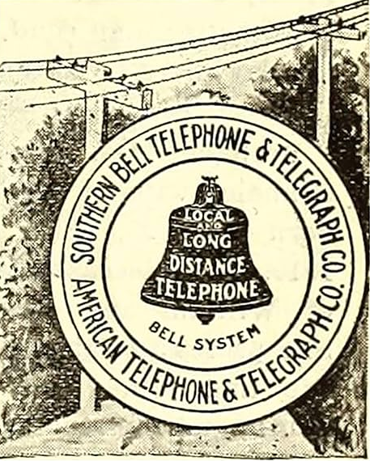
Historical Example: AT&T
Alexander Graham Bell’s Bell System, led by AT&T, dominated U.S. telephone service for most of the 20th century.
The network’s high fixed costs made it inefficient for multiple firms to build parallel infrastructures.
The U.S. government recognized AT&T as a regulated natural monopoly under the Kingsbury Commitment (1913), but later its monopoly was dismantled in 1984.
AT&T remains a textbook example of a natural monopoly in telecommunications.

Slide 11
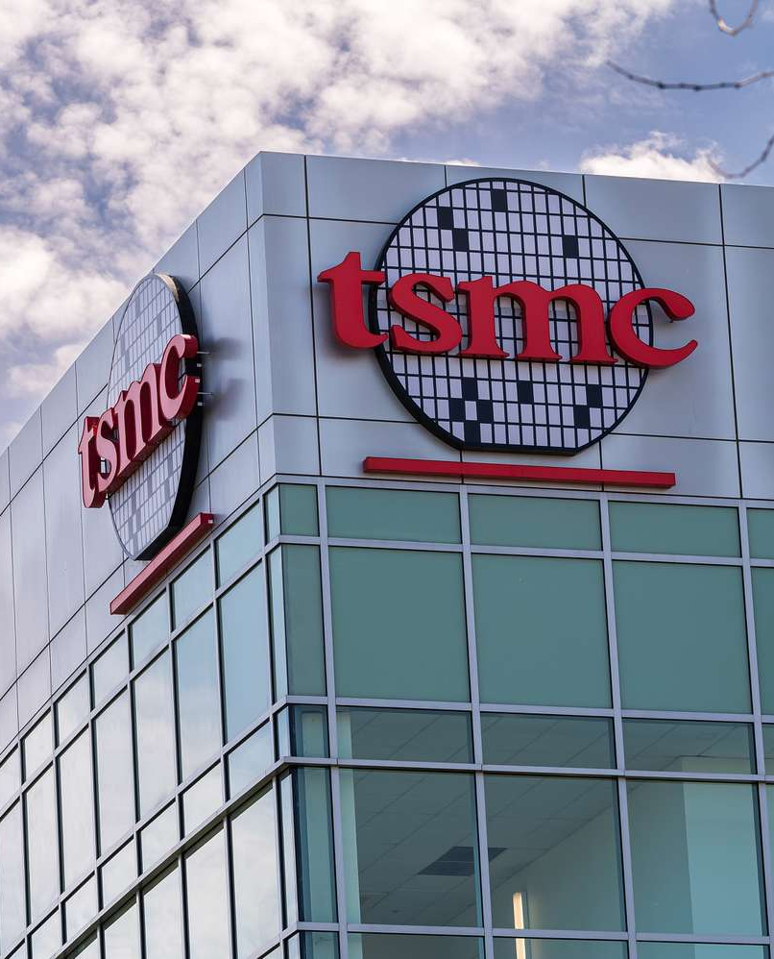
Causes of Monopolies: Technological Advantage
A firm that pioneers a superior technology can achieve a large cost or quality advantage over competitors.
When rivals cannot replicate the technology quickly, the firm may act like a monopoly in the short term.
  TSMC dominates global semiconductor fabrication through unmatched technological precision and scale.
  Xerox commercialized the first plain-paper copier in 1959, far ahead of competitors using older duplicating methods.
  IBM dominated mainframe computing from the 1950s through the 1970s
Such monopolies are often temporary, as technology eventually diffuses or rivals catch up.

Slide 12
Pricing and Production
Decisions of Monopolies

Slide 13
Monopoly vs. Competition
The key difference between a firm in a competitive market and a monopoly is the firm’s ability to influence market prices.
An individual firm in a competitive market:
  Is a price taker with no control over the market price of its good or service.
  Faces a very small share of total market demand, so the demand curve it perceives is perfectly elastic (horizontal).
A monopolist:
  Is the only firm supplying the good or service in the market.
  Faces the entire market demand curve, which is downward sloping and not perfectly elastic.
  Therefore, can influence the market price by adjusting the quantity it produces.

Slide 14
The Monopoly’s Revenue
Quantity | Price | Total Revenue | Marginal Revenue | Average Revenue
0 | $11
1 | $10
2 | $9
3 | $8
4 | $7
5 | $6
6 | $5
7 | $4
8 | $3
Suppose that a monopoly producer is given the following table.
Q1: What is the firm’s Total Revenue?
  The formula for calculating TR is P×Q.
Q2: What is the firm’s Marginal Revenue?
  The additional revenue gained from selling one more unit of output.
Q3: What is the firm’s Average Revenue?
  The formula for calculating AR is TR/Q.
Quantity | Price | Total Revenue | Marginal Revenue | Average Revenue
0 | $11 | $0
1 | $10 | $10
2 | $9 | $18
3 | $8 | $24
4 | $7 | $28
5 | $6 | $30
6 | $5 | $30
7 | $4 | $28
8 | $3 | $24
Quantity | Price | Total Revenue | Marginal Revenue | Average Revenue
0 | $11 | $0 | -
1 | $10 | $10 | $10
2 | $9 | $18 | $8
3 | $8 | $24 | $6
4 | $7 | $28 | $4
5 | $6 | $30 | $2
6 | $5 | $30 | $0
7 | $4 | $28 | -$2
8 | $3 | $24 | -$4
Quantity | Price | Total Revenue | Marginal Revenue | Average Revenue
0 | $11 | $0 | - | -
1 | $10 | $10 | $10 | $10
2 | $9 | $18 | $8 | $9
3 | $8 | $24 | $6 | $8
4 | $7 | $28 | $4 | $7
5 | $6 | $30 | $2 | $6
6 | $5 | $30 | $0 | $5
7 | $4 | $28 | -$2 | $4
8 | $3 | $24 | -$4 | $3

Slide 15
The Monopoly’s Revenue
Quantity | Price | Total Revenue | Marginal Revenue | Average Revenue
0 | $11 | $0 | - | -
1 | $10 | $10 | $10 | $10
2 | $9 | $18 | $8 | $9
3 | $8 | $24 | $6 | $8
4 | $7 | $28 | $4 | $7
5 | $6 | $30 | $2 | $6
6 | $5 | $30 | $0 | $5
7 | $4 | $28 | -$2 | $4
8 | $3 | $24 | -$4 | $3
Notice that the monopolist’s marginal revenue (MR) is less than the price (P).
When a monopolist increases its output, it faces two opposing forces on its TR:
  Output Effect: More output is sold (Q↑), which increases the firm’s total revenue.
  Price Effect: The market price falls (P↓), which decreases the firm’s total revenue.
A firm in a competitive market does not face the price effect, and its marginal revenue is equal to the market price at all quantities.

Slide 16
The Monopoly’s Revenue Visualized
Cost and
Revenue
Let’s plot a graph showing the relationship between a monopolist’s demand curve (D) and marginal revenue curve (MR):
Quantity | Price | Total Revenue | Marginal Revenue | Average Revenue
0 | $11 | $0 | - | -
1 | $10 | $10 | $10 | $10
2 | $9 | $18 | $8 | $9
3 | $8 | $24 | $6 | $8
4 | $7 | $28 | $4 | $7
5 | $6 | $30 | $2 | $6
6 | $5 | $30 | $0 | $5
7 | $4 | $28 | -$2 | $4
8 | $3 | $24 | -$4 | $3
MR
D
Output

Slide 17

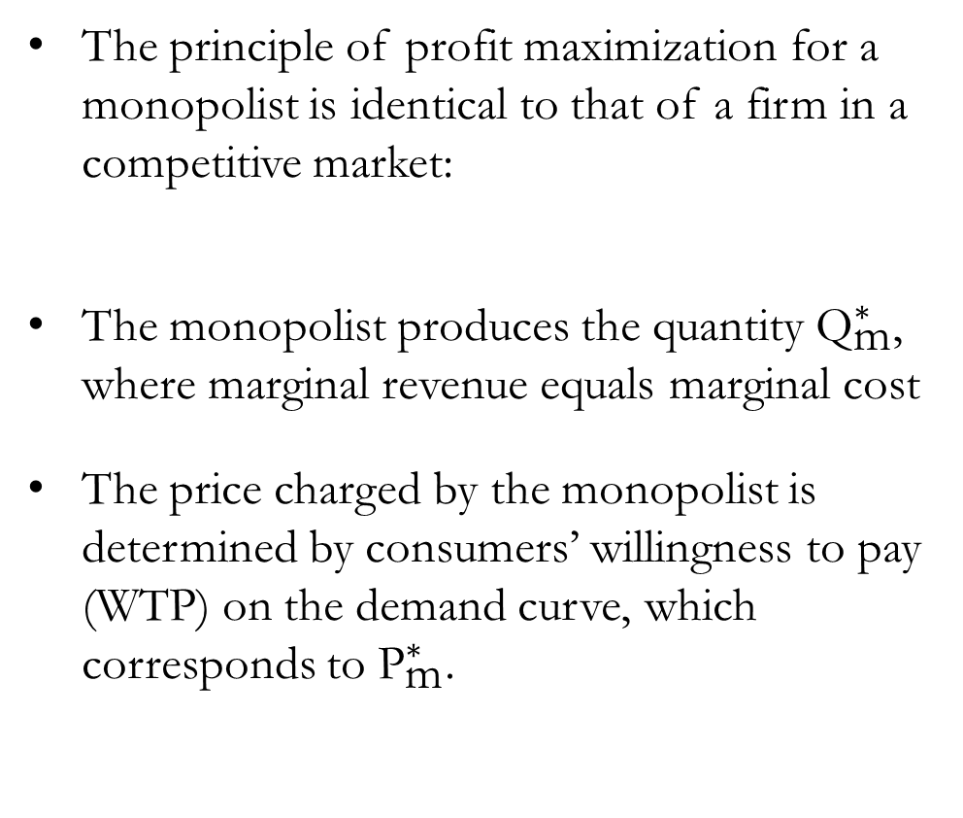

The Monopoly’s Profit Maximization
The principle of profit maximization for a monopolist is identical to that of a firm in a competitive market:
The monopolist produces the quantity ${\text{Q}}_{\text{m}}^{∗}$, where marginal revenue equals marginal cost
The price charged by the monopolist is determined by consumers’ willingness to pay (WTP) on the demand curve, which corresponds to ${\text{P}}_{\text{m}}^{∗}$.
MC
Profit is maximized when MR=MC
$${\text{P}}_{\text{m}}^{∗}$$
ATC
MR
D
$${\text{Q}}_{\text{m}}^{∗}$$
Output

Slide 18
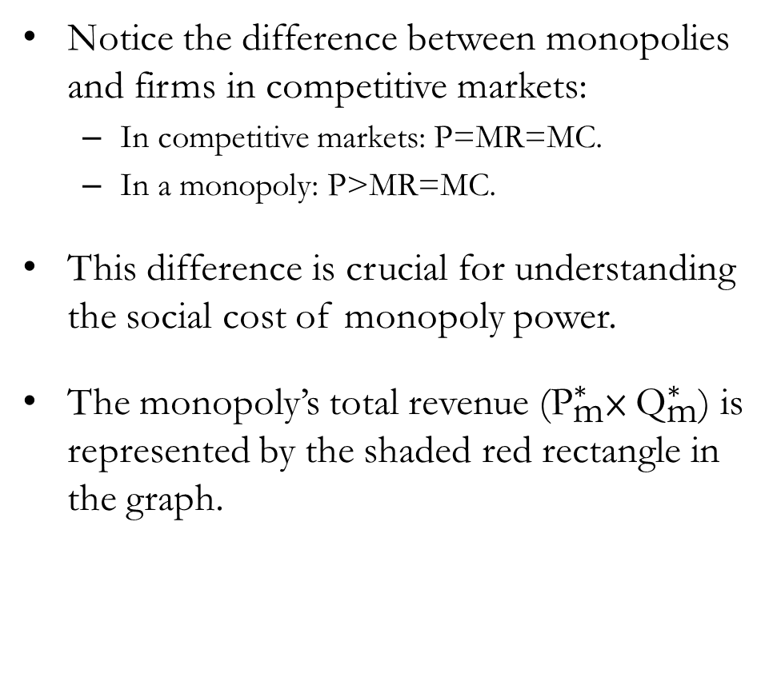
The Monopoly’s Profit Maximization
Cost and
Revenue
Notice the difference between monopolies and firms in competitive markets:
  In competitive markets: P=MR=MC.
  In a monopoly: P>MR=MC.
This difference is crucial for understanding the social cost of monopoly power.
The monopoly’s total revenue (${\text{P}}_{\text{m}}^{∗}$× ${\text{Q}}_{\text{m}}^{∗}$) is represented by the shaded red rectangle in the graph.
MC
$${\text{P}}_{\text{m}}^{∗}$$
ATC
MR
D
$${\text{Q}}_{\text{m}}^{∗}$$
Output

Slide 19
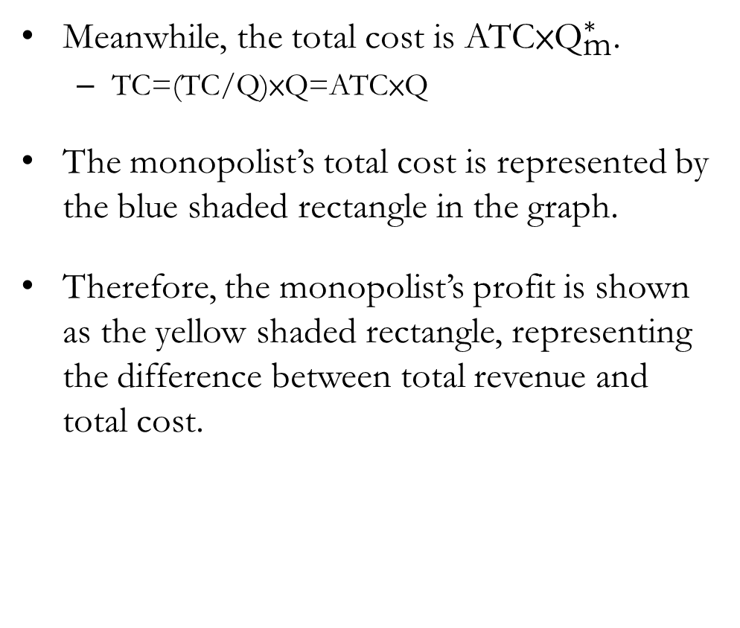
The Monopoly’s Profit Maximization
Cost and
Revenue
Meanwhile, the total cost is ATC×${\text{Q}}_{\text{m}}^{∗}$.
  TC=(TC/Q)×Q=ATC×Q
The monopolist’s total cost is represented by the blue shaded rectangle in the graph.
Therefore, the monopolist’s profit is shown as the yellow shaded rectangle, representing the difference between total revenue and total cost.
MC
$${\text{P}}_{\text{m}}^{∗}$$
ATC
Monopoly
Profit
MR
D
$${\text{Q}}_{\text{m}}^{∗}$$
Output

Slide 20
The Welfare Cost of Monopolies

Slide 21

The Welfare Cost of Monopolies
Compared with a competitive market:
  Prices are higher under monopoly?
  The quantity supplied is lower under monopoly?
  The monopoly firm earns positive economic profits.
Most economists agree that, in general, monopolies are not an efficient way to organize markets.
To understand why, we conduct a welfare analysis of the market.

Slide 22
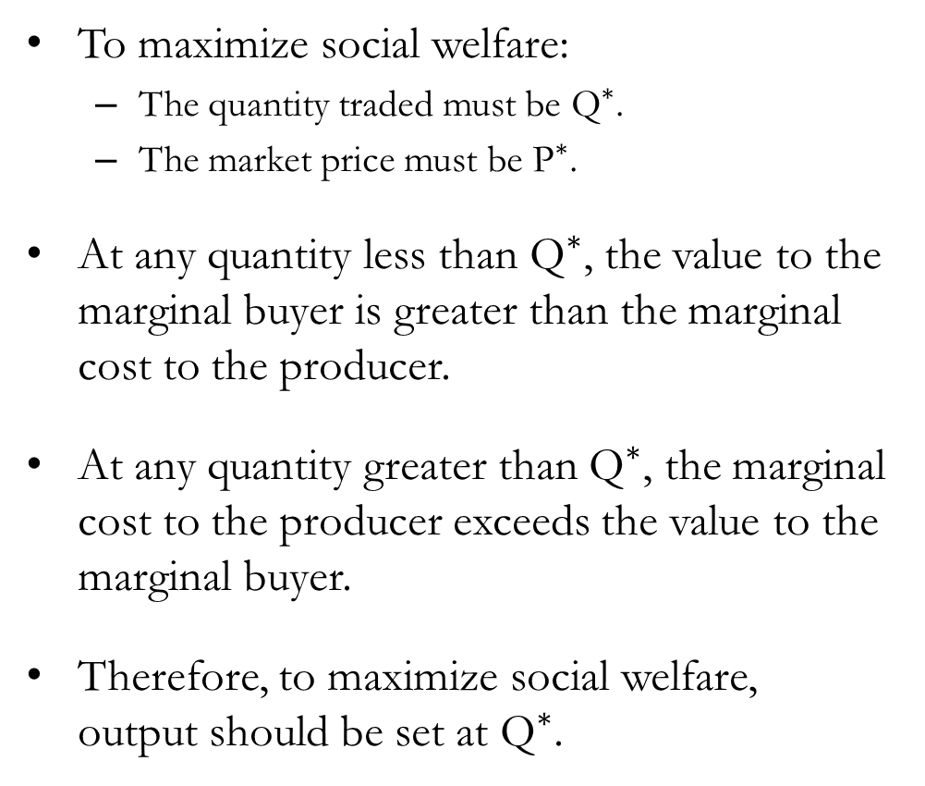


Monopoly vs. Competition Visualized
Cost and
Revenue
To maximize social welfare:
  The quantity traded must be ${\text{Q}}^{∗}$.
  The market price must be ${\text{P}}^{∗}$.
At any quantity less than ${\text{Q}}^{∗}$, the value to the marginal buyer is greater than the marginal cost to the producer.
At any quantity greater than ${\text{Q}}^{∗}$, the marginal cost to the producer exceeds the value to the marginal buyer.
Therefore, to maximize social welfare, output should be set at ${\text{Q}}^{∗}$.
MC
$${\text{P}}_{\text{m}}^{∗}$$
$${\text{P}}^{∗}$$
Cost to
Produce
Benefit to marginal buyer
Benefit to marginal buyer
Cost to
Produce
MR
D
$${\text{Q}}_{\text{m}}^{∗}$$
$${\text{Q}}^{∗}$$
Output

Slide 23
The Deadweight Loss
Cost and
Revenue
The monopolist produces less than the socially efficient quantity of output, which is equivalent to charging a price that is too high.
The inefficiency of monopoly can be measured by the deadweight loss triangle.
Because a monopolist exerts market power by setting price above marginal cost, it creates a wedge similar to that of a tax:
  Taxation: Generates tax revenue.
  Monopoly: Generates positive economic profits.
MC
$${\text{P}}_{\text{m}}^{∗}$$
$${\text{P}}^{∗}$$
MR
D
$${\text{Q}}_{\text{m}}^{∗}$$
$${\text{Q}}^{∗}$$
Output

Slide 24

The Welfare Cost of Monopolies?
Monopolies are often criticized for “profiteering” at the public’s expense.
However, the existence of positive economic profits is not necessarily a social problem.
  The issue concerns how the economic “pie” is divided between producers and consumers.
  Economics does not determine who is more “deserving” of those profits.
The real problem with monopoly power is that it reduces total surplus.
  A monopolist produces less than the socially efficient quantity, so the “size of the pie” shrinks.

Slide 25
Price Discrimination

Slide 26

CNBC International (2018, August 2). How do airlines price tickets? | CNBC Explains
[Video]. YouTube. https://youtu.be/EhhLXZB3kRw?si=bDmlG8edaNRY_8ax

Slide 27

Price Discrimination
So far, we assumed that a monopoly producer charges the same price to all customers.
This must be true in competitive markets, as consumers would not pay a higher price.
But if the firm has market power, firms can set multiple different prices.
Price Discrimination: The practice of selling the same good or service at different prices to different customers.

Slide 28
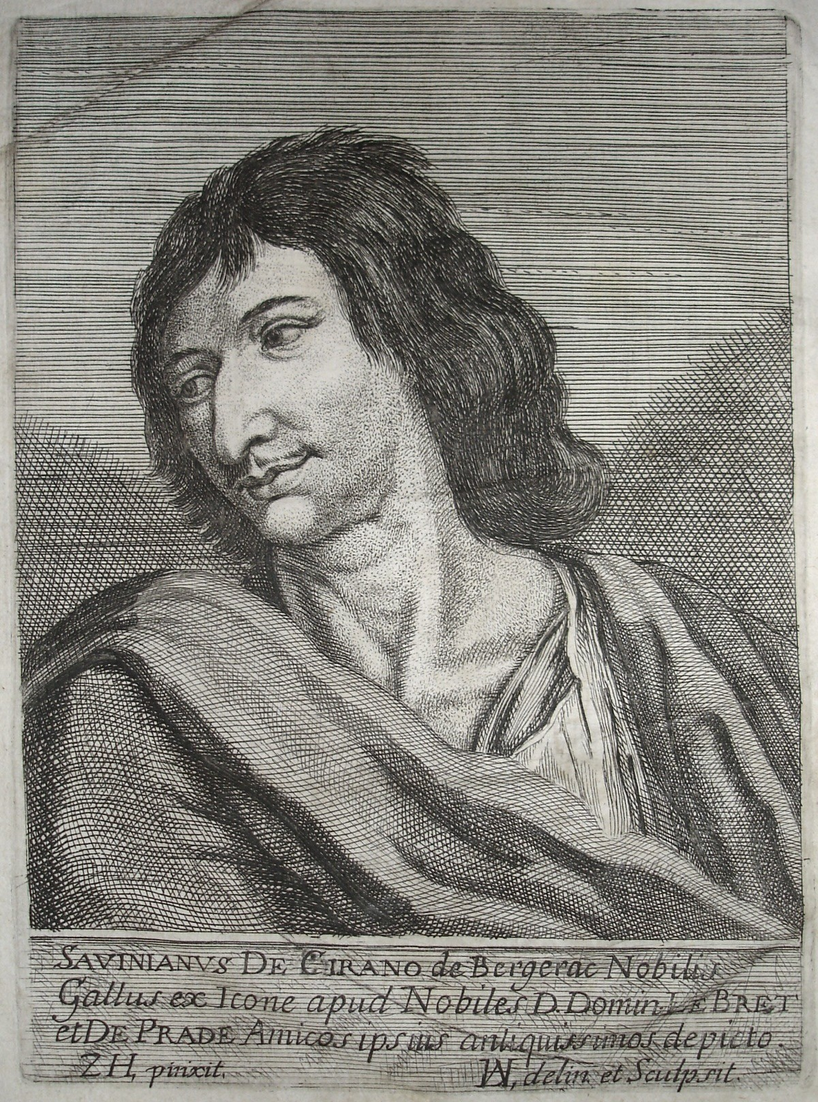
Price Discrimination
Suppose a talented local poet, Cyrano, writes high-quality love letters on behalf of star-struck lovers.
There is no close substitute for Cyrano’s letters, as he is uniquely gifted in expressing emotion through words.
Cyrano, the monopoly producer, now faces a question:
  Should he charge every client the same price for his writing?
  Or should he charge different prices based on each client’s willingness to pay for eloquent expression?
Let’s analyze a scenario to see which pricing strategy maximizes his profits.

Slide 29
Exercise: Single Price
Assume that:
  Cyrano can write an unlimited number of letters at a total cost of $600 per week.
  There are two types of clients: 10 Nobles (N) and 50 Common Folk (C).
  Each noble is willing to pay $100 per letter.
  Each commoner is willing to pay $20 per letter.
What is Cyrano’s profit if he sells his letters for $20 each?
  He sells 60 letters at $20 each, earning $1,200 in revenue.
  After accounting for his $600 production cost, Cyrano’s profit is $600.
What is Cyrano’s profit if he sells his letters for $100 each?
  He sells 10 letters to the nobles at $100 each, earning $1,000 in revenue.
  After accounting for his $600 production cost, Cyrano’s profit is $400.

Slide 30
Exercise: Price Discrimination
Assume that:
  Cyrano can write an unlimited number of letters at a total cost of $600 per week.
  There are two types of clients: 10 Nobles (N) and 50 Common Folk (C).
  Each noble is willing to pay $100 per letter.
  Each commoner is willing to pay $20 per letter.
What is Cyrano’s profit if he decides to price discriminate, charging nobles $100 each and common folk $20 each?
  He sells 10 letters to the nobles for a revenue of $1,000.
  He also sells 50 letters to the commoners for an additional $1,000 in revenue.
  After accounting for his $600 production cost, Cyrano’s profit is $1,400.

Slide 31
Notes on Price Discrimination
Price discrimination is a rational strategy for profit-maximizing monopolists.
  By setting different prices, the monopolist can increase its profits.
  This works by setting a price as close as possible to each consumer’s willingness to pay.
For price discrimination to work, the monopolist must be able to separate customers according to their willingness to pay.
  Location, age, income, or other socio-economic characteristics can be used for price discrimination.
  Now, firms may use data analytics to estimate individual consumers’ willingness to pay.
Price discrimination may increase social welfare by minimizing “potentially mutually beneficial trades.”
  Economic efficiency is lost when prices exceed many consumers’ willingness to pay.
  Price discrimination can reduce the number of consumers excluded from the market.

Slide 32
Types of Price Discrimination
First-degree price discrimination
  Firms charge each individual exactly their willingness to pay (“perfect price discrimination”).
  The monopoly firm captures the entire surplus as profit.
  This outcome is socially efficient, as there is no deadweight loss.
  Not possible in the real world, as no firms can accurately estimate every consumer’s WTP.
Second-degree price discrimination
  Firms charge different prices based on the quantity purchased or the product version (“menu pricing”).
  Examples include bulk discounts, buy-one-get-two offers, and loyalty rewards.
Third-degree price discrimination
  Firms charge different prices based on identifiable consumer characteristics (“group pricing”).
  Examples include student pricing, senior discounts, and early-bird offers.

Slide 33
Policies Towards Monopolies

Slide 34

CNET (2024, April 18). US vs. Apple: Antitrust Lawsuit Explained [Video]. YouTube. https://youtu.be/q7UfPdwPqFM?si=ggrDDK97w1K_RzRn

Slide 35

Policies Towards Monopolies
Monopolies fail to allocate resources efficiently:
  They produce less than the socially desirable quantity of output.
  They set prices higher than the marginal cost of production.
Governments around the world address this problem through various approaches:
  Promoting competition within monopolized industries.
  Regulating the behavior and pricing of monopolies.
  Converting private monopolies into public enterprises.
  In some cases, choosing to take no action.

Slide 36

Promoting Competition
The government regulates private industries through a variety of antitrust laws.
  Statutes designed to curb monopoly power.
  Sherman Antitrust Act (1890)
  Clayton Antitrust Act (1914)
  The Federal Trade Commission Act (1914)
Actions include:
  Preventing potentially harmful mergers.
  Breaking up firms with excessive market power.
  Preventing collusion among competing firms.

Slide 37

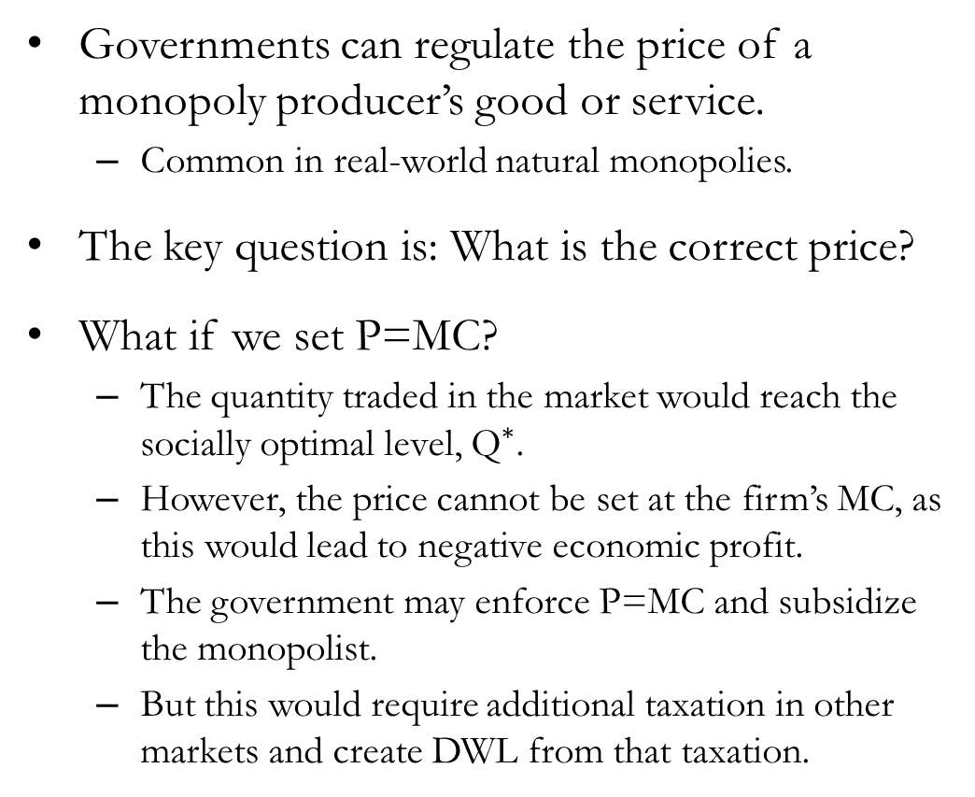
Regulation
Cost and
Revenue
Governments can regulate the price of a monopoly producer’s good or service.
  Common in real-world natural monopolies.
The key question is: What is the correct price?
What if we set P=MC?
  The quantity traded in the market would reach the socially optimal level, ${\text{Q}}^{∗}$.
  However, the price cannot be set at the firm’s MC, as this would lead to negative economic profit.
  The government may enforce P=MC and subsidize the monopolist.
  But this would require additional taxation in other markets and create DWL from that taxation.
ATC
MC
D
$${\text{Q}}^{∗}$$
Output

Slide 38

Public Ownership
Instead of regulating a natural monopoly run by a private firm, the government can operate the monopoly directly.
A common solution to natural monopolies more popular outside the U.S.
The U.S. Post Office Department (now USPS) was a publicly owned natural monopoly.
Public ownership often reduces incentives for innovation and may lead to lower efficiency.

Slide 39
Do Nothing
Each of the preceding policies aimed at reducing the problem of monopoly has drawbacks.
Some economists argue that the government should be cautious not to make matters worse when attempting to correct monopoly pricing.
“A famous theorem in economics states that a competitive enterprise economy will produce the largest possible income from a given stock of resources. No real economy meets the exact conditions of the theorem, and all real economies will fall short of the ideal economy—a difference called market failure. In my view, however, the degree of market failure for the American economy is much smaller than the political failure arising from the imperfections of economic policies found in real political systems.”

Slide 40
Recap of Chapter 16

Slide 41
Recap
A monopoly is a firm that is the sole seller of a product without close substitutes.
Monopolies may arise due to:
  Exclusive access to key resources
  Government creation or protection
  Natural monopoly conditions
  Technological advantages
A monopolist is similar to a firm in a competitive market in that it:
  Aims to maximize profits
  Follows the rule for profit maximization, MR=MC
  Can earn positive economic profits in the short run

Slide 42
Recap
A monopoly differs from a firm in a competitive market in that it:
  Can influence the market price by adjusting output
  Faces a marginal revenue curve below the market price of the good
  Sets the market price above marginal cost
  Produces less than the socially optimal level of output
  Can earn sustained positive economic profit in the long run
  Can engage in price discrimination
Public policies often aim to curb the market power of monopolies by:
  Promoting competition
  Regulating firm behavior
  Converting private monopolies into public enterprises
  In some cases, choosing to take no action

