Slide 1
PRINCIPLES OF GLOBAL ECONOMICS
Chapter 15: Firms in Competitive Markets

Slide 2
Preview
Up to this point, we have examined how firms make production and cost decisions.
Now we extend our analysis to how these firms interact in perfectly competitive markets.
In a competitive market:
There are many buyers and sellers, each too small to influence the market price.
Goods offered for sale are largely identical.
Firms can freely enter or exit the market in the long run.
Because firms are price takers, their decisions about output determine quantity, not price.
In this chapter, we connect individual firm behavior to market outcomes, showing how prices and profits adjust in both the short run and the long run.

Slide 3
Competitive Markets

Slide 4
Two Characteristics of Competitive Markets
Perfectly competitive markets have many buyers and many sellers.
Because the market has many participants, no single buyer or seller can influence the market price.
e.g., In a smaller market, a single buyer who account for 30% of all purchases may demand a discount, but this is not the case in a perfectly competitive market.
Goods traded in a perfectly competitive market are largely identical.
Since the goods traded in the market are identical, the only dimension of competition is price.
e.g., If two products are nearly identical, buyers will always choose the cheaper option.
The two characteristics above together guarantee that all consumers and producers act as price takers, agents who accept the market determined price, in a competitive market.
We also assume that in a perfectly competitive market, there is no cost of entry or exit.

Slide 5

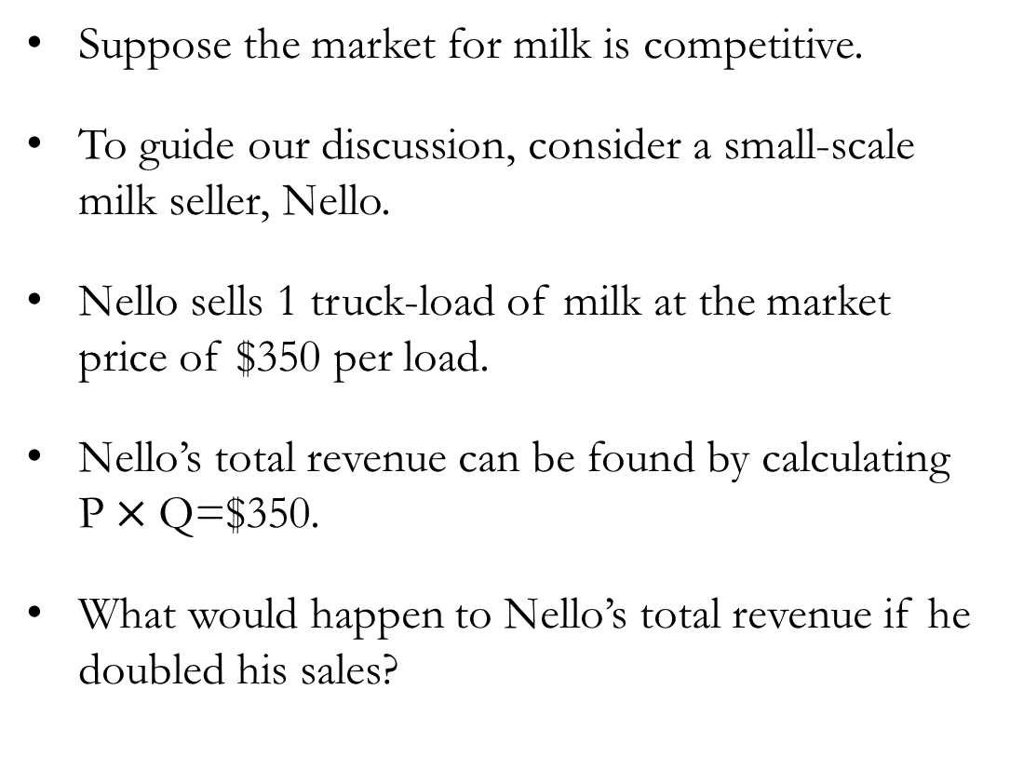
Revenue of Competitive Firms
Suppose the market for milk is competitive.
To guide our discussion, consider a small-scale milk seller, Nello.
Nello sells 1 truck-load of milk at the market price of $350 per load.
Nello’s total revenue can be found by calculating $\text{P}×\text{Q}\text{=}$$350.
What would happen to Nello’s total revenue if he doubled his sales?

Slide 6
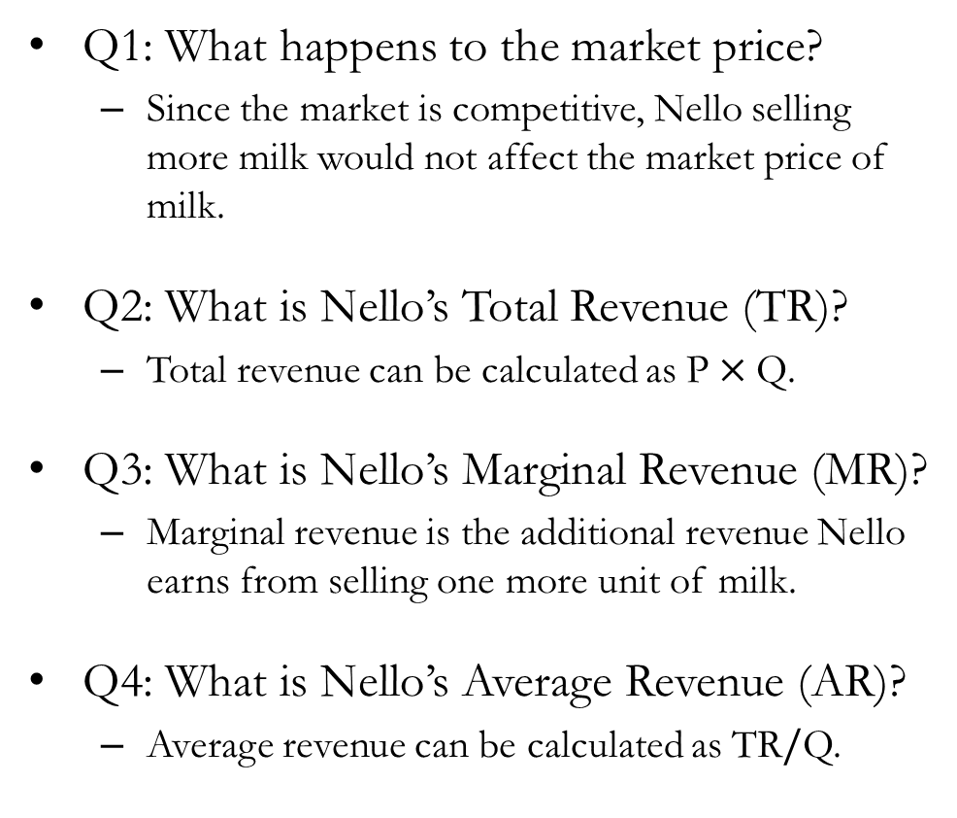
Revenue of Firms in Competitive Markets
Quantity | Price | Total Revenue | Marginal Revenue | Average Revenue
0 | $350 | $0 | - | -
1 | $350 | $350 | $350 | $350
2 | $350 | $700 | $350 | $350
3 | $350 | $1,050 | $350 | $350
4 | $350 | $1,400 | $350 | $350
5 | $350 | $1,750 | $350 | $350
6 | $350 | $2,100 | $350 | $350
7 | $350 | $2,450 | $350 | $350
8 | $350 | $2,800 | $350 | $350
Q1: What happens to the market price?
Since the market is competitive, Nello selling more milk would not affect the market price of milk.
Q2: What is Nello’s Total Revenue (TR)?
Total revenue can be calculated as $\text{P}×\text{Q}$.
Q3: What is Nello’s Marginal Revenue (MR)?
Marginal revenue is the additional revenue Nello earns from selling one more unit of milk.
Q4: What is Nello’s Average Revenue (AR)?
Average revenue can be calculated as $\text{TR}/\text{Q}$.
Quantity | Price | Total Revenue | Marginal Revenue | Average Revenue
0 | $350 | $0 | -
1 | $350 | $350 | $350
2 | $350 | $700 | $350
3 | $350 | $1,050 | $350
4 | $350 | $1,400 | $350
5 | $350 | $1,750 | $350
6 | $350 | $2,100 | $350
7 | $350 | $2,450 | $350
8 | $350 | $2,800 | $350
Quantity | Price | Total Revenue | Marginal Revenue | Average Revenue
0 | $350
1 | $350 | $350
2 | $350
3 | $350
4 | $350
5 | $350
6 | $350
7 | $350
8 | $350
Quantity | Price | Total Revenue | Marginal Revenue | Average Revenue
0 | $350 | $0
1 | $350 | $350
2 | $350 | $700
3 | $350 | $1,050
4 | $350 | $1,400
5 | $350 | $1,750
6 | $350 | $2,100
7 | $350 | $2,450
8 | $350 | $2,800
Quantity | Price | Total Revenue | Marginal Revenue | Average Revenue
0
1 | $350 | $350
2
3
4
5
6
7
8

Slide 7
Quick Recap
Total Revenue (TR)
The total income a firm earns from selling its goods or services before any costs are deducted.
Marginal Revenue (MR)
The additional income generated from selling one more unit of a good or service.
Average Revenue (AR)
A firm’s total revenue divided by the number of units sold, representing the average revenue earned per unit.
TR = P×Q MR = $\frac{∆\text{TR}}{∆\text{Q}}$ AR = $\frac{\text{TR}}{\text{Q}}$

Slide 8
Profit Maximization and
the Firm’s Supply Curve

Slide 9
Profit Maximization: A Simple Example
Q | TR | TC | MR | MC | Profit
0 | $0 | $100 | - | -
1 | $350 | $350 | $350 | $250
2 | $700 | $625 | $350 | $275
3 | $1,050 | $925 | $350 | $300
4 | $1,400 | $1,250 | $350 | $325
5 | $1,750 | $1,600 | $350 | $350
6 | $2,100 | $1,975 | $350 | $375
7 | $2,450 | $2,375 | $350 | $400
8 | $2,800 | $2,800 | $350 | $425
Nello’s objective is to maximize his profit (Revenue − Cost).
Notice that Nello’s profit is maximized at either 4 or 5 units of output.
Another way to arrive at this conclusion is by comparing the Marginal Revenue (MR) and Marginal Cost (MC) for each unit produced.
Claim: Profit is maximized when MR equals MC.
Q | TR | TC | MR | MC | Profit
0 | $0 | $100 | - | - | -$100
1 | $350 | $350 | $350 | $250 | $350
2 | $700 | $625 | $350 | $275 | $75
3 | $1,050 | $925 | $350 | $300 | $125
4 | $1,400 | $1,250 | $350 | $325 | $150
5 | $1,750 | $1,600 | $350 | $350 | $150
6 | $2,100 | $1,975 | $350 | $375 | $125
7 | $2,450 | $2,375 | $350 | $400 | $75
8 | $2,800 | $2,800 | $350 | $425 | $0

Slide 10
The Relationship Between MR, MC, and Profit
Q | TR | TC | MR | MC | Profit
0 | $0 | $100 | - | - | -$100
1 | $350 | $350 | $350 | $250 | $350
2 | $700 | $625 | $350 | $275 | $75
3 | $1,050 | $925 | $350 | $300 | $125
4 | $1,400 | $1,250 | $350 | $325 | $150
5 | $1,750 | $1,600 | $350 | $350 | $150
6 | $2,100 | $1,975 | $350 | $375 | $125
7 | $2,450 | $2,375 | $350 | $400 | $75
8 | $2,800 | $2,800 | $350 | $425 | $0
When MR>MC:
By increasing output by one unit, Nello earns more in sales (MR) than the cost of producing that unit (MC).
Therefore, when MR > MC, Nello should increase production and sell more milk.
When MR<MC:
Selling one additional unit earns less in sales (MR) than the cost of producing it (MC).
Therefore, when MR < MC, Nello should reduce production and sell less milk.
Profit is maximized where MR = MC.

Slide 11
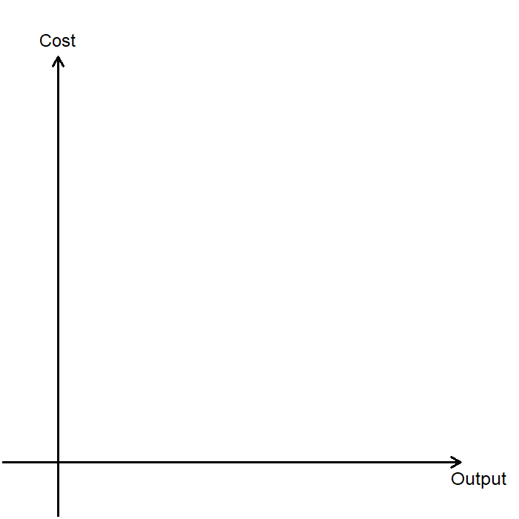
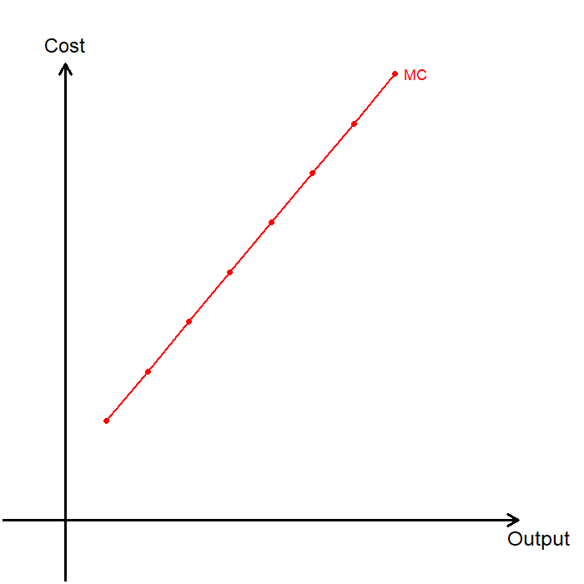
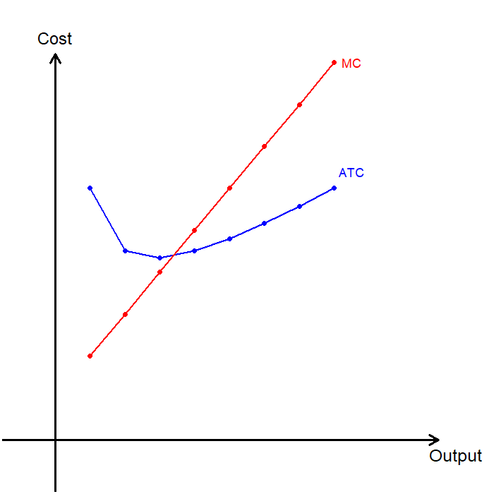
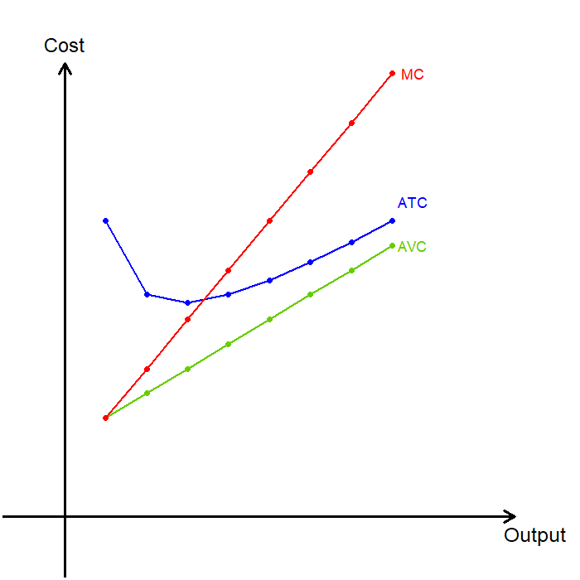
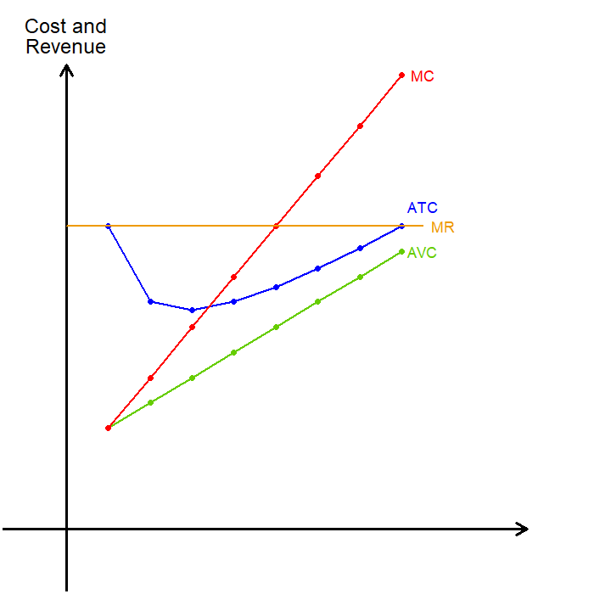
MC, ATC, AVC, and MR
Q | TC | FC | VC | MC | ATC | AVC
0 | $100 | $100 | - | - | -
1 | $350 | $100 | $250 | $250 | $350 | $250
2 | $625 | $100 | $525 | $275 | $312.5 | $262.5
3 | $925 | $100 | $825 | $300 | $308.33 | $275
4 | $1,250 | $100 | $1,150 | $325 | $312.5 | $287.5
5 | $1,600 | $100 | $1,500 | $350 | $320 | $300
6 | $1,975 | $100 | $1,875 | $375 | $329.17 | $312.5
7 | $2,375 | $100 | $2,275 | $400 | $339.29 | $325
8 | $2,800 | $100 | $2,700 | $425 | $350 | $337.5
The firm’s marginal revenue (MR) is $350, represented by the horizontal line at the market price.

Slide 12
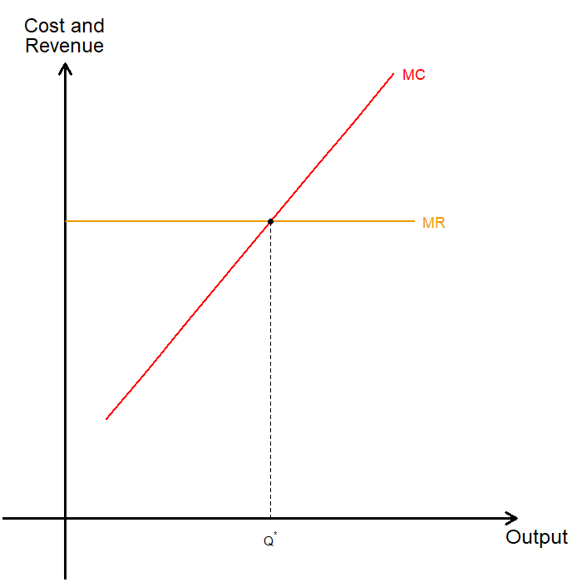
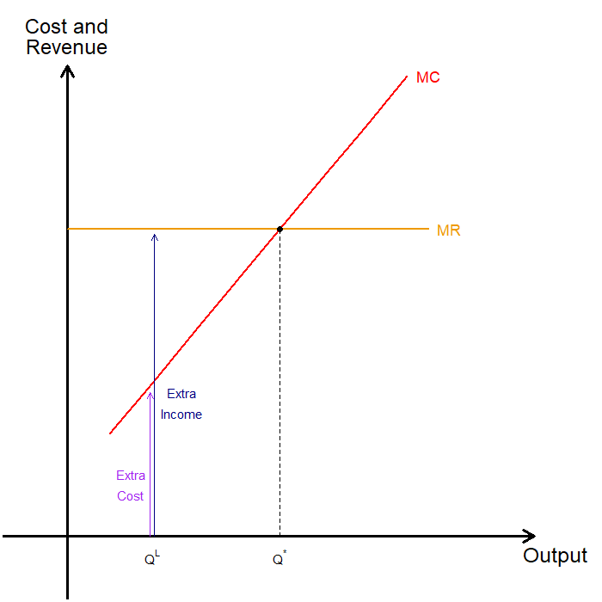
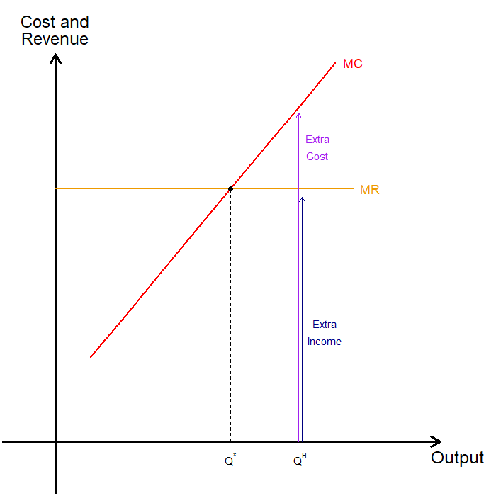
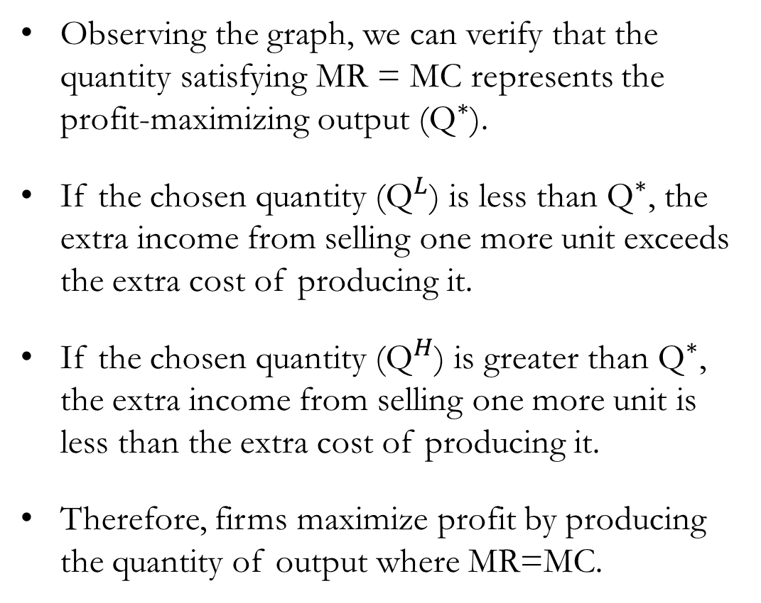
Profit Maximization at MR = MC
Observing the graph, we can verify that the quantity satisfying MR = MC represents the profit-maximizing output (${\text{Q}}^{∗}$).
If the chosen quantity (${\text{Q}}^{L}$) is less than ${\text{Q}}^{∗}$, the extra income from selling one more unit exceeds the extra cost of producing it.
If the chosen quantity (${\text{Q}}^{H}$) is greater than ${\text{Q}}^{∗}$, the extra income from selling one more unit is less than the extra cost of producing it.
Therefore, firms maximize profit by producing the quantity of output where MR=MC.

Slide 13
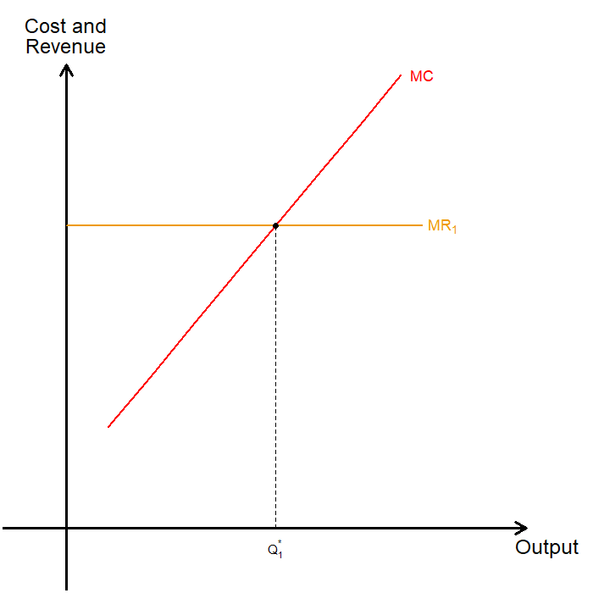
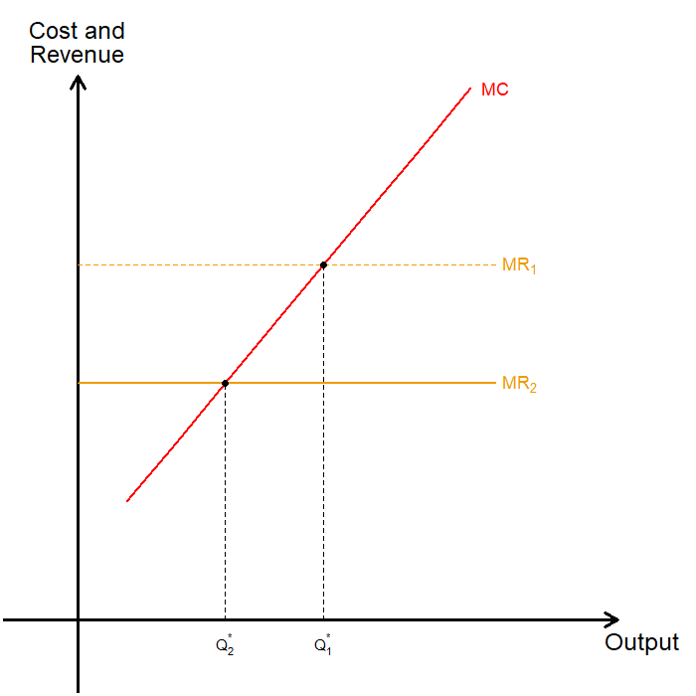
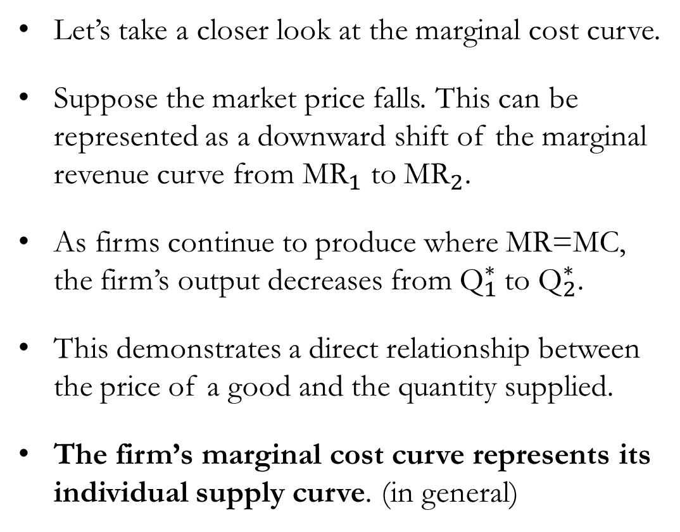
MC and the Supply Curve
Let’s take a closer look at the marginal cost curve.
Suppose the market price falls. This can be represented as a downward shift of the marginal revenue curve from ${\text{MR}}_{1}$ to ${\text{MR}}_{2}$.
As firms continue to produce where MR=MC, the firm’s output decreases from ${\text{Q}}_{1}^{∗}$to ${\text{Q}}_{2}^{∗}$.
This demonstrates a direct relationship between the price of a good and the quantity supplied.
The firm’s marginal cost curve represents its individual supply curve. (in general)

Slide 14
Supply in the Short-Run
Cost and
Revenue
In the short run, firms will decide to shut down production if the revenue they would earn is less than their variable cost of production.
Why not shut down when TR<TC?
In the short run, fixed costs are unavoidable.
Even if the firm produces zero units of output, fixed costs must still be paid.
Therefore, fixed costs are sunk costs, as they cannot be recovered and should not affect the shutdown decision.
Sunk costs are costs that have already been committed, and cannot be recovered.
MC
SR: Shutdown if TR<VC
ATC
AVC
Output

Slide 15

Detour: The Sunk Cost Fallacy
In the 1960s, Britain and France jointly developed the Concorde, a supersonic passenger jet.
The project faced massive cost overruns and limited demand, yet both governments continued funding it for decades.
However, decision-makers justified continued spending by arguing that “too much had already been invested to stop now.”
The earlier investments were sunk costs, money that could not be recovered and should not have affected future decisions.

Slide 16

Supply in the Short-Run
Cost and
Revenue
Let’s do a little bit of math:
In the short run, the firm produces along the MC curve as long as P≥AVC.
But if P<AVC, the firm shuts down and chooses to produce zero units of output.
$\text{TR}\text{<}\text{VC}$ $⟹$ $\frac{\text{TR}}{\text{Q}}<\frac{\text{VC}}{\text{Q}}$ $⟹$ $\text{P}\text{<}\text{A}\text{VC}$
MC
ATC
AVC
The competitive firm’s short-run supply curve is the portion of its MC curve that
lies above the AVC curve
Output

Slide 17

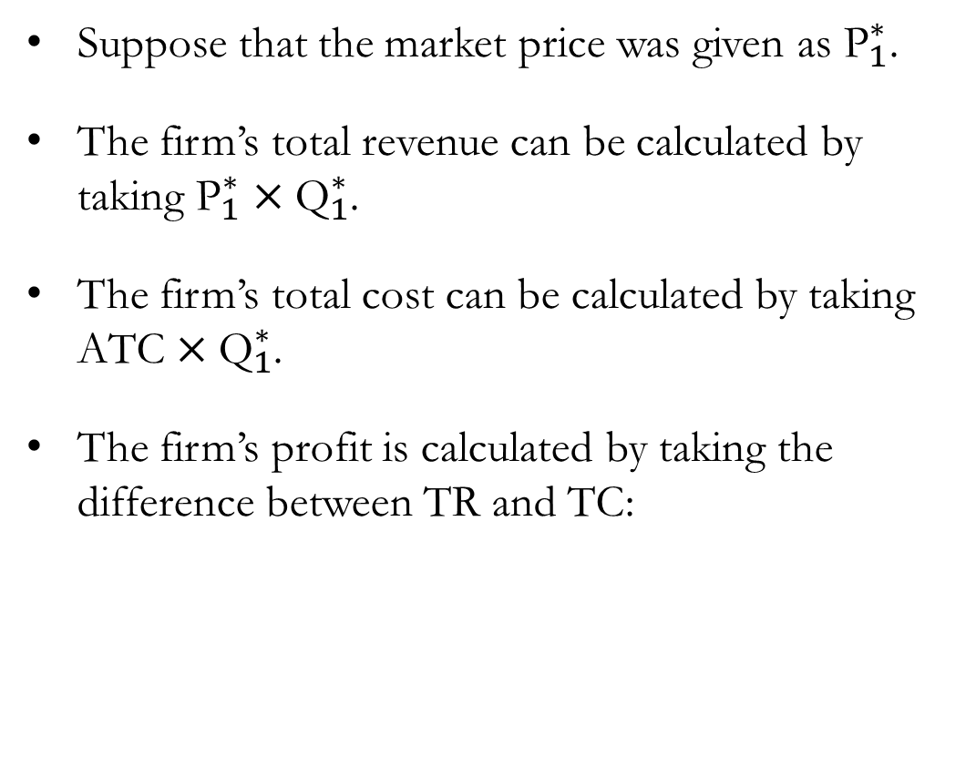



Firms with Positive Profits
Cost and
Revenue
Suppose that the market price was given as ${\text{P}}_{1}^{∗}$.
The firm’s total revenue can be calculated by taking ${\text{P}}_{1}^{∗}×{\text{Q}}_{1}^{∗}$.
The firm’s total cost can be calculated by taking $\text{ATC}×{\text{Q}}_{1}^{∗}$.
The firm’s profit is calculated by taking the difference between TR and TC:
MC
ATC
$${\text{P}}_{1}^{∗}$$
$${\text{MR}}_{1}$$
Profit = $\left({\text{P}}_{1}^{∗}−\text{ATC}\right)×{\text{Q}}_{1}^{∗}$
$${\text{Q}}_{1}^{∗}$$
Output

Slide 18

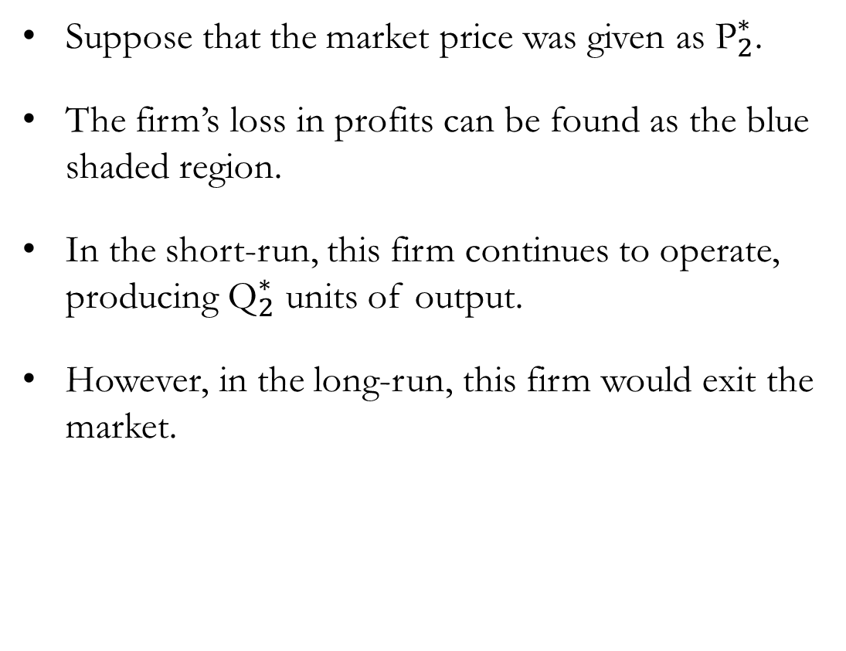


Firms with Negative Profits
Cost and
Revenue
Suppose that the market price was given as ${\text{P}}_{2}^{∗}$.
The firm’s loss in profits can be found as the blue shaded region.
In the short-run, this firm continues to operate, producing ${\text{Q}}_{2}^{∗}$ units of output.
However, in the long-run, this firm would exit the market.
MC
ATC
AVC
$${\text{P}}_{2}^{∗}$$
$${\text{MR}}_{2}$$
$${\text{Q}}_{2}^{∗}$$
Output

Slide 19
Supply in the Long-Run
Cost and
Revenue
In the long run, firms will decide to exit the market if the revenue they would earn is less than their total cost of production.
Reminder that in the long run, fixed costs do not exist, as it can be recovered by exiting the market altogether.
Entry into the market works similarly: firms enter the market when TR>TC.
MC
LR: Exit Market if TR<TC
ATC
Output

Slide 20

Supply in the Long-Run
Cost and
Revenue
Using a bit of math:
In the long run, firms will…
Exit the market if the price of the good is less than the average total cost of production.
Enter the market if the price of the good is greater than the average total cost of production.
The competitive firm’s long-run supply curve is the portion of its marginal-cost curve that lies above the average-total-cost curve.
$\text{TR}\text{<}\text{TC}$ $⟹$ $\frac{\text{TR}}{\text{Q}}<\frac{\text{T}\text{C}}{\text{Q}}$ $⟹$ $\text{P}\text{<}\text{AT}\text{C}$
MC
ATC
Output

Slide 21
The Supply Curve in a
Competitive Market

Slide 22
Market Supply
To move from individual firms’ supply functions to the market supply, we make several simplifying assumptions:
First, all existing firms and potential entrants have identical cost curves.
Second, each firm’s costs do not change as other firms enter or exit the market.
Finally, the number of firms in the market is fixed in the short run but variable in the long run.
We also assume that in a perfectly competitive market, there is no cost of entry or exit.

Slide 23







Market Supply in the Short-Run
Cost and
Revenue
Assuming P≥AVC, each firm produces its profit-maximizing quantity ${\text{Q}}^{∗}$ where MR=MC.
Using individual firms’ marginal cost curves, we can derive their supply schedule:
Note that the supply schedule shown above is abridged, listing only three possible price–quantity combinations.
MC
ATC
P | Q
P | Q
$5 | 5
$10 | 10
$15 | 15
P | Q
$5 | 5
$10 | 10
P | Q
$5 | 5
$$\$15$$
AVC
$$\$10$$
$$\$5$$
$$5$$
$$10$$
$$15$$
Output

Slide 24
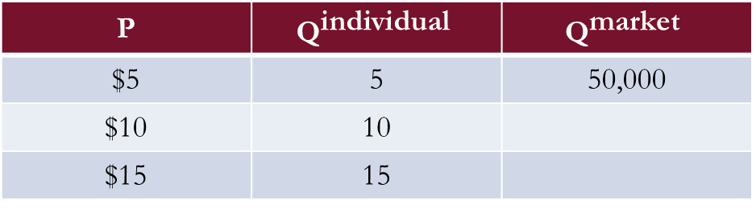

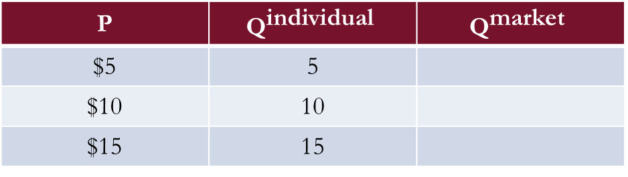

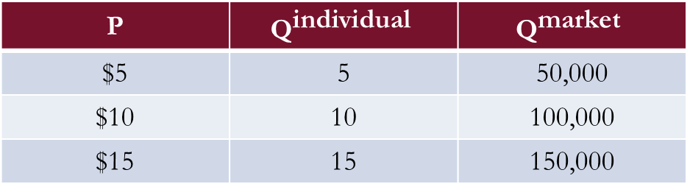
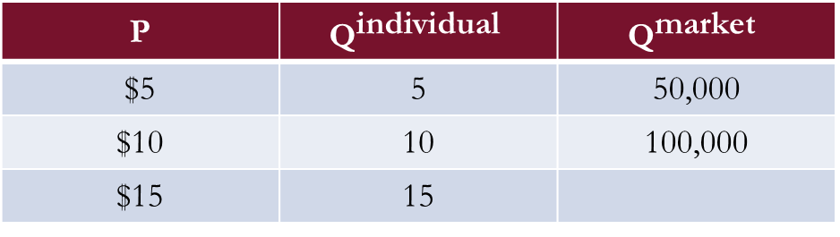

Market Supply in the Short-Run
Price
Suppose we have 10,000 firms in the market:
By plotting the relationship between the market price and the total quantity supplied, we obtain the market supply curve in the short run.
P | $${\text{Q}}^{\text{individual}}$$ | $${\text{Q}}^{\text{market}}$$
$5 | 5
$10 | 10
$15 | 15
P | $${\text{Q}}^{\text{individual}}$$ | $${\text{Q}}^{\text{market}}$$
$5 | 5 | 50,000
$10 | 10
$15 | 15
P | $${\text{Q}}^{\text{individual}}$$ | $${\text{Q}}^{\text{market}}$$
$5 | 5 | 50,000
$10 | 10 | 100,000
$15 | 15
P | $${\text{Q}}^{\text{individual}}$$ | $${\text{Q}}^{\text{market}}$$
$5 | 5 | 50,000
$10 | 10 | 100,000
$15 | 15 | 150,000
S
$$\$15$$
$$\$10$$
$$\$5$$
$$50,000$$
$$100,000$$
$$150,000$$
Output

Slide 25
Market Supply in the Long-Run
Now consider the long run, when firms can freely enter and exit the market.
Through the process of entry and exit, all firms that remain in the market will eventually earn zero economic profit in the long run.
If firms in the market are earning positive economic profits:
New producers are attracted to enter.
Entry of new producers lowers the market price of the good.
Profits shrink for all firms in the market.
If firms are earning negative economic profits:
Some existing producers will exit the market.
Exit of producers raises the market price of the good.
Profits increase for all firms in the market.

Slide 26

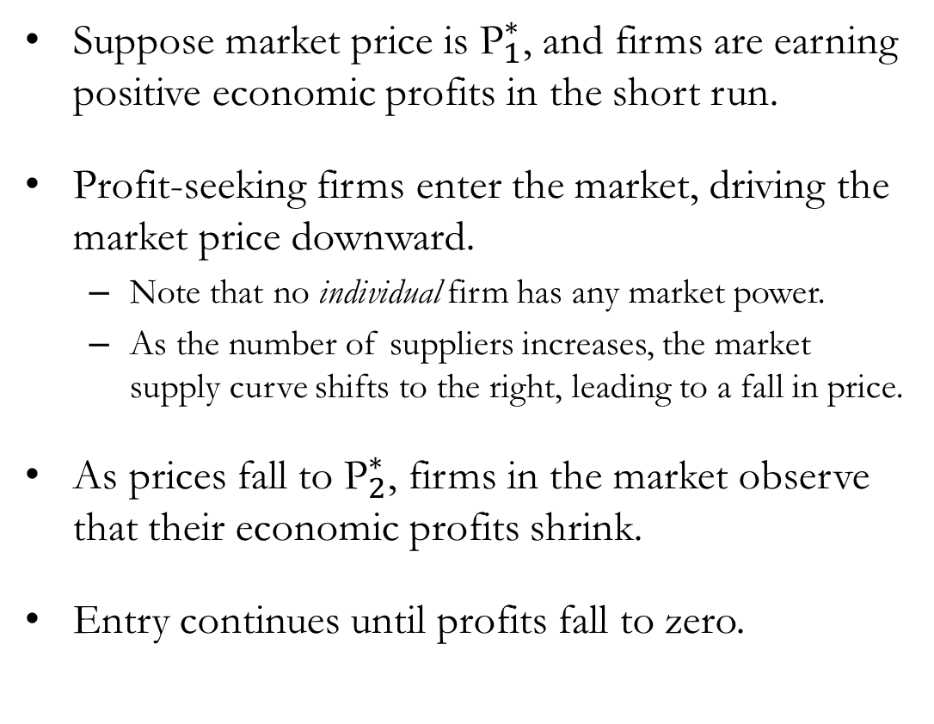

Positive Profits in the Long-Run
Cost and
Revenue
Suppose market price is ${\text{P}}_{1}^{∗}$, and firms are earning positive economic profits in the short run.
Profit-seeking firms enter the market, driving the market price downward.
Note that no individual firm has any market power.
As the number of suppliers increases, the market supply curve shifts to the right, leading to a fall in price.
As prices fall to ${\text{P}}_{2}^{∗}$, firms in the market observe that their economic profits shrink.
Entry continues until profits fall to zero.
MC
ATC
$${\text{P}}_{1}^{∗}$$
$${\text{P}}_{2}^{∗}$$
$${\text{Q}}_{2}^{∗}$$
$${\text{Q}}_{1}^{∗}$$
Output

Slide 27


Positive Profits in the Long-Run
Cost and
Revenue
Price
$${\text{S}}_{1}$$
$${\text{S}}_{2}$$
MC
ATC
$${\text{P}}_{1}^{∗}$$
$${\text{P}}_{2}^{∗}$$
D
$${\text{Q}}_{2}^{∗}$$
$${\text{Q}}_{1}^{∗}$$
Output
Output

Slide 28
Market Supply in the Long-Run
A similar process occurs when firms in the market face negative economic profits.
We can observe a few key points:
Free entry and exit force the market price to equal average total cost (ATC).
Profit-maximizing firms produce where MR = MC.
ATC and MC are equal only at the lowest point of the ATC curve (the bottom of the U-shape).
The quantity that minimizes ATC is called the efficient scale.
Therefore, in the long-run equilibrium of a competitive market with free entry and exit, firms operate at their efficient scale.
Only one price prevails in the market, and the long-run supply curve is horizontal (perfectly elastic) at the minimum of average total cost.

Slide 29



Positive Profits in the Long-Run
Cost and
Revenue
Price
MC
ATC
$${\text{P}}^{∗}$$
$${\text{S}}_{LR}$$
$${\text{Q}}^{∗}$$
Output
Output

Slide 30

Zero (Economic) Profits
One might ask: Why would any firm stay in a market where profits are zero?
Note that the “profit” we are discussing here refers to economic profits:
Accounting Profit: Total Revenue – Explicit Costs
Economic Profit: Total Revenue – Explicit and Implicit Costs
A firm earning zero economic profit is still covering all its opportunity costs.

Slide 31
Shifts in the Demand Function
Suppose that, as consumers’ tastes change, the demand for milk increases.
As demand increases (the demand curve shifts to the right), the market price rises.
The higher market price leads to short-run economic profits for producers in the market.
These positive profits attract new producers to enter the market, causing the supply curve to shift to the right.
As the supply curve shifts rightward, market prices fall until all firms in the market once again earn zero economic profit.

Slide 32






Shifts in the Demand Function
Cost and
Revenue
Price
MC
$${\text{S}}_{1}$$
ATC
$${\text{P}}_{2}^{∗}$$
$${\text{P}}_{1}^{∗}$$
$${\text{D}}_{2}$$
$${\text{D}}_{1}$$
$${\text{Q}}_{1}^{∗}$$
$${\text{Q}}_{2}^{∗}$$
Output
Output

Slide 33

Shifts in the Demand Function
Cost and
Revenue
Price
MC
$${\text{S}}_{1}$$
ATC
$${\text{S}}_{2}$$
$${\text{P}}_{2}^{∗}$$
$${\text{P}}_{1}^{∗}$$
$${\text{D}}_{2}$$
$${\text{D}}_{1}$$
$${\text{Q}}_{1}^{∗}$$
$${\text{Q}}_{2}^{∗}$$
Output
Output

Slide 34
Non-Horizontal Long-Run Supply
In the real world, the long-run supply curve may slope upward for two main reasons.
First: Costs may increase as more producers enter the market.
As more milk producers enter the market, the amount of available grazing land may shrink.
Therefore, the cost of producing milk may rise as additional producers enter.
Second: Firms may have different costs of production.
In reality, producers with the lowest operating costs are the first to enter the market.
New producers entering later are likely to face higher operating costs.
Since the market price reflects the average total cost of the marginal firm, the long-run supply curve shifts upward.
Due to free entry and exit, LR supply is more elastic than SR supply.

Slide 35
Recap of Chapter 15

Slide 36
Recap
In a perfectly competitive market, many buyers and sellers trade identical products, and no individual participant can influence the market price.
Because firms are price takers, each firm’s total revenue equals P×Q, and its average and marginal revenue both equal the market price.
Firms maximize profit by producing the quantity where Marginal Revenue (MR) equals Marginal Cost (MC).
In the short run, a firm will continue producing as long as P≥AVC, and if P<AVC, the firm shuts down.
The portion of a firm’s MC curve above AVC represents its short-run supply curve.

Slide 37
Recap
In the long run, firms can freely enter or exit the market.
Entry occurs when existing firms earn positive economic profits.
Exit occurs when firms face economic losses.
This process of entry and exit ensures that all firms in the market earn zero economic profit in long-run (LR) equilibrium.
At LR equilibrium, P=MR=MC=minimum ATC, and firms operate at their efficient scale.
Market supply in the long run may be:
Horizontal, if costs remain constant as the industry expands.
Upward-sloping, if input costs rise or firms differ in efficiency.

