Slide 1
PRINCIPLES OF GLOBAL ECONOMICS
Chapter 14: The Costs of Production

Slide 2
Preview
Up to this point, we have handled the supply curve in two different but logically linked ways:
  The collection of answers to the question, “How many units of a good or service are you willing and able to sell at a given price X?”
  A marginal producer’s willingness to sell.
  A marginal producer’s cost of production.
Strictly speaking, the supply curve directly reflects the cost of production.
In this chapter, we take a closer look at the costs of production.

Slide 3
Total Cost

Slide 4
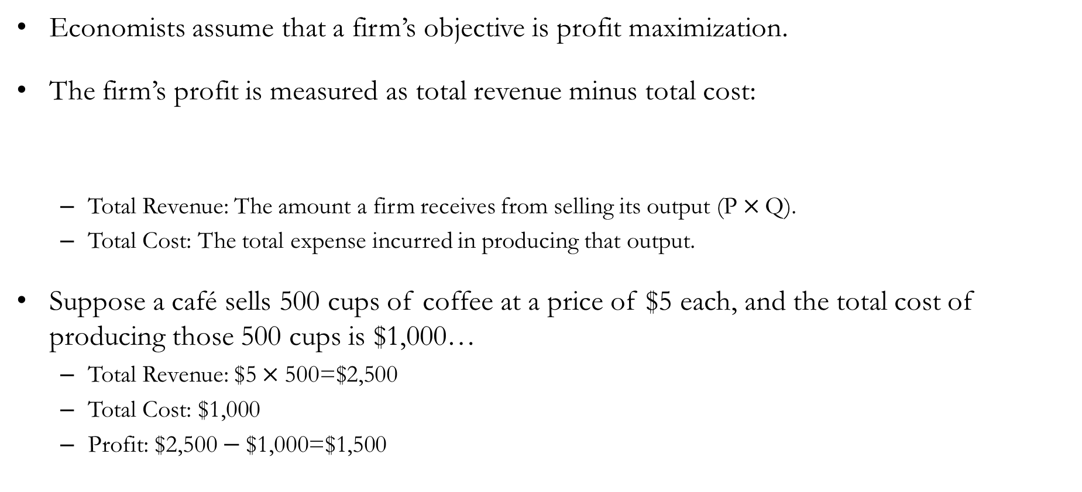
Profit, Total Revenue, and Total Cost
Economists assume that a firm’s objective is profit maximization.
The firm’s profit is measured as total revenue minus total cost:
  Total Revenue: The amount a firm receives from selling its output ($\text{P}×\text{Q}$).
  Total Cost: The total expense incurred in producing that output.
Suppose a café sells 500 cups of coffee at a price of $5 each, and the total cost of producing those 500 cups is $1,000…
  Total Revenue: $\text{\$5}×\text{500}\text{=\$2,500}$
  Total Cost: $\text{\$}\text{1}\text{,}\text{0}\text{00}$
  Profit: $\text{\$2,500}−\text{\$1,000}\text{=\$}\text{1}\text{,}\text{5}\text{00}$
Profit = Total Revenue – Total Cost

Slide 5
Total Cost: Opportunity Cost
When measuring a firm’s total cost of production, economists consider the firm’s opportunity cost, which includes both explicit and implicit costs.
Recap: The opportunity cost is the value of the best alternative forgone.
Explicit costs are input costs that require an outlay of money by the firm:
  Explicit costs are opportunity costs because the money could have been used for something else.
  e.g., The cost of purchasing coffee beans.
Implicit Costs are input costs that do not require an outlay of money by the firm:
  Implicit costs are opportunity costs because the owner could have used that time for something else.
  e.g., The value of forgone income for the owner of the café.
Total Cost = Explicit Cost + Implicit Cost

Slide 6
Accounting vs. Economic Profit
When we think about profits in everyday life, we tend to think of accounting profits.
Accounting Profit
  Total revenue minus explicit costs.
  Objective is to track how much money flows in and out of a firm.
Economic Profit
  Total revenue minus explicit and implicit costs.
  Objective is to study the production decisions of the firm, which are affected by implicit costs as well.
  Firms that makes positive economic profit will stay in business because it is covering all its opportunity costs and has some revenue left to reward the firm’s owners.
  When a firm makes negative economic profits, it is failing to bring in enough revenue to cover all the costs of production.

Slide 7
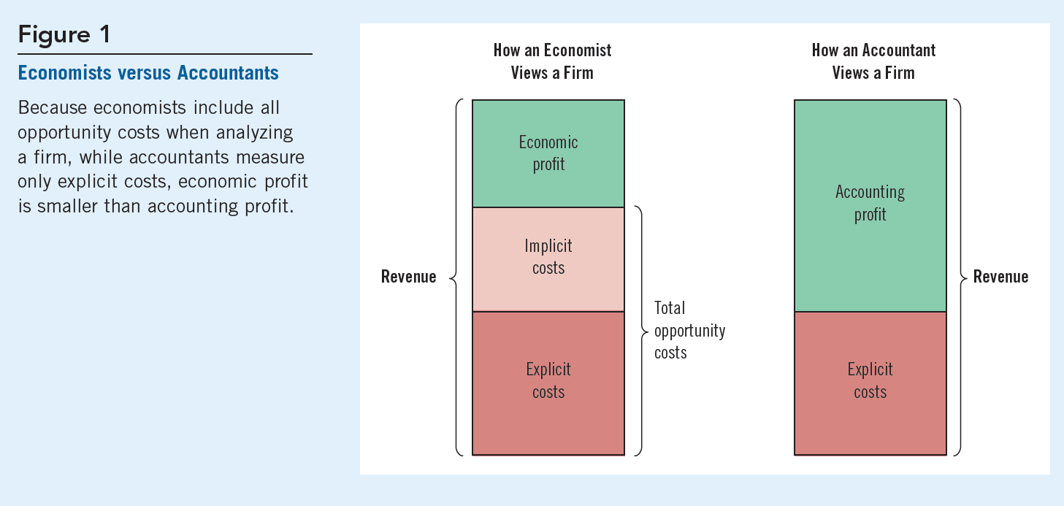
Total Cost: Accounting and Economic Costs

Slide 8

Total Cost: Counting Implicit Costs
Why do economists include implicit costs?
Suppose the best software engineer in the world started a café instead of working for NVIDIA.
The explicit cost of starting a café would cover only a fraction of the true total cost of that decision.
A median junior software engineer might earn $200,000 in base pay, plus at least $50,000 in bonuses, before stock options.
We should not ignore this forgone income when deciding whether to start a café!

Slide 9
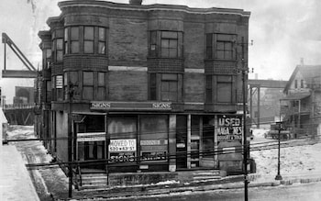
Exercise: Calculating Total Cost
Mr. Holmes operates a hotel in Chicago. He pays $300,000 a year for workers’ salaries and $200,000 for property upkeep. If he had not run a hotel, he could have worked as a pharmacist earning $150,000 per year instead.
Explicit Cost
  Workers’ salaries and the cost of upkeep
  $300,000 + $200,000 = $500,000
Implicit Cost
  Opportunity cost of Mr. Holmes’ time
  $150,000
Total Cost
  Explicit Cost + Implicit Cost
  $500,000 + $150,000 = $650,000

Slide 10
Exercise: Calculating Total Cost
Mr. Holmes operates a hotel in Chicago. He pays $300,000 a year for workers’ salaries and $200,000 for property upkeep. If he had not run a hotel, he could have worked as a pharmacist earning $150,000 per year instead. To build the hotel, he borrowed $500,000 at a 10% interest rate and withdrew another $500,000 from his savings account, which earns 5% interest annually.
Implicit Cost
  Opportunity cost of time and lost interest.
  $150,000 + $25,000 = $175,000
Explicit Cost
  Salaries, cost of upkeep, and interest.
  $300,000 + $200,000 + $50,000 = $550,000
Total Cost
  Explicit Cost + Implicit Cost.
  $550,000 + $175,000 = $725,000

Slide 11

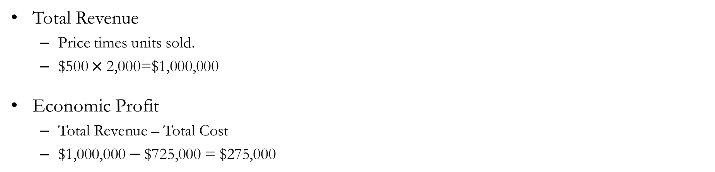
Exercise: Calculating Total Cost
Mr. Holmes operates a hotel in Chicago. He pays $300,000 a year for workers’ salaries and $200,000 for property upkeep. If he had not run a hotel, he could have worked as a pharmacist earning $150,000 per year instead. To build the hotel, he borrowed $500,000 at a 10% interest rate and withdrew another $500,000 from his savings account, which earns 5% interest annually. The hotel hosted 2,000 guests, each paying $500 for their stay.
Total Revenue
  Price times units sold.
  $\text{\$}\text{500}×\text{2,0}\text{00=\$}\text{1,000}\text{,}\text{0}\text{00}$
Economic Profit
  Total Revenue – Total Cost
  $\text{\$1,000,000}−\text{\$725,000 = \$275,000}$

Slide 12
Production and Costs

Slide 13
Production, Inputs, and Cost
Let’s examine the relationship between a firm’s production and its costs in the context of hotel management.
Some assumptions:
  Production is examined in the short run.
  The size of the hotel is fixed in the short run.
  The only way to increase output (serve more customers) is to hire additional workers.
The production function shows how the quantity of inputs determines the quantity of output.

Slide 14
Production, Inputs, and Cost
The table below shows the relationship between the number of workers, output, the marginal product of labor, and the costs of running the hotel.
Number of Workers | Output: Guests Serviced | Marginal Product of Labor | Labor Cost | Cost of Hotel | Total Cost
0 | 0 | N/A | $0 | $100,000 | $100,000
1 | 200 |  | $30,000 | $100,000 | $130,000
2 | 350 |  | $60,000 | $100,000 | $160,000
3 | 475 |  | $90,000 | $100,000 | $190,000
4 | 575 |  | $120,000 | $100,000 | $220,000
5 | 650 |  | $150,000 | $100,000 | $250,000
6 | 700 |  | $180,000 | $100,000 | $280,000

Slide 15
Marginal Products
The marginal product is the additional output generated by using one more unit of an input.
Number of Workers | Output: Guests Serviced | Marginal Product of Labor | Labor Cost | Cost of Hotel | Total Cost
0 | 0 | N/A | $0 | $100,000 | $100,000
1 | 200 | 200 | $30,000 | $100,000 | $130,000
2 | 350 | 150 | $60,000 | $100,000 | $160,000
3 | 475 | 125 | $90,000 | $100,000 | $190,000
4 | 575 | 100 | $120,000 | $100,000 | $220,000
5 | 650 | 75 | $150,000 | $100,000 | $250,000
6 | 700 | 50 | $180,000 | $100,000 | $280,000
Number of Workers | Output: Guests Serviced | Marginal Product of Labor | Labor Cost | Cost of Hotel | Total Cost
0 | 0 | N/A | $0 | $100,000 | $100,000
1 | 200 |  | $30,000 | $100,000 | $130,000
2 | 350 |  | $60,000 | $100,000 | $160,000
3 | 475 |  | $90,000 | $100,000 | $190,000
4 | 575 |  | $120,000 | $100,000 | $220,000
5 | 650 |  | $150,000 | $100,000 | $250,000
6 | 700 |  | $180,000 | $100,000 | $280,000

Slide 16
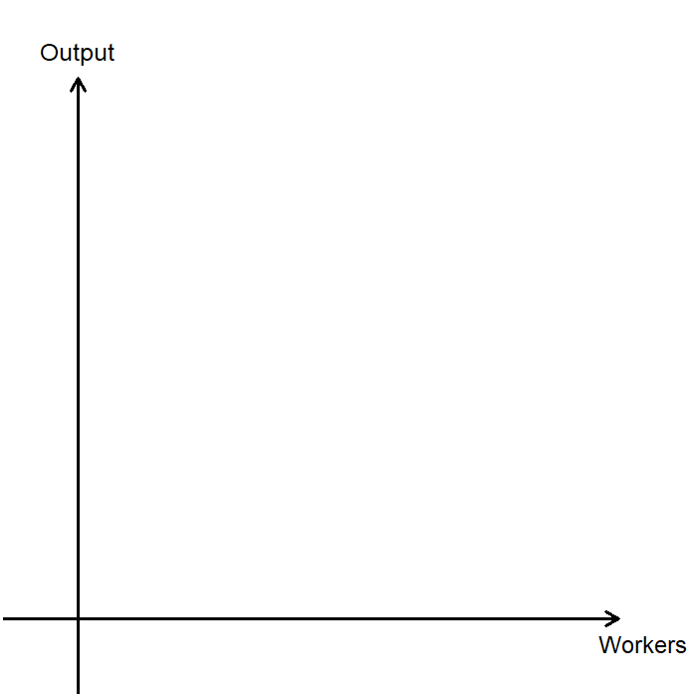
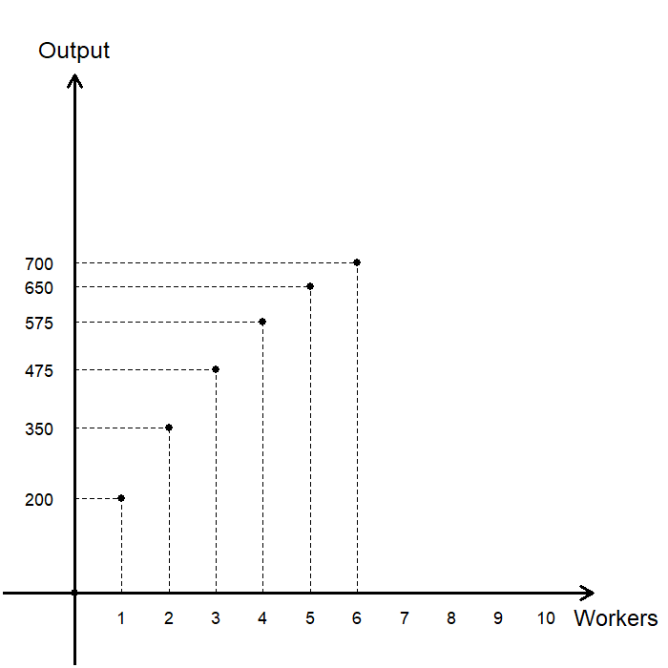
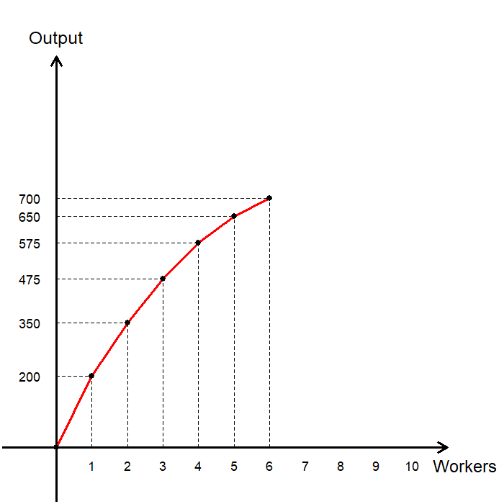
The Production Function
By plotting the relationship between the number of workers and the output, we can visualize the hotel’s production function.
Number of Workers | Output: Guests Serviced | Marginal Product of Labor
0 | 0 | N/A
1 | 200 | 200
2 | 350 | 150
3 | 475 | 125
4 | 575 | 100
5 | 650 | 75
6 | 700 | 50

Slide 17
Diminishing Marginal Product
Observe what happens as we hire more workers:
  With one worker, the hotel can serve 200 guests.
  Adding a second worker allows the hotel to serve 150 additional guests per day, for a total of 350 guests.
  Adding a third worker increases service by 125 guests per day, for a total of 475 guests.
As the number of workers increases, the marginal product of labor decreases.
Visually, the production function becomes flatter as output increases.

Slide 18
Diminishing Marginal Product
Diminishing Marginal Product refers to the property whereby the marginal product of an input declines as the quantity of the input increases.
Diminishing Marginal Product in the real world?
  Suppose you are running a factory.
  At first, there are 10 machines and only 5 workers.
  Each additional worker can operate an unused machine, so the marginal product is high.
  Now suppose you hire more workers so there are 10 machines and 10 workers.
  Each additional worker still contributes to production, as there may be tasks that don’t involve operating the machinery.
  Now suppose you have 10 machines but 100 workers.
  Adding another worker wouldn’t increase output much (or even decrease it), as the factory floor becomes overcrowded and workers get in each other’s way.

Slide 19
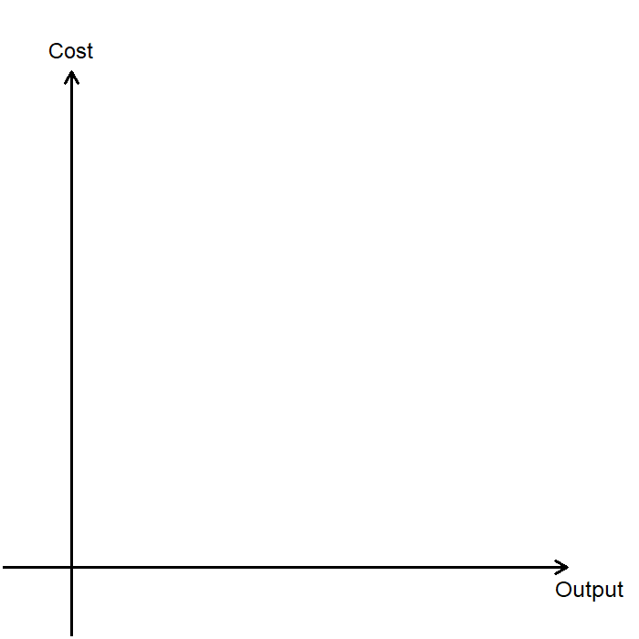
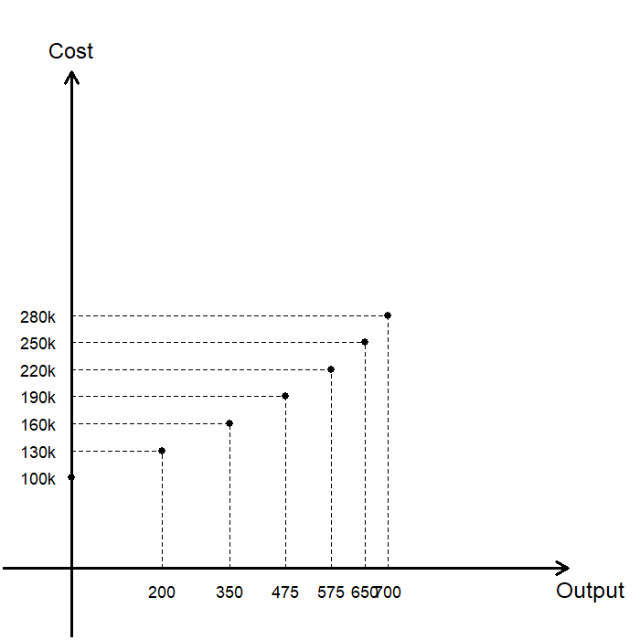
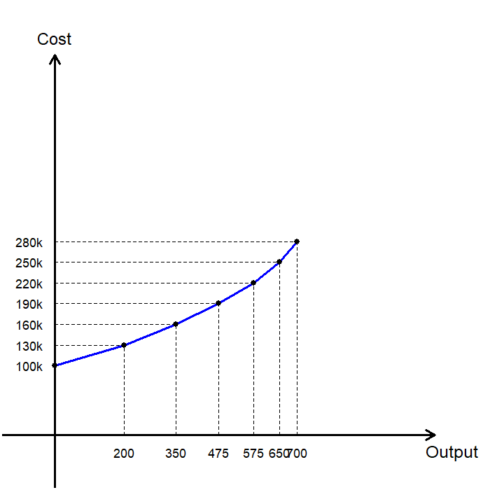
The Total Cost Curve
By plotting the relationship between the output and the cost of production, we can visualize the hotel’s total cost function.
Output: Guests Serviced | Total Cost
0 | $100,000
200 | $130,000
350 | $160,000
475 | $190,000
575 | $220,000
650 | $250,000
700 | $280,000

Slide 20
Various Measures of Cost

Slide 21
Fixed Cost and Variable Cost
Fixed Costs (FC) are costs that do not vary with the quantity of output produced.
  Fixed costs are incurred even if the firm does not produce any output.
  e.g., If Mr. Holmes hires a full-time bookkeeper for the hotel, it would be a fixed cost, as the bookkeeper would be paid a salary regardless of the number of guests served by the hotel.
Variable Costs (VC) are costs that vary with the quantity of output produced.
  Variable costs is 0 if the firm does not produce any output.
  e.g., The salaries of additional workers hired by the hotel would be an example of variable costs.
Total Cost of production includes both fixed and variable costs.

Slide 22
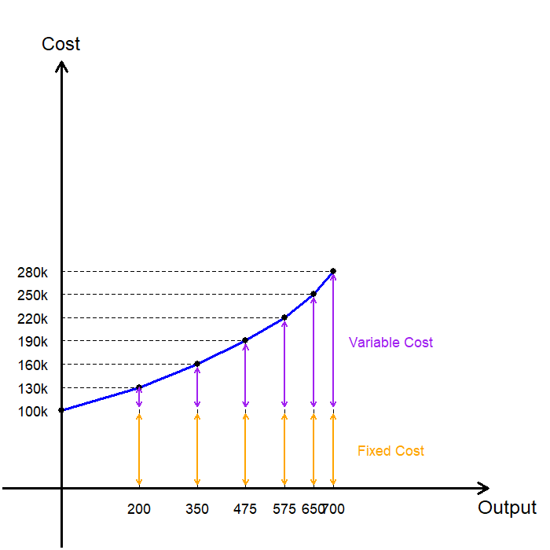
Fixed Cost and Variable Cost
In our numerical example on hotel management:
  Fixed Cost: Constant over output
  Variable Cost: Variable over output
Output: Guests Serviced | Labor Cost (VC) | Cost of Hotel (FC) | Total Cost (TC)
0 | $0 | $100,000 | $100,000
200 | $30,000 | $100,000 | $130,000
350 | $60,000 | $100,000 | $160,000
475 | $90,000 | $100,000 | $190,000
575 | $120,000 | $100,000 | $220,000
650 | $150,000 | $100,000 | $250,000
700 | $180,000 | $100,000 | $280,000

Slide 23
Average and Marginal Costs
Average costs represent the cost of producing each unit of output:
  Average Total Cost (ATC) is the total cost divided by the quantity of output.
  Average Fixed Cost (AFC) is the fixed cost divided by the quantity of output.
  Average Variable Cost (AVC) is the variable cost divided by the quantity of output.
Marginal Cost (MC) of production is the increase in total cost that results from producing one additional unit of output.
ATC = $\frac{\text{T}\text{otal} \text{Cost}}{\text{Q}}$ AFC = $\frac{\text{Fixed} \text{Cost}}{\text{Q}}$ AVC = $\frac{\text{Variable} \text{Cost}}{\text{Q}}$
MC = $\frac{\text{Change} \text{in} \text{Total} \text{Cost}}{\text{Change} \text{in} \text{Q}}\text{= }\frac{Δ\text{Total} \text{Cost}}{Δ\text{Q}}$

Slide 24
Exercise: Average and Marginal Costs
Output | VC | FC | TC | AVC | AFC | ATC | MC
0 | $0 | $3,000 | $3,000 | - | -
1 | $200 | $3,000 | $3,200 | $200 | $3,000
2 | $500 | $3,000 | $3,500 | $250 | $1,500
3 | $900 | $3,000 | $3,900 | $300 | $1,000
4 | $1,400 | $3,000 | $4,400 | $350 | $750
5 | $2,000 | $3,000 | $5,000 | $400 | $600
6 | $2,700 | $3,000 | $5,700 | $450 | $500
7 | $3,500 | $3,000 | $6,500 | $500 | $428.57
8 | $4,400 | $3,000 | $7,400 | $550 | $375
9 | $5,400 | $3,000 | $8,400 | $600 | $333.33
10 | $6,500 | $3,000 | $9,500 | $650 | $300
Output | VC | FC | TC | AVC | AFC | ATC | MC
0 | $0 | $3,000 | $3,000
1 | $200 | $3,000 | $3,200
2 | $500 | $3,000 | $3,500
3 | $900 | $3,000 | $3,900
4 | $1,400 | $3,000 | $4,400
5 | $2,000 | $3,000 | $5,000
6 | $2,700 | $3,000 | $5,700
7 | $3,500 | $3,000 | $6,500
8 | $4,400 | $3,000 | $7,400
9 | $5,400 | $3,000 | $8,400
10 | $6,500 | $3,000 | $9,500
Output | VC | FC | TC | AVC | AFC | ATC | MC
0 | $0 | $3,000 | $3,000 | -
1 | $200 | $3,000 | $3,200 | $200
2 | $500 | $3,000 | $3,500 | $250
3 | $900 | $3,000 | $3,900 | $300
4 | $1,400 | $3,000 | $4,400 | $350
5 | $2,000 | $3,000 | $5,000 | $400
6 | $2,700 | $3,000 | $5,700 | $450
7 | $3,500 | $3,000 | $6,500 | $500
8 | $4,400 | $3,000 | $7,400 | $550
9 | $5,400 | $3,000 | $8,400 | $600
10 | $6,500 | $3,000 | $9,500 | $650
Output | VC | FC | TC | AVC | AFC | ATC | MC
0 | $0 | $3,000 | $3,000 | - | - | -
1 | $200 | $3,000 | $3,200 | $200 | $3,000 | $3,200
2 | $500 | $3,000 | $3,500 | $250 | $1,500 | $1,750
3 | $900 | $3,000 | $3,900 | $300 | $1,000 | $1,300
4 | $1,400 | $3,000 | $4,400 | $350 | $750 | $1,100
5 | $2,000 | $3,000 | $5,000 | $400 | $600 | $1,000
6 | $2,700 | $3,000 | $5,700 | $450 | $500 | $950
7 | $3,500 | $3,000 | $6,500 | $500 | $428.57 | $928.57
8 | $4,400 | $3,000 | $7,400 | $550 | $375 | $925
9 | $5,400 | $3,000 | $8,400 | $600 | $333.33 | $933.33
10 | $6,500 | $3,000 | $9,500 | $650 | $300 | $950
Output | VC | FC | TC | AVC | AFC | ATC | MC
0 | $0 | $3,000 | $3,000 | - | - | - | -
1 | $200 | $3,000 | $3,200 | $200 | $3,000 | $3,200 | $200
2 | $500 | $3,000 | $3,500 | $250 | $1,500 | $1,750 | $300
3 | $900 | $3,000 | $3,900 | $300 | $1,000 | $1,300 | $400
4 | $1,400 | $3,000 | $4,400 | $350 | $750 | $1,100 | $500
5 | $2,000 | $3,000 | $5,000 | $400 | $600 | $1,000 | $600
6 | $2,700 | $3,000 | $5,700 | $450 | $500 | $950 | $700
7 | $3,500 | $3,000 | $6,500 | $500 | $428.57 | $928.57 | $800
8 | $4,400 | $3,000 | $7,400 | $550 | $375 | $925 | $900
9 | $5,400 | $3,000 | $8,400 | $600 | $333.33 | $933.33 | $1,000
10 | $6,500 | $3,000 | $9,500 | $650 | $300 | $950 | $1,100

Slide 25
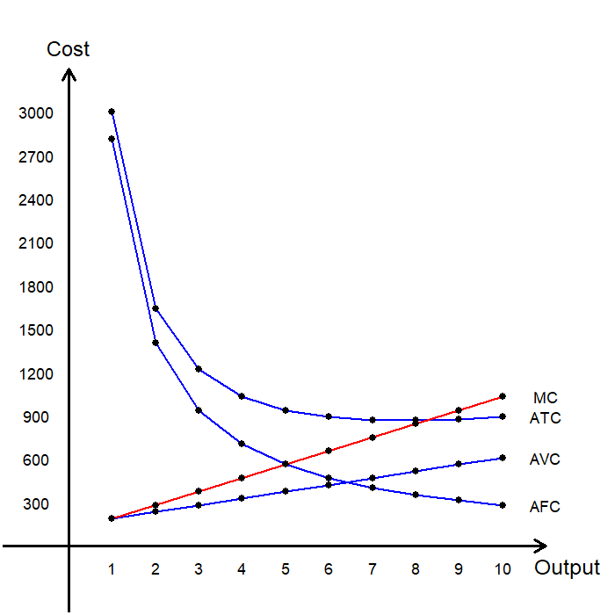
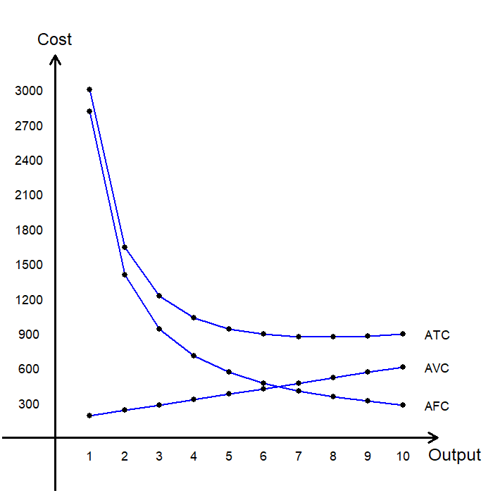
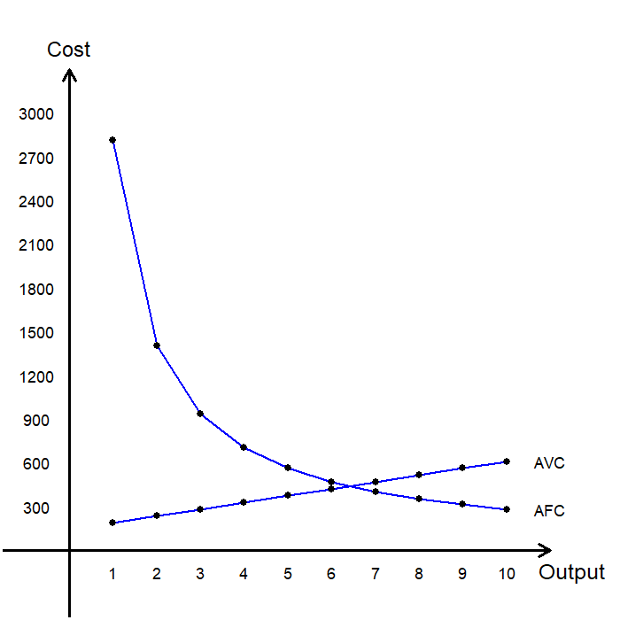
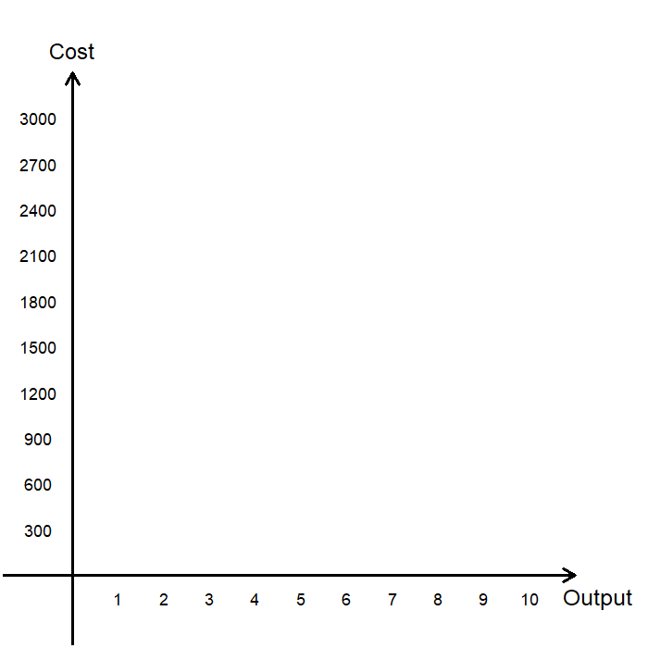
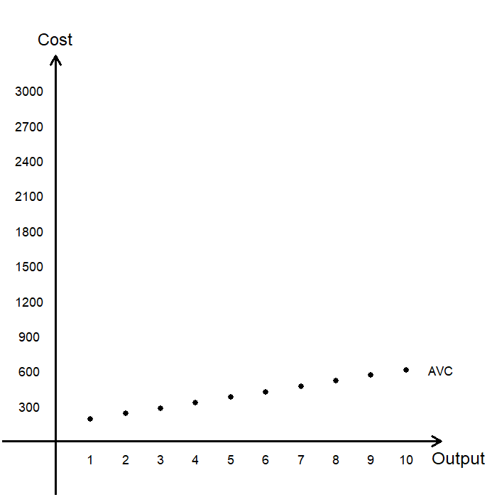
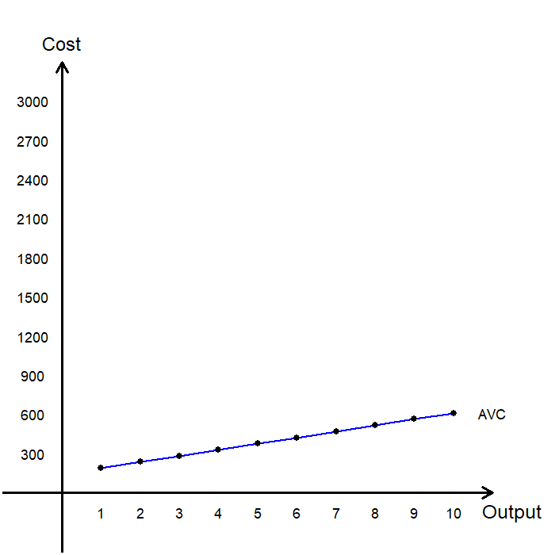
Average and Marginal Costs
Output | AVC | AFC | ATC | MC
0 | - | - | - | -
1 | $200 | $3,000 | $3,200 | $200
2 | $250 | $1,500 | $1,750 | $300
3 | $300 | $1,000 | $1,300 | $400
4 | $350 | $750 | $1,100 | $500
5 | $400 | $600 | $1,000 | $600
6 | $450 | $500 | $950 | $700
7 | $500 | $428.57 | $928.57 | $800
8 | $550 | $375 | $925 | $900
9 | $600 | $333.33 | $933.33 | $1,000
10 | $650 | $300 | $950 | $1,100

Slide 26
Characteristics of Cost Curves
Increasing Marginal Cost
  When the operation is small and inputs are underutilized, the marginal product of workers is high, so the cost of producing an extra unit is low.
  As the operation expands and inputs become overutilized, the marginal product of workers falls, and the cost of producing an extra unit rises.
U-Shaped Average Total Cost
  When output is low, the average fixed cost drops sharply, so the average total cost decreases.
  When output is high, the average variable cost dominates, driving the average total cost upward.
Efficient Scale
  The bottom of the U-shape occurs at the quantity that minimizes ATC.
  This quantity is called the Efficient Scale of the firm.

Slide 27
Characteristics of Cost Curves
Marginal Cost and Average Total Cost
  Whenever marginal cost is less than the average total cost, the ATC is falling.
  Whenever marginal cost is greater than the average total cost, the ATC is rising.
  The marginal cost curve passes through the lowest point of the ATC.
Analogy:
  Suppose you start the semester with a CGPA of 3.7
  If your GPA for this semester’s courses is 4.0, your CGPA will increase.
  If your GPA for this semester’s courses is 3.4, your CGPA will decrease.
  In this analogy, your CGPA is the ATC, and your GPA for this semester is the MC.

Slide 28
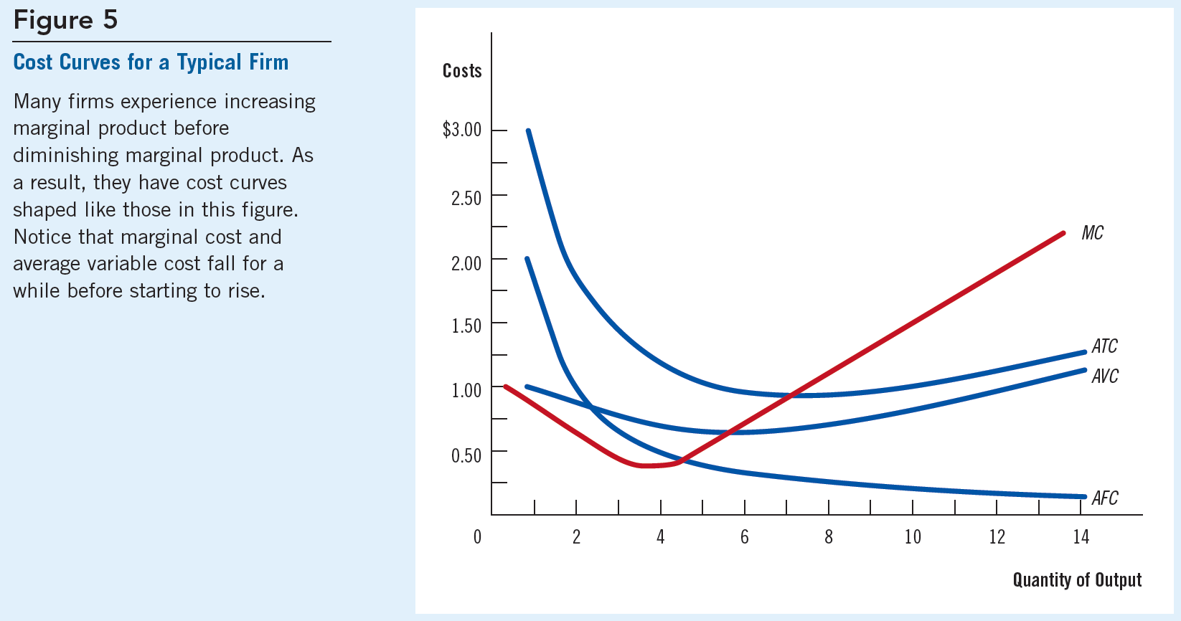
Typical Cost Curves

Slide 29
Short-run and Long-run Costs

Slide 30
The Short-run vs. the Long-run
Short-run (SR)
  Some inputs of production (typically capital) are fixed in the short run.
  The cost of these fixed inputs is the firm’s fixed cost.
Long-run (LR)
  All inputs of production are variable in the long run.
  Since all inputs are variable, there are no fixed costs.
The long-run average total cost (LRATC) at any quantity represents the cost per unit when the firm uses the most efficient combination of inputs for that level of output.
  Let’s examine what this means using some graphs!

Slide 31



The Short-run vs. the Long-run
Cost
Suppose the firm is choosing between three levels of capacity:
  Small Factory (S)
  Medium Factory (M)
  Large Factory (L)
Each capacity has its own short-run average total cost (SRATC) curve.
In the long-run, the firm can adjust its capacity by moving between these SRATC curves, but it cannot do so in the short run.
$$\text{AT}{\text{C}}_{\text{S}}$$
$$\text{AT}{\text{C}}_{\text{M}}$$
$$\text{AT}{\text{C}}_{\text{L}}$$
Output

Slide 32

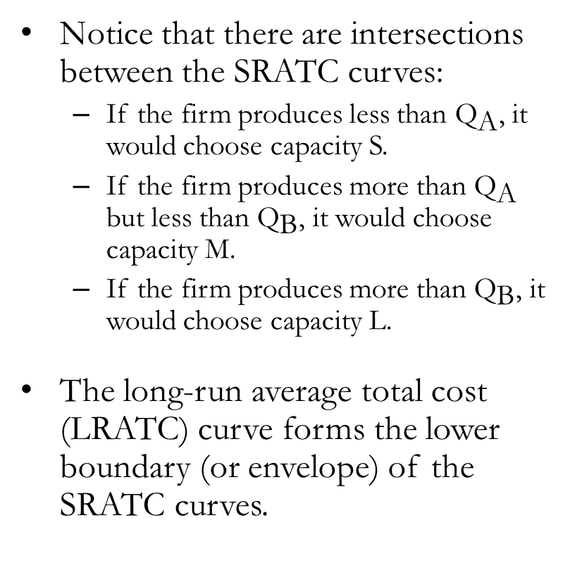

The Short-run vs. the Long-run
Cost
Notice that there are intersections between the SRATC curves:
  If the firm produces less than ${\text{Q}}_{\text{A}}$, it would choose capacity S.
  If the firm produces more than ${\text{Q}}_{\text{A}}$ but less than ${\text{Q}}_{\text{B}}$, it would choose capacity M.
  If the firm produces more than ${\text{Q}}_{\text{B}}$, it would choose capacity L.
The long-run average total cost (LRATC) curve forms the lower boundary (or envelope) of the SRATC curves.
LRATC
$$\text{AT}{\text{C}}_{\text{S}}$$
$$\text{AT}{\text{C}}_{\text{M}}$$
$$\text{AT}{\text{C}}_{\text{L}}$$
$${\text{Q}}_{\text{A} }$$
$${\text{Q}}_{\text{B} }$$
Output

Slide 33
The Short-run vs. the Long-run
Cost
In the real world, there are many possible capacity choices, not just S, M, and L.
Notice some facts about the LRATC curve:
  The LR cost decreases as output increases when output is low (Economy of Scale)
  The LR cost is constant when output is at a moderate level (Constant Returns to Scale)
  The LR cost increases with output when output is high (Diseconomy of Scale)
LRATC
Output

Slide 34
Economies and Diseconomies of Scale
Economies of Scale
  The property whereby long-run average total cost decreases as the quantity of output increases.
  May occur when higher production levels enable specialization, better utilization of equipment, or bulk purchasing of inputs.
Diseconomies of Scale
  The property whereby long-run average total cost increases as the quantity of output increases.
  May occur when coordination and communication problems arise as production expands beyond an efficient scale.
Constant Returns to Scale
  The property whereby long-run average total cost remains unchanged as the quantity of output changes.

Slide 35
Recap of Chapter 14

Slide 36
Recap
Firms’ goal is to maximize profit, defined as total revenue minus total cost.
Economic costs are opportunity costs, which include both explicit and implicit costs.
  Explicit costs: Require an outlay of money by the firm.
  Implicit costs: Do not require a monetary outlay by the firm.
A firm’s costs reflect its production process, which is illustrated by its production function.
  Typical production functions become flatter as output increases, due to diminishing marginal product.
  As a result, the total cost curve becomes steeper as output increases.
The total cost of a firm can be divided into fixed and variable components.
  Fixed costs: Remain constant regardless of output level.
  Variable costs: Change as output changes.

Slide 37
Recap
A firm’s average cost is the cost per unit of output:
  Average Total Cost (ATC): Total cost divided by output.
  Average Fixed Cost (AFC): Fixed cost divided by output.
  Average Variable Cost (AVC): Variable cost divided by output.
A firm’s marginal cost (MC) is the increase in total cost from producing one additional unit of output.
A firm’s costs depend on the time horizon considered:
  In the short run (SR), some inputs are fixed.
  In the long run (LR), all inputs are variable.
  In the long run, firms may experience economies of scale, constant returns to scale, or diseconomies of scale, depending on output level.

