Slide 1
PRINCIPLES OF GLOBAL ECONOMICS
Chapter 10: Externalities

Slide 2
Preview
Principle #6: Markets are Usually a Good Way to Organize Economic Activity.
The First Fundamental Theorem of Welfare Economics:
  Under certain conditions, market equilibrium leads to an efficient allocation of resources.
  One Key Condition: Markets must be perfectly competitive.
  A requirement of perfect competition: No Externalities.
Buyers and sellers in a market do not consider the external effects of their actions. As a result, the market equilibrium is not efficient from society’s perspective.
Principle #7: “Government Action can Sometimes Improve Upon Market Outcomes.”

Slide 3
Externalities and
Market Inefficency

Slide 4
Market Failures and Externalities
Market Failures: A situation in which the market outcome is not efficient.
Externality: The uncompensated impact of one person’s actions on the well-being of an unrelated bystander.
Real World Examples:
  A confectioner’s candy production creates noise that may disturb a doctor working nearby.
  Exposure to secondhand smoke can negatively affect the health of non-smokers.
  A beekeeper produces honey, while the bees also provide free pollination to a neighboring orchard.
  Quality education produces better-informed voters, contributing to a healthy democracy.
Externalities can be positive or negative, and they represent an important case of market failure.

Slide 5
Positive and Negative Externalities
Positive Externalities:
  Occur when the external effect benefits a bystander.
  Think of it as an “extra benefit” not captured by the individual decision-maker.
  As a result, Societal Benefit > Private Benefit.
  Examples: Vaccination, Education, Public Art, etc.
Negative Externalities:
  Occur when the external effect harms a bystander.
  Think of it as an “extra cost” imposed on others.
  As a result, Societal Cost > Private Cost.
  Examples: Pollution, Traffic Congestion, Noise, etc.

Slide 6
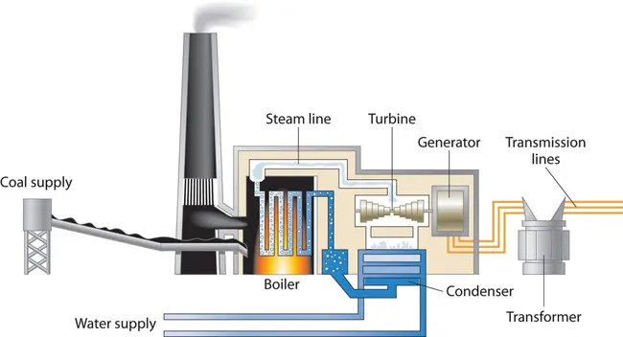
Externalities in the Real World: Coal Power Plants

Slide 7
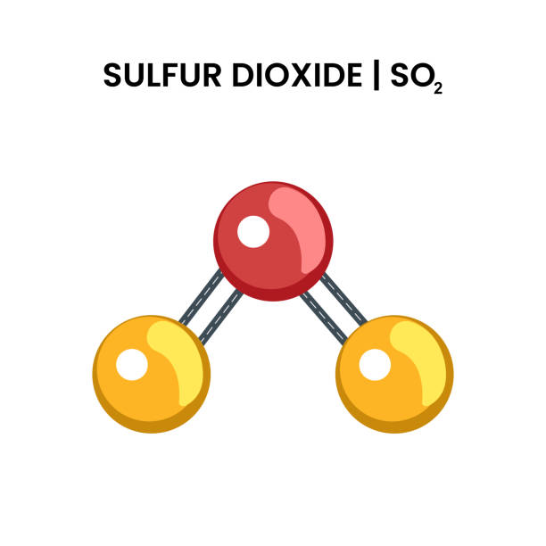
Externalities in the Real World: Sulfur Dioxide
Forms acidic particulates that can enter the human bloodstream.
A known cause of numerous respiratory and cardiovascular conditions.
Also contributes to acid rain, which damages crops, forests, and soil quality.
A typical plant emits over 14,000 tons of SO₂ annually.
With available technology, emissions can be reduced by nearly half.

Slide 8

Externalities in the Real World: Particulate Matter
A catch-all term for all airborne small particles emitted into the atmosphere.
Causes respiratory and cardiovascular problems in humans.
Among the most costly air pollutants.
A typical plant emits over 500 tons of particulate matter (PM) annually.
With current technology, emissions can be reduced to negligible levels.

Slide 9
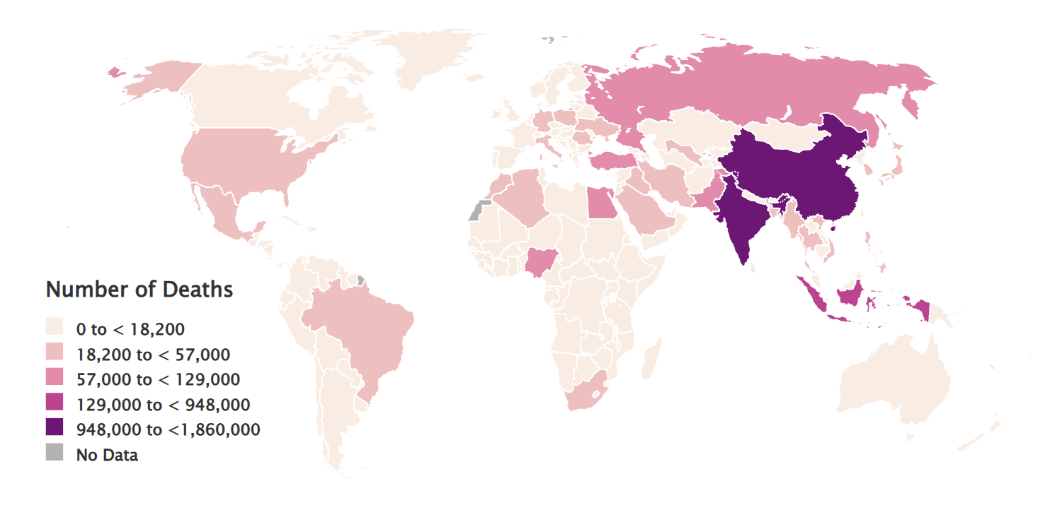
Externalities in the Real World: Particulate Matter

Slide 10
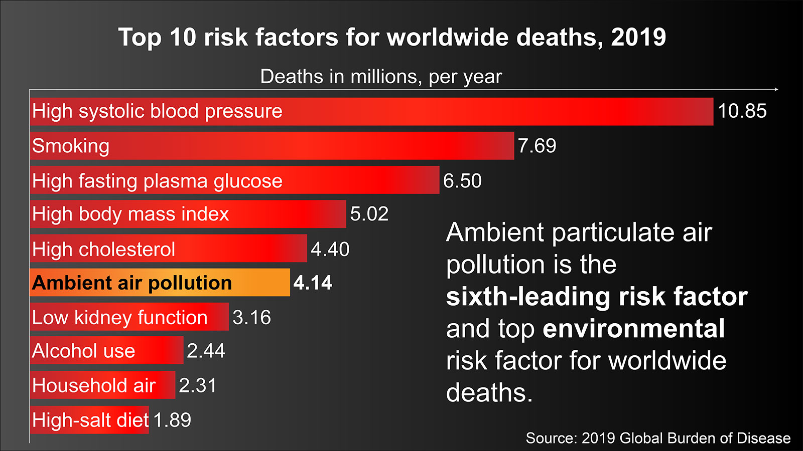
Externalities in the Real World: Particulate Matter

Slide 11
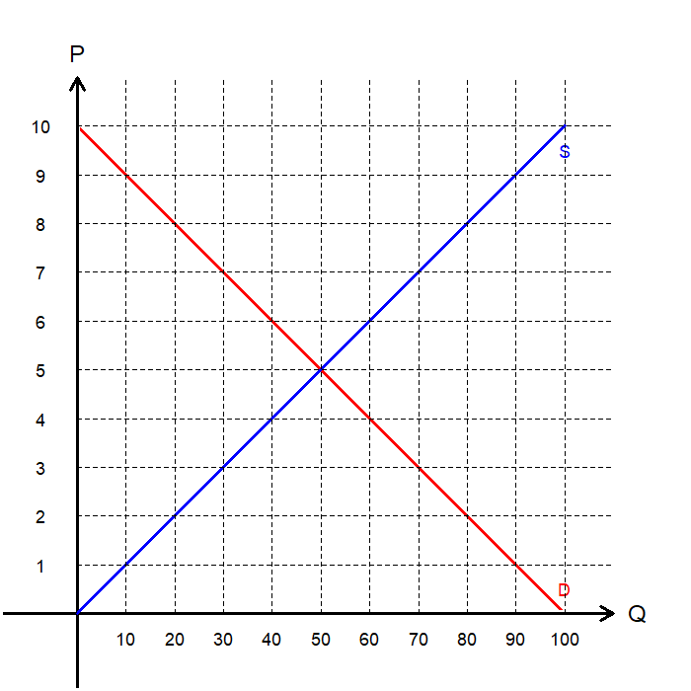
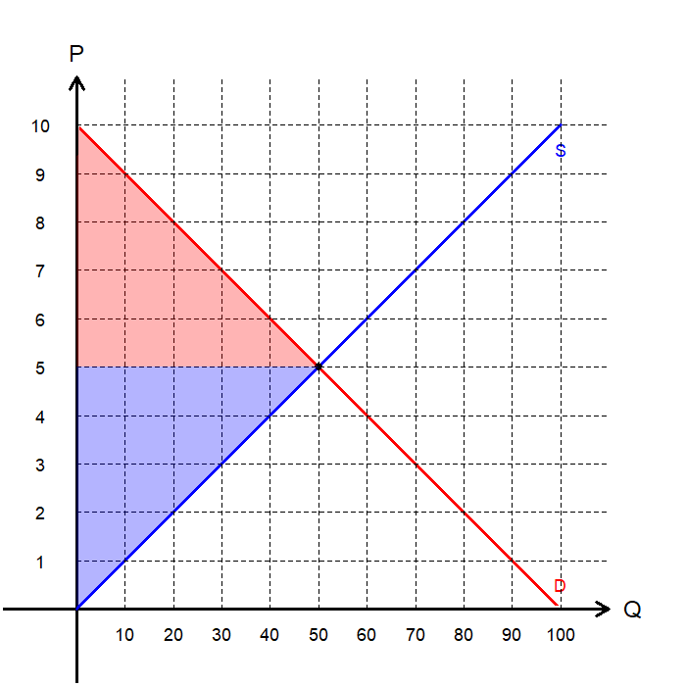
Recap: Markets are Efficient
When the market is perfectly competitive, the outcome is efficient.
The equilibrium outcome is:
  Price: $5
  Quantity: 50
  Consumer Surplus: $125
  Producer Surplus: $125
  Total Surplus: $250
Regardless of the presence of externalities, without external intervention, this is the market outcome.

Slide 12
Benefits and Costs with Externalities
Individuals in the market often ignore (or underestimate) external costs and benefits.
  This may be because they act in their own self-interest, or…
  …because they are unaware of the full extent of those externalities.
As a result, market outcomes typically reflect private welfare, not social welfare.
In the presence of externalities, societal benefits and costs do not align with the private benefits and costs of individuals.
  Social Marginal Cost (SMC): PMC plus any additional costs imposed on bystanders.
  Social Marginal Benefit (SMB): PMB plus any additional benefits given to bystanders.
The key question is “Does a market outcome that maximizes private welfare also maximize total social welfare?”

Slide 13

Private vs. Social Costs
Relationship between Private and Social Costs:
  The private cost, which determines the market supply curve, only accounts for costs paid directly by the producer.
  The social cost also includes external costs, costs incurred by bystanders.
Example: Paper Production in Paper Mills
  Private Cost: The cost of ingredients, labor, rent, etc.
  Social Cost: Private Cost + Cost of Pollution
Therefore, the social cost is greater than private cost.
Social Marginal Cost (SMC)
= Private Marginal Cost (PMC) + External Cost

Slide 14
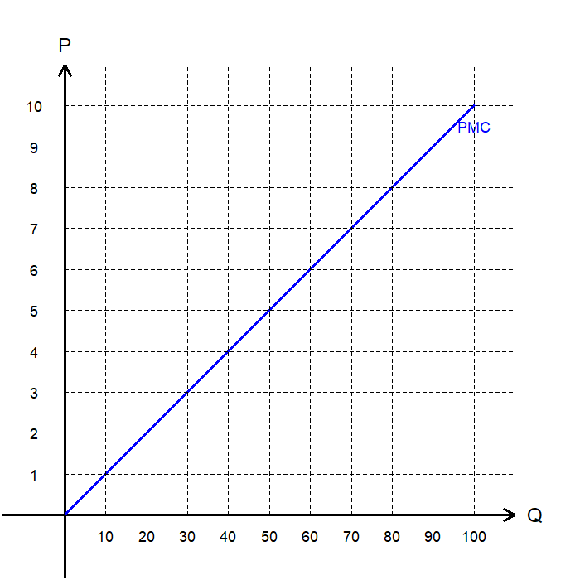
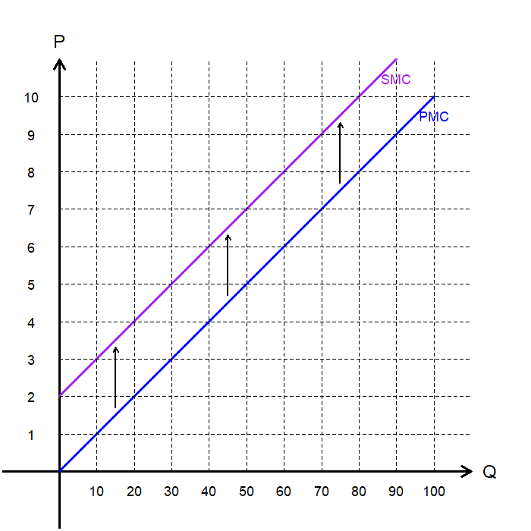
Private vs. Social Costs Visualized
Remember that the market supply curve (PMC) reflects the private marginal cost of production.
Suppose there is a $2 per unit external cost that is “paid” by bystanders.
  Adding a $2 external cost at each quantity shifts the SMC curve upward, so the SMC lies above the PMC.
  When there is no external cost involved, PMC is equal to SMC.
The social marginal cost (SMC) curve reflects society’s total cost of production, so it is used when determining the social optimum.

Slide 15
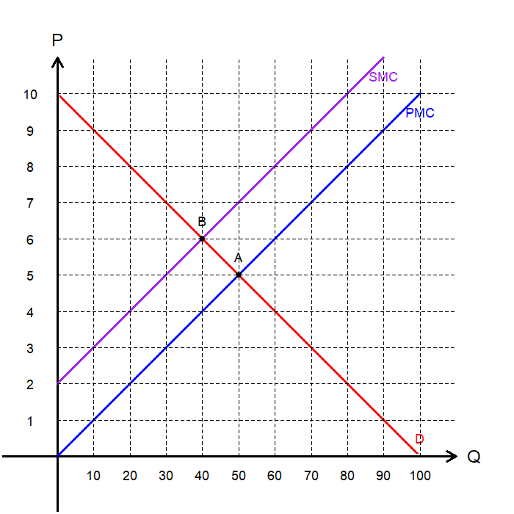
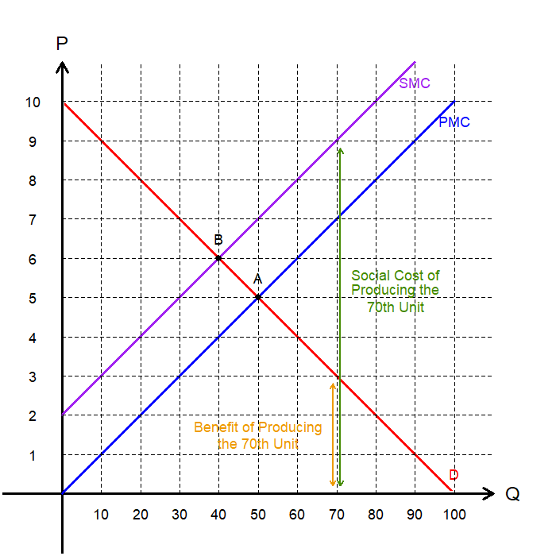
Markets with Negative Externalities
Let’s identify the socially optimal allocation.
  We update the diagram to reflect the gap between the social marginal cost and the private marginal cost.
  Keep in mind that the market allocation occurs at A.
Claim: The socially optimal quantity is 40.
  At any quantity greater than 40, the social marginal cost of production exceeds the marginal benefit.
  At any quantity less than 40, the marginal benefit of production exceeds the social marginal cost.
Therefore, social welfare is maximized at B.
  In the presence of negative externalities, the market overproduces the good or service.

Slide 16
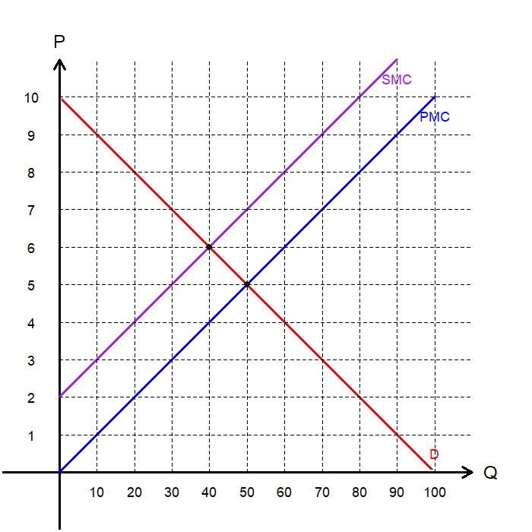
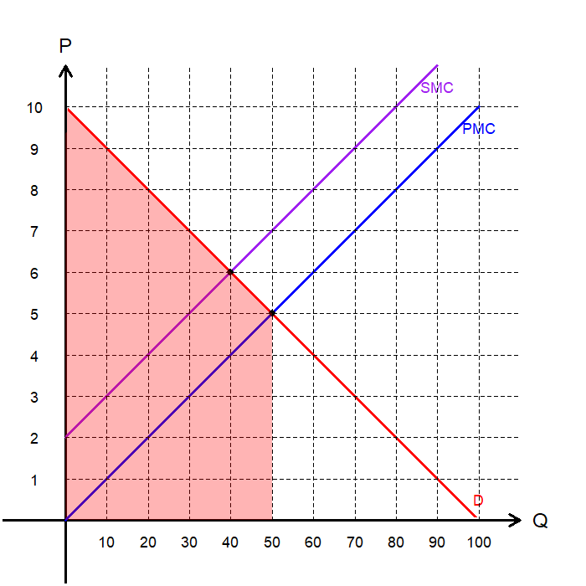
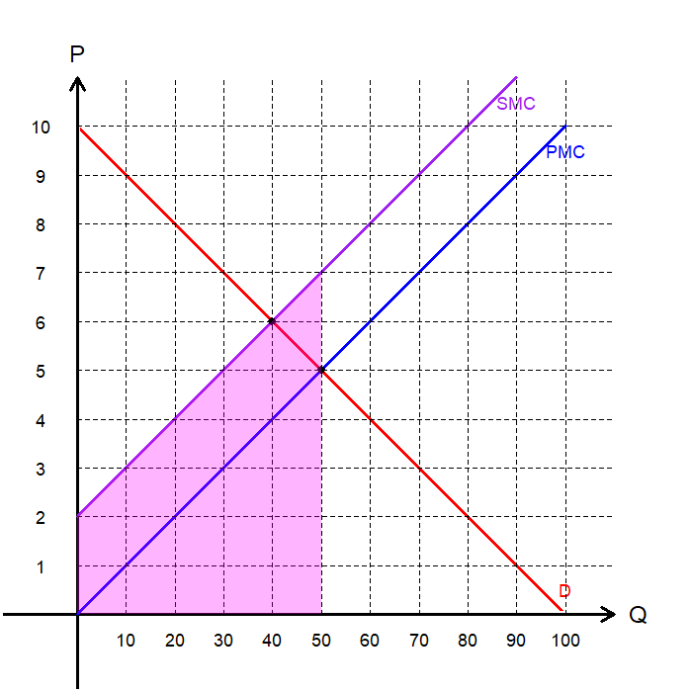
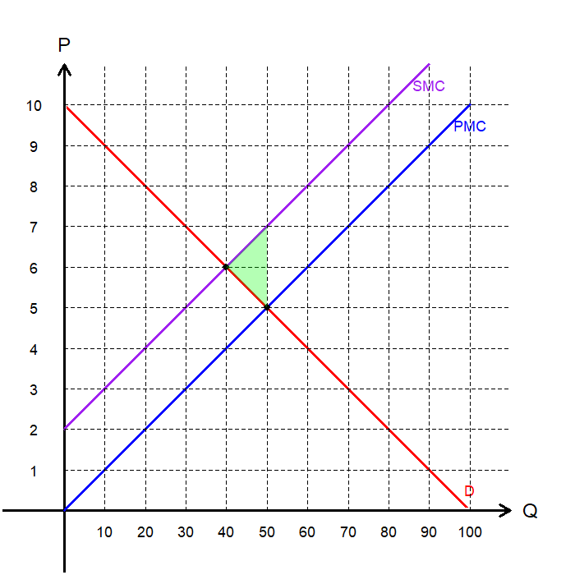
Welfare Loss: Negative Externalities
Let’s examine the potential loss in social welfare associated with negative externalities.
The total benefit to consumers at the market allocation is the area under the demand curve.
The total societal cost of production is the area under the social marginal cost (SMC) curve.
The overproduced quantity results in a welfare loss that is not captured by any market participant.
Therefore, negative externalities lead to deadweight loss due to overproduction.

Slide 17

Private vs. Social Benefits
Relationship between Private and Social Benefits:
  The private benefit, which determines the market demand curve, reflects benefits received directly by the consumer.
  The social benefit also includes external benefits, or additional gains experienced by bystanders.
Example: Public works of Art
  Private Benefit: Enjoyment the commissioning entity.
  Social Benefit: Enjoyment by the wider public.
Therefore, the social benefit exceeds the private benefit.
Social Marginal Benefit (SMB)
= Private Marginal Benefit (PMB) + External Benefit

Slide 18
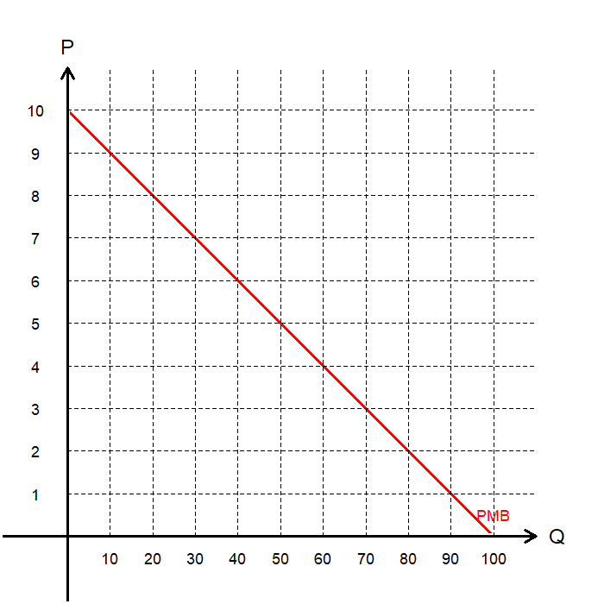
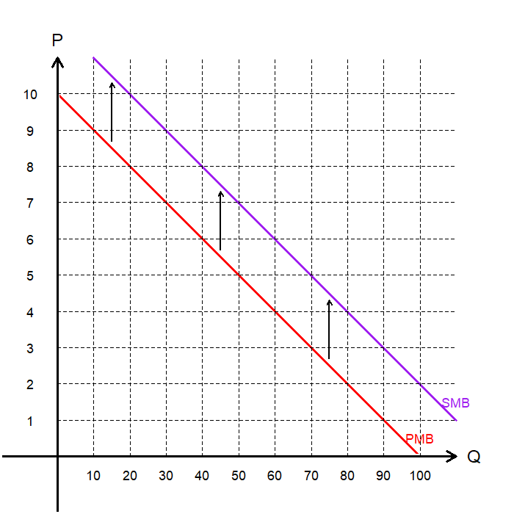
Private vs. Social Benefits Visualized
Remember that the market demand curve (PMB) reflects the private marginal benefit of consumption.
Suppose there is a $2 per unit external benefit that bystanders derive.
  Adding a $2 external benefit at each quantity shifts the SMB curve upward, so the SMB lies above the PMB.
  When there is no external benefit, PMB=SMB.
The social marginal benefit (SMB) curve reflects society’s total benefit from consumption, so it is used when determining the social optimum.

Slide 19
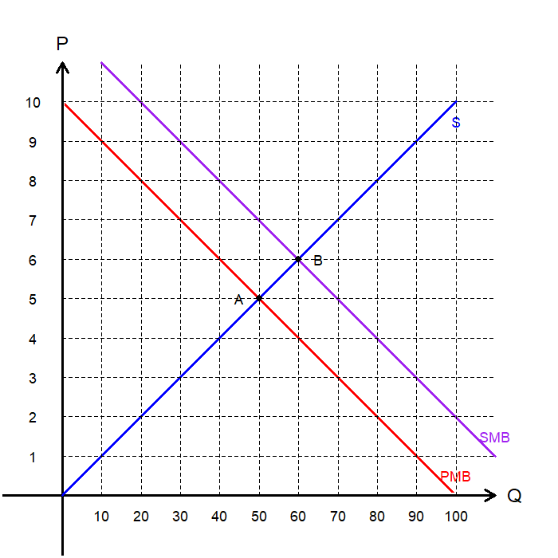
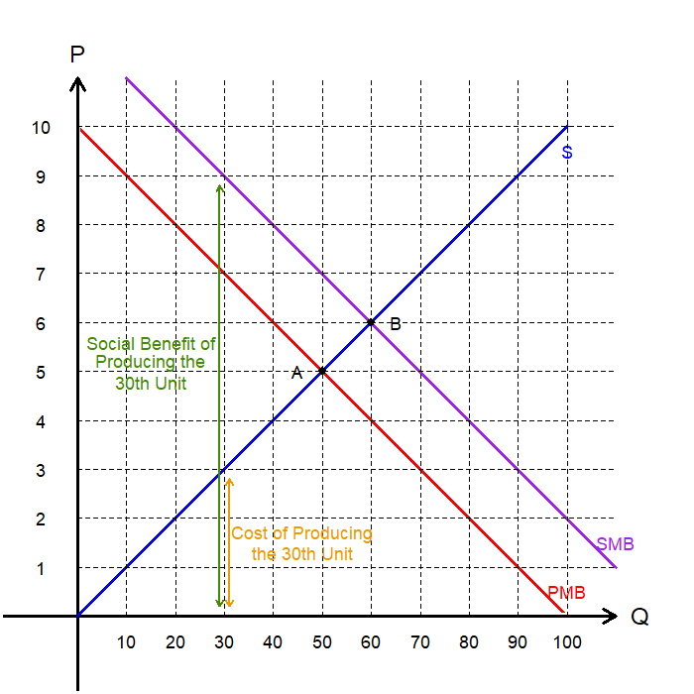
Markets with Positive Externalities
Let’s identify the socially optimal allocation.
  We update the diagram to reflect the gap between SMB and PMB.
  Keep in mind that the market allocation is point A.
Claim: The socially optimal quantity is 60.
  At any quantity less than 60, the social marginal benefit exceeds the marginal cost of production.
  At any quantity greater than 60, the marginal cost exceeds the social marginal benefit.
Therefore, social welfare is maximized at B.
  In the presence of positive externalities, the market underproduces the good or service.

Slide 20

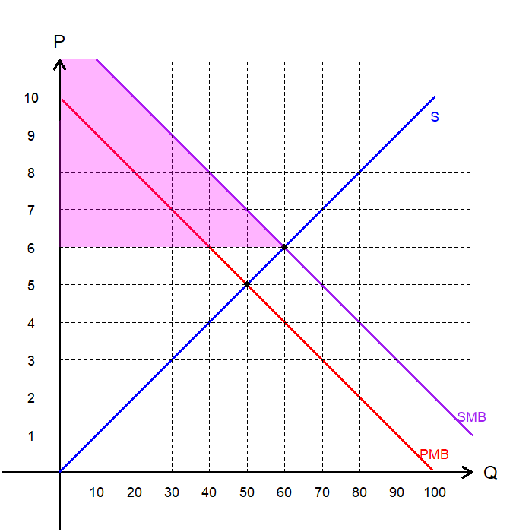
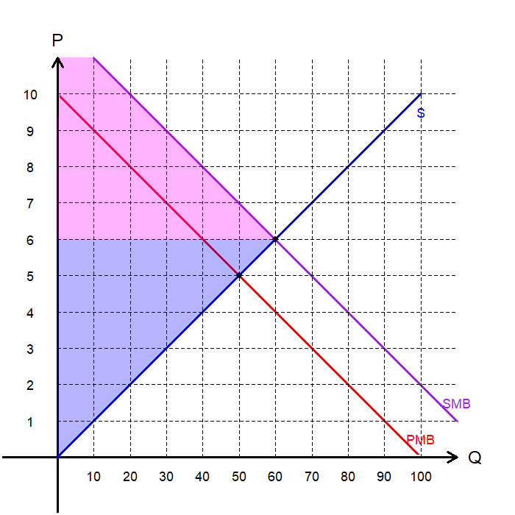
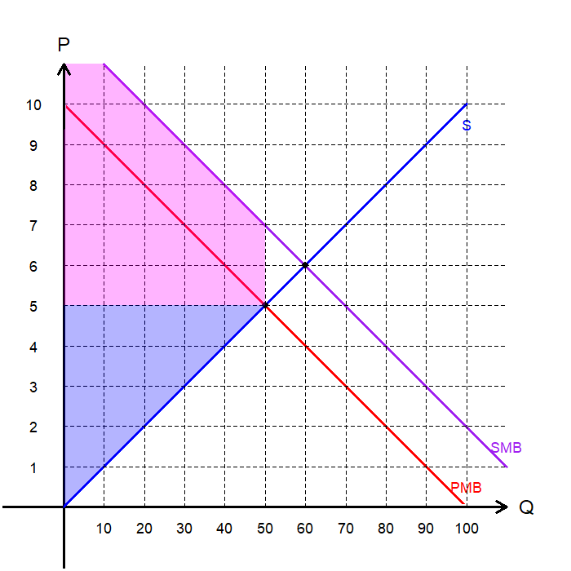
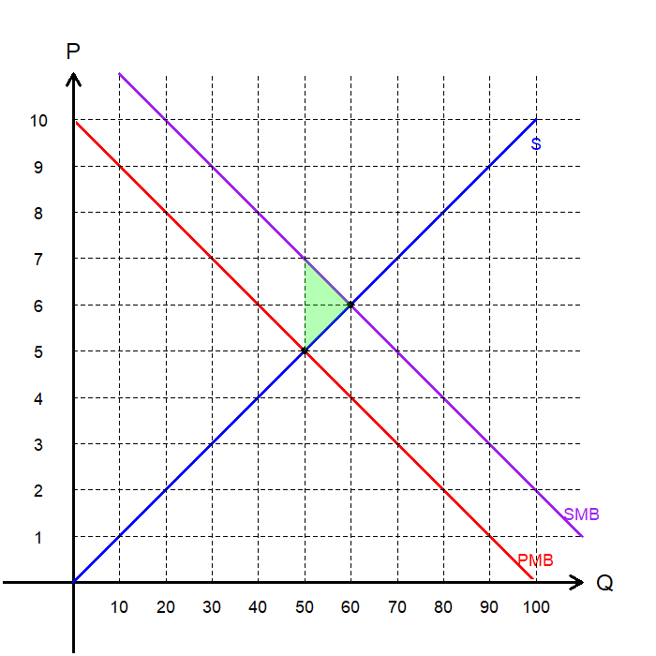
Welfare Loss: Positive Externalities
Let’s examine the potential loss in social welfare associated with positive externalities.
At the social optimum, total surplus is:
  Consumer Surplus: SMB – Price
  Producer Surplus: Price – PMC
    Note that PMC=SMC when there are no negative externalities.
The market underproduces the good, leading to a smaller total surplus compared to the social optimum.
Positive externalities therefore result in deadweight loss.

Slide 21
Public Policy Solutions
to Externalities

Slide 22
Command-and-Control
A straightforward way to manage externalities is through direct mandates or bans on specific behaviors, often referred to as “command-and-control (CAC)” policies.
These approaches were common in the early years of environmental regulation:
  Simple and Intuitive: Easier to communicate and “sell” to the public.
  Low Enforcement Cost: Officials only need to verify whether the technology has been installed.
However, CAC policies have notable drawbacks:
  No Incentive for Innovation: Polluters are not encouraged to develop newer or more efficient abatement technologies.
  Regulatory Burden: Requires regulators to have detailed knowledge of production processes and available technologies.
  Economic Inefficiency: CAC often impose the same requirements for all polluters, regardless of the cost of abatement, which leads to inefficiencies.

Slide 23

Command-and-Control in the Real World
The Clean Air Act (CAA) mandates the adoption of the “best available control technology.”
Catalytic converters were required in all new cars beginning in 1975.
Scrubbers were mandated for coal-fired power plants under the 1990 Amendments to the CAA.
While CAC policies still exist, modern environmental regulations have increasingly shifted toward market-based approaches that promote flexibility and efficiency.

Slide 24
Market-Based Policies
Externalities arise when individuals do not account for the full costs or benefits that their actions impose on others.
Regulators can “internalize” these externalities by introducing incentives such as taxes or subsidies that align private behavior with social welfare.
For example, consider a confectioner who produces candy but also creates noise that disturbs nearby residents.
  The Private Marginal Cost (PMC) includes ingredients, labor, and rent.
  The External Marginal Cost (EMC) is the noise imposed on neighbors.
The two most widely used market-based policy instruments are:
  Corrective taxes and subsidies
  Tradable permits

Slide 25
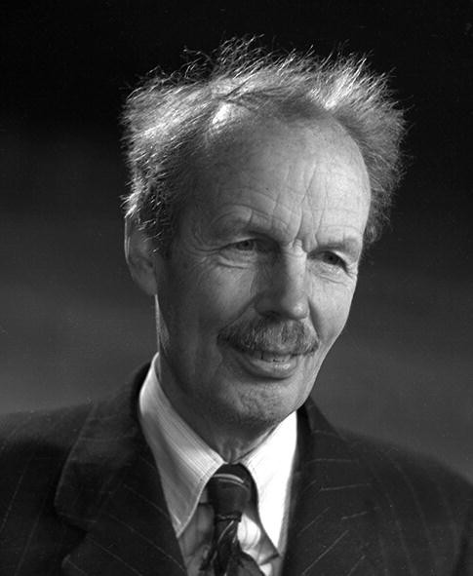
Arthur Cecil Pigou (1877 – 1959)
Major figure in early welfare economics, studying how economic activity affects overall social welfare.
Formalized the concept of externalities, situations where private costs or benefits diverge from social costs or benefits.
Proposed government intervention to align private incentives with social welfare.
  If private actions impose external costs, society should impose a tax equal to that external cost.
  When private actions create external benefits, a subsidy can encourage additional production or consumption.

Slide 26
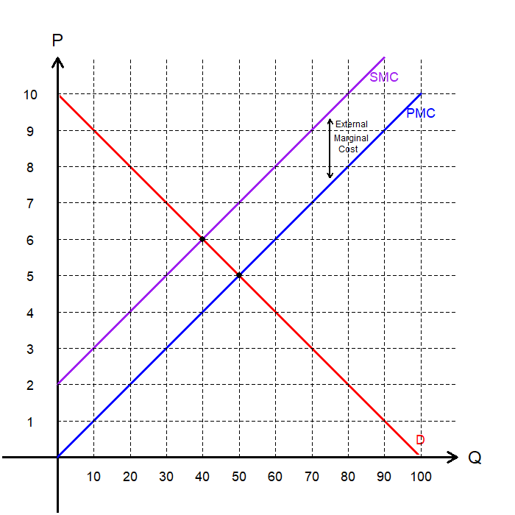
Corrective Taxes Illustrated
Consider a polluting industry that generates an external cost borne by bystanders.
Suppose we can estimate the exact external cost the polluter is generating.
  This process is highly complex in real-world applications.
  It often requires assigning a monetary value to health impacts or environmental damage, which can be controversial.
Policymakers can then impose a tax equal to this external cost on the polluter.

Slide 27
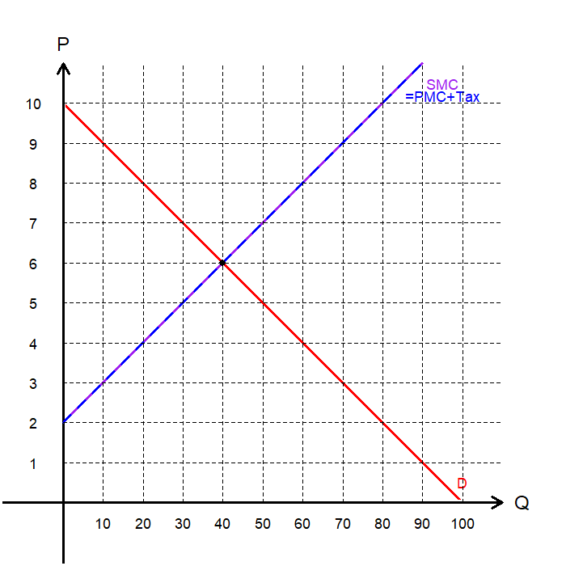
Corrective Taxes Illustrated
Let’s assume for now that the tax is calculated correctly to match the value of the external marginal cost of production.
This tax aligns PMC with SMC, ensuring that private incentives match social incentives.
As a result, the market reaches an efficient allocation where total welfare is maximized.
These types of taxes are called “corrective taxes,” or “Pigouvian taxes.”

Slide 28
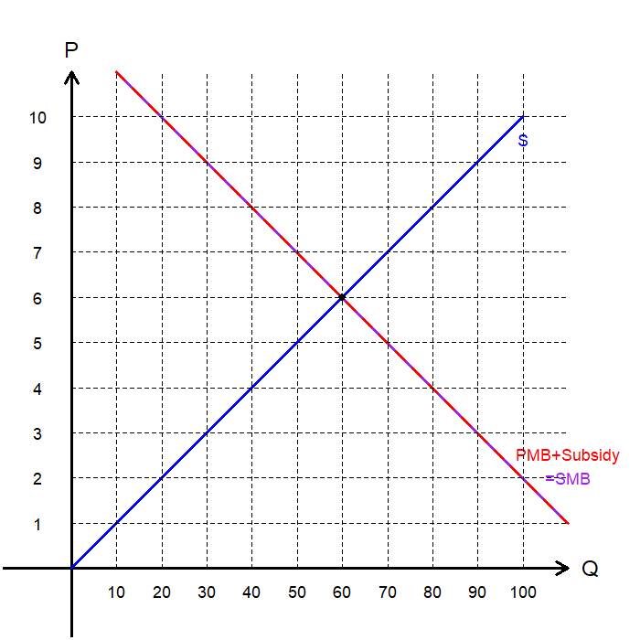
Corrective Subsidies Illustrated
For goods and services associated with positive externalities, we can estimate the external benefit provided to society.
A subsidy can then be offered equal to the value of this external marginal benefit, the gap between PMB and SMB.
This policy aligns private and social incentives by shifting PMB upward until PMB = SMB.
Once aligned, the market achieves an efficient allocation of resources.

Slide 29
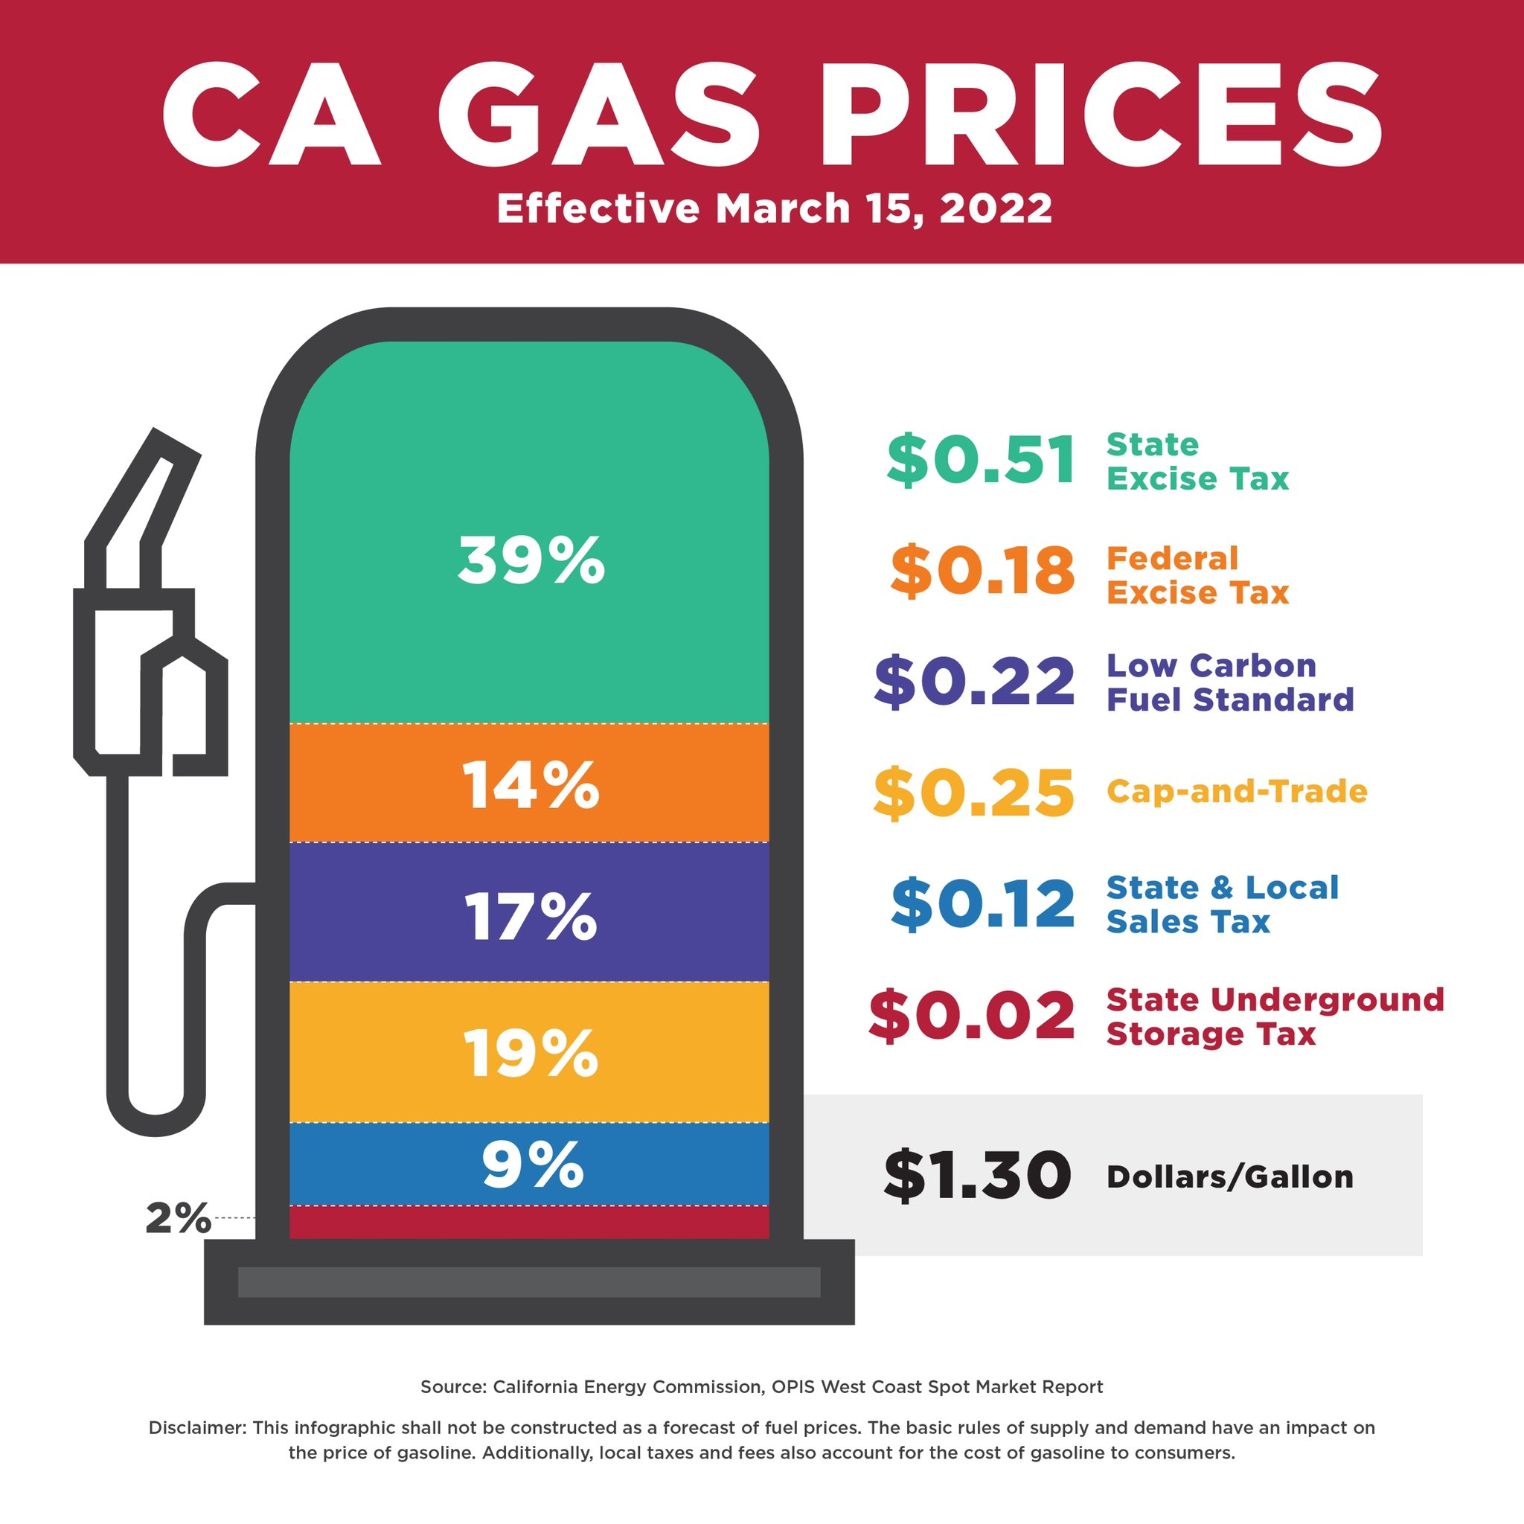
Corrective Taxes in the Real World
As of July 2024, the average driver pays roughly $0.51 in taxes per gallon of gasoline.
Gasoline is taxed due to negative externalities:
  Congestion: More drivers increase traffic congestion.
  Accidents: Higher vehicle density raises the likelihood of accidents.
  Pollution: More driving results in greater environmental damage.
A recent study estimates that the optimal tax rate, accounting for all externalities, should be $3.75 per gallon (in 2025 dollars).

Slide 30

Tradable Permits
A market-based policy that limits total emissions through a system called “cap-and-trade.”
  Regulators set a cap on total allowable pollution.
  A fixed number of permits are issued for emissions under the cap.
  Firms can buy and sell permits in a regulated market.
  Firms that can cut pollution cheaply sell excess permits to others.
This system creates financial incentives to reduce emissions and promotes cost-effective abatement across firms.

Slide 31
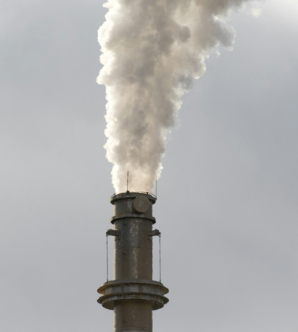
Tradable Permits in the Real World
In 1963, scientists in New Hampshire found rain with acid levels 100 times higher than normal, damaging ecosystems and infrastructure..
The cause was traced to emissions of nitrogen oxides (NOx) and sulfur dioxide (SO₂) from power plants.
By the 1980s, lawmakers launched the Acid Rain Program, introducing a cap-and-trade system for these pollutants.
The cap started high, with plans to tighten every five years to gradually cut total emissions.

Slide 32
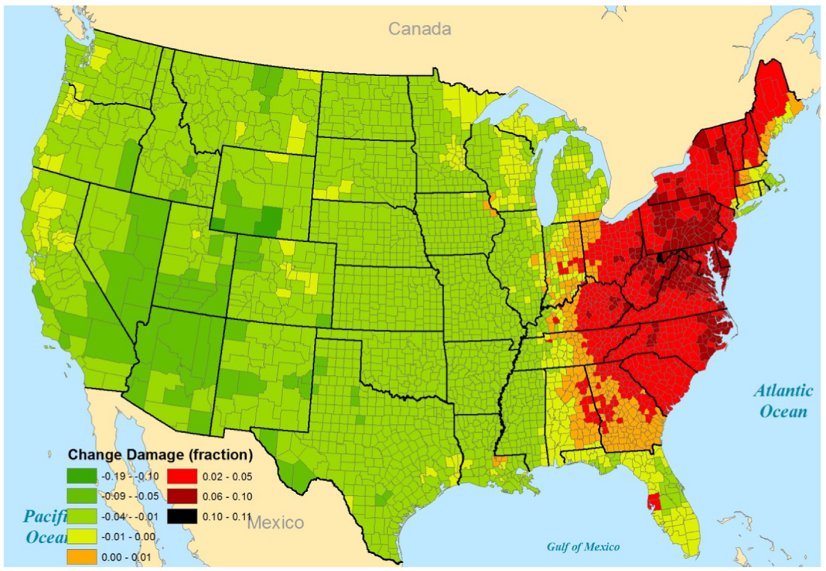
Tradable Permits in the Real World
The Acid Rain Program (ARP) was a landmark policy showcasing the potential of tradable permits.
Later studies found that the ARP caused greater environmental and health damages in the eastern U.S.
The main reason: the East Coast’s dense population made pollution more harmful than in other regions.
Chen et al. (2018)

Slide 33
Tradable Permits: Considerations
How should the initial permits be allocated?
  Viable methods include initial auctions, grandfathering, and lotteries.
  Regardless of the method, the permit market can still achieve an efficient outcome, as long as the cap is set appropriately, and trading is allowed.
What if the external cost of pollution varies across locations?
  Emissions from a plant in a densely populated area may cause significantly more harm than the same emissions in a rural area.
  A uniform permit price in the face of heterogeneous damages leads to inefficiencies.
  Trading ratios: Require polluters in high-risk areas to purchase more permits for the same emissions.
  Zonal trading: Segment the market so firms trade permits within regions of similar damage profiles.

Slide 34
Taxation vs. Permits
When the demand for producing externalities is known to regulators, taxes and tradable permits are effective tools for steering the market toward the socially optimal outcome.
Producers of externalities are essentially paying for the right to produce them:
  Under corrective taxes, producers pay the government.
  Under tradable permits, producers pay other firms that can reduce externalities at lower cost.
By internalizing the external cost, both policies help align private incentives with social welfare, leading to an efficient outcome.

Slide 35
Exercise: Regulation vs. Tradable Permits
Suppose two regions in a country: Camelot and Avalon
  Camelot is a prosperous region known for its steelworks and forges.
  Avalon produces fine textiles, but its workshops also discharge waste into the atmosphere.
  Both Camelot and Avalon emit 100 tons of particulate matter (PM) each month.
The cost of reducing pollution is:
  $100 per ton for Camelot’s blacksmiths.
  $50 per ton for Avalon’s textile plants.
The social planner’s goal is to reduce total pollution to 140 tons. Two policy options exist:
  Regulation: Both Camelot and Avalon must each cut 30 tons of emissions.
  Tradable Permits: A total cap of 140 tons is imposed, and permits can be traded.
Question: Which policy achieves the reduction more efficiently?

Slide 36
Exercise: Regulation vs. Tradable Permits
Setup: Tradable Permits
  The government issues 140 permits, each allowing 1 ton of PM to be emitted.
  Each region receives 70 permits.
  A marketplace for regions to trade permits is established by the government.
Price Analysis of Tradable Permits
  What is the Highest Price of a Permit:
  What is the Lowest Price of a Permit:
Cost Analysis of Tradable Permits
  Assume that Avalon uses 40 permits and sells the rest to Camelot for the midpoint price, $75.
  The Abatement Cost for Avalon:
  The Abatement Cost for Camelot:
  Total Abatement Cost:
$100
$50
60×$50 – 30×$75 =$750
30×$75=$2,250
$3,000

Slide 37
Exercise: Regulation vs. Tradable Permits
Setup: Regulation
  $100 per ton for Camelot’s blacksmiths.
  $50 per ton for Avalon’s textile plants.
  Both Camelot and Avalon must each cut 30 tons of emissions.
Cost Analysis of Regulation
  The Abatement Cost for Camelot:
  The Abatement Cost for Avalon:
  Total Abatement Cost:
Takeaway:
  Tradable permits achieve the same level of pollution reduction at a lower cost.
30×$100=$3,000
30×$50=$1,500
$4,500

Slide 38
Private Solutions
to Externalities

Slide 39
Private Solutions to Externalities
So far, we’ve explored various regulatory tools available to policymakers..
But are there private solutions that can address externalities without regulators?
  Moral codes and social pressure.
  Charitable actions.
  Vertical integration (e.g., merging polluter and affected party).
  Voluntary contracts or negotiations between interested parties.
Can any of these private mechanisms lead to an efficient allocation of resources?
Ronald Coase offers an answer in his influential paper, “The Problem of Social Cost.”

Slide 40
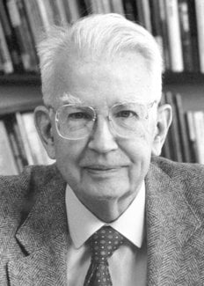
Ronald H. Coase (1910–2013)
Best known for his work on transaction costs and property rights.
Challenged Pigou’s view that government intervention was always needed to correct externalities.
Argued that if property rights are clearly defined and transaction costs are low, private bargaining can lead to efficient outcomes without regulation, the Coase Theorem.
His work emphasized the importance of institutions and legal frameworks in shaping economic efficiency.

Slide 41
The Coase Theorem
The Coase Theorem states that even when externalities are present, an efficient outcome can be achieved without government intervention, provided that:
  Property rights are clearly defined
  Transaction costs are negligible
If these conditions are met, the initial assignment of property rights does not impact the efficiency of the final outcome.
Through Coasean bargaining, the right to create externalities will end up with the party that values it most.
To understand this more intuitively, let’s revisit the classic case of the noisy confectioner.

Slide 42

Quimbee (2021, March 25). Sturges v. Bridgman Case Brief Summary | Law Case
Explained [Video]. YouTube. https://youtu.be/FWSM6STkH18?si=-UhPAVJ-MAOIS59P

Slide 43
Sturges v. Bridgman (1879)
Agents:
  Doctor: Established a consulting room adjacent to the confectioner’s business.
  Confectioner: Produces and sells candy using machinery that generates noise and vibrations.
Conflict:
  The confectioner’s operations interfere with the doctor’s ability to provide medical consultations.
  The noise and vibration represent a negative externality.
  More noise: More candy, but fewer medical services.
  Less noise: Fewer candies, but more medical services.
The socially optimal outcome depends on the relative value society places on candy versus medical care.

Slide 44
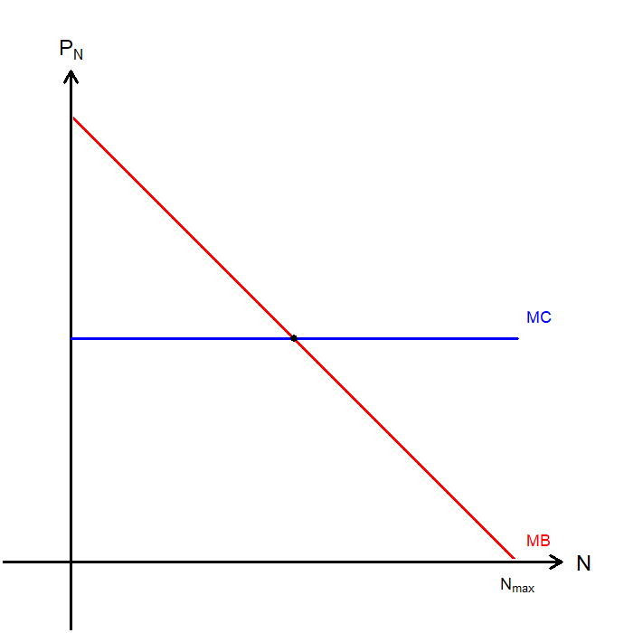
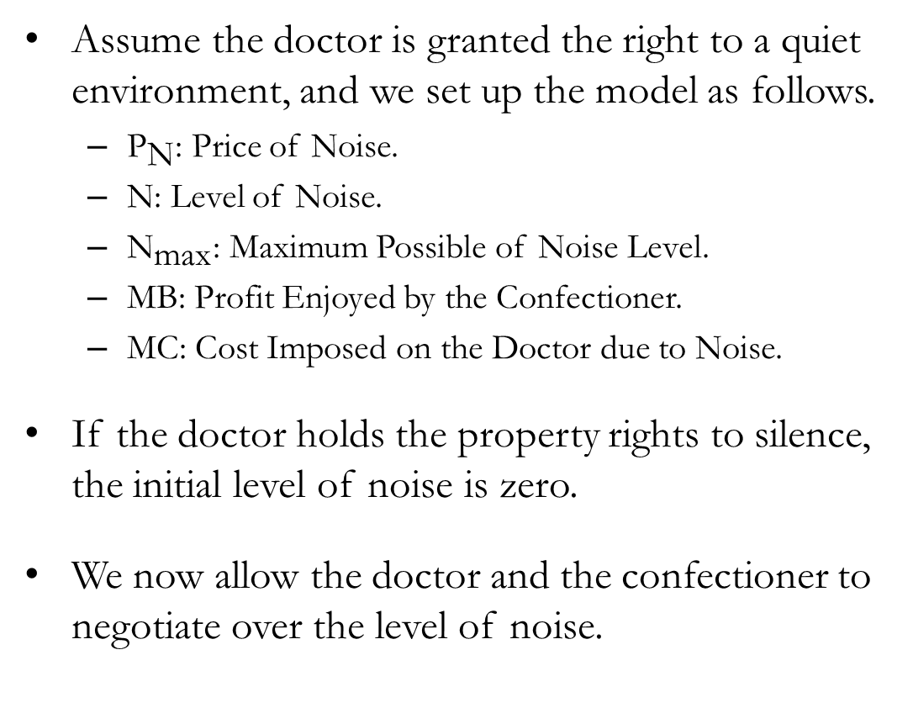
The Coase Theorem Illustrated
Assume the doctor is granted the right to a quiet environment, and we set up the model as follows.
  ${\text{P}}_{\text{N}}$: Price of Noise.
  $\text{N}$: Level of Noise.
  ${\text{N}}_{\text{max}}$: Maximum Possible of Noise Level.
  MB: Profit Enjoyed by the Confectioner.
  MC: Cost Imposed on the Doctor due to Noise.
If the doctor holds the property rights to silence, the initial level of noise is zero.
We now allow the doctor and the confectioner to negotiate over the level of noise.

Slide 45
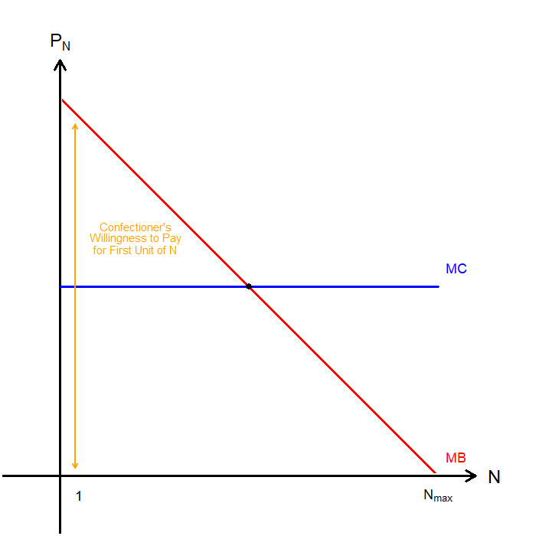
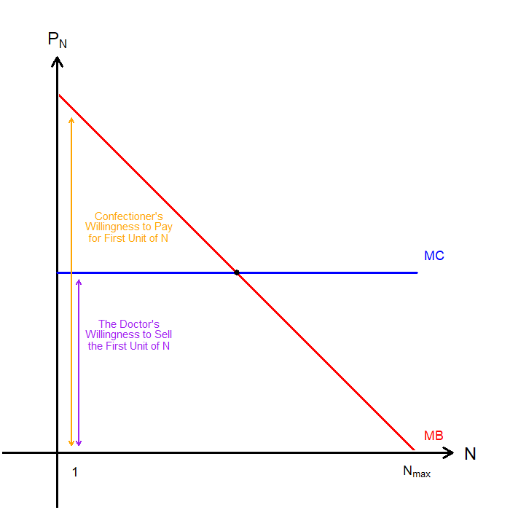
The Coase Theorem Illustrated
The negotiation begins with the confectioner requesting a 1-unit increase in noise.
The confectioner’s willingness to pay for this unit equals the height of the MB curve.
The doctor’s willingness to accept (sell) one unit of noise equals the height of the MC curve.
The doctor accepts if the payment for that unit is at least equal to MC, and the noise level increases.
The process continues with new negotiations for each additional unit of noise.

Slide 46
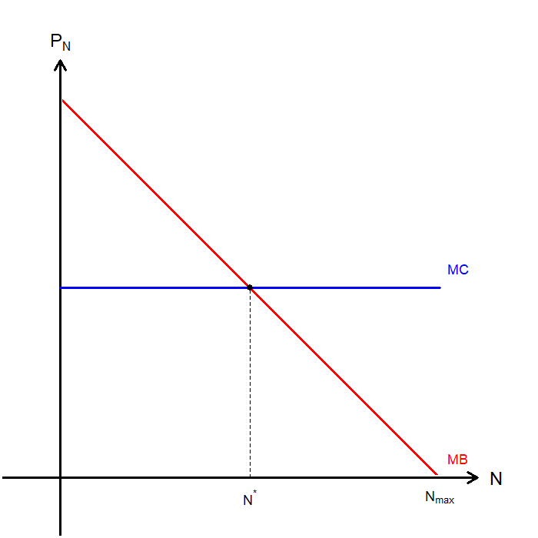
The Coase Theorem Illustrated
Through repeated rounds of Coasean bargaining, the process continues until the doctor’s willingness to sell equals the confectioner’s willingness to pay.
Continued bargaining moves the economy toward a socially optimal level of noise.
Even though the final outcome is efficient, owning the property rights remains valuable.
Who is more likely to gain from this transaction?

Slide 47
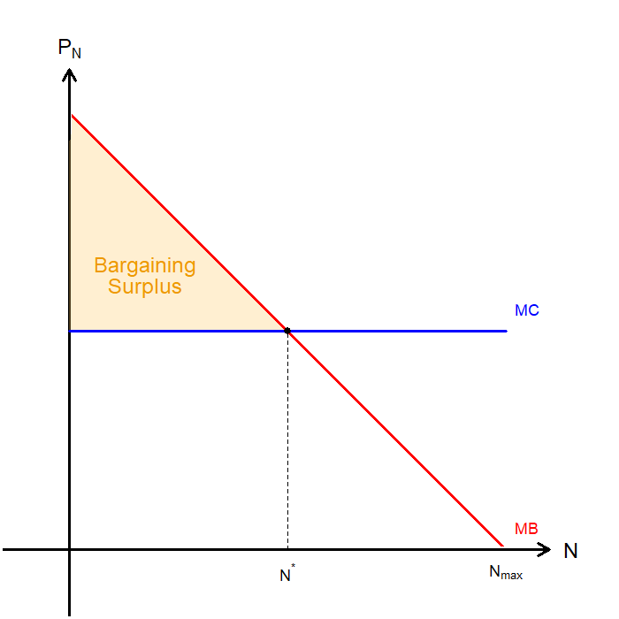
The Coase Theorem Illustrated
What gains can be generated through this bargaining process?
The shaded region represents the maximum bargaining surplus the doctor can extract from the confectioner.
This surplus equals the difference between the confectioner’s willingness to pay and the doctor’s willingness to sell.
  For each level of noise, the doctor can require payment up to the confectioner’s WTP.
  In this case, the entire surplus accrues to the doctor, who holds the property rights.

Slide 48
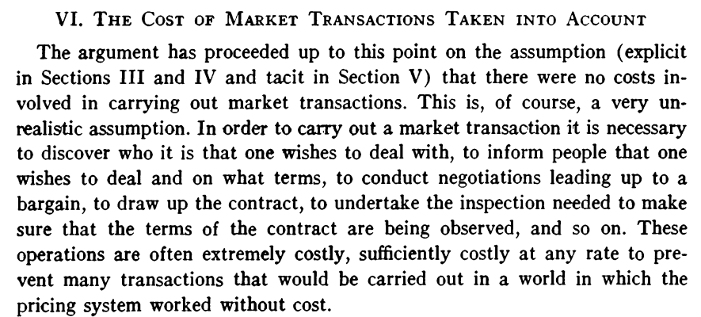
Coase, R. H. (1960). The problem of social cost.
The journal of Law and Economics, 3, 1–44.

Slide 49
The Coase Theorem and Transaction Costs
Recall that the validity of the Coase Theorem depends on two key conditions:
  Property rights are clearly defined.
  Transaction costs are negligible.
Transaction costs are the expenses parties incur during the bargaining process, and they can often be prohibitively high.
  If transaction costs exceed the bargaining surplus, negotiations break down.
  Costs rise when many parties are involved.
  They increase when information is unevenly distributed.
  Legal and administrative costs may arise if the dispute requires litigation.
Read Ronald Coase’s Nobel Lecture:
  https://www.nobelprize.org/prizes/economic-sciences/1991/coase/lecture/

Slide 50
Recap of Chapter 9

Slide 51
Recap
Externalities: When a transaction between a buyer and seller directly affects a third party.
  For negative externalities, the socially optimal quantity is less than the market equilibrium.
  For positive externalities, the socially optimal quantity is greater than the market equilibrium.
Governments can address the inefficiencies caused by externalities through:
  Direct Regulations
  Corrective Taxes and Subsidies
  Tradable Permits
Private solutions may also resolve externalities under certain conditions.
  When one party imposes an externality on another, both can internalize the effect through negotiation or agreement.
  The Coase Theorem states that if bargaining is costless, parties can reach an efficient allocation of resources regardless of initial property rights.

