Slide 1
PRINCIPLES OF GLOBAL ECONOMICS
Chapter 9: International Trade

Slide 2
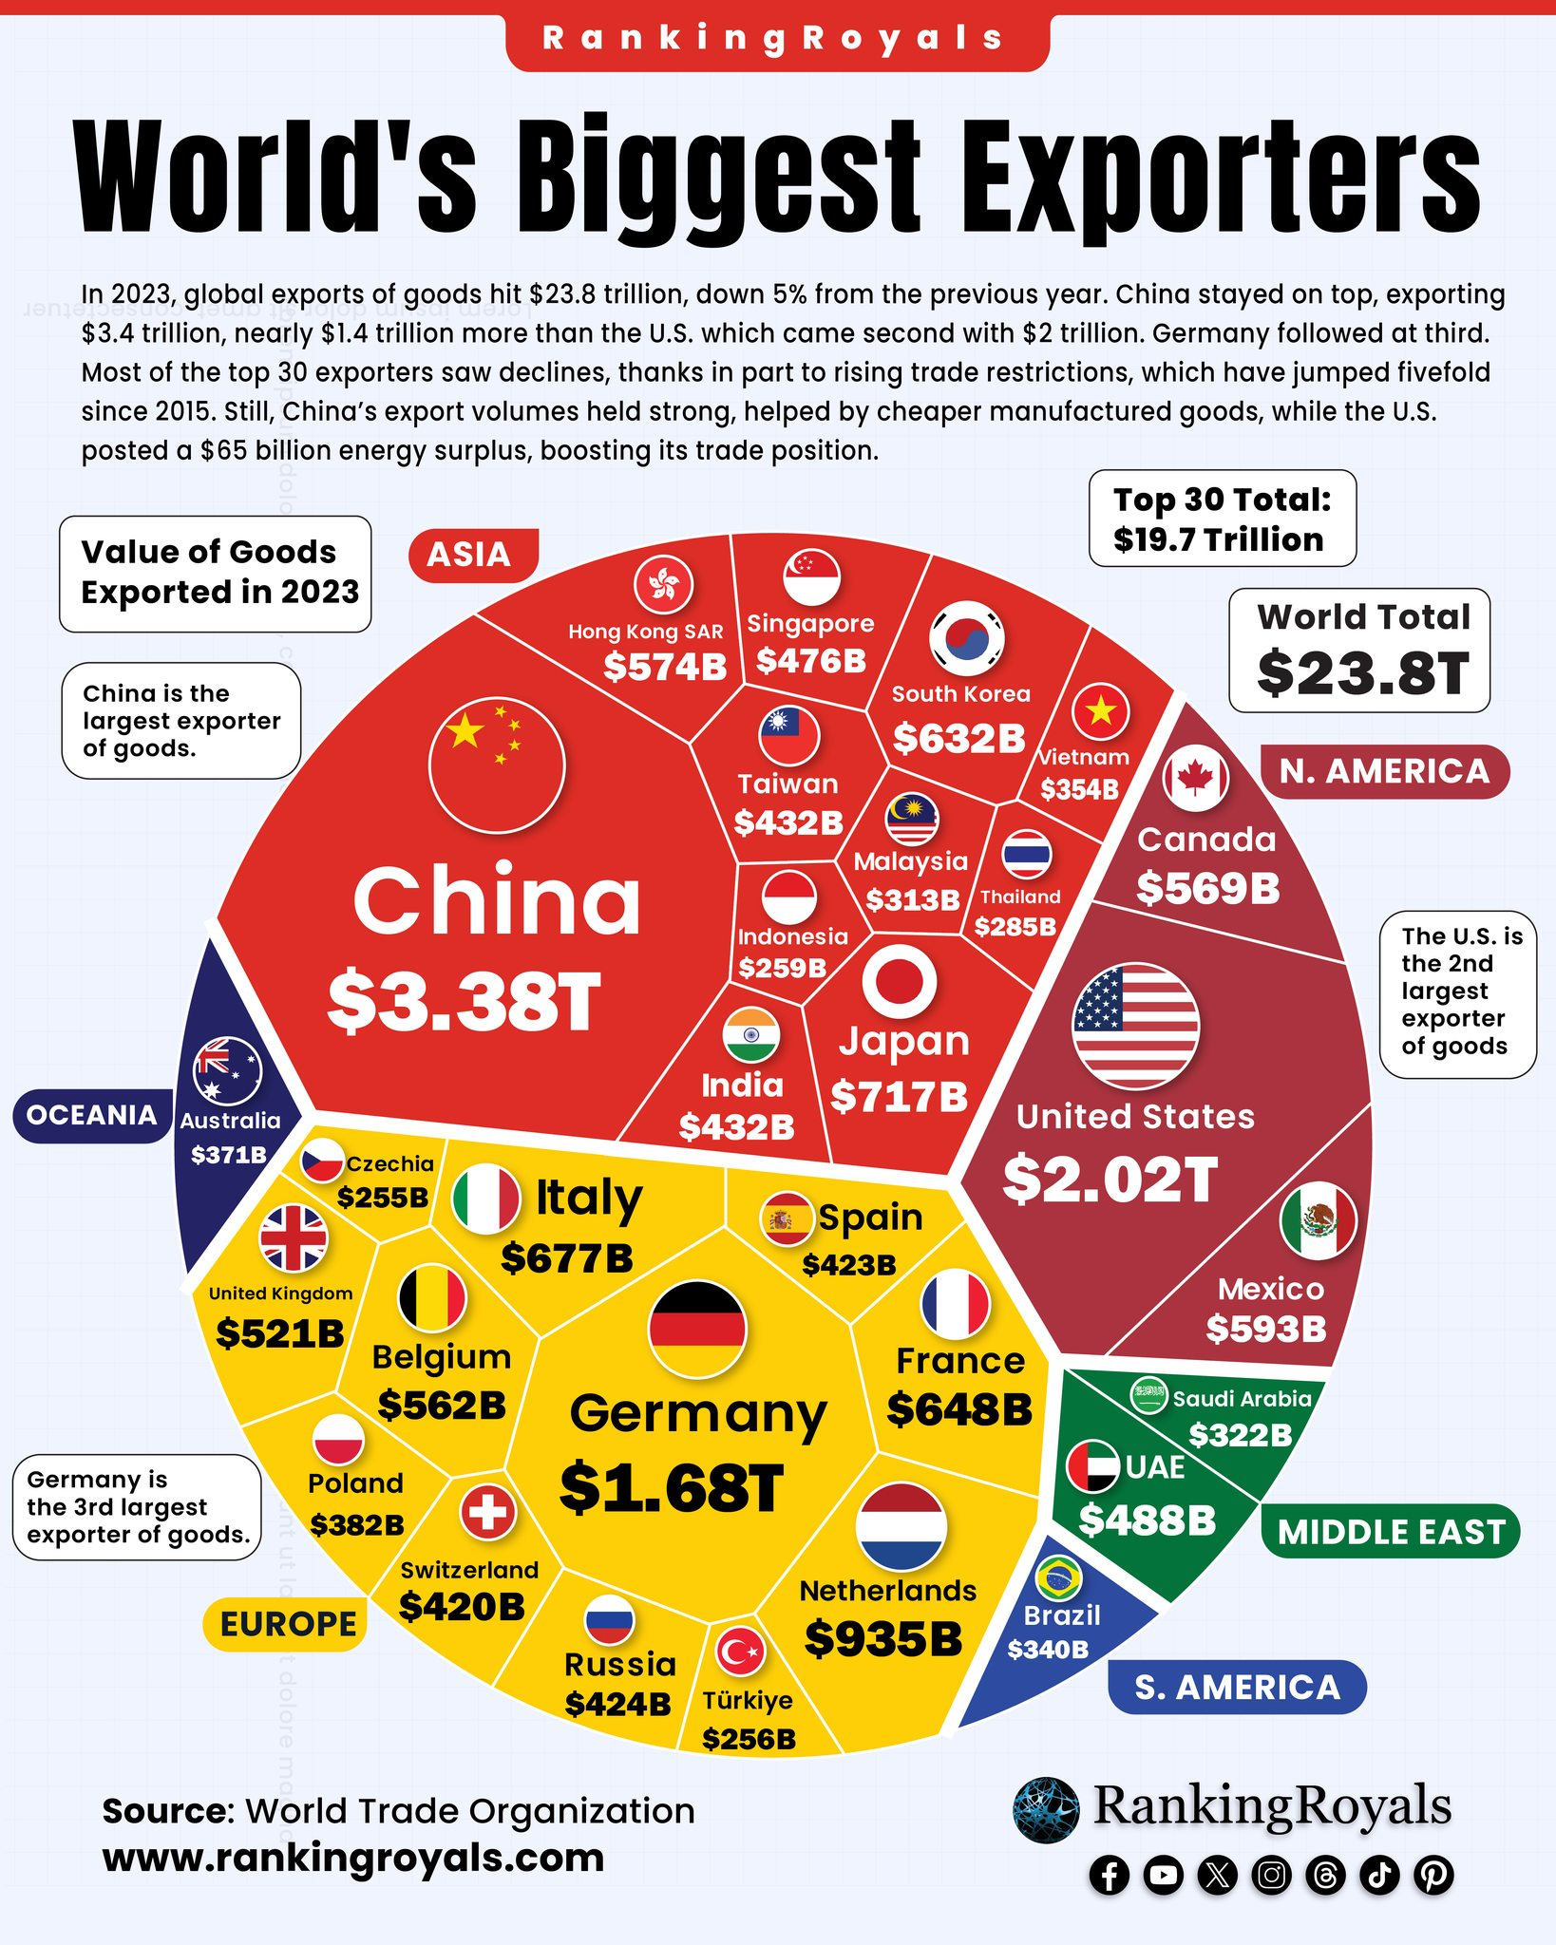
Global Trade
Global trade reached $33 trillion in 2024, according to the World Trade Organization.
This figure is roughly 43 times the level recorded in 1950.
The average value of exports as a share of a country’s GDP is now about 25 percent.
For the U.S, exports account for roughly 12 percent of GDP.
For more export-oriented economies such as Vietnam, that figure is closer to 40 percent.
Trade has become central to global prosperity, amplifying both its gains and vulnerabilities.

Slide 3
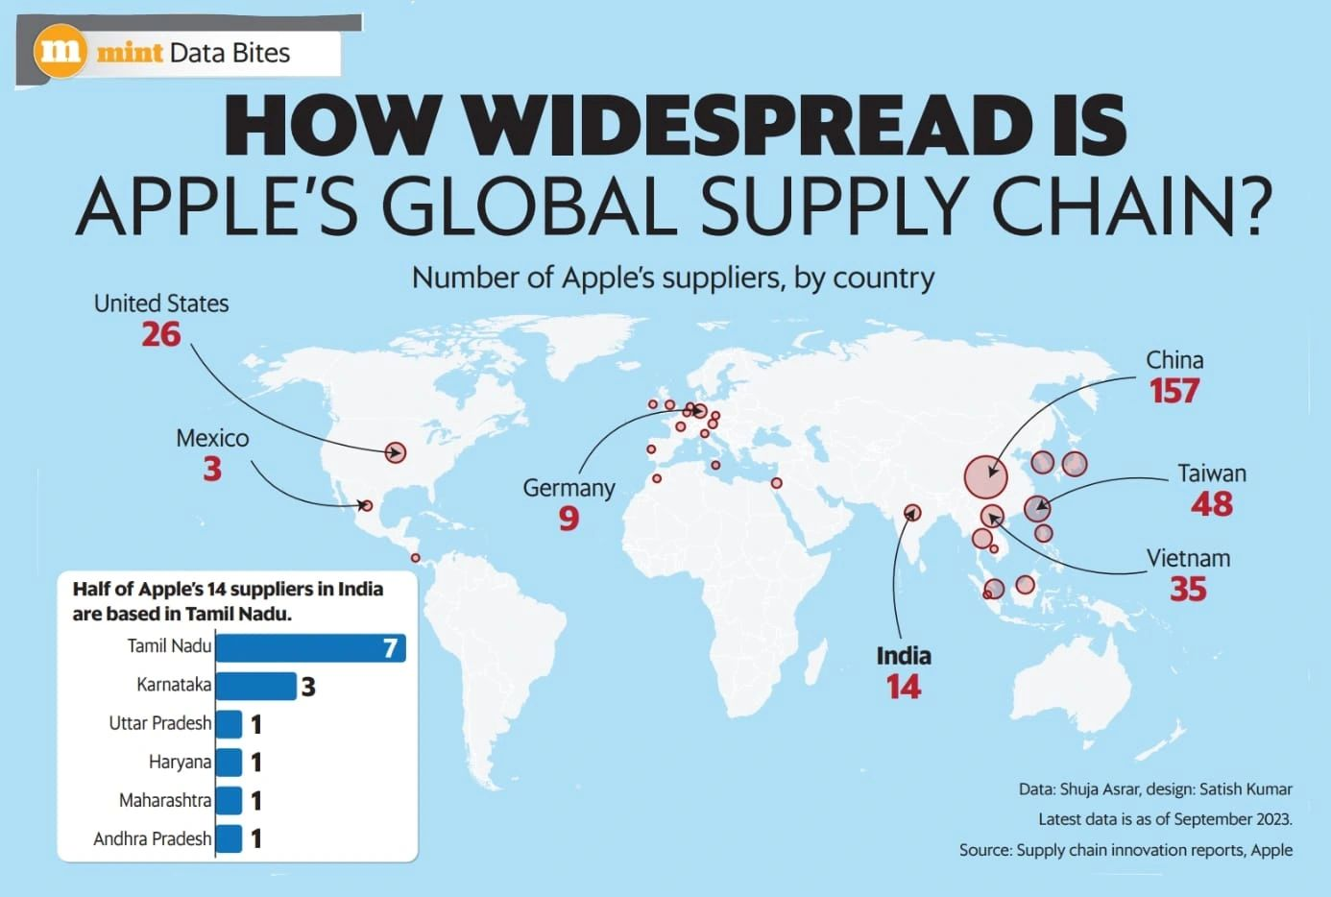
The iPhone Supply Chain: Trade in One Product
Modern trade is no longer just about goods crossing borders.
Entire value chains now cross borders multiple times in the production of a single product.
The iPhone alone depends on 30 or more countries, each contributing parts, materials, or assembly.
Every product we use reflects international interdependence.

Slide 4
The Determinants of Trade

Slide 5
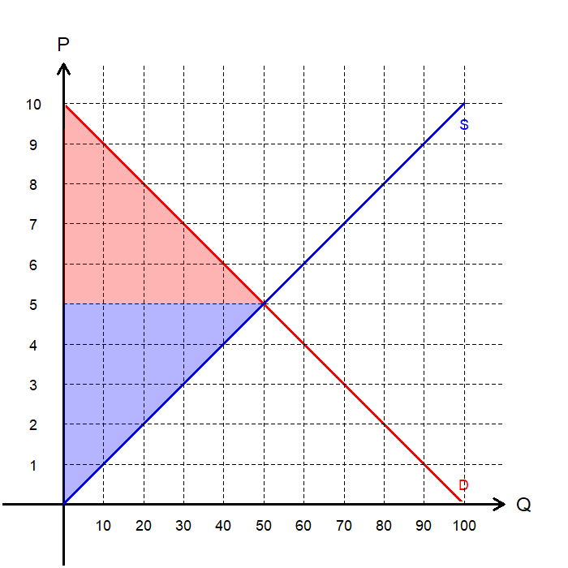
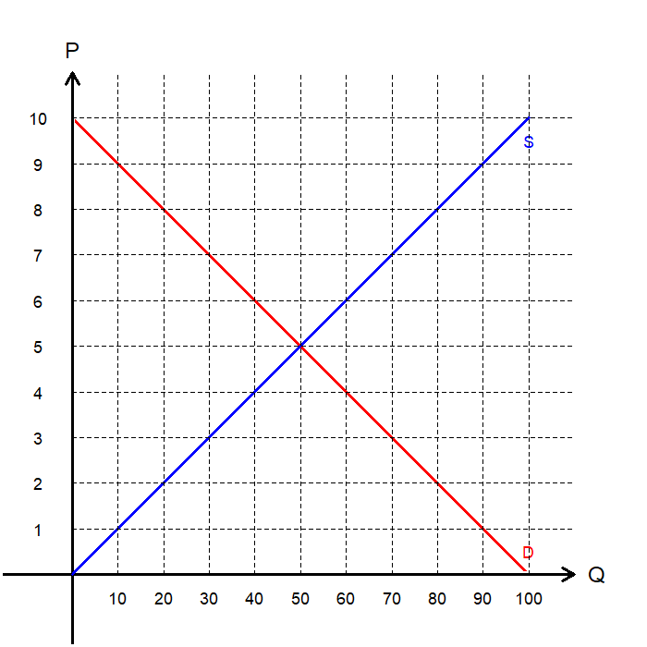
The Closed Market: Autarky
Consider a closed market with no trade where only domestic buyers and sellers participate in the market.
The equilibrium price and quantity is determined solely on the domestic market.
Equilibrium P = 5
Equilibrium Q = 50.
The total benefits from trade is equal to total surplus.
CS = $125
PS = $125
Total Surplus = $250.

Slide 6
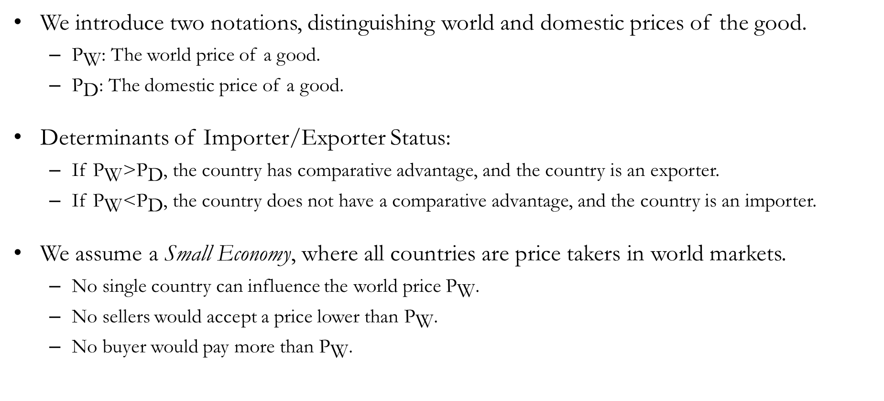
World Prices and Comparative Advantage
We introduce two notations, distinguishing world and domestic prices of the good.
${\text{P}}_{\text{W}}$: The world price of a good.
${\text{P}}_{\text{D}}$: The domestic price of a good.
Determinants of Importer/Exporter Status:
If ${\text{P}}_{\text{W}}\text{>}{\text{P}}_{\text{D}}$, the country has comparative advantage, and the country is an exporter.
If ${\text{P}}_{\text{W}}\text{<}{\text{P}}_{\text{D}}$, the country does not have a comparative advantage, and the country is an importer.
We assume a Small Economy, where all countries are price takers in world markets.
No single country can influence the world price ${\text{P}}_{\text{W}}$.
No sellers would accept a price lower than ${\text{P}}_{\text{W}}$.
No buyer would pay more than ${\text{P}}_{\text{W}}$.

Slide 7
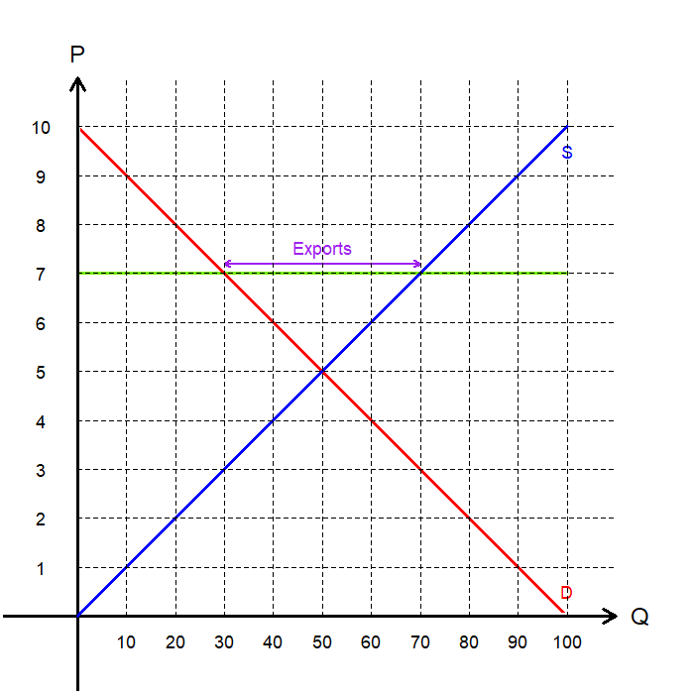
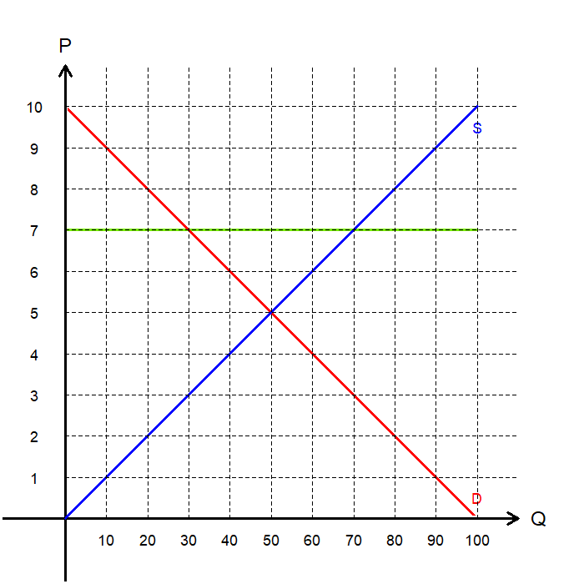
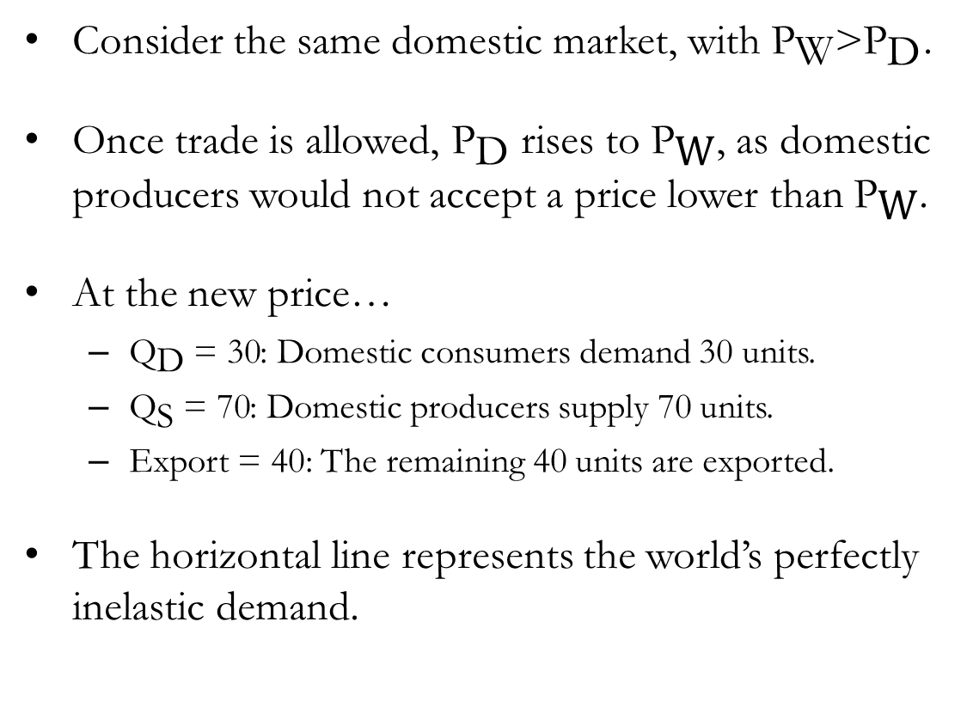
The Open Market: ${\text{P}}_{\text{W}}\text{>}{\text{P}}_{\text{D}}$
Consider the same domestic market, with ${\text{P}}_{\text{W}}\text{>}{\text{P}}_{\text{D}}$.
Once trade is allowed, ${\text{P}}_{\text{D}}$ rises to ${\text{P}}_{\text{W}}$, as domestic producers would not accept a price lower than ${\text{P}}_{\text{W}}$.
At the new price…
${\text{Q}}_{\text{D}} \text{= 30}$: Domestic consumers demand 30 units.
${\text{Q}}_{\text{S}} \text{=}\text{ 70}$: Domestic producers supply 70 units.
Export = 40: The remaining 40 units are exported.
The horizontal line represents the world’s perfectly inelastic demand.

Slide 8
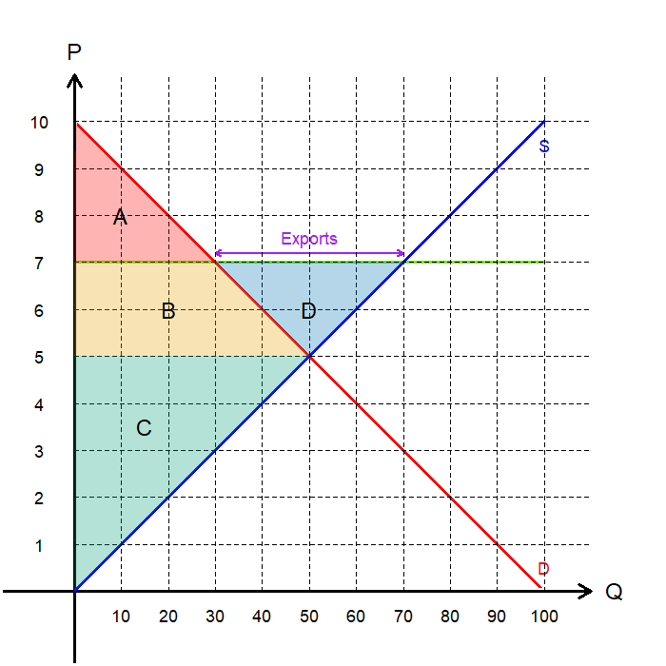
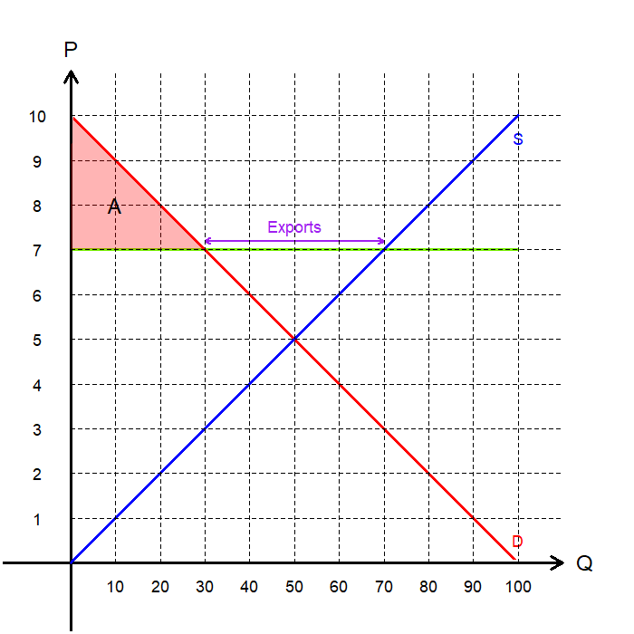
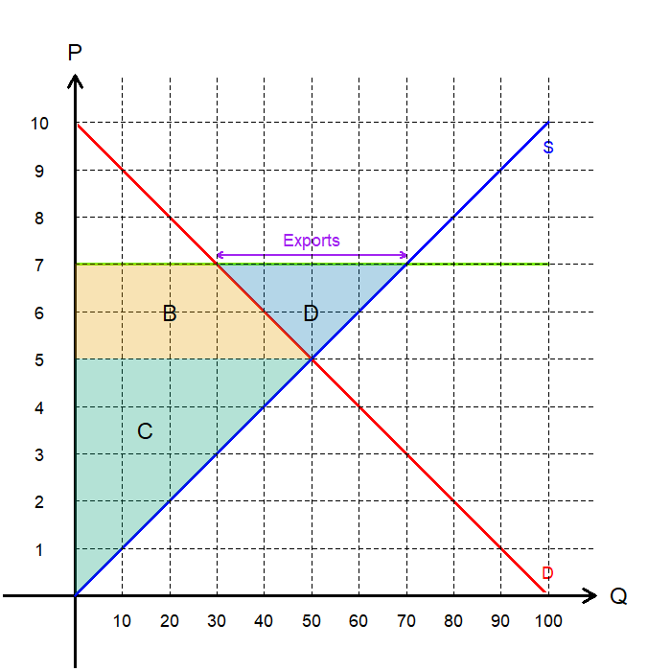
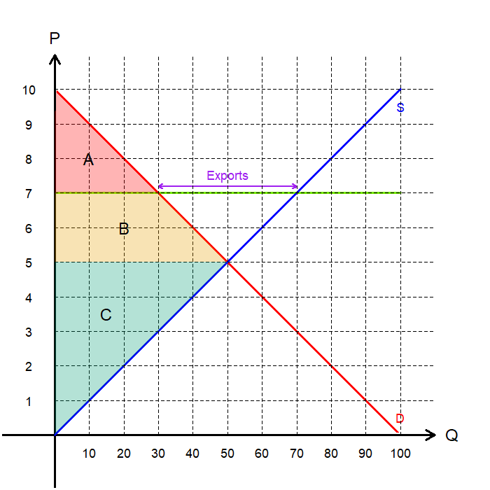
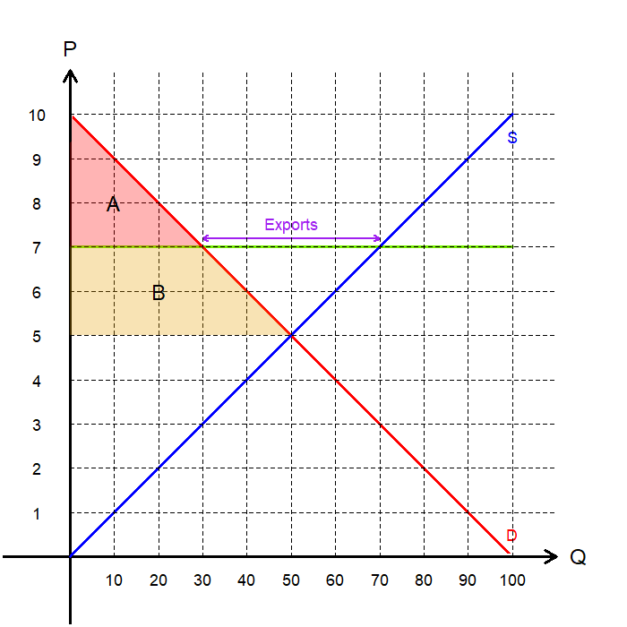
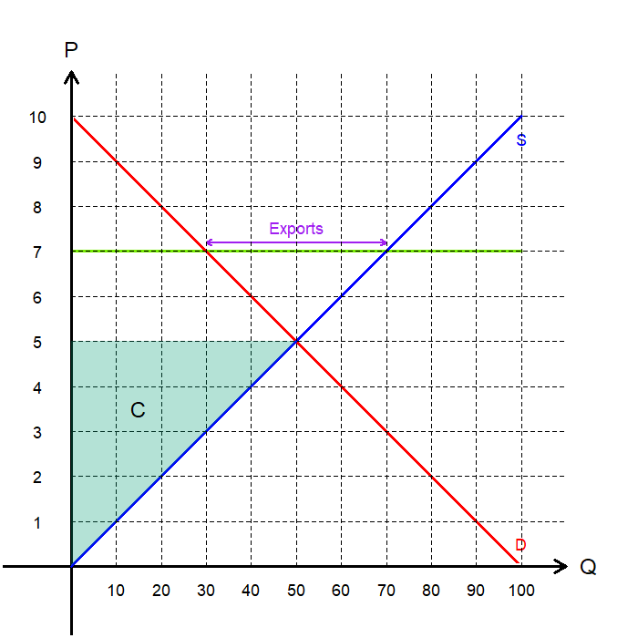
The Open Market: ${\text{P}}_{\text{W}}\text{>}{\text{P}}_{\text{D}}$
Let us compare the welfare implications.
In a closed economy without trade:
Producer Surplus: C ($125)
Consumer Surplus: A+B ($125)
Total Surplus: A+B+C ($250)
In the open economy with trade:
Producer Surplus: B+C+D ($245)
Consumer Surplus: A ($45)
Total Surplus: A+B+C+D ($290)
Gains from Trade: D ($40)

Slide 9
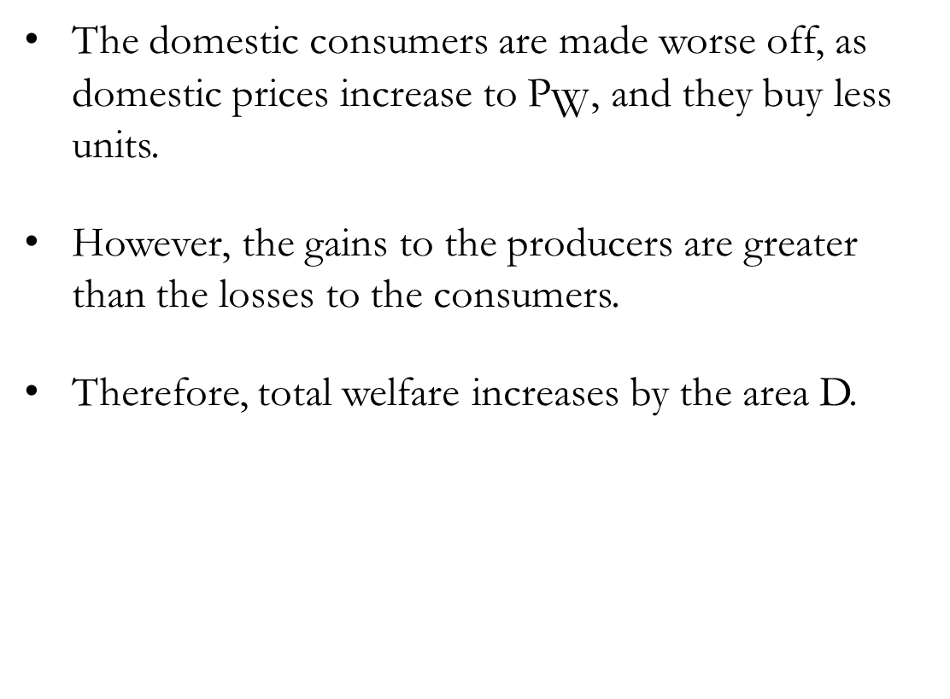
The Open Market: ${\text{P}}_{\text{W}}\text{>}{\text{P}}_{\text{D}}$
The domestic consumers are made worse off, as domestic prices increase to ${\text{P}}_{\text{W}}$, and they buy less units.
However, the gains to the producers are greater than the losses to the consumers.
Therefore, total welfare increases by the area D.

Slide 10
Exercise: International Trade and Welfare
Scenario:
Suppose a country that has closed off its agricultural sector to international trade opened its agricultural market. Following this change, the price of oranges nearly doubled.
Questions:
Does this country have a comparative advantage in the production of oranges?
Are the domestic consumers of oranges better off or worse off following this change?
Are there any gains from international trade?
The domestic price increased, which means that the world price is higher than the domestic price. So, this country has comparative advantage in the production of oranges and would export them.
Domestic consumers now pay a higher price (world price), and consume less, so are worse off.
The gains to the domestic producers of oranges outweigh the loss of the consumers, so overall the economy is better off.

Slide 11
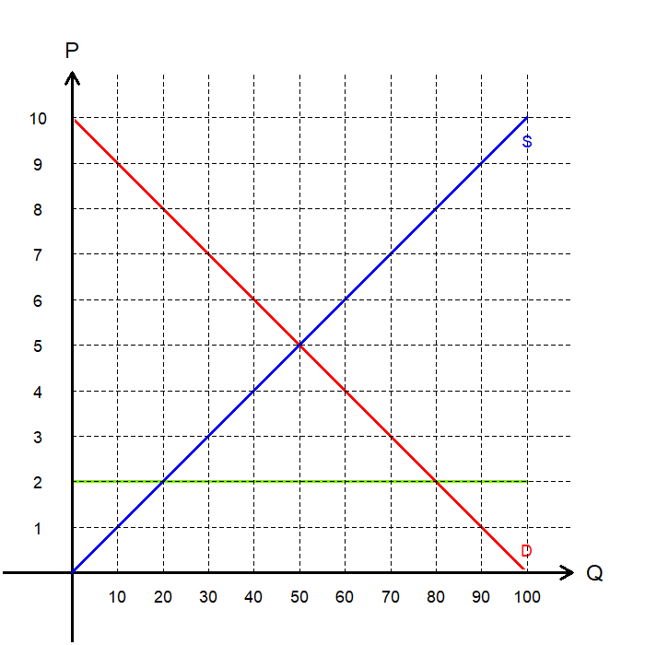
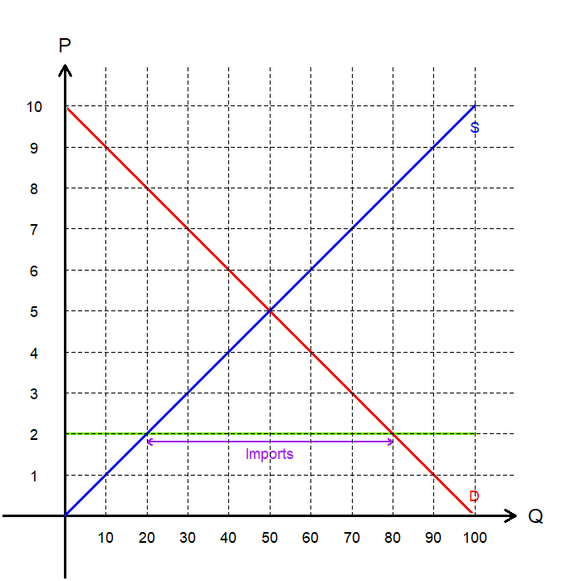
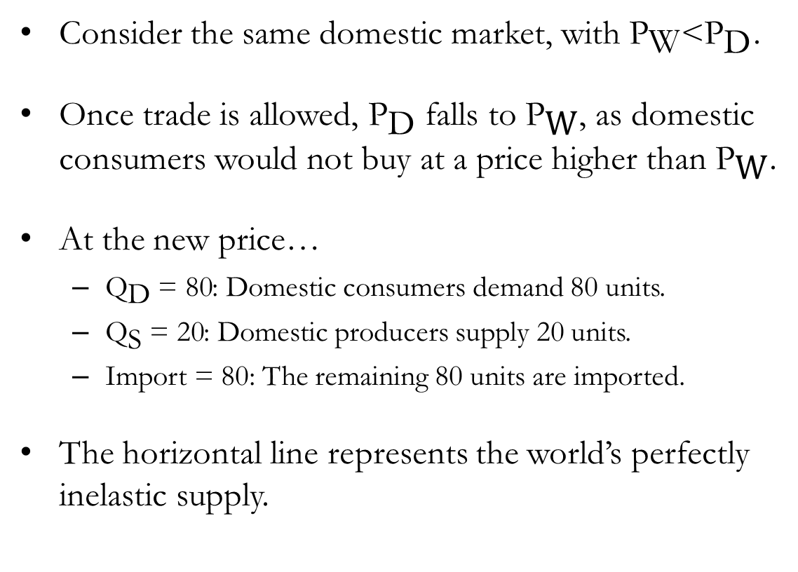
The Open Market: ${\text{P}}_{\text{W}}\text{<}{\text{P}}_{\text{D}}$
Consider the same domestic market, with ${\text{P}}_{\text{W}}\text{<}{\text{P}}_{\text{D}}$.
Once trade is allowed, ${\text{P}}_{\text{D}}$ falls to ${\text{P}}_{\text{W}}$, as domestic consumers would not buy at a price higher than ${\text{P}}_{\text{W}}$.
At the new price…
${\text{Q}}_{\text{D}} \text{= 80}$: Domestic consumers demand 80 units.
${\text{Q}}_{\text{S}} \text{=}\text{ 20}$: Domestic producers supply 20 units.
Import = 80: The remaining 80 units are imported.
The horizontal line represents the world’s perfectly inelastic supply.

Slide 12
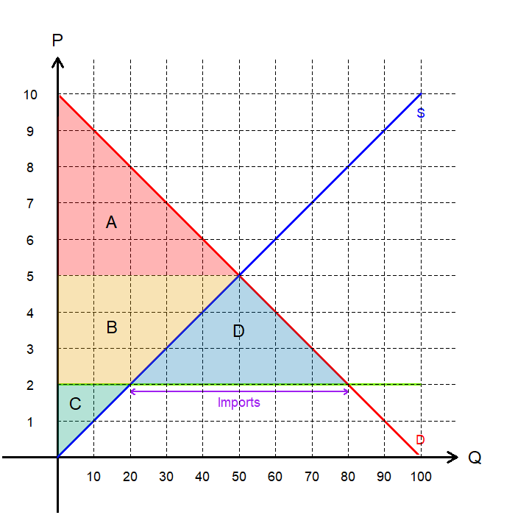
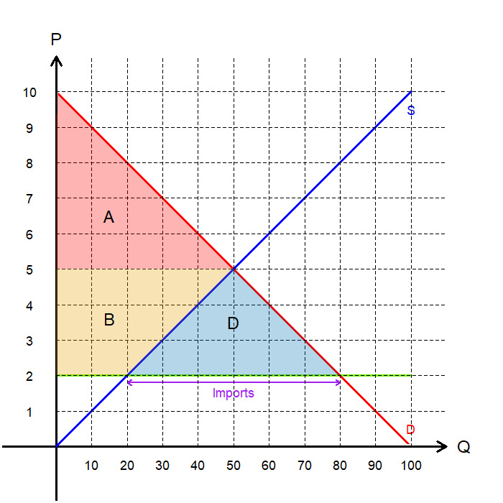
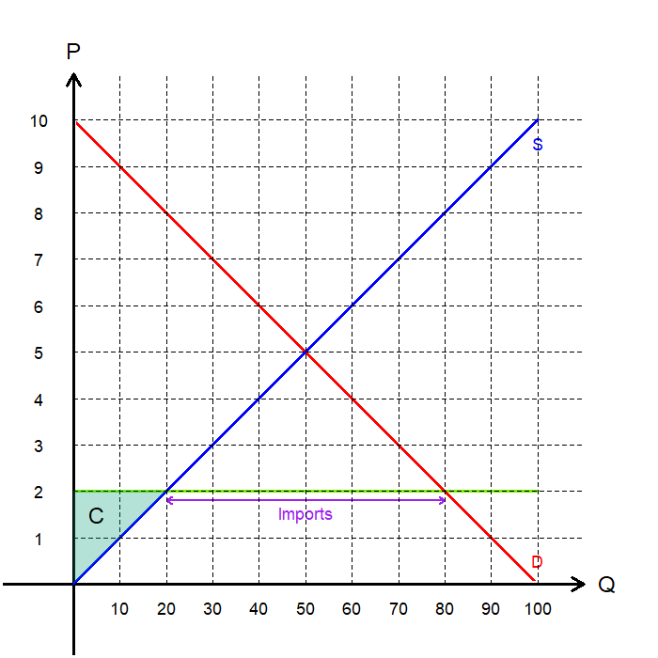
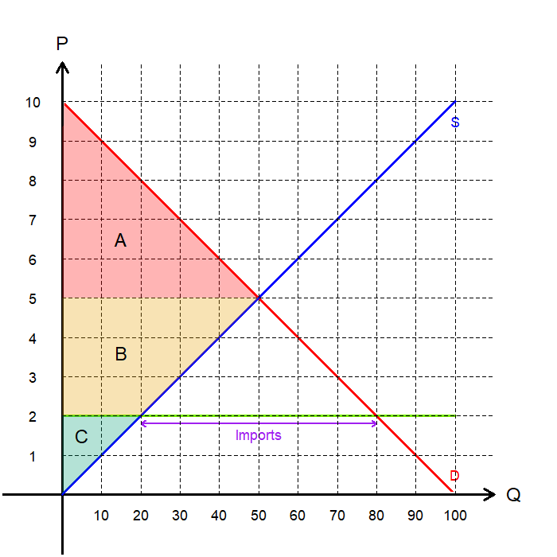
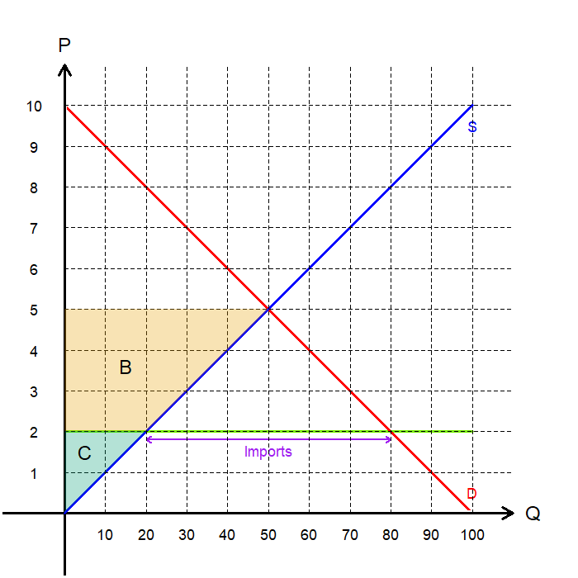
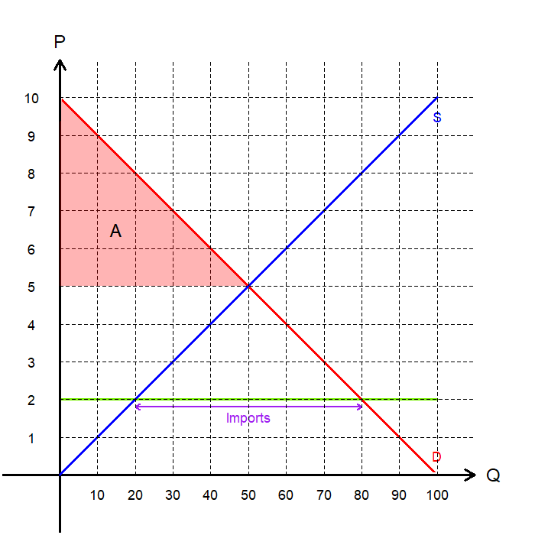
The Open Market: ${\text{P}}_{\text{W}}\text{<}{\text{P}}_{\text{D}}$
Let us compare the welfare implications.
In a closed economy without trade:
Producer Surplus: B+C ($125)
Consumer Surplus: A ($125)
Total Surplus: A+B+C ($250)
In the open economy with trade:
Producer Surplus: C ($20)
Consumer Surplus: A ($320)
Total Surplus: A+B+C+D ($340)
Gains from Trade: D ($90)

Slide 13
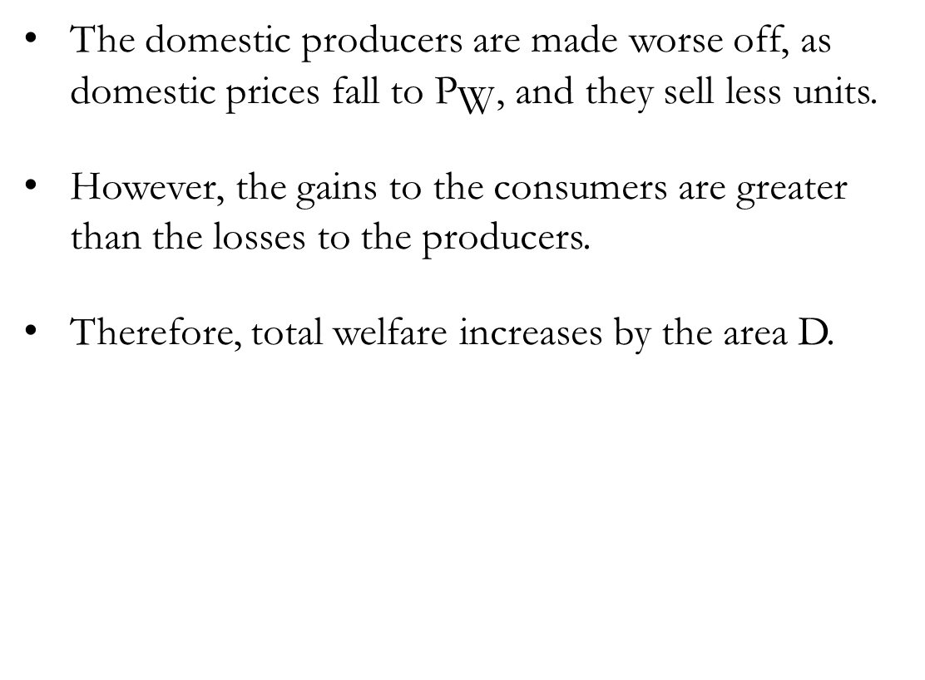
The Open Market: ${\text{P}}_{\text{W}}\text{<}{\text{P}}_{\text{D}}$
The domestic producers are made worse off, as domestic prices fall to ${\text{P}}_{\text{W}}$, and they sell less units.
However, the gains to the consumers are greater than the losses to the producers.
Therefore, total welfare increases by the area D.

Slide 14
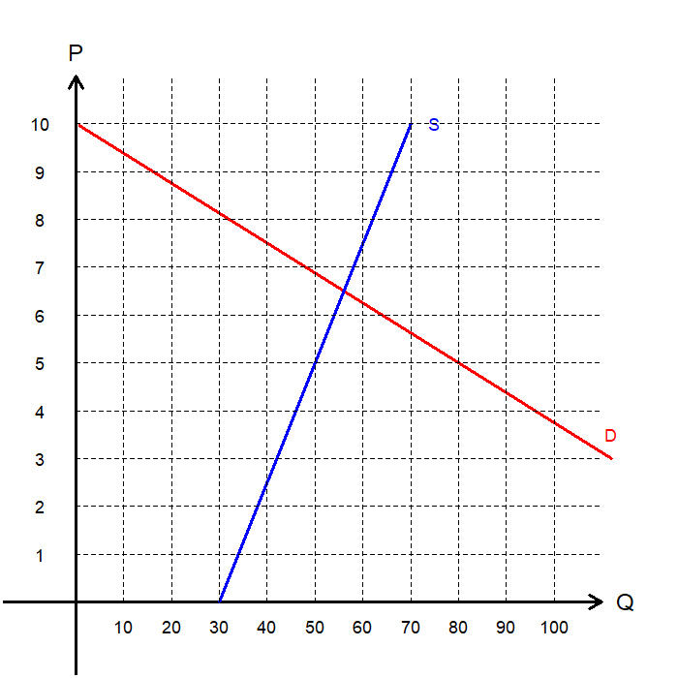
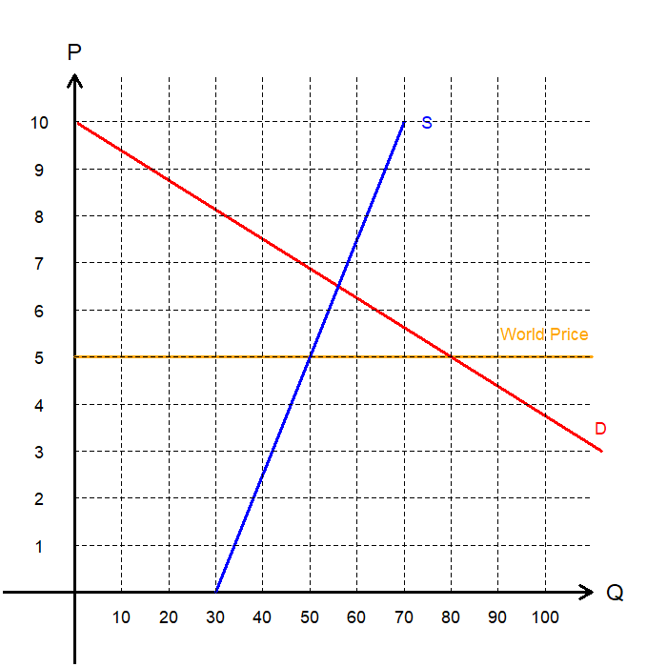
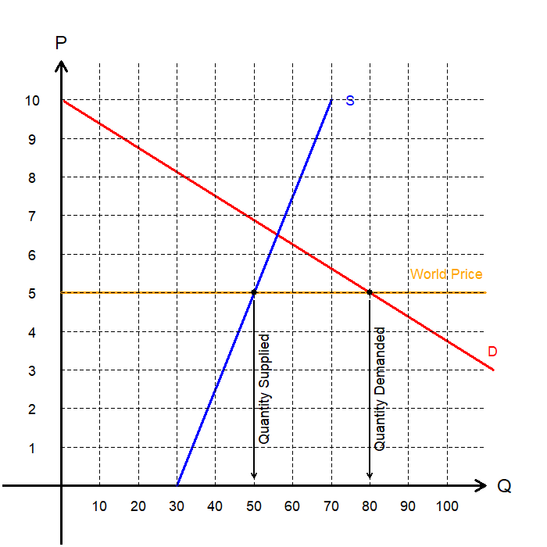
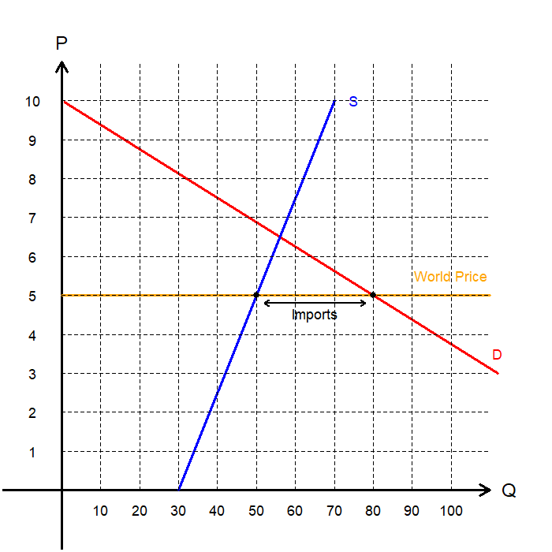
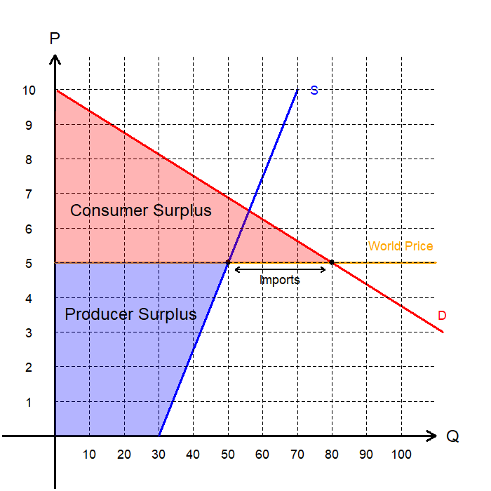
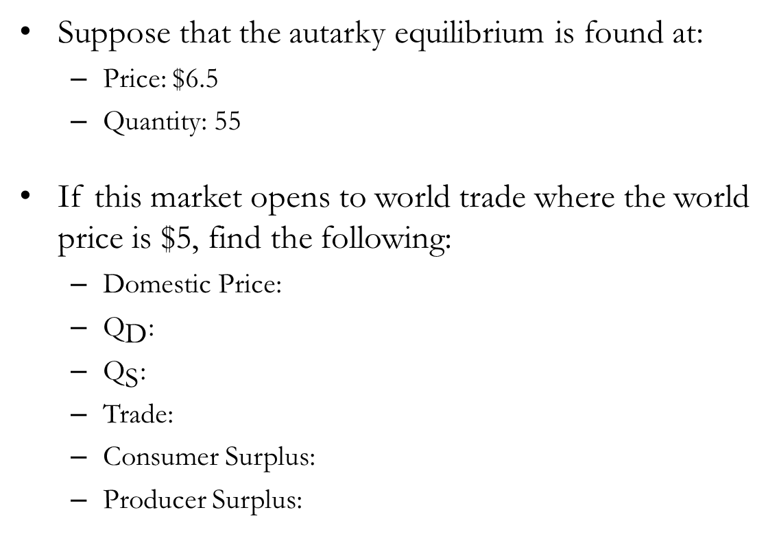
Exercise: World Price and Domestic Price
Suppose that the autarky equilibrium is found at:
Price: $6.5
Quantity: 55
If this market opens to world trade where the world price is $5, find the following:
Domestic Price:
${\text{Q}}_{\text{D}}$:
${\text{Q}}_{\text{S}}$:
Trade:
Consumer Surplus:
Producer Surplus:
$5
80
50
Import 30 Units
$200
$200

Slide 15
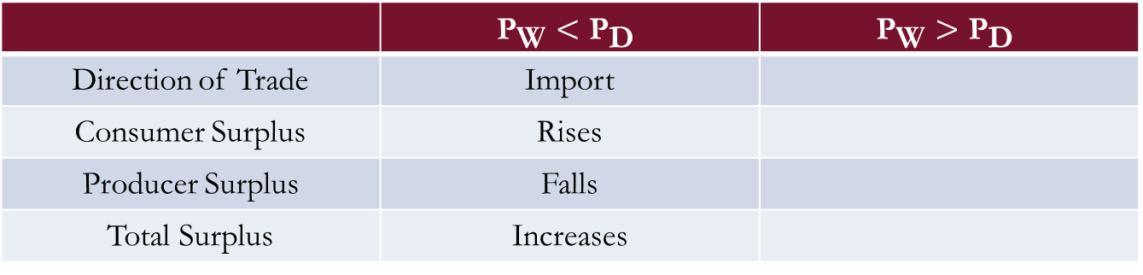
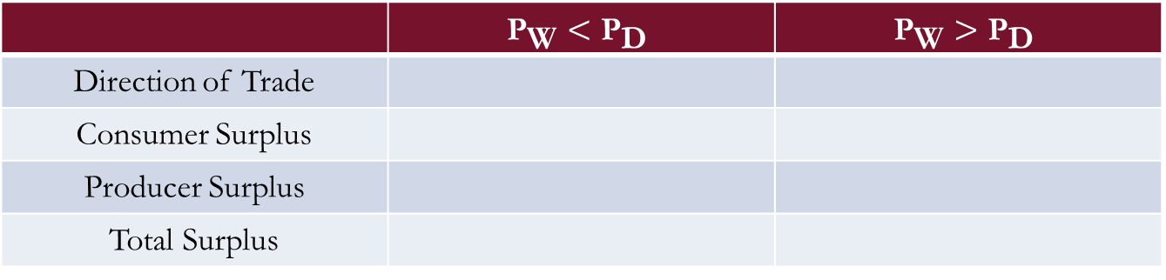
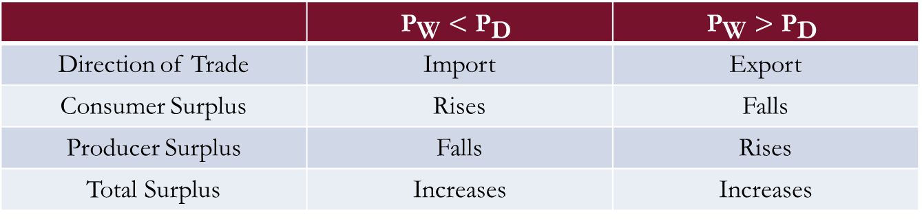
Summary: International Trade and Welfare
The following table summarizes the main points from previous slides:
Takeaways:
Trade creates winners and losers, but the gains exceed the losses.
By redistributing part of the gains from trade from the winners to the losers, everyone can be better off.
Compensating the losers from any government policy is often highly contentious.
In the real-world, the losing side often exert more political power, which lead to barriers to trade.
 | $${\text{P}}_{\text{W}}<{\text{P}}_{\text{D}}$$ | $${\text{P}}_{\text{W}}>{\text{P}}_{\text{D}}$$
Direction of Trade | Import
Consumer Surplus | Rises
Producer Surplus | Falls
Total Surplus | Increases
 | $${\text{P}}_{\text{W}}<{\text{P}}_{\text{D}}$$ | $${\text{P}}_{\text{W}}>{\text{P}}_{\text{D}}$$
Direction of Trade | Import | Export
Consumer Surplus | Rises | Falls
Producer Surplus | Falls | Rises
Total Surplus | Increases | Increases
 | $${\text{P}}_{\text{W}}<{\text{P}}_{\text{D}}$$ | $${\text{P}}_{\text{W}}>{\text{P}}_{\text{D}}$$
Direction of Trade
Consumer Surplus
Producer Surplus
Total Surplus

Slide 16
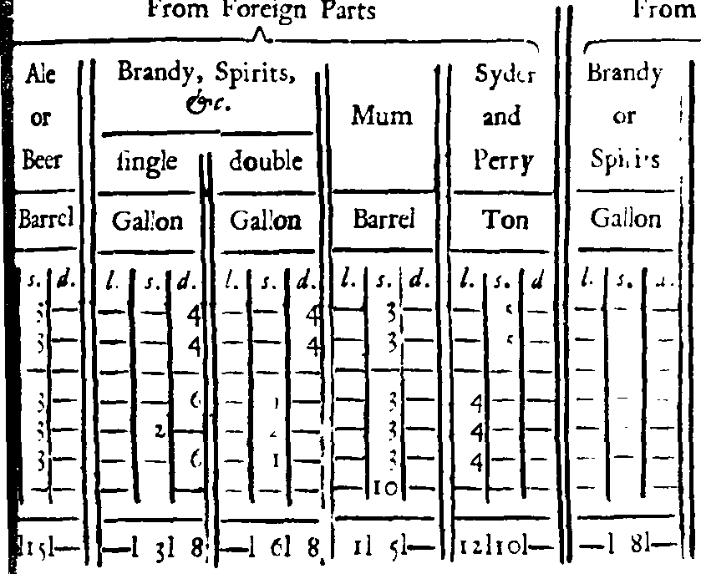
Tariffs
A Tariff is a tax on goods produced abroad and sold domestically.
Curious etymology:
Originates from Arabic تعريف, (“taʿrīf”) meaning ‘notification,’ or ‘announcement.’
Turned into Ottoman Turkish تعرفه, (“taʿrife”) which referred to the table of custom rates.
Origin of the Medieval Latin term “tariffe,” which means a ‘set price’.
Designed to raise the price of imported goods to discourage consumption.

Slide 17
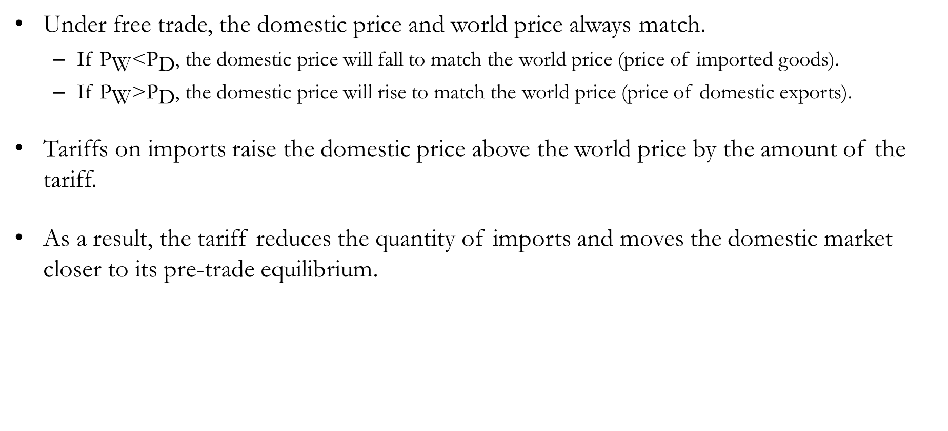
Tariffs
Under free trade, the domestic price and world price always match.
If ${\text{P}}_{\text{W}}\text{<}{\text{P}}_{\text{D}}$, the domestic price will fall to match the world price (price of imported goods).
If ${\text{P}}_{\text{W}}\text{>}{\text{P}}_{\text{D}}$, the domestic price will rise to match the world price (price of domestic exports).
Tariffs on imports raise the domestic price above the world price by the amount of the tariff.
As a result, the tariff reduces the quantity of imports and moves the domestic market closer to its pre-trade equilibrium.

Slide 18
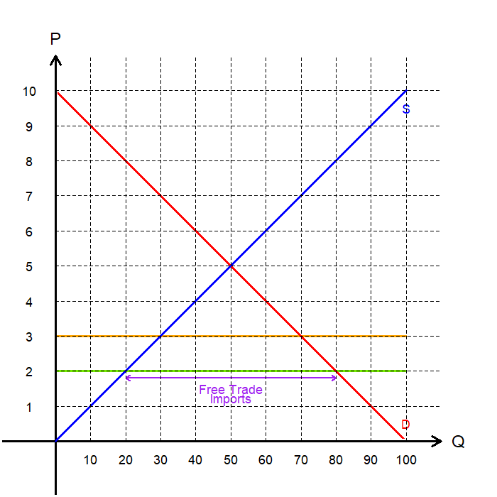
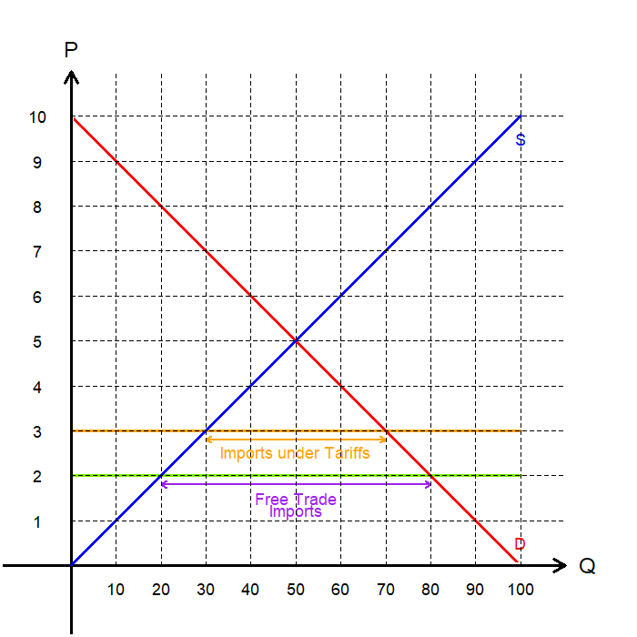
Tariffs on Imports: ${\text{P}}_{\text{W}}\text{<}{\text{P}}_{\text{D}}$
Suppose that a new $1 per-unit tariff is enacted.
Compared to the free-trade example, the price rises by the amount of the tariff.
Now, the world price is effectively $3.
The market responds by:
Domestic quantity demanded decreases to 70 units.
Domestic quantity supplied increases to 30 units.
Imports fall to 40 units (previously 60).
The market approaches its closed economy (autarky) equilibrium.

Slide 19
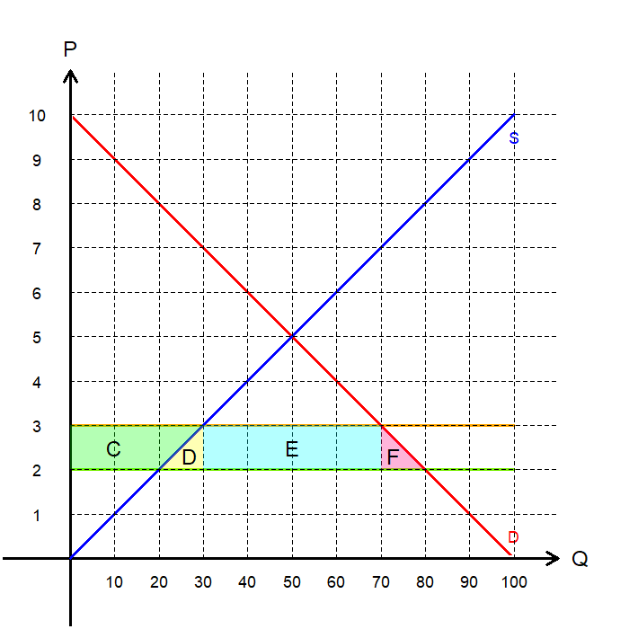
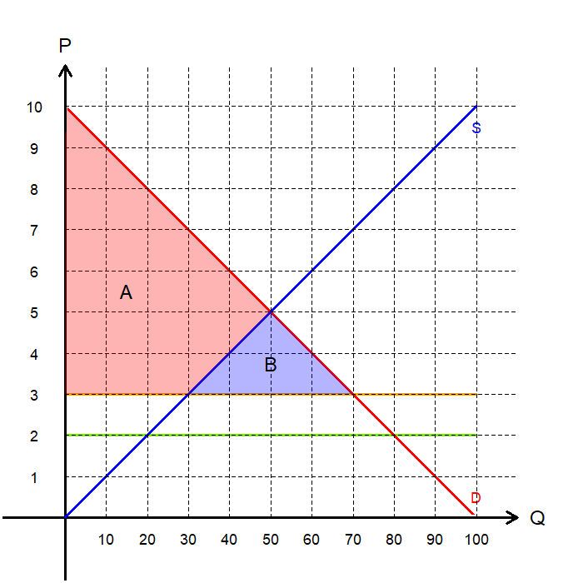
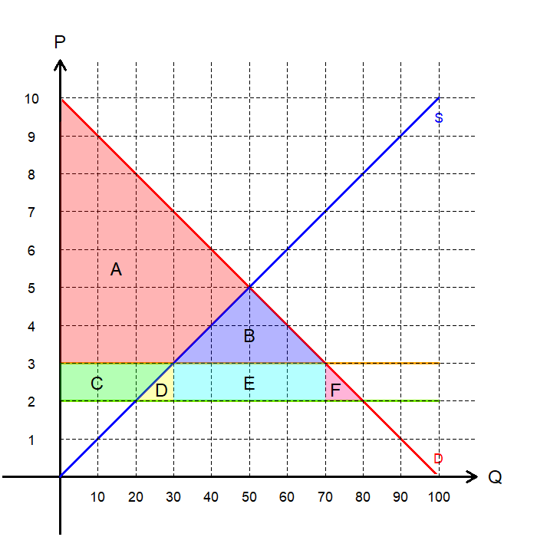
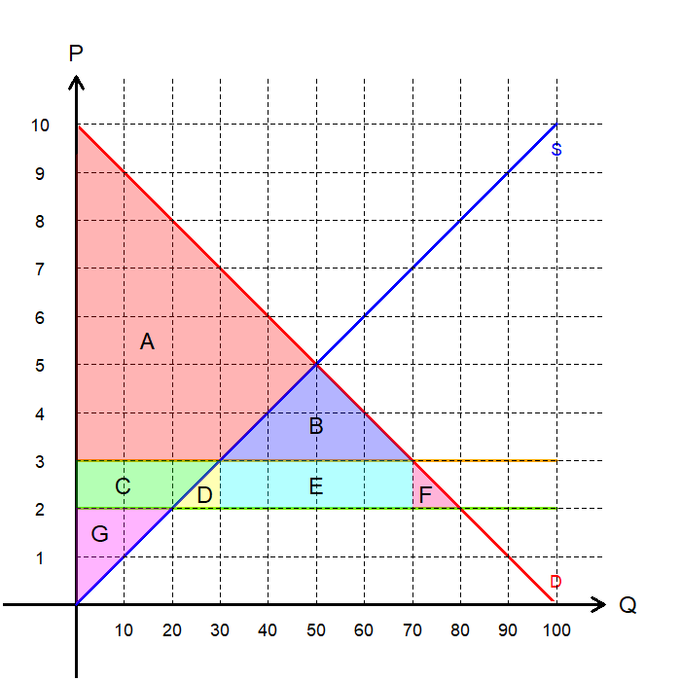
Tariffs on Imports: Consumers’ Loss
Let’s examine the welfare implications of tariffs.
Consumer Surplus:
Free Trade: A+B+C+D+E+F
Tariffs: A+B
Loss: C+D+E+F
Tariffs make consumers worse off, because they now pay a higher price.
A portion of this loss is absorbed by the domestic producers.

Slide 20
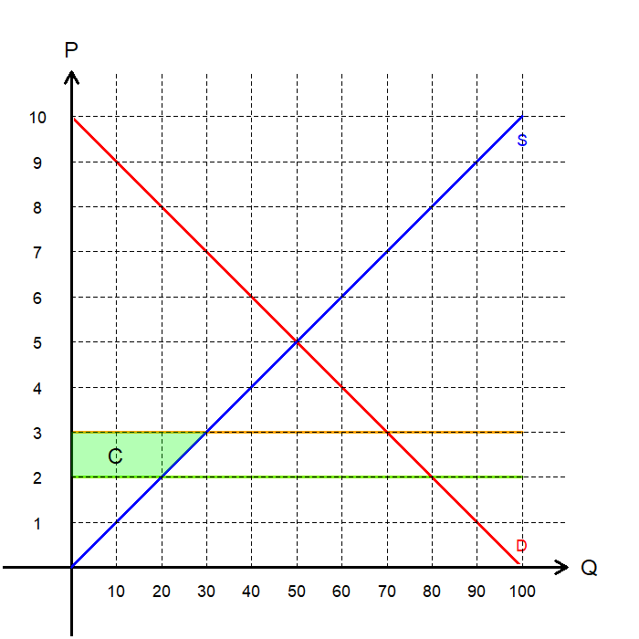
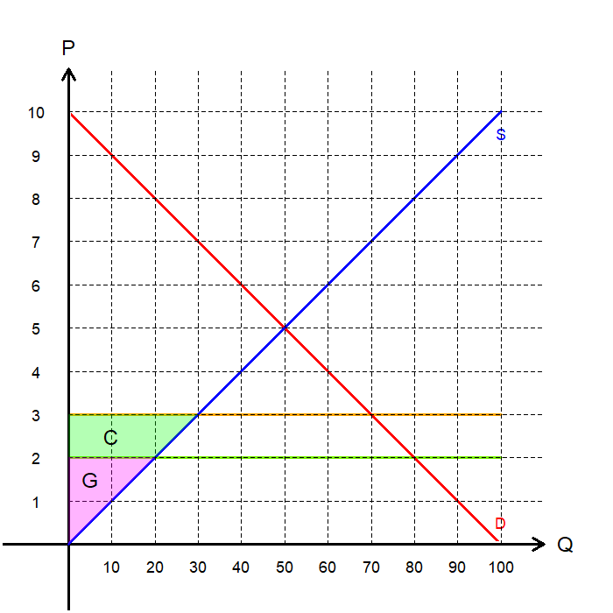
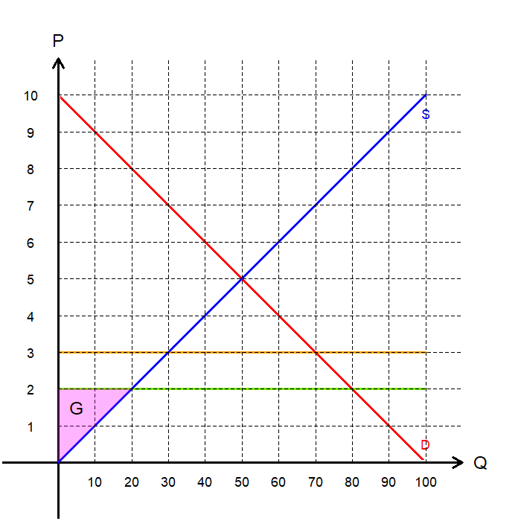
Tariffs on Imports: Producers’ Gain
Producer Surplus:
Free Trade: G
Tariffs: C+G
Gain: C
Tariffs benefit domestic producers, because they can sell at a higher price.
The domestic producers’ gains come from the loss in consumers’ surplus.
Loss in CS: C+D+E+F
Gain in PS: C

Slide 21
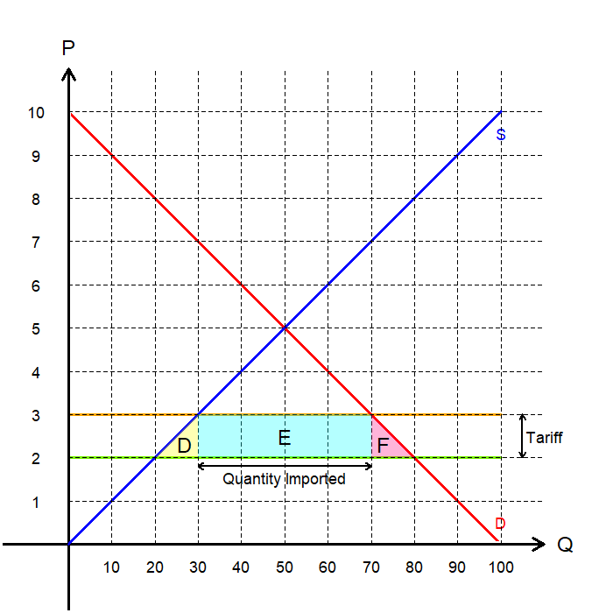
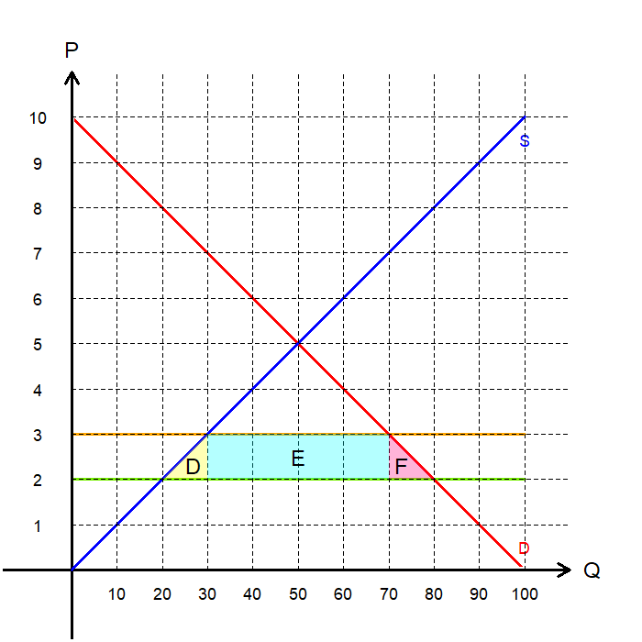
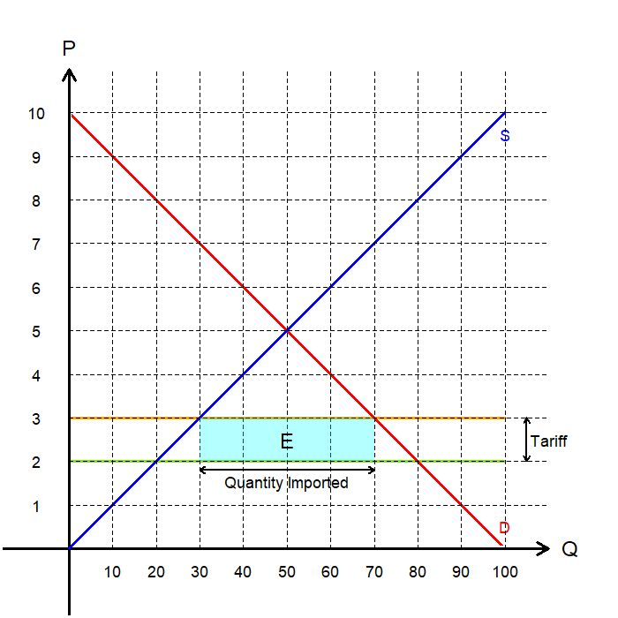
Tariffs on Imports: Tariff Revenues
The loss of D+E+F remains unaccounted for.
The government’s revenue from enacting the tariff is the size of the tariff multiplied by units imported.
In the diagram, E represents the tariff revenue.
Summary:
The consumers lose C+D+E+F
The producers absorb C
The government absorbs E
D+F is not absorbed by any other actor

Slide 22
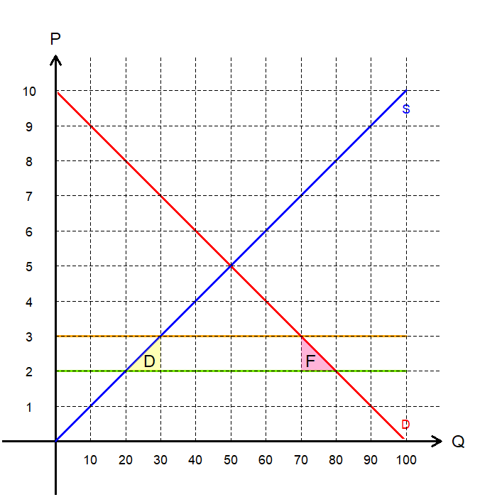
Tariffs on Imports: Deadweight Loss
The area D+F represents the Deadweight Loss (DWL) of tariffs.
Tariffs are taxes, taxes distort incentives, and this leads to DWL in the market.
The tariff causes the economy to devote more resources to produce a good that could have been produced at a lower opportunity cost (Area D).
The tariff also prices out some consumers, due to the increased price of said good (Area F).
Overall, the welfare loss from the tariffs is greater than the welfare gain, so total surplus falls.

Slide 23
Tariffs on Imports: A Summary
A quick summary of the welfare implications of tariffs is listed in the table below:
 | Free Trade | With Tariffs | Change
CS | A+B+C+D+E+F | A+B | -C-D-E-F
PS | G | C+G | +C
Tax Revenue | - | E | +E
Total Surplus
 | Free Trade | With Tariffs | Change
CS | A+B+C+D+E+F | A+B | -C-D-E-F
PS | G | C+G | +C
Tax Revenue | - | E | +E
Total Surplus | A+B+C+D+E+F+G | A+B+C+E+G | -D-F
 | Free Trade | With Tariffs | Change
CS | A+B+C+D+E+F | A+B | -C-D-E-F
PS
Tax Revenue
Total Surplus
 | Free Trade | With Tariffs | Change
CS
PS
Tax Revenue
Total Surplus
 | Free Trade | With Tariffs | Change
CS | A+B+C+D+E+F | A+B | -C-D-E-F
PS | G | C+G | +C
Tax Revenue
Total Surplus

Slide 24
Discussions on Trade

Slide 25
Benefits of Trade
The primary benefits of trade come from the increased total surplus in the economy.
When a country acts as an exporter, producer surplus increases substantially.
When a country acts as an importer, consumer surplus increases substantially.
Although there is a “losing side,” the total gains outweigh the losses in surplus.
Trade increases the variety of goods available to domestic consumers:
For example, people in Finland consume the most coffee per capita, yet Finland produces none.
Although the U.S. produces cars, German cars differ from U.S. cars in design and quality.
Trade can lower costs by leveraging economies of scale:
Economies of scale occur when the average cost of production falls as output increases.
A firm cannot fully realize economies of scale if it is limited to selling in a small domestic market.

Slide 26
Benefits of Trade
Trade can lead to increased competition:
Companies shielded from foreign competitors are more likely to gain market power.
Concentration of market power leads to inefficiencies in the market, which trade can help correct.
Trade can increase productivity:
When a nation opens to international trade, its most productive firms expand their markets.
Meanwhile, the least productive firms are forced out by increased competition.
Resources shift from less productive to more productive firms.
Trade can enhance the flow of ideas:
The transfer of technological advances around the world is often linked to the exchange of goods.
For example, economic development is often spurred by the introduction of information technology to developing nations.

Slide 27

Arguments of Restricting Trade
The Jobs Argument:
Opponents of free trade often argue that it destroys domestic jobs in industries that face foreign competition.
When imports increase, domestic production declines, and workers in affected industries may lose employment.
However, trade also creates new jobs in other sectors as resources shift toward industries where the country has a comparative advantage.
Over time, displaced workers can find employment in expanding industries that benefit from trade.
The main challenge is that workers cannot always transition quickly or easily between industries.

Slide 28
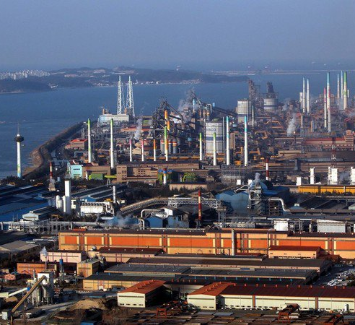
Arguments of Restricting Trade
The National Security Argument:
Some argue that industries vital to national defense should be protected from foreign competition.
For example, free trade in steel could make a nation dependent on foreign suppliers for key military materials.
Economists agree that protection may be justified when true security risks exist.
However, this argument is often used by industries seeking protection for profit rather than genuine security needs.
Lower-cost imports can even benefit the military by reducing the cost of obtaining essential materials.

Slide 29

Arguments of Restricting Trade
The Infant Industry Argument:
Some argue that new industries need temporary protection from foreign competition until they become established.
The idea is that, once mature, these industries will be able to compete internationally without support.
Political influence often leads to protection being granted to industries with the most lobbying power rather than true economic potential.
However, this argument is often used by industries seeking protection for profit rather than genuine security needs.

Slide 30

Arguments of Restricting Trade
The Unfair Competition Argument:
Some argue that free trade is unfair if foreign producers operate under different rules or government policies.
Even if foreign governments subsidize their industries, domestic consumers benefit from the resulting lower prices.
Domestic producers may lose, but the total gains to consumers exceed the producers’ losses.
In effect, foreign subsidies benefit the importing country, since its consumers enjoy lower prices paid for by foreign taxpayers.

Slide 31

Arguments of Restricting Trade
The Protection-as-a-Bargaining-Chip Argument:
Some policymakers argue that trade restrictions can be used as leverage in international negotiations.
For example, a country might threaten tariffs on certain goods to pressure another country into lowering its own trade barriers.
However, this strategy is risky because the threat may fail.
If it fails, the country must either impose the restriction while harming its own economy, or back down and lose credibility in future negotiations.
Economists generally view this approach as unreliable and potentially self-defeating.

Slide 32
Recap of Chapter 9

Slide 33
Recap
International trade allows countries to specialize based on comparative advantage, raising total economic welfare.
Exporting countries gain mainly through higher producer surplus.
Importing countries gain through higher consumer surplus.
Trade creates winners and losers, but the total gains from trade exceed the total losses.
Barriers to trade reduce overall welfare by creating deadweight losses.
A tariff is a tax on imported goods that raises the domestic price above the world price.
Consumers lose from higher prices and reduced choices.
Domestic producers gain from the higher price, and the government collects tariff revenue.
The loss in total surplus (deadweight loss) comes from inefficient production and reduced consumption.
While tariffs help some groups, they make the economy as a whole worse off.

