Slide 1
PRINCIPLES OF GLOBAL ECONOMICS
Chapter 8: The Costs of Taxation

Slide 2

Taxation is Inevitable

Slide 3
Taxation and Welfare
In previous chapters, we examined:
How taxes alter the market equilibrium.
How the burden is split between consumers and producers.
We learned that both buyers and sellers of goods and services are worse off when taxed:
Buyers pay more, lowering their consumer surplus.
Sellers receive less, lowering their producer surplus.
A group of sellers and buyers are “priced out” of the market altogether.
To fully understand how taxation affects societal well-being, we must compare the losses to the amount of revenue the government collects.

Slide 4
The Deadweight Loss of Taxation

Slide 5
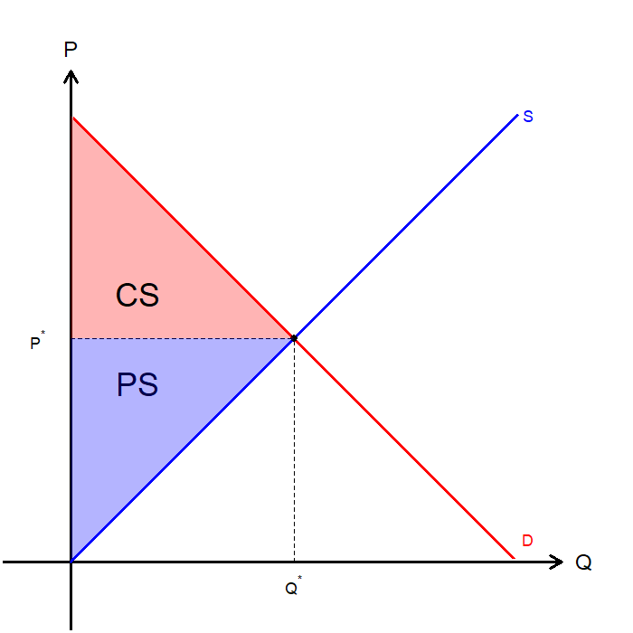
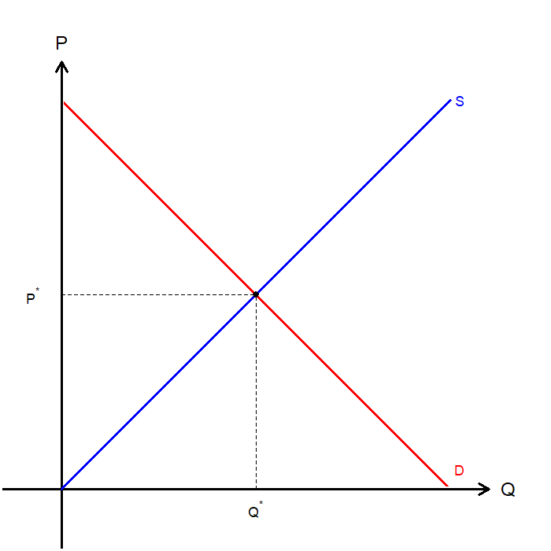
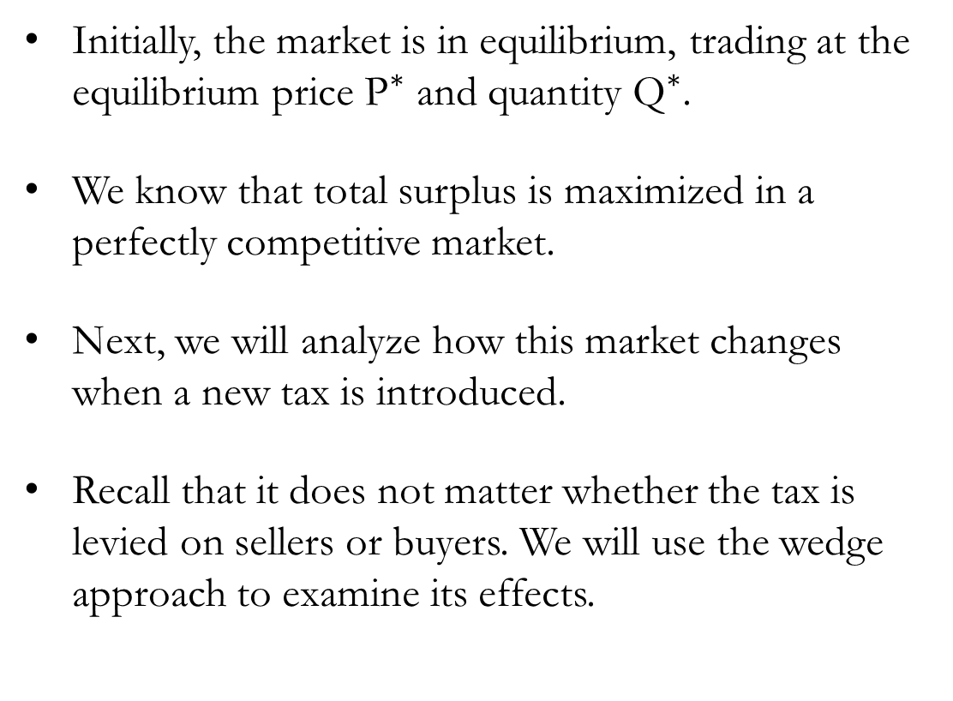
Welfare Analysis: Tax-Free
Initially, the market is in equilibrium, trading at the equilibrium price ${\text{P}}^{∗}$ and quantity ${\text{Q}}^{∗}$.
We know that total surplus is maximized in a perfectly competitive market.
Next, we will analyze how this market changes when a new tax is introduced.
Recall that it does not matter whether the tax is levied on sellers or buyers. We will use the wedge approach to examine its effects.

Slide 6
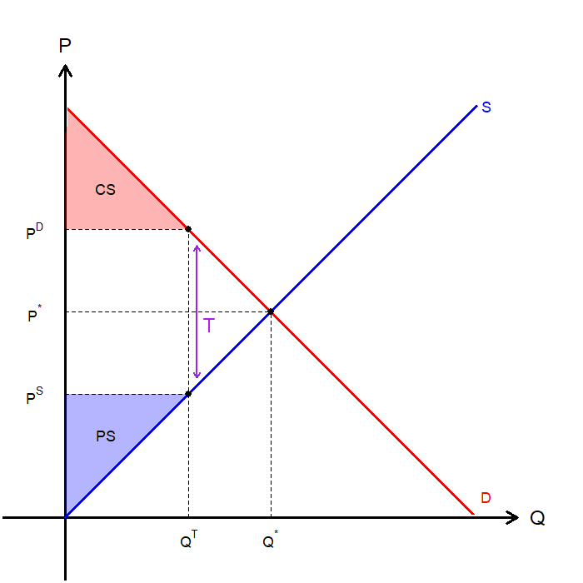
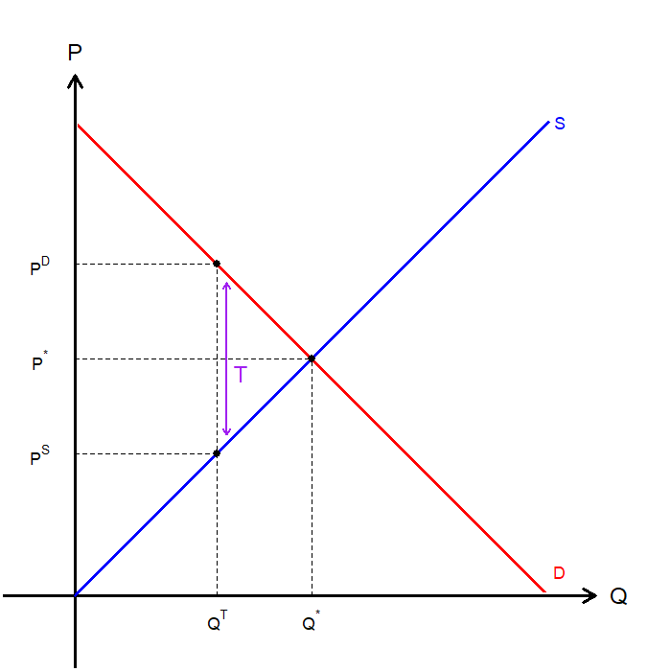
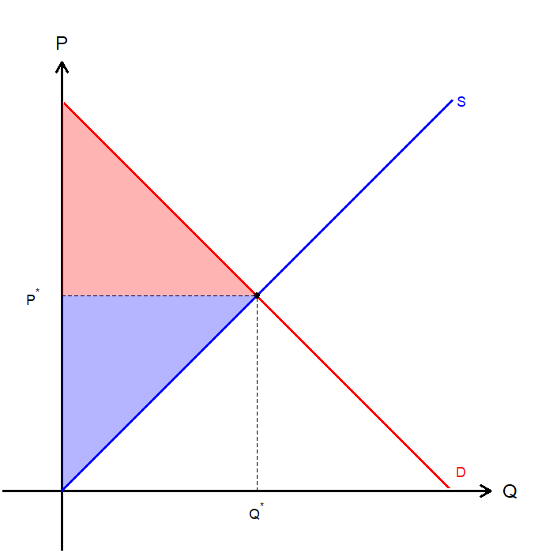
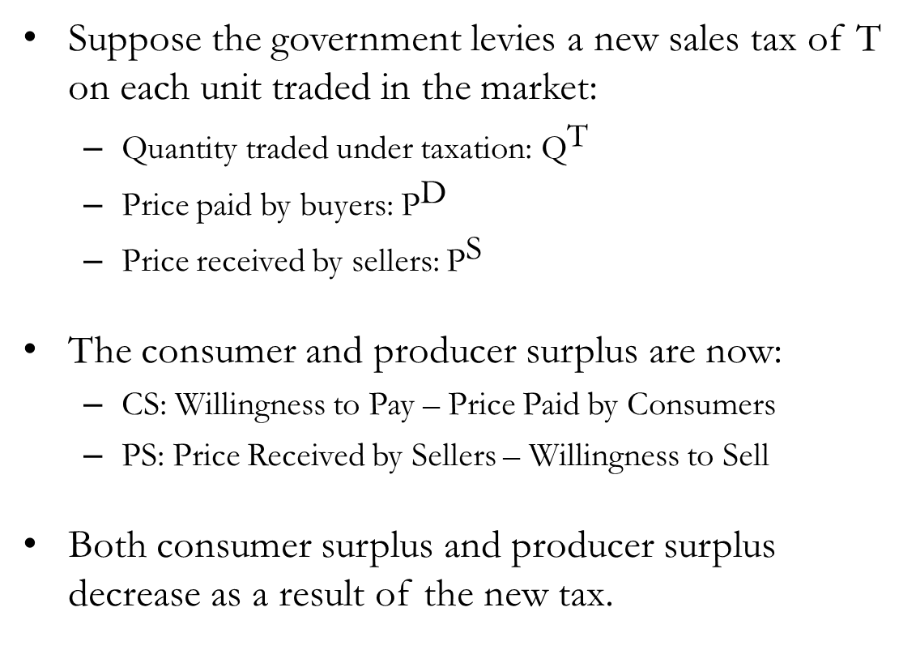
Welfare Analysis: CS and PS under Taxation
Suppose the government levies a new sales tax of T on each unit traded in the market:
Quantity traded under taxation: ${\text{Q}}^{\text{T}}$
Price paid by buyers: ${\text{P}}^{\text{D}}$
Price received by sellers: ${\text{P}}^{\text{S}}$
The consumer and producer surplus are now:
CS: Willingness to Pay – Price Paid by Consumers
PS: Price Received by Sellers – Willingness to Sell
Both consumer surplus and producer surplus decrease as a result of the new tax.

Slide 7
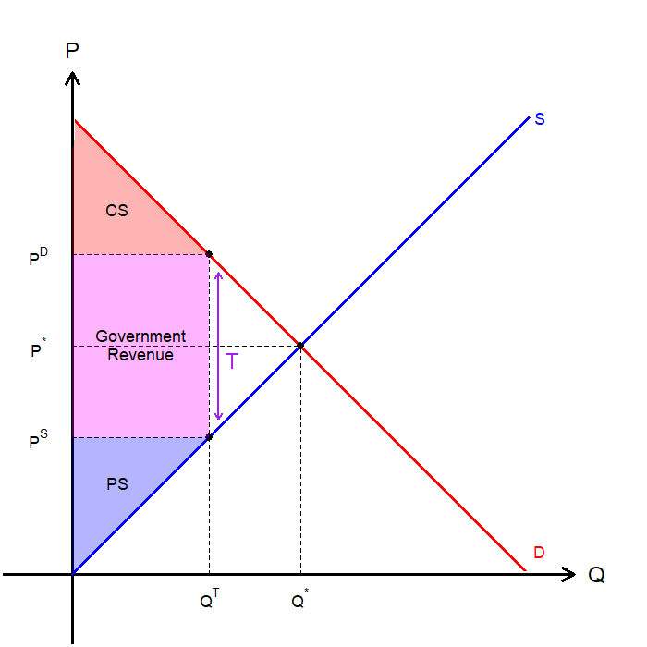
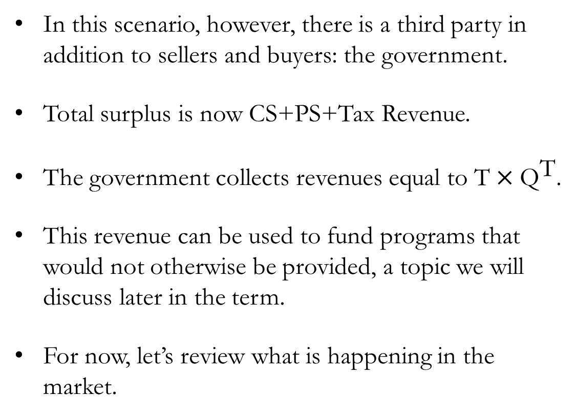
Welfare Analysis: Government Revenue
In this scenario, however, there is a third party in addition to sellers and buyers: the government.
Total surplus is now CS+PS+Tax Revenue.
The government collects revenues equal to $\text{T}×{\text{Q}}^{\text{T}}$.
This revenue can be used to fund programs that would not otherwise be provided, a topic we will discuss later in the term.
For now, let’s review what is happening in the market.

Slide 8
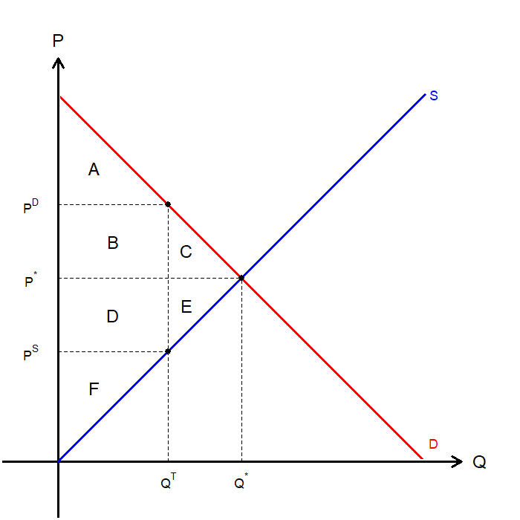
Welfare Analysis: Breakdown
In this scenario, however, there is a third party in addition to sellers and buyers: the government.
We find that the area C+E is no longer captured by any agent in the market.
This represents the Deadweight Loss, the fall in total surplus that results from market distortions.
 | Without Tax | With Tax | Change
CS
PS
Tax Revenue
Total Surplus
 | Without Tax | With Tax | Change
CS | A+B+C
PS | D+E+F
Tax Revenue | 0
Total Surplus | A+B+C+D+E+F
 | Without Tax | With Tax | Change
CS | A+B+C | A
PS | D+E+F | F
Tax Revenue | 0 | B+D
Total Surplus | A+B+C+D+E+F | A+B+D+F
 | Without Tax | With Tax | Change
CS | A+B+C | A | Lose B+C
PS | D+E+F | F | Lose D+E
Tax Revenue | 0 | B+D | Gain B+D
Total Surplus | A+B+C+D+E+F | A+B+D+F | Lost C+E

Slide 9
Exercise: Deadweight Losses and Gains from Trade
Scenario:
Producing a local confectioner (candy manufacturer) can mass-produce one crate of candy at a cost of $200. The local grocery store is willing to pay up to $220 for each crate of candy. The confectioner and the grocery store agrees on a price of $205.
Calculate CS, PS, and TS
Consumer Surplus: Producer Surplus: Total Surplus:
Calculate CS, PS, and TS if the government levies a $25 per crate tax on candy.
Consumer Surplus: Producer Surplus: Total Surplus:
Even if the grocery store pays their WTP of $220, the confectioner receives $195, which is below their WTS, and trade cannot happen.
$15
$5
$20
$0
$0
$0

Slide 10
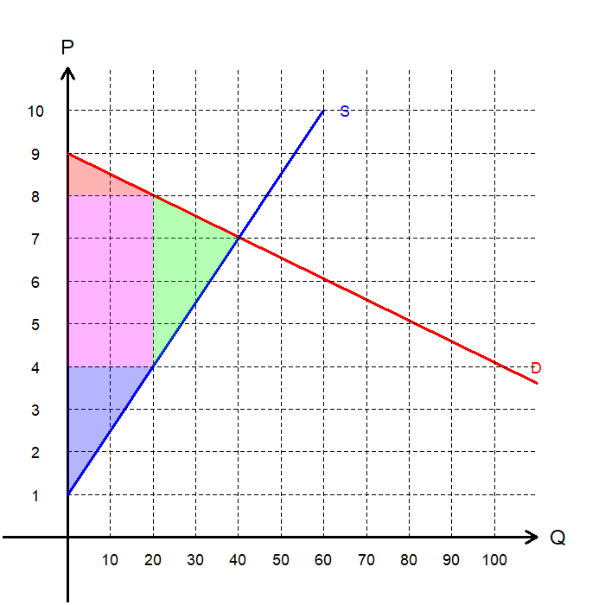
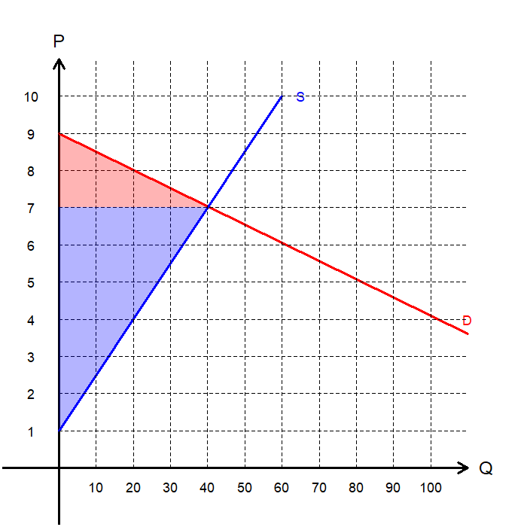
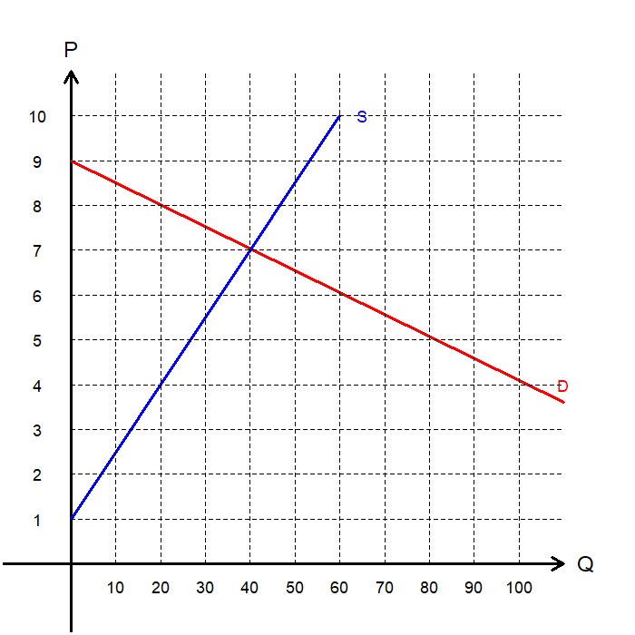
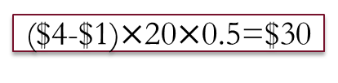
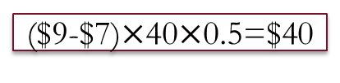
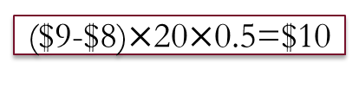
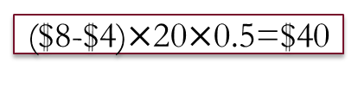
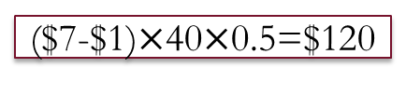
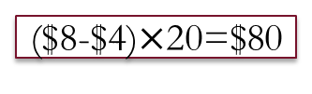
Exercise: Deadweight Losses and Gains from Trade
Calculate CS and PS:
Consumer Surplus:
Producer Surplus:
Calculate CS, PS, Tax Revenue, Total Surplus, and Deadweight Loss when the government levies a $3 per unit tax.
Consumer Surplus:
Producer Surplus:
Tax Revenue:
Total Surplus:
Deadweight Loss:
($9-$7)$×$40$×$0.5=$40
($7-$1)$×$40$×$0.5=$120
($9-$8)$×$20$×$0.5=$10
($4-$1)$×$20$×$0.5=$30
($8-$4)$×$20=$80
PS+CS+Tax Revenue=$120
($8-$4)$×$20$×$0.5=$40

Slide 11
The Determinants of
Deadweight Loss

Slide 12
The Determinants of Deadweight Loss
Deadweight loss arises from a distortion in prices that prevents buyers and sellers from realizing some of the potential gains from trade.
In other words, the more buyers or sellers are “priced out” of the market, the larger the deadweight loss.
Therefore, if sellers or buyers are more sensitive to price, the DWL becomes larger.
For a given demand, the more elastic the supply curve, the larger the DWL.
For a given supply, the more elastic the demand curve, the larger the DWL.
The greater the elasticity of supply and demand, the greater the DWL caused by taxation.

Slide 13
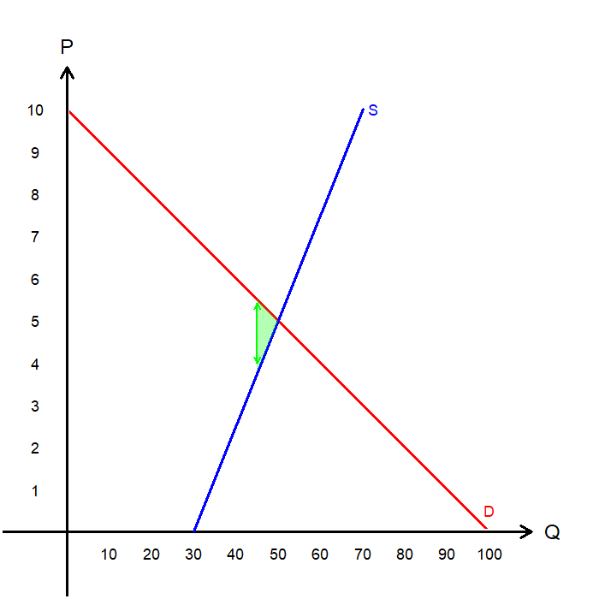
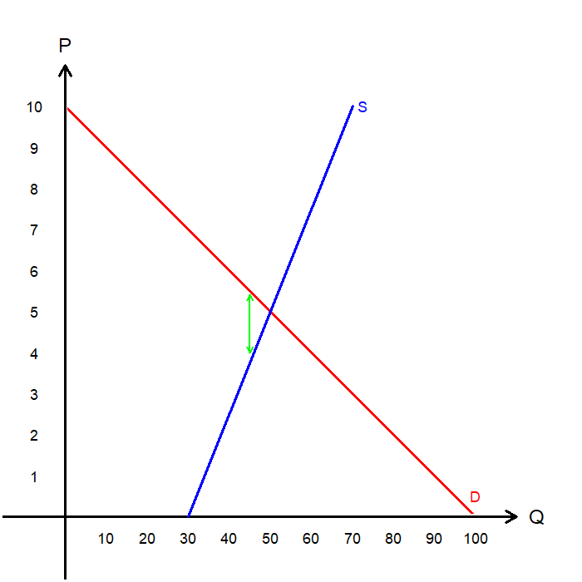
DWL and Elasticities: Inelastic Supply
Suppose the supply of a good is inelastic.
The government levies a tax of T on each unit of the good traded in the market.
Because the supply is inelastic, the tax results in only a small decrease in the quantity traded.
Consequently, the deadweight loss is also small.
Now, let’s compare this to an alternative scenario where the same tax is levied when supply is elastic.

Slide 14
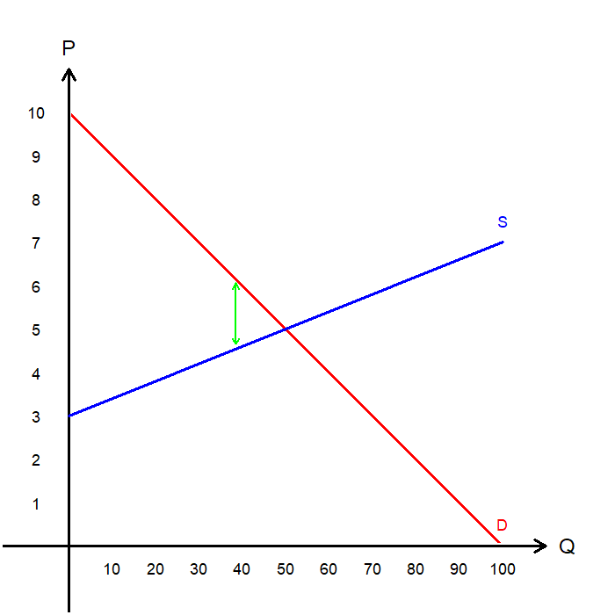
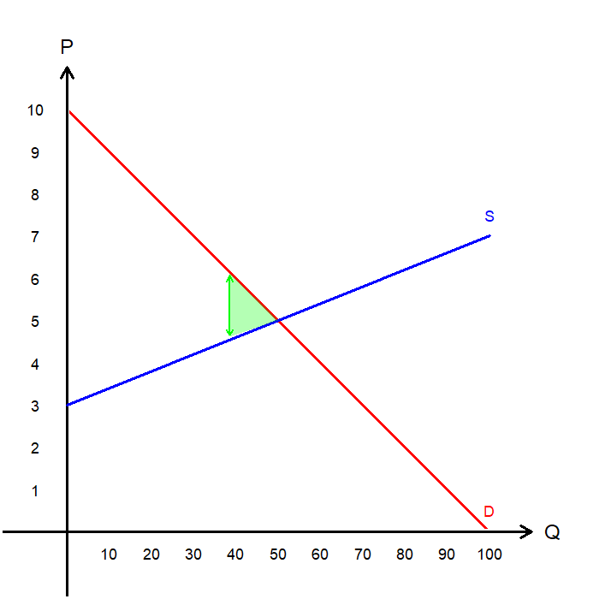
DWL and Elasticities: Elastic Supply
Now, suppose the supply is elastic, with the same tax T.
Because the supply is elastic, the same tax causes a larger decrease in the quantity traded in the market.
The DWL is therefore larger, as more buyers and sellers are priced out of the market.
To minimize DWL, the government should tax goods with a less elastic price elasticity of supply.
What about demand?

Slide 15
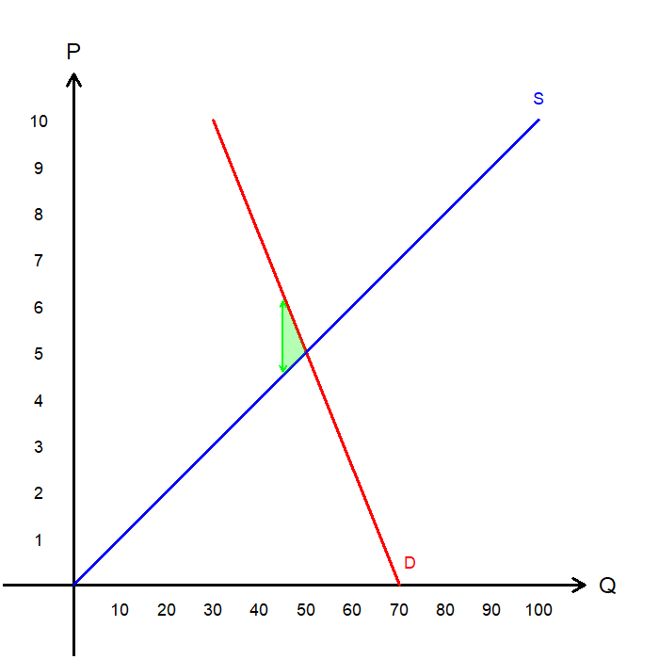
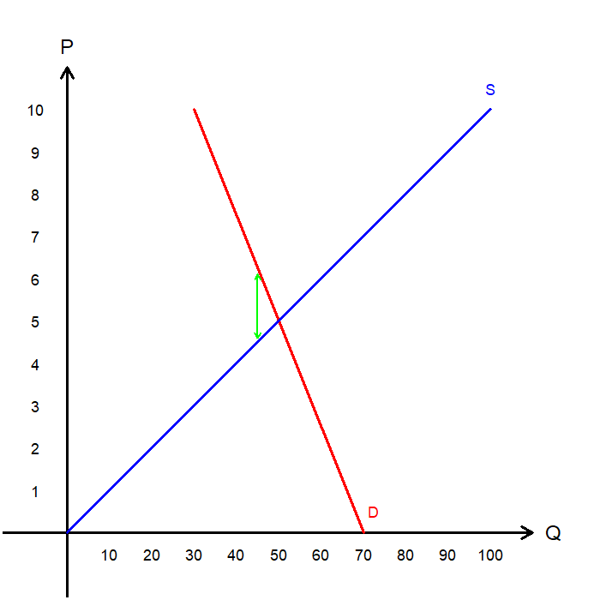
DWL and Elasticities: Inelastic Demand
Suppose the demand of a good is inelastic.
The government levies a tax of T on each unit of the good traded in the market.
Because the demand is inelastic, the tax results in only a small decrease in the quantity traded.
Consequently, the deadweight loss is also small.
Now, let’s compare this to an alternative scenario where the same tax is levied when demand is elastic.

Slide 16
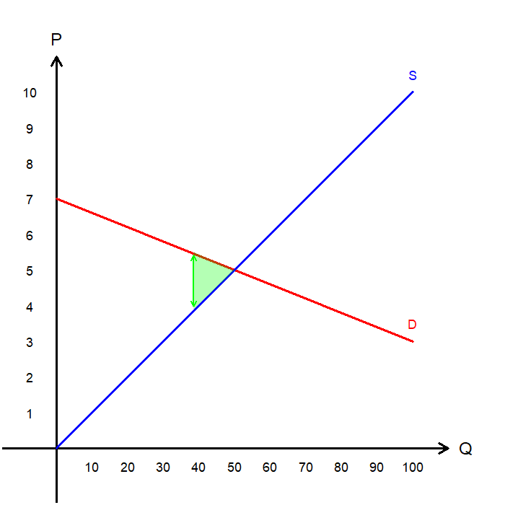
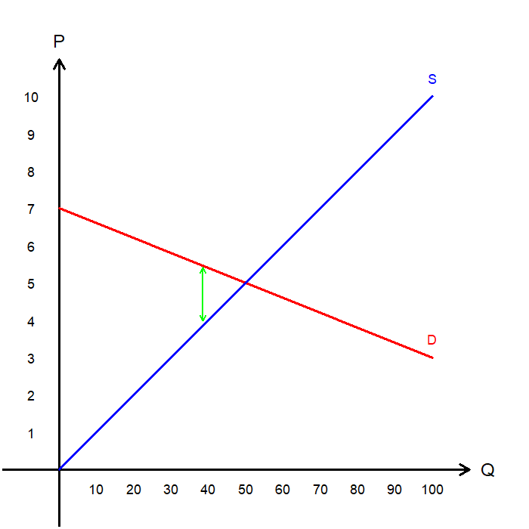
DWL and Elasticities: Elastic Demand
Now, suppose the demand is elastic, with the same tax T.
Because the demand is elastic, the same tax causes a larger decrease in the quantity traded in the market.
The DWL is therefore larger, as more buyers and sellers are priced out of the market.
To minimize DWL, the government should tax goods with a less elastic price elasticity of demand.
Let’s consider some real-world scenarios.

Slide 17
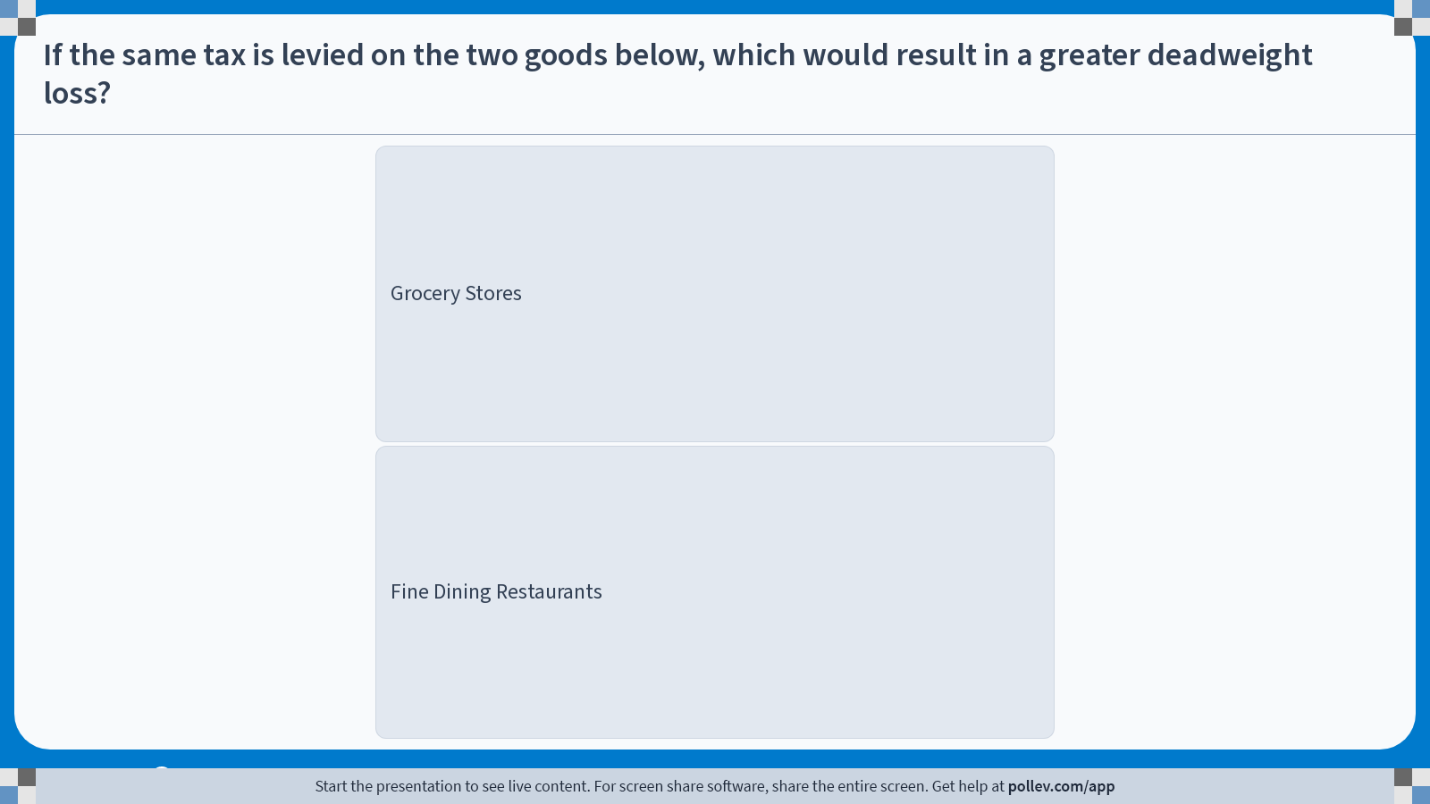
Poll Everywhere multiple choice poll instructions screen Activity Title: If the same tax is levied on the two goods below, which would result in a greater deadweight loss? Slide 17
Notes:
Do not modify the notes in this section to avoid tampering with the Poll Everywhere activity. More info at polleverywhere.com/support If the same tax is levied on the two goods below, which would result in a greater deadweight loss? https://www.polleverywhere.com/multiple_choice_polls/YYx7tqUPw1aJfeoLLmekX?display_state=instructions&activity_state=opened&state=opened&flow=Engagement&onscreen=persist

Slide 18
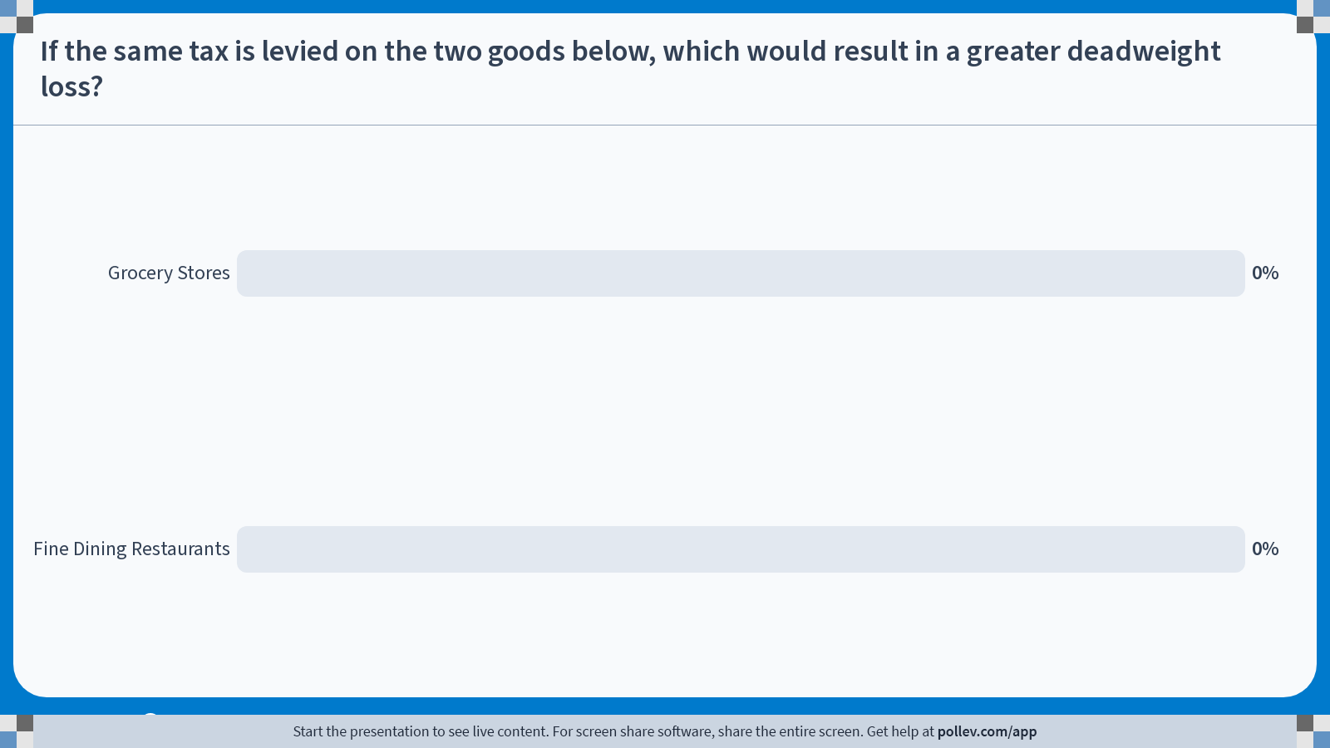
Poll Everywhere multiple choice poll chart screen Activity Title: If the same tax is levied on the two goods below, which would result in a greater deadweight loss? Slide 18
Notes:
Do not modify the notes in this section to avoid tampering with the Poll Everywhere activity. More info at polleverywhere.com/support If the same tax is levied on the two goods below, which would result in a greater deadweight loss? https://www.polleverywhere.com/multiple_choice_polls/YYx7tqUPw1aJfeoLLmekX?display_state=chart&activity_state=opened&state=opened&flow=Engagement&onscreen=persist

Slide 19
Poll Everywhere multiple choice poll chart screen Activity Title: If the same tax is levied on the two goods below, which would result in a greater deadweight loss? Slide 19
Notes:
Do not modify the notes in this section to avoid tampering with the Poll Everywhere activity. More info at polleverywhere.com/support If the same tax is levied on the two goods below, which would result in a greater deadweight loss? https://www.polleverywhere.com/multiple_choice_polls/YYx7tqUPw1aJfeoLLmekX?display_state=chart&activity_state=closed&state=closed&flow=Engagement&onscreen=persist

Slide 20
Case Study: Federal Income Tax
There are philosophical, political, and sociological arguments both for and against large versus small governments.
From an economic perspective, one way to evaluate the size of government is to consider the deadweight loss (DWL) associated with taxation.
If taxation creates a large DWL, it may provide a strong case for a smaller government.
If taxation imposes only a small DWL on the economy, it may support the case for a larger or more active government.
The impact of an increase in the income tax on DWL depends on whether the supply of labor is elastic or inelastic.

Slide 21
Case Study: Federal Income Tax
Labor Supply is Inelastic:
Most people choose to work full-time regardless of the wage.
This is especially true for workers in their prime working years.
It is also true for workers who are the primary source of household income.
Therefore, an increase in the tax on labor results in a small deadweight loss (DWL).
Labor Supply is Elastic:
Some groups of workers have a more elastic labor supply and respond more strongly to changes in incentives.
Many workers can adjust their hours or switch to part-time employment.
Many households have dual earners, allowing one member to reduce hours when taxes rise.
Some workers may even shift to the underground economy to avoid taxes.
Therefore, an increase in the tax on labor results in a large deadweight loss (DWL).

Slide 22
Deadweight Loss and
Tax Revenue

Slide 23
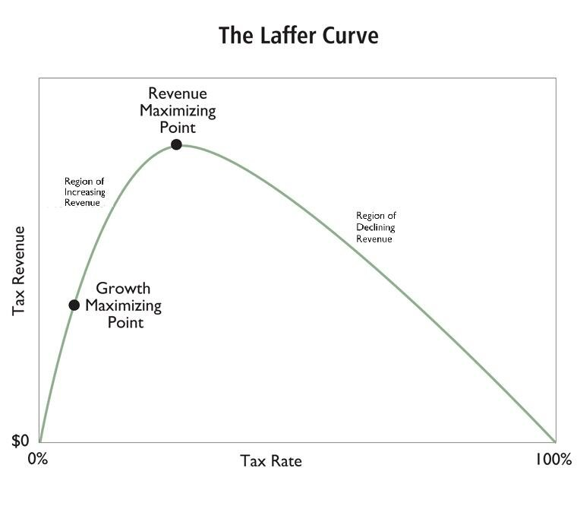
The Laffer Curve
Generally, as the tax rate increases, tax revenue rises at first.
However, tax revenue eventually begins to decline as the tax rate becomes too high.
This relationship is illustrated by the Laffer Curve, popularized by Arthur Laffer, who served during the Reagan administration.
The theory was used to argue for lowering U.S. income tax rates to stimulate economic growth and increase overall tax revenue.

Slide 24
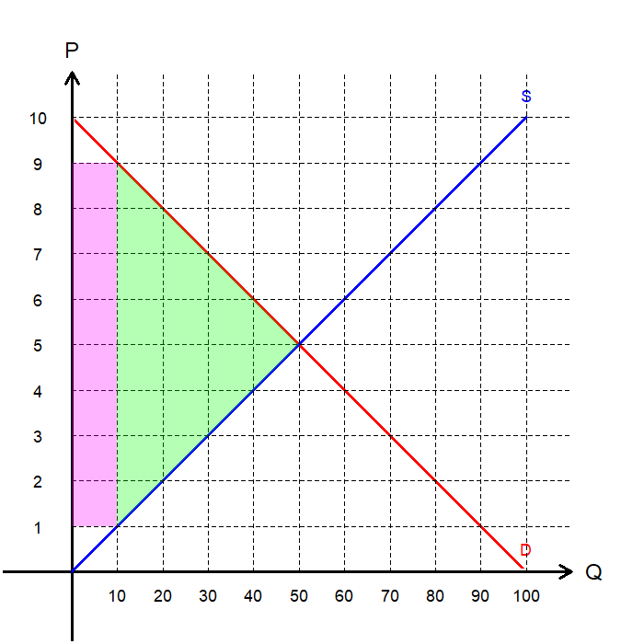
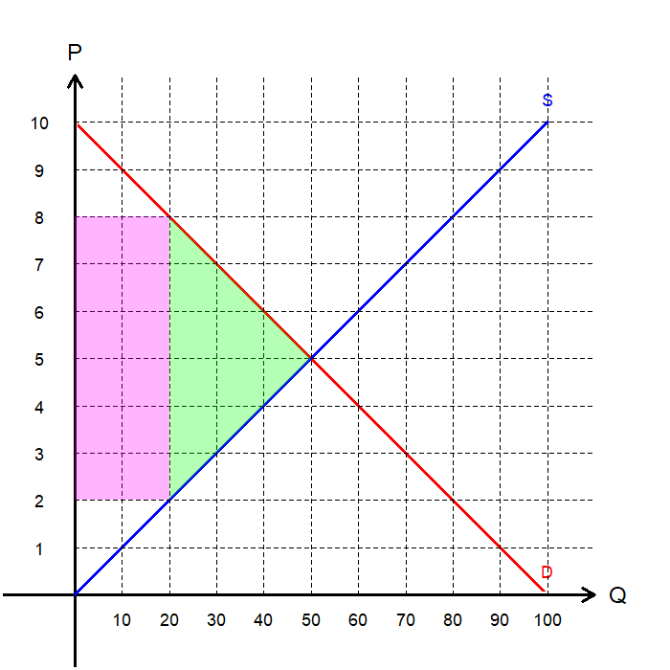
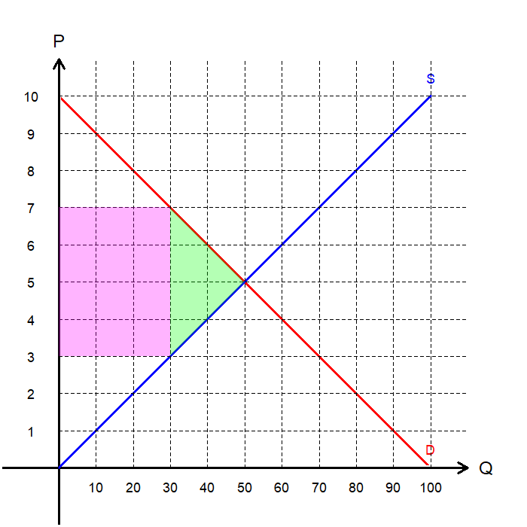
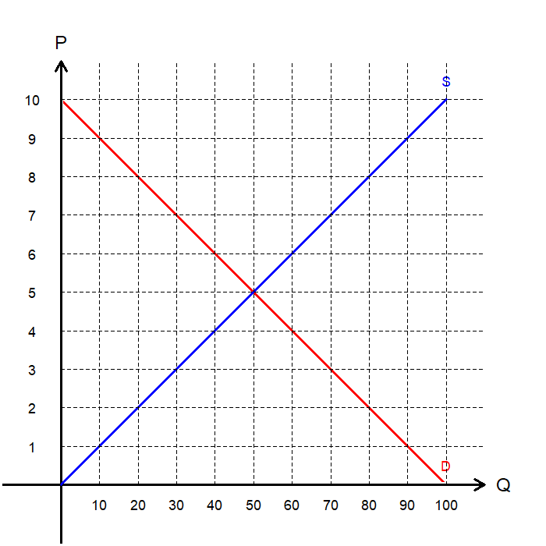
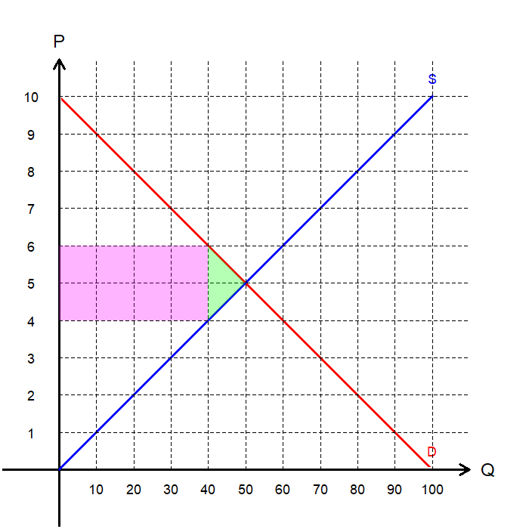
The Laffer Curve
Let’s examine whether the model supports the implications of the Laffer Curve.
By varying the tax rate, we can calculate the corresponding tax revenue and DWL:
We find that while DWL increases continuously, tax revenue reaches a maximum at a certain point before declining.
Per Unit Tax | Tax Revenue | Deadweight Loss
$2 | $80 | $10
$4 | $120 | $40
$6 | $120 | $90
$8
Per Unit Tax | Tax Revenue | Deadweight Loss
$2 | $80 | $10
$4 | $120 | $40
$6
$8
Per Unit Tax | Tax Revenue | Deadweight Loss
$2 | $80 | $10
$4
$6
$8
Per Unit Tax | Tax Revenue | Deadweight Loss
$2
$4
$6
$8
Per Unit Tax | Tax Revenue | Deadweight Loss
$2 | $80 | $10
$4 | $120 | $40
$6 | $120 | $90
$8 | $80 | $160

Slide 25
The Laffer Curve
Below is a quick visual comparison of markets with different levels of taxation.
Let’s plot our own version of the Laffer Curve and examine the relationship between deadweight loss (DWL) and tax rates.

Slide 26
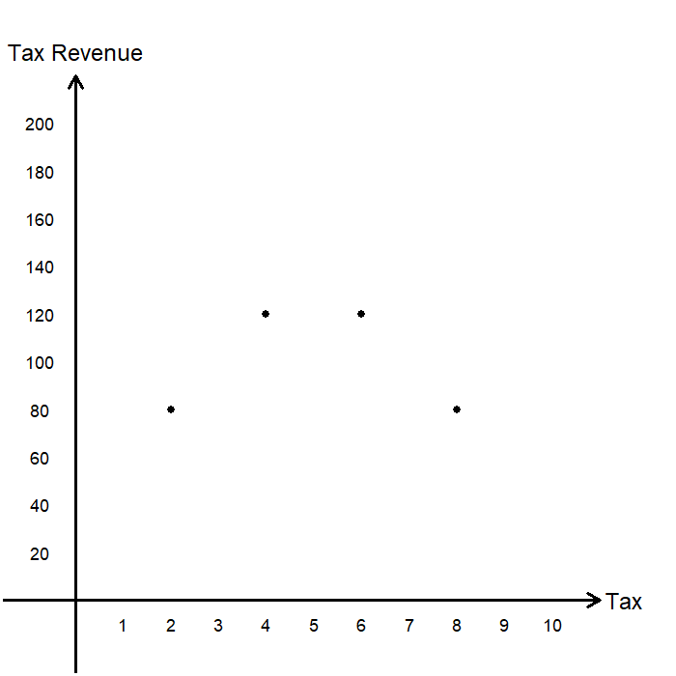
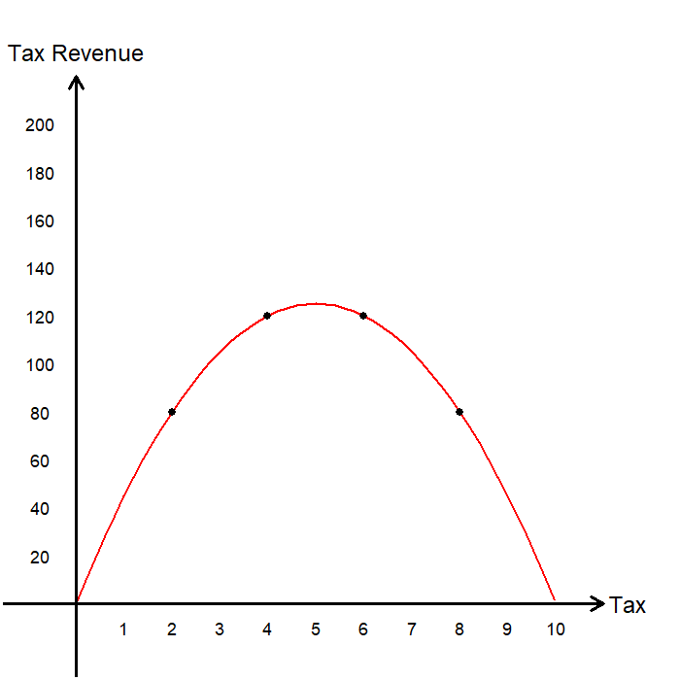
The Laffer Curve
By plotting the four data points, we obtain a rough outline of the Laffer Curve.
Using the exact functional forms of the supply and demand curves, we can derive a smooth version of the Laffer Curve.
According to our model, tax revenue is maximized when the per-unit tax is set at $5.
Meanwhile, what happens to the deadweight loss?

Slide 27
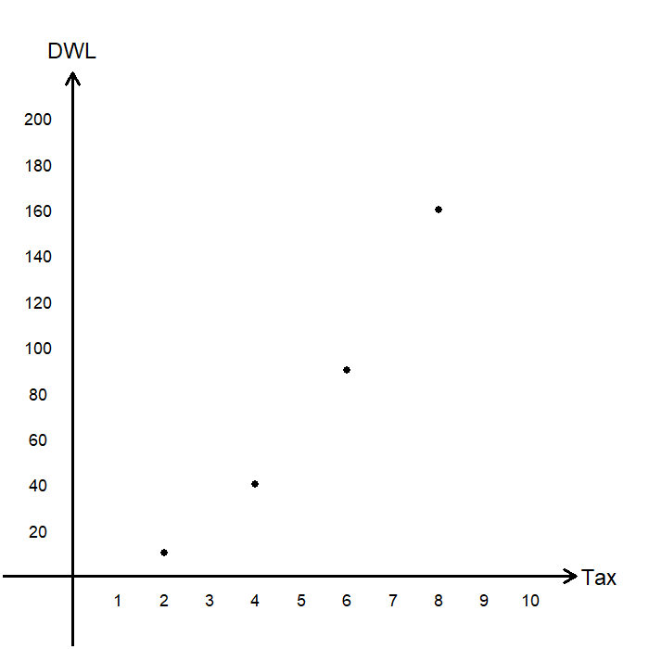
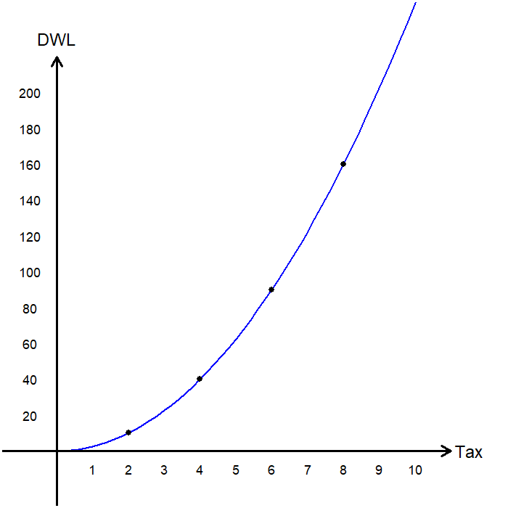
The Laffer Curve
By plotting the four points based on our DWL calculations, we observe that deadweight loss increases as the tax rate rises.
Using the exact functional forms, we can derive a smooth version of the DWL curve.
DWL increases at a much faster rate than tax revenue.
Most economists agree that applying the Laffer Curve as a justification for reducing federal income taxes was misguided.

Slide 28
Case Study: Reagan Tax Cuts
In the late 1970s, economist Arthur Laffer argued that very high tax rates reduce incentives to work and invest, which can lower total tax revenue.
His idea, known as the Laffer Curve, influenced President Ronald Reagan's economic advisors during the 1980 campaign.
The Economic Recovery Tax Act of 1981 reduced the top marginal income tax rate from 70% to 50%, and later to 28% by 1986.
The stated goals were to stimulate economic growth, increase investment and labor supply, and eventually raise total tax revenue through stronger overall activity.

Slide 29
Case Study: Reagan Tax Cuts
Supporters
The cuts helped end stagflation and supported rapid economic growth in the mid-1980s.
Private investment and job creation increased, showing stronger incentives to produce.
The stock market expanded and inflation fell, which supporters attributed partly to tax policy changes.
Critics
Federal deficits grew sharply as tax revenues declined faster than government spending.
Evidence showed that the United States was below the revenue-maximizing point on the Laffer Curve, so tax cuts reduced total revenue.
Income inequality widened, and much of the growth benefited higher-income households.
Later analyses by the Congressional Budget Office and the U.S. Treasury found that tax cuts recovered only a small portion of lost revenue.

Slide 30
Recap of Chapter 8

Slide 31
Recap
Taxation reduces the welfare of both buyers and sellers.
Buyers consume less and pay a higher price.
Sellers produce less and receive a lower price.
The reduction in consumer surplus (CS) and producer surplus (PS) generally exceeds the tax revenue collected by the government.
The resulting fall in total surplus is the deadweight loss (DWL) of taxation.
The deadweight loss of taxation is larger when demand and supply are more elastic.
As the tax increases:
The deadweight loss grows larger.
Tax revenue rises at low tax rates but eventually falls once the tax rate becomes too high.

