Slide 1
PRINCIPLES OF GLOBAL ECONOMICS
Chapter 6: Supply, Demand, and Government Policies

Slide 2
Introduction
In the previous chapters, we had our “Economist as a Scientist” hat, and analyzed:
How market demand is determined
How market supply is determined
How the market forces of supply and demand determine the equilibrium
How elasticities can affect the equilibrium
In this chapter, we switch to “Economist as a Policy Advisor” to examine the impacts of government interventions to the market, and examine:
The impact of price controls
The impact of taxation
The intended and unintended effects of the policies

Slide 3
Price Controls

Slide 4
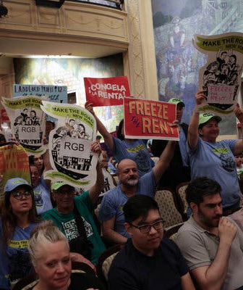
Real-World Price Control: Rent Control
The low-end estimate of the average rent of a one-bedroom apartments in New York City as of Sep. 2025 is $4,046 per month.
The median take-home monthly earnings for an individual worker in New York City is $4,865 per month.
The median worker would spend 83% of their income on rent.
NYC enacted a form of rent control which limits the rate that landlords can charge for rent in certain units.

Slide 5
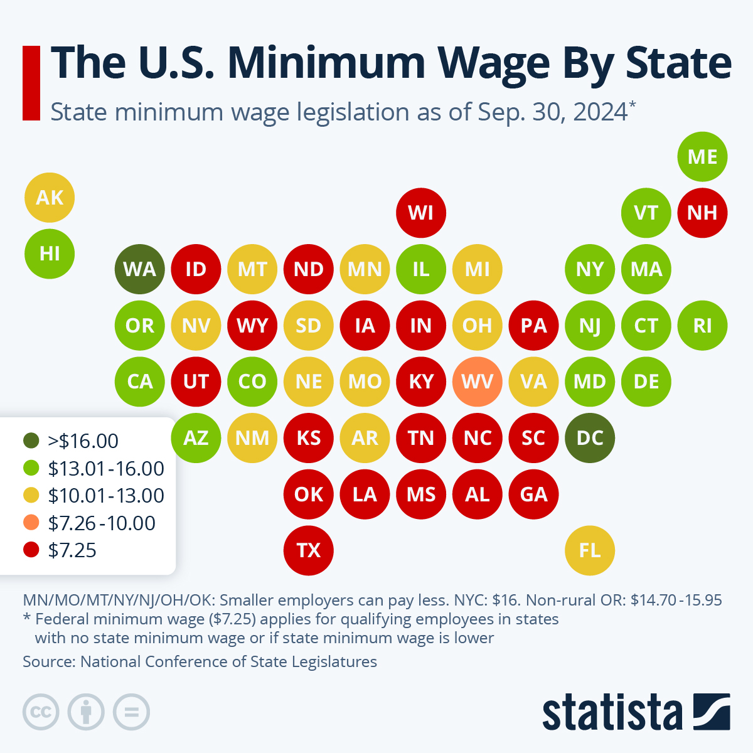
Real-World Price Control: Minimum Wage
Minimum wage is another ubiquitous form of price control in the real-world.
The current Federal minimum wage is $7.25.
Federal, State, and City governments can set their own minimum wages:
ND: $7.25
MN: $11.13
Chicago: $16.60
San Francisco: $18.67
So… do these price controls work?

Slide 6
Price Control
Price control comes in two flavors, a price ceiling, or a price floor.
Price Ceilings refer to a legal maximum on the price at which a good can be sold.
Rent control is a real-world example of a price ceiling.
Price Floors refer to a legal minimum on the price at which a good can be sold.
Minimum wage legislation is a real-world example of a price floor.
A price control is said to be Binding if…
The price ceiling is set below the equilibrium price, or
The price floor is set above the equilibrium price.

Slide 7
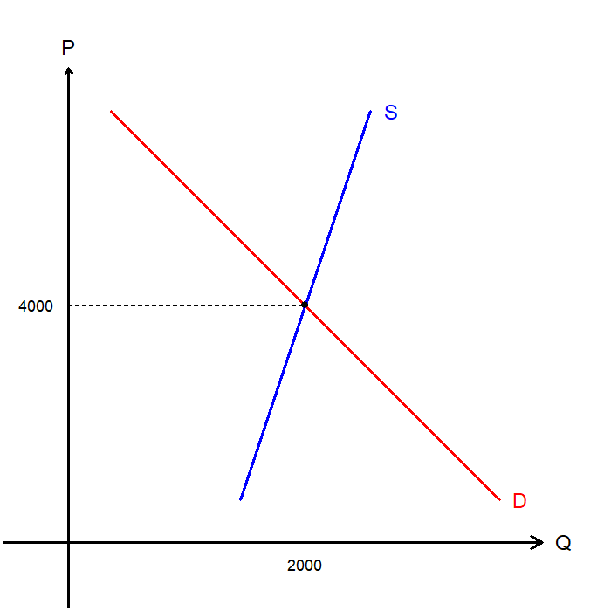
Price Ceilings: Market for Apartments
Suppose that we are looking into the market for rental apartments.
The current equilibrium rent is at $4,000 with 2,000 units of apartments being traded in the market.
Suppose that the government determined that the current rent is too high, so they would impose a price ceiling.
What happens when the government enacts a $4,500 price ceiling?

Slide 8
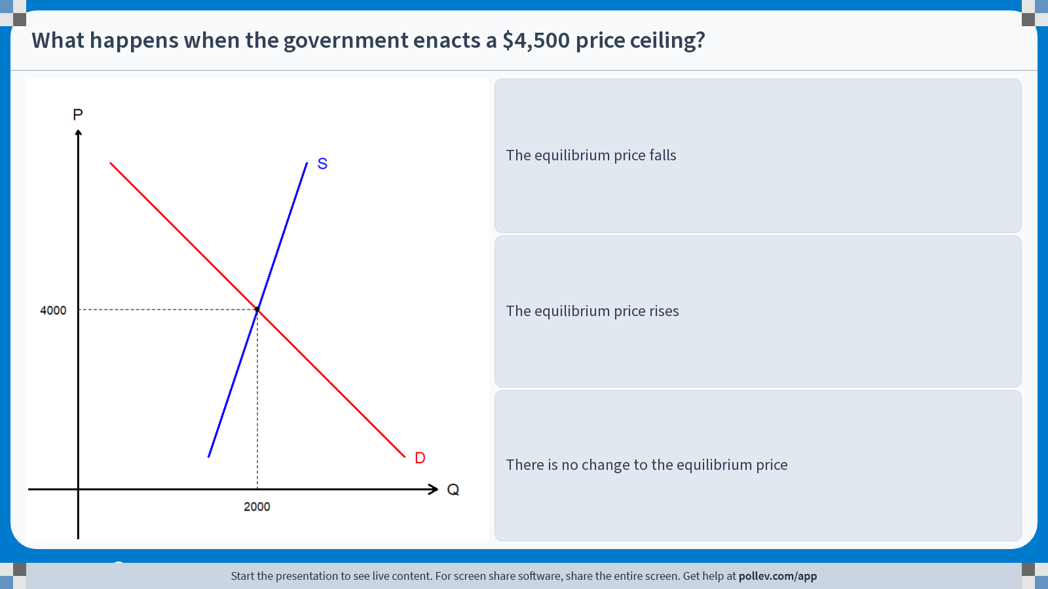
Poll Everywhere multiple choice poll instructions screen Activity Title: What happens when the government enacts a $4,500 price ceiling? Slide 8
Notes:
Do not modify the notes in this section to avoid tampering with the Poll Everywhere activity. More info at polleverywhere.com/support What happens when the government enacts a $4,500 price ceiling? https://www.polleverywhere.com/multiple_choice_polls/chHhNRhE6NB40OM5drRxp?display_state=instructions&activity_state=opened&state=opened&flow=Engagement&onscreen=persist

Slide 9
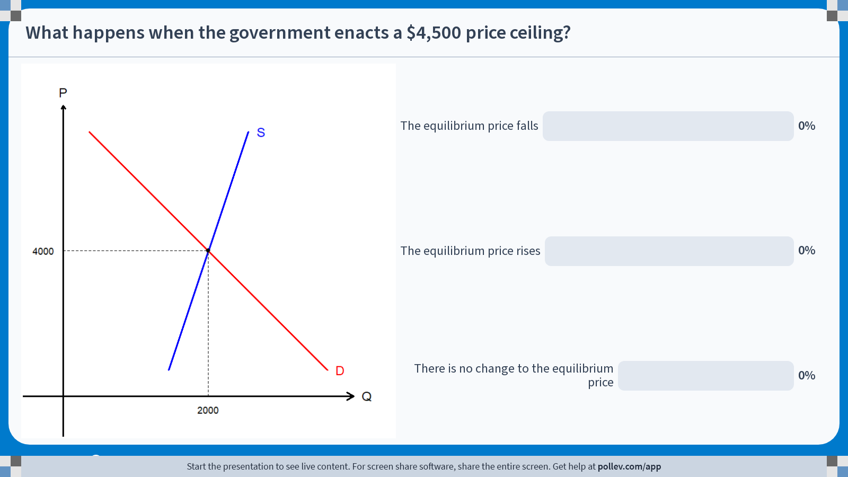
Poll Everywhere multiple choice poll chart screen Activity Title: What happens when the government enacts a $4,500 price ceiling? Slide 10
Notes:
Do not modify the notes in this section to avoid tampering with the Poll Everywhere activity. More info at polleverywhere.com/support What happens when the government enacts a $4,500 price ceiling? https://www.polleverywhere.com/multiple_choice_polls/chHhNRhE6NB40OM5drRxp?display_state=chart&activity_state=closed&state=closed&flow=Engagement&onscreen=persist

Slide 10
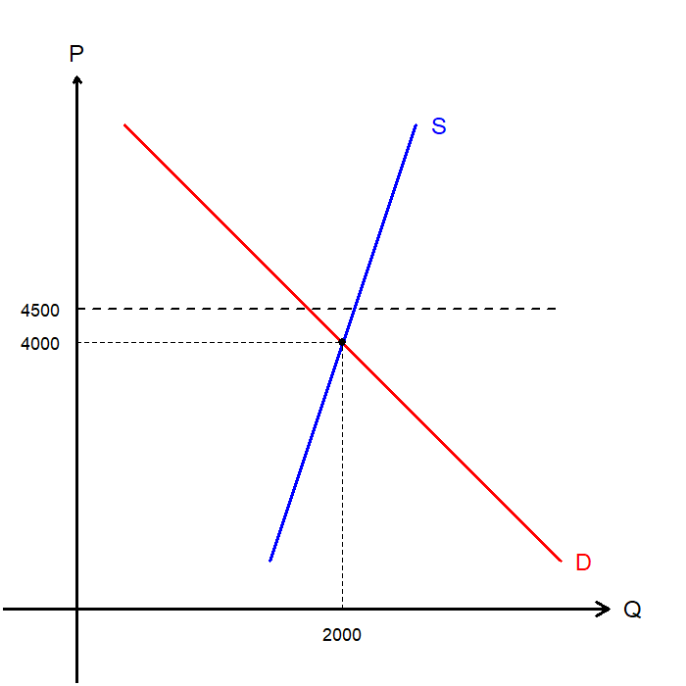
Solutions to In-class Poll #1
The price ceiling is set at $4,500, which is above the current equilibrium price of $4,000.
Therefore, this price ceiling is not binding.
So, there is no change to the equilibrium price.

Slide 11
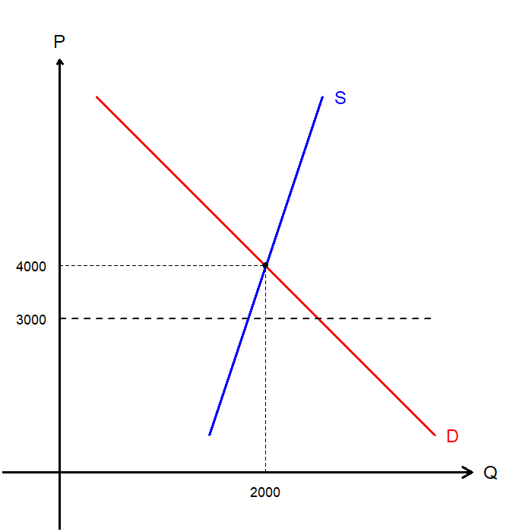
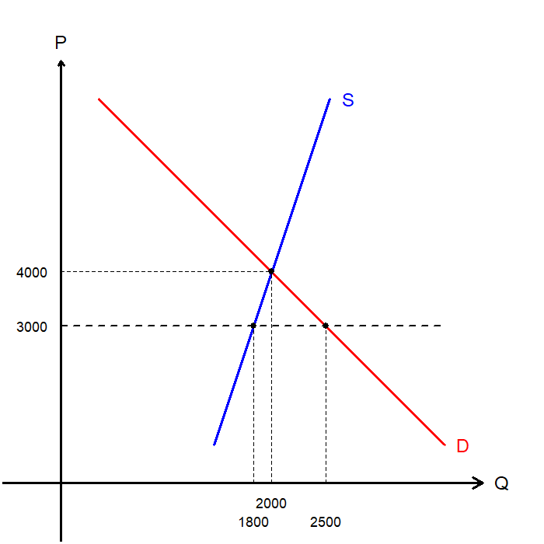
Price Ceilings: Market for Apartments
Now suppose that the price ceiling was set at $3,000.
The price ceiling is now binding, as it is set below the market equilibrium price.
Landlords cannot charge the equilibrium rent and may now only charge up to $3,000.
When the rent is $3,000…
Quantity Demanded is 2,500 units, and
Quantity Supplied is 1,800 units, so
There is a shortage of 700 units.

Slide 12
Price Ceilings: The Short vs. Long Run
The short-run effect of price control is reduced rent and a relatively small shortage.
This shortage itself could pose a problem in an economy, but it may be a trade-off that policymakers are willing to accept.
But in the long-run, this problem may get worse, because…
Landlords have less incentive to maintain existing apartments due to the limit on rent they can charge.
Less houses would be built in the region, due to the limit on rent landlords can charge.
So, in the long-run, supply is more elastic!
There would be demand-side responses as well, but for now, we’ll consider the supply-side story of rent control.

Slide 13
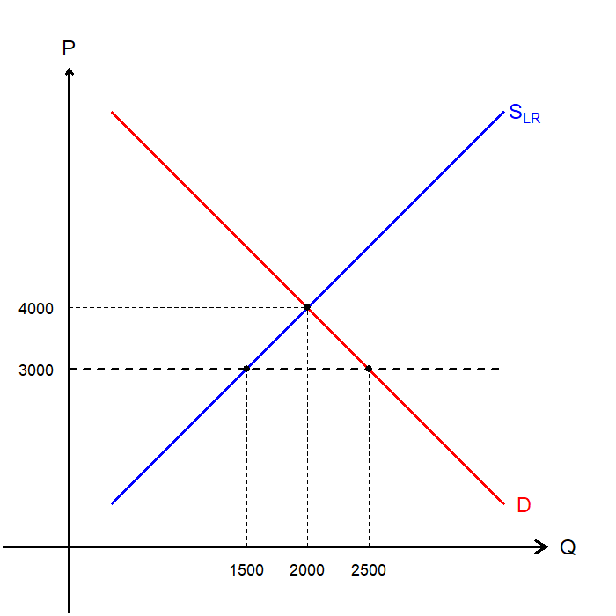
Price Ceilings: Market for Apartments (Long-run)
Let us examine the long-run implications of rent control in the same market.
When the rent is $3,000 in long-run,
Quantity Demanded is 2,500 units, and
Quantity Supplied is 1,500 units, so
There is a shortage of 1,000 units.
The shortage tends to grow over time, as the sellers are given more time to adjust their supply.
What are landlords doing with their properties that they aren’t renting out then?

Slide 14

Long-run Response to Rent Control
Studies suggest that landlords in New York City turned to Airbnb instead.
The NYC Comptroller’s office found in 2018:
Airbnb listings in 2010: Approx. 1,000
Airbnb listings in 2015: Over 43,000
Approximately 9.2% of the citywide increase in rent is attributed to Airbnb. (Rent increased by 25%)
NYC renters paid an additional $616 million in 2016.
For every 1% of all residential units in a neighborhood listed on Airbnb, rent in that region increased by 1.58%.
Rent control may help those in rent-controlled units but may end up hurting everyone else.

Slide 15

CNBC Television. (2023, September 5). NYC Airbnb crackdown: What you need to know [Video]. YouTube. https://youtu.be/-iY5kEHAC6g?si=F-0KMCM3ECPwELSW

Slide 16
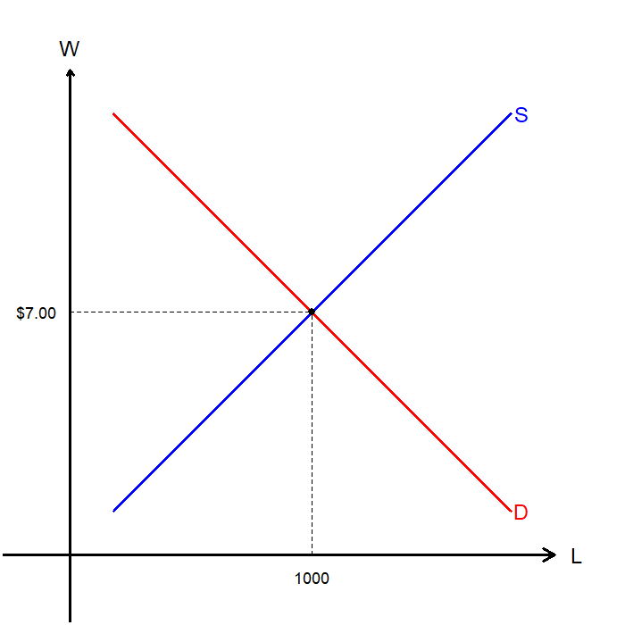
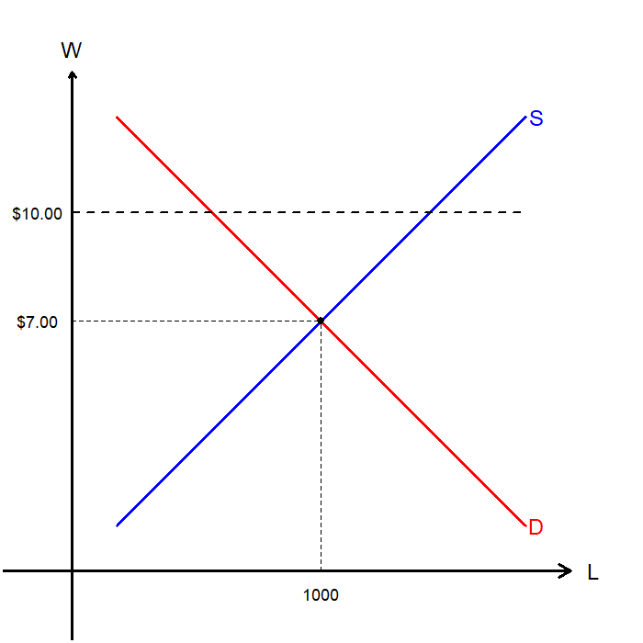
Price Floors: The Labor Market
Consider the labor market where…
Employees are the sellers of Labor (L), and
Employers are buyers of Labor (L)
The price of labor is the hourly pay, Wage (w).
The current market equilibrium is found where 1,000 workers are employed, earning a $7 per hour wage.
Suppose that the government believes that this is too low to support workers and enacts a $10 per hour minimum wage policy.

Slide 17
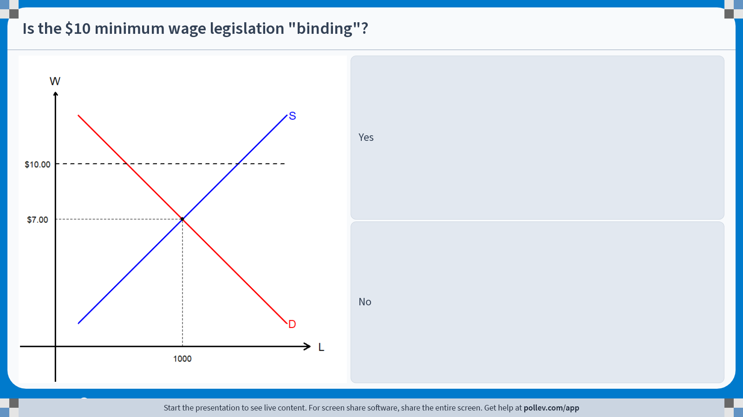
Poll Everywhere multiple choice poll instructions screen Activity Title: Is the $10 minimum wage legislation "binding"? Slide 17
Notes:
Do not modify the notes in this section to avoid tampering with the Poll Everywhere activity. More info at polleverywhere.com/support Is the $10 minimum wage legislation "binding"? https://www.polleverywhere.com/multiple_choice_polls/bMm7yAztv2AEOkiYrTKYj?display_state=instructions&activity_state=opened&state=opened&flow=Engagement&onscreen=persist

Slide 18
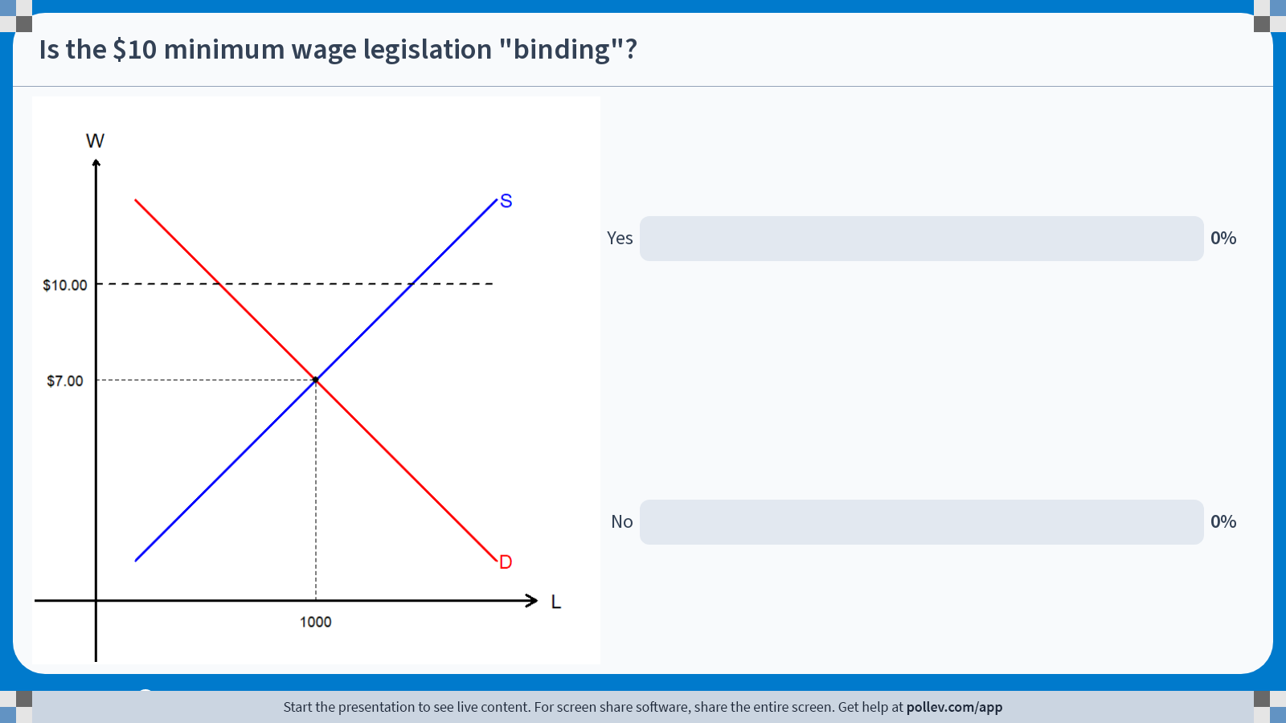
Poll Everywhere multiple choice poll chart screen Activity Title: Is the $10 minimum wage legislation "binding"? Slide 19
Notes:
Do not modify the notes in this section to avoid tampering with the Poll Everywhere activity. More info at polleverywhere.com/support Is the $10 minimum wage legislation "binding"? https://www.polleverywhere.com/multiple_choice_polls/bMm7yAztv2AEOkiYrTKYj?display_state=chart&activity_state=closed&state=closed&flow=Engagement&onscreen=persist

Slide 19
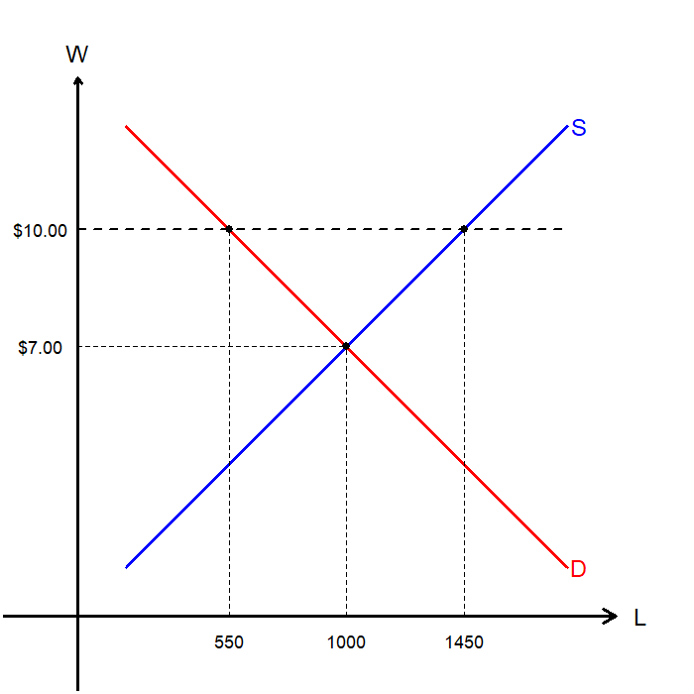
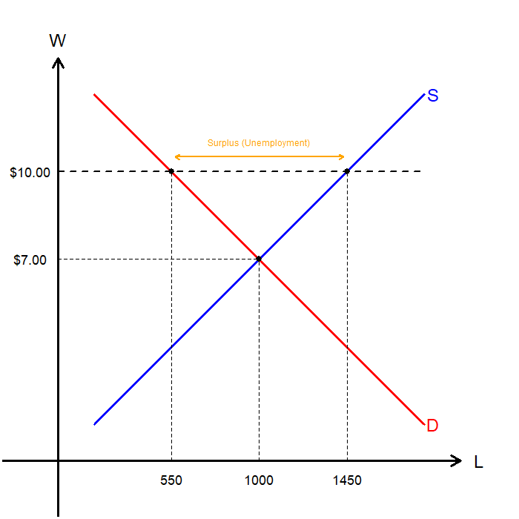
Price Floors: The Labor Market
Since the minimum wage ($10) is set above the current equilibrium wage ($7), it is binding.
When the wage is $10…
Employers want to hire 550 workers, and
There are 1450 people who want jobs, so
There are 900 people left unemployed.
The effect of a binding minimum wage is a higher wage for those employed, while creating some unemployment.

Slide 20
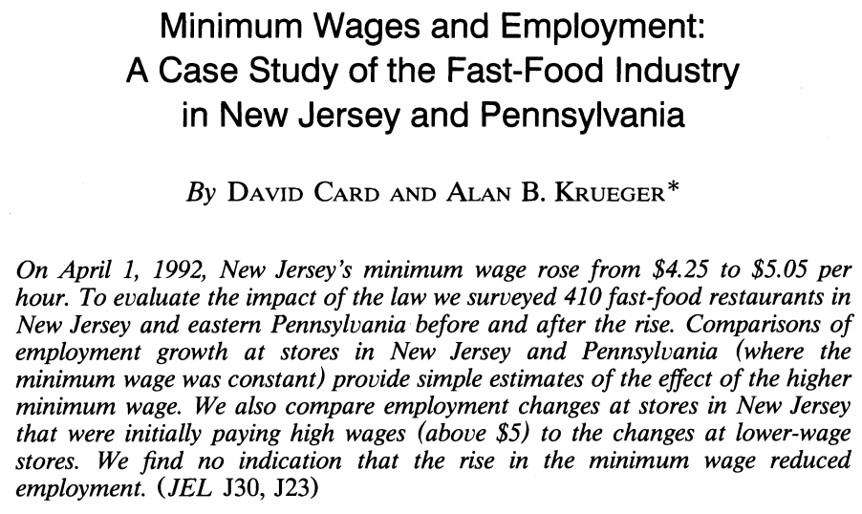
Minimum Wages: Card & Krueger (1994)

Slide 21
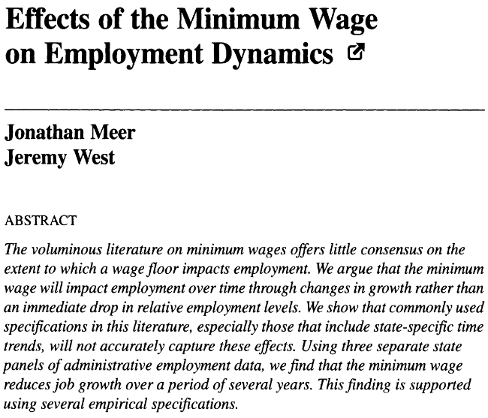
Minimum Wages: Meer & West (2013)

Slide 22
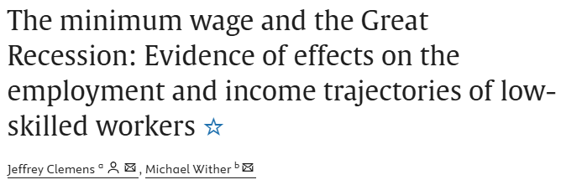
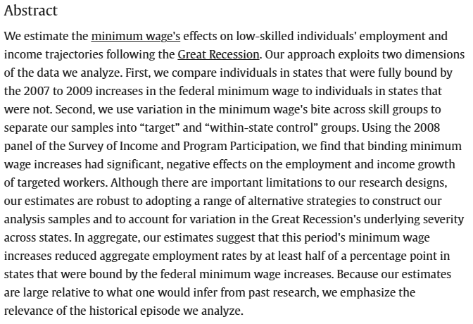
Minimum Wages: Clemens & Wither (2019)

Slide 23
Discussions on Minimum Wages
Arguments for Minimum Wage
Humane and effective method to raise the income of the working class.
The theory predicting an increase in unemployment is not necessarily exactly true.
The trade-off between a slight increase in unemployment and increased wages is worth it.
Arguments against Minimum Wage
Minimum wages cause unemployment
May encourage teenagers to drop out of school
Current policies are poorly targeted as less than 1/3 of the minimum wage-earners are in families with incomes below the poverty line.
Overall, price controls can distort the market by disallowing prices to act as accurate signals to the buyers and sellers of the market.

Slide 24
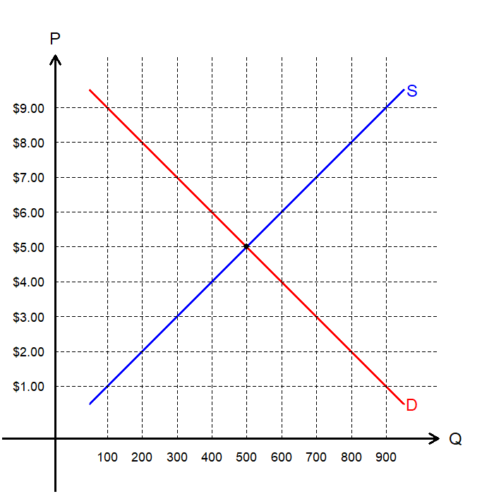
Price Control: Exercise
What is the current market equilibrium?
Equilibrium Price:
Equilibrium Quantity:
What happens when there is a minimum price of $7 enforced on this market?
Price:
Quantity Demanded:
Quantity Supplied:
What is the surplus / shortage in this market due to this minimum price enforcement?
Surplus/Shortage:
$5
500
$7
300
700
Surplus of 400

Slide 25

CNBC. (2023, March 15). Why Rent Control Might Be A Bad Idea [Video]. YouTube. https://youtu.be/ysBWViBCI6c?si=aw5UQqu3mXBSRNdo

Slide 26
Taxation

Slide 27
Taxation and Tax Incidence
All governments around the world rely on some form of taxation to raise revenue for public projects.
Taxes are also often used to encourage or discourage consumption of certain goods:
“Sin Taxes” are placed on tobacco or alcohol products to discourage consumption.
“Carbon Taxes” are charged against polluters to discourage carbon emissions.
Legally speaking, these taxes can be levied on either the buyer or the seller.
Taxes being levied on the buyer does not necessarily mean that most of the burden is placed on the buyer.
Taxes being placed on the seller does not necessarily mean that most of the burden is placed on the seller.
These issues involve Tax Incidence, the study of how the burden of the tax is distributed among the various actors in the economy.

Slide 28
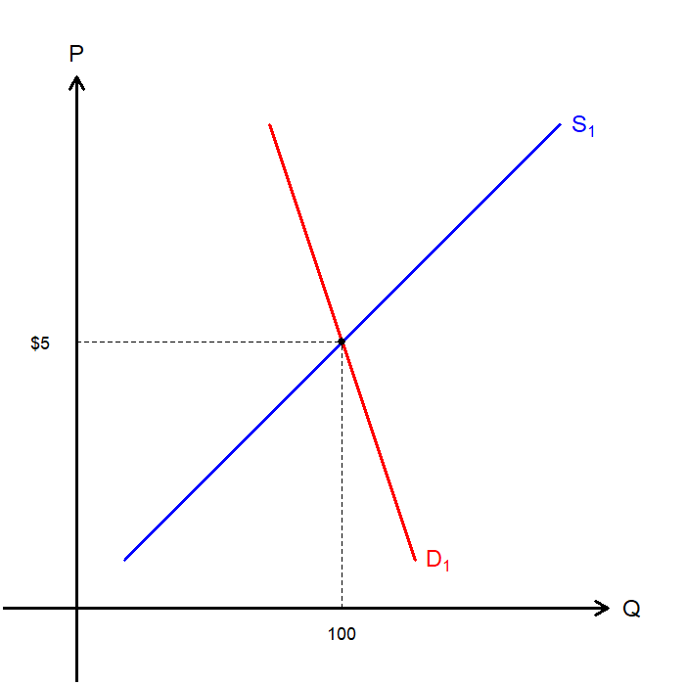
Taxation: Taxation on Sellers
Suppose that the market for coffee is in equilibrium:
Buyers pay $5 for each cup of coffee traded, and
Sellers receive $5 for each cup of coffee they sell, and
100 cups of coffee is traded in the market.
Suppose the government imposes a $2 per cup tax on coffee, and the sellers must pay the tax.
Now, let’s go over the three steps of market analysis:
Decide whether the law affects the supply curve or the demand curve.
Decide which way the curve shifts.
Examine how the shift affects the equilibrium price and quantity.

Slide 29
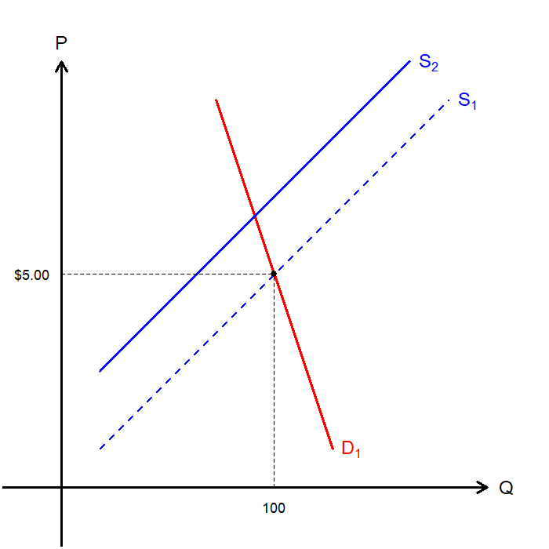

Taxation: Taxation on Sellers
Step #1:
The quantity demanded and price remain the same for buyers, so the demand curve does not shift.
The immediate impact is on the sellers, as selling coffee is less profitable, so it shifts the supply curve.
Step #2:
Because the production (and sale) of coffee is more costly at every price point, the quantity supplied would decrease at each price point.
Therefore, the supply curve would shift to the left.
Caveat on Step #2:
It is easier if we shift the supply curve upward by the taxed amount.

Slide 30
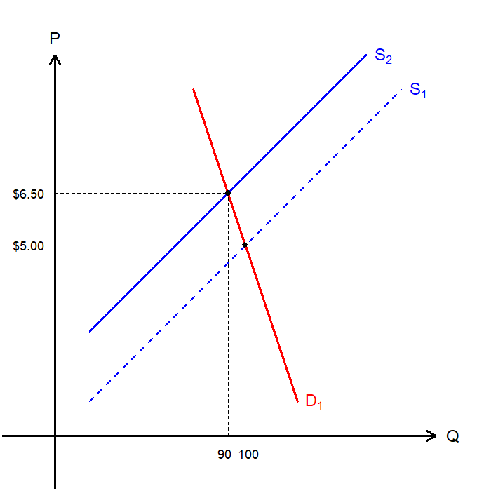
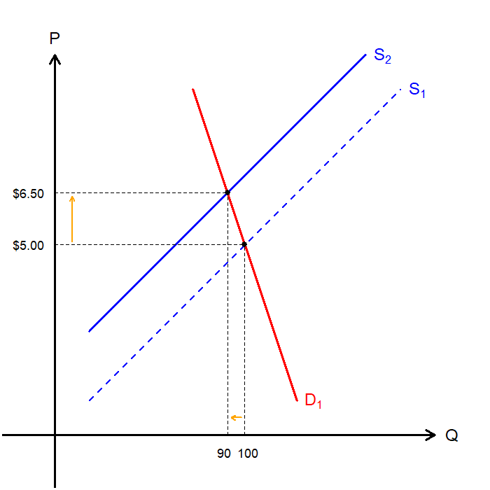
Taxation: Taxation on Sellers
Step #3:
Following the shift of the supply curve, we reach the new equilibrium with price $6.50 per cup of coffee, and 90 cups being traded in the market.
So, the new $2 per cup on coffee…
Raised the market price by $1.50, and
Reduced the size of the market for coffee.
Now, let’s consider the question of tax incidence.

Slide 31
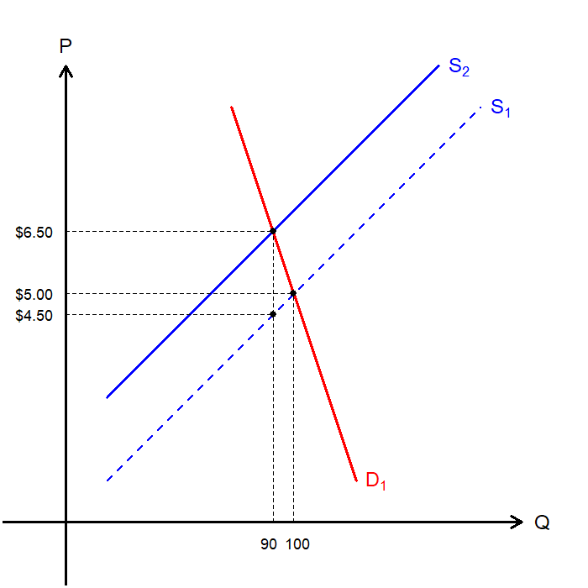
Taxation: Taxation on Sellers
Sellers are responsible of sending the money to the government, but buyers and sellers share the burden.
For each cup of coffee sellers sell, they must send $2 to the government…
The price buyers pay is $6.50 per cup
The price sellers actually receive is $4.50 per cup
Effectively, buyers are left with 75% of the tax burden, while sellers account for 25%.
Advanced: The side whose price elasticity is lower bears a greater burden from taxation.

Slide 32
Taxation: Taxation on Buyers
Let’s reset the market and suppose that the taxation is now placed on the buyers.
For each cup of coffee buyers purchase, they must send $2 to the government…
Step #1:
The quantity supplied and price remain the same for sellers, so the supply curve does not shift.
The immediate impact is on the buyers, as they face an additional cost of purchasing coffee, so it shifts the demand curve.

Slide 33
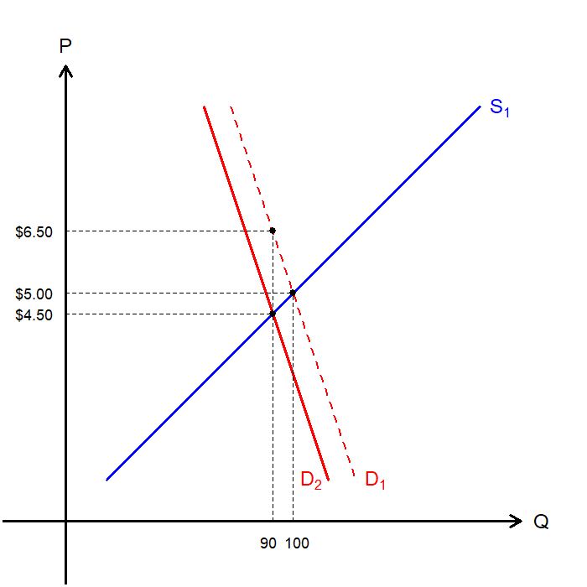
Taxation: Taxation on Buyers
Step #2:
Because the purchasing of coffee is more costly at every price point, the quantity demanded would decrease at each price point.
Therefore, the demand curve would shift to the left.
When plotting, we think of shifting the demand curve downward by $2.
Step #3:
Following the shift of the demand curve, we reach the new equilibrium with price $6.50 per cup of coffee, and 90 cups being traded in the market.
Notice something similar?

Slide 34
Taxation on Sellers vs. Buyers
Taxes placed on sellers and taxes placed on buyers are equivalent.

Slide 35
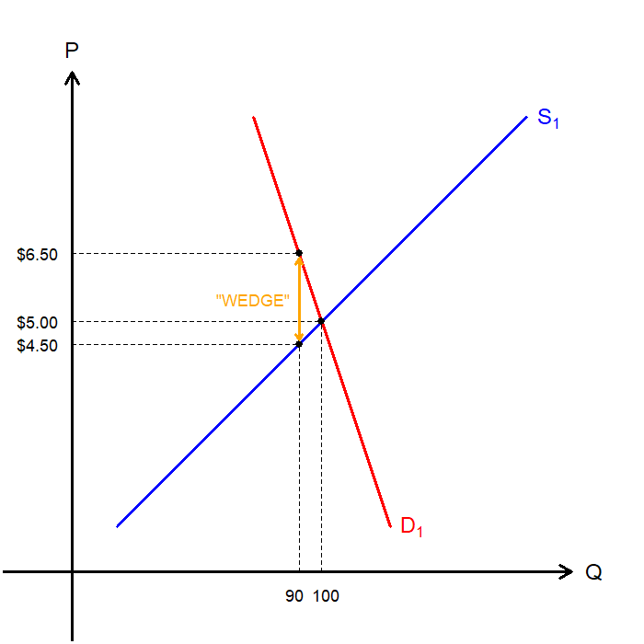
Taxation: Taxation as a “Wedge”
We can think of the tax as a “wedge” between the price buyers pay and the price sellers receive.
On a supply–demand diagram, this wedge is a vertical line segment, illustrated in orange.
You can think of taking a toothpick the size of the tax and wedging it between the supply and demand curves.
The quantity at which the toothpick fits just snuggly is the new equilibrium quantity.

Slide 36
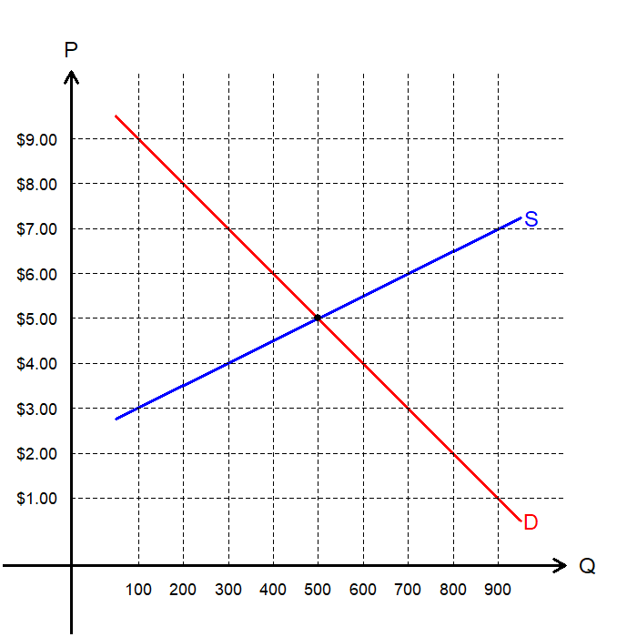
Taxation: Exercise
What is the current market equilibrium?
Equilibrium Price:
Equilibrium Quantity:
Suppose that a $3 per unit sales tax was levied in this market. What is the new…
Price for Buyers:
Price for Sellers:
Quantity Traded:
Who bears more of the burden?
$5
500
$7
$4
300
The buyers must bear more of the burden.

Slide 37
Tax Incidence and Elasticities
The rule of thumb is that “the side whose price elasticity is lower (less elastic) ends up bearing more of the burden.”
The side of the market that is more elastic has flexibility to change their behavior in response to any changes in prices.
The side of the market that is less elastic cannot easily shift their consumption/production to respond to changes in prices.
The tax burden falls more on the side with fewer escape options (lower elasticity), because that side is less responsive to price changes and therefore “trapped” into paying.
Let’s examine a real-world case where this relationship between tax incidence and elasticities has been highlighted.

Slide 38

Tax Incidence: 1990 U.S. Luxury Tax
Enacted as part of the 1990 budget deal to raise revenue and target the wealthy.
A 10% excise tax on the portion of the price above certain thresholds for luxury goods:
Yachts over $100,000
Cars over $30,000
Jewelry and Furs over $10,000
…and more
Congress expected the tax would mostly be paid by wealthy consumers purchasing luxury goods.

Slide 39
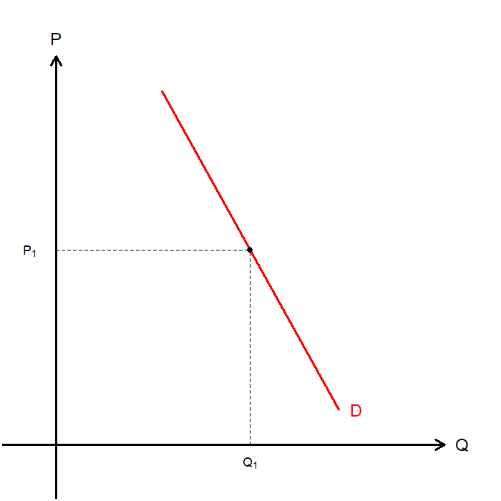
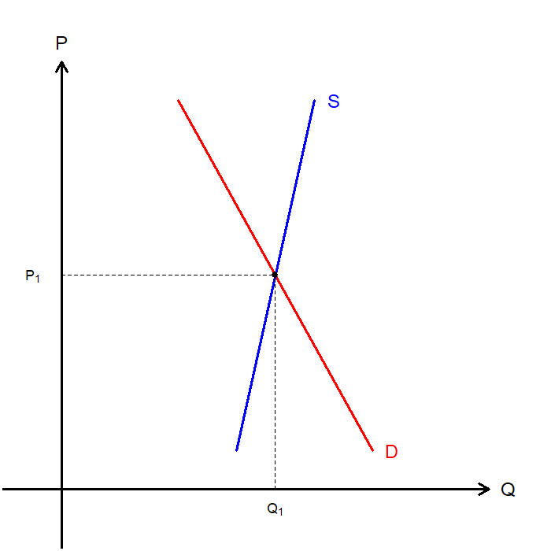
Tax Incidence: 1990 U.S. Luxury Tax
It was true that the demand for ultra-luxury goods were relatively inelastic.
The problem was that the supply was much more inelastic than demand.
Incredibly high fixed costs of setting up production for a niche market.
Suppliers of ultra-luxury goods operate at low volume with long production timelines, making it difficult to adjust.
The wealthy consumers could delay purchases, buy used, or shop abroad.

Slide 40

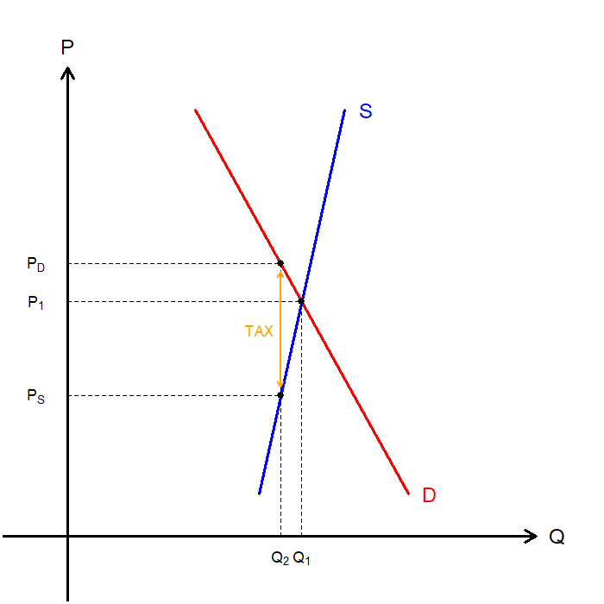
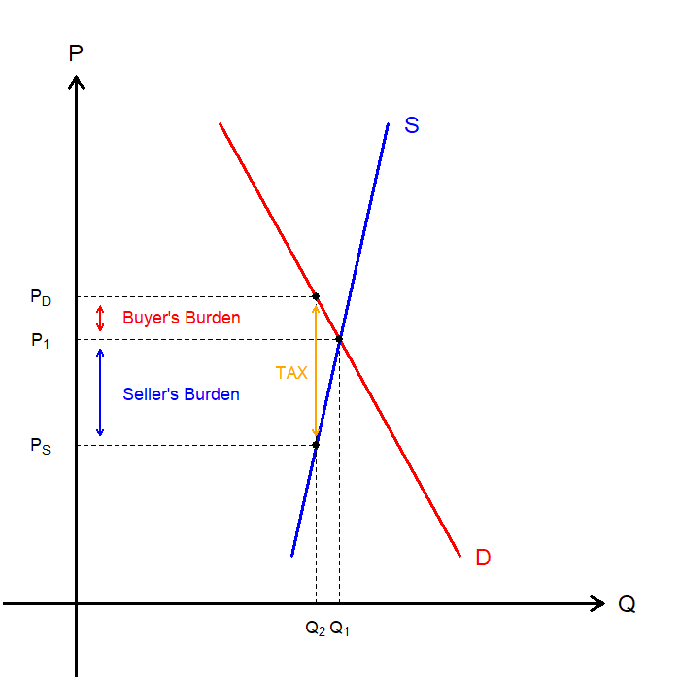
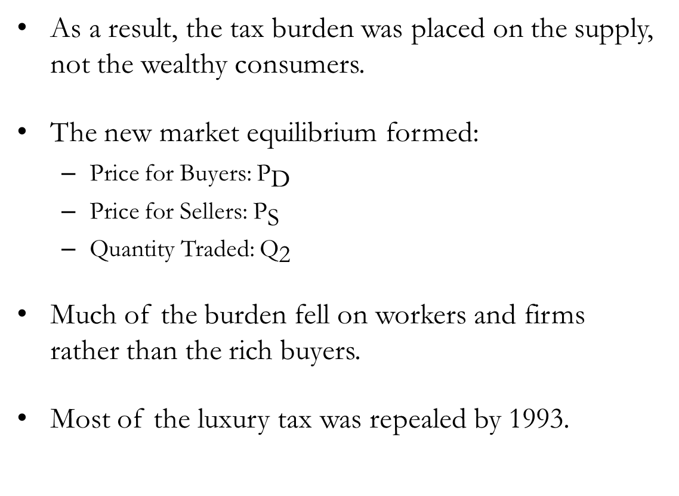
Tax Incidence: 1990 U.S. Luxury Tax
As a result, the tax burden was placed on the supply, not the wealthy consumers.
The new market equilibrium formed:
Price for Buyers: ${\text{P}}_{\text{D}}$
Price for Sellers: ${\text{P}}_{\text{S}}$
Quantity Traded: ${\text{Q}}_{\text{2}}$
Much of the burden fell on workers and firms rather than the rich buyers.
Most of the luxury tax was repealed by 1993.

Slide 41
Recap of Chapter 6

Slide 42
Recap
Price Ceilings:
Legal maximum on the price of a good or service.
Binding if below the equilibrium price.
If binding, leads to a shortage in the market.
e.g. Rent control
Price Floors:
Legal minimum on the price of a good or service.
Binding if above the equilibrium price.
If binding, leads to a surplus in the market.
e.g. Minimum wage

Slide 43
Recap
Tax:
Taxation shrinks the size of the market.
Places a wedge between the price paid by the buyers and the price sellers receive.
Buyers pay more, and sellers receive less.
Tax Incidence:
Measures how much of the burden falls on the buyers and sellers.
The side that is less elastic bears more of the burden.

