Slide 1
PRINCIPLES OF GLOBAL ECONOMICS
Chapter 5: Elasticity and its Application

Slide 2

PollEverywhere
This is a QR code to PollEverywhere, an online polling system.
  Please scan the QR code and have your device ready as there will be a few in-class exercises.
  If you do not have access to your mobile device, log in using the URL below:
  Your responses are anonymous and not be used in grading.
https://pollev.com/brianpark046

Slide 3
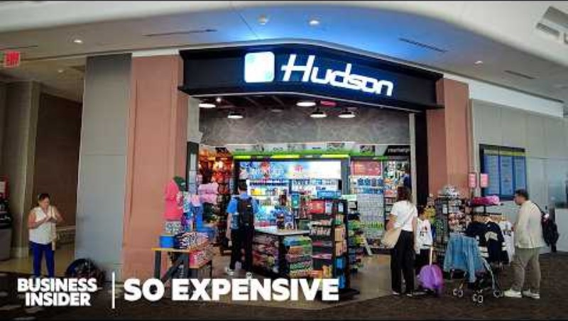
Business Insider. (2025, September 13). Why Everything At Airports Is So Expensive
[Video]. YouTube. https://youtu.be/TTCDLykCk5I?si=Pr8vqlXvOVneusPR

Slide 4
Elasticities of Demand

Slide 5
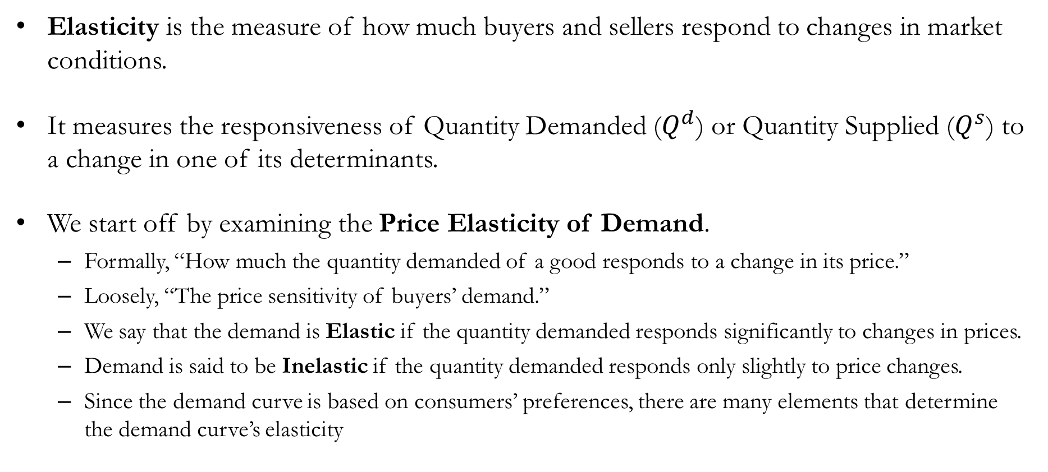
The Elasticity of Demand
Elasticity is the measure of how much buyers and sellers respond to changes in market conditions.
It measures the responsiveness of Quantity Demanded ($Q^{d}$) or Quantity Supplied ($Q^{s}$) to a change in one of its determinants.
We start off by examining the Price Elasticity of Demand.
  Formally, “How much the quantity demanded of a good responds to a change in its price.”
  Loosely, “The price sensitivity of buyers’ demand.”
  We say that the demand is Elastic if the quantity demanded responds significantly to changes in prices.
  Demand is said to be Inelastic if the quantity demanded responds only slightly to price changes.
  Since the demand curve is based on consumers’ preferences, there are many elements that determine the demand curve’s elasticity

Slide 6
The Price Elasticity of Demand: Determinants
Availability of Close Substitutes:
  Goods and services with close substitutes tend to have more elastic demand.
  Goods with services with fewer substitutes tend to have more inelastic demand.
Example #1: Coca-Cola vs. Pepsi (Substitutes)
  If the price of Pepsi rises,
  Consumers will purchase more Coca-Cola instead of Pepsi,
  And the quantity demanded of Pepsi will decrease greatly.
Example #2: Insulin (No Substitutes)
  If the price of insulin rises,
  Consumers cannot switch to another product,
  And the quantity demanded of insulin will decrease only slightly.

Slide 7
The Price Elasticity of Demand: Determinants
Necessities vs. Luxuries:
  Goods and services that are necessities tend to have more inelastic demand.
  Goods and services that are luxuries tend to have more elastic demand.
Example #1: Toilet Paper (Necessity)
  If the price of toilet paper rises,
  Consumers cannot easily reduce their usage,
  And the quantity demanded of toilet paper will decrease only slightly.
Example #2: Flight to Las Vegas (Luxury)
  If the price for a flight to Las Vegas rises,
  Consumers can postpone their plans easily (or choose other cities to visit),
  And the quantity demanded of flights to Las Vegas will decrease greatly.

Slide 8
The Price Elasticity of Demand: Determinants
Narrowly vs. Broadly Defined Markets:
  Narrowly defined markets tend to have more elastic demand.
  Broadly defined markets tend to have more inelastic demand.
Example #1: Market for Coca-Cola (Narrow)
  If the price of Coca-Cola rises,
  Consumers can easily switch to Pepsi,
  And the quantity demanded of Coca-Cola will decrease greatly.
Example #2: Market for Carbonated Drinks (Broad)
  If the price of all carbonated drinks rise,
  Consumers will have fewer alternatives to switch to,
  And the quantity demanded of carbonated drinks will decrease only slightly.

Slide 9
The Price Elasticity of Demand: Determinants
Time Horizon:
  Demand tends to be more elastic over longer periods of time.
  In the short run, consumers have fewer options to adjust.
  In the long run, consumers can make more adjustments.
Example: Price of Gasoline
  If the price of gasoline increases,
  In the short run, consumers can only make small adjustments, and the quantity demanded of gasoline decreases only slightly.
  In the long run, consumers may switch to more fuel-efficient vehicles or arrange carpooling, and the quantity demanded of gasoline decreases more substantially.

Slide 10
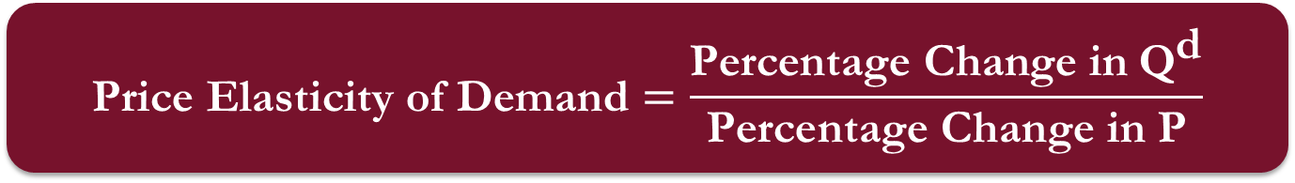
The Price Elasticity of Demand
$$\text{Price} \text{Elasticity} \text{of} \text{Demand}=\frac{\text{Percentage} \text{Change} \text{in} {\text{Q}}^{\text{d}}}{\text{Percentage} \text{Change} \text{in} \text{P}}$$

Slide 11
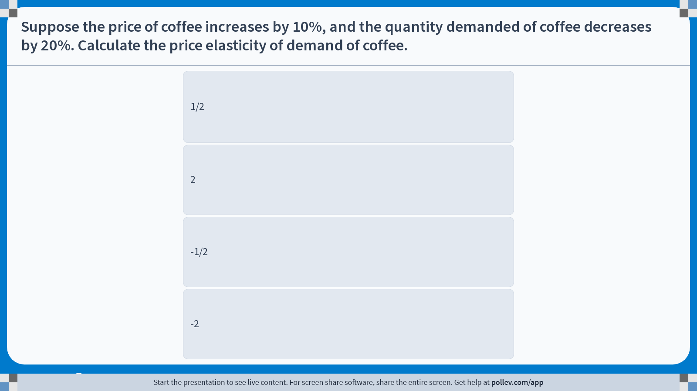
Poll Everywhere multiple choice poll instructions screen
Activity Title: Suppose the price of coffee increases by 10%, and the quantity demanded of coffee decreases by 20%. Calculate the price elasticity of demand of coffee.
Slide 10
Notes:
Do not modify the notes in this section to avoid tampering with the Poll Everywhere activity.
More info at polleverywhere.com/support
Suppose the price of coffee increases by 10%, and the quantity demanded of coffee decreases by 20%. Calculate the price elasticity of demand of coffee.
https://www.polleverywhere.com/multiple_choice_polls/m1vYfAhzL18s7e8xCY9xG?display_state=instructions&activity_state=opened&state=opened&flow=Engagement&onscreen=persist

Slide 12
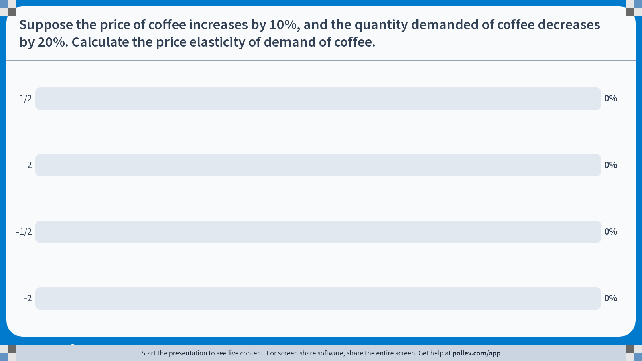
Poll Everywhere multiple choice poll chart screen
Activity Title: Suppose the price of coffee increases by 10%, and the quantity demanded of coffee decreases by 20%. Calculate the price elasticity of demand of coffee.
Slide 12
Notes:
Do not modify the notes in this section to avoid tampering with the Poll Everywhere activity.
More info at polleverywhere.com/support
Suppose the price of coffee increases by 10%, and the quantity demanded of coffee decreases by 20%. Calculate the price elasticity of demand of coffee.
https://www.polleverywhere.com/multiple_choice_polls/m1vYfAhzL18s7e8xCY9xG?display_state=chart&activity_state=closed&state=closed&flow=Engagement&onscreen=persist

Slide 13
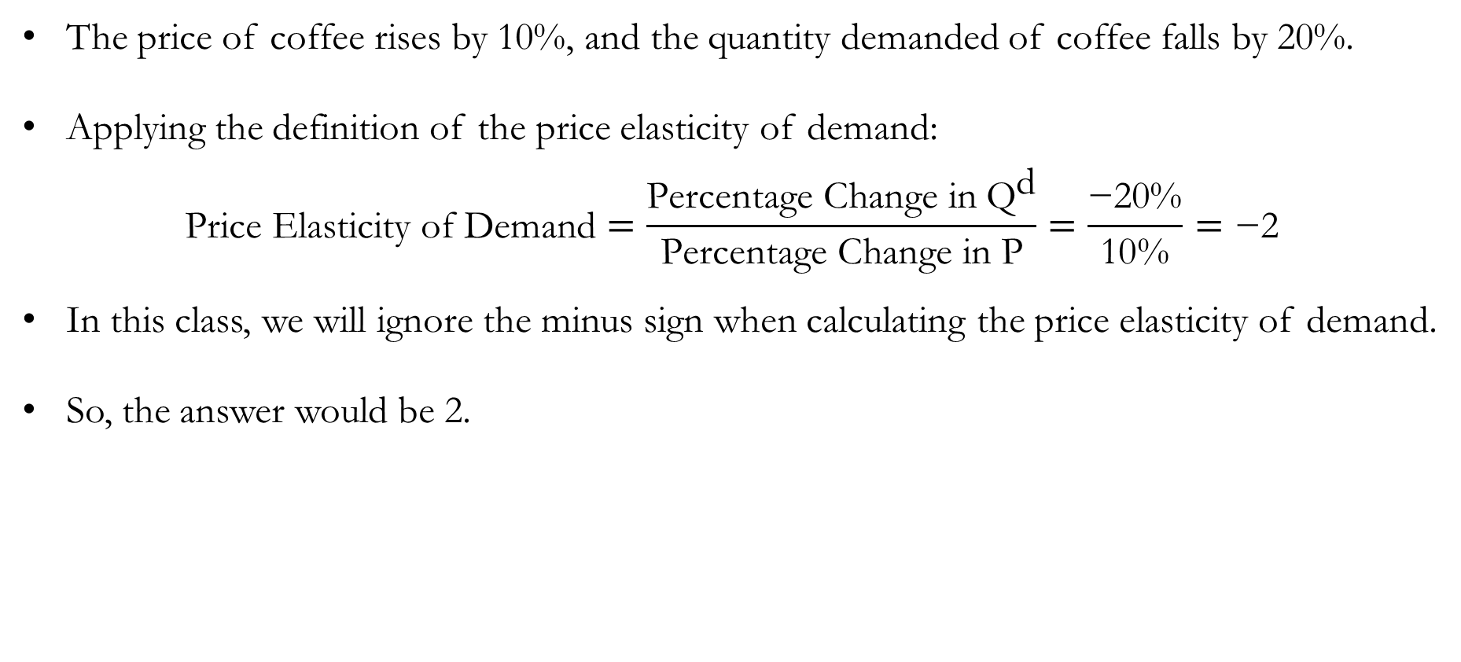
Solution to In-class Poll #1
The price of coffee rises by 10%, and the quantity demanded of coffee falls by 20%.
Applying the definition of the price elasticity of demand:
$$\text{Price} \text{Elasticity} \text{of} \text{Demand}=\frac{\text{Percentage} \text{Change} \text{in} {\text{Q}}^{\text{d}}}{\text{Percentage} \text{Change} \text{in} \text{P}}=\frac{\text{−20\%}}{\text{10\%}}=\text{−2}$$
In this class, we will ignore the minus sign when calculating the price elasticity of demand.
So, the answer would be 2.

Slide 14
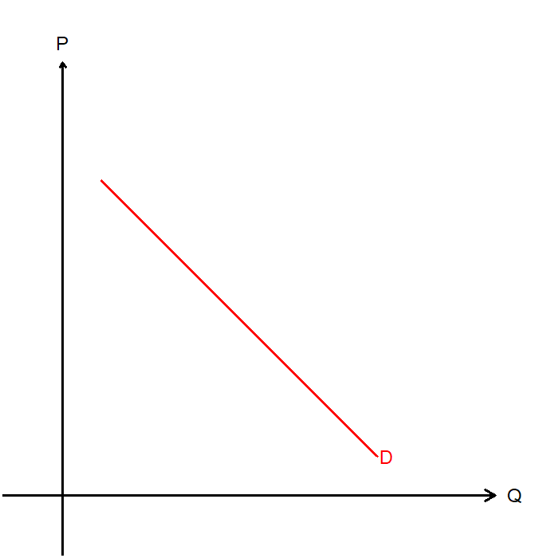
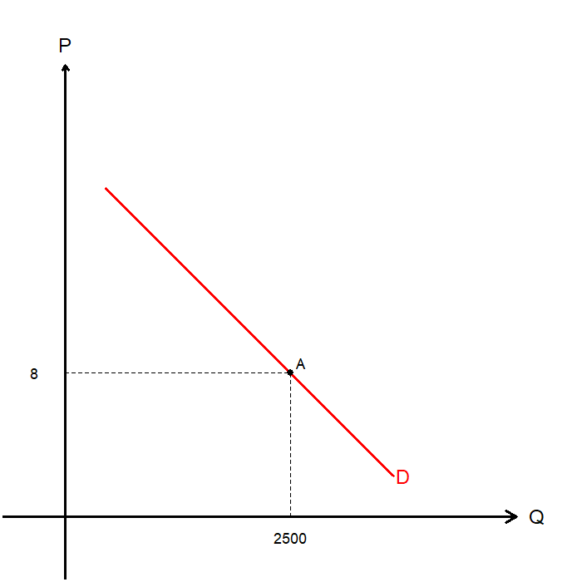
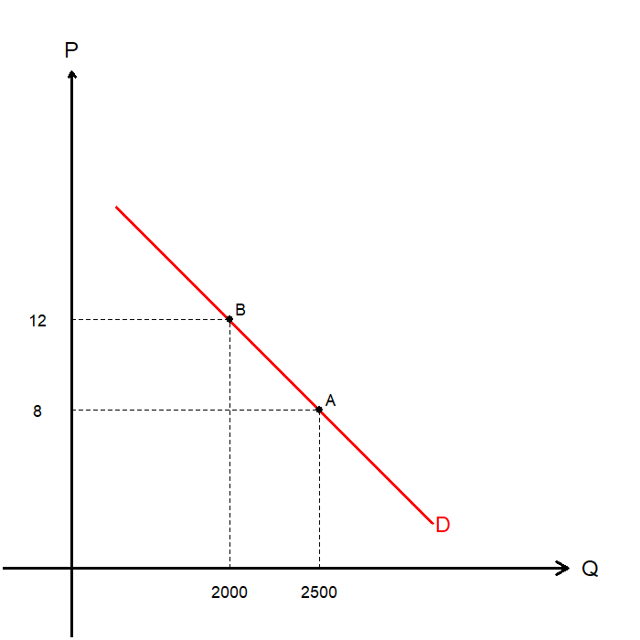
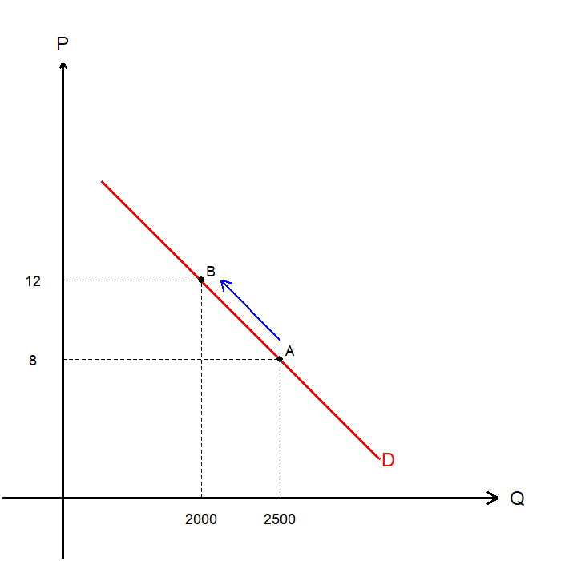
The Price Elasticity of Demand
Visualizing what we are trying to measure…
Suppose we observe the demand curve, and find:
  When prices are $8, quantity demanded is 2,500 (A)
  When prices are $12, quantity demanded is 2,000 (B)
Suppose that the market was originally at point A, the moved to point B.
What is the percent change in Prices?
What is the percent change in Quantity Demanded?

Slide 15
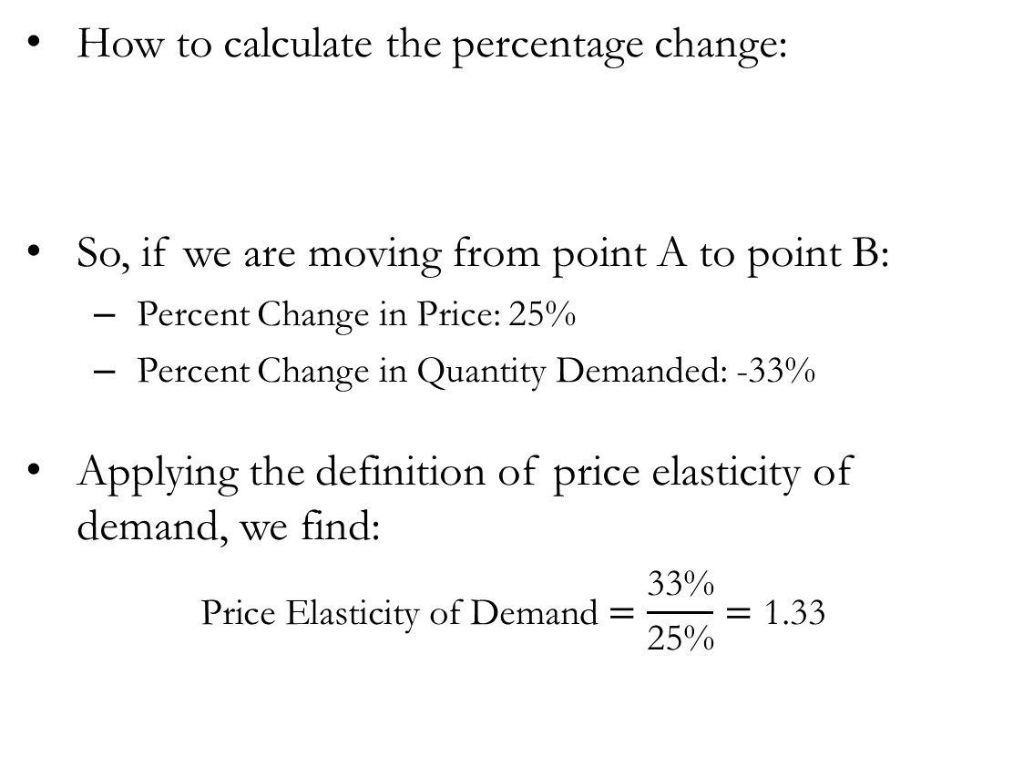

The Price Elasticity of Demand
How to calculate the percentage change:
So, if we are moving from point A to point B:
  Percent Change in Price: 25%
  Percent Change in Quantity Demanded: -33%
Applying the definition of price elasticity of demand, we find:
$$\text{Price} \text{Elasticity} \text{of} \text{Demand}=\frac{\text{33\%}}{\text{25\%}}=\text{1.3}\text{3}$$
$$\text{Percent} \text{Change}=\frac{\text{End} \text{Value}\text{ − }\text{Start} \text{Value}}{\text{Start} \text{Value}}$$

Slide 16
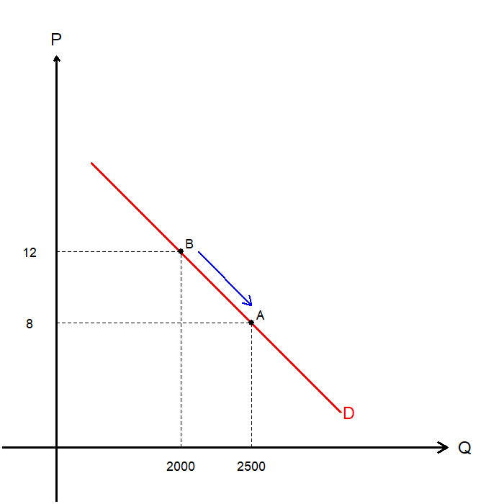
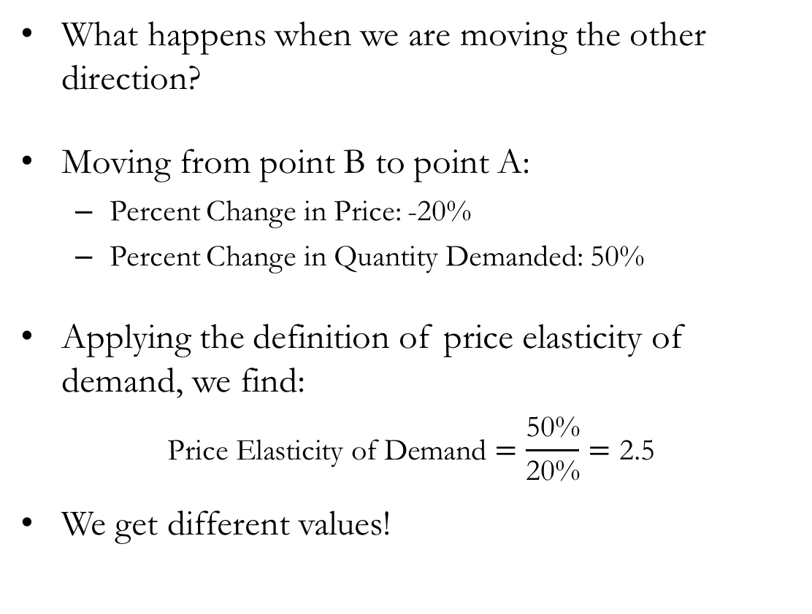
The Price Elasticity of Demand
What happens when we are moving the other direction?
Moving from point B to point A:
  Percent Change in Price: -20%
  Percent Change in Quantity Demanded: 50%
Applying the definition of price elasticity of demand, we find:
$$\text{Price} \text{Elasticity} \text{of} \text{Demand}=\frac{\text{50\%}}{\text{20\%}}=\text{2.5}$$
We get different values!

Slide 17
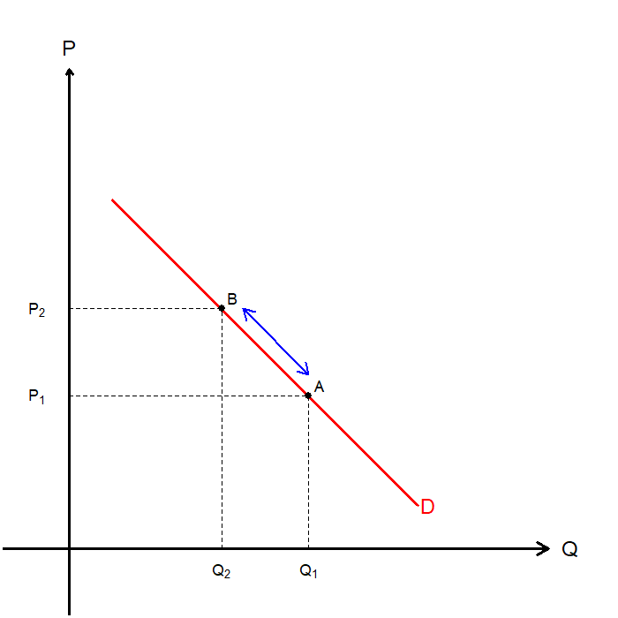
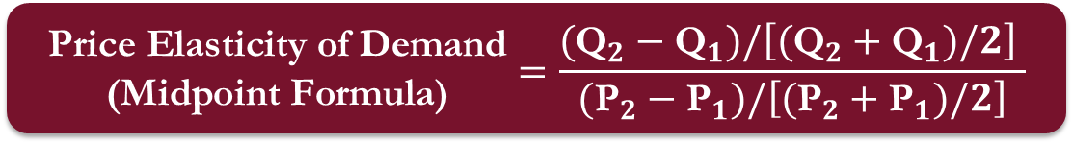

The Price Elasticity of Demand: Midpoint Method
Finding different values itself isn’t necessarily a problem, but it can be confusing.
The Midpoint Method solves this issue by changing the way we calculate percentage changes.
Instead of dividing by the start value, we divide by the midpoint value.
$$\begin{matrix}\text{Percent} \text{Change} \\ \text{(}\text{Midpoint} \text{Formula}\text{)}\end{matrix}=\frac{\text{End} \text{Value}\text{ − }\text{Start} \text{Value}}{\text{Midpoint}}$$
$$\begin{matrix}\text{Price} \text{Elasticity} \text{of} \text{Demand} \\ \text{(}\text{Midpoint} \text{Formula}\text{)}\end{matrix}=\frac{({\text{Q}}_{2}−{\text{Q}}_{1})/\left[({\text{Q}}_{2}+{\text{Q}}_{1})/2\right] }{({\text{P}}_{2}−{\text{P}}_{1})/\left[({\text{P}}_{2}+{\text{P}}_{1})/2\right]}$$

Slide 18
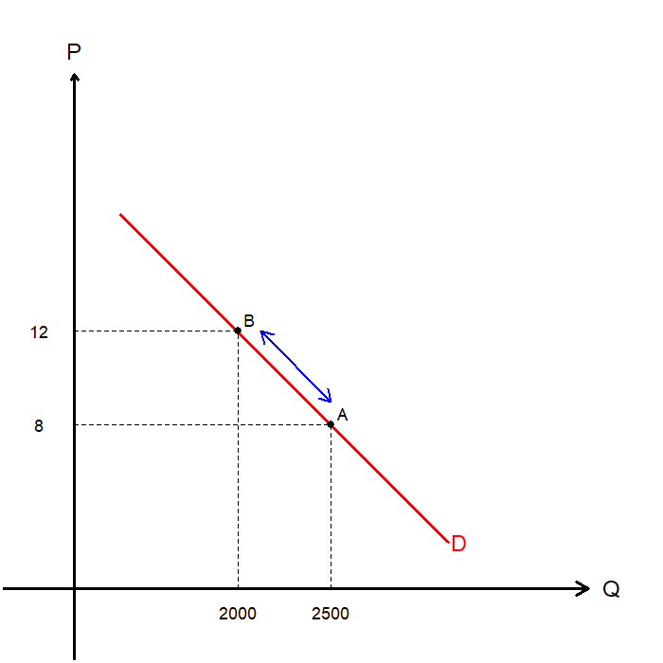
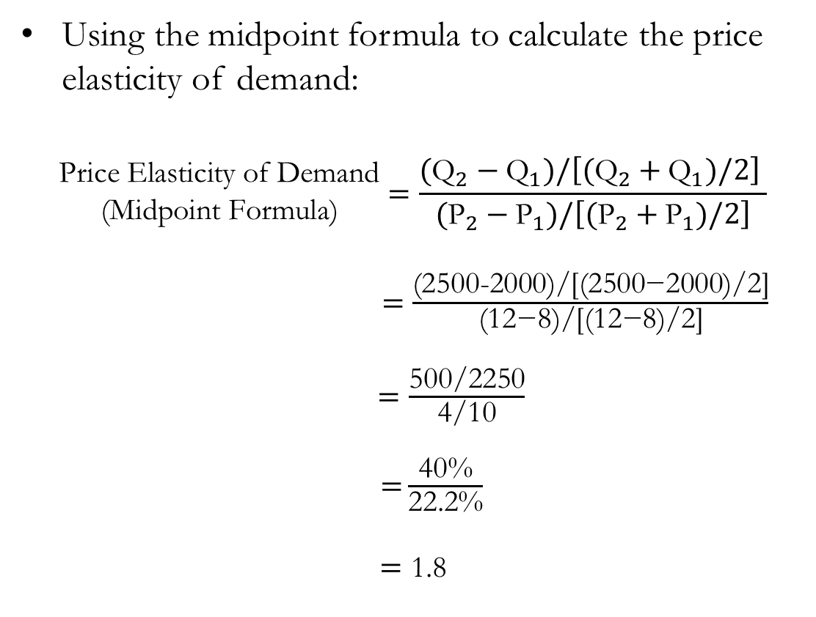
The Price Elasticity of Demand: Midpoint Method
Using the midpoint formula to calculate the price elasticity of demand:
$$\begin{matrix}\text{Price} \text{Elasticity} \text{of} \text{Demand} \\ \text{(}\text{Midpoint} \text{Formula}\text{)}\end{matrix}=\frac{({\text{Q}}_{2}−{\text{Q}}_{1})/\left[({\text{Q}}_{2}+{\text{Q}}_{1})/2\right] }{({\text{P}}_{2}−{\text{P}}_{1})/\left[({\text{P}}_{2}+{\text{P}}_{1})/2\right]}$$
$=\frac{\text{(2500−2000)/}\left[\text{(2500−2000}\text{)/2}\right]}{\text{(}\text{12}\text{−}\text{8}\text{)/}\left[\text{(}\text{12}\text{−}\text{8}\text{)/2}\right]}$
$=\frac{\text{500/2250}}{\text{4/10}}$
$\text{=}\frac{\text{40\%}}{\text{22}\text{.2\%}}$
$$=\text{1.8}$$

Slide 19
Variety of Demand Curves
Demand curves can be classified by their price elasticity of demand.
When the price elasticity of demand is equal to 1, we say that demand is Unit Elastic.
When the price elasticity of demand is greater than 1, we say that demand is Elastic.
When the price elasticity of demand is less than 1, we say that demand is Inelastic.
When the price elasticity of demand is 0, we say that demand is Perfectly Elastic.
When the price elasticity of demand is infinite, we say that demand is Perfectly Inelastic.

Slide 20
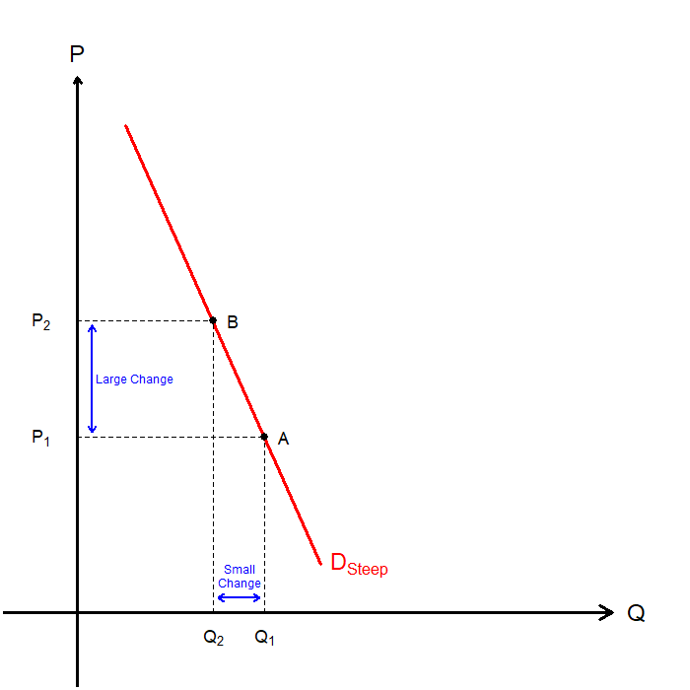
Variety of Demand Curves: Inelastic
The demand is inelastic when consumers’ price sensitivity is relatively low.
Consider an everyday necessity, eggs.
Suppose that the price of eggs increase greatly.
As eggs are necessities of many households, the quantity demanded of eggs will not fall greatly.
Price elasticity of demand would be less than 1, and the demand curve is “steep.”

Slide 21
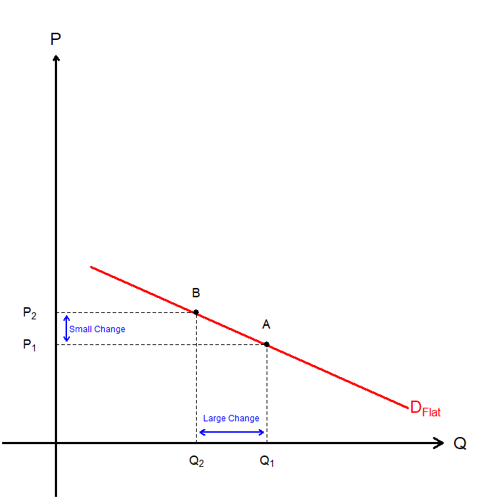
Variety of Demand Curves: Elastic
The demand is elastic when the consumers’ price sensitivity is relatively high.
Consider goods with many substitutes: Coffee.
Suppose one specific café decides to increase its price by a small amount.
The café would see a large drop in the quantity demanded of coffee, as there are many substitutes.
Price elasticity of demand would be greater than 1, and the demand curve is “flat.”

Slide 22
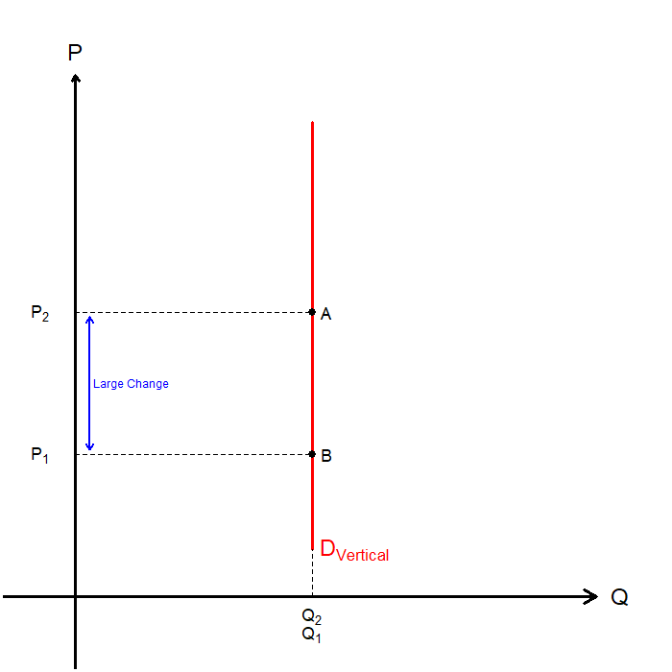
Variety of Demand Curves: Perfectly Inelastic
The demand is perfectly inelastic when the consumers are not sensitive to price at all.
Any change in price cannot affect the quantity demanded of the good or service.
There are probably no real-world examples of a perfectly inelastic demand.
  Certain defense contractors that handle the maintenance of critical defense infrastructure may be the closest real-world example.
The price elasticity of demand is infinite, and the demand curve is vertical.

Slide 23
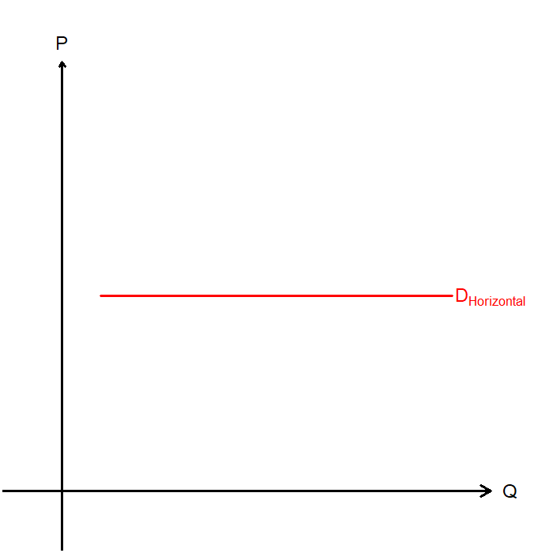
Variety of Demand Curves: Perfectly Elastic
The demand is perfectly elastic when the consumers’ price sensitivity is infinite.
Any small increase in price means that the quantity demanded falls to zero.
Any small decrease in price means that the quantity demanded increases infinitely.
The price elasticity of demand is infinite, and the demand curve is horizontal.
Later in the semester, we will come across this demand curve again!

Slide 24
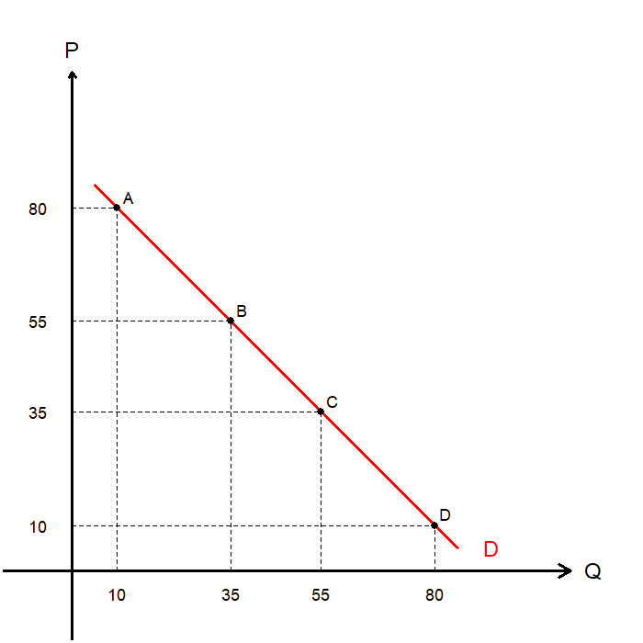
Variety of Demand Curves: Disclaimer
A linear demand curve has a constant slope.
But the price elasticity of demand for a linear demand curve depends on where we measure it.
For instance,
  From A to B: Price Elasticity of Demand is 8
  From B to C: Price Elasticity of Demand is 1.1
  From C to D: Price Elasticity of Demand is 0.6
The previous graphs were plotted as a straight line for simplicity.

Slide 25


Total Revenues and Elasticities
Total Revenue (TR) is defined as the amount paid by buyers and received by the sellers of a good or service.
Using math, total revenue is defined as:
A price increase exerts both an upward and downward pressure on total revenue:
  Upward Pressure: Price is increasing
  Downward Pressure: Quantity is expected to fall (“Law of Demand”)
Which effect prevails depends on the price elasticity of demand.
$$\text{Total} \text{Revenue}=\text{Price}×\text{Quantity}$$
$$\text{TR}=\text{P}×\text{Q}$$

Slide 26
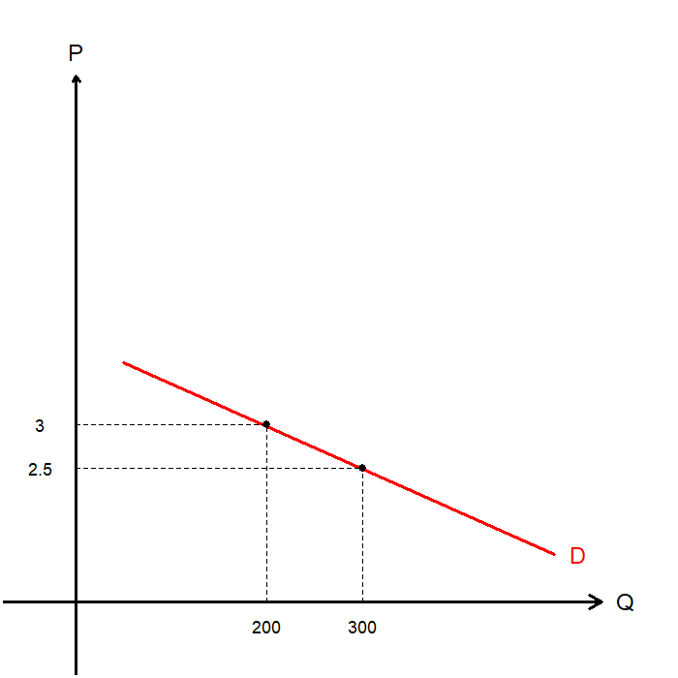
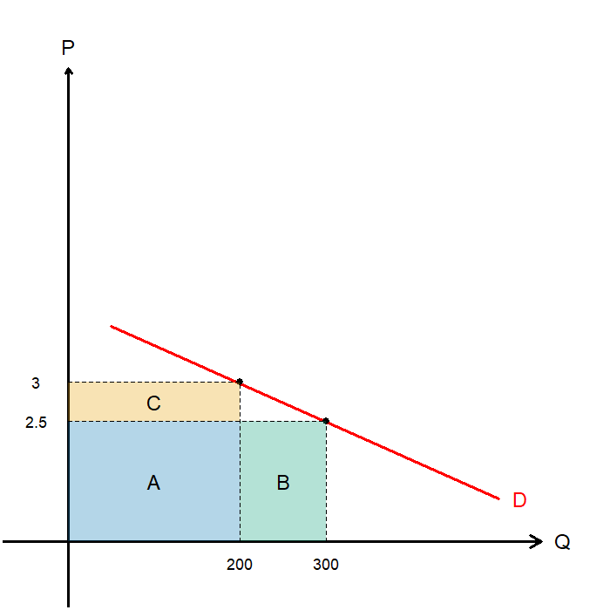
Total Revenues and Elasticities
Consider a café selling 300 cups of coffee at a price of $2.5 each, where the owner is considering raising the price to $3 a cup.
Let’s examine the changes to the café’s total revenue:
  Current TR: A+B
  Future TR: A+C
So, by raising prices from $2.5 to $3 per cup, the café would lose B and gain C.
Whether the trade-off is worth it depends on the price elasticity of demand.

Slide 27
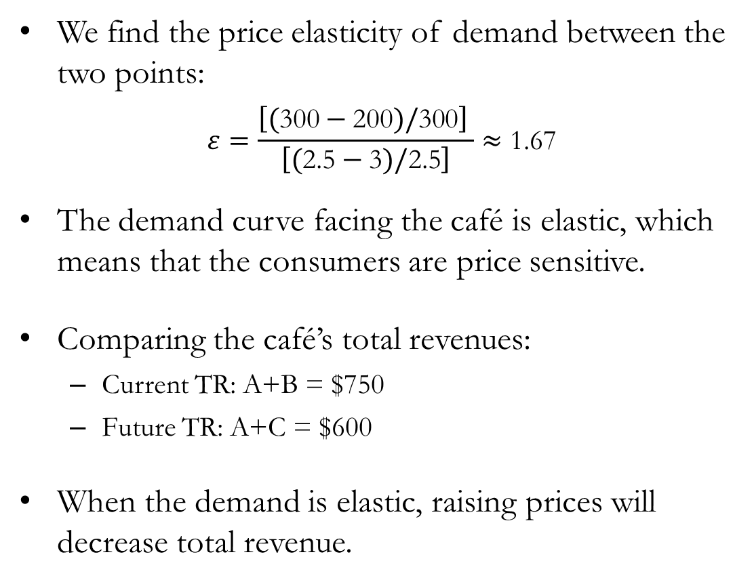
Total Revenues and Elasticities
We find the price elasticity of demand between the two points:
$$ε=\frac{\left[(\text{3}\text{00}−\text{200})/\text{3}\text{00}\right] }{\left[(\text{2}\text{.5}−\text{3})/\text{2.5}\right]}≈\text{1.67}$$
The demand curve facing the café is elastic, which means that the consumers are price sensitive.
Comparing the café’s total revenues:
  Current TR: A+B = $750
  Future TR: A+C = $600
When the demand is elastic, raising prices will decrease total revenue.

Slide 28
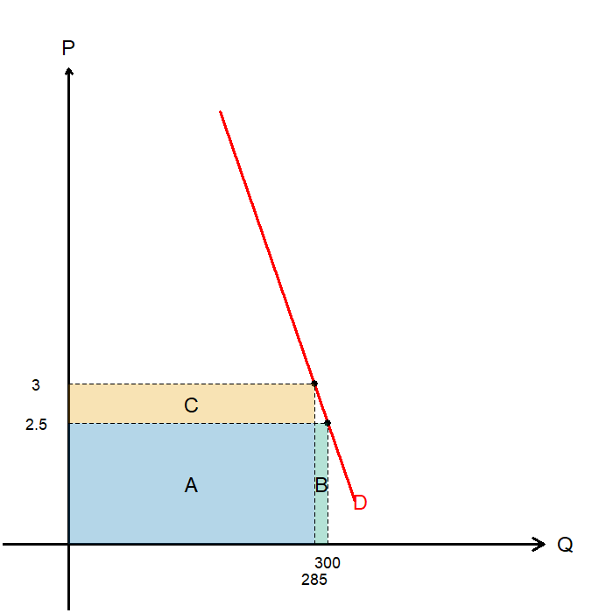
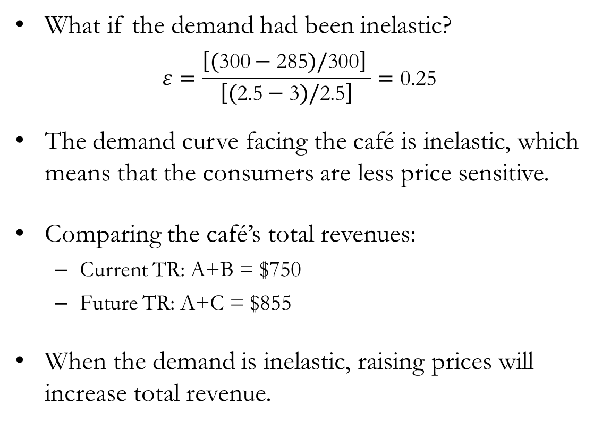
Total Revenues and Elasticities
What if the demand had been inelastic?
$$ε=\frac{\left[(\text{300}−\text{285})/\text{300}\right] }{\left[(\text{2}\text{.5}−\text{3})/\text{2.5}\right]}=\text{0.25}$$
The demand curve facing the café is inelastic, which means that the consumers are less price sensitive.
Comparing the café’s total revenues:
  Current TR: A+B = $750
  Future TR: A+C = $855
When the demand is inelastic, raising prices will increase total revenue.

Slide 29
Total Revenues and Elasticities
A quick reference table for TR, price elasticity of demand, and price change:
Consider the following scenarios, and think about what happens to TR:
  Pharmaceuticals companies increase the price of Insulin by 10%.
  Luxury cruise lines offer a discount of 20% on their products.
  Rent for student housing is increased by 15%.
  Parking fees in downtown parking lots are increased by 10%.
 | Elastic | Unit Elastic | Inelastic
Price Increase | TR Decreases | No Change in TR | TR Increases
Price Decrease | TR Increases | No Change in TR | TR Decreases

Slide 30

Income Elasticity of Demand
The Income Elasticity of Demand measures “How much the quantity demanded of a good responds to a change in consumers’ income.”
  Goods whose income elasticity of demand is greater than 0 is a normal good.
  Good whose income elasticity of demand is less than 0 is an inferior good.
Normal Goods can further be subcategorized as necessities or luxuries:
  Goods whose income elasticity of demand if greater than 1 is a luxury.
  Goods whose income elasticity of demand is greater than 0, but less than 1 is a necessity.
$$\text{Income} \text{Elasticity} \text{of} \text{Demand}=\frac{\text{Percentage} \text{Change} \text{in} {\text{Q}}^{\text{d}}}{\text{Percentage} \text{Change} \text{in} \text{Consumers}\text{′ }\text{Income}}$$

Slide 31

Cross-Price Elasticity of Demand
The Cross-Price Elasticity of Demand measures “How much the quantity demanded of one good responds to a change in another good’s prices.”
  Two goods whose cross-price elasticity of demand is greater than 0 are substitutes.
  Two goods whose cross-price elasticity of demand is less than 0 are complements.
Consider substitute goods, Coca-Cola and Pepsi:
  If the price of Pepsi increases (Positive Change in P of Pepsi)
  More consumers would switch to consuming more Coca-Cola (Positive Change in Q of Coca-Cola)
  So, the cross-price elasticity of demand would be positive.
$$\text{Cross}\text{−}\text{Price} \text{Elasticity} \text{of} \text{Demand}=\frac{\text{Percentage} \text{Change} \text{in} {\text{Q}}^{\text{d}}\text{of} \text{One} \text{Good}}{\text{Percentage} \text{Change} \text{in} \text{the} \text{P} \text{of} \text{the} \text{Other} \text{Good}}$$

Slide 32
Elasticities of Supply

Slide 33

The Price Elasticity of Supply
We now turn our attention to the Price Elasticity of Supply.
  Formally, “How much the quantity supplied of a good responds to a change in its price.”
  Loosely, “The price sensitivity of sellers’ supply.”
  We say that the supply is Elastic if the quantity supplied responds significantly to changes in prices.
  Supply is said to be Inelastic if the quantity supplied responds only slightly to price changes.
  Since the supply curve is based on sellers’ preferences, there are many elements that determine the supply curve’s elasticity
$$\text{Price} \text{Elasticity} \text{of} \text{Supply}=\frac{\text{Percentage} \text{Change} \text{in} {\text{Q}}^{\text{s}}}{\text{Percentage} \text{Change} \text{in} \text{P}}$$

Slide 34
The Price Elasticity of Supply: Determinants
Flexibility in Production:
  If sellers can easily change the quantity they produce, the more elastic the price elasticity of supply.
  If sellers cannot easily change the quantity they produce, the less elastic the price elasticity of supply.
Short-run vs. Long-run Scope:
  In the short-run, supply tends to be less elastic.
  In the long-run, supply tends to be more elastic.
Example: The Supply of New Houses in the Short-run
  Even if the price of new houses increased by a great amount,
  Producers need time to design, obtain permits, hire workers, procure materials, to build more houses.
  So, the supply would be less responsive to price changes.

Slide 35
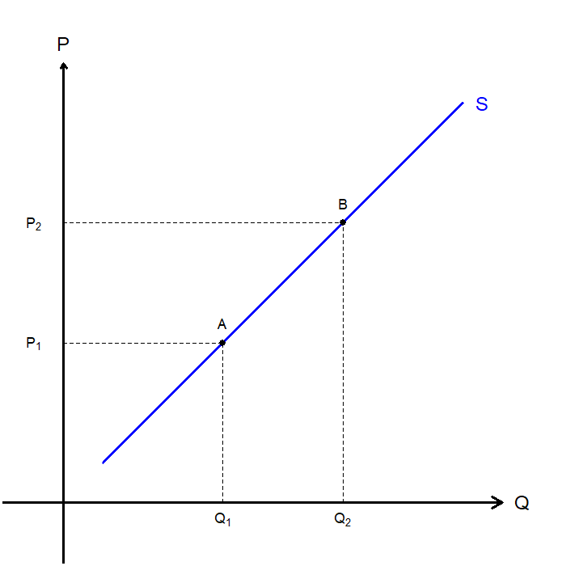
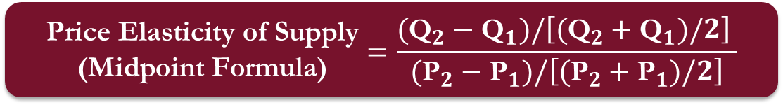
The Price Elasticity of Supply
Similar in nature to the price elasticity of demand.
We see different results when we measure the price elasticity of supply…
  Moving from A to B, and
  Moving from B to A.
While it is not itself a problem, we can apply the midpoint method for the price elasticity of supply.
$$\begin{matrix}\text{Price} \text{Elasticity} \text{of} \text{Supply} \\ \text{(}\text{Midpoint} \text{Formula}\text{)}\end{matrix}=\frac{({\text{Q}}_{2}−{\text{Q}}_{1})/\left[({\text{Q}}_{2}+{\text{Q}}_{1})/2\right] }{({\text{P}}_{2}−{\text{P}}_{1})/\left[({\text{P}}_{2}+{\text{P}}_{1})/2\right]}$$

Slide 36
Variety of Supply Curves
Supply curves can be classified by their price elasticity of supply.
When the price elasticity of supply is equal to 1, we say that supply is Unit Elastic.
When the price elasticity of supply is greater than 1, we say that supply is Elastic.
When the price elasticity of supply is less than 1, we say that supply is Inelastic.
When the price elasticity of supply is 0, we say that supply is Perfectly Elastic.
When the price elasticity of supply is infinite, we say that supply is Perfectly Inelastic.

Slide 37
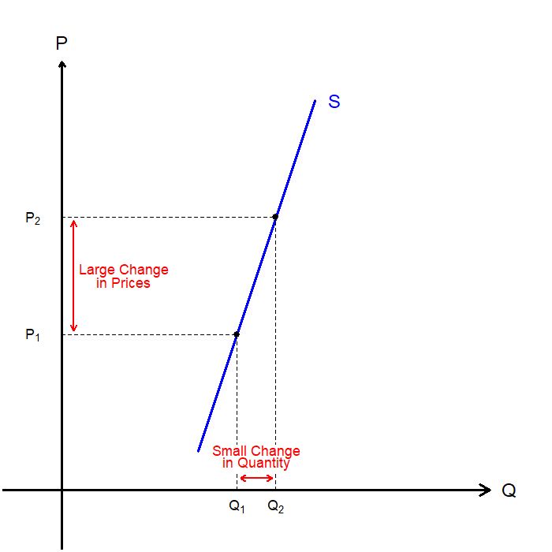
Variety of Supply Curves: Inelastic
The supply is inelastic when producers’ price sensitivity is relatively low.
This means that even for large shifts in prices, the quantity supplied would not change very much.
Price elasticity of supply would be less than 1, and the supply curve is “steep.”
Examples may include:
  Agricultural Products (in the short-run).
  Rare Natural Resources.
  Highly Specialized Workers.

Slide 38
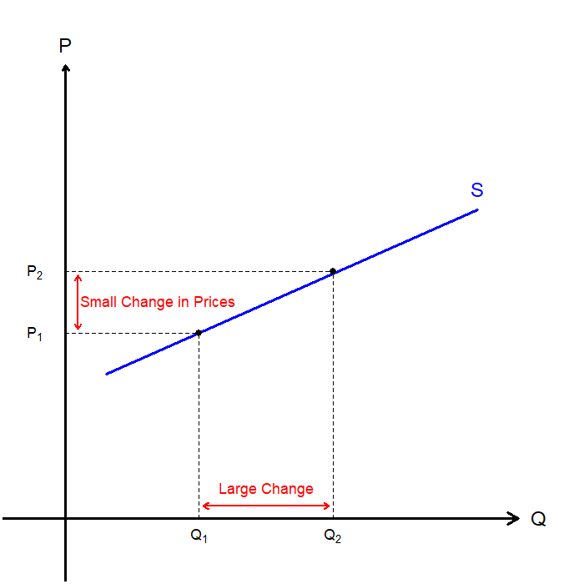
Variety of Supply Curves: Elastic
The supply is elastic when producers’ price sensitivity is relatively high.
This means that even for small shifts in prices, the quantity supplied would change substantially.
Price elasticity of supply would be greater than 1, and the supply curve is “flat.”
Examples may include:
  Mass Manufactured Goods (T-shirts, Toys, etc).
  Low-Skilled Workers.

Slide 39
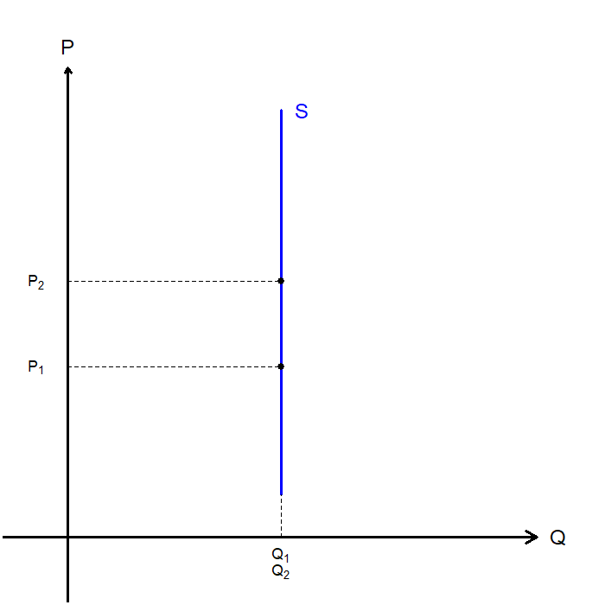
Variety of Supply Curves: Perfectly Inelastic
The supply is perfectly inelastic when the producers are not sensitive to price at all.
Any change in price cannot affect the quantity supplied of the good or service.
There are probably no real-world examples of a perfectly inelastic supply.
  The supply of unique works of art, or real estate in a specific location may be perfectly inelastic.
The price elasticity of supply is infinite, and the supply curve is vertical.

Slide 40
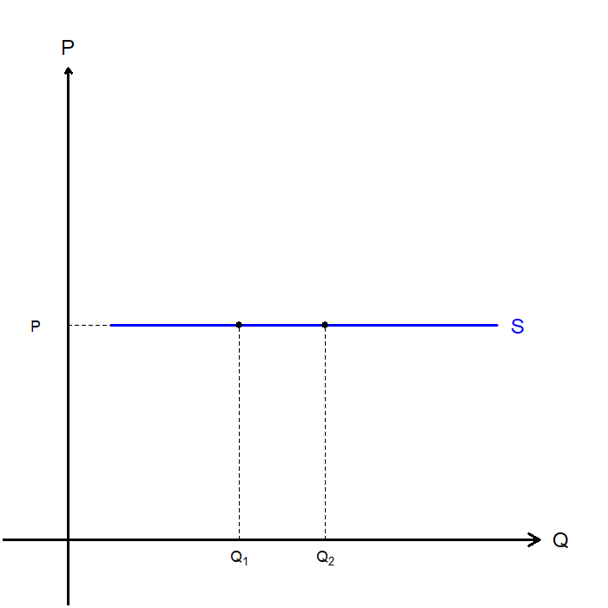
Variety of Supply Curves: Perfectly Elastic
The supply is perfectly elastic when the producers’ price sensitivity is infinite.
Any small increase in price means that the quantity supplied falls to zero.
Any small decrease in price means that the quantity supplied increases infinitely.
The price elasticity of supply is infinite, and the supply curve is horizontal.
Later in the semester, we will come across this demand curve again!

Slide 41
Real-World Applications

Slide 42
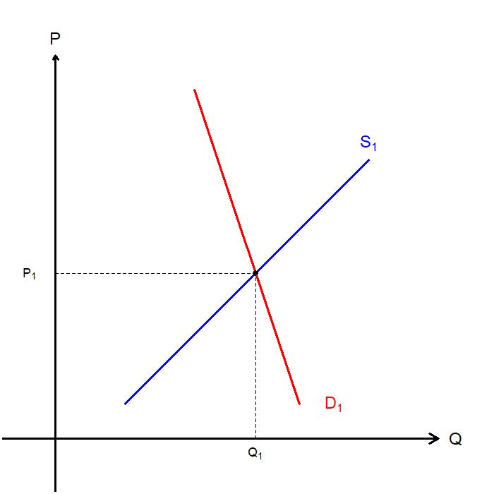
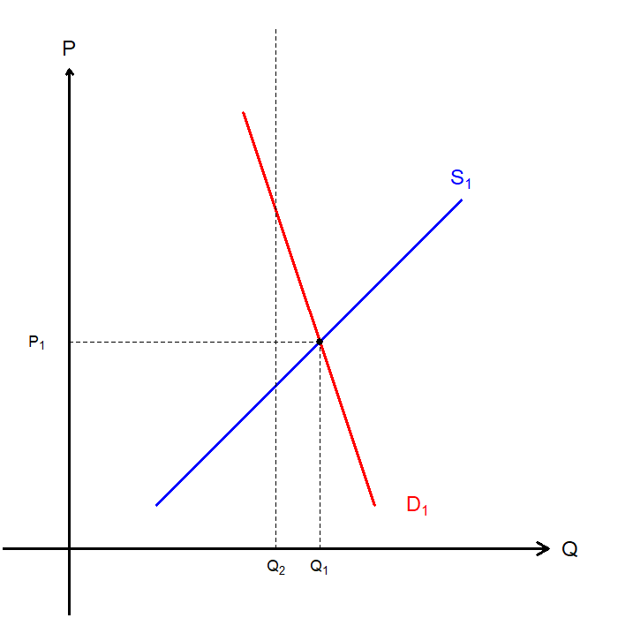
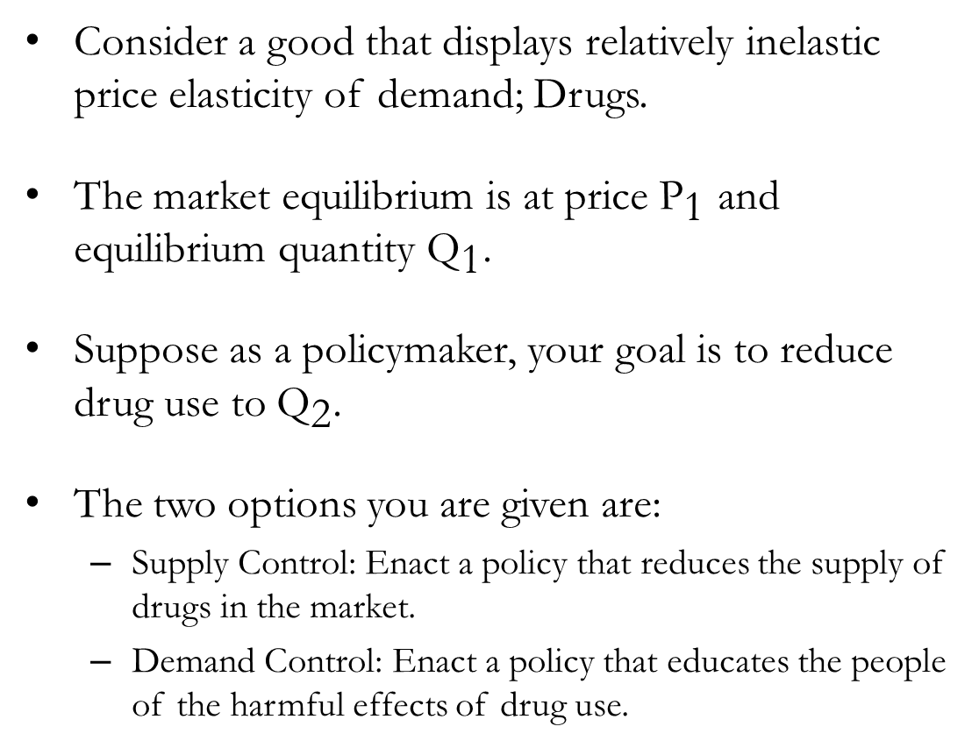
Drug Enforcement
Consider a good that displays relatively inelastic price elasticity of demand; Drugs.
The market equilibrium is at price ${\text{P}}_{\text{1}}$ and equilibrium quantity ${\text{Q}}_{\text{1}}$.
Suppose as a policymaker, your goal is to reduce drug use to ${\text{Q}}_{\text{2}}$.
The two options you are given are:
  Supply Control: Enact a policy that reduces the supply of drugs in the market.
  Demand Control: Enact a policy that educates the people of the harmful effects of drug use.

Slide 43
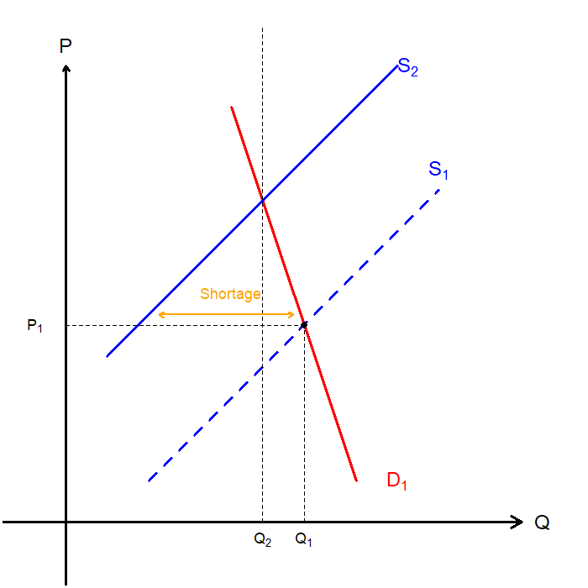
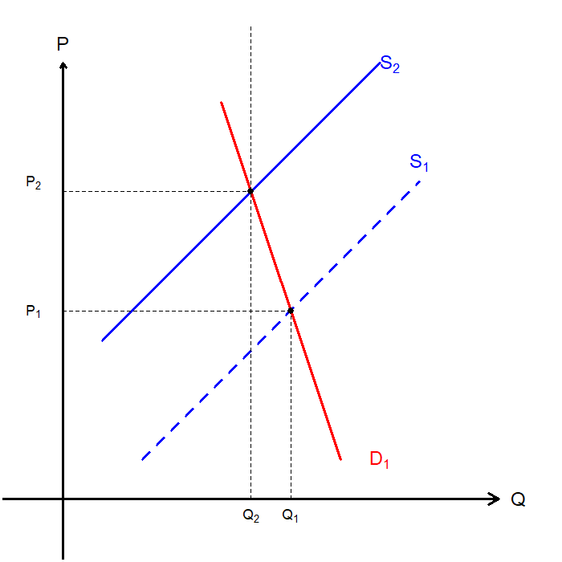
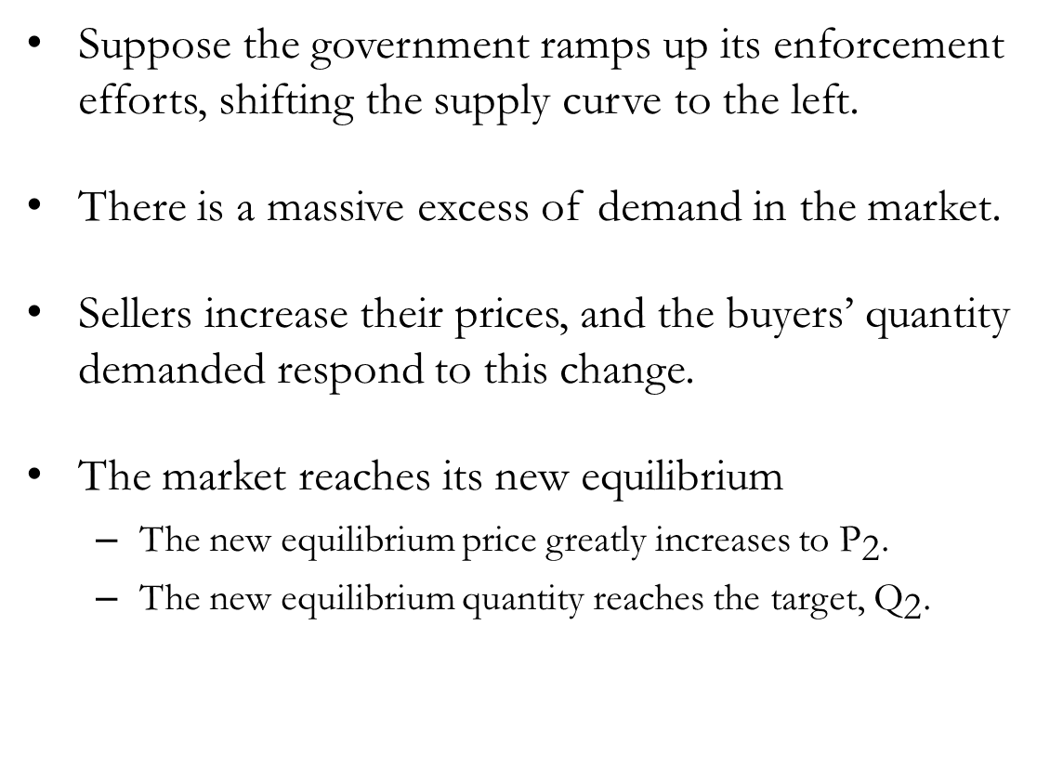
Drug Enforcement: Supply Control
Suppose the government ramps up its enforcement efforts, shifting the supply curve to the left.
There is a massive excess of demand in the market.
Sellers increase their prices, and the buyers’ quantity demanded respond to this change.
The market reaches its new equilibrium
  The new equilibrium price greatly increases to ${\text{P}}_{\text{2}}$.
  The new equilibrium quantity reaches the target, ${\text{Q}}_{\text{2}}$.

Slide 44
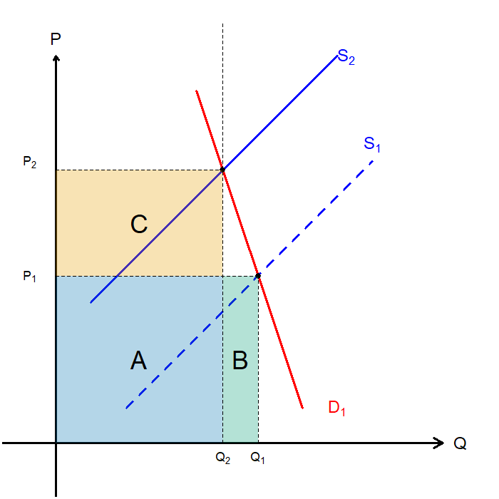
Drug Enforcement: Supply Control
Let us examine any potential side-effects.
Notice the disproportional increase in the price, and relatively low decrease in quantity demanded.
The total revenue for drug suppliers increases:
  Originally: A+B
  Post-policy: A+C
An increase in total spending on drugs, and in drug-related crime is expected.

Slide 45
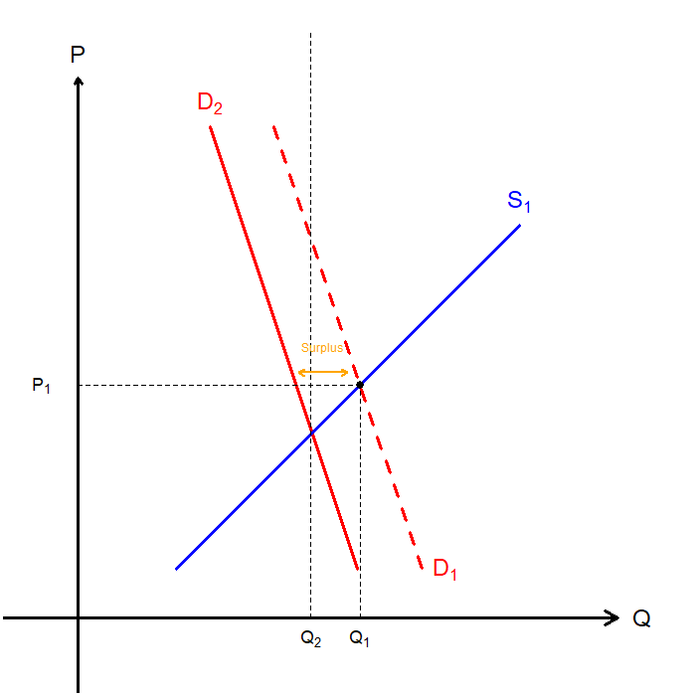
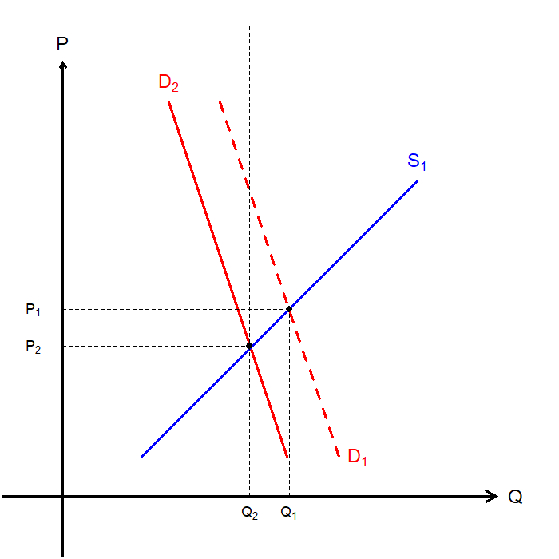
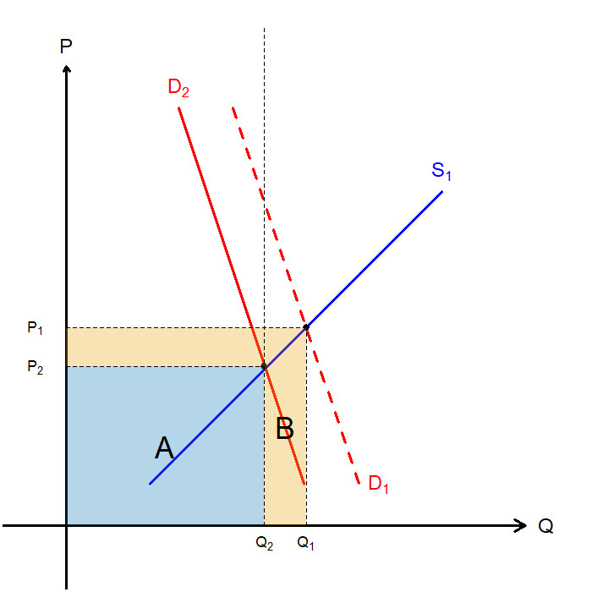
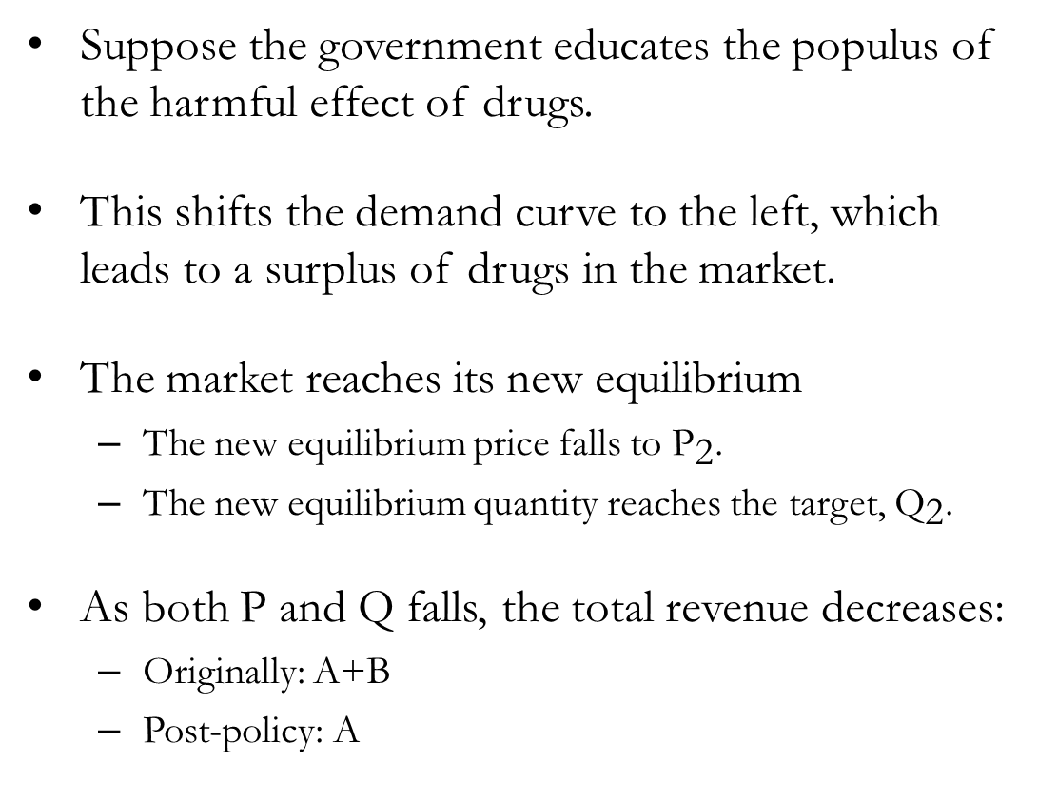
Drug Enforcement: Demand Control
Suppose the government educates the populus of the harmful effect of drugs.
This shifts the demand curve to the left, which leads to a surplus of drugs in the market.
The market reaches its new equilibrium
  The new equilibrium price falls to ${\text{P}}_{\text{2}}$.
  The new equilibrium quantity reaches the target, ${\text{Q}}_{\text{2}}$.
As both P and Q falls, the total revenue decreases:
  Originally: A+B
  Post-policy: A

Slide 46
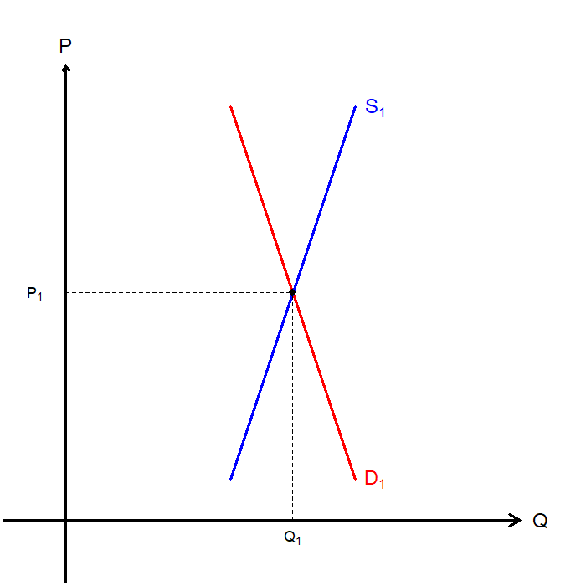
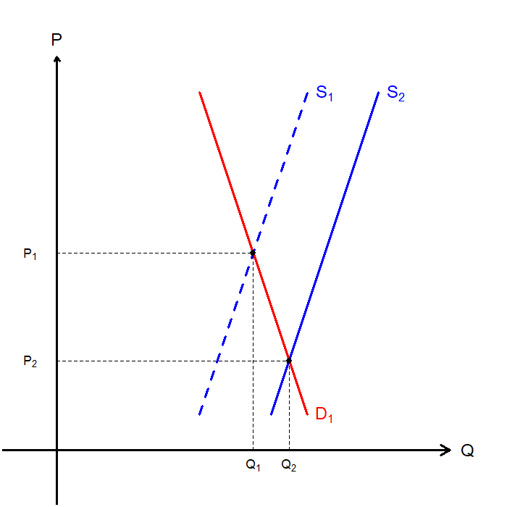
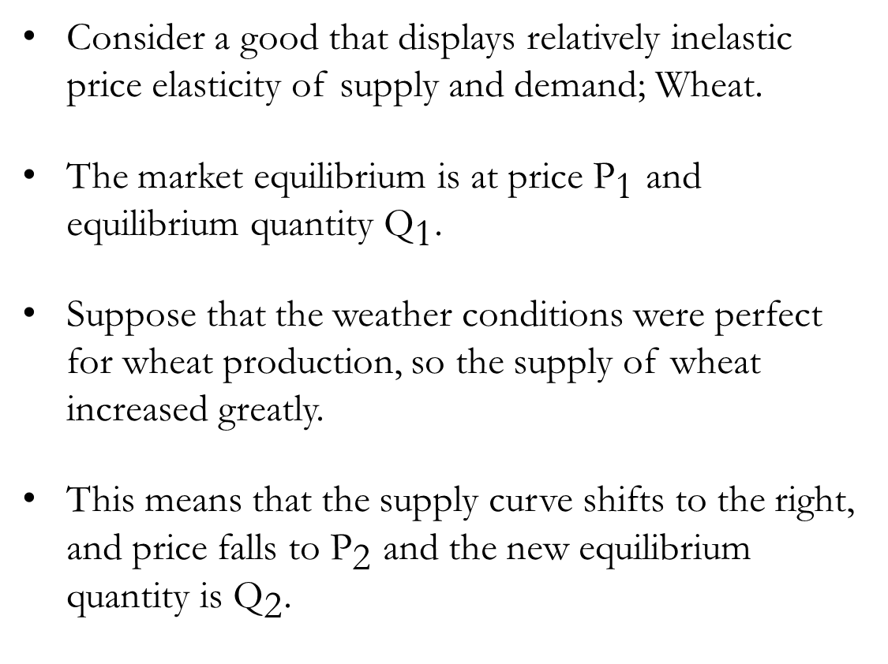
Agricultural Production
Consider a good that displays relatively inelastic price elasticity of supply and demand; Wheat.
The market equilibrium is at price ${\text{P}}_{\text{1}}$ and equilibrium quantity ${\text{Q}}_{\text{1}}$.
Suppose that the weather conditions were perfect for wheat production, so the supply of wheat increased greatly.
This means that the supply curve shifts to the right, and price falls to ${\text{P}}_{\text{2}}$ and the new equilibrium quantity is ${\text{Q}}_{\text{2}}$.

Slide 47
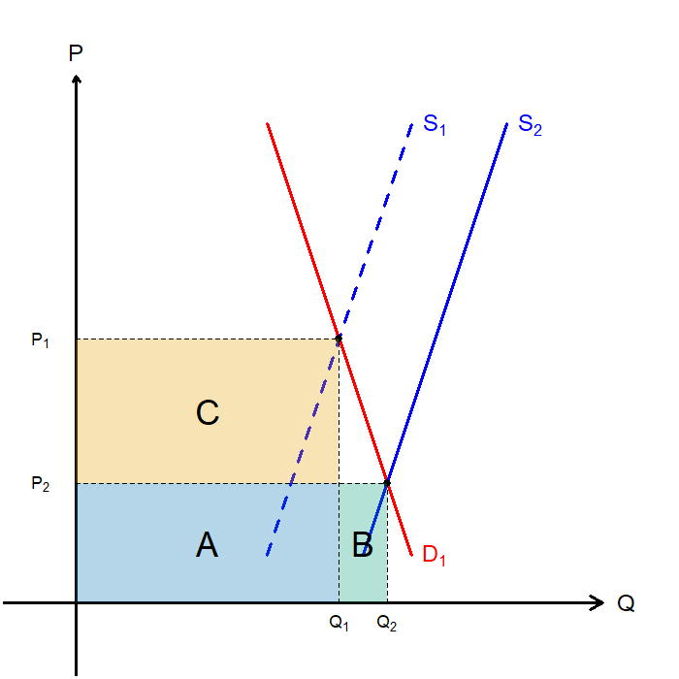
Agricultural Production
Ironically, when the harvest goes too well, it may spell bad news for wheat farmers.
Let’s examine the changes to farmers’ total revenue.
  Originally: A+B
  Post-policy: A
Due to the lower price elasticity of demand, the falling prices did not translate to an increase in quantity demanded.

Slide 48
Recap of Chapter 5

Slide 49
Recap
The price elasticity of demand measures how much the quantity demanded responds to price changes.
Demand tends to be more elastic when…
  Close substitutes are available
  The good is a luxury, rather than a necessity
  The market is narrowly defined
  Buyers are given enough time to react to price changes
The price elasticity of demand is calculated as the percentage change in quantity demanded divided by the percentage change in price.
  When the price elasticity of demand is greater than 1, demand is said to be elastic
  When the price elasticity of demand is less than 1, demand is said to be inelastic
  When the price elasticity of demand is 1, demand is said to be unit elastic

Slide 50
Recap
The income elasticity of demand measures how much the quantity demanded responds to changes in consumers’ income.
  When the income elasticity of demand is less than 0, the good is said to be an inferior good.
  When the income elasticity of demand is greater than 0, the good is said to be a normal good.
The cross-price elasticity of demand measures how much the quantity demanded of one good responds to changes in the price of another good.
  When the cross-price elasticity between two goods is greater than 0, the goods are substitutes.
  When the cross-price elasticity between two goods is less than 0, the goods are complements.
The price elasticity of supply measures how much the quantity supplied responds to price changes.

Slide 51
Recap
Supply tends to be more elastic when…
  Suppliers are given enough time and flexibility to react to price changes
The price elasticity of supply is calculated as the percentage change in quantity supplied divided by the percentage change in price.
  When the price elasticity of supply is greater than 1, supply is said to be elastic
  When the price elasticity of supply is less than 1, supply is said to be inelastic
  When the price elasticity of supply is 1, supply is said to be unit elastic
The supply and demand framework can be applied to many different markets to understand producer and consumer behavior.

