Slide 1
PRINCIPLES OF GLOBAL ECONOMICS
Chapter 4: The Market Forces of Supply and Demand

Slide 2

PollEverywhere
This is a QR code to PollEverywhere, an online polling system.
  Please scan the QR code and have your device ready as there will be a few in-class exercises.
  If you do not have access to your mobile device, log in using the URL below:
  Your responses are anonymous and not be used in grading.
https://pollev.com/brianpark046

Slide 3
Markets and Competition
A Market is defined as a group of buyers and sellers of a particular good or service.
  The buyers determine the Demand for the product.
  The sellers determine the Supply of the product.
  Markets can be either highly organized (e.g. commodity markets), or less organized (e.g. local food trucks).
There is a varying degree of competition happening in any given market.
  Most sellers in a market compete against each other over buyers.
  They may be competing over various dimensions; price, quality, new features, etc.
  Depending on the level and nature of competition, we can sort markets into different structures.
    Perfect Competition
    Monopolistic Competition
    Oligopolies
    Monopolies / Monopsonies

Slide 4
Markets and Competition
Competitive Markets are markets where many buyers and sellers exist, so each has a negligible impact on the price of the product.
  Market A has a single seller of coffee within a 10-minute walk from campus.
  Market B has ten sellers of coffee within a 10-minute walk from campus.
  The single seller in market A can raise their prices more easily than one of the ten sellers in market B.
  Market B is more competitive than market A.
Perfectly Competitive Markets are the gold standard of economic analysis. In a perfectly competitive market…
  The goods offered for sale are all exactly the same, and
  The buyers and sellers are so numerous that no single buyer or seller has influence over the market price, so everyone is a Price Taker.

Slide 5
Markets and Competition
In the real-world, the vast majority of the goods and services we consume are traded in markets that are not perfectly competitive.
  The Wheat market is considered to be almost perfectly competitive.
Economists analyze a perfectly competitive market mot because it is realistic, but because it gives us a best-case benchmark (and is the easiest to analyze).

Slide 6
Demand

Slide 7
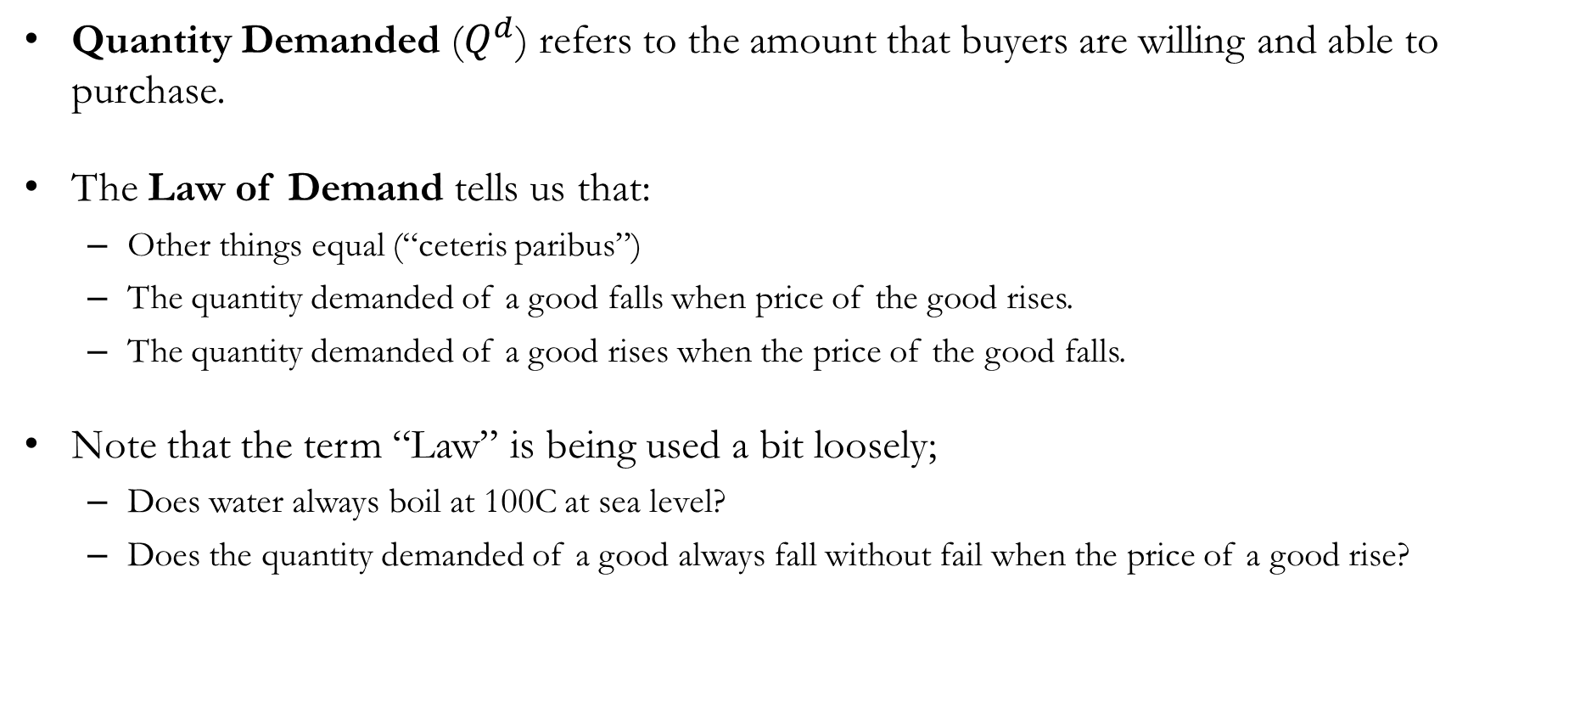
Demand
Quantity Demanded ($Q^{d}$) refers to the amount that buyers are willing and able to purchase.
The Law of Demand tells us that:
  Other things equal (“ceteris paribus”)
  The quantity demanded of a good falls when price of the good rises.
  The quantity demanded of a good rises when the price of the good falls.
Note that the term “Law” is being used a bit loosely;
  Does water always boil at 100C at sea level?
  Does the quantity demanded of a good always fall without fail when the price of a good rise?

Slide 8

Demand: A Quick Detour
A Veblen Good is a type of luxury good for which the quantity demanded increases as the price increases.
First formally identified by Thorstein Veblen in his 1899 publication, “The Theory of the Leisure Class.”
“Conspicuous consumption of valuable goods is a means of reputability to the gentleman of leisure.”
Luxury watches, designer handbags, tailor-made suits are often sought after because they are expensive, and signal wealth.
Veblen goods do not obey the Law of Demand.

Slide 9
Demand Schedules
Suppose that Elizabeth, would purchase:
  10 cups of coffee a day if the price was $0 per cup.
  8 cups of coffee a day if the price was $1 per cup.
  6 cups of coffee a day if the price was $2 per cup.
  4 cups of coffee a day if the price was $3 per cup.
  2 cups of coffee a day if the price was $4 per cup.
  0 cups of coffee a day if the price was $5 per cup.
This long blurb can be expressed as a Demand Schedule, a table that shows the relation-ship between the price of the good, and the quantity demanded.
According to this demand schedule, does the Elizabeth’s preferences obey the law of demand?
Price of Coffee | Quantity Demanded
$0
$1
$2
$3
$4
$5
Price of Coffee | Quantity Demanded
$0 | 10
$1 | 8
$2 | 6
$3 | 4
$4 | 2
$5 | 0

Slide 10
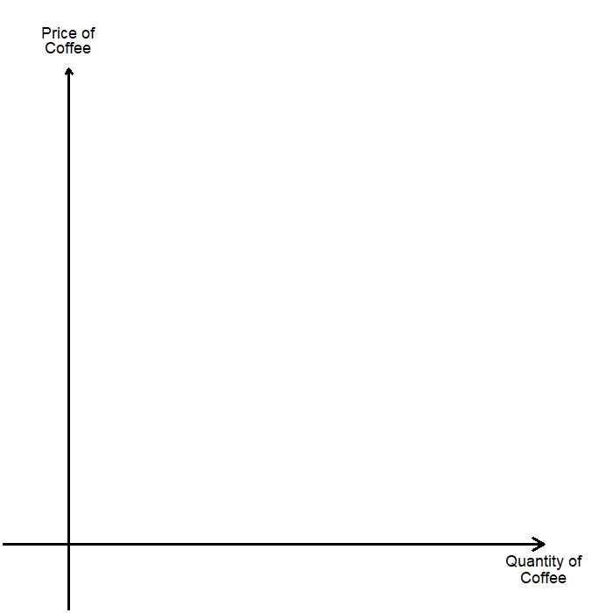
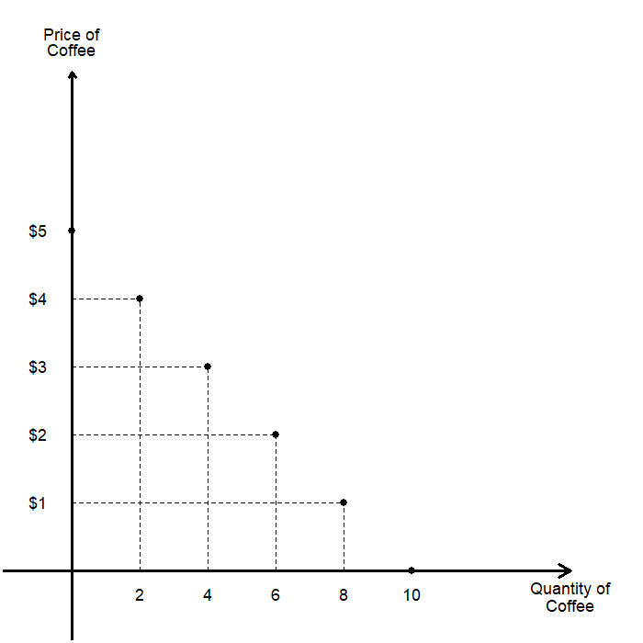
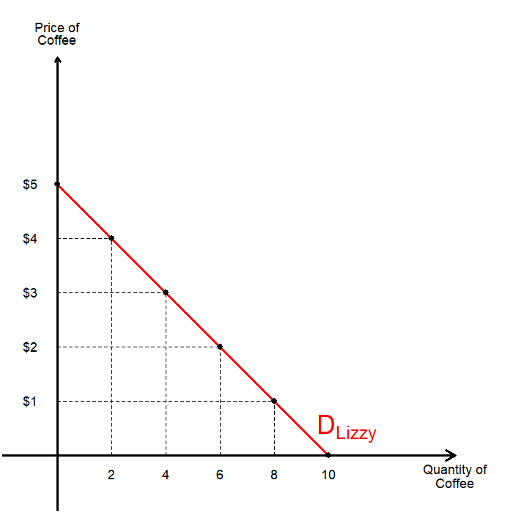
Demand Curves
We can further visualize Elizabeth’s demand by plotting the Demand Curve, a graph of the relationship between the price of a good and the quantity demanded.
It is custom in the field to plot the price of a good on the vertical axis, and the quantity demanded on the horizontal axis.
Plot the points on the demand schedule.
Then connect the dots to complete the Elizabeth’s demand curve for coffee.

Slide 11
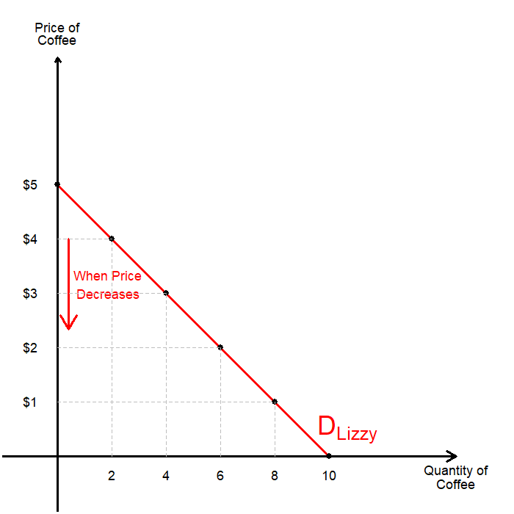
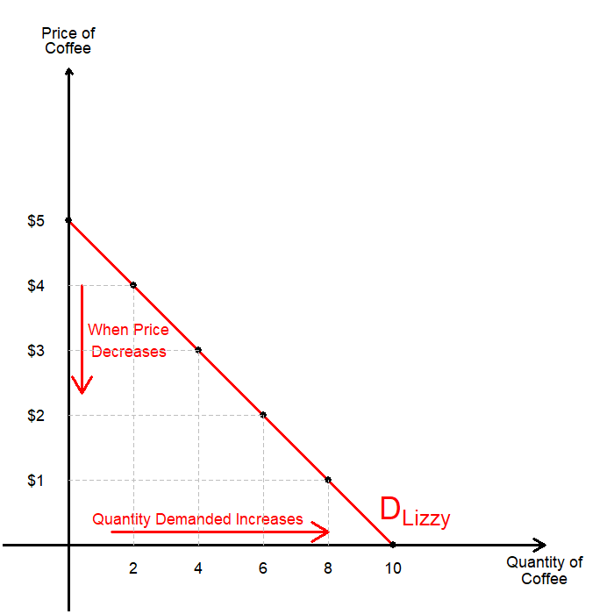
Demand Curves
Does this demand curve indicate that Elizabeth’s preference obeys the Law of Demand?
  When the price of coffee decreases…
  Quantity demanded increases…
  The Law of Demand holds.
Note that this is Elizabeth’s individual demand for coffee.
This does not represent the entire market’s demand for coffee.
Understanding the market’s demand is important to understand how markets function.

Slide 12
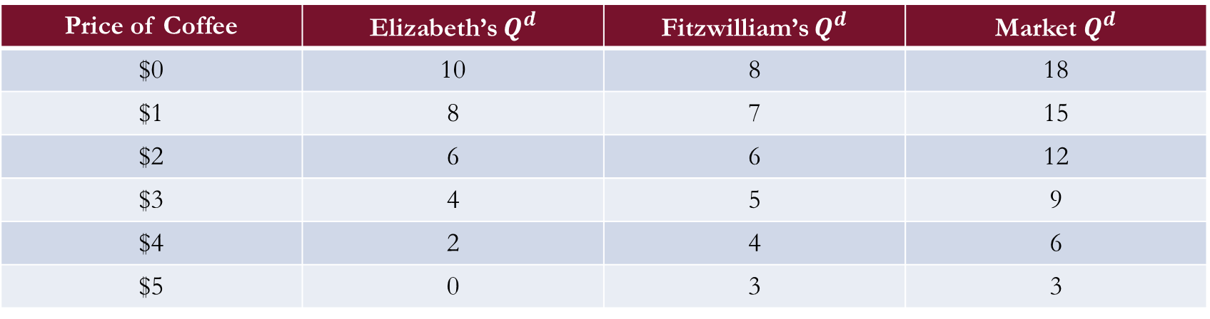
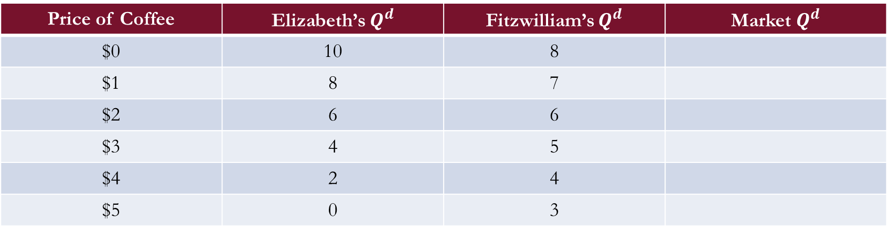
Individual and Market Demand
Market Demand is the sum of all individual demands for a good or service.
To find the market demand, we sum all individual demand curves horizontally.
  To find the quantity demanded at any price, we add the individual quantities demanded.
Suppose that there are two people in the market for coffee now:
Price of Coffee | Elizabeth’s $Q^{d}$ | Fitzwilliam’s $Q^{d}$ | Market $Q^{d}$
$0 | 10 | 8 | 18
$1 | 8 | 7 | 15
$2 | 6 | 6 | 12
$3 | 4 | 5 | 9
$4 | 2 | 4 | 6
$5 | 0 | 3 | 3
Price of Coffee | Elizabeth’s $Q^{d}$ | Fitzwilliam’s $Q^{d}$ | Market $Q^{d}$
$0 | 10 | 8
$1 | 8 | 7
$2 | 6 | 6
$3 | 4 | 5
$4 | 2 | 4
$5 | 0 | 3

Slide 13
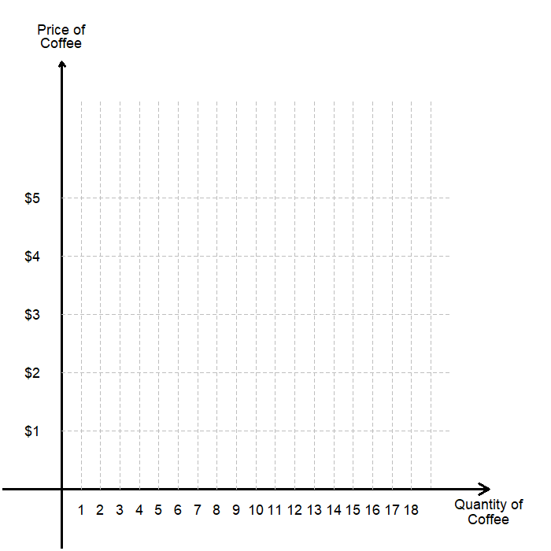
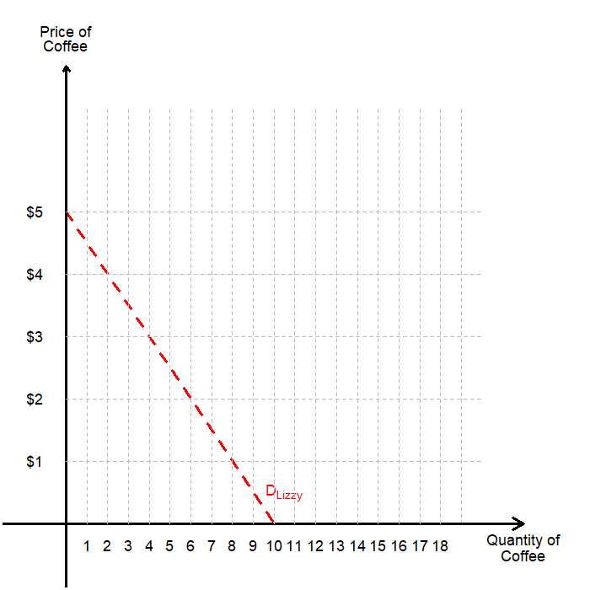
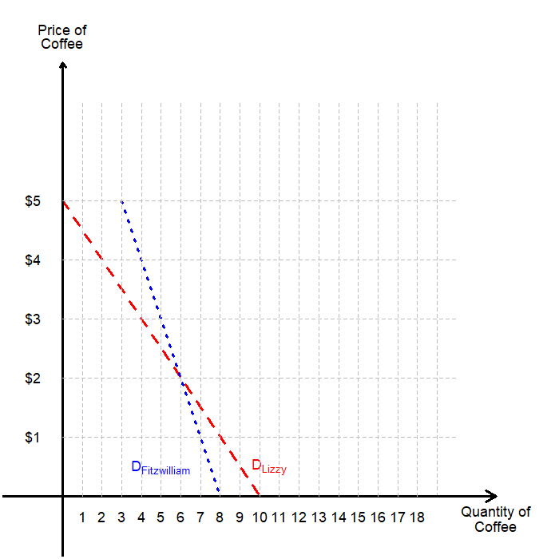
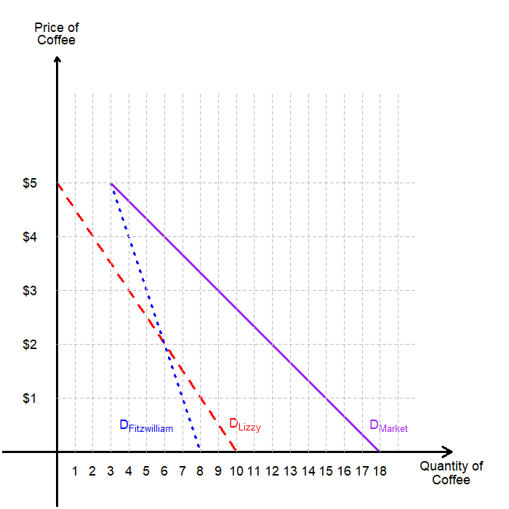
Individual and Market Demand
Graphically, we can understand finding the market demand as horizontally adding individual demand curves.
First, we plot Elizabeth’s individual demand.
Then, we plot Fitzwilliam’s individual demand.
Add them up horizontally to get the market demand.

Slide 14
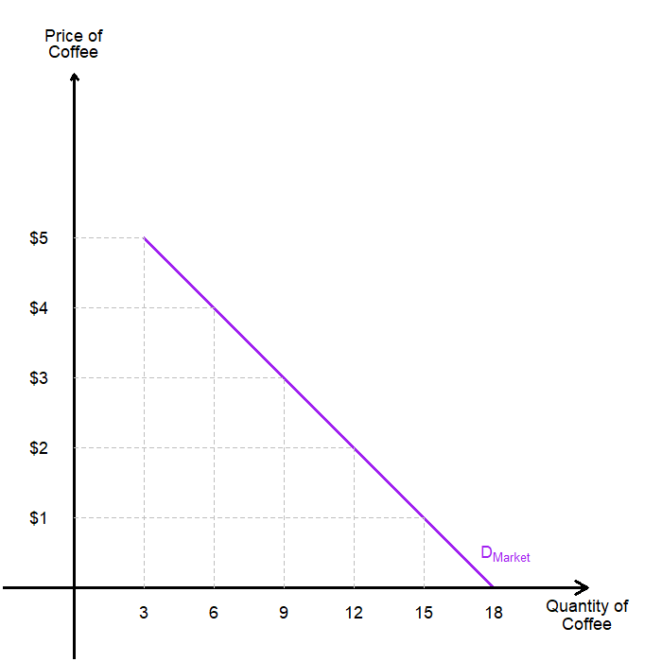
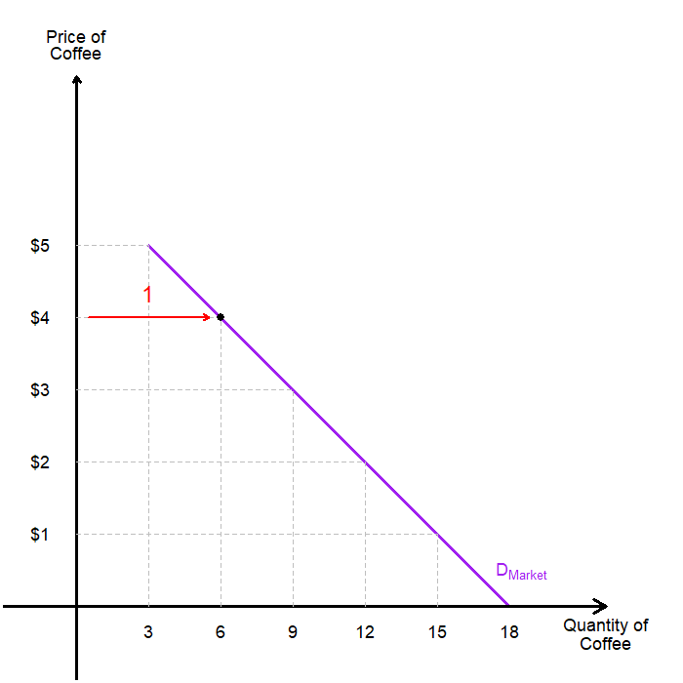
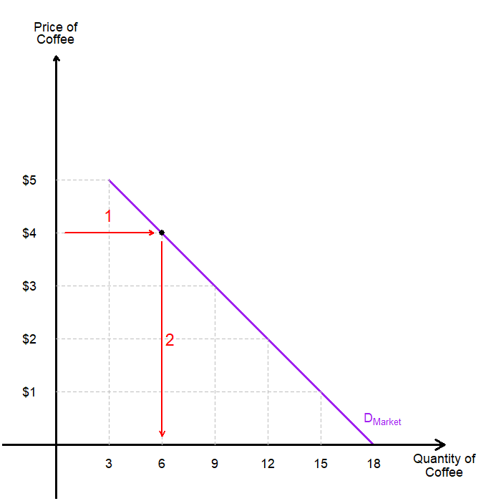
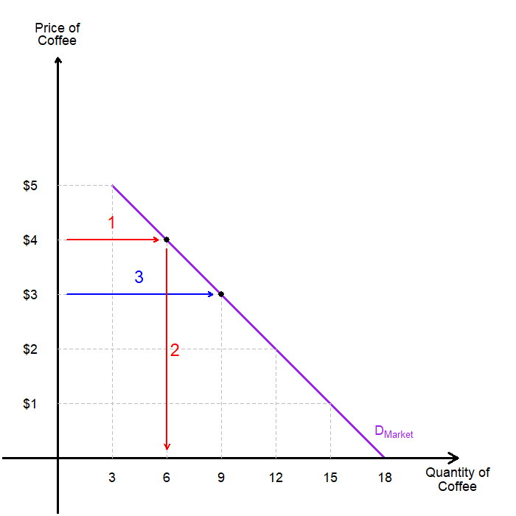
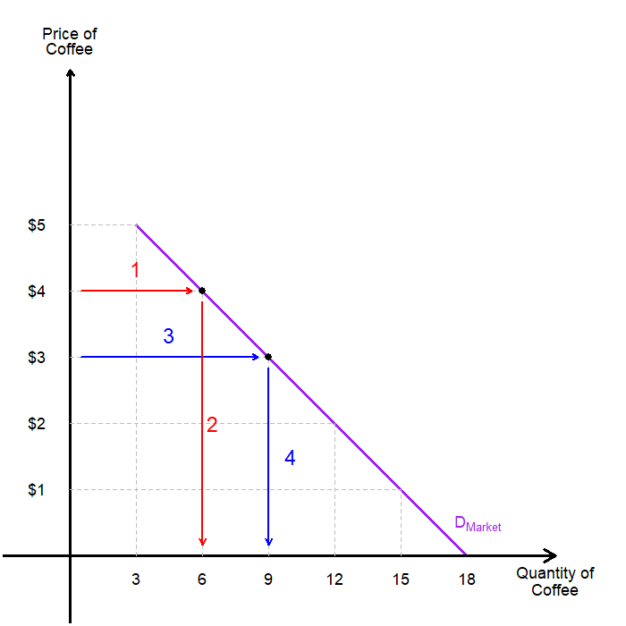
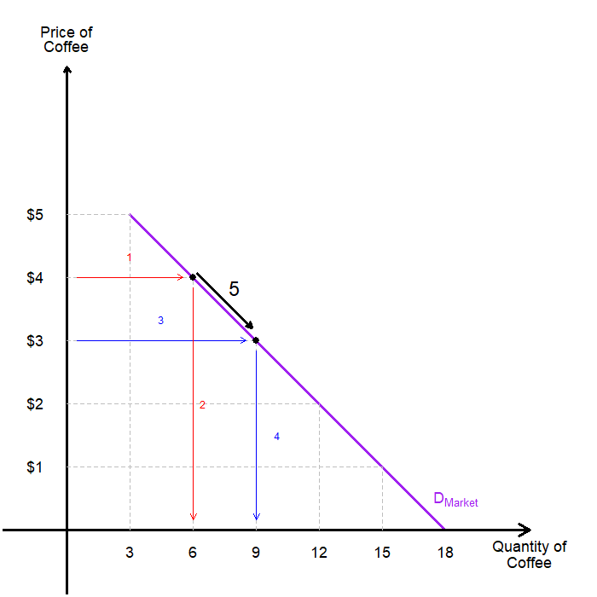
Movements Along the Demand Curve
We say that “the quantity demanded of coffee changes due to the change in the price of coffee.”
These changes are represented as shift along the demand curve.
Let us walk through an example:
  Suppose the price of coffee was originally at $4.
  The quantity demanded is sitting at 6 cups.
  Suppose the price of coffee falls to $3.
  Then, the quantity demanded increases to 9 cups.
  This change is represented as a shift along the demand curve.

Slide 15
Shifts in the Demand Curve
The demand curve shows how price affects quantity demanded, other things being equal.
Meanwhile, there are Non-Price Determinants of Demand, things that determine the buyers’ demand for a good other than the goods price.
  Number of Buyers in a Market
  Income of Buyers in the Market
  Price of Related Goods
  Consumers’ Tastes
  Consumers’ Expectations
  …and More
Any changes in these non-price determinants will shift the demand curve itself.

Slide 16
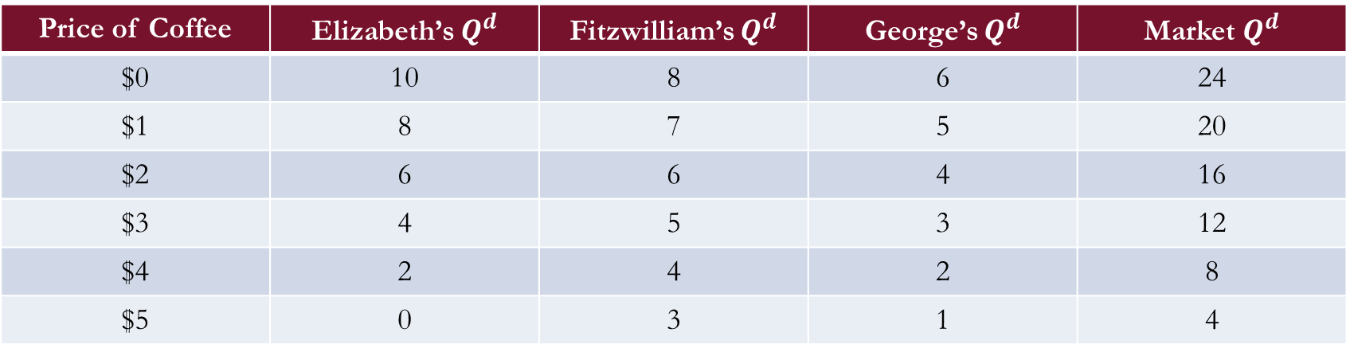
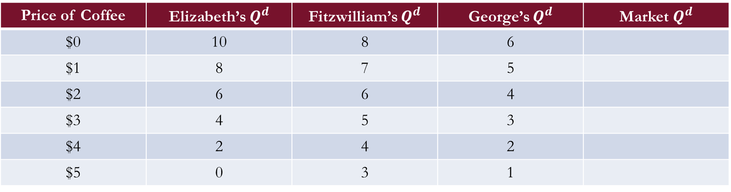
Demand Shifters: More Consumers
Suppose there was an increase in the number of buyers in our example; George enters.
Since the new buyer increases the quantity demanded at each price, we expect this to shift the demand curve to the right.
Let us examine how this change manifests in the demand curve.
Price of Coffee | Elizabeth’s $Q^{d}$ | Fitzwilliam’s $Q^{d}$ | George’s $Q^{d}$ | Market $Q^{d}$
$0 | 10 | 8 | 6
$1 | 8 | 7 | 5
$2 | 6 | 6 | 4
$3 | 4 | 5 | 3
$4 | 2 | 4 | 2
$5 | 0 | 3 | 1
Price of Coffee | Elizabeth’s $Q^{d}$ | Fitzwilliam’s $Q^{d}$ | George’s $Q^{d}$ | Market $Q^{d}$
$0 | 10 | 8 | 6 | 24
$1 | 8 | 7 | 5 | 20
$2 | 6 | 6 | 4 | 16
$3 | 4 | 5 | 3 | 12
$4 | 2 | 4 | 2 | 8
$5 | 0 | 3 | 1 | 4

Slide 17
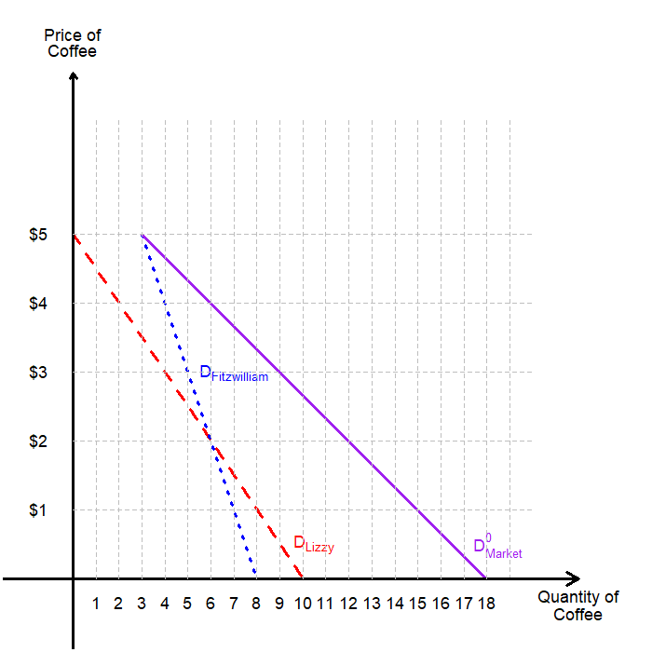
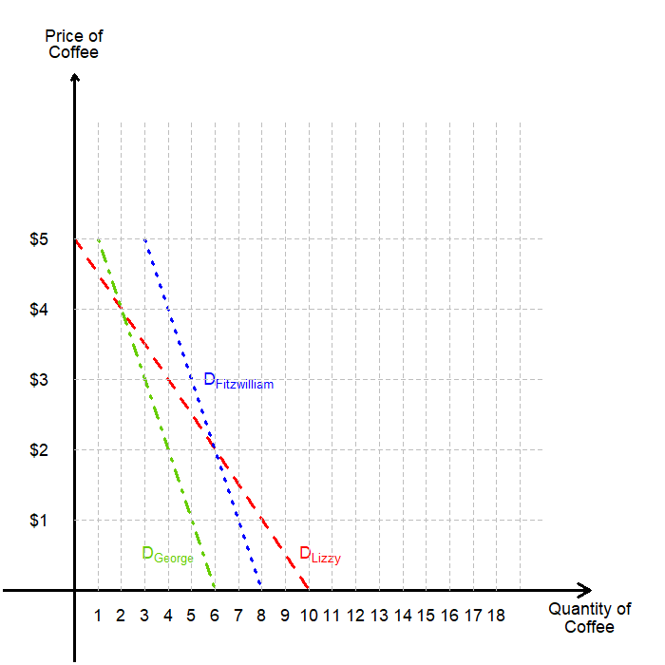
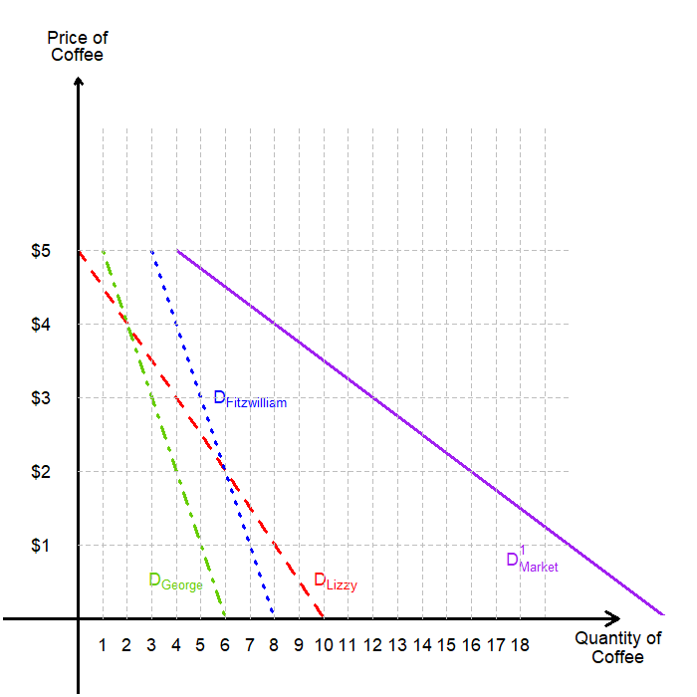
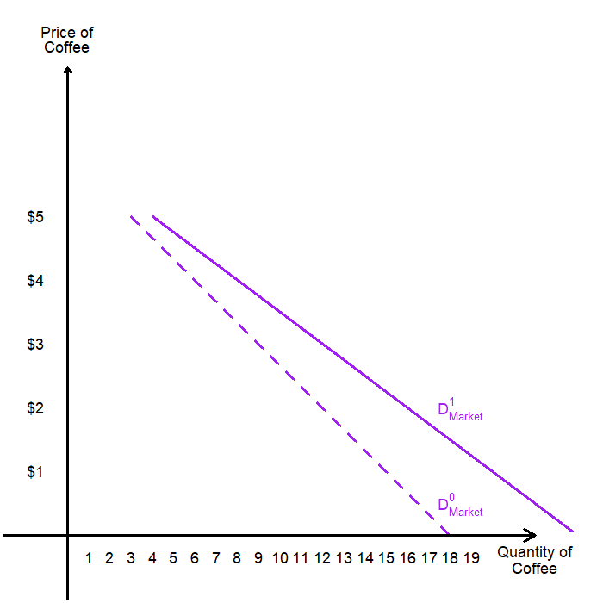
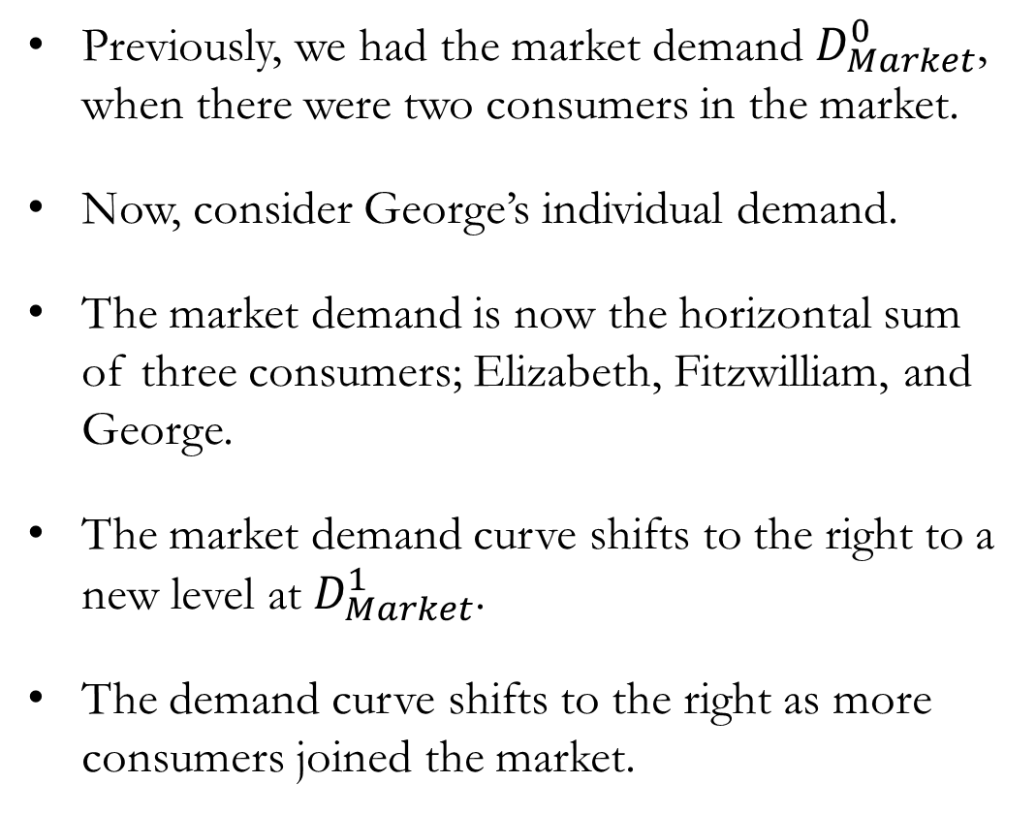
Demand Shifters: More Consumers
Previously, we had the market demand $D_{Market}^{0}$, when there were two consumers in the market.
Now, consider George’s individual demand.
The market demand is now the horizontal sum of three consumers; Elizabeth, Fitzwilliam, and George.
The market demand curve shifts to the right to a new level at $D_{Market}^{1}$.
The demand curve shifts to the right as more consumers joined the market.

Slide 18
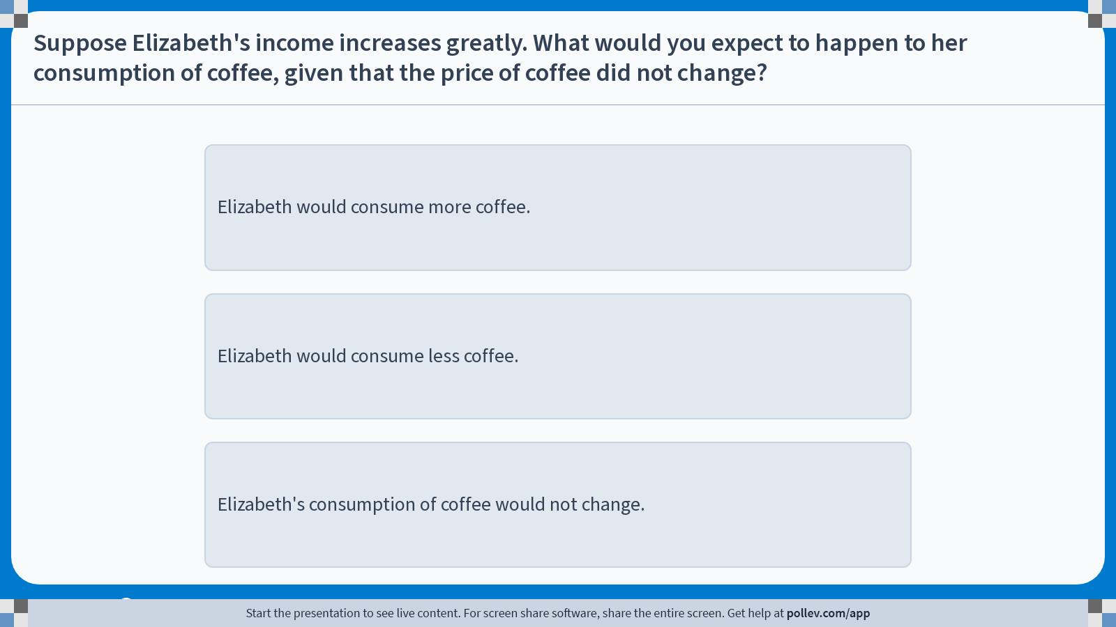
Poll Everywhere multiple choice poll instructions screen
Activity Title: Suppose Elizabeth's income increases greatly. What would you expect to happen to her consumption of coffee, given that the price of coffee did not change?
Slide 18
Notes:
Do not modify the notes in this section to avoid tampering with the Poll Everywhere activity.
More info at polleverywhere.com/support
Suppose Elizabeth's income increases greatly. What would you expect to happen to her consumption of coffee, given that the price of coffee did not change?
https://www.polleverywhere.com/multiple_choice_polls/5LXwY5Am46PRDiK1jPtQ1?display_state=instructions&activity_state=opened&state=opened&flow=Engagement&onscreen=persist

Slide 19
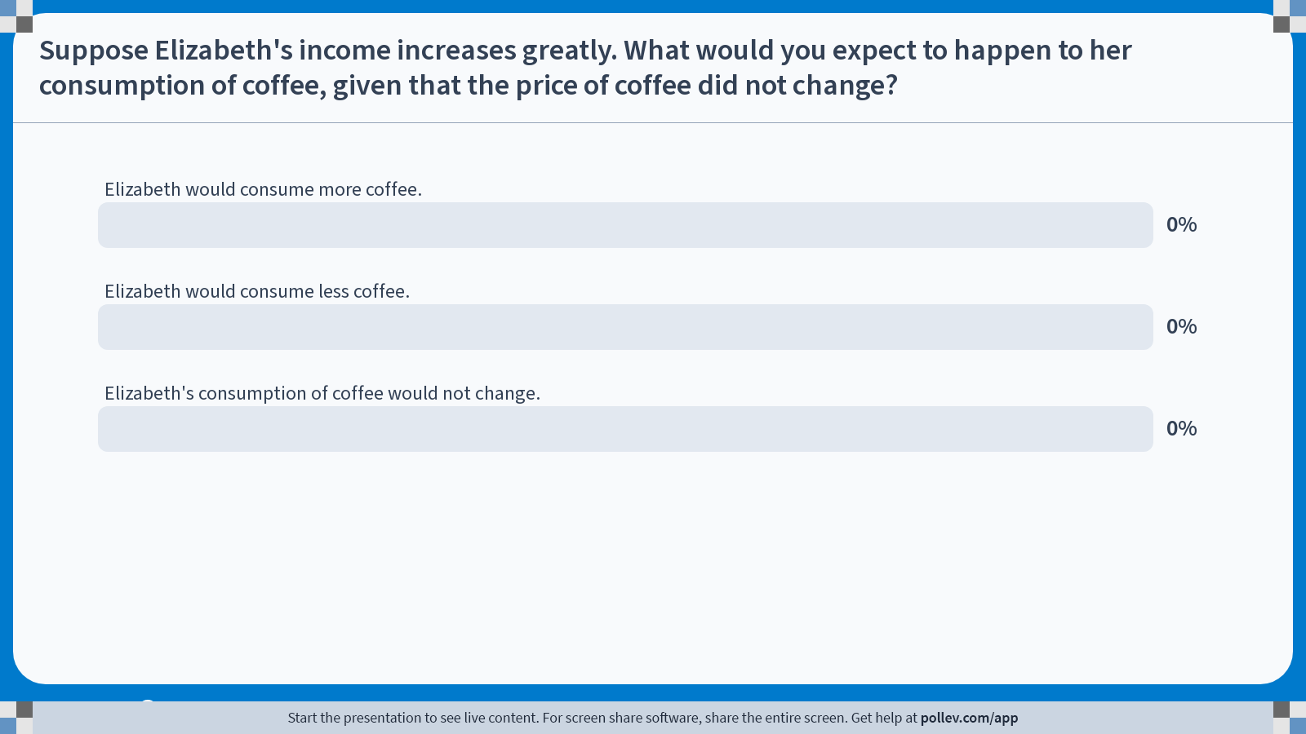
Poll Everywhere multiple choice poll chart screen
Activity Title: Suppose Elizabeth's income increases greatly. What would you expect to happen to her consumption of coffee, given that the price of coffee did not change?
Slide 20
Notes:
Do not modify the notes in this section to avoid tampering with the Poll Everywhere activity.
More info at polleverywhere.com/support
Suppose Elizabeth's income increases greatly. What would you expect to happen to her consumption of coffee, given that the price of coffee did not change?
https://www.polleverywhere.com/multiple_choice_polls/5LXwY5Am46PRDiK1jPtQ1?display_state=chart&activity_state=closed&state=closed&flow=Engagement&onscreen=persist

Slide 20
Solutions to In-class Poll #1
First off, lets assume that coffee is a normal good for Elizabeth.
When Elizabeth’s income increases, she would be willing to purchase more cups of coffee at each price point.
Elizabeth’s individual demand curve will shift to the right.
As a result, the entire market demand curve will shift to the right.

Slide 21
Demand Shifters: Changes in Income
Changes to consumers’ income can shift the demand curve in either direction, depending on the nature of the good.
Normal Goods are goods in which an increase in income, other things equal, leads to an increase in demand.
Inferior Goods are goods in which an increase in income, other things equal, leads to a decrease in demand.
The canonical example of a normal good vs. inferior good can be found in Pizza:
  Fresh Hand-thrown Pizza would be a normal good, and
  Frozen Pizza from a supermarket would be an inferior good.

Slide 22
Demand Shifters: Price of Related Goods
Changes to the price goods that are related to each other can also impact the demand for one another.
Two goods are Substitute Goods if an increase in the price of one leads to an increase in the demand for the other, vice versa.
  The canonical example of substitute goods are Coca-Cola and Pepsi… Maybe…
  The logic is that if Coca-Cola raises its prices, consumers will shift more of their purchases to Pepsi.
Two goods are Complementary Goods if an increase in the price of one leads to a decrease in the demand for the other, vice versa.
  The canonical example of complementary goods are Bagels and Cream Cheese.
  The logic is that if the price of Bagels increase, consumers would buy less bagels, therefore need less cream cheese.

Slide 23
Demand Shifters: Tastes and Expectations
Changes in consumers’ tastes or their outlook on the future may shift the demand curve.
Tastes (or Preferences) refer to an order by which an agent ranks their alternatives.
  In layman’s terms, preferences refer to how much consumers value certain items over others.
  Changes in tastes that lead to a good being preferred leads to the demand curve shifting right.
  Advertisement is a $800 million industry, aiming to influence consumers’ tastes.
Consumers’ Expectations about future events can shift the demand curve as well.
  If consumers expect a rise in income, the demand will shift to the right.
  If consumers expect the price of a good to increase, the demand will shift to the right.

Slide 24
Influences on Demand
The following table is a summary of potential changes that may affect the consumers, and how the demand would respond to said changes.
Change | Effect
Price of the Good itself | Movement Along the Demand Curve
Consumers’ Income | Shifts the Demand Curve
Prices of Related Goods | Shifts the Demand Curve
Consumers’ Tastes | Shifts the Demand Curve
Consumers’ Expectations | Shifts the Demand Curve
Number of Consumers | Shifts the Demand Curve

Slide 25
Supply

Slide 26
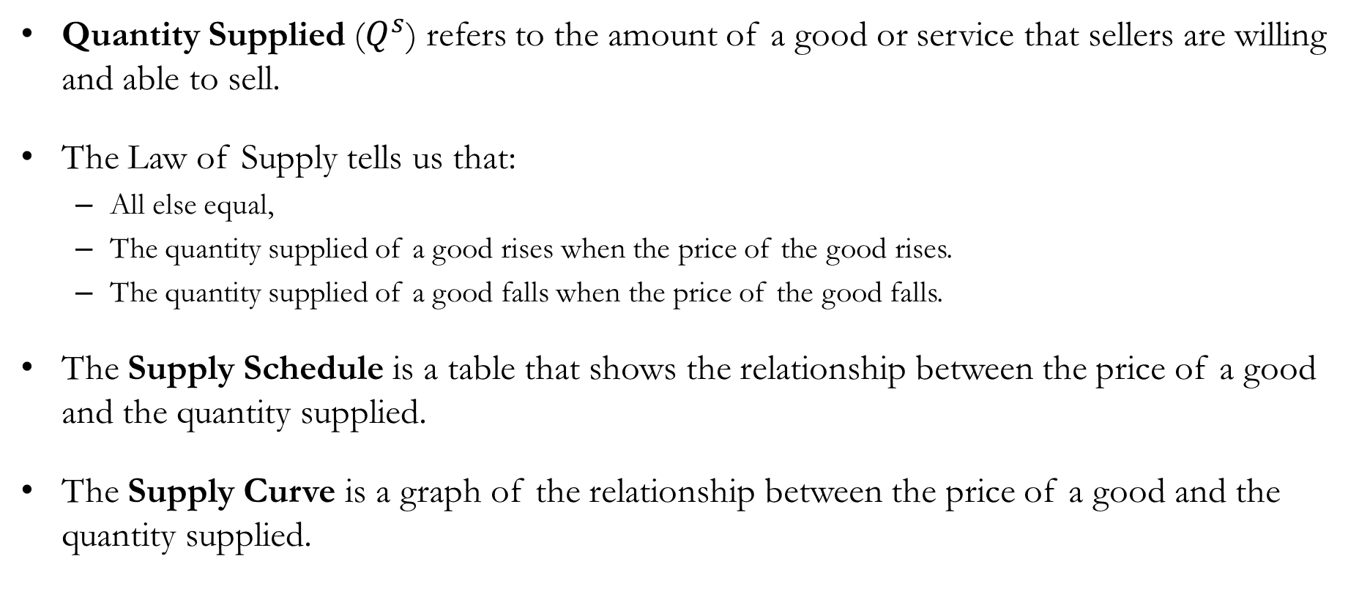
Supply
Quantity Supplied ($Q^{s}$) refers to the amount of a good or service that sellers are willing and able to sell.
The Law of Supply tells us that:
  All else equal,
  The quantity supplied of a good rises when the price of the good rises.
  The quantity supplied of a good falls when the price of the good falls.
The Supply Schedule is a table that shows the relationship between the price of a good and the quantity supplied.
The Supply Curve is a graph of the relationship between the price of a good and the quantity supplied.

Slide 27
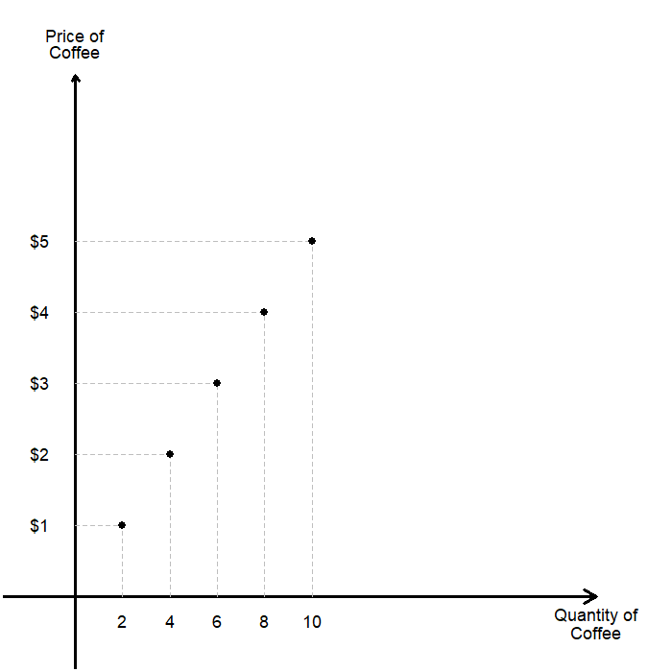
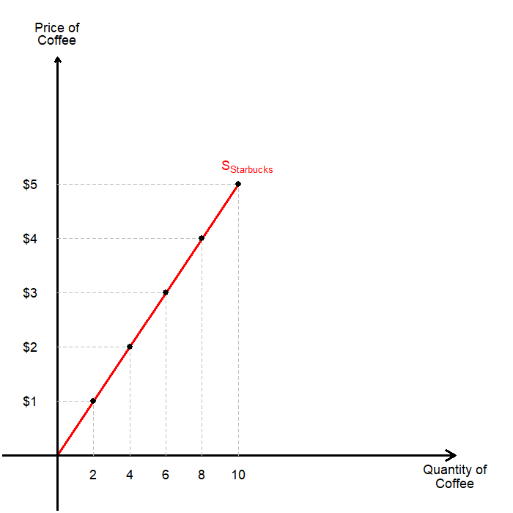
Individual Supply Schedules and Supply Curves
Consider Starbucks’ individual supply schedule illustrated below.
Starbucks’ supply schedule obeys the law of supply; the higher the price of coffee, the more coffee they supply.
Price of Coffee | Quantity Supplied
$0 | 0
$1 | 2
$2 | 4
$3 | 6
$4 | 8
$5 | 10

Slide 28
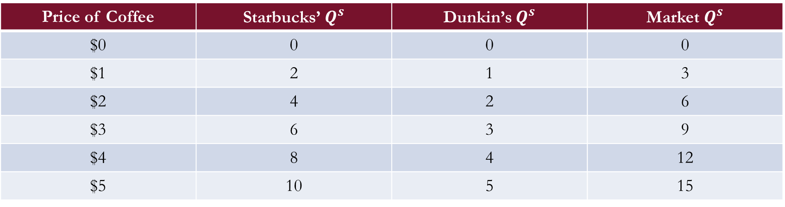
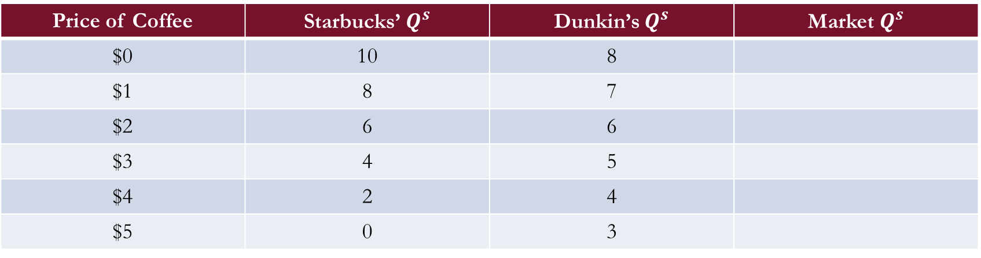
Individual and Market Supply
Market Supply is the sum of all individual supplies for a good or service.
To find the market supply, we sum all individual supply curves horizontally.
  To find the quantity supplied at any price, we add the individual quantities supplied.
Suppose that there are two sellers in the market for coffee now:
Price of Coffee | Starbucks’ $Q^{s}$ | Dunkin’s $Q^{s}$ | Market $Q^{s}$
$0 | 10 | 8
$1 | 8 | 7
$2 | 6 | 6
$3 | 4 | 5
$4 | 2 | 4
$5 | 0 | 3
Price of Coffee | Starbucks’ $Q^{s}$ | Dunkin’s $Q^{s}$ | Market $Q^{s}$
$0 | 0 | 0 | 0
$1 | 2 | 1 | 3
$2 | 4 | 2 | 6
$3 | 6 | 3 | 9
$4 | 8 | 4 | 12
$5 | 10 | 5 | 15

Slide 29
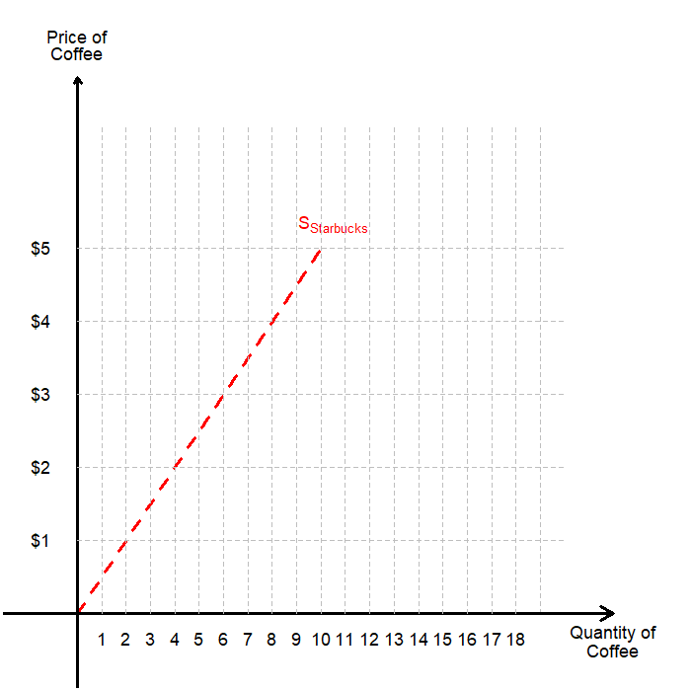
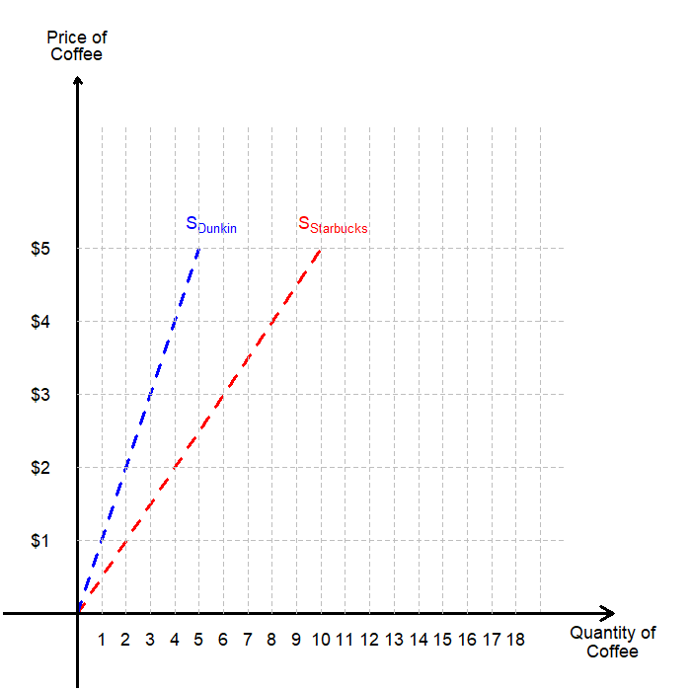
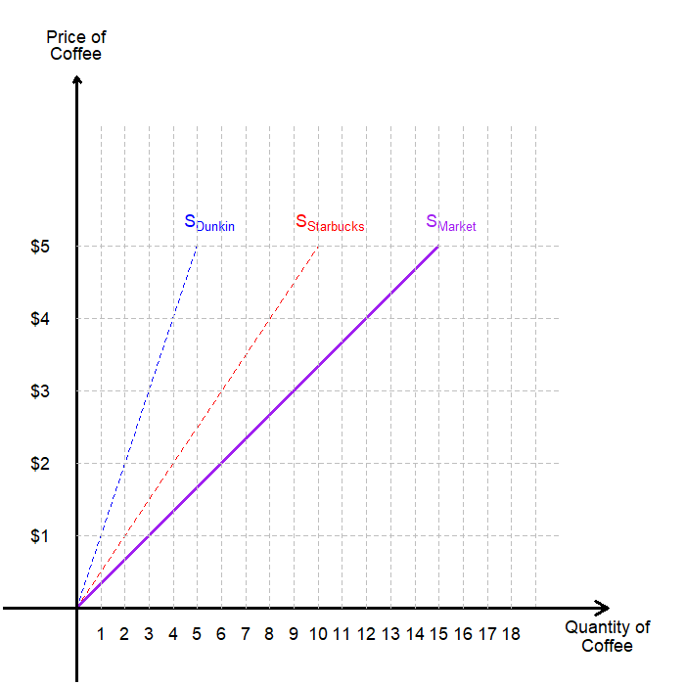
Individual Supply Schedules and Supply Curves
Graphically, we can understand finding the market supply as horizontally adding individual supply curves.
First, we plot Starbucks’ individual supply.
Then, we plot Dunkin’s individual supply.
Add them up horizontally to get the market supply.

Slide 30
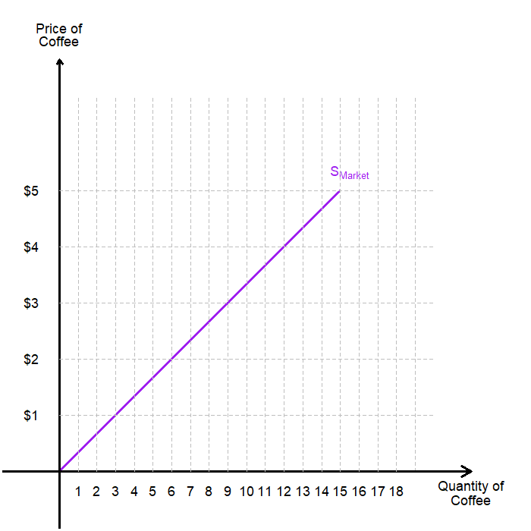
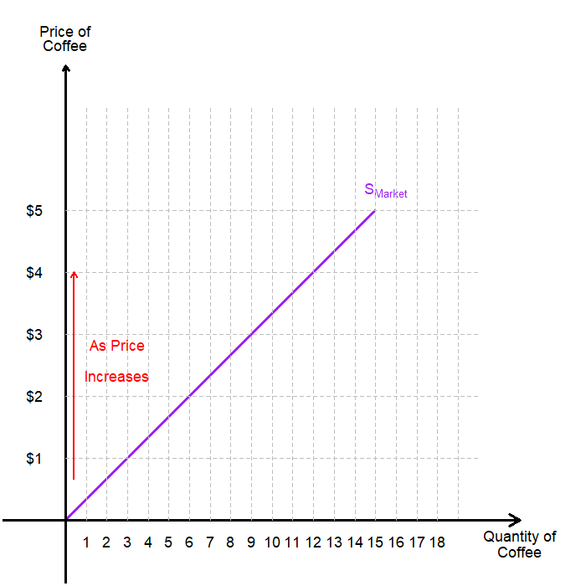
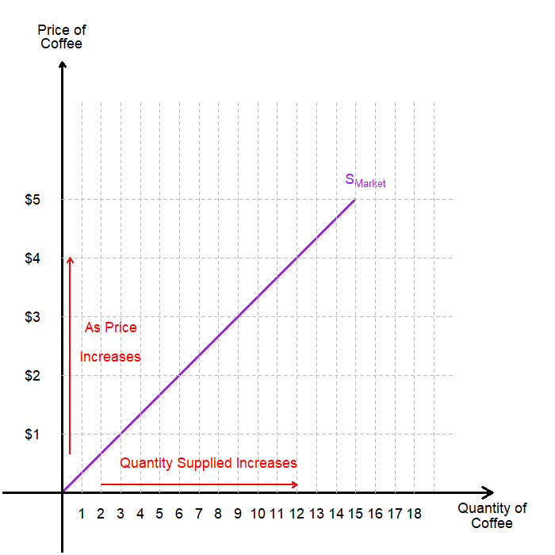
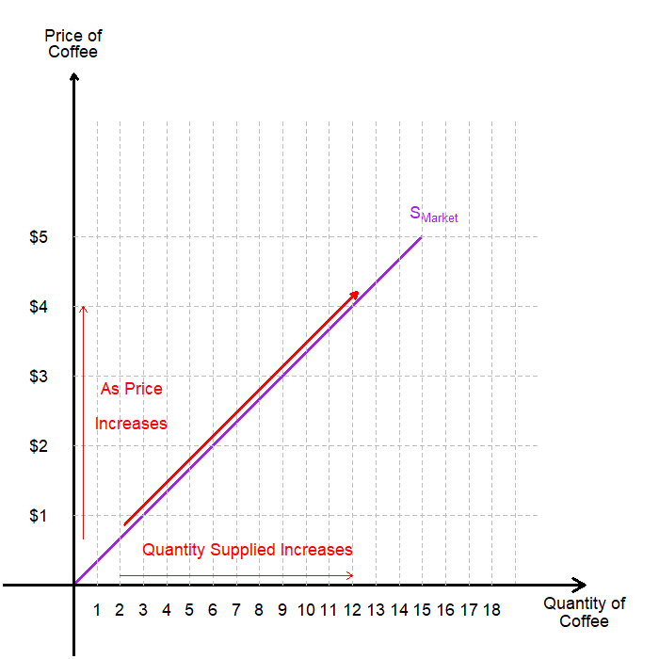
Movements Along the Supply Curve
We say that “the quantity supply of coffee changes due to the change in the price of coffee.”
These changes are represented as shift along the supply curve.
  As the price of coffee increases,
  The quantity supplied by the market increases,
  Which leads to a movement along the supply curve.
This is similar to our previous example of “movements along the demand curve.”

Slide 31
Shifts in the Supply Curve
The supply curve shows how price affects quantity supplied, other things being equal.
Meanwhile, there are Non-Price Determinants of Supply, things that determine the sellers’ supply for a good other than the goods price.
  The price of inputs
  The state of technology
  Number of sellers
  Expectations about the future
Any changes in these non-price determinants will shift the supply curve itself.

Slide 32
Supply Shifters: Input Prices
Input prices may include a wide variety of costs:
  Price of Ingredients (e.g. Coffee Beans)
  Price of Labor (e.g. Employee Salaries)
  Price of Raw Materials (e.g. Price of Paper Cups)
  …and much more.
Suppose that the price of inputs fall:
  Production becomes more profitable at each output price.
  Firms supply a larger quantity at each price.
  Individual sellers’ supply curves, and thus the market supply curve, shift to the right.
Supply is negatively related to prices of inputs.

Slide 33
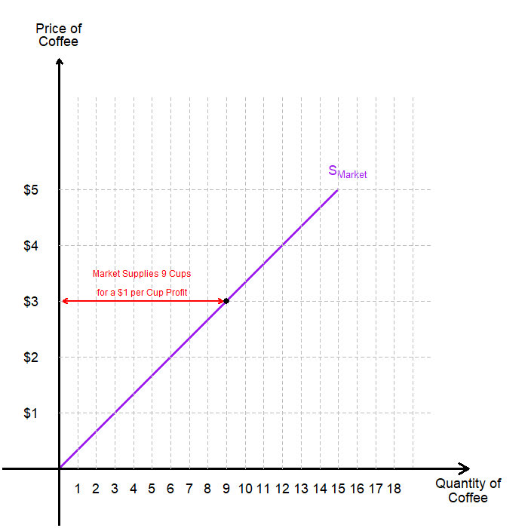
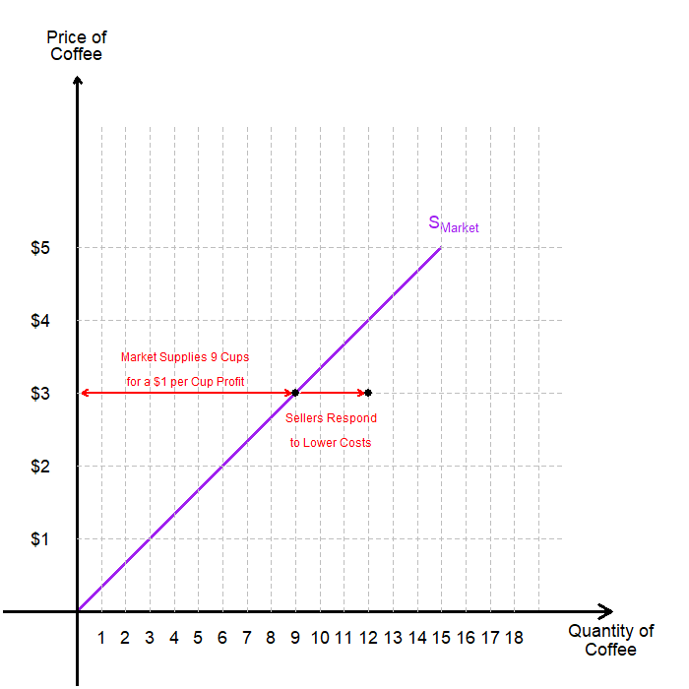
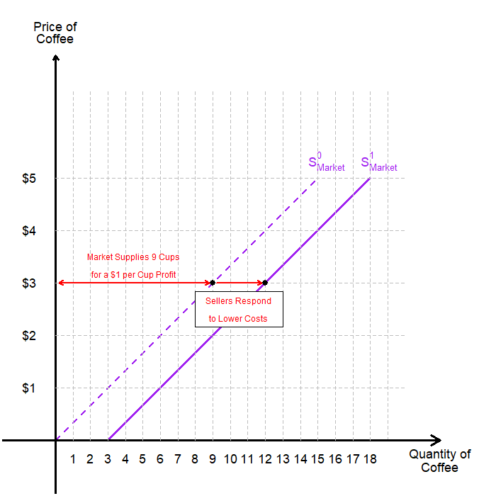
Supply Shifters: Input Prices
Suppose that a cup of coffee is selling at $3, when its cost of producing a cup is $2.
If the cost of production falls to $1.5 per cup of coffee, its profit margin increases.
Sellers would be willing to sell more coffee, as it enjoys a greater level of profit.
This is true for all price levels!
Individual suppliers’ supply curve shifts to the right, leading to the right-hand side shift of the market supply.

Slide 34
Supply Shifters: Changes in Technology
Technology dictates how much inputs are required to product a unit of output.
  Recall chapter 2, and the Production Possibility Frontier.
  In our example, the U.S. produced a ton of coffee with 10 workers, and Brazil with 25 workers.
  This means that the U.S. has a technological edge over Brazil when it comes to producing coffee.
(Cost-reducing) Technological advancements allow the producer to use less units of inputs to produce the same level of output, and for the producer, the effect is identical to a fall in input prices.
The supply curve is expected to shift to the right.
There may be different types of technological advancements that are different:
  The invention of the automobile made the cost of producing horse drawn carriages fall.
  This did not mean that the supply of carriages increased over time.

Slide 35
Supply Shifters: Number of Sellers and Expectations
An increase in the number of sellers in the market increases the quantity supplied at each price level, so the supply curve shifts to the right.
A decrease in the number of sellers in the market decreases the quantity supplied at each price level, so the supply curve shifts to the left.
Sellers may adjust supply when their expectations of future prices change.
There are also some complexities involving this discussion as well:
  “What happens to the competitive nature of the market when there are too few sellers?”
  “What happens when it is difficult to enter / exit the market?”
  …and More!

Slide 36
Influences on Supply
Changes in supply occurs when a non-price determinant of supply changes, and the supply curve itself shifts.
Changes in the quantity supplied happens when the output price changes, and it manifests as a movement along the supply curve.
The following table is a summary of potential changes regarding supply.
Change | Effect
Price of the Good itself | Movement Along the Supply Curve
Input Prices | Shifts the Supply Curve
Technology | Shifts the Supply Curve
Expectations | Shifts the Supply Curve
Number of Sellers | Shifts the Supply Curve

Slide 37
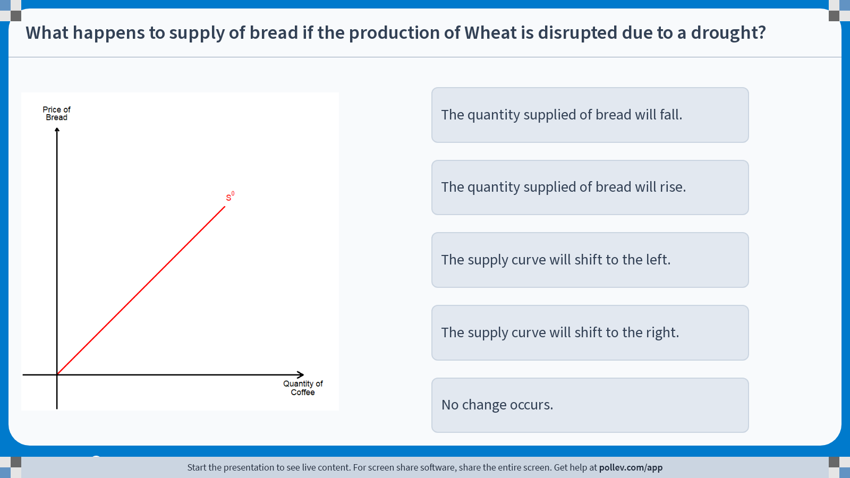
Poll Everywhere multiple choice poll instructions screen
Activity Title: What happens to supply of bread if the production of Wheat is disrupted due to a drought?
Slide 37
Notes:
Do not modify the notes in this section to avoid tampering with the Poll Everywhere activity.
More info at polleverywhere.com/support
What happens to supply of bread if the production of Wheat is disrupted due to a drought?
https://www.polleverywhere.com/multiple_choice_polls/QqVqJ4WrVcvzOEAA71JNZ?display_state=instructions&activity_state=opened&state=opened&flow=Engagement&onscreen=persist

Slide 38
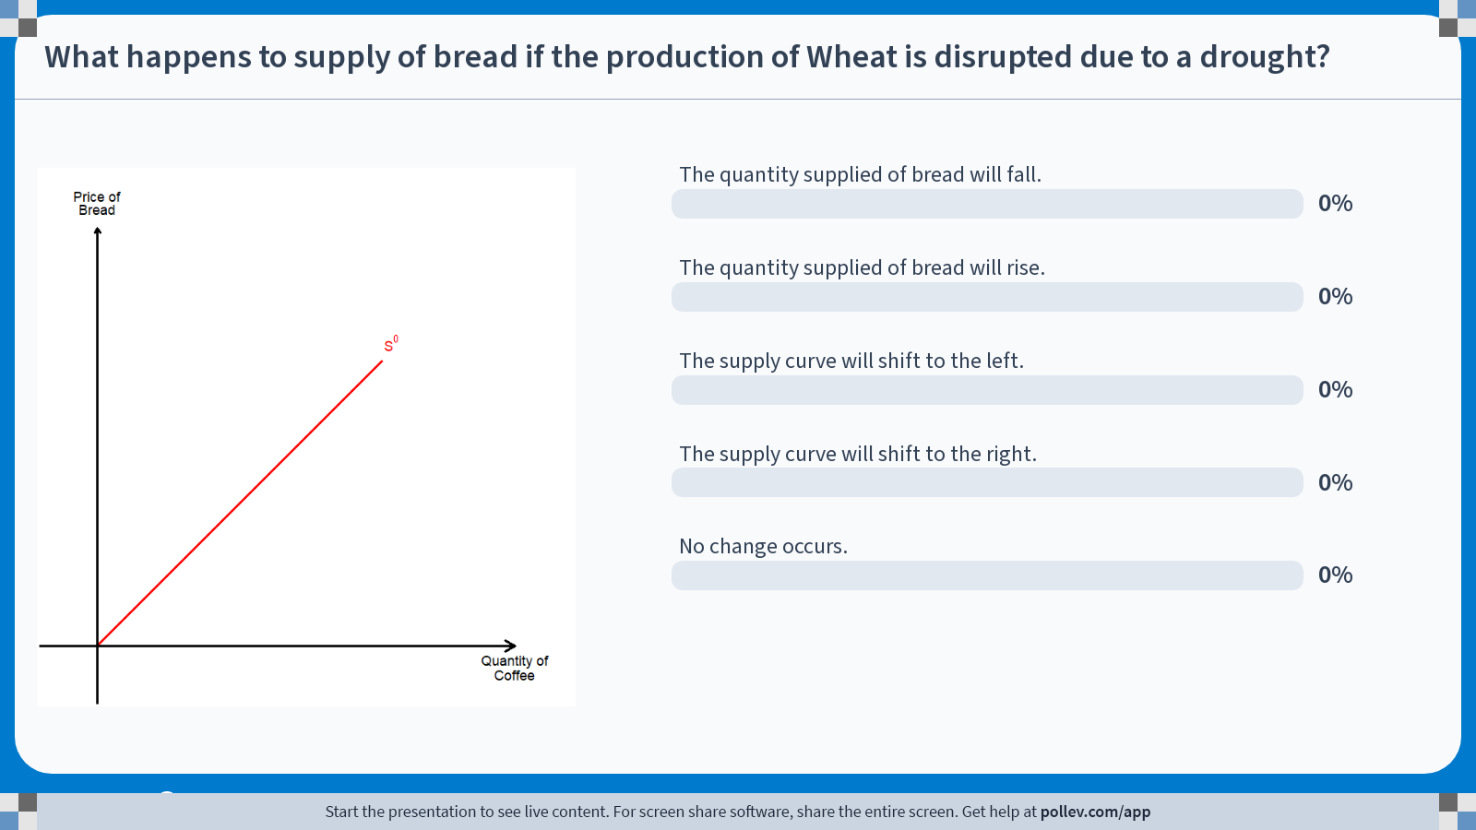
Poll Everywhere multiple choice poll chart screen
Activity Title: What happens to supply of bread if the production of Wheat is disrupted due to a drought?
Slide 39
Notes:
Do not modify the notes in this section to avoid tampering with the Poll Everywhere activity.
More info at polleverywhere.com/support
What happens to supply of bread if the production of Wheat is disrupted due to a drought?
https://www.polleverywhere.com/multiple_choice_polls/QqVqJ4WrVcvzOEAA71JNZ?display_state=chart&activity_state=closed&state=closed&flow=Engagement&onscreen=persist

Slide 39
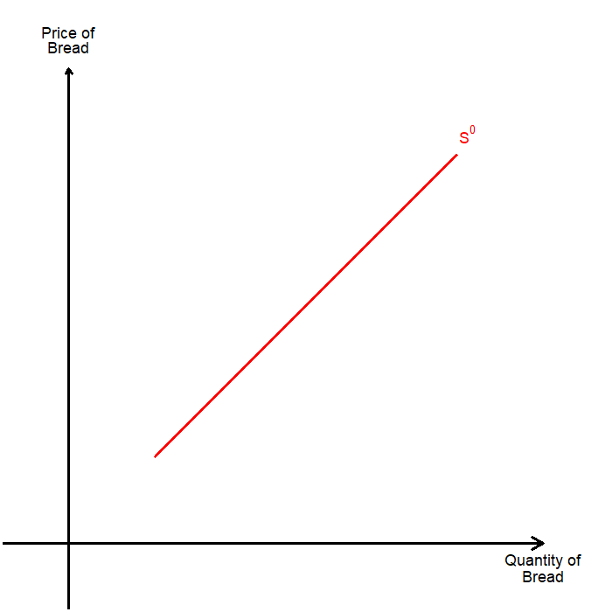
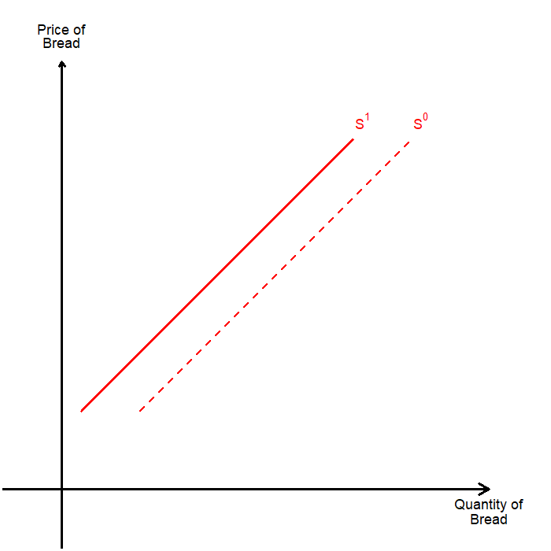
Solution to In-class Poll #2
A disruption in the production of wheat will lead to the price of wheat increasing.
The cost of producing bread, a non-price determinant of supply, increases.
For each price level, the sellers’ quantity supplied falls.
The supply curve shifts to the left.

Slide 40
Supply and Demand

Slide 41
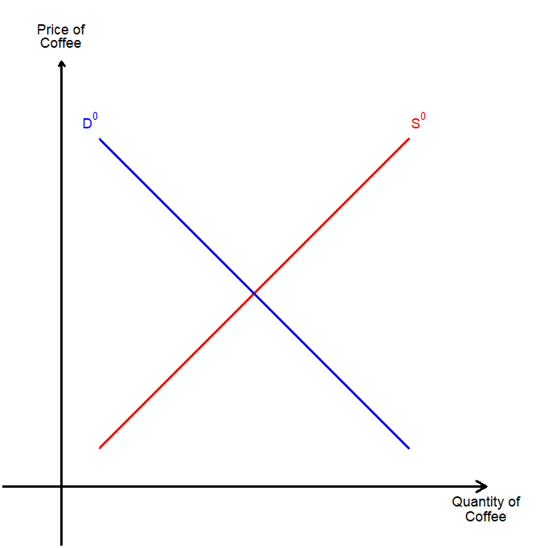
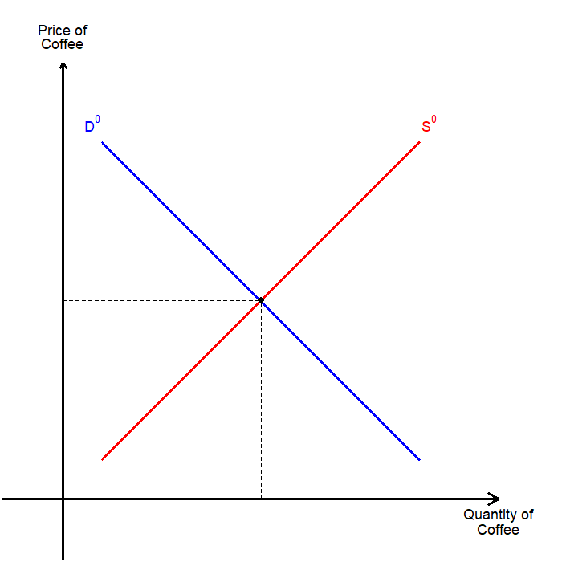
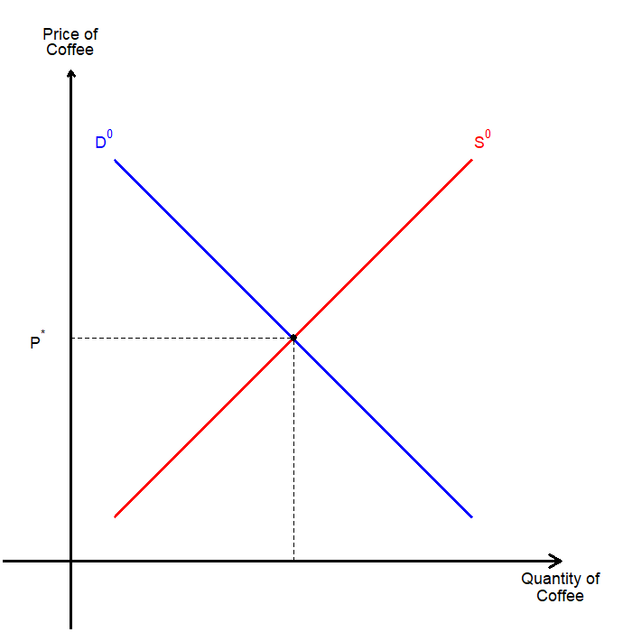

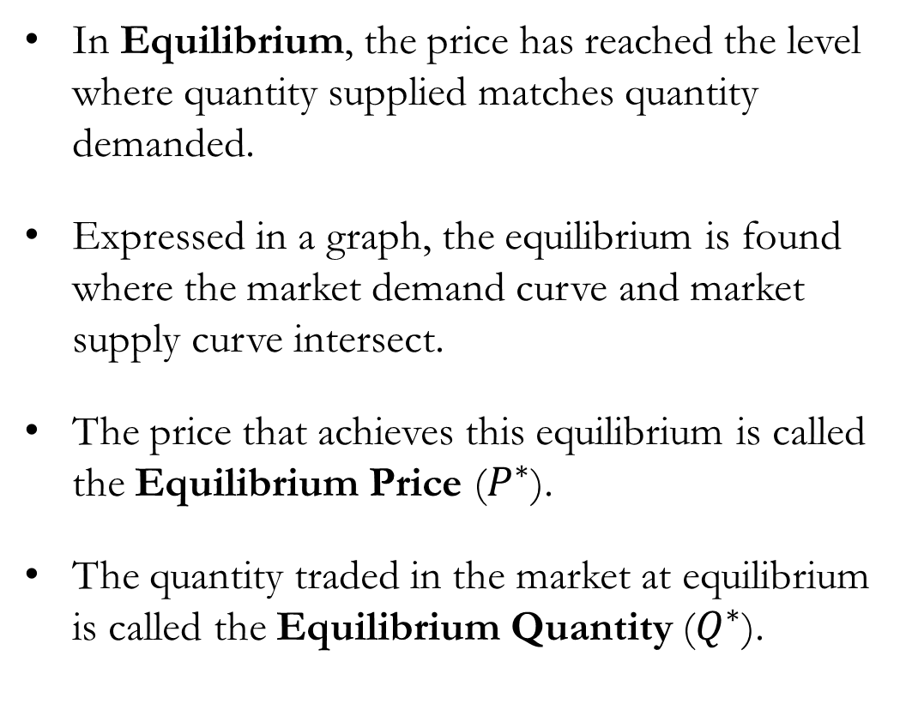
The Market Equilibrium
In Equilibrium, the price has reached the level where quantity supplied matches quantity demanded.
Expressed in a graph, the equilibrium is found where the market demand curve and market supply curve intersect.
The price that achieves this equilibrium is called the Equilibrium Price ($P^{∗}$).
The quantity traded in the market at equilibrium is called the Equilibrium Quantity ($Q^{∗}$).

Slide 42

The Market Equilibrium
Let us use numbers to assist in this discussion:
So, $5 is the equilibrium price, with 50 being the equilibrium quantity traded.
Price of Coffee | Quantity Demanded | Quantity Supplied
$1 | 90 | 10
$2 | 80 | 20
$3 | 70 | 30
$4 | 60 | 40
$5 | 50 | 50
$6 | 40 | 60
$7 | 30 | 70
$8 | 20 | 80
$9 | 10 | 90

Slide 43




The Market Equilibrium
Let us examine the market out-of-balance to see what happens when we are not at the equilibrium.
Suppose that the price was set at $8 per cup, which is well above the equilibrium price of $5.
  Buyers want to purchase 20 cups according to the market demand curve.
  Sellers want to sell 80 cups according to the market supply curve.
  There is a 60-cup surplus of coffee in the market.
Facing a surplus, sellers would try to lower their prices to increase sales.

Slide 44


The Market Equilibrium
Suppose that the sellers collectively lower the price of a cup of coffee to $7.
  Buyers want to purchase 30 cups of coffee.
  Sellers want to sell 70 cups of coffee.
  There is a 50-cup surplus in the market.
  Sellers reduce the price further…
We can expect this process of price adjustments to repeat until there is no longer any surplus in the market.
So, the market eventually reaches its equilibrium.

Slide 45

The Market Equilibrium
A similar adjustment occurs when the price is set lower than the equilibrium price. Suppose a cup of coffee costs $2.
  Buyers want to purchase 80 cups of coffee.
  Sellers want to sell 20 cups of coffee.
  There is a 60-cup shortage of coffee in the market.
Facing a shortage in the market, sellers can raise the price.
  Causing quantity demanded to fall, while
  Causing quantity supplied to increase, which
  Reduces the shortage in the market.
Adjustments lead to the equilibrium!

Slide 46
The Laws of Supply and Demand
The Law of Supply and Demand tells us that the price of any good adjusts to bring the quantity supplied and quantity demanded of that good into balance.
Regardless of where the price starts, the activities of buyers and sellers push the market price toward equilibrium.
Once the market reaches equilibrium, there is no further upward or downward pressure on the price.
Changes to supply and/or demand can change the equilibrium itself.

Slide 47
How Prices Allocate Resources
Principle #6:
“Markets are usually a good way to organize economic activity.”
In market economies, prices adjust to balance supply and demand.
These equilibrium prices are the signals that guide economic decisions and thereby allocate scarce resources.

Slide 48
Analyzing Supply and Demand Together
These three steps can be a useful tool in analyzing changes in equilibrium.
Decide whether the event shifts the supply curve, demand curve, or, in come cases, both supply and demand curves.
Decide whether the curve(s) shifts to the right or to the left.
Use the supply-and-demand diagram to compare the initial and new equilibrium, and its effects on equilibrium price and quantity.

Slide 49

The Market Equilibrium: Shifts in the Market #1
Suppose that the price of Coffee (beans) imports from Brazil fell.
  Does this impact demand?
  Does this impact supply?
Sellers will see their production cost fall, and they would want to sell more coffee at any given price.
The supply curve shifts to the right.
At the old equilibrium price of $5, there will be a surplus of coffee in the market.
Price falls, and quantity of coffee traded rises.

Slide 50

The Market Equilibrium: Shifts in the Market #2
Suppose that the price of caffeinated drinks other than coffee increases.
  Does this impact demand?
  Does this impact supply?
Buyers would shift consumption from other drinks to coffee, as it is now relatively cheaper.
The demand curve shifts to the right.
At the old equilibrium price of $5, there will be a shortage of coffee in the market.
The price and quantity of coffee traded rises.

Slide 51
Recap of Chapter 4

Slide 52
Recap
Economists use the model of supply and demand to analyze competitive markets:
  Many buyers and sellers, all are price takers.
The demand curve shows how the quantity demanded depends on its price.
  Law of Demand: As a good’s price falls, the quantity demanded rises, so the demand curve slopes downward.
  Changes to the Non-price Determinants of Demand (income, price of related goods, etc) can shift the demand curve.
The supply curve shows how the quantity supplied depends on its price.
  Law of Supply: As a good’s price rises, the quantity supplied rises, so the supply curve slopes upward.
  Changes to the Non-price Determinants of Supply (technology, input price, etc) can shift the supply curve.

Slide 53
Recap
The intersection of supply and demand curves represent the market equilibrium.
The behavior of buyers and sellers naturally drive markets towards equilibrium.
To analyze how any event influences the equilibrium price and quantity in a market:
  Decide if the event shifts the supply curve or the demand curve (or both).
  Decide in which direction the curve(s) shifts.
  Compare the new equilibrium with the initial one
In market economies, prices are the signals that allocate scarce resources.
  The price ensures that supply and demand are in balance
  The equilibrium price determines how much buyers choose to consume and how much sellers choose to produce

