Slide 1
PRINCIPLES OF GLOBAL ECONOMICS
Chapter 3: Interdependence and the Gains from Trade

Slide 2

PollEverywhere
This is a QR code to PollEverywhere, an online polling system.
  Please scan the QR code and have your device ready as there will be a few in-class exercises.
  If you do not have access to your mobile device, log in using the URL below:
  Your responses are anonymous and not be used in grading.
https://pollev.com/brianpark046

Slide 3
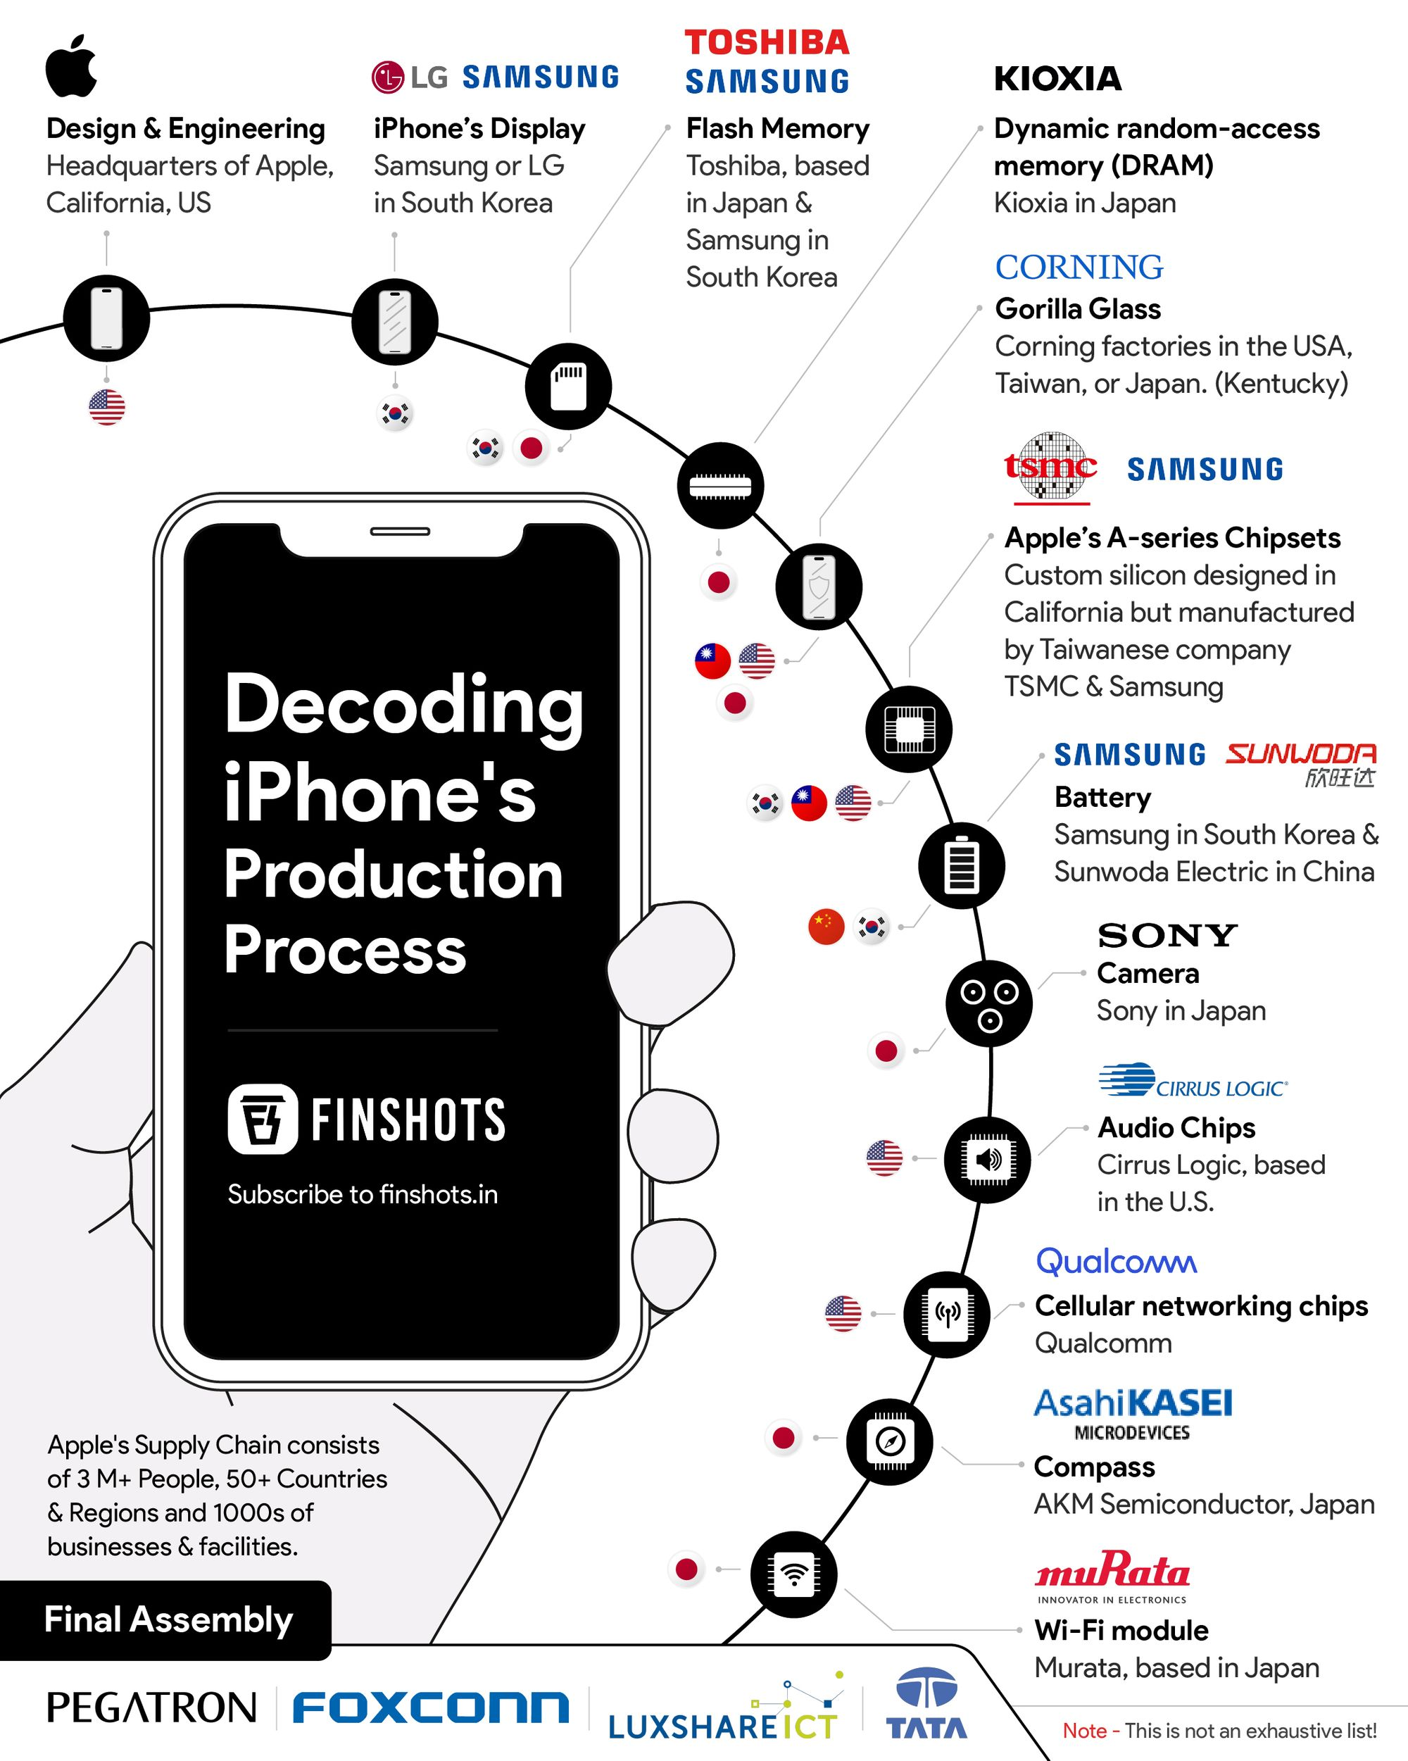
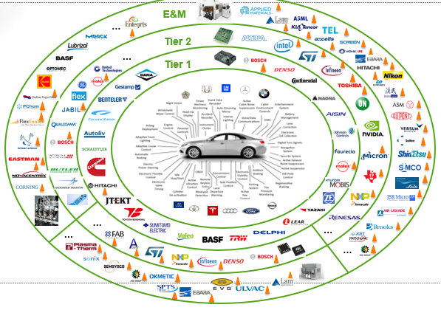
Interdependence in the Modern World

Slide 4
Interdependence in the Modern World
“Principle #5: Trade can make Everyone Better Off”
The reality is that we are deeply dependent on people across the world.
Advancements in information technology and more efficient transportation have made both domestic and international trade possible.
However, having the conditions that allow us to do something does not necessarily mean that we should do it.
  We should eat food because we are hungry, not merely because food is available.
So why is it that individuals and nations choose to be economically interdependent?

Slide 5
A Simple Model of Trade

Slide 6
A Simple Model of Trade
Let’s begin by building a simple model to explain why trade might occur.
For now, assume the following:
  Two Countries: the U.S. and Brazil.
  Two Outputs: Airplanes and Coffee.
  Single Input: Labor, measured in hours of work.
We will first determine how much each country can produce and consume if it is entirely self-sufficient.
Let’s start by examining the U.S.

Slide 7
A Simple Model of Trade
The U.S. has 50,000 units of Labor available.
The U.S. can produce 1 Airplane with every 500 units of Labor.
The U.S. can produce 1 ton of Coffee with every 10 units of Labor.
 | Labor in Airplanes | Labor in Coffee | Output of Airplanes | Output of Coffee
A | 50,000 | 0
B | 40,000 | 10,000
C | 30,000 | 20,000
D | 20,000 | 30,000
E | 10,000 | 40,000
F | 0 | 50,000
 | Labor in Airplanes | Labor in Coffee | Output of Airplanes | Output of Coffee
A | 50,000 | 0 | 100 | 0
B | 40,000 | 10,000 | 80 | 1,000
C | 30,000 | 20,000 | 60 | 2,000
D | 20,000 | 30,000 | 40 | 3,000
E | 10,000 | 40,000 | 20 | 4,000
F | 0 | 50,000 | 0 | 5,000

Slide 8
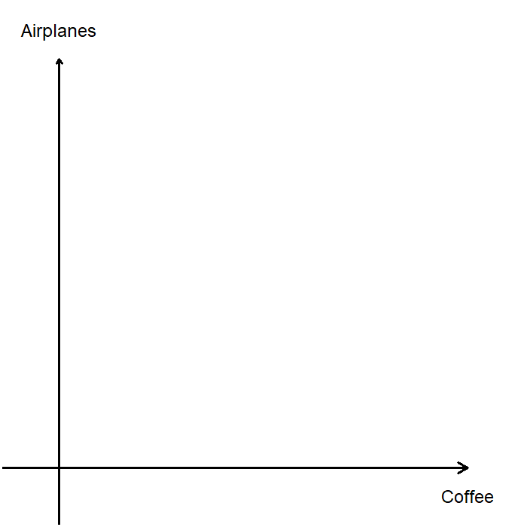
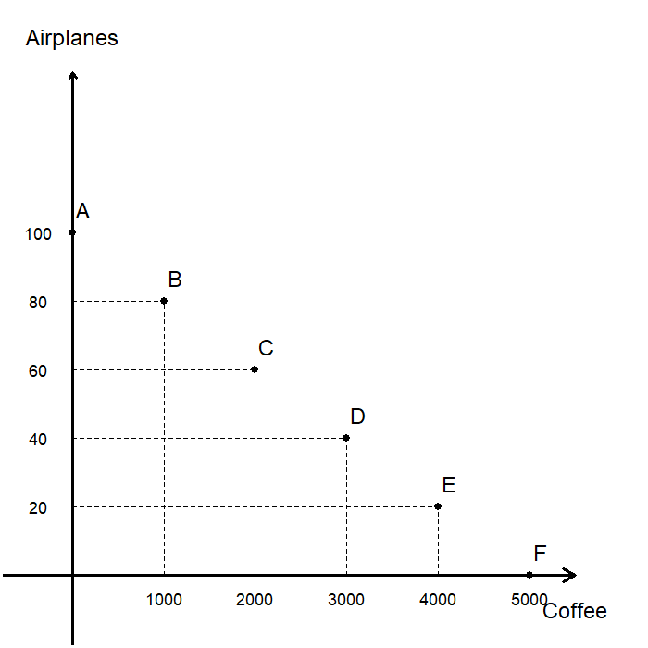
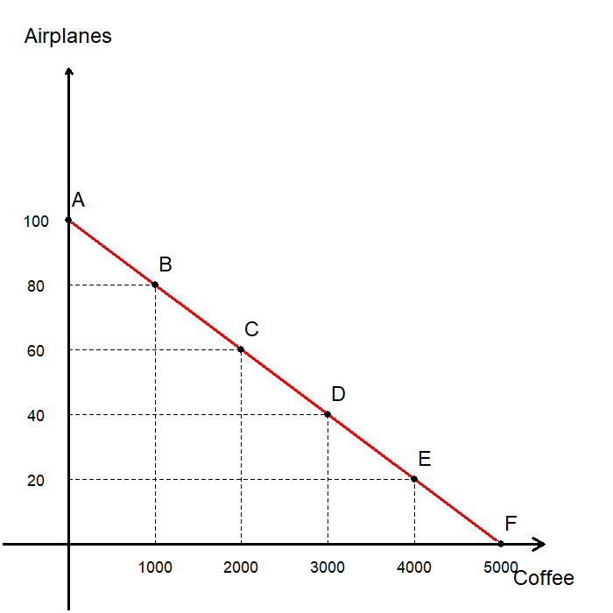
A Simple Model of Trade
We can visualize U.S. production by plotting the PPF using the table.
Points A~F can be plotted on the diagram.
  Point A: all U.S. workers work on Airplanes.
  Point F: all U.S. workers work on Coffee.
  Points B~E: U.S. workers divide their time between both goods.
Connecting these points gives us the PPF.
Recall that any combination of Airplanes and Coffee lying “above” the PPF cannot be produced.

Slide 9
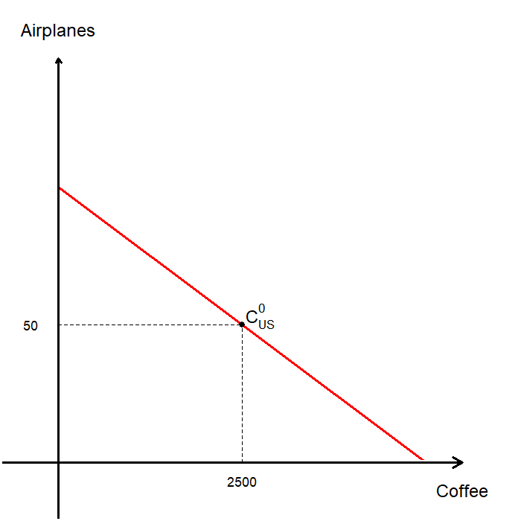
A Simple Model of Trade
Without trade, U.S. consumers must choose a point on the PPF as their level of consumption.
Suppose half of all U.S. workers produce Airplanes and the other half produce Coffee:
  25,000 Labor units in Airplanes, and
  25,000 Labor units in Coffee.
This would result in U.S. production levels:
  50 Airplanes, and
  2,500 tons of Coffee.
Without trade, every country must consume exactly what it produces!

Slide 10
A Simple Model of Trade
Let’s now consider the production of Brazil.
Brazil has 30,000 units of Labor available.
Brazil uses 625 units of labor to produce 1 Airplane.
Brazil uses 25 units of Labor to produce 1 ton of Coffee.

Slide 11
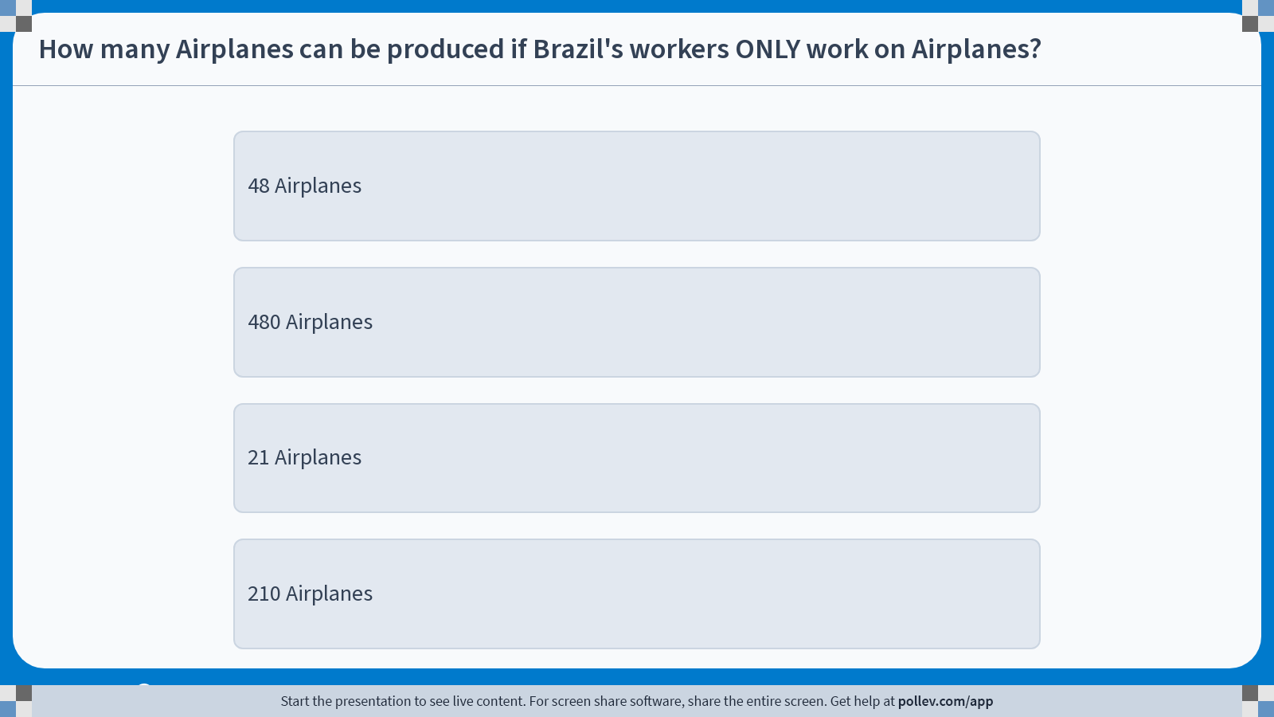
Poll Everywhere multiple choice poll instructions screen
Activity Title: How many Airplanes can be produced if Brazil's workers ONLY work on Airplanes?
Slide 10
Notes:
Do not modify the notes in this section to avoid tampering with the Poll Everywhere activity.
More info at polleverywhere.com/support
How many Airplanes can be produced if Brazil's workers ONLY work on Airplanes?
https://www.polleverywhere.com/multiple_choice_polls/hOsCpFzNaUiLOVQsHExVO?display_state=instructions&activity_state=opened&state=opened&flow=Engagement&onscreen=persist

Slide 12
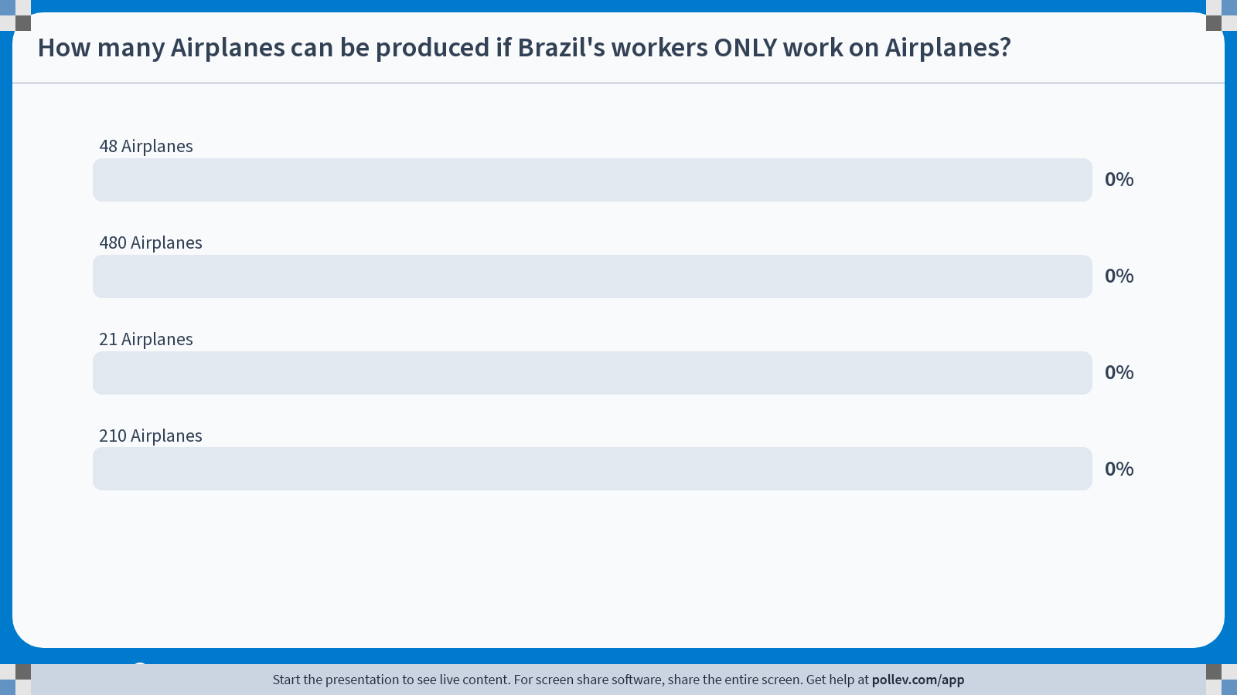
Poll Everywhere multiple choice poll chart screen
Activity Title: How many Airplanes can be produced if Brazil's workers ONLY work on Airplanes?
Slide 12
Notes:
Do not modify the notes in this section to avoid tampering with the Poll Everywhere activity.
More info at polleverywhere.com/support
How many Airplanes can be produced if Brazil's workers ONLY work on Airplanes?
https://www.polleverywhere.com/multiple_choice_polls/hOsCpFzNaUiLOVQsHExVO?display_state=chart&activity_state=closed&state=closed&flow=Engagement&onscreen=persist

Slide 13
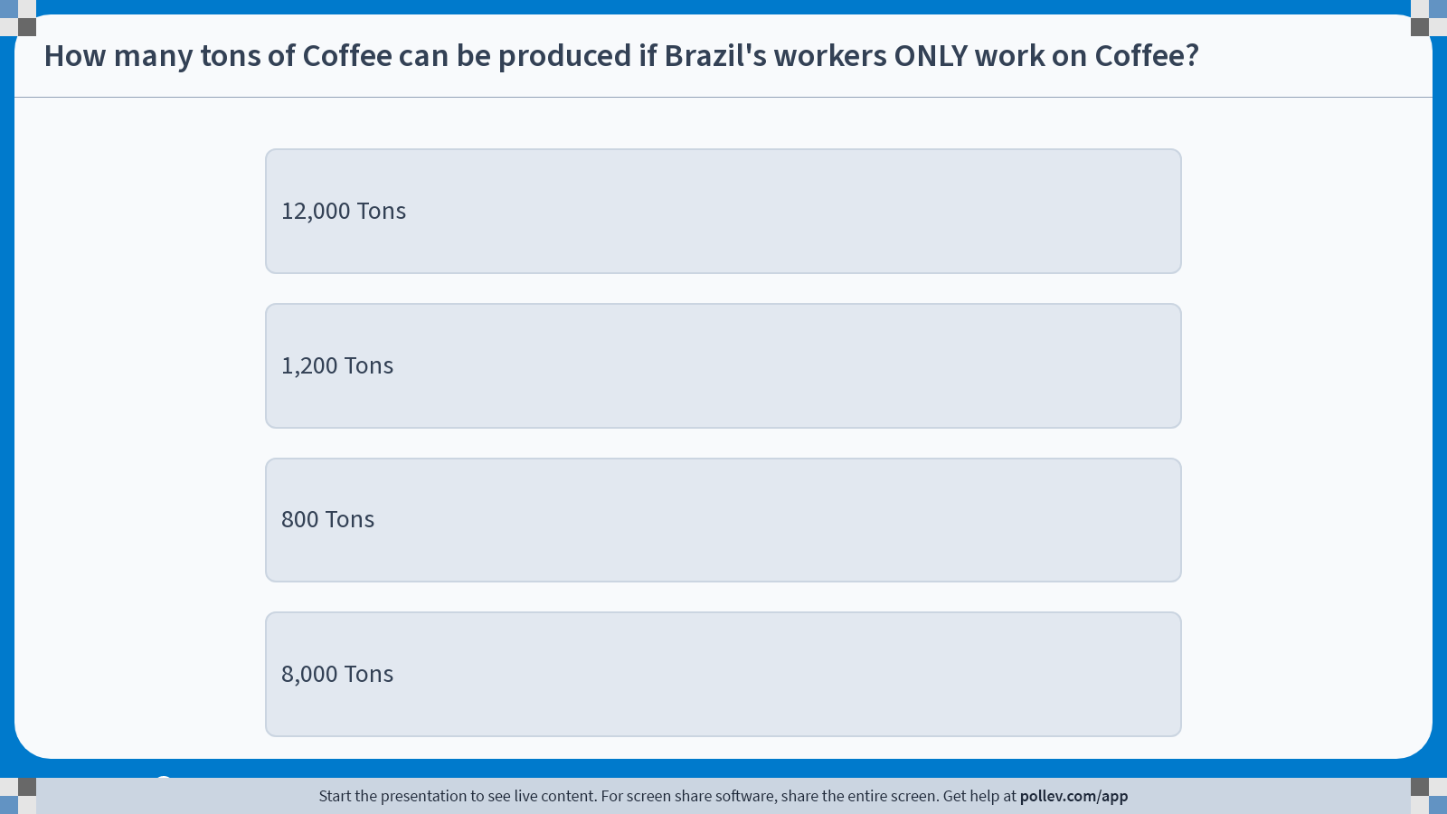
Poll Everywhere multiple choice poll instructions screen
Activity Title: How many tons of Coffee can be produced if Brazil's workers ONLY work on Coffee?
Slide 12
Notes:
Do not modify the notes in this section to avoid tampering with the Poll Everywhere activity.
More info at polleverywhere.com/support
How many tons of Coffee can be produced if Brazil's workers ONLY work on Coffee?
https://www.polleverywhere.com/multiple_choice_polls/81fi1SBP5ZfMEZDVAwHqB?display_state=instructions&activity_state=opened&state=opened&flow=Engagement&onscreen=persist

Slide 14
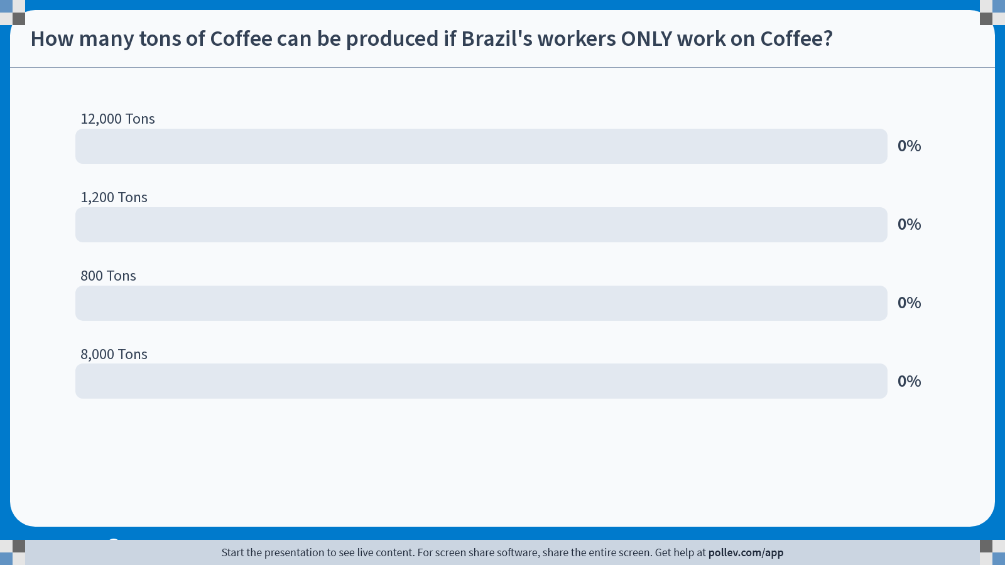
Poll Everywhere multiple choice poll chart screen
Activity Title: How many tons of Coffee can be produced if Brazil's workers ONLY work on Coffee?
Slide 14
Notes:
Do not modify the notes in this section to avoid tampering with the Poll Everywhere activity.
More info at polleverywhere.com/support
How many tons of Coffee can be produced if Brazil's workers ONLY work on Coffee?
https://www.polleverywhere.com/multiple_choice_polls/81fi1SBP5ZfMEZDVAwHqB?display_state=chart&activity_state=closed&state=closed&flow=Engagement&onscreen=persist

Slide 15
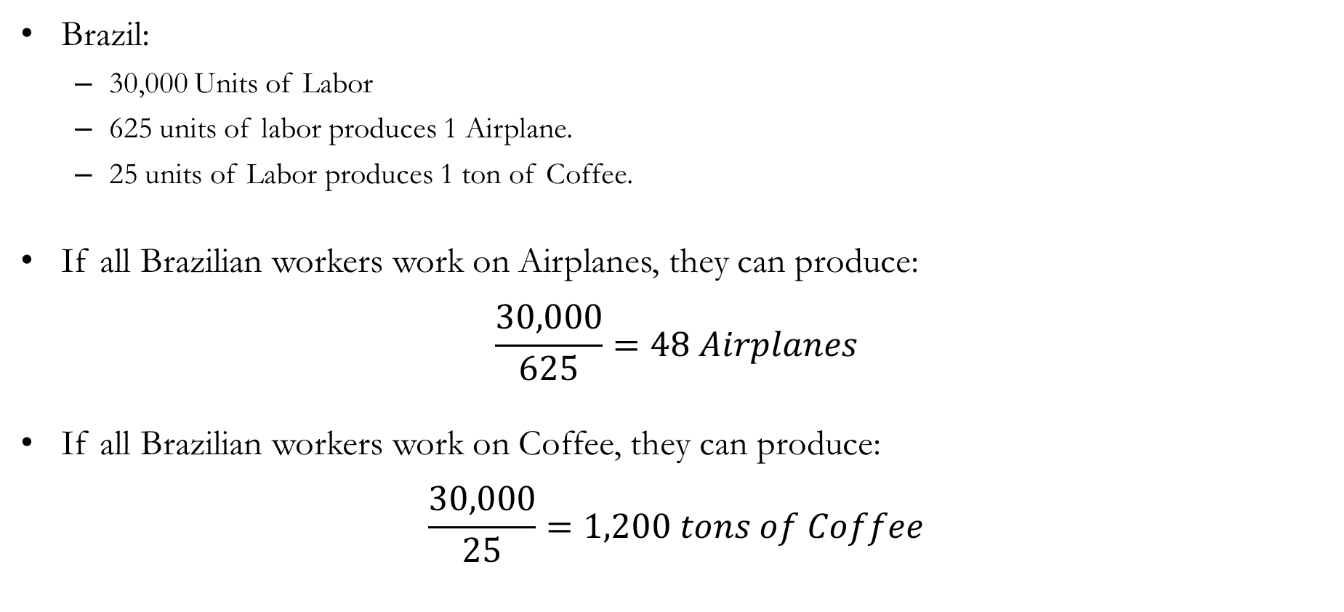
Solution to In-class Poll #1
Brazil:
  30,000 Units of Labor
  625 units of labor produces 1 Airplane.
  25 units of Labor produces 1 ton of Coffee.
If all Brazilian workers work on Airplanes, they can produce:
$$\frac{30,000}{625}=48 Airplanes$$
If all Brazilian workers work on Coffee, they can produce:
$$\frac{30,000}{25}=1,200 tons of Coffee$$

Slide 16
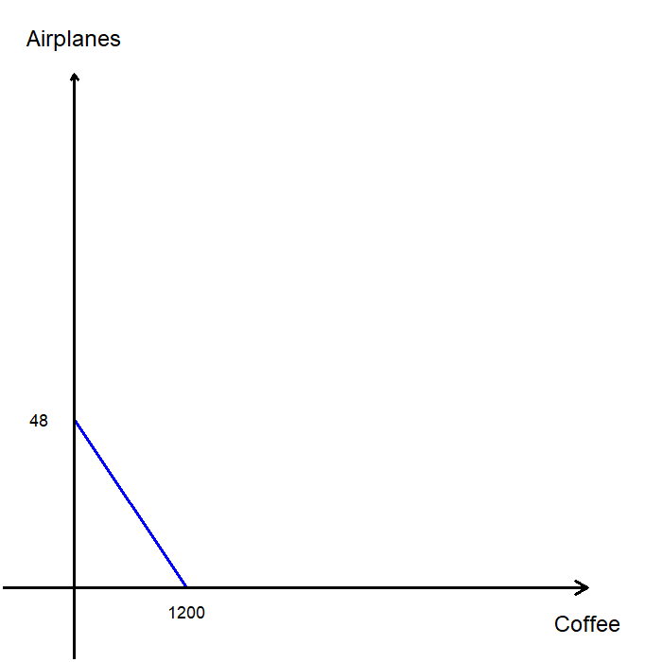
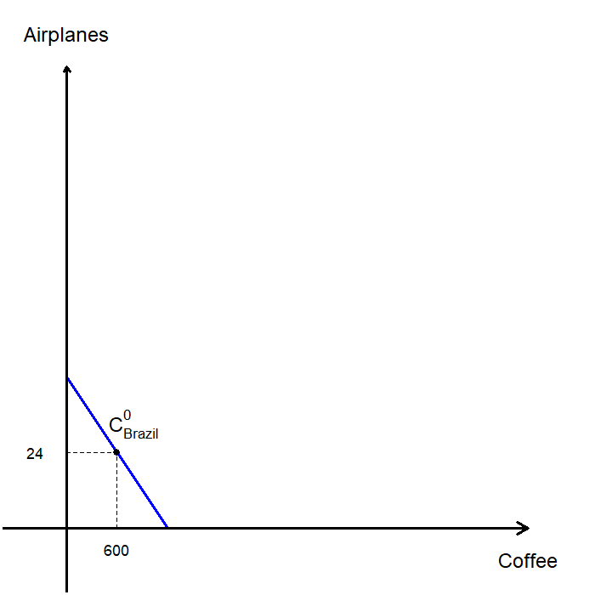
A Simple Model of Trade
We can now plot Brazil’s PPF.
Notice that Brazil is less productive than the U.S. in both Airplanes and Coffee.
  Recall that the U.S. can produce up to 100 Airplanes or up to 5,000 tons of Coffee.
For simplicity, suppose half of all Brazilian workers produce Airplanes and the other half produce Coffee.
In this case, Brazil would produce (and consume) 24 Airplanes and 600 tons of Coffee without trade.

Slide 17
A Simple Model of Trade
When the U.S. and Brazil are not trading, each consumes what it produces:
  The U.S. consumes 50 Airplanes and 2,500 tons of Coffee
  Brazil consumes 24 Airplanes and 1,200 tons of Coffee
Note that the U.S. is more productive in producing both Airplanes and Coffee.
Yet, both countries can still benefit from trade.
Let’s examine what happens when the U.S. and Brazil are allowed to trade.
In that case, they may end up producing different amounts of airplanes and coffee than they would under a no-trade scenario.

Slide 18
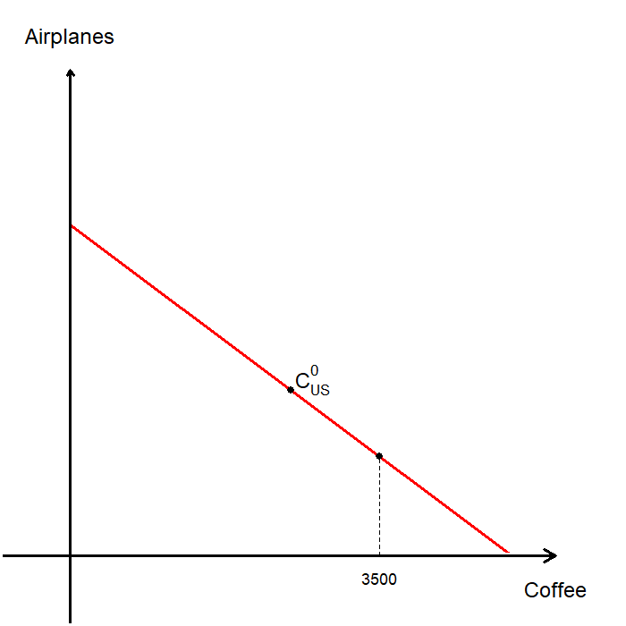
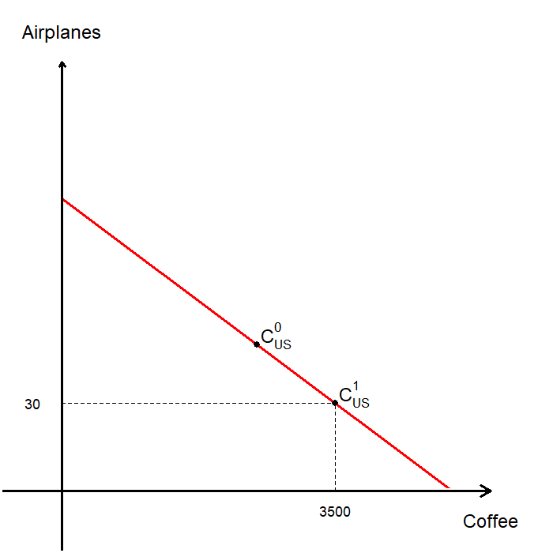
A Simple Model of Trade
Suppose the U.S. decides to produce 3,500 tons of Coffee. How many Airplanes can it produce?
Producing 3,500 tons of Coffee requires 35,000 units of Labor, leaving the U.S. with 15,000 units of Labor.
Those 15,000 units of Labor can produce 30 Airplanes.
Thus, the U.S. produces 30 Airplanes and 3,500 tons of Coffee.
Importantly, the U.S. does not have to consume this exact combination!

Slide 19
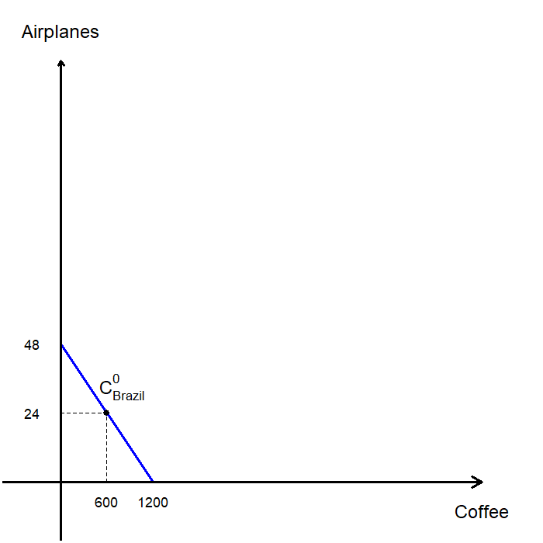
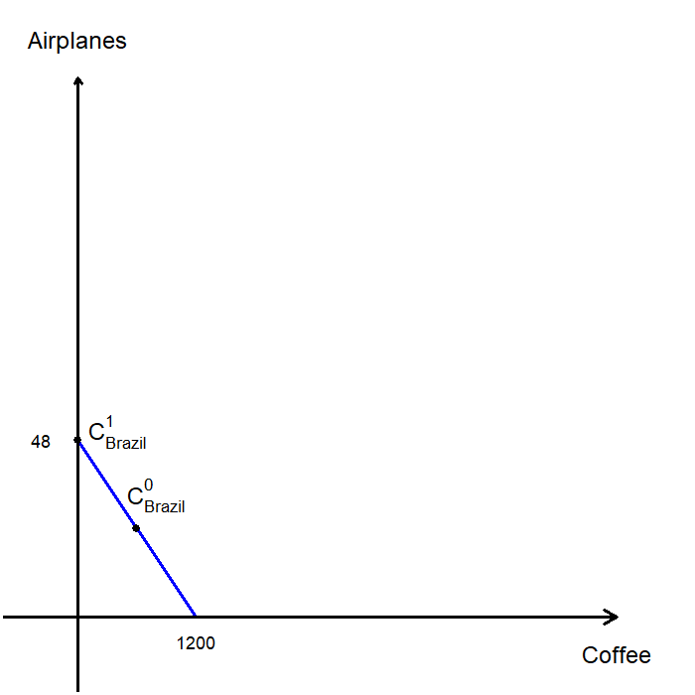
A Simple Model of Trade
Suppose Brazil decides to produce 48 Airplanes. How much Coffee can it produce?
Producing 48 Airplanes uses up all of Brazil’s Labor.
As a result, Brazil can produce 0 tons of Coffee.
Thus, Brazil produces 48 Airplanes and no Coffee.
As in the U.S. case, this does not mean Brazil must consume 48 Airplanes and no Coffee, since trade is now possible.

Slide 20
A Simple Model of Trade
In a world with trade, countries can both import and export goods.
  Import: Goods produced abroad sold domestically.
  Export: Goods produced domestically sold abroad.
Suppose the countries trade 22 Airplanes for 880 tons of Coffee.
At this rate, the price of 1 Airplane is 40 tons of Coffee.
We will later discuss how this trade price is determined.

Slide 21
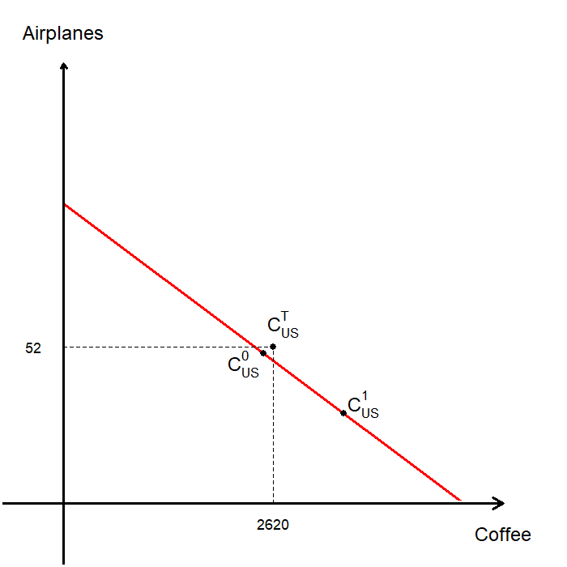
A Simple Model of Trade
In a world with trade, the U.S. produces 30 Airplanes and 3,500 tons of Coffee.
Suppose the U.S. exports 880 tons of Coffee and imports 22 Airplanes from Brazil.
Then, U.S. consumption becomes:
  30 + 22 = 52 Airplanes
  3,500 - 880 = 2,620 tons of Coffee
This combination was not achievable before trade!

Slide 22
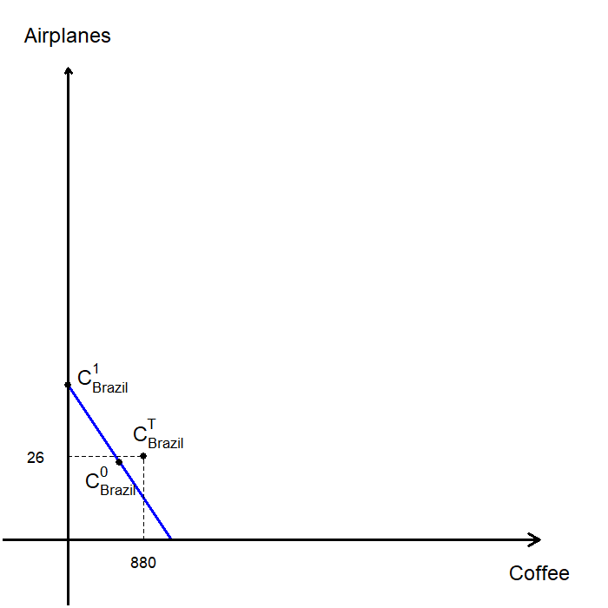
A Simple Model of Trade
In a world with trade, Brazil produces 48 Airplanes and 0 tons of Coffee.
Suppose Brazil imports 880 tons of Coffee and exports 22 Airplanes to the U.S.
Then, Brazil’s consumption becomes:
  48 – 22 = 26 Airplanes
  0 + 880 = 880 tons of Coffee
This combination was not achievable before trade!

Slide 23
A Simple Model of Trade
In the scenario without trade, consumption was as follows:
  U..S: 50 Airplanes and 2,500 tons of Coffee.
  Brazil: 24 Airplanes and 600 tons of Coffee.
With trade, each country reached a higher level of consumption:
  U.S.: 52 Airplanes and 2,620 tons of Coffee.
  Brazil: 26 Airplanes and 880 tons of Coffee.
Both countries were able to consume more than they could produce on their own, without technological progress or an increase in resources.
So, where did these gains come from?

Slide 24
Gains from Trade

Slide 25
Absolute and Comparative Advantages
Absolute Advantage: The ability to produce a good using fewer inputs (lower cost) than others.
In our example, the U.S. has an absolute advantage in producing both goods.
  The U.S. produces an Airplane with 500 units of Labor while Brazil uses 625 units of Labor.
  The U.S. produces one ton of Coffee with 10 units of Labor while Brazil uses 25 units of Labor.
It may seem natural to think the U.S. has nothing to gain from trading with Brazil, since it is more efficient in producing both goods.
However, both countries can still benefit from trade by specializing in the good they produce at the lowest relative cost.

Slide 26
Absolute and Comparative Advantages
Comparative Advantage: The ability to produce a good at a lower opportunity cost than others.
  Recall: Opportunity Cost is the value of the best alternative forgone.
The principle of comparative advantage states that each good should be produced by the agent with the lower opportunity cost of producing that good.
In our example, the opportunity cost of producing one Airplane is the amount of Coffee that could have been produced with the Labor required to make that Airplane.
Let’s now calculate each country’s opportunity costs of producing Airplanes and Coffee.

Slide 27
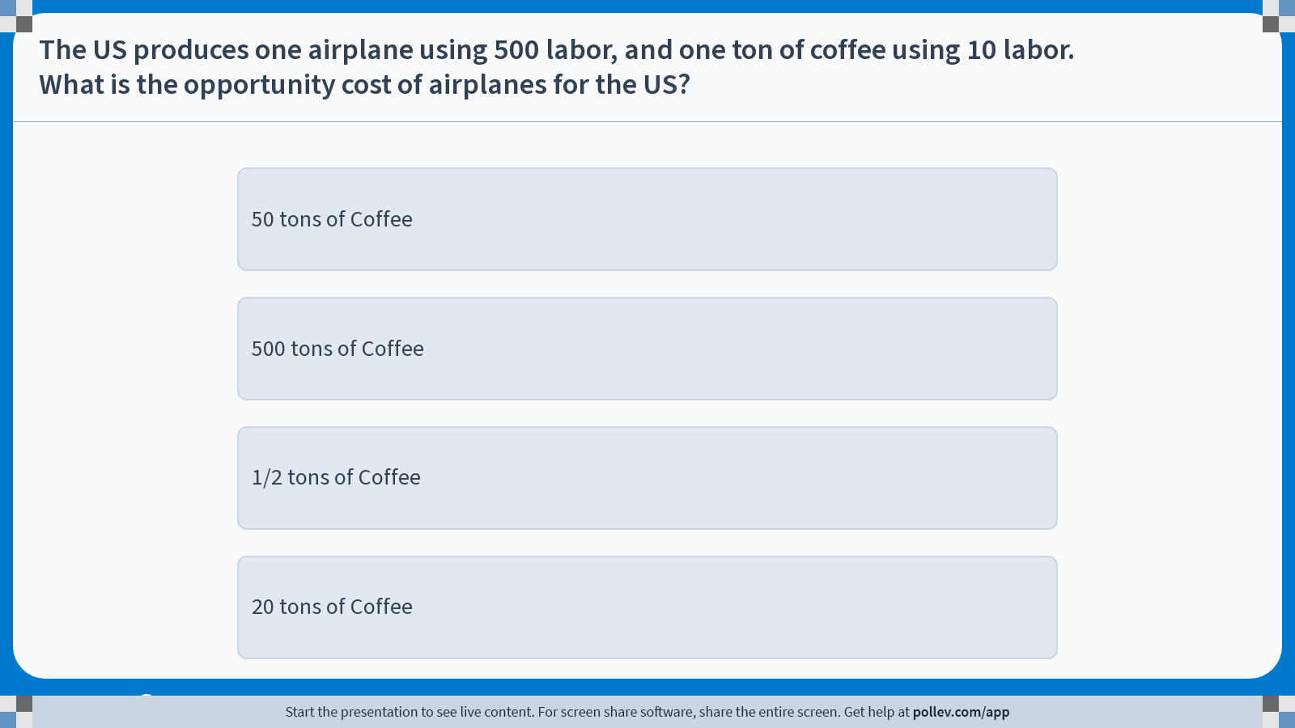
Poll Everywhere multiple choice poll instructions screen
Activity Title: The US produces one airplane using 500 labor, and one ton of coffee using 10 labor.What is the opportunity cost of airplanes for the US?
Slide 25
Notes:
Do not modify the notes in this section to avoid tampering with the Poll Everywhere activity.
More info at polleverywhere.com/support
The US produces one airplane using 500 labor, and one ton of coffee using 10 labor.What is the opportunity cost of airplanes for the US?
https://www.polleverywhere.com/multiple_choice_polls/Ek2n6qfpNvLPacHLfUtri?display_state=instructions&activity_state=opened&state=opened&flow=Engagement&onscreen=persist

Slide 28
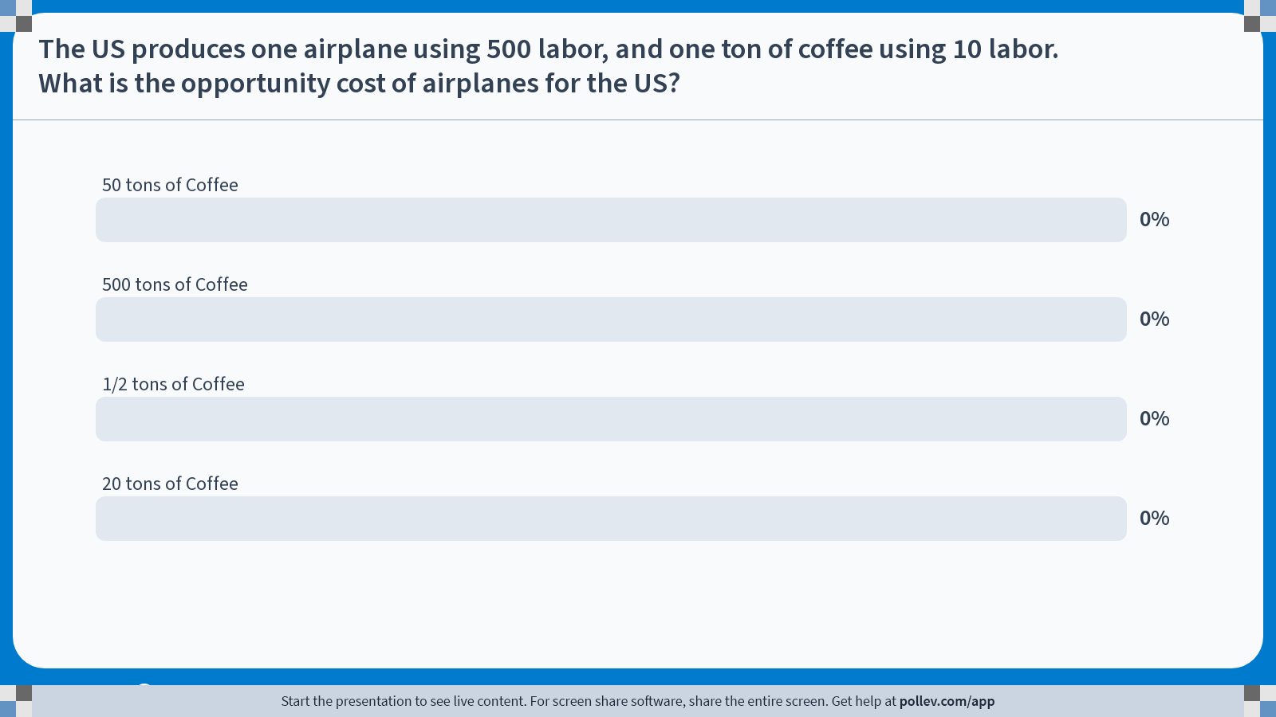
Poll Everywhere multiple choice poll chart screen
Activity Title: The US produces one airplane using 500 labor, and one ton of coffee using 10 labor.What is the opportunity cost of airplanes for the US?
Slide 27
Notes:
Do not modify the notes in this section to avoid tampering with the Poll Everywhere activity.
More info at polleverywhere.com/support
The US produces one airplane using 500 labor, and one ton of coffee using 10 labor.What is the opportunity cost of airplanes for the US?
https://www.polleverywhere.com/multiple_choice_polls/Ek2n6qfpNvLPacHLfUtri?display_state=chart&activity_state=closed&state=closed&flow=Engagement&onscreen=persist

Slide 29
Solution to In-class Poll #2
The U.S. produces one Airplane using 500 units of Labor and one ton of Coffee using 10 units of Labor.
If the U.S. does not produce an Airplane, it frees up 500 units of Labor for Coffee production.
With 500 units of Labor, U.S. workers could produce 50 tons of Coffee.
Therefore, the U.S. opportunity cost of producing one Airplane is 50 tons of Coffee.

Slide 30
Absolute and Comparative Advantages
Calculate the opportunity costs:
For any producer, the opportunity cost of producing one good is the inverse of the opportunity cost of producing the other good.
Brazil has a comparative advantage in producing Airplanes, since it gives up 25 tons of Coffee per Airplane, compared with the 50 tons the U.S. would give up.
The U.S. has a comparative advantage in producing Coffee, since it gives up only 0.02 Airplanes per ton of Coffee, compared with 0.04 Airplanes for Brazil.
 | U.S. | Brazil
Airplanes | 50 Tons
Coffee
 | U.S. | Brazil
Airplanes | 50 Tons of Coffee | 25 Tons of Coffee
Coffee | 0.02 Airplanes | 0.04 Airplanes

Slide 31
Absolute and Comparative Advantages
A country may have an absolute advantage in both goods, but it cannot have a comparative advantage in both.
One party will have a comparative advantage in one good, while the other has a comparative advantage in the other.
Gains from trade arise from comparative advantage, which exists because of differences in opportunity costs.
When each country specializes in the good in which it has a comparative advantage:
  Total production across both countries increases (the world’s “economic pie” becomes larger)
  All countries can benefit from trade, provided the terms of trade (prices) are favorable.

Slide 32
The Price of Trade
The price of trade must fall between the two countries’ opportunity costs for both to benefit.
In this example, we assumed that 1 Airplane can be traded for 40 tons of Coffee.
  The U.S. opportunity cost of 1 Airplane is 50 tons of Coffee
  Brazil’s opportunity cost of 1 Airplane is 25 tons of Coffee
At this trade price, both countries gain:
  For the U.S., importing 1 Airplane for 40 tons of Coffee is cheaper than producing it domestically at a cost of 50 tons of Coffee.
  For Brazil, producing 1 Airplane costs 25 tons of Coffee, but selling it to the U.S. yields 40 tons of Coffee.

Slide 33

TEDx Talks. (2017, May 24). Global Interdependence: The Value of Trade|Ping Zhou|TEDxYDL [Video].
YouTube. https://youtu.be/hUv6UQciRbI?si=mgimK0wdgzdSHQbQ

Slide 34
In-class Activity #1
Suppose there are
  Two countries: France and Germany.
  Two goods: Wine and Cars.
  One Input: Both countries have 10,000 units of Labor.
Which country has an absolute advantage in the production of wine?
  France needs 2 hours of labor for 1 barrel of wine
  Germany needs 1 hour of labor for 1 barrel of wine
  Germany has an absolute advantage in the production of wine
 | France | Germany
Wine | Requires 2 hours of labor | Requires 1 hour of labor
Cars | Requires 4 hours of labor | Requires 5 hours of labor

Slide 35
In-class Activity #1
Suppose there are
  Two countries: France and Germany.
  Two goods: Wine and Cars.
  One Input: Both countries have 10,000 units of Labor.
Which country has a comparative advantage in the production of wine?
  France’s opportunity cost of producing 1 barrel of wine is 1/2 cars.
  Germany’s opportunity cost of producing 1 barrel of wine is 1/5 cars.
  Germany has a comparative advantage in the production of wine.
 | France | Germany
Wine | Requires 2 hours of labor | Requires 1 hour of labor
Cars | Requires 4 hours of labor | Requires 5 hours of labor

Slide 36
In-class Activity #2: Preview of “Current Events”
In June 2025, the U.S. doubled its tariffs on imported steel from
25 % to 50 %. Nominally, this expanded tariff regime aims to
support and revitalize the U.S. steel and aluminum industries.
Will the U.S. be better off if we limit steel and aluminum imports? Why?
Will anyone in the U.S. be better off if we limit steel imports? Why?
In the real-world, does every person in the country gain when restrictions on imports are reduced? Why?

Slide 37
In-class Activity #2: Preview of “Current Events”
In June 2025, the U.S. doubled its tariffs on imported steel from
25 % to 50 %. Nominally, this expanded tariff regime aims to
support and revitalize the U.S. steel and aluminum industries.
Will the U.S. be better off if we limit steel imports? Why?
  Probably not.
  Limiting the imports of goods may help domestic steel producers.
  However, it hurts all businesses that need to buy steel.
  This leads to increased price to all consumers.
  The “economic pie” shrinks because the U.S. ends up spending more resources producing steel.

Slide 38
In-class Activity #2: Preview of “Current Events”
In June 2025, the U.S. doubled its tariffs on imported steel from
25 % to 50 %. Nominally, this expanded tariff regime aims to
support and revitalize the U.S. steel and aluminum industries.
Will anyone in the U.S. be better off if we limit steel imports? Why?
  Yes.
  Steel producers and workers at those firms may be better off, because they can sell more steel at a higher price.
  However, those gains come at the expense of everyone else.
  Some groups win, but more people would lose.

Slide 39
In-class Activity #2: Preview of “Current Events”
In June 2025, the U.S. doubled its tariffs on imported steel from
25 % to 50 %. Nominally, this expanded tariff regime aims to
support and revitalize the U.S. steel and aluminum industries.
In the real-world, does every person in the country gain when restrictions on imports are reduced? Why?
  No.
  When trade barriers are removed, consumers usually gain as goods are cheaper.
  However, some workers and firms lose because they face steeper competition.
  Trade generally makes the country as a whole richer, but not everyone gets richer.

Slide 40
Recap of Chapter 3

Slide 41
Recap
Everyone consumes goods and services produced both domestically and abroad.
This is desirable because trade allows people to achieve a higher overall level of consumption than they could on their own.
The gains from trade arise from comparative advantage, not absolute advantage.
Comparative advantage means that each party specializes in producing the goods they can make at the lowest opportunity cost.
By specializing and trading, both individuals and nations can benefit.
This principle applies equally to trade between countries and trade between individuals.

