Slide 1
PRINCIPLES OF GLOBAL ECONOMICS
Chapter 2: Thinking Like an Economist

Slide 2

PollEverywhere
This is a QR code to PollEverywhere, an online polling system.
  Please scan the QR code and have your device ready as there will be a few in-class exercises.
  If you do not have access to your mobile device, log in using the URL below:
  Your responses are anonymous and not be used in grading.
https://pollev.com/brianpark046

Slide 3
The Economist as a Scientist

Slide 4
The Scientific Method
“Observation, Theory, and More Observation”
The scientific method in Economics follows the standard:
  Observation: Observe the world, collect, and analyze data.
  Theory: Develop a theory based on observed data to explain the world.
  Verification: Conduct further observations to evaluate the theory.
For example, if we are interested in the relationship between inflation (the overall increase in prices) and unemployment, the scientific method can be applied to study this relationship.

Slide 5
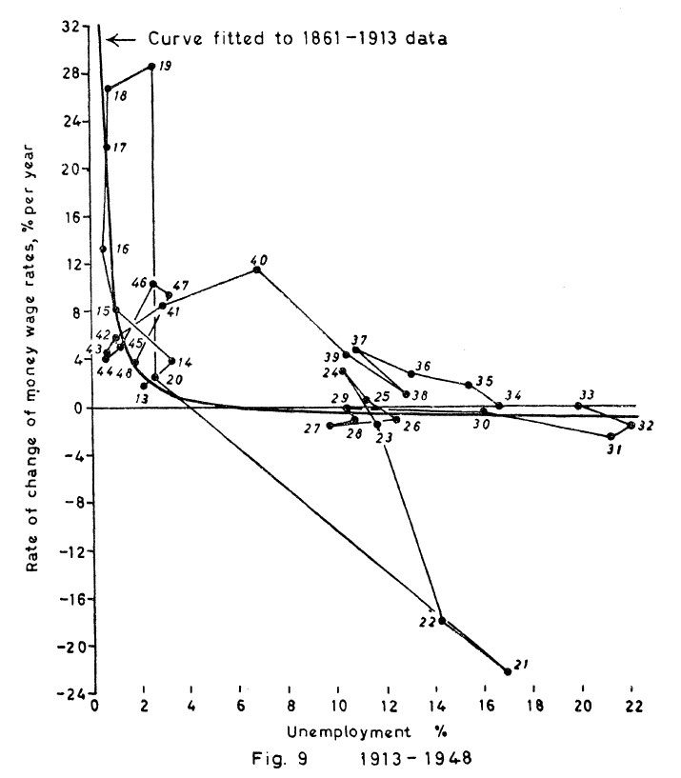
The Scientific Method
A. W. Phillips, an economist from New Zealand, studied the relationship between unemployment and inflation in the UK.
He observed a connection between inflation and money wage rates.
Later, Paul Samuelson and Robert Solow verified a similar relationship using U.S. data and coined the term “Phillips curve.”
The Phillips curve has been revised multiple times as new observations became available.

Slide 6
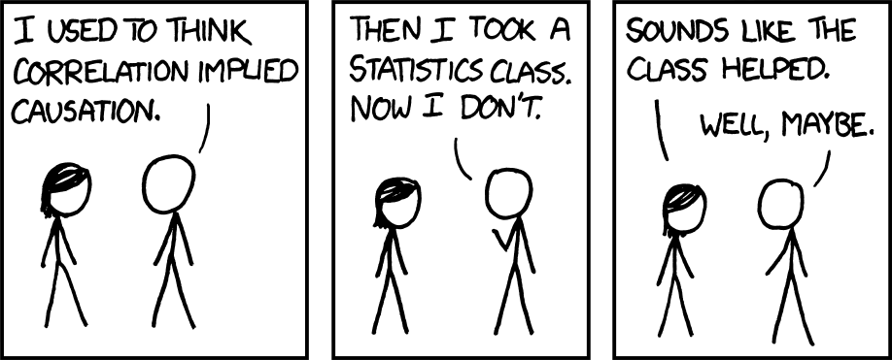
The Scientific Method
There are important differences between economics and the natural sciences (such as physics)
In economics, opportunities for controlled laboratory experiments are rare.

Slide 7

The Scientific Method
A common mistake in the social sciences is to assume correlation implies causation.
It should be clear that neither the number of Psychology degrees awarded nor the number of groundskeepers in Utah explains the other.
As scientists, we are interested in causation: “Does A cause B to happen?”
In many cases, we only observe correlations: “Do A and B tend to occur at the same time?”

Slide 8
Assumptions in Economics
“Let us assume that…”
Economists make many assumptions in order to simplify the complex world.
  When studying international trade, we often assume a world with two countries and two goods.
  When studying consumer behavior, we often consumers don’t save money for the future.
  When studying pricing, we often assume that prices can be changed instantaneously.
These, while extreme at times, simplify the problem without compromising the results.
Making assumptions itself does not pose a threat to constructing accurate models that can explain real-world events: knowing what assumptions are reasonable is the key.

Slide 9
Models in Economics
Based on the assumptions made, economists build models to explain the world and predict future events.
However, we omit many details to allow us to concentrate on the truly important factors.
The role of a model is to simplify reality to improve our understanding of the world.
Similar to the assumptions we make, the key is to know what is the right model for the right time, and how complex it must be to serve a purpose.
Let’s examine two examples of assumptions and models in economics.

Slide 10
Example: The Circular-Flow Diagram
Objective: Explain how the economy is organized and how agents in the economy interact.
Assumptions:
  Agents in the economy: Households and Firms.
  Markets in the economy: The markets for goods and services and the market for factors.
  Households: Sell factors of production and buy goods and services.
  Firms: Buy factors of production and sell goods and services.
Based on these assumptions and setup, we can build a simple model of the economy.

Slide 11
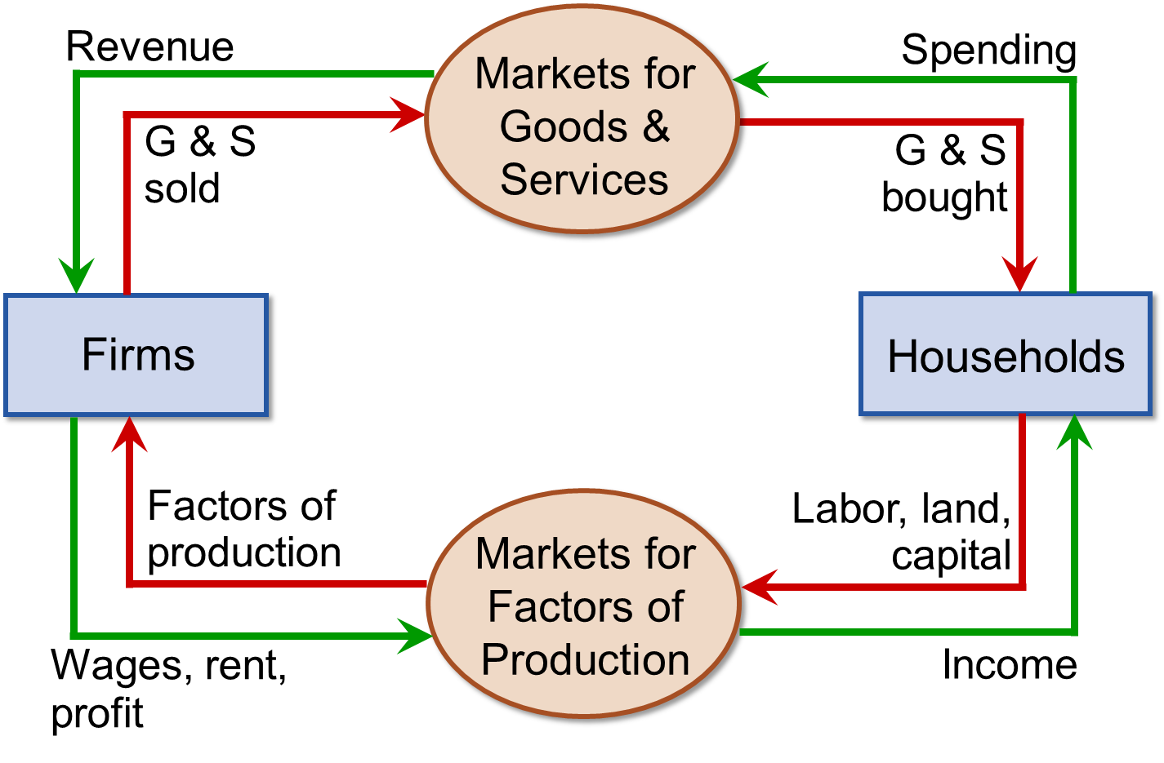
Example: The Circular-Flow Diagram
Red: Flow of “Things”
  Goods and Services
  Factors of Production
Green: Flow of “Money”
For simplicity, per our assumptions, we are leaving out:
  The Government
  The Financial Sector
  Foreign Markets
  Etc.

Slide 12
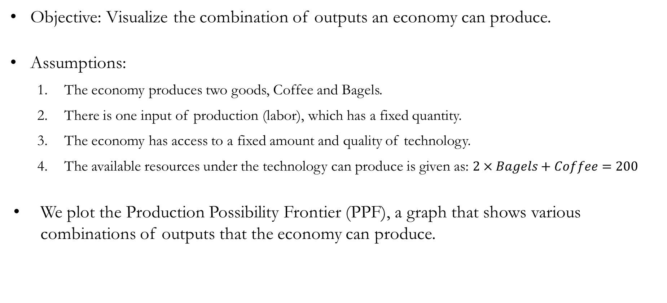
Example: Production Possibility Frontier
Objective: Visualize the combination of outputs an economy can produce.
Assumptions:
  The economy produces two goods, Coffee and Bagels.
  There is one input of production (labor), which has a fixed quantity.
  The economy has access to a fixed amount and quality of technology.
  The available resources under the technology can produce is given as: $2×Bagels+Coffee=200$
We plot the Production Possibility Frontier (PPF), a graph that shows various combinations of outputs that the economy can produce.

Slide 13
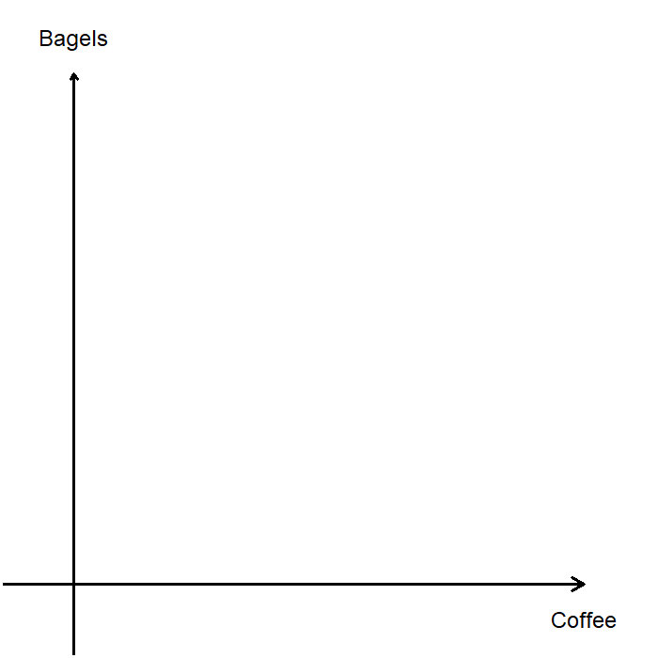
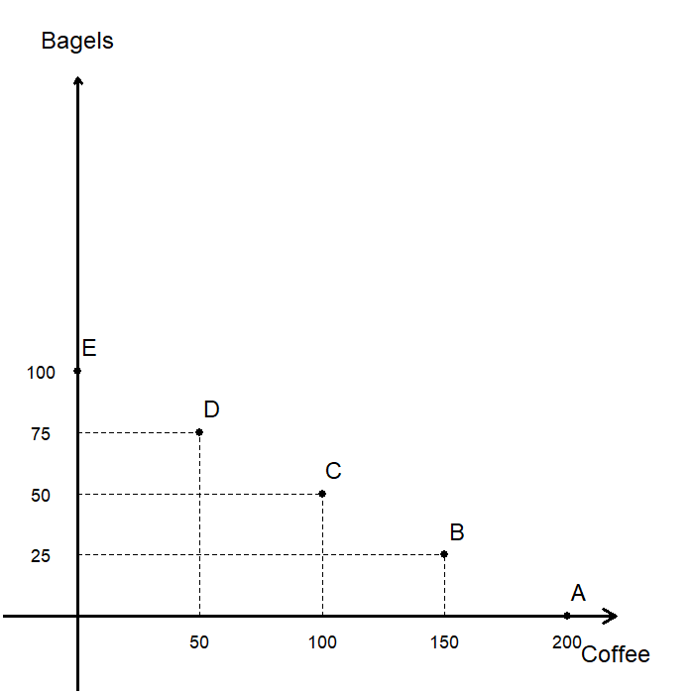
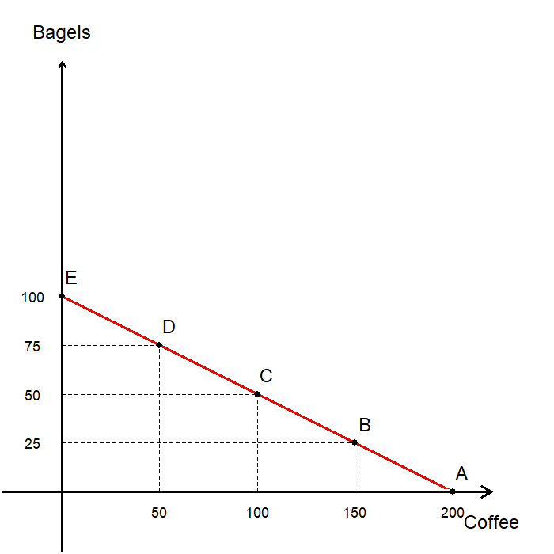
Example: Production Possibility Frontier
Given the technology, these are some possible combinations of production:
Plot each point on the graph.
Connect each point to find the PPF.
 | Coffee | Bagels
A | 200 | 0
B | 150 | 25
C | 100 | 50
D | 50 | 75
E | 0 | 100

Slide 14
Example: Production Possibility Frontier
At any point along the PPF the economy is producing efficiently.
  Efficiency: We cannot produce more of one good without reducing the production of the other good.
Any point “under” the PPF is a point in which the economy is operating inefficiently.
Any points “above” the PPF is a point that can’t be reached given the resources and technology.
The PPF represent the trade-off an economy faces in production.

Slide 15
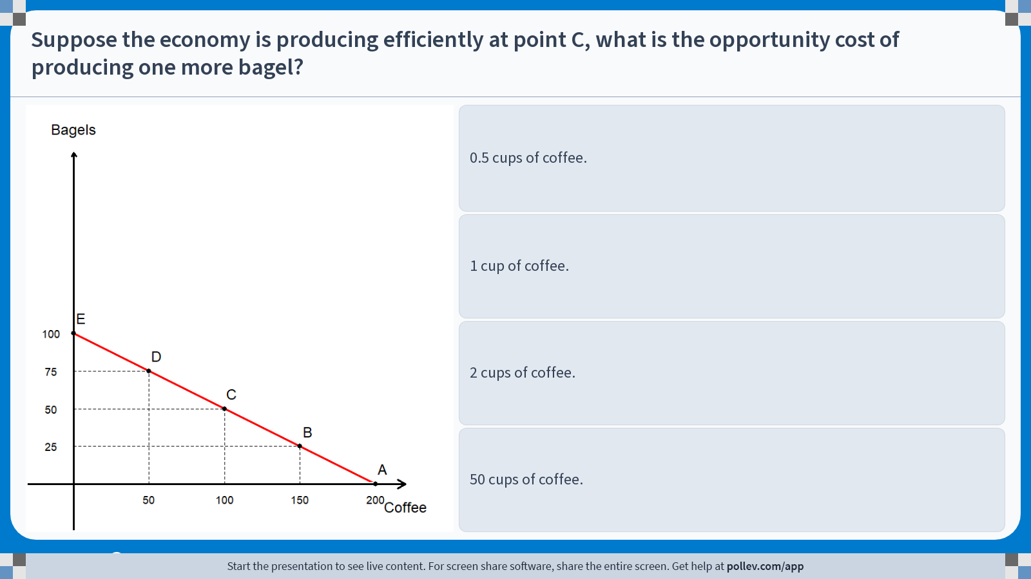
Poll Everywhere multiple choice poll instructions screen
Activity Title: Suppose the economy is producing efficiently at point C, what is the opportunity cost of producing one more bagel?
Slide 16
Notes:
Do not modify the notes in this section to avoid tampering with the Poll Everywhere activity.
More info at polleverywhere.com/support
Suppose the economy is producing efficiently at point C, what is the opportunity cost of producing one more bagel?
https://www.polleverywhere.com/multiple_choice_polls/CF4dJR96V0R9qBl3bBitB?display_state=instructions&activity_state=opened&state=opened&flow=Engagement&onscreen=persist

Slide 16
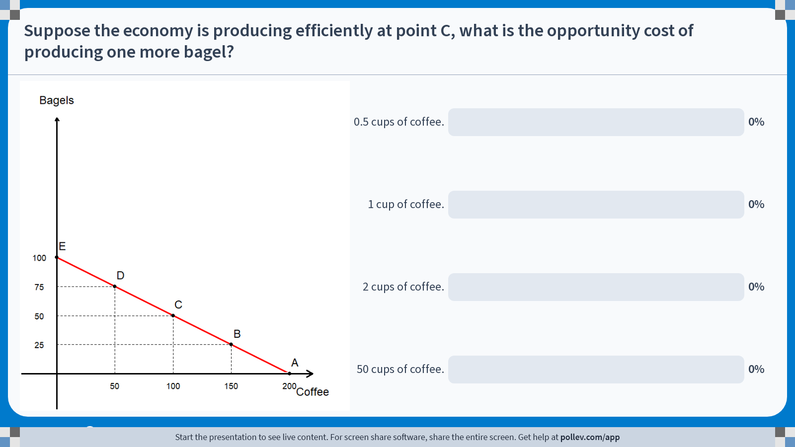
Poll Everywhere multiple choice poll chart screen
Activity Title: Suppose the economy is producing efficiently at point C, what is the opportunity cost of producing one more bagel?
Slide 18
Notes:
Do not modify the notes in this section to avoid tampering with the Poll Everywhere activity.
More info at polleverywhere.com/support
Suppose the economy is producing efficiently at point C, what is the opportunity cost of producing one more bagel?
https://www.polleverywhere.com/multiple_choice_polls/CF4dJR96V0R9qBl3bBitB?display_state=chart&activity_state=closed&state=closed&flow=Engagement&onscreen=persist

Slide 17
Solution to In-class Poll #1
Suppose we start off at point C.
When we move to point D, we can produce 25 more bagels while losing 50 cups of coffee.
So, we can conclude that the opportunity cost of producing one bagel is 2 cups of coffee.
The slope of the PPF is the opportunity cost of one good in terms of the other.
  The opportunity cost of 1 bagel is 2 cups of coffee.
  The opportunity cost of 1 cup of coffee is 0.5 of a bagel.

Slide 18
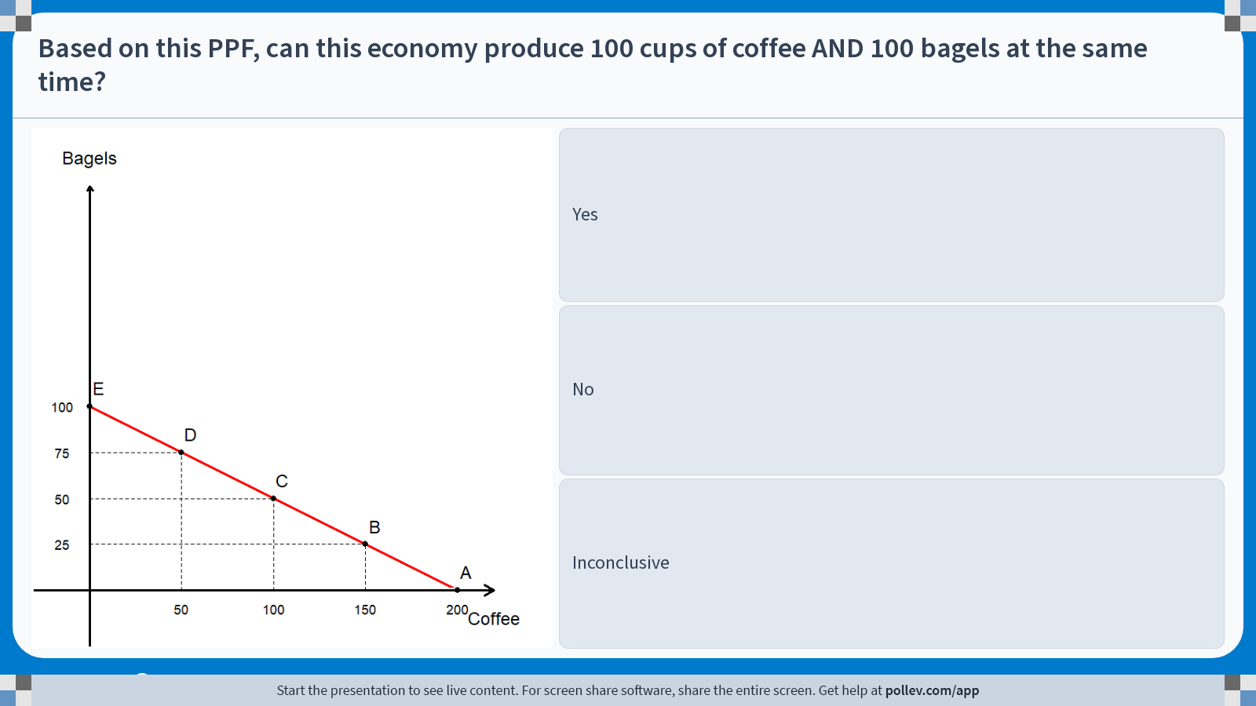
Poll Everywhere multiple choice poll instructions screen
Activity Title: Based on this PPF, can this economy produce 100 cups of coffee AND 100 bagels at the same time?
Slide 18
Notes:
Do not modify the notes in this section to avoid tampering with the Poll Everywhere activity.
More info at polleverywhere.com/support
Based on this PPF, can this economy produce 100 cups of coffee AND 100 bagels at the same time?
https://www.polleverywhere.com/multiple_choice_polls/U13kjtUtSBajG8wXuXvf3?display_state=instructions&activity_state=opened&state=opened&flow=Engagement&onscreen=persist

Slide 19
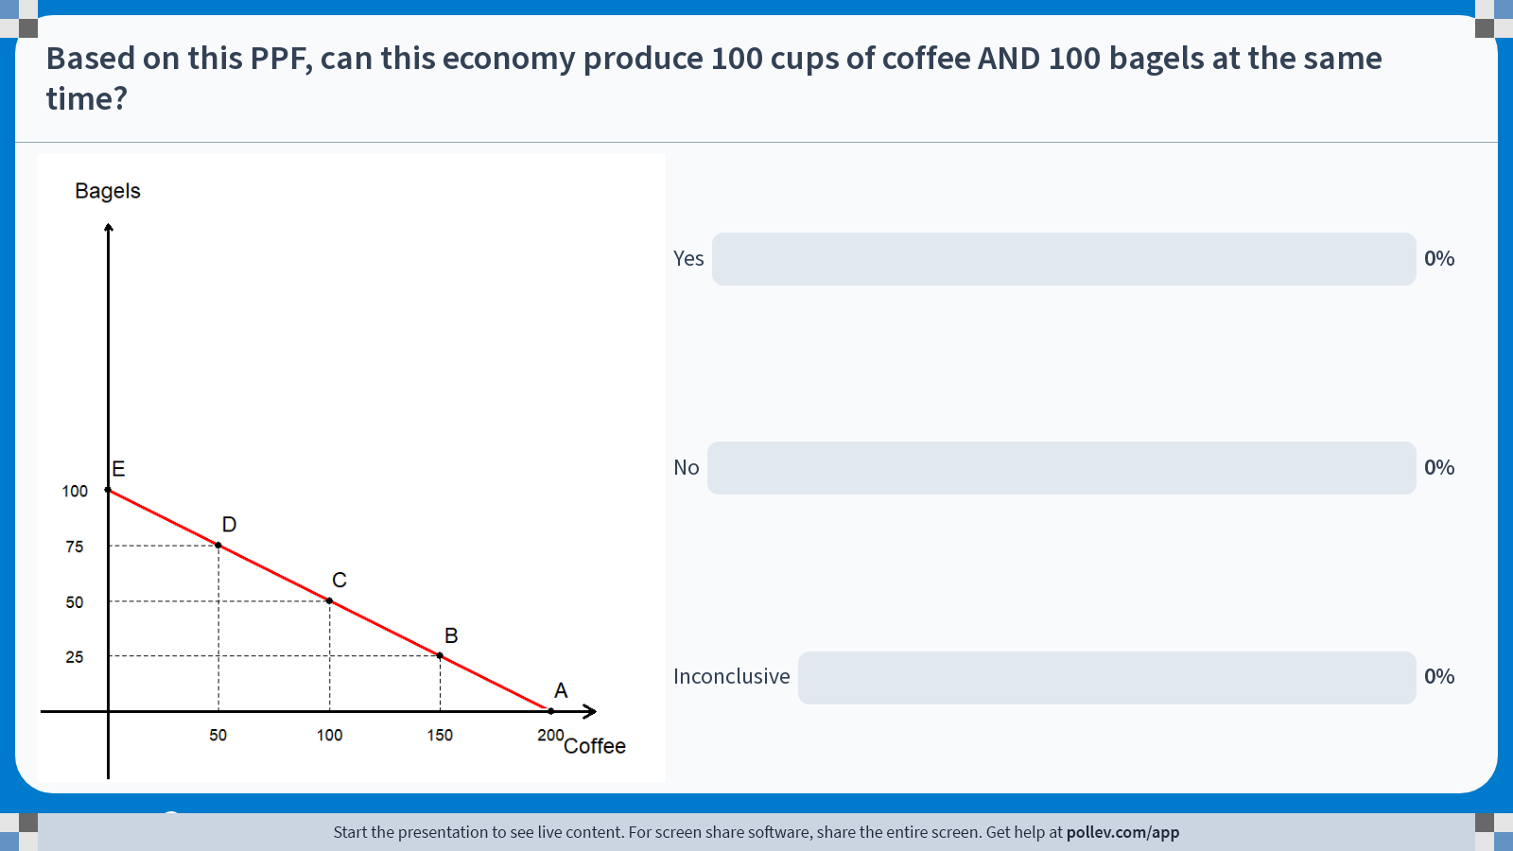
Poll Everywhere multiple choice poll chart screen
Activity Title: Based on this PPF, can this economy produce 100 cups of coffee AND 100 bagels at the same time?
Slide 20
Notes:
Do not modify the notes in this section to avoid tampering with the Poll Everywhere activity.
More info at polleverywhere.com/support
Based on this PPF, can this economy produce 100 cups of coffee AND 100 bagels at the same time?
https://www.polleverywhere.com/multiple_choice_polls/U13kjtUtSBajG8wXuXvf3?display_state=chart&activity_state=closed&state=closed&flow=Engagement&onscreen=persist

Slide 20
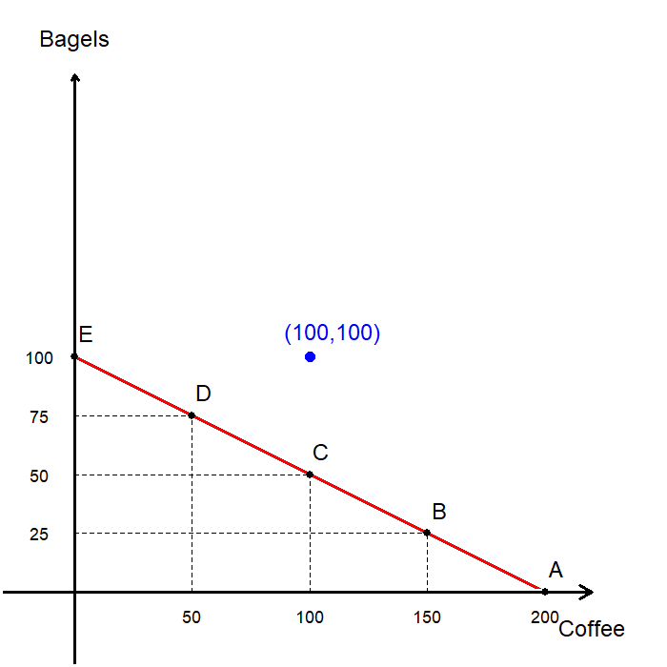
Solution to In-class Poll #2
Let us plot on the graph 100 cups of coffee and 100 bagels.
It is “above” the PPF, which means that it is not feasible to produce 100 cups of coffee and 100 bagels in this economy.
Either the economy needs more resources (labor), or the technology must improve for the economy to produce 100 cups of coffee and 100 bagels.

Slide 21
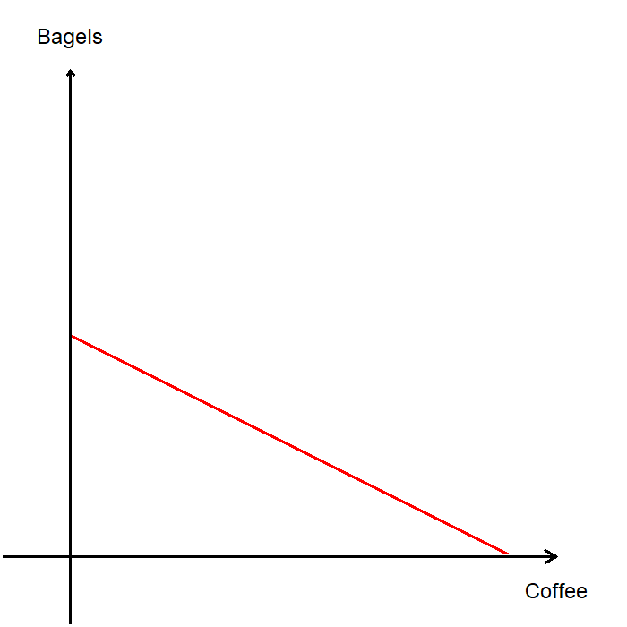
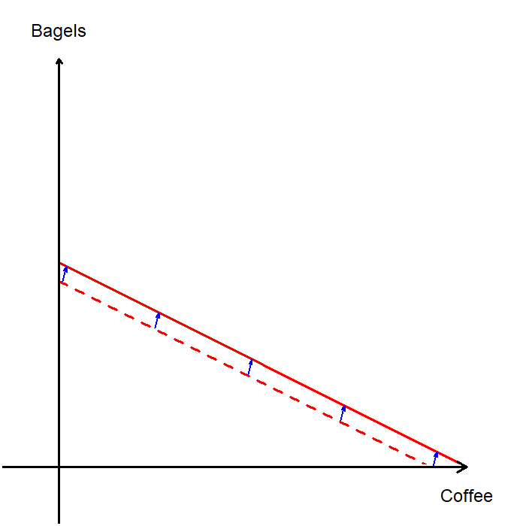
Example: Production Possibility Frontier
Suppose that the economy grows in the form of additional resources being discovered.
Then, with the additional resources, the economy can produce more coffee and/or more bagels.
Plotted on a graph, the PPF shifts outward.
A similar effect takes place if the production technology evolves as well.
This is an example of the theory / model being updated to reflect real-world changes.

Slide 22
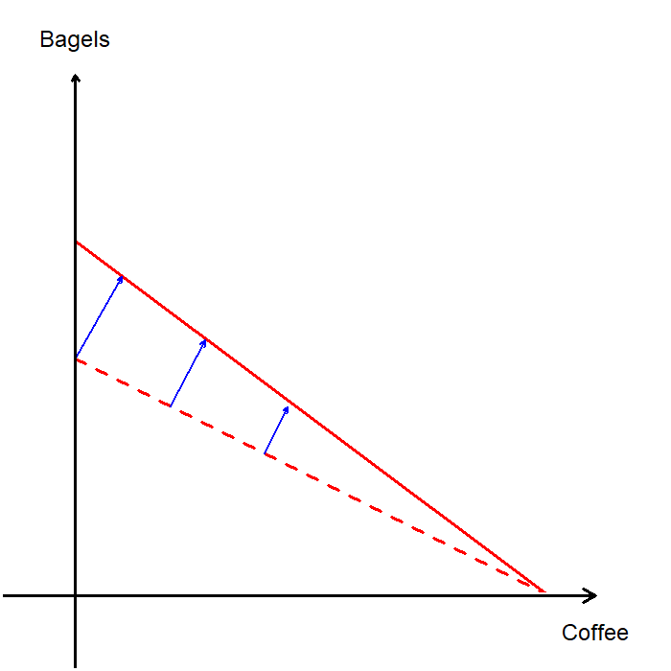
Example: Production Possibility Frontier
In our simple example, we assume that change in the economy causes a parallel outward shift of the PPF.
A parallel shift means that the trade-off relation between the two goods remain unchanged.
In the real world, the PPF rarely shifts like this, since technology rarely develops in all sectors equally.
For instance, if baking technology unrelated to coffee improved, the PPF may have “tilted.”

Slide 23
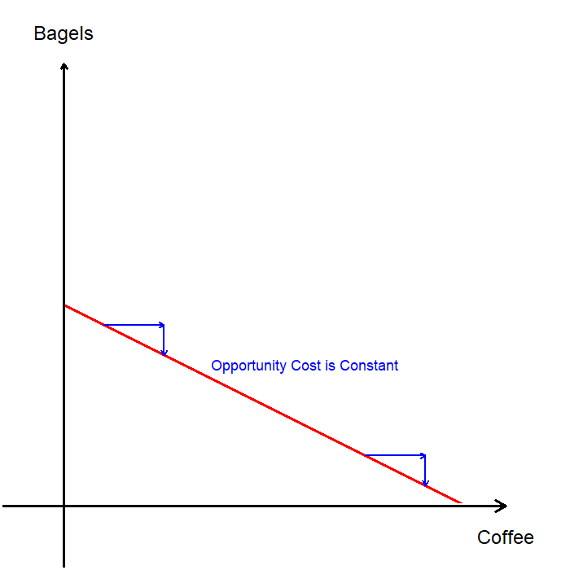
Example: Production Possibility Frontier
The PPF in our example is a straight line, which follows from our assumed production technology.
Specifically, that the opportunity cost is constant.
Under this assumption, whether the economy is producing a lot of bagels or only a few units, the opportunity cost of producing one more unit of bagel is always 2 cups of coffee.
Is this realistic?

Slide 24
Example: Production Possibility Frontier
In the real-world, opportunity cost will most likely be increasing.
Which means that “as more units of a good are produced, we need to give up increasing amounts of the other goods produced.”
Some people are going to be more talented in baking bagels, while some people are going to be more talented in brewing coffee.
To produce a lot of bagels, we guide people more talented in brewing coffee to bake bagels.

Slide 25
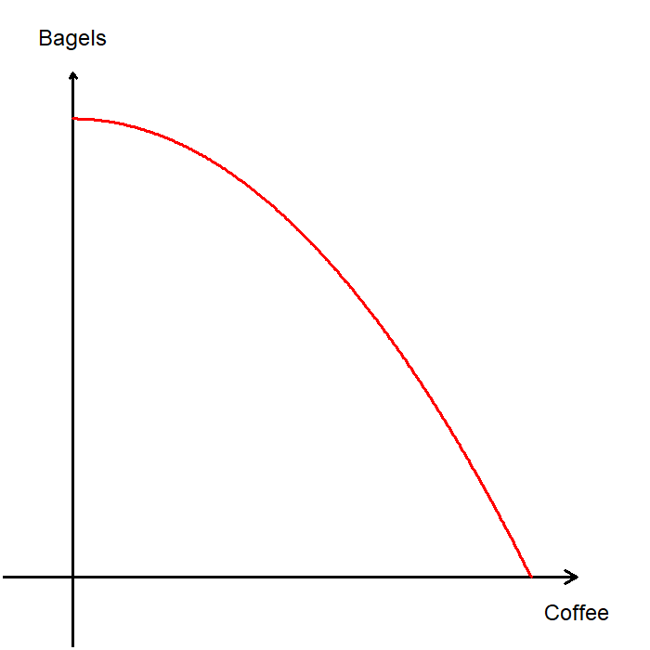
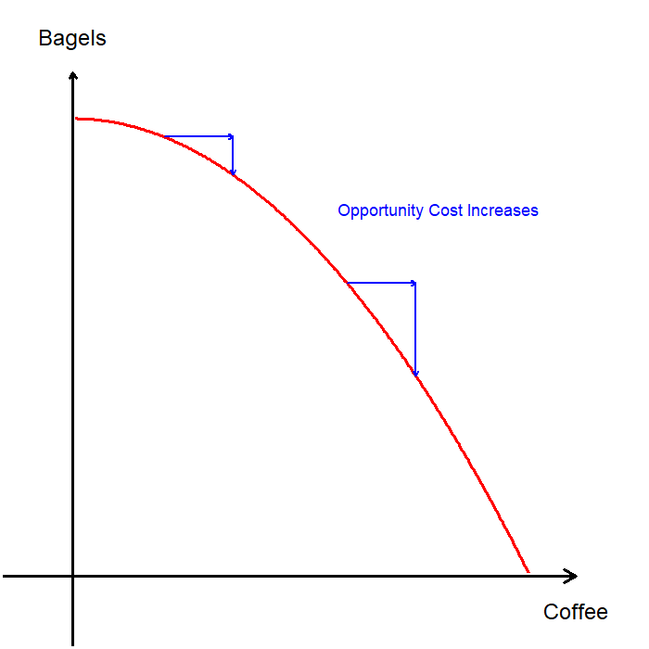
Example: Production Possibility Frontier
When we allow the worker most talented in brewing coffee to stop baking bagels and brew coffee, they will produce a lot of coffee.
This means that the PPF should be curved outward to reflect this changing opportunity costs.
The opportunity cost of a cup of coffee is very low when we are producing too many bagels.
In other words, to get one extra cup of coffee, we only need to give up a fraction of a bagel.

Slide 26
The Economist as a Policy Advisor

Slide 27
The Economist as a Policy Advisor
While economists act as scientists, they also serve as policy advisors.
They recommend policies to improve economic outcomes based on rigorous analysis of real-world evidence.
As a scientist, the economist may be asked fact-based questions such as “why is the unemployment rate higher for one group over another?”
As a policy advisor, the economist may be asked judgement-based questions such as “what can we do to lower the unemployment rate for a certain group of people?”

Slide 28
Positive and Normative Statements
Positive Statements
  Descriptive in nature; describe the world as it is.
  Can be confirmed or refuted by examining evidence.
  e.g. “Raising the minimum rage can cause an increase in unemployment.”
Normative Statements
  Prescriptive in nature; state how the world “should” be.
  Depend on values and goals.
  e.g. “The government should raise the minimum wage.”
Positive and Normative Statements are distinct but intertwined.
  Positive findings inform value judgments about which policies are desirable.
  Normative judgments can influence which aspects of the world economists choose to study.

Slide 29
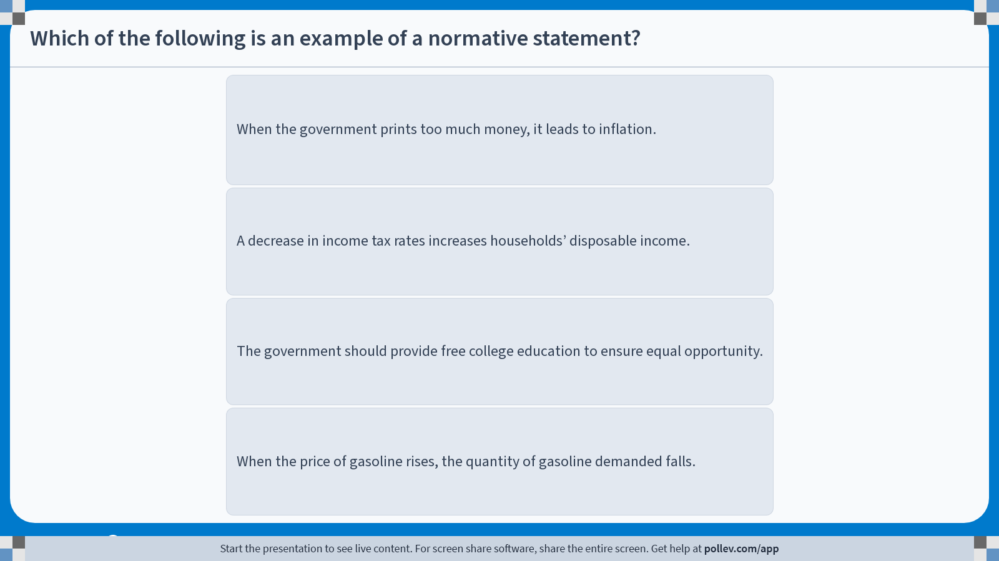
Poll Everywhere multiple choice poll instructions screen
Activity Title: Which of the following is an example of a normative statement?
Slide 30
Notes:
Do not modify the notes in this section to avoid tampering with the Poll Everywhere activity.
More info at polleverywhere.com/support
Which of the following is an example of a normative statement?
https://www.polleverywhere.com/multiple_choice_polls/UqJn5T0dOORmMh7opne0L?display_state=instructions&activity_state=opened&state=opened&flow=Engagement&onscreen=persist

Slide 30
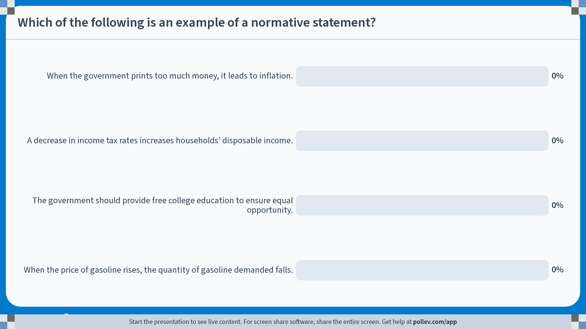
Poll Everywhere multiple choice poll chart screen
Activity Title: Which of the following is an example of a normative statement?
Slide 32
Notes:
Do not modify the notes in this section to avoid tampering with the Poll Everywhere activity.
More info at polleverywhere.com/support
Which of the following is an example of a normative statement?
https://www.polleverywhere.com/multiple_choice_polls/UqJn5T0dOORmMh7opne0L?display_state=chart&activity_state=closed&state=closed&flow=Engagement&onscreen=persist

Slide 31
Solution to In-class Poll #3
When the government prints too much money, it leads to inflation.
  Positive statement: describes a relationship, which can be confirmed or refuted.
A decrease in income tax rates increases households’ disposable income.
  Positive statement: describes a relationship, which can be confirmed or refuted.
The government should provide free college education to ensure equal opportunity.
  Normative statement: Based on a value judgement which cannot be confirmed or refuted.
When the price of gasoline rises, the quantity of gasoline demanded falls.
  Positive statement: describes a relationship, which can be confirmed or refuted.

Slide 32
Economists in Washington
Economists serve advisory roles in government.
  The Federal Reserve
  Federal Government
  Congressional Budget Office
  Think Tanks
  …and many other positions
Economists provide crucial input in the policy process, but their advice is only one ingredient in the complex recipe of policymaking.
As a result, their recommendations are not always followed.

Slide 33
Why Economists Disagree

Slide 34
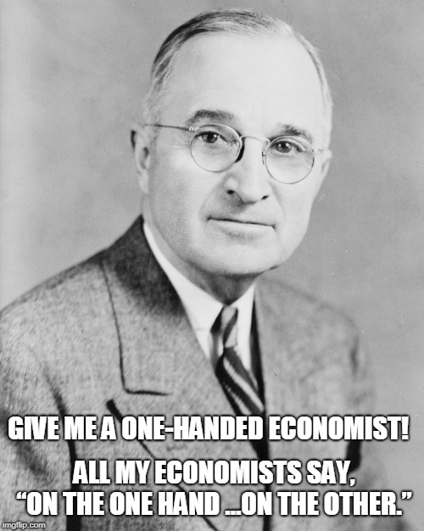
Why Economists Disagree
Economists are well known for offering conflicting policy advice.
They may disagree about the validity of alternative positive theories of how the world works.
They may also hold different values, leading to differing normative views on policy goals.
But at the same time, economists agree on many issues.

Slide 35
Statements that U.S. Economists Generally Agree On
A ceiling on rents reduces both the quantity and quality of housing available.
Tariffs and import quotas generally reduce overall economic welfare.
The U.S. should not restrict employers from outsourcing work to foreign countries.
The U.S. should eliminate agricultural subsidies.
Local and state governments should eliminate subsidies for professional sports franchises.
Cash payments increase the welfare of recipients more than in-kind transfers of equal cash value.
…and more!

Slide 36
Recap of Chapter 2

Slide 37
Recap
Economists act as scientists making appropriate assumptions to build models to explain the world (positive analysis).
Economists are also policy advisors making assertions about how the world should be (normative analysis).
Economists often offer conflicting advice due to differences in scientific judgements and/or differences in values.
Economists may also be united in their advice, but not all advice is followed by policymakers due to real-world constraints.

