Slide 1
PRINCIPLES OF GLOBAL ECONOMICS
Chapter 1: The Ten Principles of Economics

Slide 2
Recap
Economics is the study of choice under scarcity.
Scarcity refers to the limited nature of society’s resources.
Economics can be broadly divided into three fields:
  Microeconomics: How individuals make choices.
  Macroeconomics: How individuals’ choices interact to impact society.
  Econometrics: Statistically testing the implications from economic theory.
Regardless of the subfield, most “mainstream” Economists agree on the Ten Principles of Economics we are going to discuss now.

Slide 3
The Ten Principles of Economics

Slide 4
The Ten Principles of Economics
The first four principles of economics concern how individuals make decisions.
Principle #1: People face trade-offs
Principle #2: The cost of something is what you give up to get it
Principle #3: Rational people think at the margin
Principle #4: People respond to incentives

Slide 5
Principle #1: People face trade-offs
“To obtain one thing, one must give up another thing.”
Due to scarcity, we usually trade of one goal in the expense of another goal.
Some people choose to volunteer for extra shifts on their job.
  Gain: Higher level of income.
  Lose: Less time to spend with friends and family.
Some people choose to invest a greater proportion of their income for retirement.
  Gain: Earlier retirement, or more income in retirement.
  Lose: The ability to spend more money on things while they are younger.

Slide 6
Principle #1: People face trade-offs
The collection of people, society, also faces similar trade-offs.
A society may devote resources to managing pollution levels.
  Gain: A cleaner environment leading to improved health of its people.
  Loss: A greater cost of running certain businesses.
A society may increase spending on public transportation.
  Gain: Less cars on the street leading to less accidents and lower levels of pollution.
  Loss: Loss of public funds in other sectors such as healthcare, education, etc.
Question: Efficiency and Equality, is there a trade-off?
  Efficiency: Gaining maximum benefits from the scarce resources.
  Equality: Distributing prosperity uniformly among the people.

Slide 7
Principle #2: The cost of something is what you give up to get it
“Opportunity Cost”
When making decisions, we compare the costs and benefits or alternatives.
So, we must fully understand both the cost and benefits of any option.
In our daily conversations, cost usually means the sticker price of an option.
When economists say cost, it almost always refer to opportunity cost.
Opportunity Cost: The value of the best alternative forgone.

Slide 8
Principle #2: The cost of something is what you give up to get it
What is the opportunity cost of going to a concert?
  The monetary cost of the ticket, AND
  The value of your time spent at the concert.
What is the opportunity cost of attending college?
  Tuition, cost of textbooks, registration and parking fees, AND
  Room and board may or may not be included, AND
  Forgone earnings
Compare these two well-known (maybe) phrases:
  “There is no such thing as a free lunch.”
  “The best things in life are free.”

Slide 9
Principle #3: Rational people think at the margin
“We evaluate the costs and benefits of marginal changes.”
Rational people systematically do the best they can to achieve their goals, given all available opportunities.
The term marginal can be understood to mean small and incremental.
Marginal Benefit: The benefit from adding one more unit of something.
  How much extra happiness do I get from drinking another sip of coffee?
Marginal Cost: The cost of adding one more unit of something.
  How much extra does it cost (opportunity cost!) to spend another hour partying?

Slide 10
Principle #3: Rational people think at the margin
Scenario #1: Hiring Decision
  You are a running a tech start-up and are considering hiring an extra engineer. Hiring an extra engineer would cost $100,000 per year. You estimate that this new engineer would generate an extra revenue of $110,000 per year. Should you hire the new engineer? Why?
Scenario #2: Airline Tickets
  You are the ticketing agent for an airline, and there is a flight from FAR to ORD leaving soon. The flight is only 30% full, and a coach ticket’s sticker price is $450. A potential consumer tells you that they are willing to pay up to $300 for the ticket on that flight. Should you accept this deal? Why?
Scenario #3: Streaming
  You have an active subscription to Netflix. Once you have a subscription, you can watch as many shows and movies as you wish for no extra charge. Should you be watching another movie? Why?

Slide 11
Principle #3: Rational people think at the margin
Scenario #1: Hiring Decision
  Marginal Benefit: $110,000 in increased revenue
  Marginal Cost: $100,000 in labor cost
  Verdict: Hire the new engineer
Scenario #2: Airline Tickets
  Marginal Benefit: $300
  Marginal Cost: Near $0
  Verdict: Sell the ticket for $300 (as long as nobody else finds out…?)
Scenario #3: Streaming
  Marginal Benefit: The happiness you get from watching another movie
  Marginal Cost: $0 in monetary cost, but there is the opportunity cost of lost time
  Verdict: It’s complicated…

Slide 12
Principle #4: People respond to incentives
“People respond to stuff that induces them to act...”
Incentives: Something that induces people to act.
  Incentives can be positive (carrots) or negative (sticks).
If the government imposes an extra 25% tax on gasoline, then consumers would…
  Drive less, and/or
  Use public transportation, and/or
  Purchase fuel-efficient cars, and/or
  Move closer to work, and/or
  Protest the government?

Slide 13
Principle #4: People respond to incentives
What would car manufacturers do?
  Increase the production of fuel-efficient cars, and/or
  Lobby policymakers in D.C.?
    American Automotive Policy Council (AAPC) spends anywhere between $20M to $55M annually on lobbying expenses.
Policies that do not provide proper incentives would not be effective, and even with the best intentions, may yield unintended consequences due to overlooked incentive structures.
Legislation mandating seat belts in cars. (Peltzman, 1975)
  Seat belts make accidents less “costly,” so
  People end up driving more recklessly, and
  The number of accidents increase, which leads to
  More fatalities due to vehicle related accidents.

Slide 14
The Ten Principles of Economics
The following three principles of economics concern how people interact
Principle #5: Trade can make everyone better off
Principle #6: Markets are usually a good way to organize economic activity
Principle #7: Governments can sometimes improve market outcomes

Slide 15
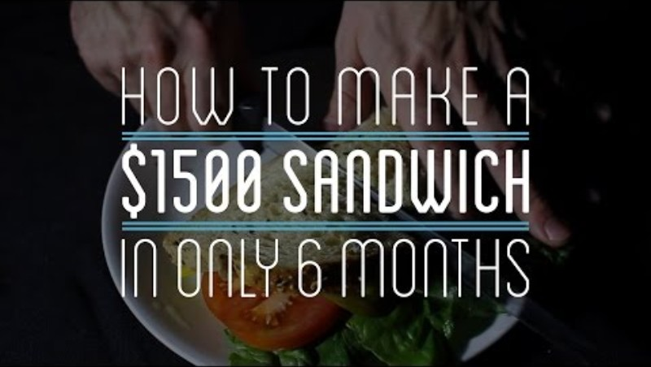
How To Make Everything. (2015, Sep 15). How to Make a $1500 Sandwich in Only
6 Months [Video]. YouTube. https://youtu.be/URvWSsAgtJE?si=OMIgPE25b-fw9pgO

Slide 16
Principle #5: Trade can make everyone better off
“Division of labor can make everyone better off.”
In a closed economy:
  Without trade, we must be our own doctors, mechanics, farmers, cooks, all at once.
  By individuals specializing in tasks and trading goods and services, our lives are generally better off.
  The cost of goods and services would be drastically lower in the presence of trade.
In an open economy:
  The same principle applies, in that countries can specialize in things they do best.
  In some cases, countries must rely on trade, if a certain resource cannot be found in their borders.
  The discussion becomes a bit more complicated when we think about issues of national security.

Slide 17
Principle #6: Markets are usually a good way to organize economic activity
A market is defined as a group of buyers and sellers.
Organizing economic activity refers to the process of determining…
  …what goods and services to produce, and
  …how to produce those goods and services, and
  …how to allocate them to the final user.
Most modern economies are market economies.
  They allocate resources through decentralized decisions.
  Each individual independently determine their consumption, and each individual firm independently determine their production plans.
Historically, market economies have proven remarkably successful in organizing economic activity to promote prosperity.

Slide 18
Principle #6: Markets are usually a good way to organize economic activity
“The invisible hand usually works.”
Market Price
  Prices are determined in the market through the interaction of buyers and sellers.
  Reflect the value that buyers assign to goods and services and the production cost for the producer.
Adam Smith’s Invisible Hand
  “He intends only his own gain, and he is in this, as in many other cases, led by an invisible hand to promote an end which was no part of his intention.”
  Prices adjusts to guide the market to outcomes that usually maximize the well-being of the society.
Caveat being that it usually works.

Slide 19
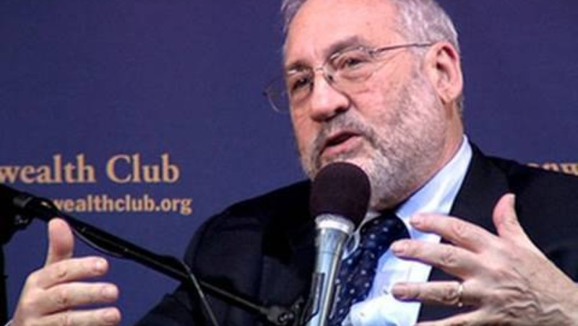
FORA.tv. (2010, Mar 8). Joseph Stiglitz: Smith's "Invisible Hand" a Myth? [Video].
YouTube. https://youtu.be/9qjvwQrZmpk?si=IkfACfDDyOw1xgFF

Slide 20
Principle #7: Governments can sometimes improve market outcomes
“The invisible hand doesn’t always work.”
Governments play a crucial role, enforcing property rights.
  Property rights: The ability of an individual to own and exercise control over scarce resources.
  Without clearly defined property rights and enforcement thereof, markets would falter.
Market Failure: Sometimes, markets fail to allocate resources efficiently.
  Even with the government enforcing property rights, markets may fail due to…
  Externalities: The consumption or production of goods affecting bystanders.
    e.g. Construction projects generating pollution and noise.
  Market Power: A small group of buyers or sellers holding substantial influence over the market prices.
    e.g. A sole producer of a life-saving medication may have an incentive to increase prices.

Slide 21
Principle #7: Governments can sometimes improve market outcomes
The government can intervene to enhance efficiency.
However, a fully efficient market outcome does not guarantee that everyone in the society is allocated enough resources for survival.
  The market rewards agents based on their ability to produce goods/services that others are willing to pay for, and everyone has different abilities.
The government can also intervene to promote equality.
  Tools such as taxes and welfare policies can be used to avoid unhealthy levels of disparity.
    e.g. SNAP, Medicare & Medicaid, Progressive Taxation
Caveat being that governments can sometimes improve market outcomes.

Slide 22
Principle #7: Governments can sometimes improve market outcomes
Does government intervention improve the outcomes in…
  Air travel?
  Protecting intellectual property through patents and copyrights?
  Public schools?
  Workplace safety regulations?
  Roads and bridges?
Example: Air travel
  Agencies such as the FAA, TSA, NTSB enhance safety in flights.
  Would private firms do a better job at enhancing safety at a cheaper rate?
  Funding through the Essential Air Service provide flights to smaller regional airports.
  Would airlines operate to smaller regional airports if left entirely to the market?

Slide 23
The Ten Principles of Economics
The final three principles of economics concern how to economy as a whole works.
Principle #8: A country’s standard of living depends on its productivity
Principle #9: Prices rise when the government prints too much money
Principle #10: Society faces a short-run trade-off between inflation and unemployment

Slide 24
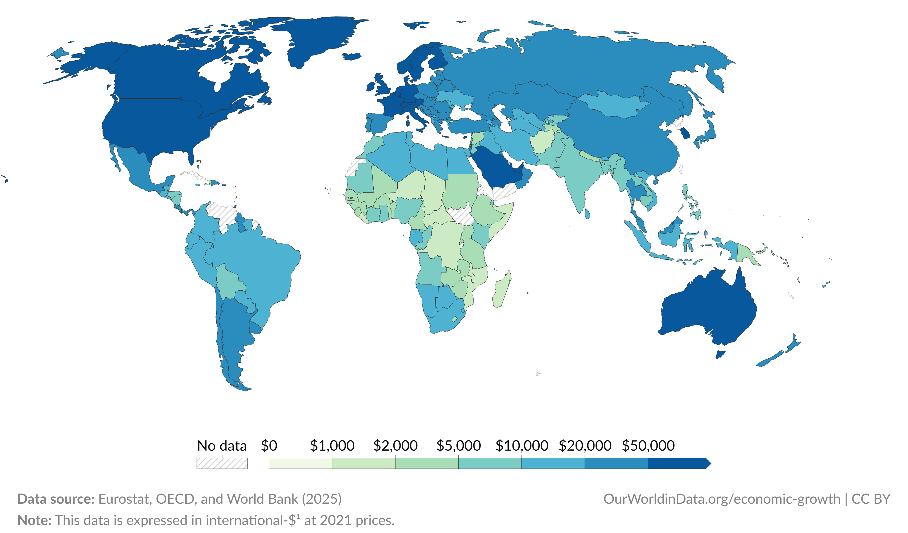
Principle #8: A country’s standard of living depends on its productivity
There is a massive divide in the income across economies:
  The median income of a full-time worker in the U.S. is approximately $62,000 in 2024.
  The median income of a full-time worker in India is approximately $16,000 in 2024.

Slide 25
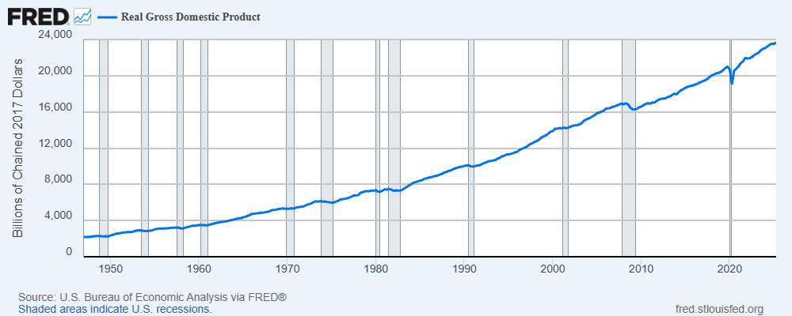
Principle #8: A country’s standard of living depends on its productivity
There is also a massive variation in the income over time in the same economy.
  The median income of a full-time worker in the U.S. was $48,000 in 1925. (adjusted for price levels)
  The U.S. economy grew on average 2% over the past 50 years.

Slide 26
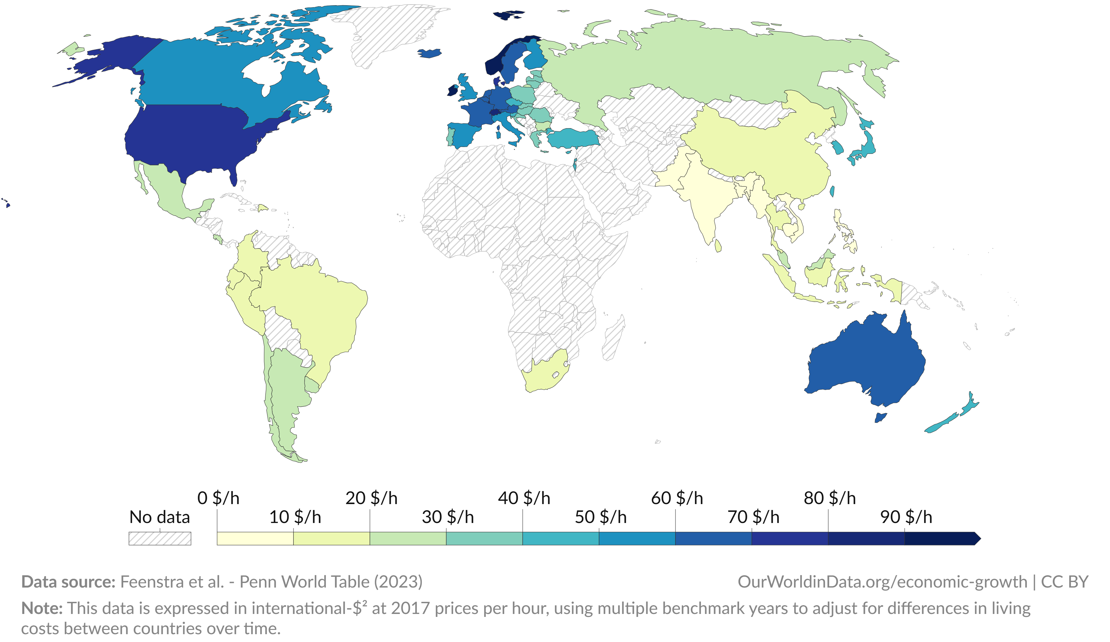
Principle #8: A country’s standard of living depends on its productivity
This variation in income can be traced to variations in workers’ productivity.
  This variation in income translates to variations in the standards of living.
  This chart depicts the average value of output per hours worked in various countries.

Slide 27
Principle #9: Prices rise when the government prints too much money
Inflation refers to the increase in the overall level of prices in an economy.
Deflation refers to the decrease in the overall level of prices in an economy.
Economists generally agree that keeping inflation near 2~3% is desirable.
  High inflation imposes various costs on the economy, and
  Deflation also causes various problems in the economy.
In the short-run, inflation can be traced to many factors.
In the long-run, most inflation is caused due to excessive growth in the money supply.
Oversimplified, the more money in the economy, the lower the value of money, so one needs more money to purchase goods and services.

Slide 28

A long, long time ago. (2022, Jan 9). 1923: Hyperinflation | GCSE History | Weimar
Germany [Video]. YouTube. https://youtu.be/O2CIeNANQMM?si=PacreIw3jb5PAZ0i

Slide 29
Principle #10: Society faces a short-run trade-off between inflation and unemployment
In the short-run, economic policies tend to push inflation and unemployment in opposite directions.
  That is, if a policy leads to lower inflation, unemployment is likely to rise, and
  If a policy targets lower unemployment, it is likely to push inflation upward.
Intuitively, why would this happen?
  The government increases money supply in the market and economic activity increases, then
  …and the demand for goods and services increase (which drive prices upwards), then
  …firms hire more workers to increase production, so unemployment decreases.
The exact nature of the trade-off can change over time and circumstances, but the trade-off is always present.

Slide 30
The Ten Principles of Economics
Principle #1: People face trade-offs
Principle #2: The cost of something is what you give up to get it
Principle #3: Rational people think at the margin
Principle #4: People respond to incentives
Principle #5: Trade can make everyone better off
Principle #6: Markets are usually a good way to organize economic activity
Principle #7: Governments can sometimes improve market outcomes
Principle #8: A country’s standard of living depends on its productivity
Principle #9: Prices rise when the government prints too much money
Principle #10: Society faces a short-run trade-off between inflation and unemployment

