Slide 1
PRINCIPLES OF GLOBAL ECONOMICS
Chapter 0: Introduction

Slide 2
Announcements: About Me
Brian H. Park
First year at Concordia College
Ph.D. in Applied Economics and Management, Cornell University
B.A. in Economics, Korea University
Research Interests
  Environmental Economics and Demographic Economics
  Climate Change and Migration Pattern of Agricultural Workers
  Interactions of Border Enforcement Policies and International Migration
  Influence of Pop Culture on Fertility Intent of Married Couples

Slide 3
Announcements: Contact
Email: HPARK3@cord.edu
  Please include BUS201 in the subject line, and my target response is within 1 business day.
Office: Grant Center 101
Regular Office Hours
  Mondays & Wednesdays 10:30 AM to 12:30 PM, and
  By appointment via Calendly
Calendly: calendly.com/brianhwpark
  Book on-demand office hours in 15-minute increments
  Calendar opens 10 days in advance, with a minimum of 90 minutes notice
  For longer sessions, you may book 2~3 sessions in a row
    e.g. Book a session at 2:00 PM, and another at 2:15 PM for a meeting from 2:00 PM through 2:30 PM.

Slide 4
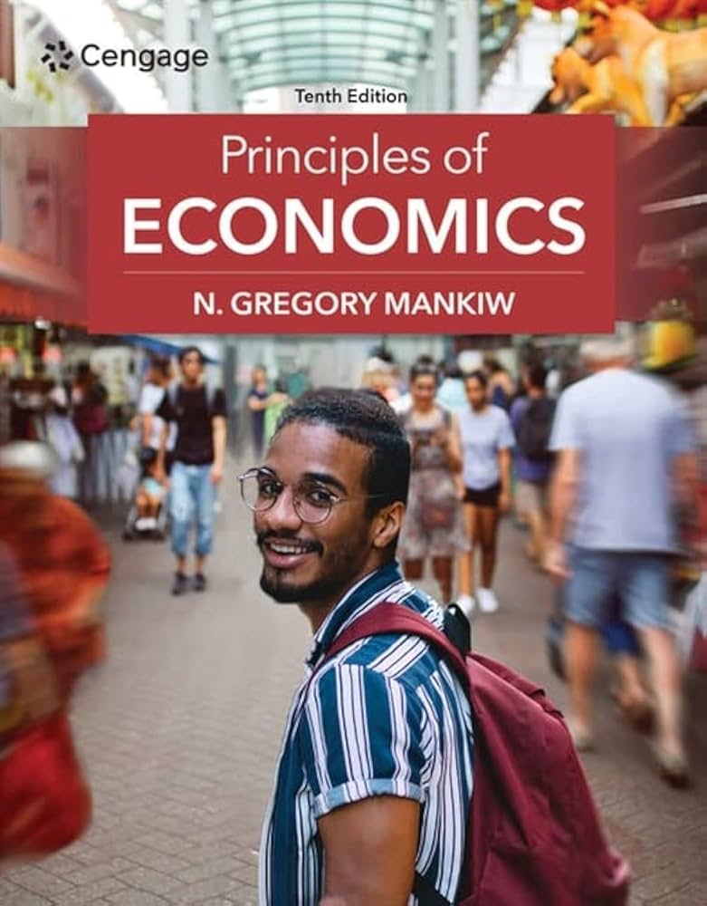
Announcements: Textbook
Principles of Economics
10th Edition
Gregory Mankiw
Cengage
Lecture notes to be distributed over Moodle
Previous versions may be acceptable

Slide 5
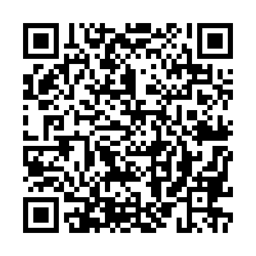
Announcements: PollEverywhere
This is a QR code to PollEverywhere, an online polling system.
  Please scan the QR code and have your device ready as there will be a few in-class exercises.
  If you do not have access to your mobile device, log in using the URL below:
  Your responses are anonymous and not be used in grading.
https://pollev.com/brianpark046

Slide 6
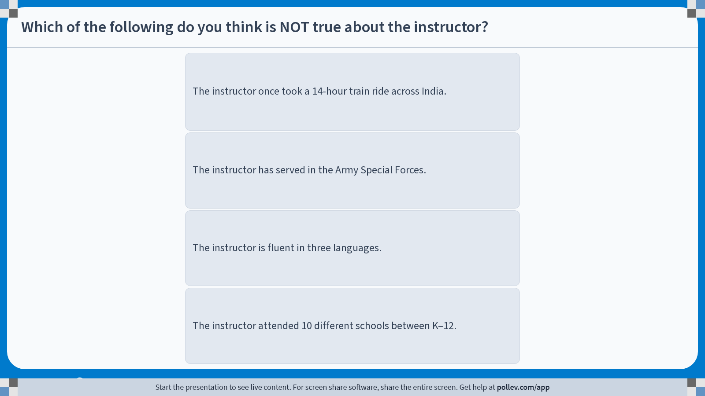
Poll Everywhere multiple choice poll instructions screen
Activity Title: Which of the following do you think is NOT true about the instructor?
Slide 6
Notes:
Do not modify the notes in this section to avoid tampering with the Poll Everywhere activity.
More info at polleverywhere.com/support
Which of the following do you think is NOT true about the instructor?
https://www.polleverywhere.com/multiple_choice_polls/9dCAEjDoSTcrselUyEGYu?display_state=instructions&activity_state=opened&state=opened&flow=Engagement&onscreen=persist

Slide 7
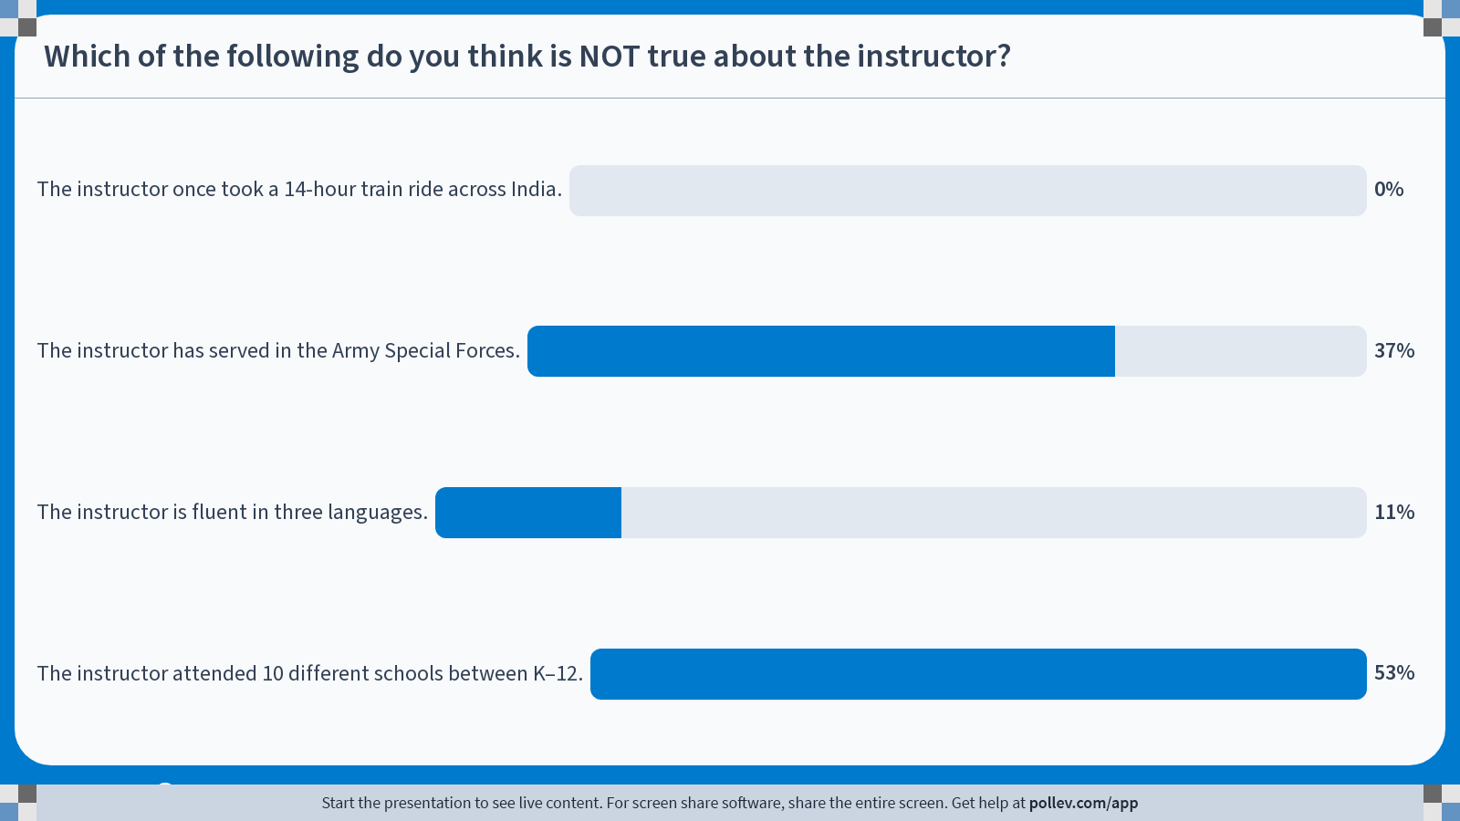
Poll Everywhere multiple choice poll chart screen
Activity Title: Which of the following do you think is NOT true about the instructor?
Slide 8
Notes:
Do not modify the notes in this section to avoid tampering with the Poll Everywhere activity.
More info at polleverywhere.com/support
Which of the following do you think is NOT true about the instructor?
https://www.polleverywhere.com/multiple_choice_polls/9dCAEjDoSTcrselUyEGYu?display_state=chart&activity_state=closed&state=closed&flow=Engagement&onscreen=persist

Slide 8
Policies: Grading
The final letter grade to be calculated using your end of semester Grand Total score.
Grand Total #1: Balanced
  20% for Homework, 35% for Quizzes, 35% for the Final Exam
Grand Total #2: Rewarding Consistency
  30% for Homework, 40% for Quizzes, 20% for the Final Exam
Grand Total #3: The “Hail Mary” option
  10% for Homework, 20% for Quizzes, 60% for the Final Exam
At the end of the term, any additional credit and attendance scores will be added to each grand total, and the highest of the three Grand Total scores is used to determine your letter grade.

Slide 9
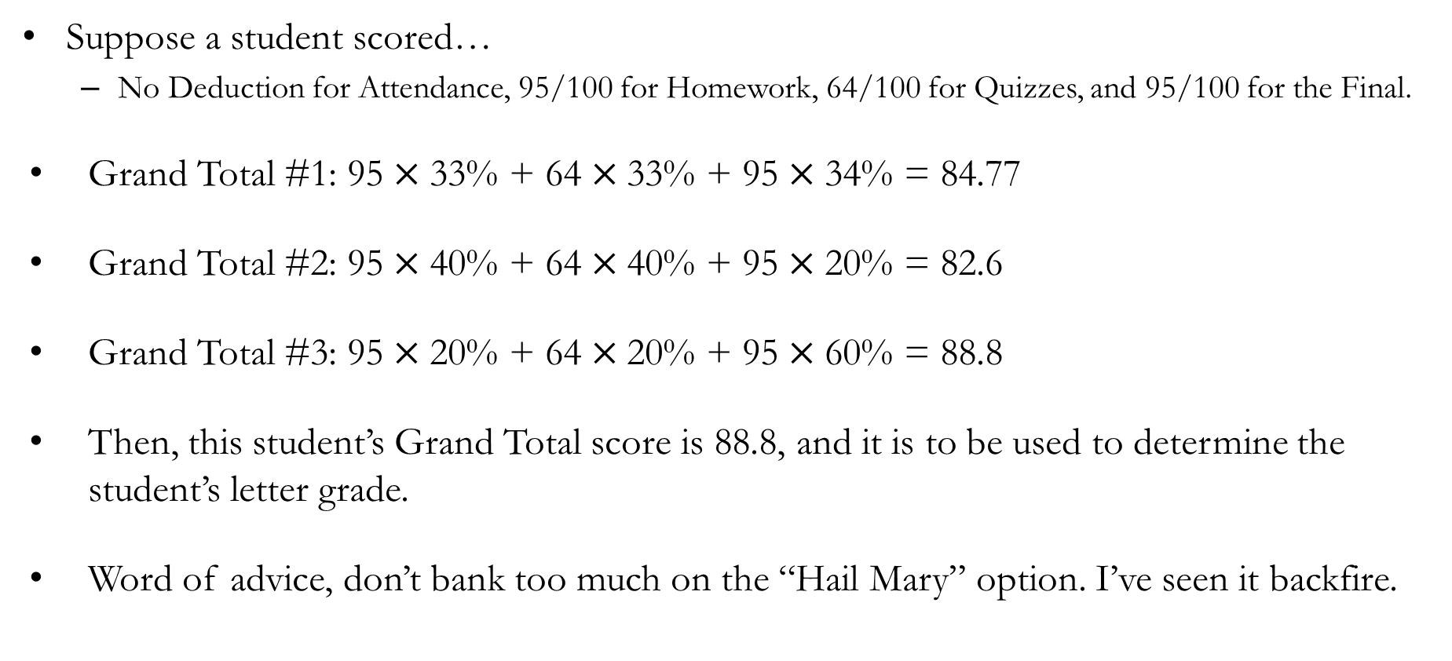
Policies: Grading
Suppose a student scored…
  No Deduction for Attendance, 95/100 for Homework, 64/100 for Quizzes, and 95/100 for the Final.
Grand Total #1: $\text{95}×\text{33}\text{\%} \text{+} \text{64}×\text{3}\text{3}\text{\%} \text{+} \text{95}×\text{3}\text{4}\text{\%}\text{ = 84.77}$
Grand Total #2: $\text{95}×\text{4}\text{0}\text{\% + 64}×\text{40}\text{\% + 95}×\text{20}\text{\%}\text{ = 82.6}$
Grand Total #3: $\text{95}×\text{20}\text{\% + 64}×\text{20}\text{\% + 95}×\text{60}\text{\%}\text{ = 88.8}$
Then, this student’s Grand Total score is 88.8, and it is to be used to determine the student’s letter grade.
Word of advice, don’t bank too much on the “Hail Mary” option. I’ve seen it backfire.

Slide 10
Policies: Attendance
Attendance may be checked at the beginning of each class session.
Attendance after the first 20 minutes of a class session will count as one-half of an absence.
Each student is permitted one unexcused absence per calendar month without penalty.
For every two unexcused absences, 3 points will be deducted from the Grand Total score.
Six or more unexcused absences may result in a failing grade, at the instructor’s discretion.
The criteria for determining whether an absence is excused or unexcused will follow Concordia College policy, with final discretion resting with the instructor.

Slide 11
Policies: Homework
Homework will primarily consist of “current event” assignments, although some may be replaced with standard problem sets.
For current event assignments, students will identify real-world events relevant to course material and write a short essay (approximately 300 words) explaining these events using theories discussed in class.
Homework assignments will be given roughly weekly, with the first assignment due by the end of the third week of the term.
If homework assignments are replaced with problem sets, students may work in groups of up to three.

Slide 12
Policies: Quizzes
Up to six closed-book, in-class quizzes will be administered throughout the semester.
Quizzes will include a mix of multiple-choice, short-answer, and essay questions.
Because quizzes are designed to be low-stakes and frequent check-ins, students will have opportunities to recover deducted points.
To participate in grade recovery, students must review their graded material, demonstrate a clear understanding of the error, and present the correct answer to the instructor in person during office hours.
Deadlines for grade recovery opportunities will be announced in class when graded quizzes are returned.

Slide 13
Policies: Final Exam
A comprehensive closed-book final exam will be administered on the date determined by the Registrar’s Office.
  This semester, it is planned on Dec. 15th, 2:00 PM ~ 4:00 PM.
The final exam will follow the quiz format, with up to 3 additional long essay questions.
There will be no opportunity to recover deducted points; however, students may request that their entire final exam be regraded to check for errors.
Deadlines for regrading requests will be announced on the day of the final exam.
In exceptional circumstances, and at the instructor’s discretion, the final exam may be substituted with a take-home essay.

Slide 14
Policies: General
Extra credit opportunities may be offered on rare occasions at the instructor’s discretion.
The maximum number of extra credit points that may be applied to a student’s Grand Total score will not exceed 5 points.
Late submissions without a written excuse approved by the instructor will not be eligible for full credit. The extent of the deduction will depend on the circumstances, at the instructor’s discretion.
Assignments submitted more than 72 hours after the deadline, without a written excuse approved by the instructor, will not be accepted and will receive a grade of zero.
Students are responsible for checking their Concordia email and the course learning platform regularly for announcements.

Slide 15
What is Economics?

Slide 16
Etymology
Οἰκονομία: “Household management”
  οἶκος (Oikos): “Household”
  -νομία (-nomia): “Allocation”, more literally “the Way”
  Xenophon’s Oeconomicus: Narrowly defined as “Household management and agriculture.”
  Over time, the meaning broadened to include the management of estates, public finance, and eventually to the modern discipline of Economics.
経済学: “Stabilize the nation and improve people's welfare”
  経世 (Keisei): “Manage society”
  済民 (Saimin): “Provide relief to the people”
  Terms derived from ancient Confucian Chinese political philosophy, but the exact term coined by Edo era Japanese scholars.

Slide 17
Modern Definition of Economics
Consider agricultural household management
  Grossly simplified, lets assume there are two tasks: Farm / House
  Who works in the Farm, and for how long?
  Who works in the House, and for how long?
  Question of how to allocate resources optimally.
Economics is essentially the study of “how people make choices.”
But does making the optimal choice in allocating resources matter in a society with unlimited workers and infinite time?
Determining the optimal allocation of resources matter chiefly due to “scarcity,” which refers to the limited nature of society’s resources.

Slide 18
Modern Definition of Economics
The study of choice under scarcity.

Slide 19
Modern Definition of Economics
Economists examine:
  How individuals decide how much time they spend working.
  How households decide to spend their income.
  How firms decide how much to produce.
Economists also examine:
  How airport delays can cause adverse health effects.
  Why cash is the best present to give each other for Christmas.
  What Karl Marx’s impact on history would have been without the Bolshevik Revolution.
If human decisions involved, it may be examined through the lens of Economics.
  This does NOT mean that it is the correct way to analyze the world.
  Does not necessarily mean that it is the correct way of analyzing human affairs.

Slide 20
Modern Definition of Economics
Microeconomics
  How individuals or households make choices.
  Labor, Production, Political Economy, Health, Development, etc.
Macroeconomics
  How individuals’ choices impact the society.
  Monetary Policy, Economic Growth, Unemployment, Inflation, etc.
Econometrics
  Method to test the theory implications from Microeconomics and Macroeconomics.
  Statistical Methods, Modelling, Causal Inference, etc.
Regardless of the subfield, most Economists agree on the Ten Principles of Economics.

